Slide 1
Welcome
We would like to welcome all of our visitors here today. We hope your visit draws you closer to Jesus, your best friend.

Slide 2
Friday Night Fellowship
Fridays at 6:00, fellowship meal. 7:00 – The Days of Noah DVD series. Consider joining us!

Slide 3
Oregon Women’s Retreat
Oregon Women’s Retreat Nov 14-16. See insert for details.

Slide 4
Singing Band
Today following fellowship meal from 2:00-2:30 pm.

Slide 5
Gratitude Sabbath
On November 22^{nd,} we will have a special Thanksgiving service followed by a delicious Thanksgiving-themed meal in the BLC. Invite your friends and neighbors.

Slide 6
November Fall Food Drive
Thank you for your generous donations to our Community Service Food Bank. Keep it coming!

Slide 7

Our Sanctuary has a
Hearing Loop System

Slide 8
Christmas Light – Shore Acres
Sign up now to join us for the Christmas light tour at Shore Acres. See insert for details.

Slide 9
Milo Academy Harvest Party
Nov 22nd at 6:00pm,. Games, activities and food for sale.

Slide 10
Helping Opportunity
See the green insert for how you can help.

Slide 11
Looking Ahead
Start marking your calendars now for upcoming church and school events.

Slide 12
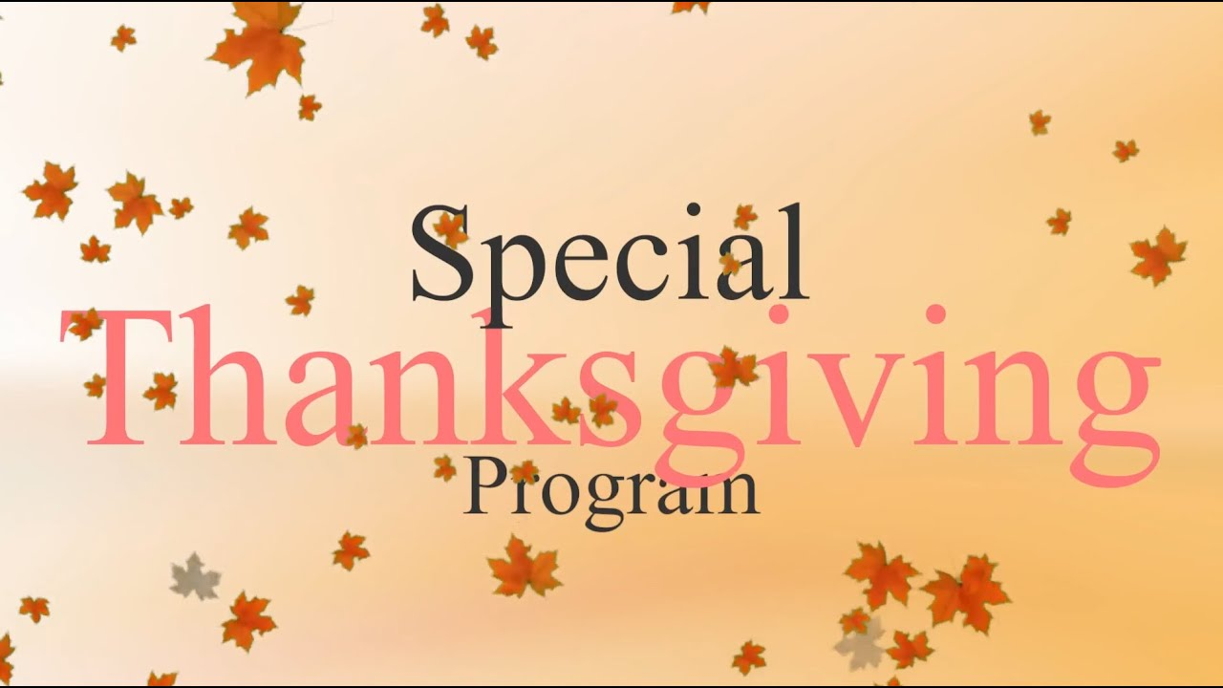

November
November 27th in BLC
Nov. 22

Slide 13

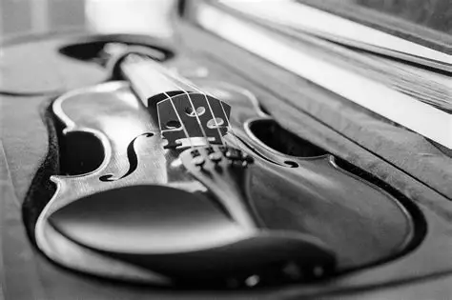
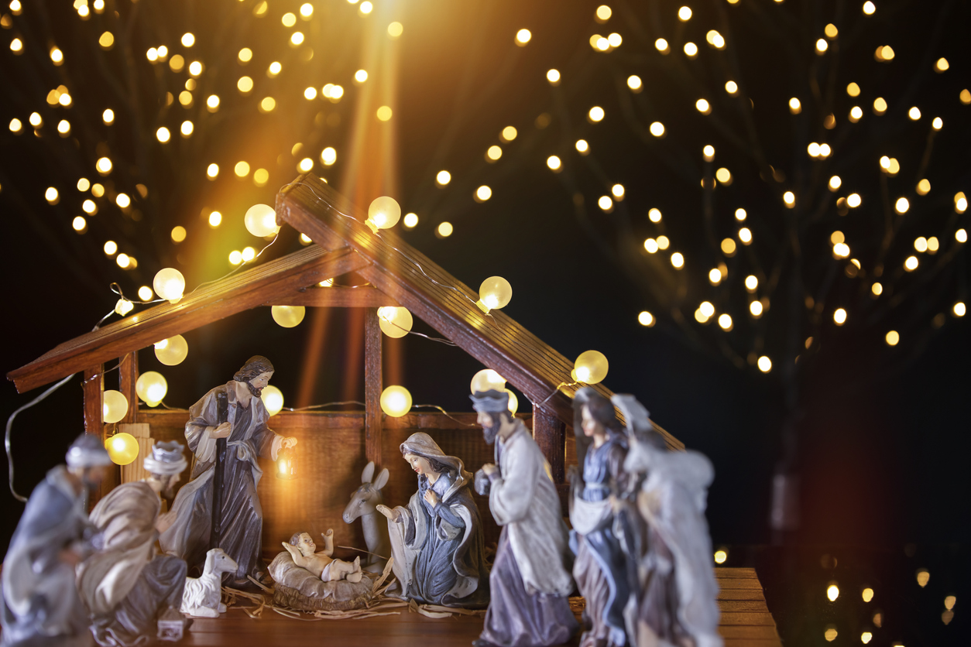

December
Christmas Concert here on 12/13
Umpqua Valley
Youth Orchestra Christmas Concert here on 12/4.
At RCA on 12/18
Shore Acres Christmas Light tour 12/6
Church Christmas Program 12/20

Slide 14


January
Happening Here!
January 22-24

