Slide 1
RICHMOND SDA 2026 BIBLE BOWL #1
Preparation Day 1
(Esther, Jonah, Philemon and 1 Peter)

Slide 2

QUESTION 1
According to Esther 1:10, who were Mehuman, Biztha, Harbona, Bigtha, Abagtha, Zethar, and Carcas?

Slide 3
QUESTION 1
ANSWER: seven eunuchs who served in the presence of King Ahasuerus

Slide 4
QUESTION 2
According to Esther 2:14, who was in charge of the second house of women?

Slide 5
QUESTION 2
ANSWER: Shaashgaz, the king's eunuch who kept the concubines

Slide 6
QUESTION 3
How much was Haman willing to pay those who do the work of terminating the Jews? (Esther 3:9)

Slide 7
QUESTION 3
ANSWER: I will pay ten thousand talents of silver into the hands of those who do the work

Slide 8
QUESTION 4
Complete the following according to Esther 4:14
For if you remain completely silent at this time, _____________ and _____________ will arise for the Jews from another place, but you and your __________________ will perish. Yet who knows whether you have come to the __________ for such a time as this?"

Slide 9
QUESTION 4
ANSWER: relief, deliverance, father’s house, kingdom

Slide 10
QUESTION 5
According to Esther 5:10, what was the name of Haman’s wife?

Slide 11
QUESTION 5
ANSWER: Zeresh

Slide 12
QUESTION 6
Who said the following “If Mordecai, before whom you have begun to fall, is of Jewish descent, you will not prevail against him but will surely fall before him” (Esther 6:13)

Slide 13
QUESTION 6
ANSWER: Haman’s wise men and his wife (Zeresh)

Slide 14
QUESTION 7
According to Esther 7:9, whose idea was it to hang Haman on the gallows that he had built?

Slide 15
QUESTION 7
ANSWER: the king (king Ahasuerus)

Slide 16
QUESTION 8
What was Mordecai’s new clothing as he went out from the presence of the king in Esther 8:15?

Slide 17
QUESTION 8
ANSWER: royal apparel of blue and white, with a great crown of gold and a garment of fine linen and purple

Slide 18
QUESTION 9
According to Esther 9:15, how many men did the Jews in Shushan kill on the 14th day of Adar?

Slide 19
QUESTION 9
ANSWER: three hundred men

Slide 20
QUESTION 10
What did king Ahasuerus impose tribute on (Esther 10:1)?

Slide 21
QUESTION 10
ANSWER: the land and on the islands of the sea

Slide 22
QUESTION 11
According to Jonah 1:17, what did the Lord prepare to swallow Jonah?

Slide 23
QUESTION 11
ANSWER: a great fish (NOT a whale)

Slide 24
QUESTION 12
According to Jonah 2:7, where did Jonah say that his prayer went up to?

Slide 25
QUESTION 12
ANSWER: You (God), Into Your holy temple

Slide 26
QUESTION 13
According to Jonah 3:8, who did the king proclaim should be covered in sackcloth?

Slide 27
QUESTION 13
ANSWER: man and beast

Slide 28
QUESTION 14
Who said the following to Jonah: "Is it right for you to be angry about the plant?" (Jonah 4:9)

Slide 29
QUESTION 14
ANSWER: God

Slide 30
QUESTION 15
How does Paul ask Philemon to receive Onesimus back (Philemon 16)?

Slide 31
QUESTION 15
ANSWER: no longer as a slave but more than a slave--a beloved brother

Slide 32
QUESTION 16
Let’s try this again… according to 1 Peter 1:1, who is the intended audience of the book of 1 Peter?

Slide 33
QUESTION 16
ANSWER: To the pilgrims of the Dispersion in Pontus, Galatia, Cappadocia, Asia, and Bithynia,

Slide 34
QUESTION 17
Complete the following from 1 Peter 2:7: "The _______ which the ________ rejected Has become the __________________,"

Slide 35
QUESTION 17
ANSWER: stone, builders, chief cornerstone

Slide 36
QUESTION 18
According to 1 Peter 3:12, who are the eyes of the Lord upon?

Slide 37
QUESTION 18
ANSWER: on the righteous

Slide 38
QUESTION 19
According to 1 Peter 4:16, if someone is suffering as a Christian, how should they respond?

Slide 39
QUESTION 19
ANSWER: let him not be ashamed, but let him glorify God in this matter.

Slide 40
QUESTION 20
Who does Peter refer to as his son in 1 Peter 5:13?

Slide 41
QUESTION 20
ANSWER: Mark

Slide 42
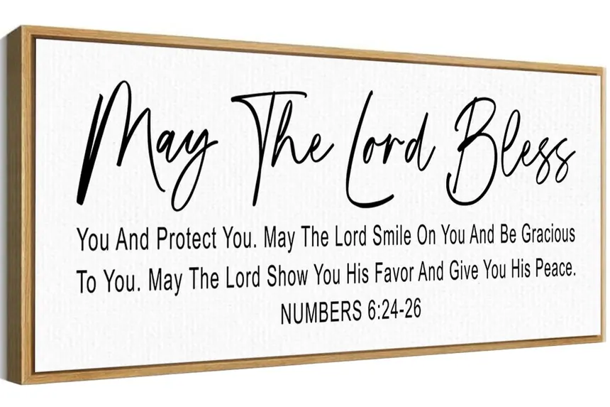
HOW DID YOU DO? I PRAY IT GOES BETTER NEXT TIME :)

