Slide 1

John Rengifo
May 23, 2026

Slide 2
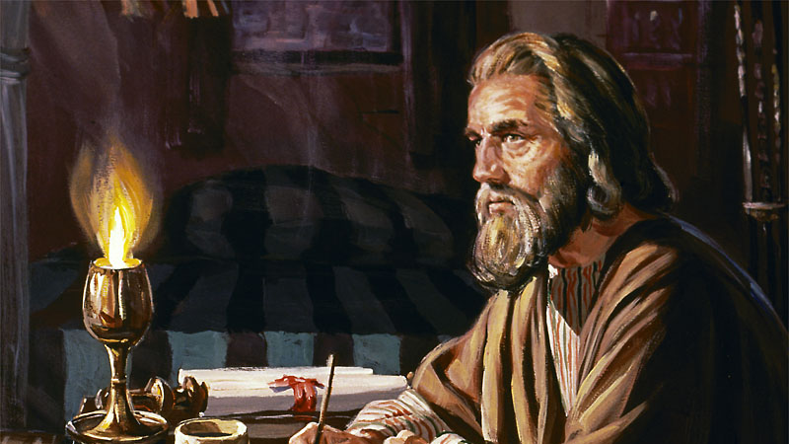

Slide 3


Slide 4

Ephesians 2:12-13
Remember that you were at that time separated from Christ, alienated from the commonwealth of Israel and strangers to the covenants of promise, having no hope and without God in the world.

Slide 5
Ephesians 2:12-13
Remember that you were at that time separated from Christ, alienated from the commonwealth of Israel and strangers to the covenants of promise, having no hope and without God in the world.

Slide 6
Ephesians 2:12-13
But now in Christ Jesus you who once were far off have been brought near by the blood of Christ.

Slide 7
