Slide 1



Slide 2


“And I, if I am lifted up from the earth,
will draw all peoples to Myself.”
John 12:32 NKJV

Slide 3

More people than we think are longing to find the way to Christ. Those who preach the last message of mercy should bear in mind that Christ is to be exalted as the sinner’s refuge. Some ministers think that it is not necessary to preach repentance and faith; they take it for granted that their hearers are acquainted with the gospel, and that matters of a different nature must be presented in order to hold their attention. But many people are sadly ignorant in regard to the plan of salvation; they need more instruction upon this all-important subject than upon any other. GW158

Slide 4
In Christ is the tenderness of the shepherd, the affection of the parent, and the matchless grace of the compassionate Saviour. His blessings He presents in the most alluring terms. He is not content merely to announce these blessings; He presents them in the most attractive way, to excite a desire to possess them. So His servants are to present the riches of the glory of the unspeakable Gift. The wonderful love of Christ will melt and subdue hearts, when the mere reiteration of doctrines would accomplish nothing….Words alone cannot tell it. Let it be reflected in the character and manifested in the life. Christ is sitting for His portrait in every disciple. DA826.3

Slide 5


PRAY LIKE JESUS
SPIRITUAL RENEWAL
FOR INDIVIDUALS
Daily devotional time – Scripture reading and intentional prayer.
Read/listen - to the four gospels and the Desire of Ages.
Prayer journaling – writing prayers and tracking answers.
Prayer walks – praying through neighborhoods, workplaces, or schools.
Praying Scripture – turning passages (Psalms, Gospels) into personal prayers.

Slide 6


PRAY LIKE JESUS
SPIRITUAL RENEWAL
FOR CONGREGATIONS
Weekly prayer gatherings – to study the gospels and the Desire of Ages.
Seasonal prayer emphases – 10 or 40 days of prayer , revival weeks, etc.
Prayer partners / triads – small groups focused specifically on prayer .
Day or night of prayer – an extended period of time for prayer .
Church-wide prayer lists – organized, updated needs shared regularly .

Slide 7


SERVE LIKE JESUS
COMPASSION & HEALING
FOR INDIVIDUALS
1. Intentional acts of kindness – helping neighbors, coworkers, strangers.
2. Volunteering locally – shelters, food banks, crisis centers.
3. Hospital/elder visits – offering presence and encouragement.
4. Using personal skills – tutoring, fixing things, mentoring.
5. Practicing “interruptibility” – being open to divine appointments.

Slide 8


SERVE LIKE JESUS
COMPASSION & HEALING
FOR CONGREGATIONS
1. Community service days – visible, hands-on outreach events.
2. Ongoing partnerships – with schools, nonprofits, social services.
3. Health ministries – health fairs, cooking classes, and healthy lifestyle education.
4. Family ministries – marriage enrichment and parenting information.
5. Social events – church block socials, seasonal events, and concerts.

Slide 9


SHARE JESUS
PROCLAMATION & RECLAMATION
FOR INDIVIDUALS
1. Personally connect – reach out to a church member who hasn’t attended recently.
2. Spiritual conversations – share your story and ask good questions about faith.
3. Inviting others – to church, small group, or events.
4. Digital witness – thoughtful, authentic faith presence on social media.
5. Giving away literature – share a book about Jesus with someone.

Slide 10
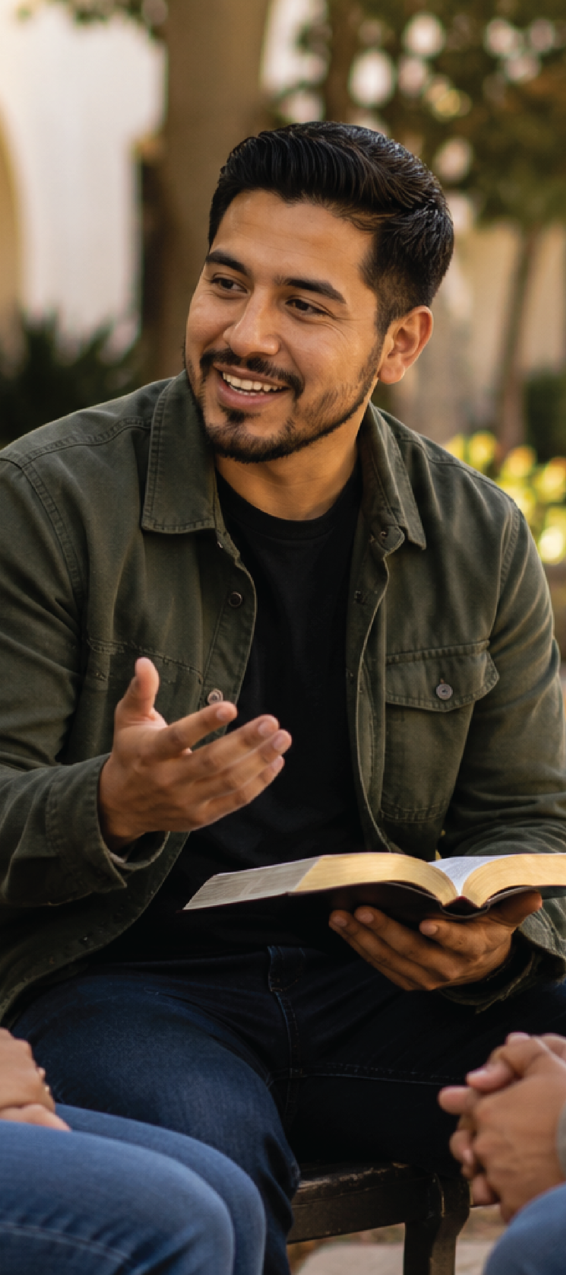

SHARE JESUS
PROCLAMATION & RECLAMATION
FOR CONGREGATIONS
1. Proclamation events – telling the message of Jesus, salvation, and His return.
2. Coordinated literature distribution – share a book about Jesus with church neighbors.
3. Missional groups – organize home-based Bible study groups.
4. Community events – concerts and programs at Christmas and Easter .
5. Intentional invitations – to inactive members and interested community friends.

Slide 11


FOLLOW JESUS
BAPTISM & DISCIPLESHIP
FOR INDIVIDUALS
1. Commitment to spiritual growth – Bible reading, study , and prayer.
2. Accountability relationships – meeting regularly with a spiritual mentor/friend.
3. Living for Jesus – actively applying what is learned.
4. Serving within the church – growing through participation.
5. Taking next steps publicly – baptism, sharing faith milestones.

Slide 12
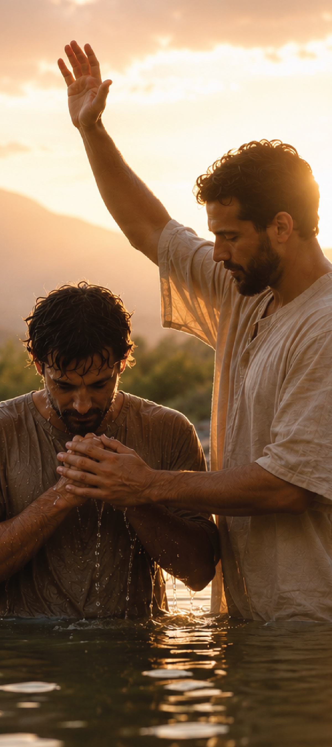

FOLLOW JESUS
BAPTISM & DISCIPLESHIP
FOR CONGREGATIONS
1. Clear discipleship pathway – from new believer to mature disciple.
2. Baptism culture – frequent, celebrated, story-rich baptisms.
3. Small group systems – relational environments for growth.
4. Leadership development tracks – multiplying disciples into leaders.
5. Priesthood of believers – every member using their spiritual gifts.

Slide 13
SUGGESTED TIMELINE
September 5, 2026
September 2026 – March 2027
January 2027 – August 2027
April 2027 – September 2027
September 2027
October 2027 – December 2027
Launch (Day of Prayer)
Pray Like Jesus
Serve Like Jesus
Share Jesus
Share Jesus Through Public Events
Follow Jesus

Slide 14
ANSWER THE CALL
READ DESIRE
OF AGES
SHARE THE DESIRE OF AGES (ABRIDGED)
SHARE JESUS ON YOUR SOCIAL MEDIA
INVITE SOMEONE TO FOLLOW JESUS
PRAY

Slide 15

www.nadadventist.org/allthingsnew

