Slide 2
Welcome to our service

Slide 3
PLEASE STAND AND JOIN US AS WE SING:
THE LORD IS IN HIS HOLY TEMPLE
THE LORD IS IN HIS HOLY TEMPLE
LET ALL THE EARTH KEEP SILENT
LET ALL THE EARTH KEEP SILENT
BEFORE HIM

Slide 4
KEEP SILENT
KEEP SILENT
BEFORE HIM
AMEN

Slide 5
PRAISE GOD FROM WHOM
ALL BLESSINGS FLOW
PRAISE HIM ALL CREATURES HERE BELOW
PRAISE HIM ABOVE
YE HEAVENLY HOSTS
PRAISE FATHER SON AND HOLY GHOST
AMEN

Slide 6
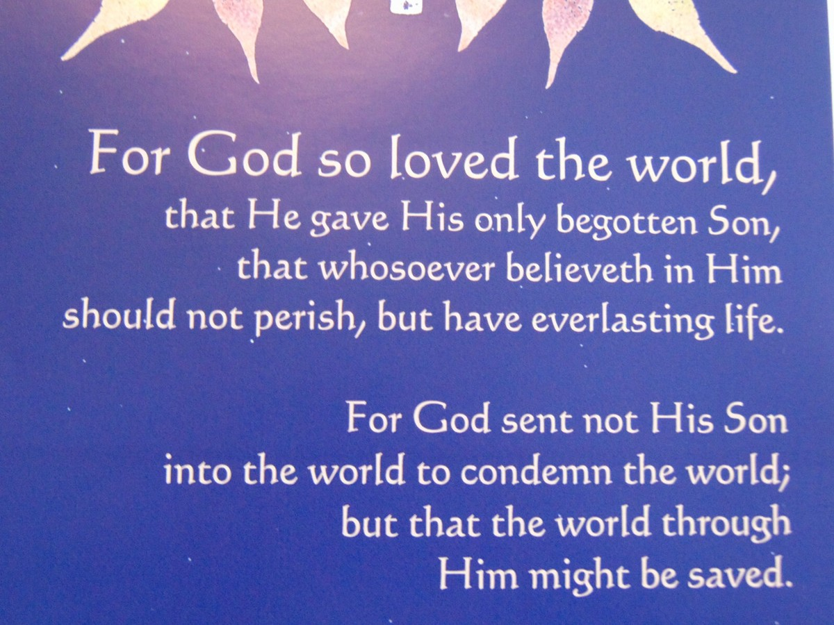

Slide 7
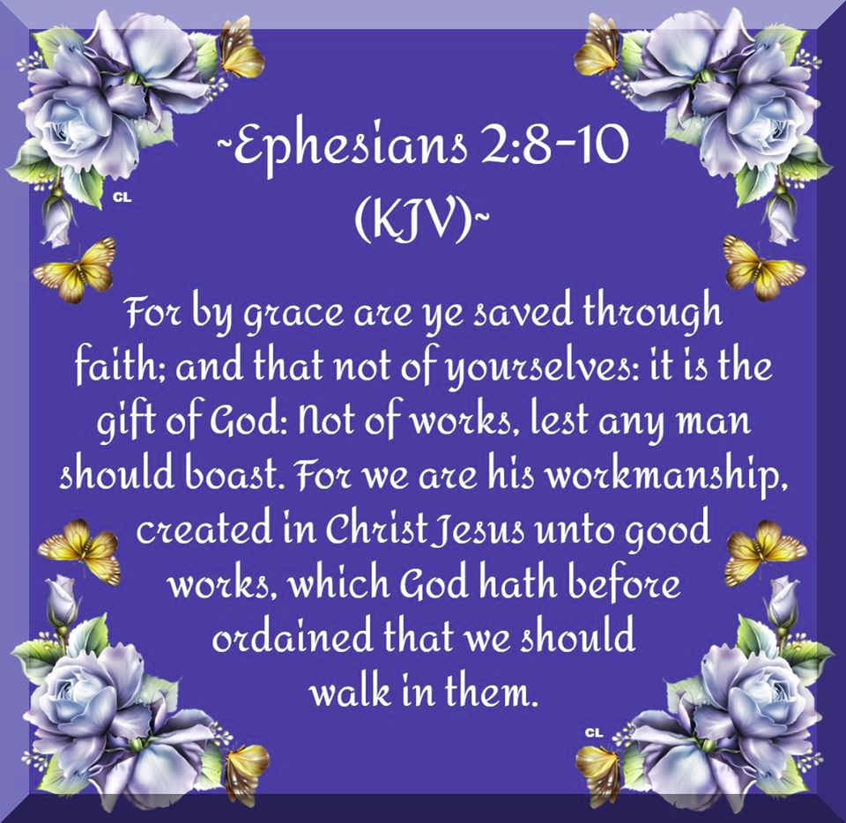

Slide 8
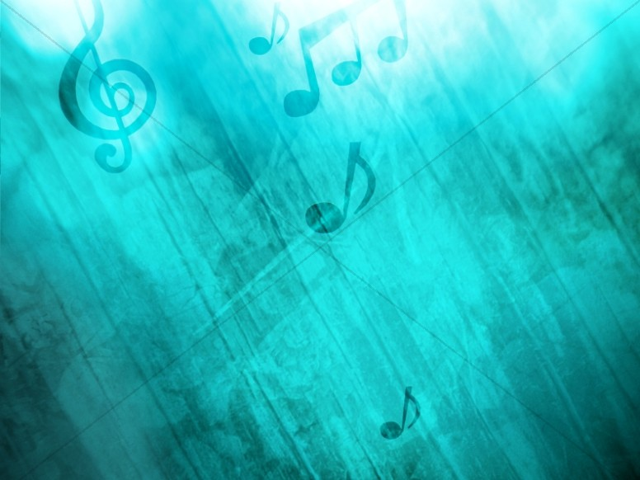
Opening Hymn
#294/293
Power
In the Blood

Slide 9
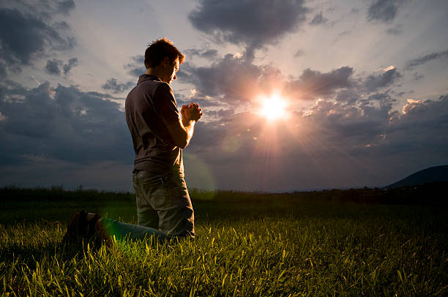
JOIN US IN PRAYER

Slide 10


Slide 11

With Brother Ivan

Slide 12
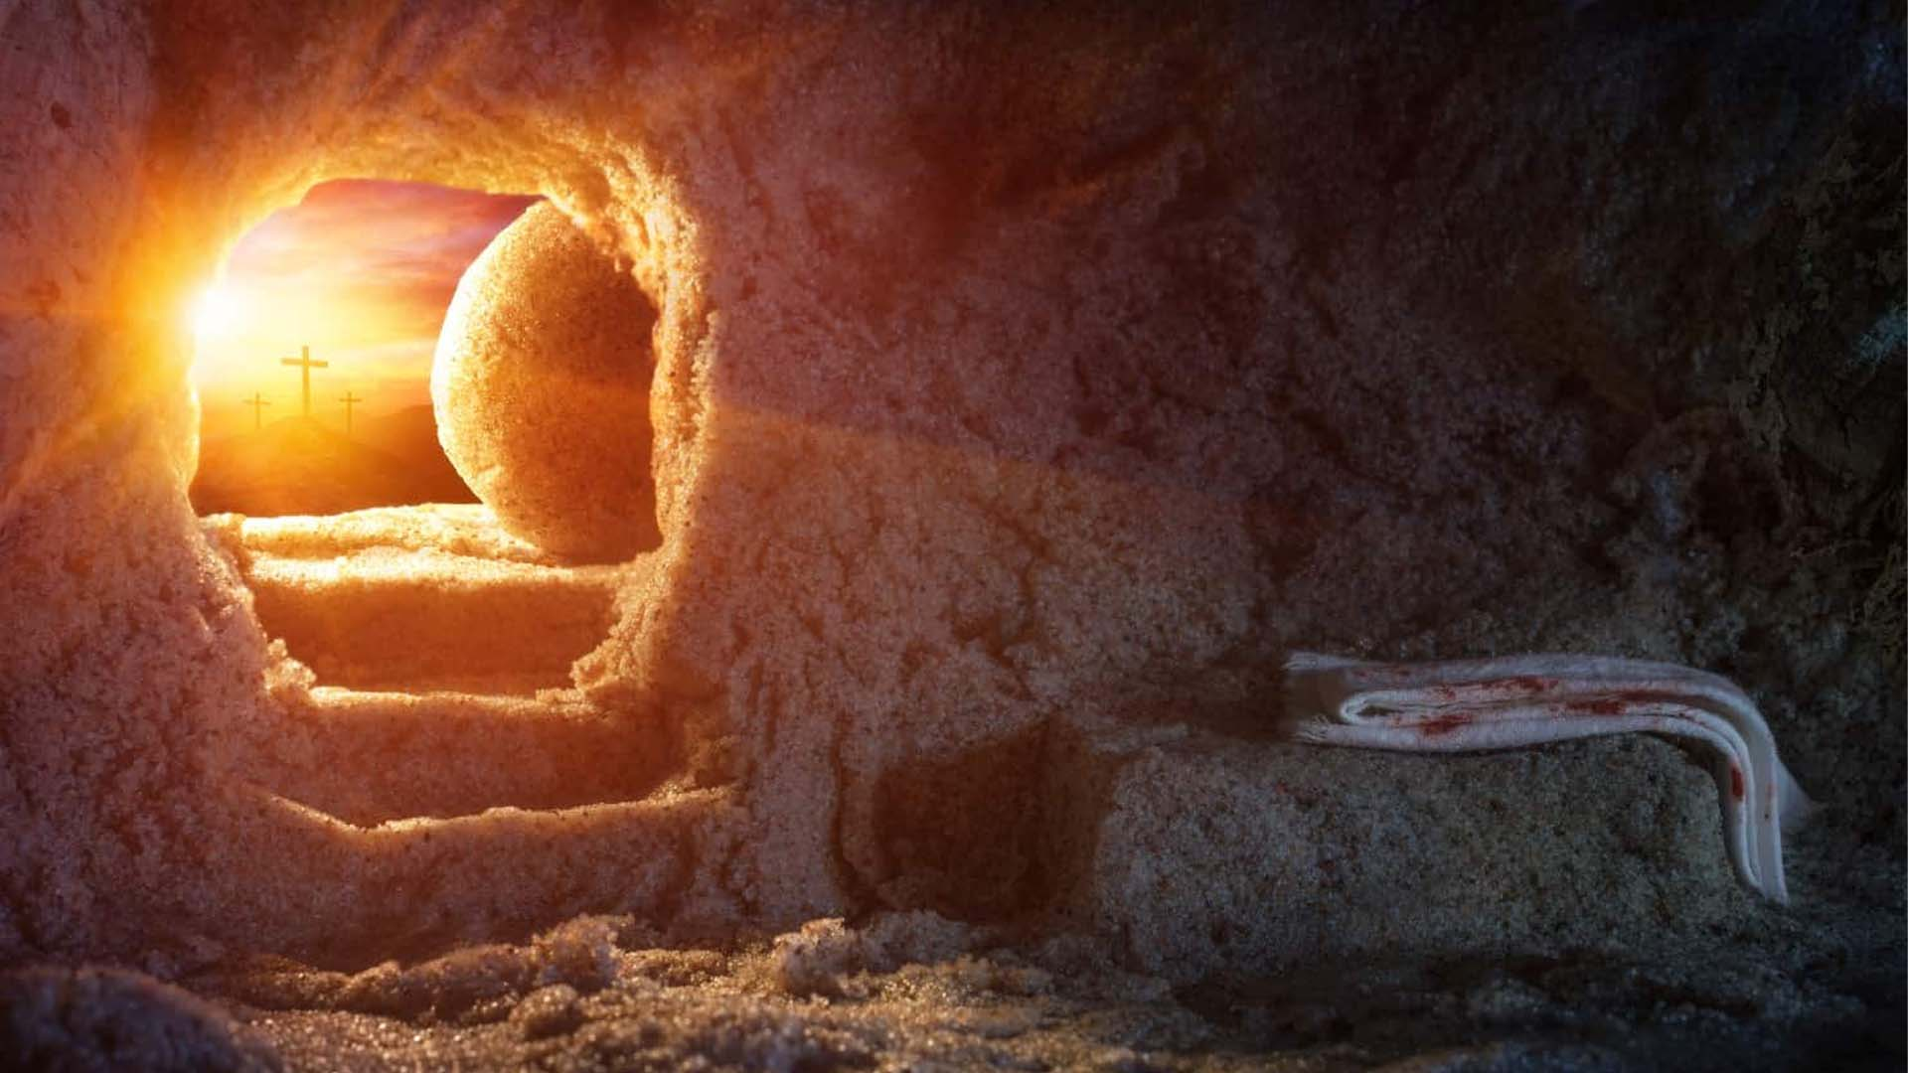
Praise Through Music
At the Cross

Slide 13
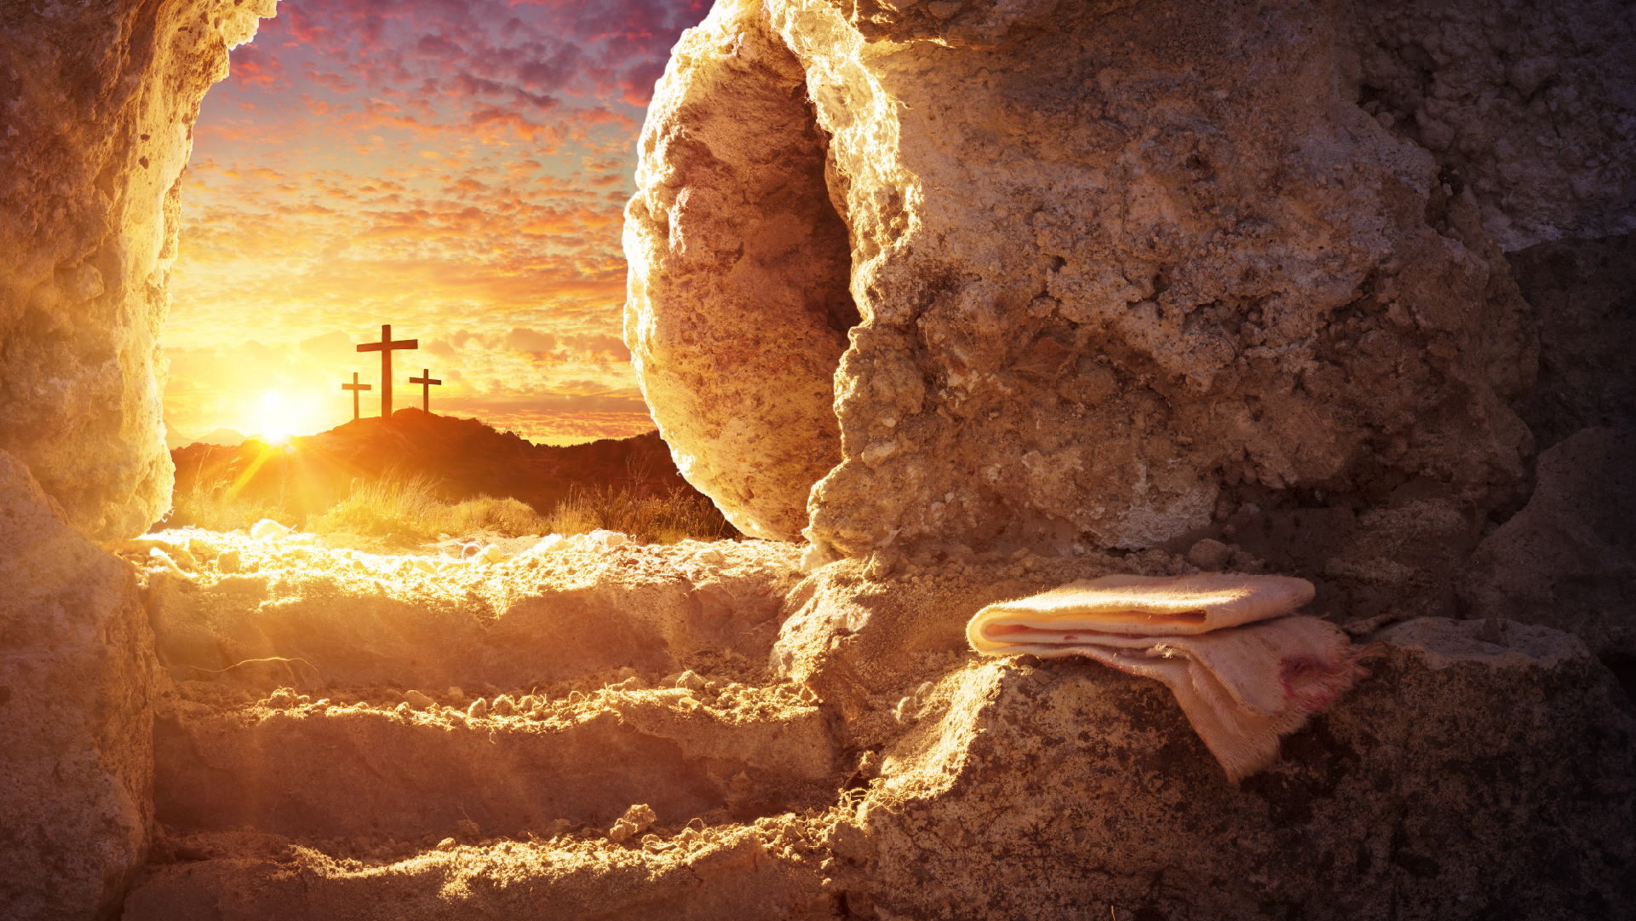
Scripture Reading
Romans 3:24-28

Slide 14
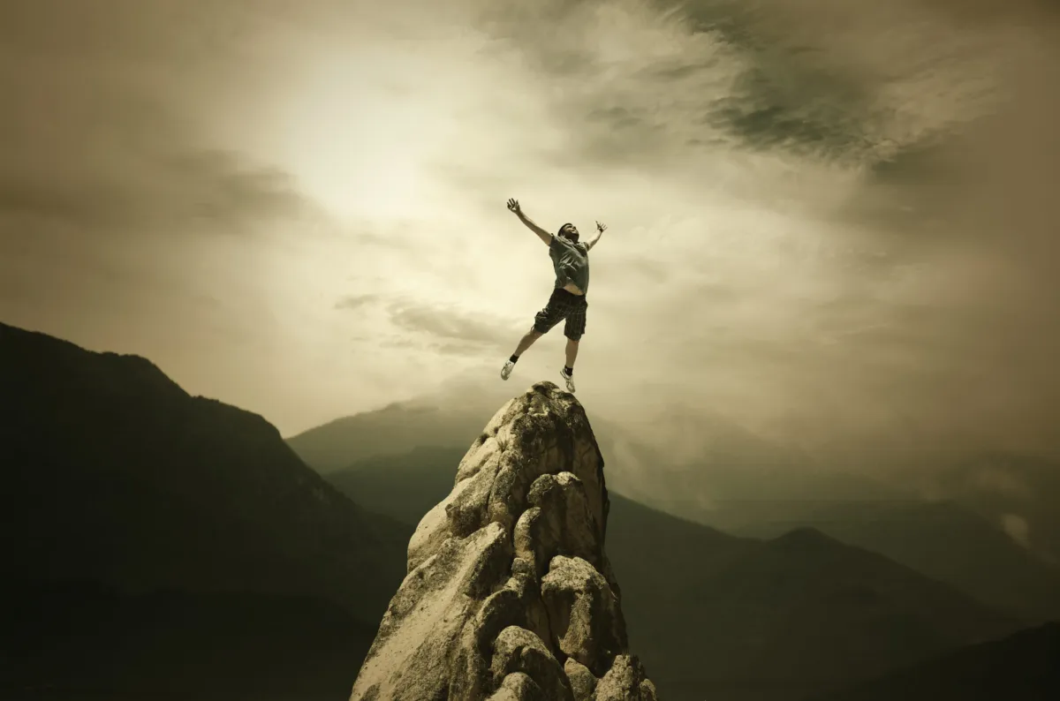
Can You
Live Successfully
Without God

Slide 15
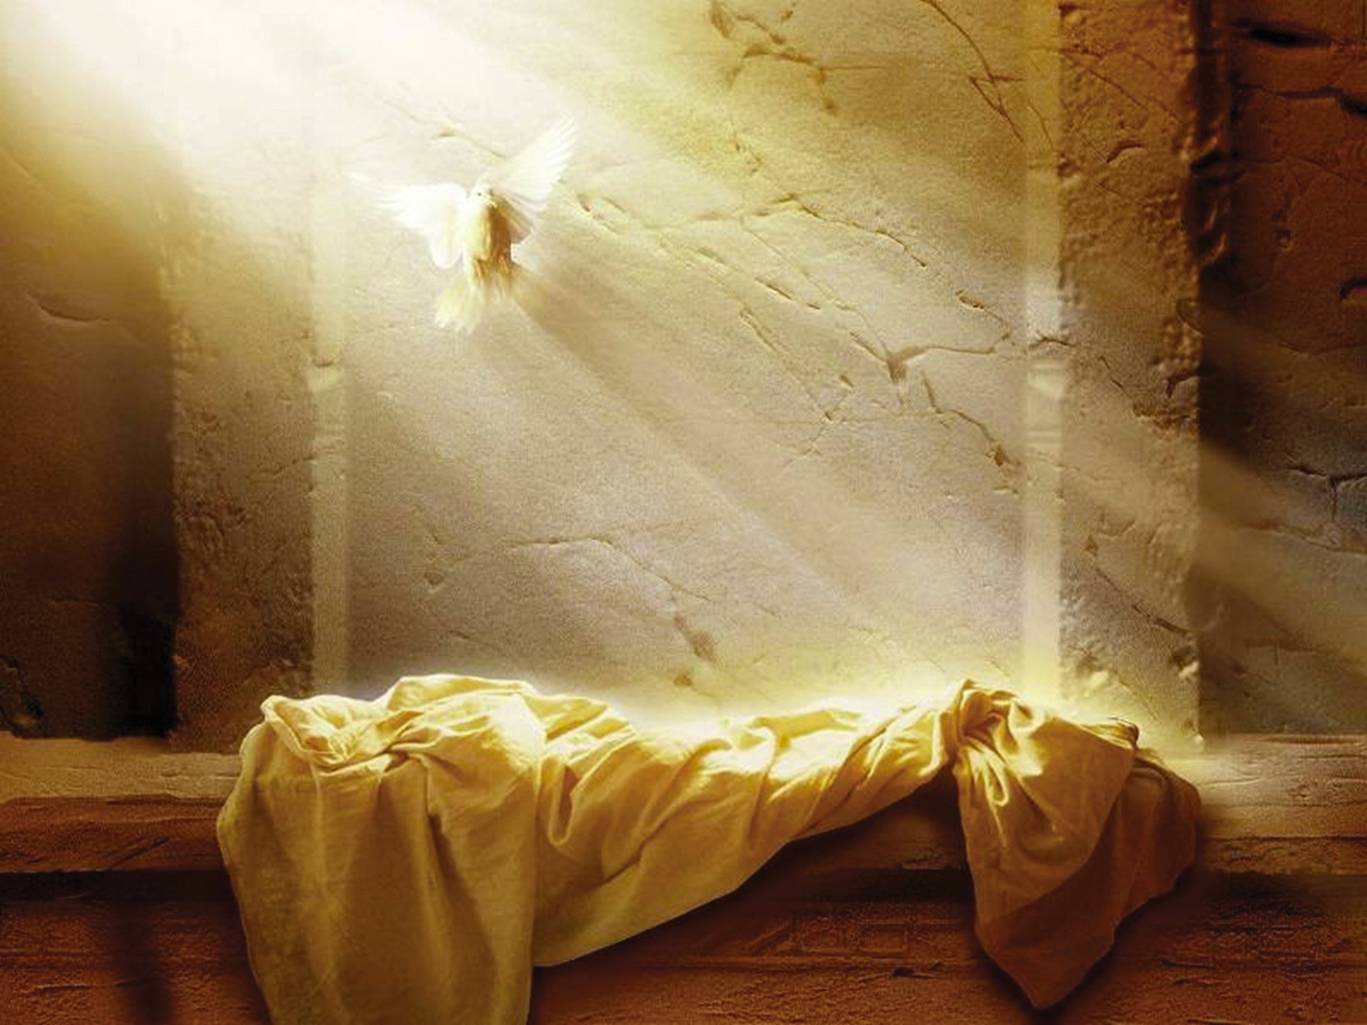
Matthew 16:24
Then Jesus said to His disciples, "If anyone desires to come after Me, let him deny himself,

Slide 16
Matthew 19:17
And He said to him, “. . . If you want to enter into life, keep the commandments.”

Slide 17
1 Corinthians 10:31
Therefore, whether you eat or drink, or whatever you do, do all to the glory of God.

Slide 18
Romans 12:18 NLT
Do all that you can to live in peace with everyone.

Slide 19
Matthew 19:19
'You shall love your neighbor as yourself.' "

Slide 20
Romans 8:4
That the righteous requirement of the law might be fulfilled in us who do not walk according to the flesh but according to the Spirit.

Slide 21
Romans 3:27
Where is boasting then? It is excluded. By what law? Of works? No, but by the law of faith.

Slide 22
Philippians 3:5,6 NLT
I am a . . . real Hebrew if there ever was one! I was a member of the Pharisees, who demand the strictest obedience to the Jewish law. I was so zealous that I harshly persecuted the church. And as for righteousness, I obeyed the law without fault.

Slide 23
Philippians 3:7-10 NLT
I once thought these things were valuable, but now I consider them worthless because of what Christ has done. Yes, everything else is worthless when compared with the infinite value of knowing Christ Jesus my Lord. . . .

Slide 24
Philippians 3:7-10 NLT
For his sake I have discarded everything else, counting it all as garbage, so that I could gain Christ and become one with him. I no longer count on my own righteousness through obeying the law; . . . .

Slide 25
Philippians 3:7-10 NLT
rather, I become righteous through faith in Christ. For God's way of making us right with himself depends on faith. I want to know Christ and experience the mighty power that raised him from the dead.

Slide 26
Can You
Live Successfully
Without God

Slide 27
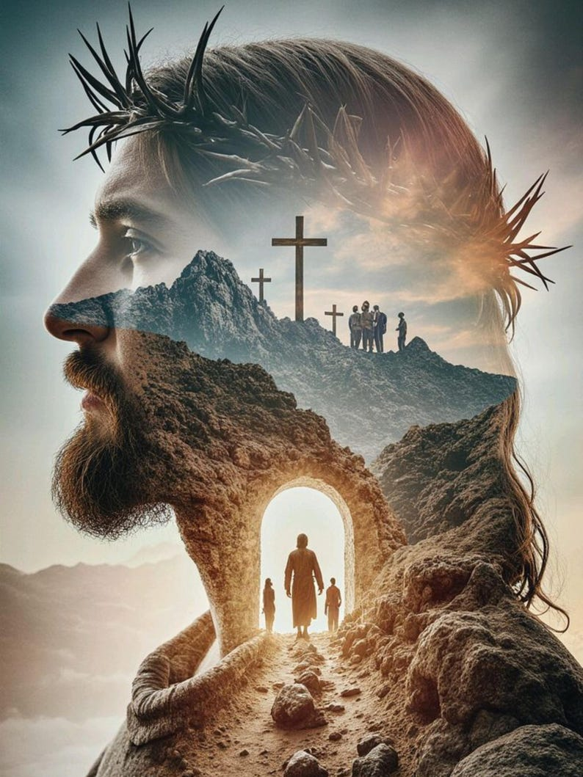
Only
Through
Him

Slide 28
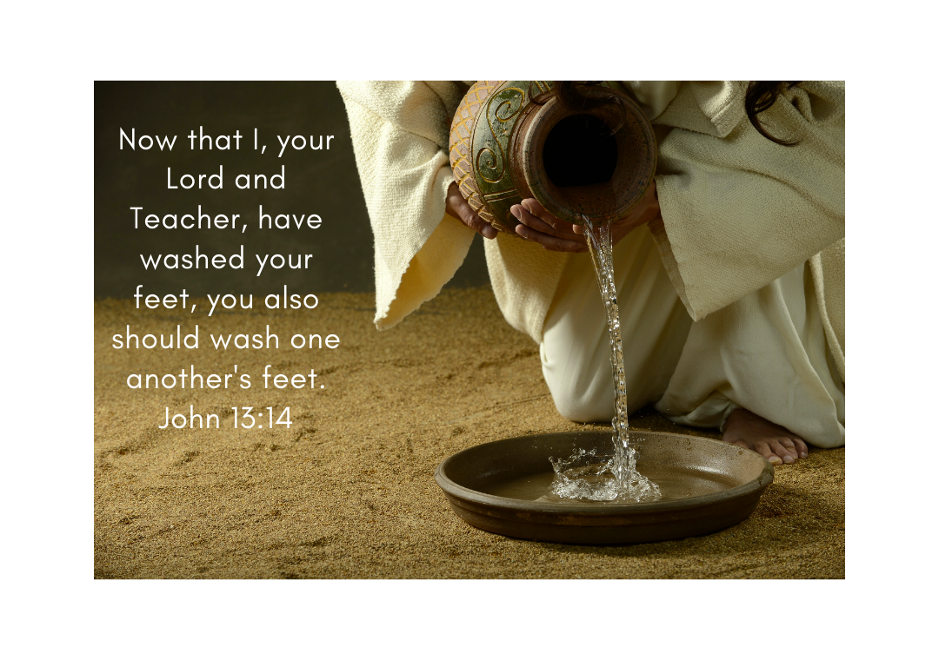

Slide 29
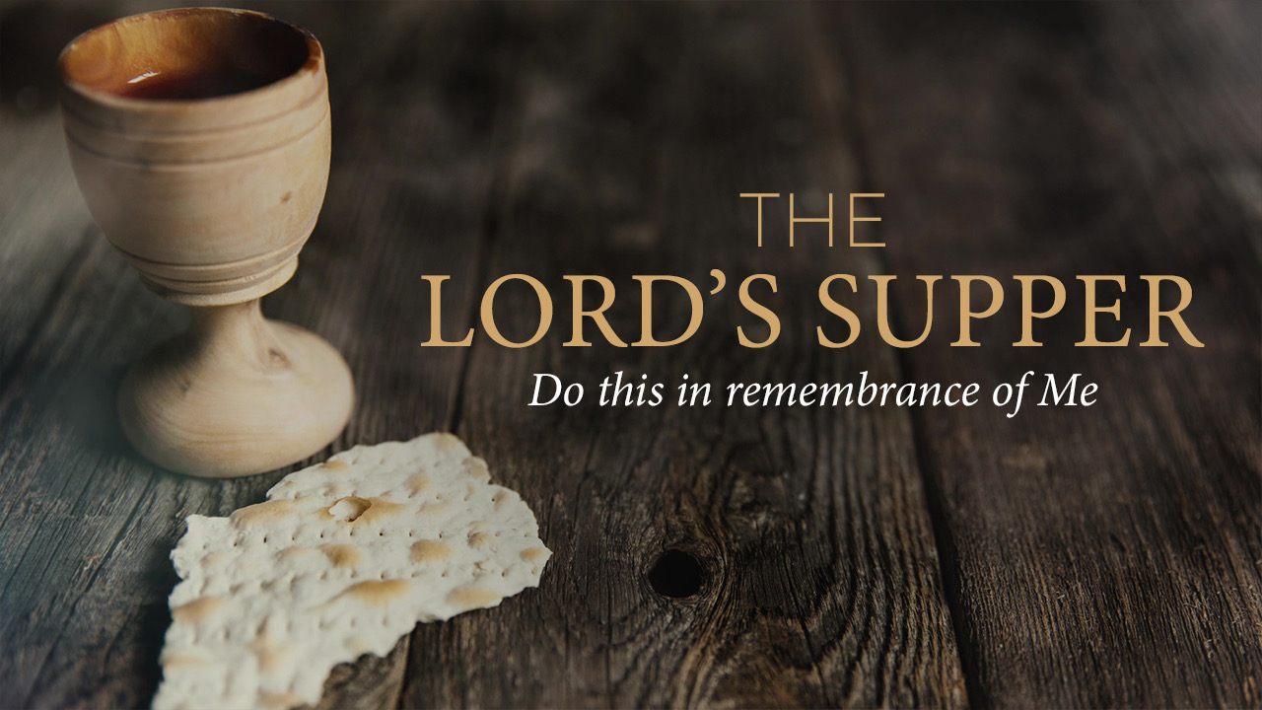

Slide 30
Closing Hymn
#184/284
Jesus Paid It All

Slide 31
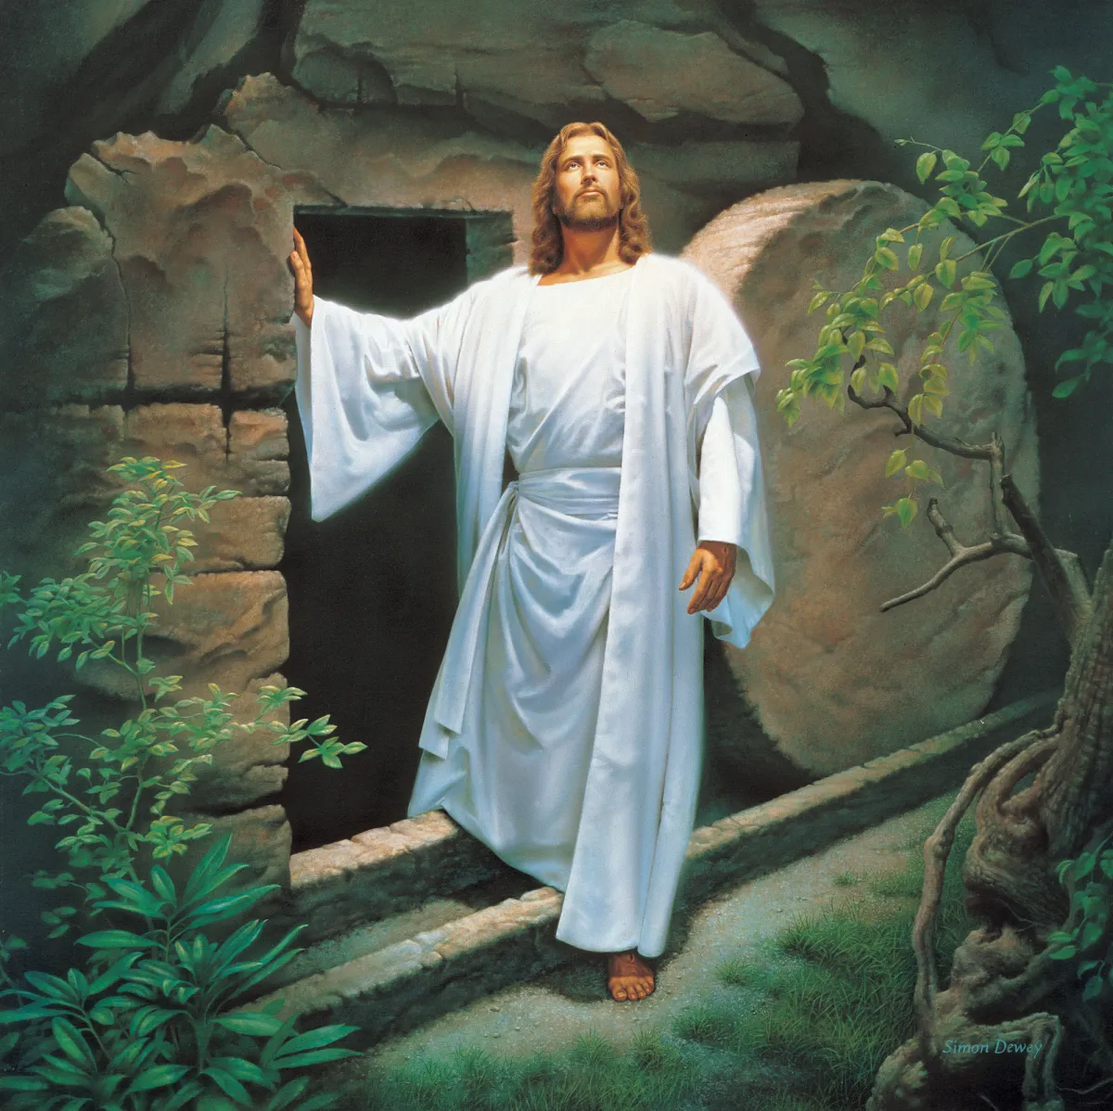
He Lives!

Slide 32


