Slide 2
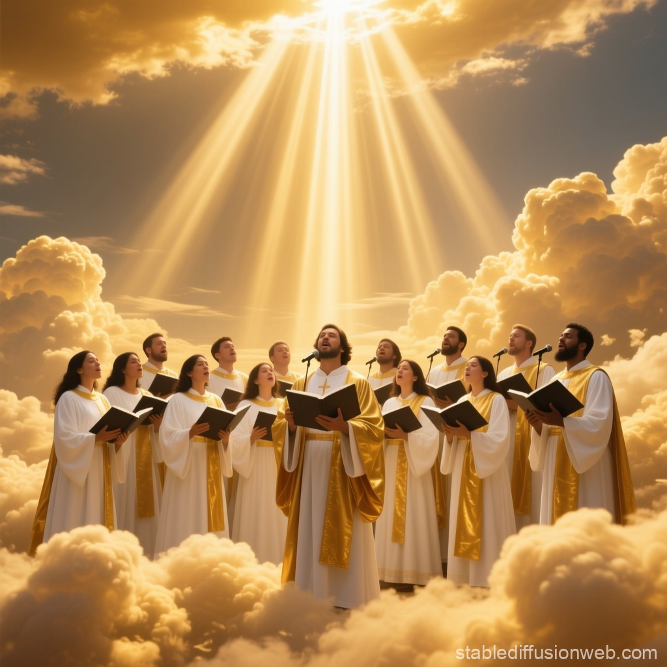
The Music
of Heaven

Slide 3
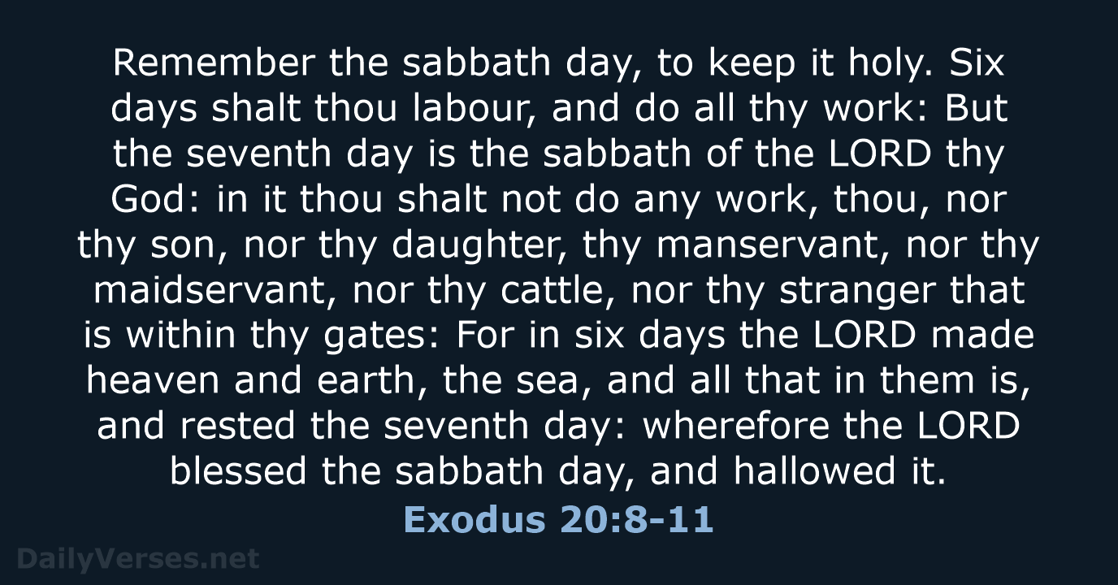

Slide 4


Slide 5

Opening Hymn
#633
When We All
Get to Heaven

Slide 6
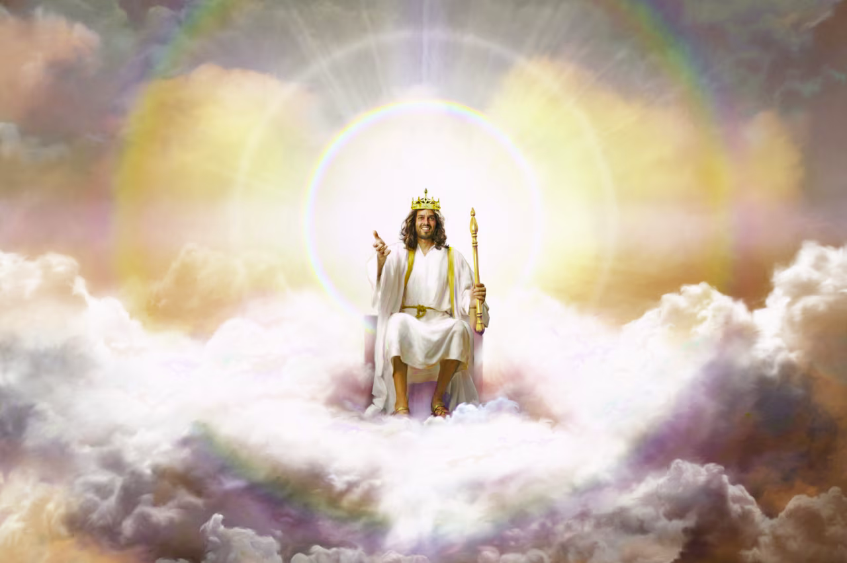

Slide 7
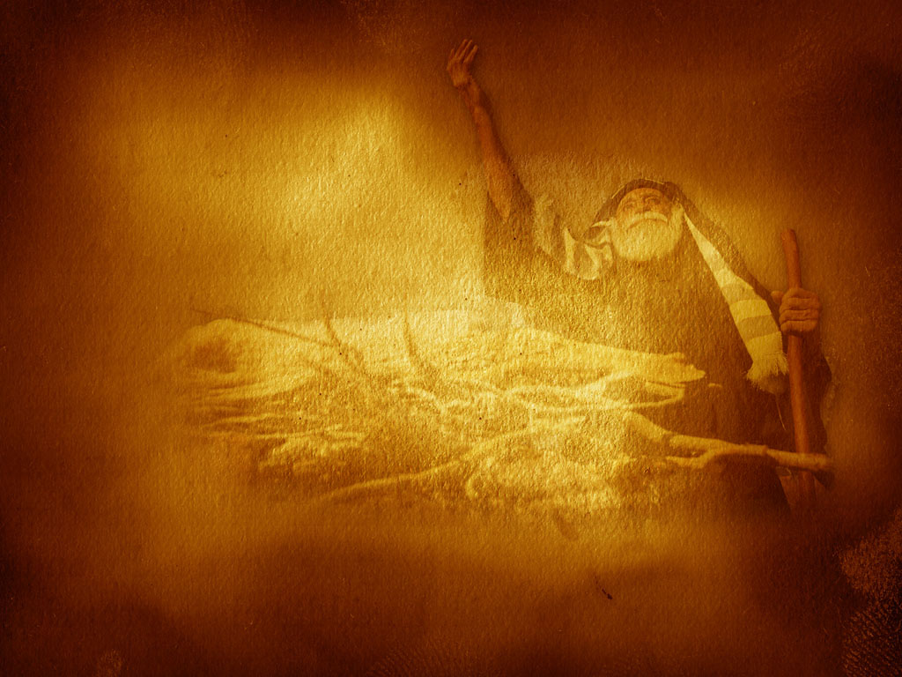
Scripture Reading
1 Corinthians 2:7-9

Slide 8
The Music
of Heaven

Slide 9
28 The New Earth
On the new earth, in which righteousness dwells, God will provide an eternal home for the redeemed and a perfect environment for everlasting life, love, joy, and learning in His presence. For here God Himself will dwell with His people, and suffering and death will have passed away. . . .

Slide 10
28 The New Earth
. . . . The great controversy will be ended, and sin will be no more. All things, animate
and inanimate, will declare that God is love; and He shall reign forever. Amen.

Slide 11

Isaiah 35

Slide 12
Isaiah 65:17-25

Slide 13

Matthew 5:5
Blessed are the meek, For they shall inherit the earth.

Slide 14
2 Peter 3:13
Nevertheless we, according to His promise, look for new heavens and a new earth in which righteousness dwells.

Slide 15
Revelation 11:15
Then the seventh angel sounded: And there were loud voices in heaven, saying, "The kingdoms of this world have become the kingdoms of our Lord and of His Christ, and He shall reign forever and ever!"

Slide 16
Revelation 21:1-7

Slide 17
Revelation 22:1-5

Slide 18
The Music
of Heaven

Slide 19


Slide 20
Closing Hymn
#432
Shall We Gather
at the River

Slide 21
The Music
of Heaven

Slide 23
Pet
There

Slide 24
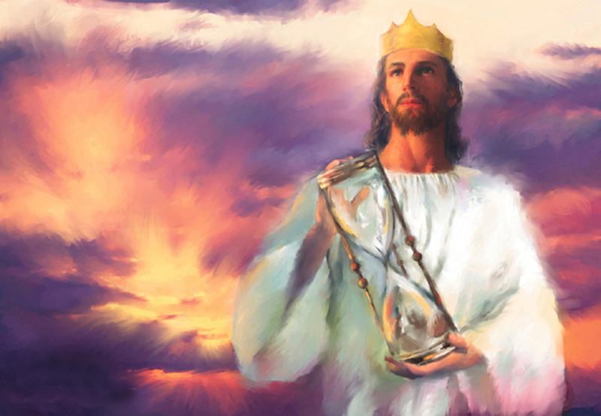

Slide 32
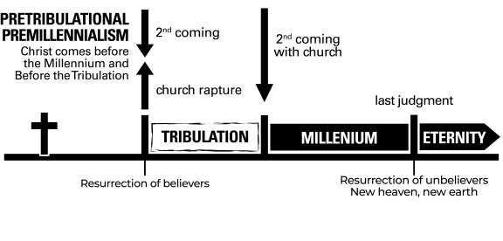

Slide 33

Millennium
Resurrection of Life at 2nd Coming

Slide 34

The Fires of Hell

Slide 35
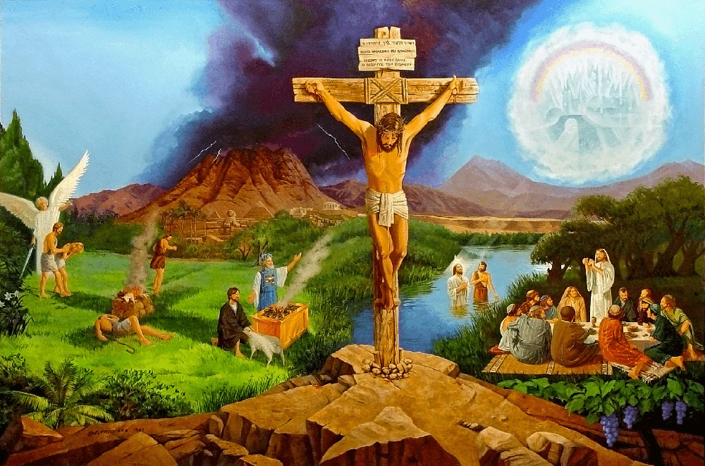

Slide 37
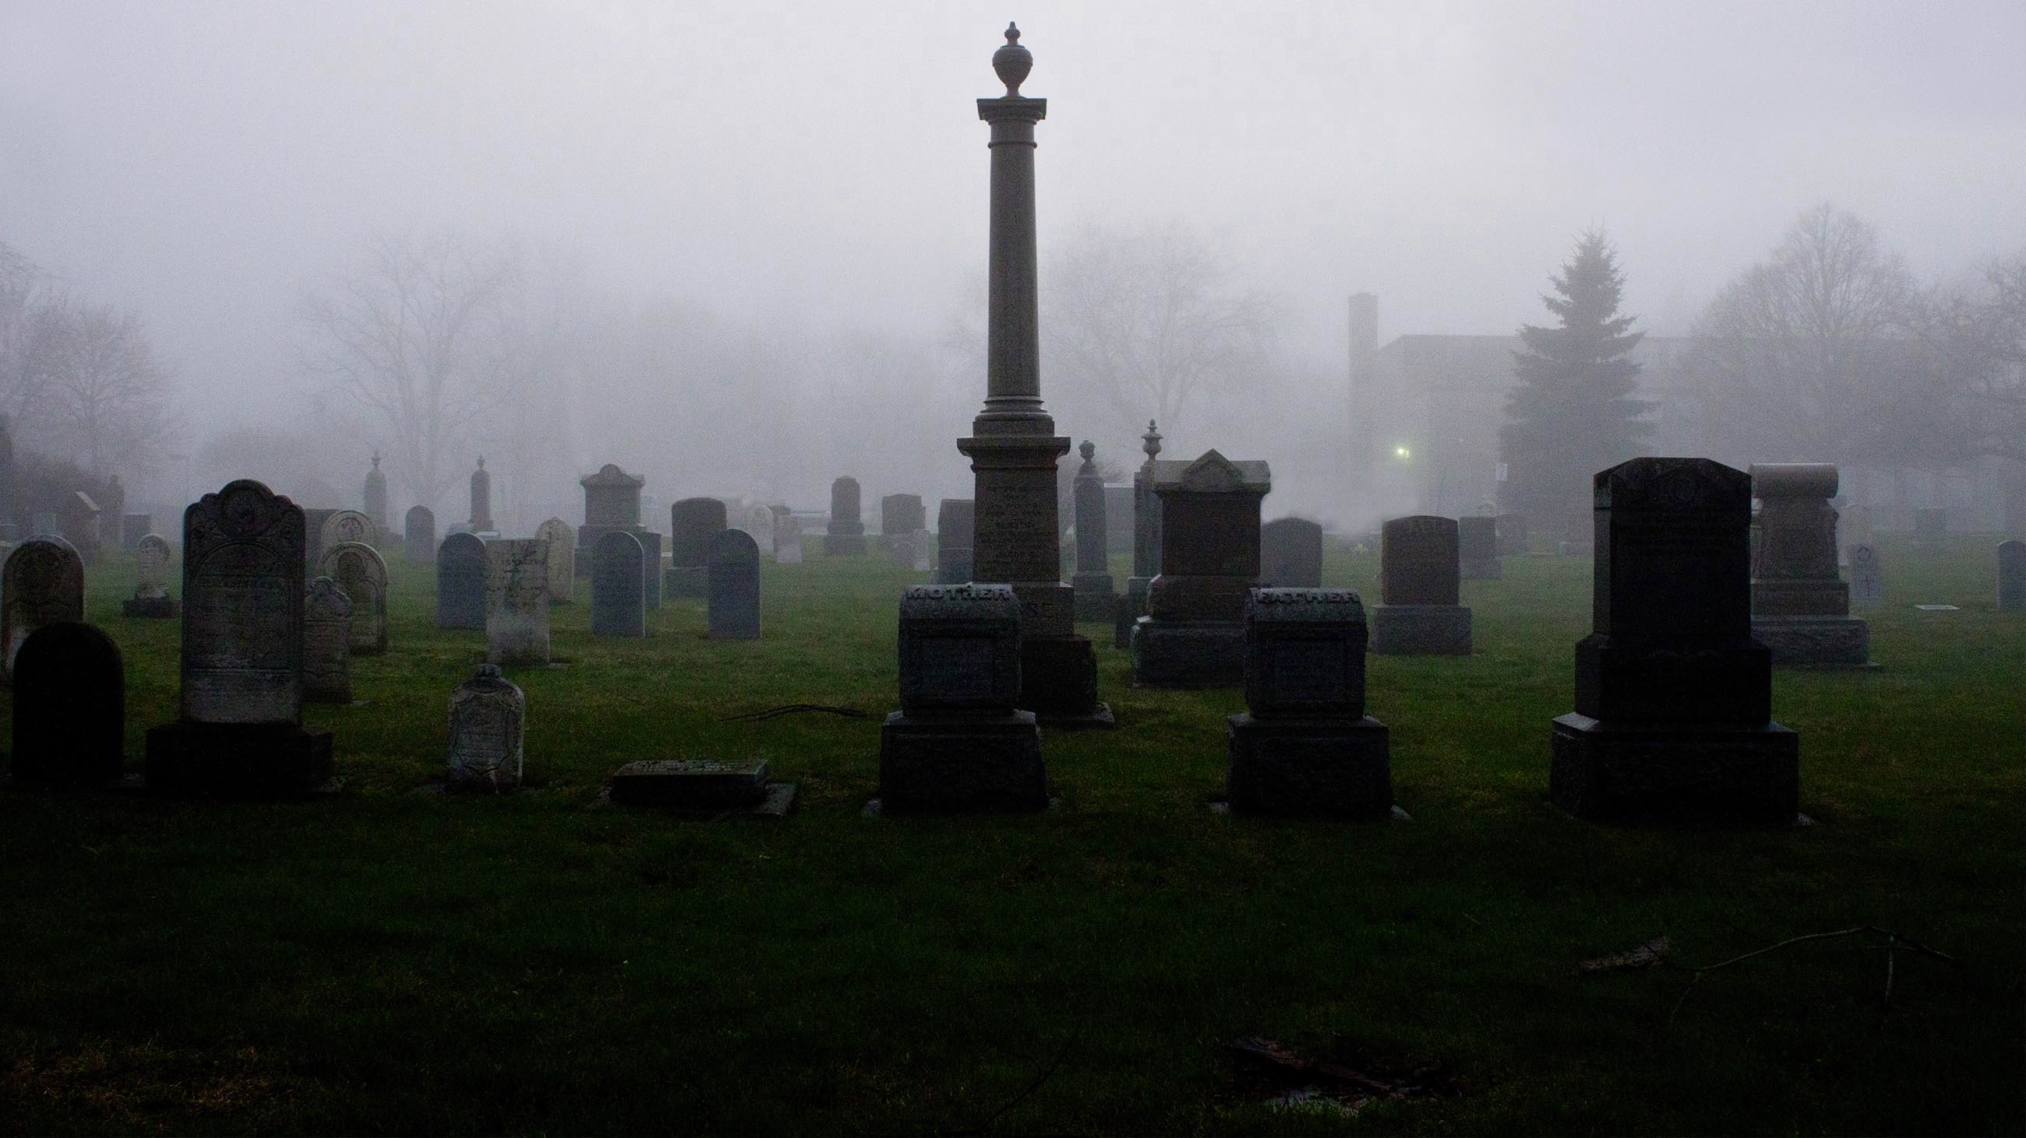
Are the Dead Really Dead
Death is the Opposite of Life
Sin Brought Mortality not Immortality

Slide 39

John
If

Slide 40

Romans
free

Slide 41
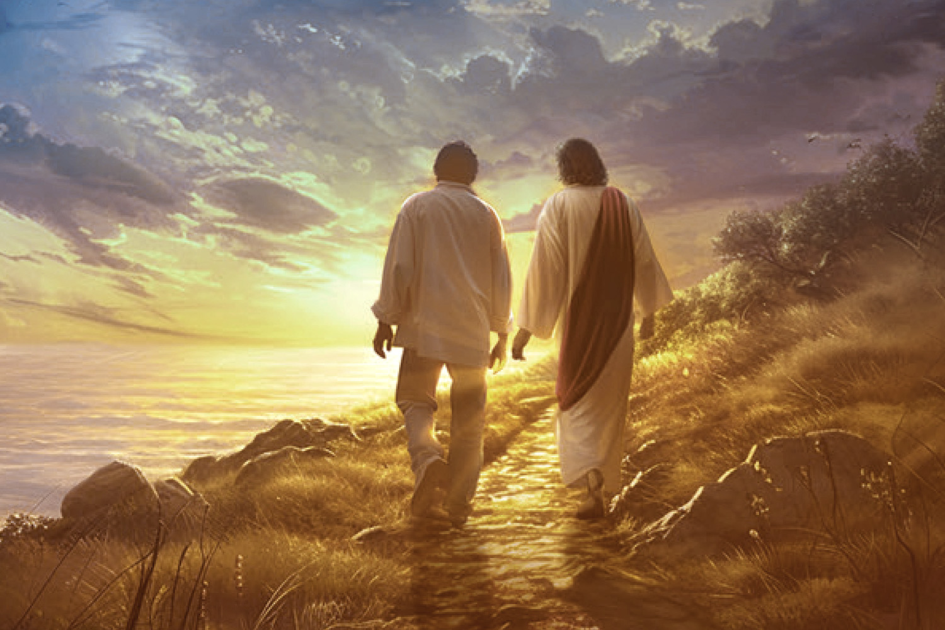
Friends do the “told” without being told

Slide 42
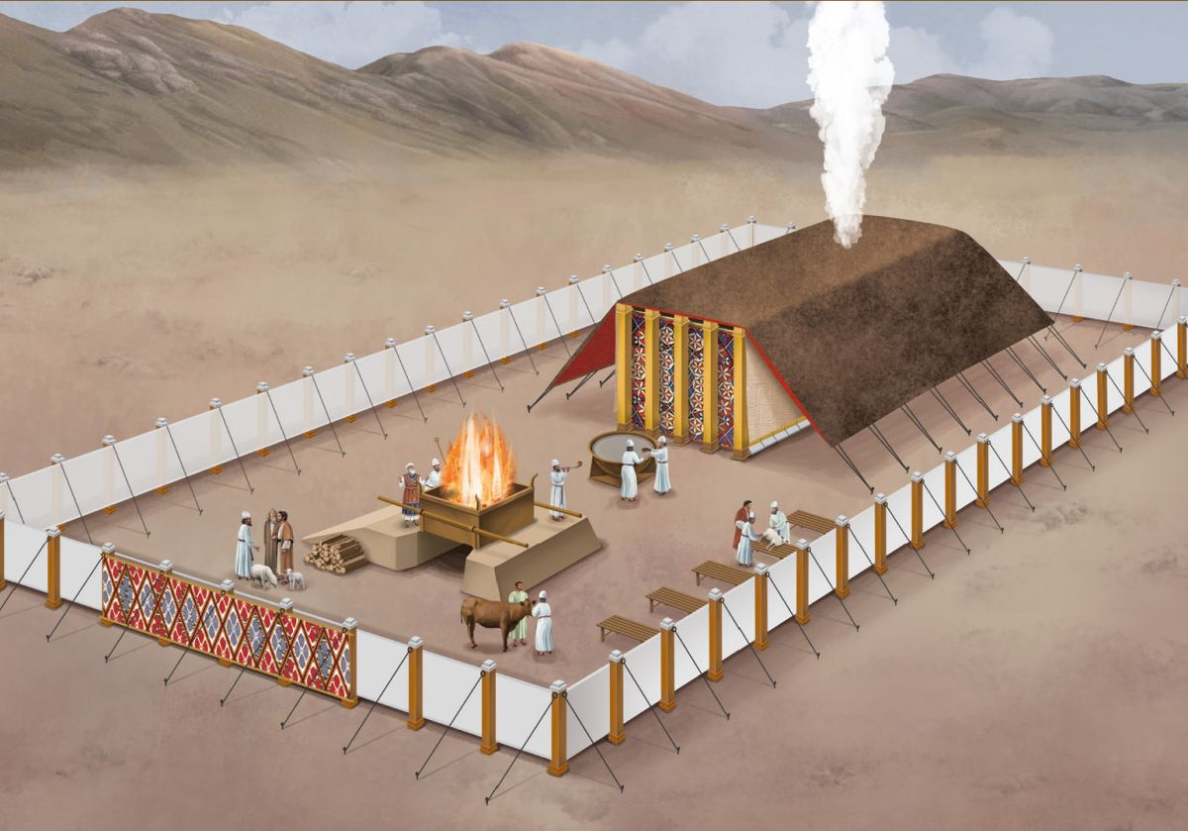
The Making or Breaking
of
Adventism

Slide 43
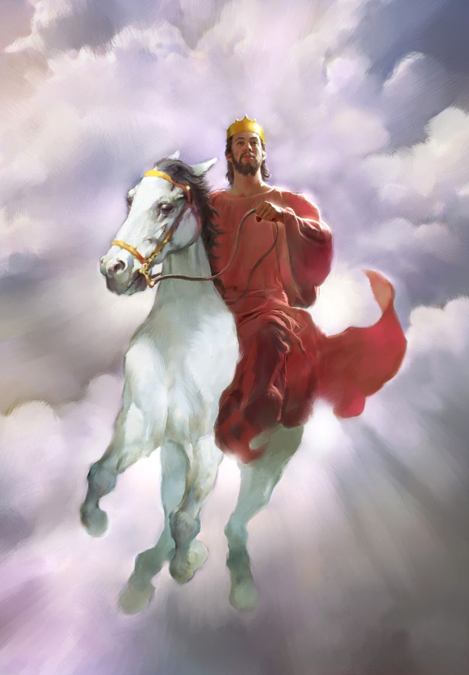
Plan of Salvation & Cosmic Conflict

Slide 44

1. Creator & Sacrifice

Slide 45
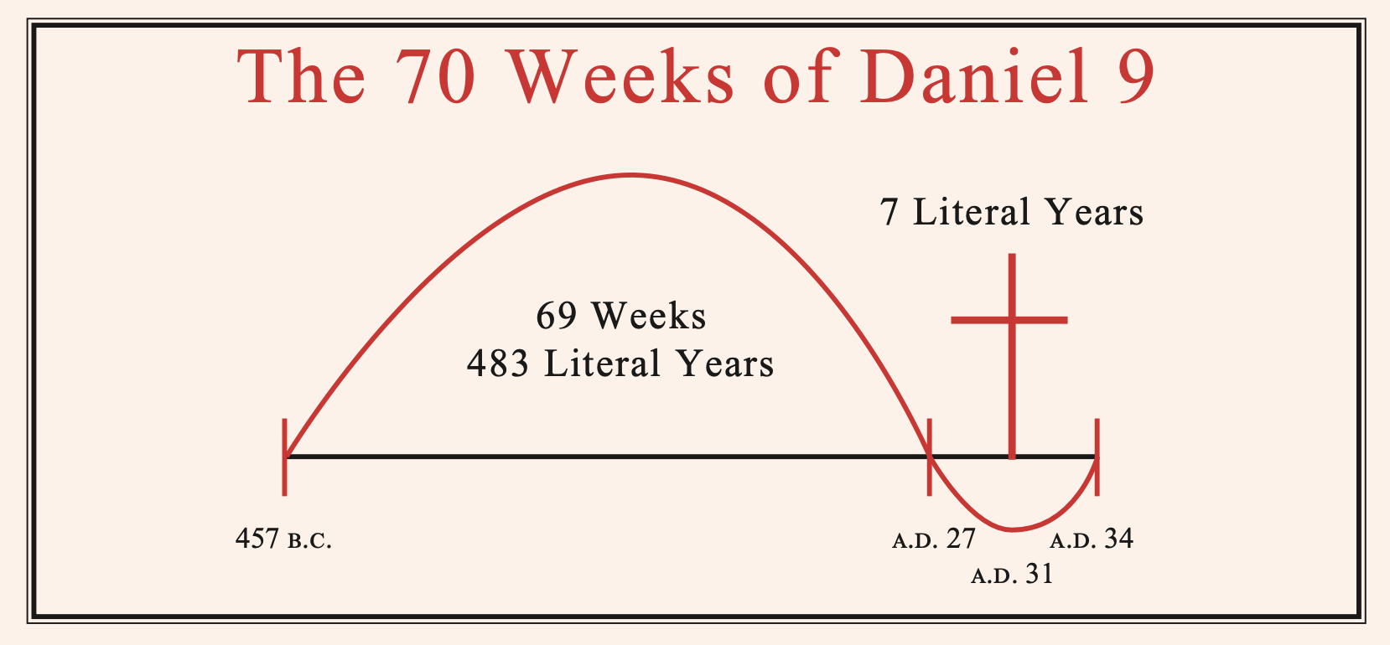
Sacrifice

Slide 46
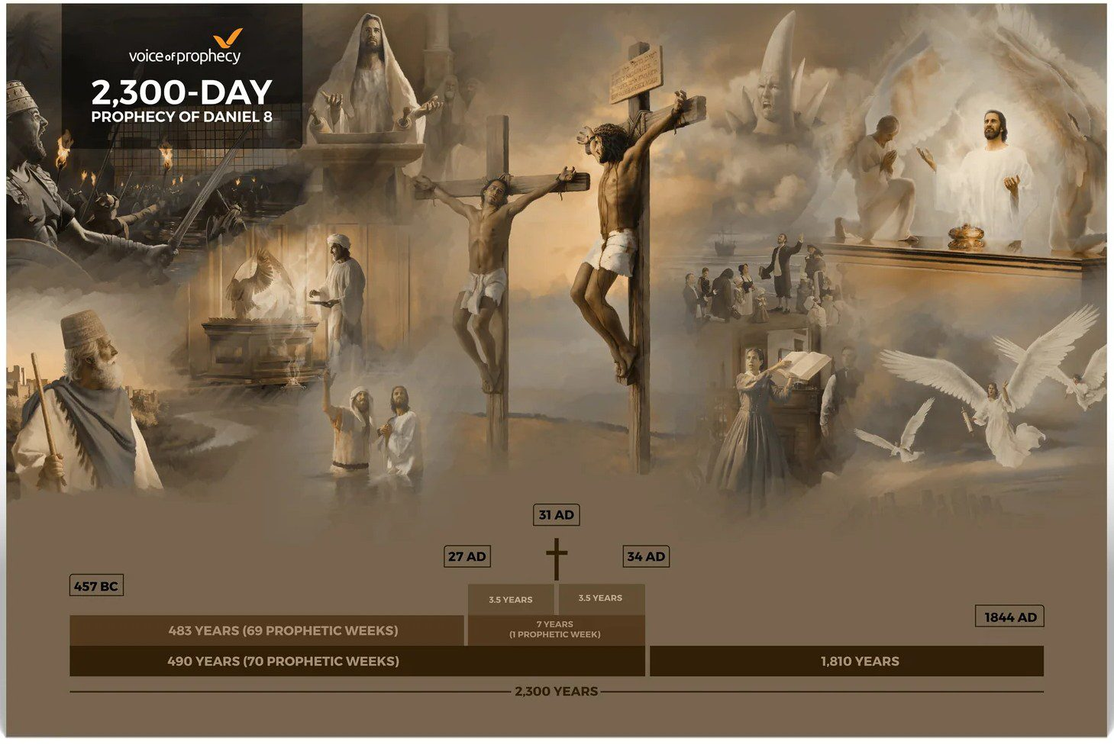
Judgment

Slide 47
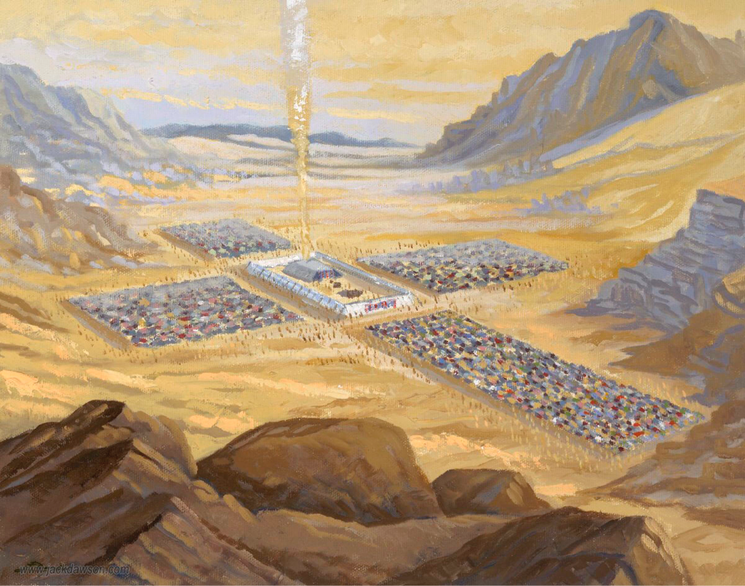
Cor
But

Slide 48

Headship Views
Traditional Christian: Unconditional Acceptance
Non-Traditional Christian: Context of Society Changes
Non-Christian: Archaic & Irrelevant

Slide 49

Headship in the Bible
God, the Head of Christ
Christ, the Head of Man
& the Church as a Whole
3. Man, the Head of Woman

Slide 50

Calvinist
View
Armenian
View
Sovereignty vs Character

Slide 51
Character
Before
Authority

Slide 52

Exo
thy

Slide 53

Leviticus 11

Slide 54

Marriage and the Family
Amusements & Entertainment
Dress & Adornment
Care for Our Bodies: Exercise & Rest
Healthy Diet
Unclean Foods
Alcohol, Tobacco, Recreational Drugs
Discipline: Wholesomeness, Joy, & Goodness

Slide 55


Slide 56


Slide 57

Therefore every teacher of the Gospel, who has been trained in the kingdom of heaven, is like the owner of a home, who brings out of his storage room, new gems of truth, as well as old.
(Matt. 13:52 Paraphrase)

Slide 58

Mark 12:41-44

