Slide 2

The Fires of Hell

Slide 3
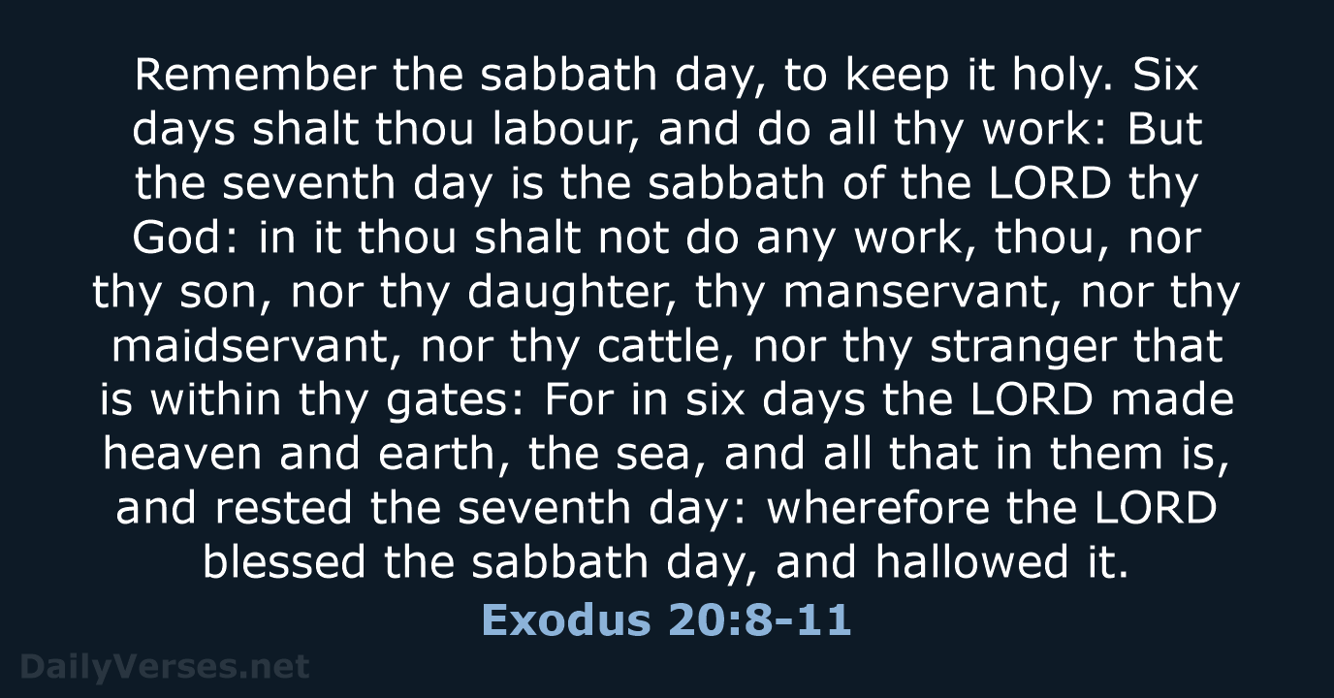

Slide 4
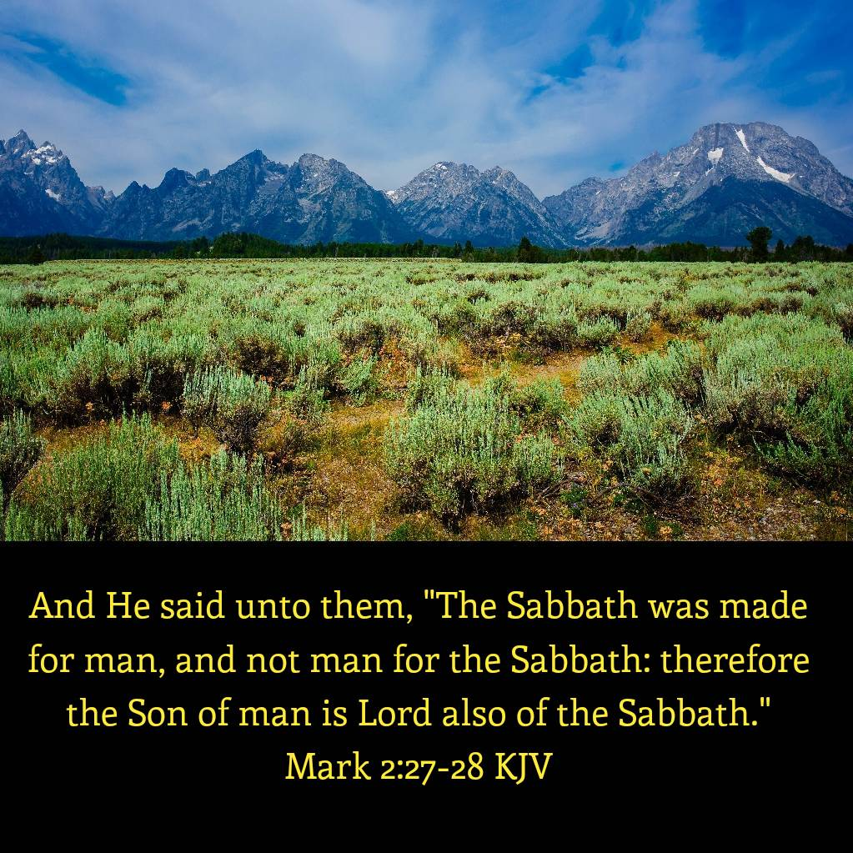

Slide 5

Opening Hymn
#506
A Mighty Fortress

Slide 6
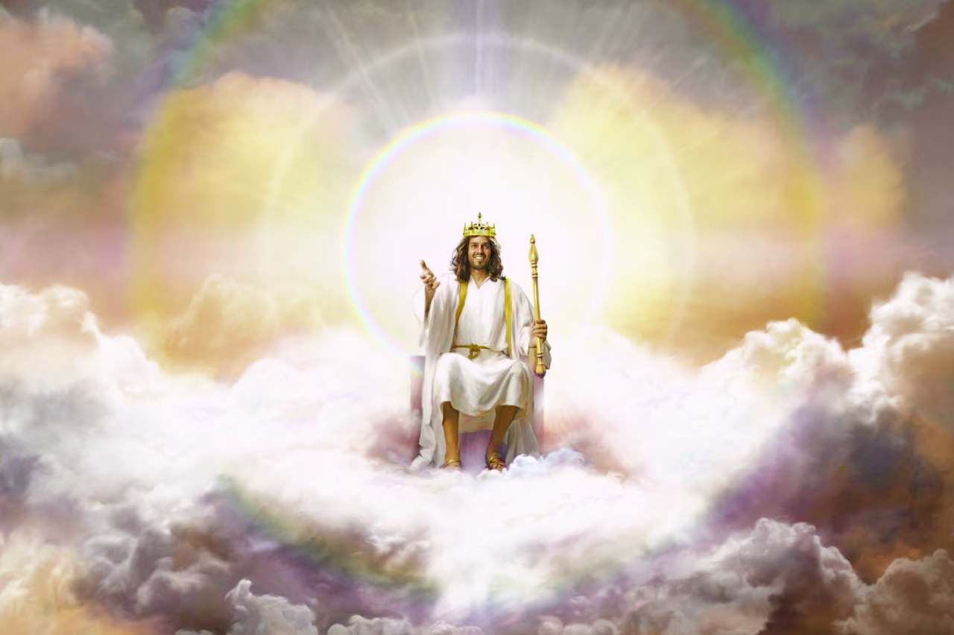

Slide 7
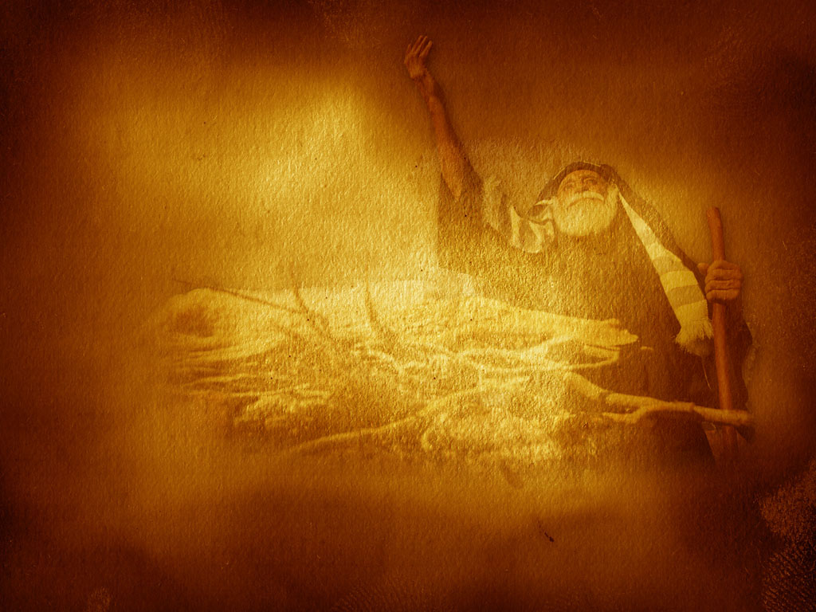
Scripture Reading
Matthew 10:27-28

Slide 8
The Fires of Hell

Slide 9

Augustine
“The spirit whose presence animates and rules the body can both suffer pain and can not die.

Slide 10
Augustine
“The spirit whose presence animates and rules the body can both suffer pain and can not die.
Genesis 2:17
But of the tree of the knowledge of good and evil, thou shalt not eat of it: for in the day that thou eatest thereof thou shalt surely die.

Slide 11
Jonathan Edwards
“The righteous are no more in the very words said to be immortal in happiness, than the wicked are said to be immortal in misery. The wicked have immortality.”

Slide 12
Romans 2:7 eternal life to those who by patient continuance in doing good seek for glory, honor, and immortality;
Jonathan Edwards
“The righteous are no more in the very words said to be immortal in happiness, than the wicked are said to be immortal in misery. The wicked have immortality.”

Slide 13
John Wesley
“For neither the righteous nor the wicked were to die any more.”

Slide 14
John Wesley
“For neither the righteous nor the wicked were to die any more.”
Genesis 3:4
And the serpent said unto the woman, Ye shall not surely die:

Slide 15
Charles Spurgeon
“Man was condemned to live forever in hell.”

Slide 16
Romans 5:12
Therefore, just as through one man sin entered the world, and death through sin, and thus death spread to all men, because all sinned --
Charles Spurgeon
“Man was condemned to live forever in hell.”

Slide 17
Chuck Swindoll
Everybody has eternal life because everyone has an eternal soul. The issue is not, do I have eternal life. It is rather, where will I spend my eternal life.”

Slide 18
Chuck Swindoll
Everybody has eternal life because everyone has an eternal soul. The issue is not, do I have eternal life. It is rather, where will I spend my eternal life.”
Romans 6:23
For the wages of sin is death, but the gift of God is eternal life in Christ Jesus our Lord.

Slide 19
Norman Geisler
“We've extensively demonstrated that every person's created soul will consciously live forever in either heaven or hell.”

Slide 20
Norman Geisler
“We've extensively demonstrated that every person's created soul will consciously live forever in either heaven or hell.”
John 11:14
Then Jesus said to them plainly, "Lazarus is dead.

Slide 21
William Lane Craig
“You will live forever either with Christ or apart from him.”

Slide 22
Romans 6:21
What fruit did you have then in the things of which you are now ashamed? For the end of those things is death.
William Lane Craig
“You will live forever either with Christ or apart from him.”

Slide 23
John Piper
“You are an embodied soul who will live forever in heaven or in hell.”

Slide 24
1 John 5:11-12
God has given us eternal life, and this life is in His Son. He who has the Son has life; he who does not have the Son of God does not have life.
John Piper
“You are an embodied soul who will live forever in heaven or in hell.”

Slide 25
John MacArthur
“The message of the Bible is that death does not end the existence of anyone that every human being who has ever lived will live forever either in hell or in heaven.”

Slide 26
John MacArthur
“The message of the Bible is that death does not end the existence of anyone that every human being who has ever lived will live forever either in hell or in heaven.”
1 Corinth. 15:52-53
In a moment, in the twinkling of an eye, at the last trump: . . . For this corruptible must put on incorruption, and this mortal must put on immortality.

Slide 27
Billy Graham
“The soul will never die, but will live forever in either heaven or hell.”

Slide 28
Billy Graham
“The soul will never die, but will live forever in either heaven or hell.”
Ezekiel 18:20
The soul who sins shall die.

Slide 29
Introduction to Biblical Interpretation, 3rd Edition
“Symbolism depicts past, present and future events in a way that requires a careful decoding of the elements of the text. Most importantly, we must recognize that revelation employs highly symbolic and figurative imagery that we dare not interpret to literally. It is crucial therefore to discover the symbolic elements of Revelation and seek to determine what they represent. . . .

Slide 30
Introduction to Biblical Interpretation, 3rd Edition
. . . . As with parables, certain parts of the Bible parts of an apocalyptic vision may function only to add life, color, or drama to the picture. The prophecies predict literal events, though the descriptions do not portray the events literally. Literal passages are more determinative than symbolic ones. . . .

Slide 31
Introduction to Biblical Interpretation, 3rd Edition
. . . . For ascertaining meaning, literal passages provide more solid ground than symbolic ones. Passages that are highly symbolic in nature, such as the book of Revelation, should be interpreted in line with what is clearly and unambiguously stated in other passages.

Slide 32
Nicholas Berdyev, a Russian political and Christian religious philosopher
“I can conceive of no more powerful and irrefutable argument in favor of atheism than the eternal torments of hell. If hell is eternal, then I am an atheist.”

Slide 33
Charles Darwin, Autobiography
I can indeed hardly see how anyone ought to wish Christianity to be true. For if so, the plain language of the text seems to show that the men who do not believe, and this would include my father, brother, and almost all of my friends, will be everlasting punished. And this is a damnable doctrine.

Slide 34
Robert Ingersoll, 19th century agnostic
“Nothing could add to the horror of hell except the presence of its creator God. As long as I have life and draw breath I shall deny with all my strength and hate with every drop of my blood this infinite lie. If indeed God did do this, the only thing that would add to the torments of hell would be the presence of the one who invented it

Slide 35
Loren Anderson, prior president of the Pacific Lutheran University
“So revolting to my moral nature is the creed of eternal punishment that it, more than any other cause, produces the most widespread unbelief. Compared with this, all objections to Christianity fade to insignificance.”

Slide 36
“It is beyond the power of the human mind to estimate the evil which has been wrought by the heresy of eternal torment. The religion of the Bible, full of love and goodness, and abounding in compassion, is darkened by superstition and clothed with terror. When we consider in what false colors Satan has painted the character of God, can we wonder that our merciful Creator is feared, dreaded, and even hated? The appalling views of God which have spread over the world from the teachings of the pulpit have made thousands, yes, millions, of skeptics and infidels.”
Great Controversy pg 536

Slide 37
John Stott, Protestant Pastor & Theologian
“Emotionally I find the concept intolerable and do not understand how people can live with it without either cauterizing their feelings or cracking under the strain. But our emotions are a fluctuating, unreliable guide to truth and must not be exalted to the place of supreme authority and determination.”

Slide 38
John Stott
“As a committed evangelical, my question must be and is, what does God's word say. And in order to answer this question, we need to survey the biblical material afresh and to open our minds to the possibility that scripture points in the direction of annihilation. And that eternal conscious torture is a tradition that has to yield to the supreme authority of scripture.”

Slide 39
Randy Alcorn, Christian Writer
“It will be hell, a place of conscious punishment for sins with no hope of relief. If I had a choice, that is, if scripture were not so clear and conclusive, I would certainly not believe in hell. Trust me when I say I do not want to believe in it.”

Slide 40
John Frame, Christian Writer
“If I were free to invent my own religion, I can assure you that eternal punishment would not be a part of it. But I am, but I must talk about it now because I'm not free to invent my own religion. I must teach only what the Bible teaches, and the Bible certainly has a lot to say about eternal punishment.”

Slide 41
Steve Gregg, Why Hell
“The one fact above all others, which I have desired to get across, is that our view of hell is inseparably joined to our view of God. I believe that many Christians have simply assumed that they already know what the Bible teaches about hell and have formed their notions of the character of God to accommodate their theory.”

Slide 42
It is Satan’s constant effort to misrepresent the character of God, the nature of sin, and the real issues at stake in the great controversy. His sophistry . . . causes them to cherish false conceptions of God so that they regard Him with fear and hate rather than with love. The cruelty inherent in his own character is attributed to the Creator; it is embodied in systems of religion.
Great Controversy 569

Slide 43
C. S. Lewis, The Problem of Pain
“But I notice that our Lord, while stressing the terror of hell with unsparing severity, usually emphasizes the idea not of duration, but of finality. Consignment to the destroying fire is usually treated as the end of the story, not as the beginning of a new story. That the lost soul is eternally fixed in its diabolical attitude, we cannot doubt. But whether this eternal fixity implies endless duration or duration at all, we cannot say.”

Slide 44
Amos Phelps
This doctrine of the natural immortality of the soul can be traced through the muddy channels of a corrupted Christianity, a perverted Judaism, a pagan philosophy and superstitious idolatry; to the great instigator of mischief in the garden of Eden. . .

Slide 45
Amos Phelps
. . . The protestants borrowed it from the Catholics, the Catholics from the pharisees, the pharisees from the pagans, and the pagans from the old serpent who first preached the doctrine amid the lofty bows of paradise. . .

Slide 46
Amos Phelps
. . . to an audience all too willing to hear and heed the new and fascinating theology. ‘You shall not surely die’”

Slide 47
Terrence Tysian
“It is now my firm conviction that if people were not previously taught, as many of us were from childhood, that hell is being consciously tormented forever by God; no one would reach that conclusion from their own careful reading of scripture itself.”

Slide 48
Edward Fudge
“Although simplistic, it is almost fair to say that this whole debate rests finally on one question. Should we interpret dozens of straightforward text throughout the Bible to match the literal sense of two symbolic texts in the apocalypse; or ought we to interpret the two apocalyptic texts symbolically as we should, to conform to the many others.”

Slide 49


Slide 50
Closing Hymn
#272
Give Me the Bible

Slide 51
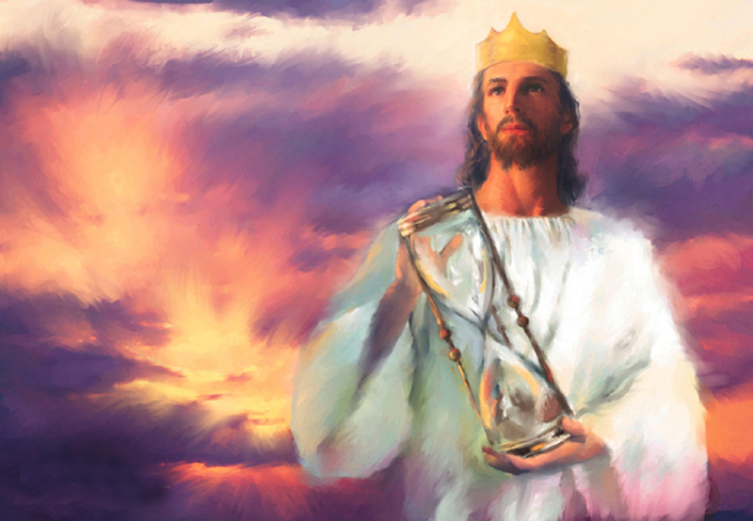

Slide 52
Chan and Sprinkle, Erasing Hell
“The Gehenna is a garbage dump suggestion is also inaccurate. The whole theory actually stands on very shaky evidence. Some commentaries and pastors still promote the idea, but there is no evidence from the time of Jesus that the Hinnom Valley was the town dump. Nor is there any archaeological evidence that this valley was ever a dump.”

Slide 53
Seventh-day Adventist Bible Commentary
“The tradition that makes the Valley of Gehenna a place for burning rubbish, and thus a type of the fires of the last day, appears to have originated with Rabbi Kimhi, a Jewish scholar of the 12th and 13th century. Ancient Jewish literature knows nothing of such an idea.”

