Slide 2
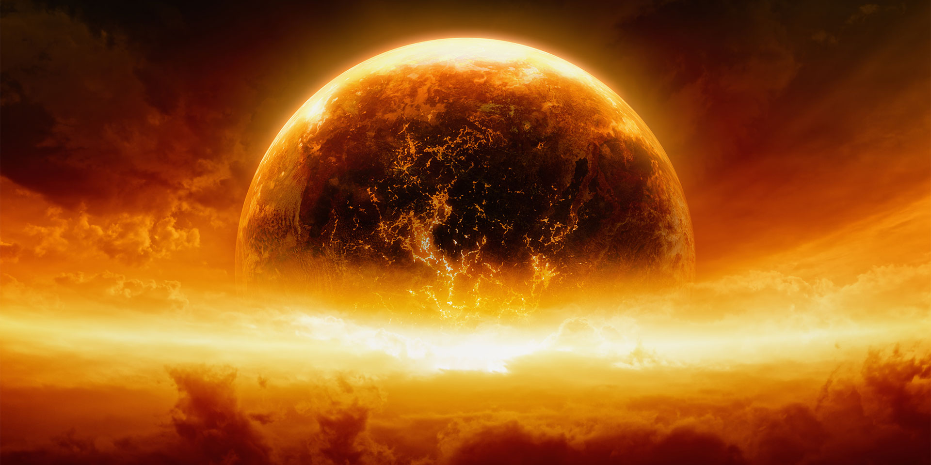
Peace on Earth
or in Heaven

Slide 3
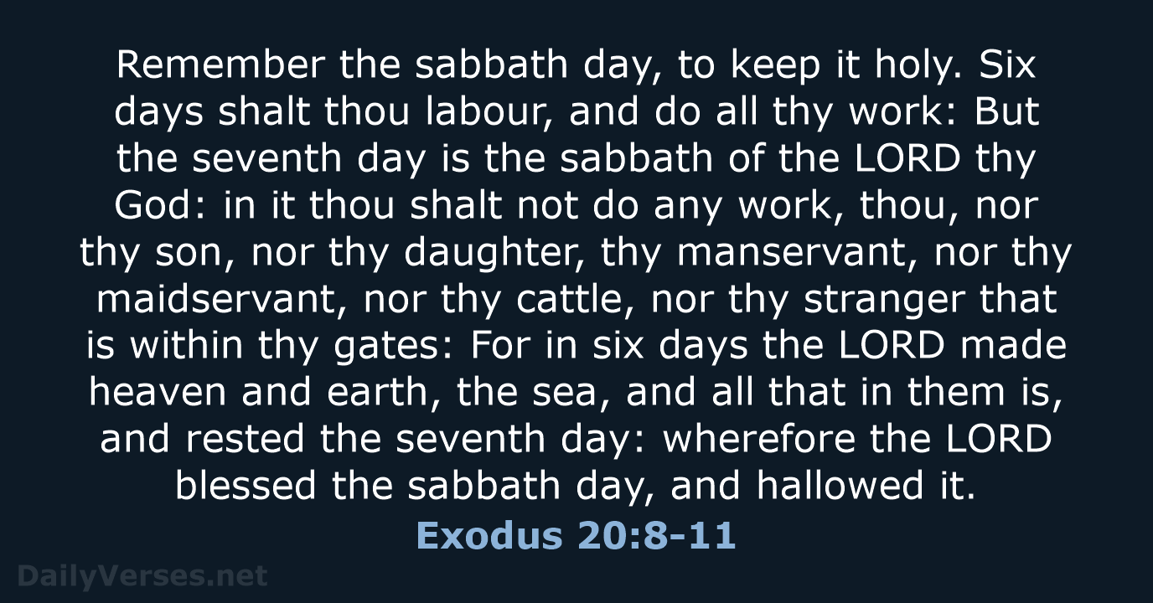

Slide 4
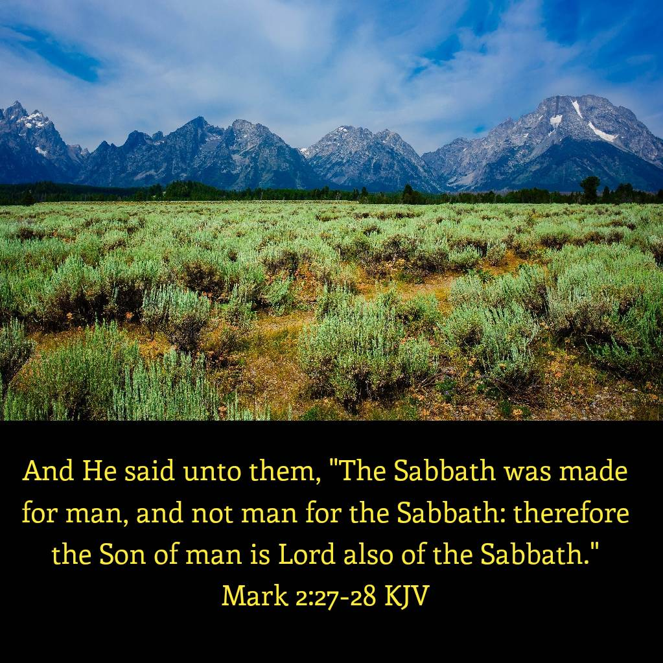

Slide 5

Opening Hymn
#216
When the Roll Is Called Up Yonder

Slide 6
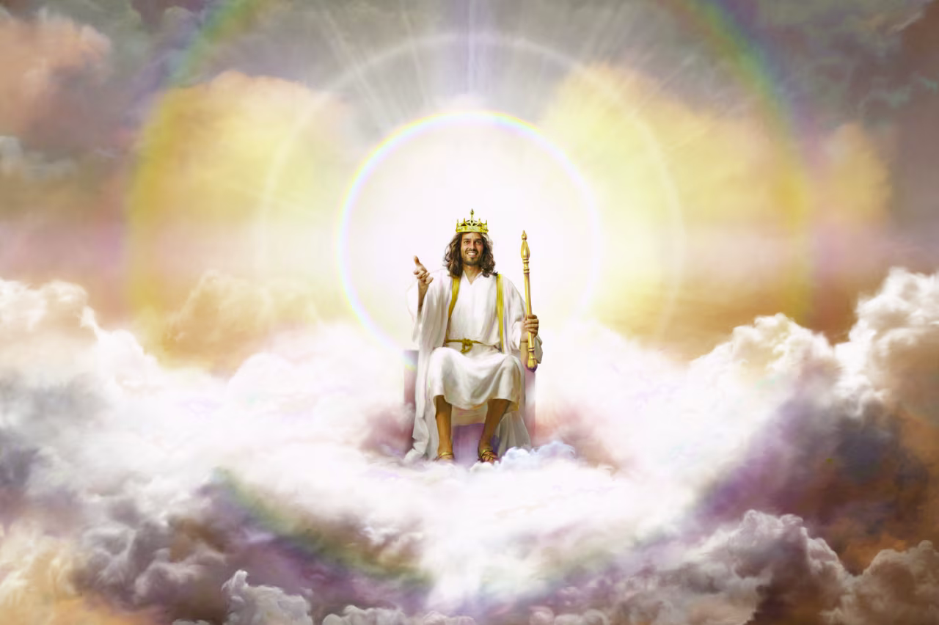

Slide 7
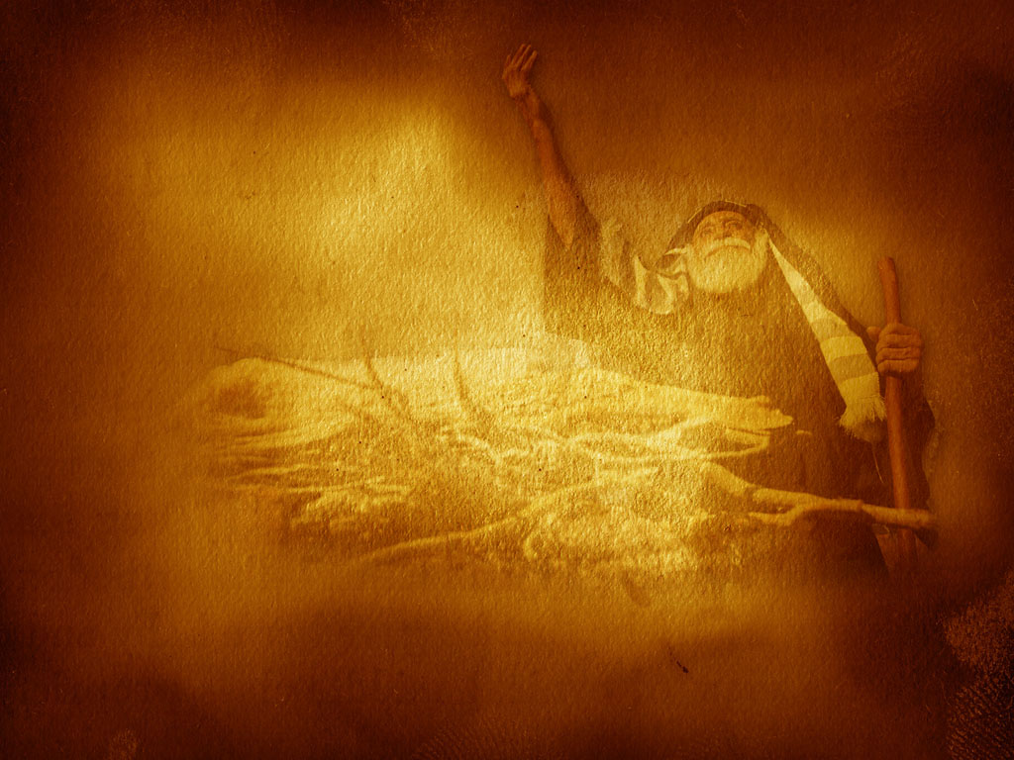
Scripture Reading
Matthew 16:24-27

Slide 8
Peace on Earth
or in Heaven

Slide 9
27 The Millennium and the End of Sin
The millennium is the thousand-year reign of Christ with His saints in heaven between the first and second resurrections. During this time the wicked dead will be judged; the earth will be utterly desolate, without living human inhabitants, but occupied by Satan and his angels. . . .

Slide 10
27 The Millennium and the End of Sin
. . . . At its close Christ with His saints and the Holy City will descend from heaven to earth.
The unrighteous dead will then be resurrected, and with Satan and his angels will surround the city; but fire from God will consume them and cleanse the earth. The universe will thus be freed of sin and sinners forever.

Slide 11
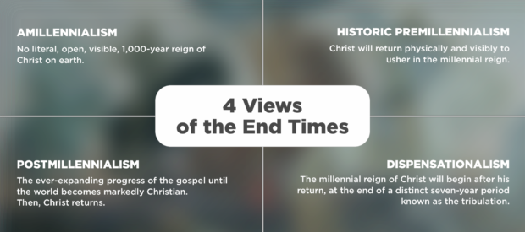

Slide 12
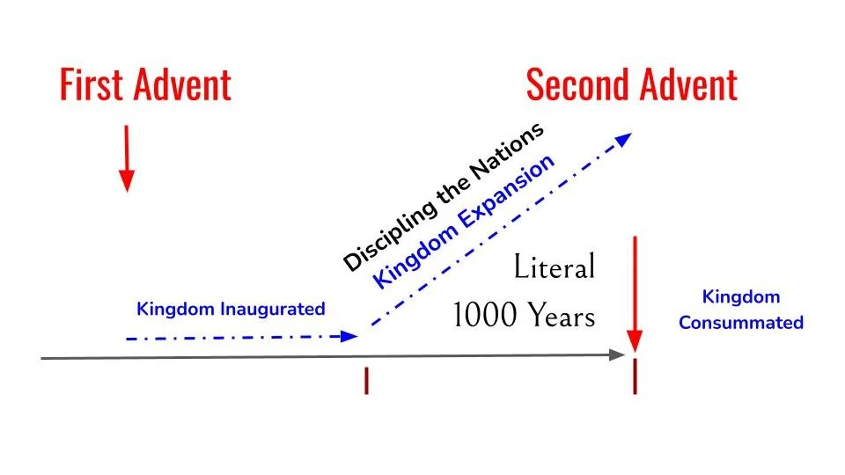

Slide 13
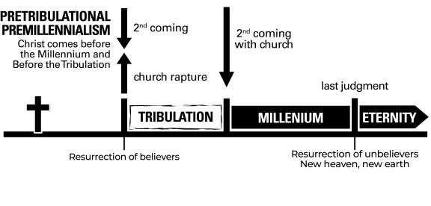

Slide 14
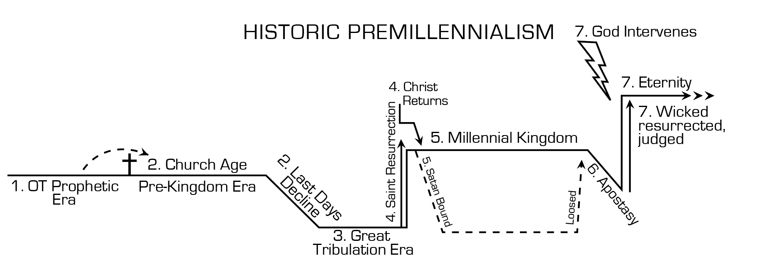

Slide 15
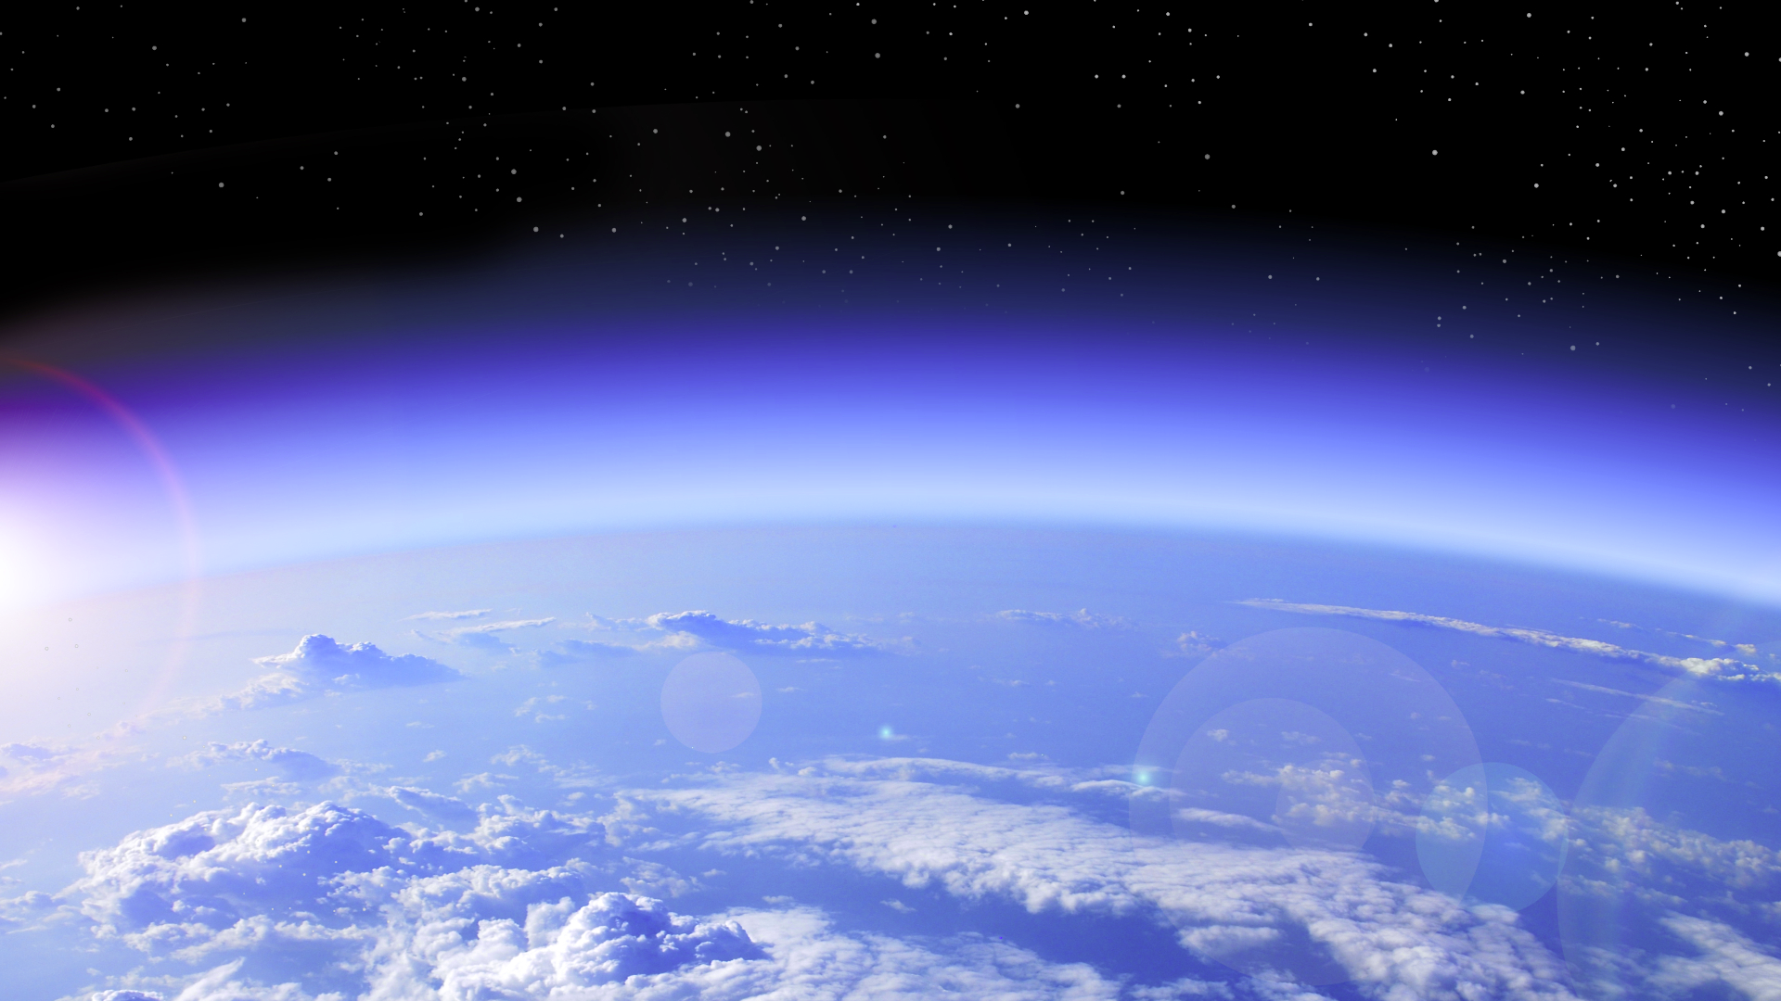
Millennium

Slide 16
Millennium
Resurrection of Life at 2nd Coming

Slide 17
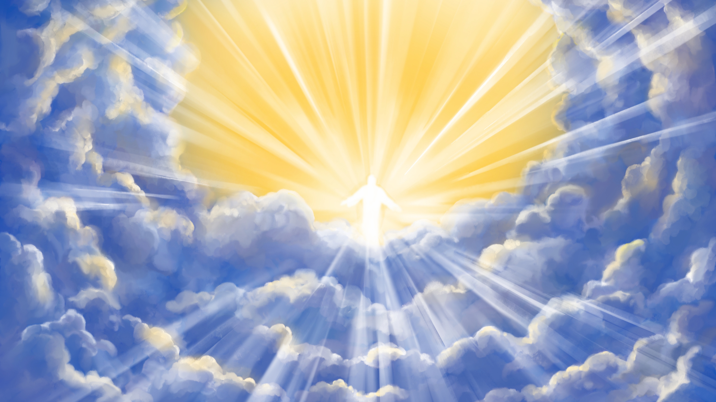
1 Corinthians 15:51-54
Behold, I tell you a mystery: We shall not all sleep, but we shall all be changed -- in a moment, in the twinkling of an eye, at the last trumpet. For the trumpet will sound, and the dead will be raised incor-ruptible, and we shall be changed. . . .

Slide 18
1 Corinthians 15:51-54
. . . . For this corruptible must put on incorruption, and this mortal must put on immortality. So when this corruptible has put on incorruption, and this mortal has put on immortality, then shall be brought to pass the saying that is written: Death is swallowed up in victory."

Slide 19
1 Thessalonians 4:13-17
. . . . For this we say unto you by the word of the Lord, that we which are alive and remain unto the coming of the Lord shall not prevent them which are asleep. For the Lord himself shall descend from heaven with a shout, with the voice of the archangel, and with the trump of God: . . .

Slide 20
1 Thessalonians 4:13-17
. . . . and the dead in Christ shall rise first: Then we which are alive and remain shall be caught up together with them in the clouds, to meet the Lord in the air: and so shall we ever be with the Lord.

Slide 21
Millennium
Resurrection of Life at 2nd Coming
2nd Coming Saved go to Heaven

Slide 22
John 14:1-3 KJV
Let not your heart be troubled: ye believe in God, believe also in me. In my Father's house are many man-sions: if it were not so, I would have told you. . .

Slide 23
John 14:1-3 KJV
. . . I go to prepare a place for you. And if I go and prepare a place for you, I will come again, and receive you unto myself; that where I am, there ye may be also.

Slide 24
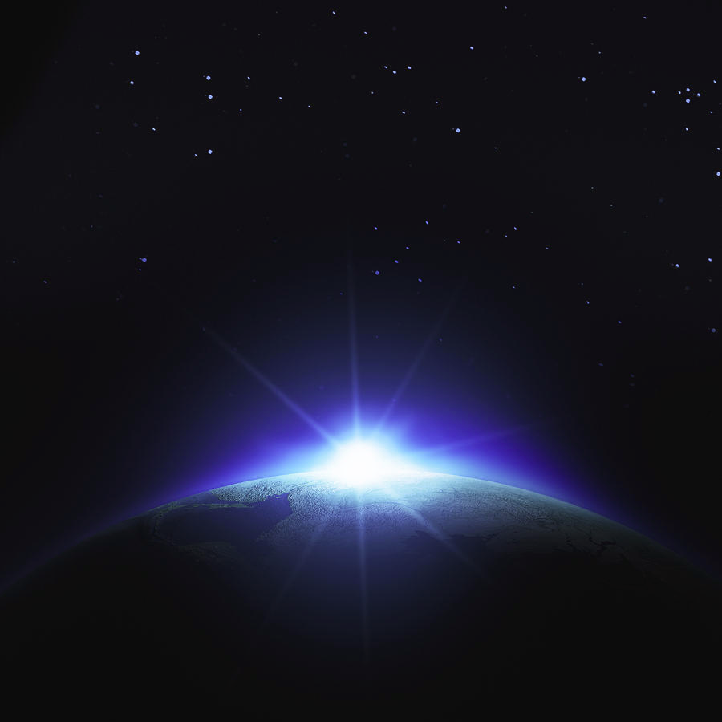
Revelation 20:4,6

Slide 25
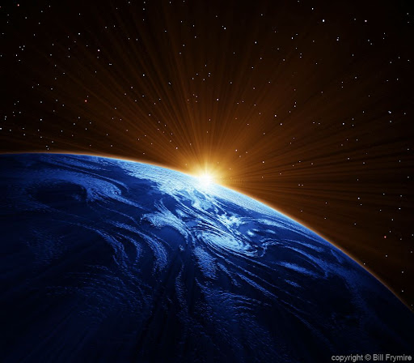
1 Peter 2:9
But you are a chosen generation, a royal priesthood, a holy nation, His own special people, that you may proclaim the praises of Him who called you out of darkness into His marvelous light;

Slide 26
1 Peter 2:7
Therefore, to you who believe, He is precious;

Slide 27
Galatians 4:7 NLT
Now you are no longer a slave but God's own child. And since you are his child, God has made you his heir.

Slide 28
Millennium
Resurrection of Life at 2nd Coming
2nd Coming Saved go to Heaven
Lost Destroyed at the 2nd Coming

Slide 29
Jeremiah 4:23-26
I beheld the earth, and indeed it was without form, and void; And the heavens, they had no light. I beheld the mountains, and indeed they trembled, And all the hills moved back and forth. . . .

Slide 30
Jeremiah 4:23-26
. . . . I beheld, and indeed there was no man, And all the birds of the heavens had fled. I beheld, and indeed the fruitful land was a wilderness, And all its cities were broken down At the presence of the LORD, By His fierce anger.

Slide 31
Malachi 4:1 NLT
The LORD of Heaven's Armies says, "The day of judgment is coming, burning like a furnace. On that day the arrogant and the wicked will be burned up like straw. They will be consumed-- roots, branches, and all.

Slide 32
2 Thessalonians 1:7 - 10
And to give you who are troubled rest with us when the Lord Jesus is revealed from heaven with His mighty angels, in flaming fire taking ven-geance on those who do not know God, and on those who do not obey the gospel of our Lord Jesus Christ. . .

Slide 33
2 Thessalonians 1:7 - 10
. . . These shall be punished with everlasting destruction from the presence of the Lord and from the glory of His power, when He comes, in that Day, to be glorified in His saints and to be admired among all those who believe.

Slide 34
2 Thessalonians 2:8
And then the lawless one will be revealed, whom the Lord will consume with the breath of His mouth and destroy with the brightness of His coming.

Slide 35
2 Thessalonians 1:7-9
And to give you who are troubled rest with us when the Lord Jesus is revealed from heaven with His mighty angels, in flaming fire taking vengeance on those who do not know God, and on those who do not obey the gospel of our Lord Jesus Christ. . .

Slide 36
2 Thessalonians 1:7-9
. . . . These shall be punished with everlasting destruction from the presence of the Lord and from the glory of His power,

Slide 37
Ezekiel 28:18-19
You defiled your sanctuaries By the multitude of your iniquities, By the iniquity of your trading; Therefore I brought fire from your midst; It devoured you, And I turned you to ashes upon the earth In the sight of all who saw you.

Slide 38
Revelation 14:14 - 19
Then I looked, and behold, a white cloud, and on the cloud sat One like the Son of Man, having on His head a golden crown, and in His hand a sharp sickle. And another angel came out of the temple, crying with a loud voice. . .

Slide 39
Revelation 14:14 - 19
. . . to Him who sat on the cloud, "Thrust in Your sickle and reap, for the time has come for You to reap, for the harvest of the earth is ripe." So He who sat on the cloud thrust in His sickle on the earth, and the earth was reaped. . . .

Slide 40
Revelation 14:14-19
. . . . So the angel thrust his sickle into the earth and gathered the vine of the earth, and threw it into the great winepress of the wrath of God.

Slide 41
Revelation 19:11 - 21
Now I saw heaven opened, and behold, a white horse. . . . And the armies in heaven, clothed in fine linen, white and clean, followed Him on white horses. Now out of His mouth goes a sharp sword, that with it He should strike the nations. . . .

Slide 42
Revelation 19:11 - 21
. . . . And the rest were killed with the sword which proceeded from the mouth of Him who sat on the horse.

Slide 43
Luke 17:26 - 30
And as it was in the days of Noah, so it will be also in the days of the Son of Man: They ate, they drank, they married wives, they were given in marriage, until the day that Noah entered the ark, and the flood came and destroyed them all. . . .

Slide 44
Luke 17:26 - 30
. . . . Likewise as it was also in the days of Lot: They ate, they drank, they bought, they sold, they planted, they built; but on the day that Lot went out of Sodom it rained fire and brimstone from heaven and destroyed them all. . .

Slide 45
Luke 17:26 - 30
. . . . Even so will it be in the day when the Son of Man is revealed.

Slide 46
Jeremiah 25:33
And at that day the slain of the LORD shall be from one end of the earth even to the other end of the earth. They shall not be lamented, or gathered, or buried; they shall become refuse on the ground.

Slide 47
Millennium
Resurrection of Life at 2nd Coming
2nd Coming Saved go to Heaven
Lost Destroyed at the 2nd Coming
Two Resurrections – Life and Judgment

Slide 48
John 5:28 – 29 NLT
Don't be so surprised! Indeed, the time is coming when all the dead in their graves will hear the voice of God's Son, and they will rise again. . . .

Slide 49
John 5:28 – 29 NLT
. . . . Those who have done good will rise to experience eternal life, and those who have continued in evil will rise to experience judgment.

Slide 50
2 Peter 2:4
For if God did not spare the angels who sinned, but cast them down to hell and delivered them into chains of darkness, to be reserved for judgment;

Slide 51
Millennium
Resurrection of Life at 2nd Coming
2nd Coming Saved go to Heaven
Lost Destroyed at the 2nd Coming
Two Resurrections – Life and Judgment
Resurrections Separated by 1000 years

Slide 52
Revelation 20:4 – 6 NLT
. . . . They had not worshiped the beast or his statue, nor accepted his mark on their forehead or their hands. They all came to life again, and they reigned with Christ for a thousand years. This is the first resurrection. . . .

Slide 53
Revelation 20:4 – 6 NLT
. . . . (The rest of the dead did not come back to life until the thousand years had ended.) Blessed and holy are those who share in the first resurrection. For them the second death holds no power, . . .

Slide 54
Revelation 20:4 – 6 NLT
. . . . but they will be priests of God and of Christ and will reign with him a thousand years.

Slide 55
Millennium
Resurrection of Life at 2nd Coming
2nd Coming Saved go to Heaven
Lost Destroyed at the 2nd Coming
Two Resurrections – Life and Judgment
Resurrections Separated by 1000 years
During 1000 Years a Work of Judgment

Slide 56
1 Corinthians 6:2-3 NLT
Don't you realize that someday we believers will judge the world? And since you are going to judge the world, can't you decide even these little things among yourselves? . . .

Slide 57
1 Corinthians 6:2-3 NLT
. . . . Don't you realize that we will judge angels? So you should surely be able to resolve ordinary disputes in this life.

Slide 58
Revelation 20:4 – 6 NLT
Then I saw thrones, and the people sitting on them had been given the authority to judge. And I saw the souls of those who had been beheaded for their testimony about Jesus and for proclaiming the word of God. . . .

Slide 59
Millennium
Resurrection of Life at 2nd Coming
2nd Coming Saved go to Heaven
Lost Destroyed at the 2nd Coming
Two Resurrections – Life and Judgment
Resurrections Separated by 1000 years
During 1000 Years a Work of Judgment
White Throne Judgment and Lake of Fire

Slide 60
Revelation 20

Slide 61
2 Peter 3:13
Nevertheless we, according to His promise, look for new heavens and a new earth in which righteousness dwells.

Slide 62
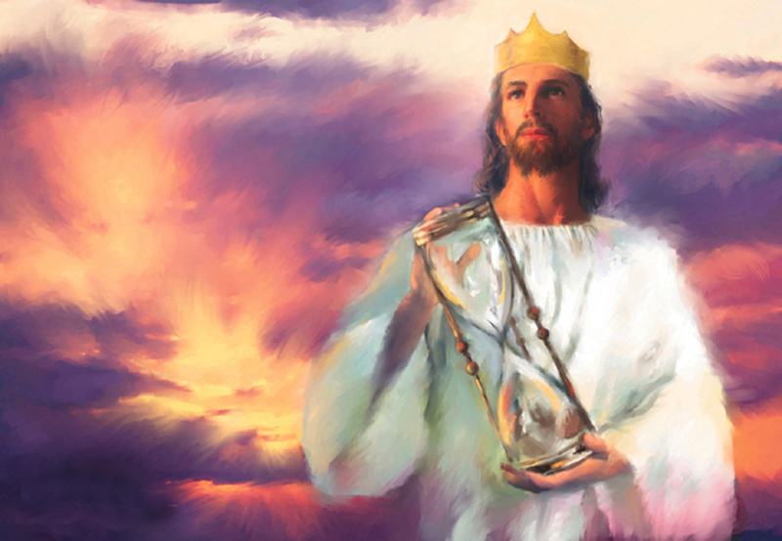

Slide 63
Peace on Earth
or in Heaven

Slide 64
Closing Hymn
#416
The Judgment
Has Set

Slide 65
