Slide 2
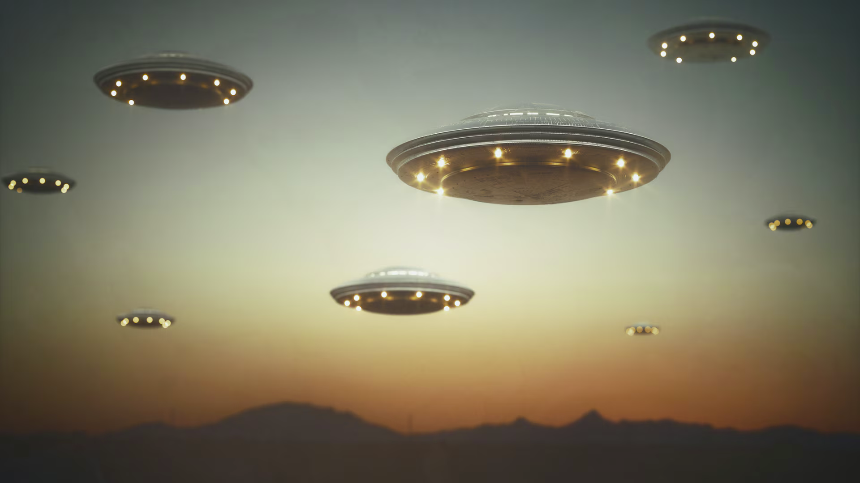
ETA
Alien Invasion

Slide 3
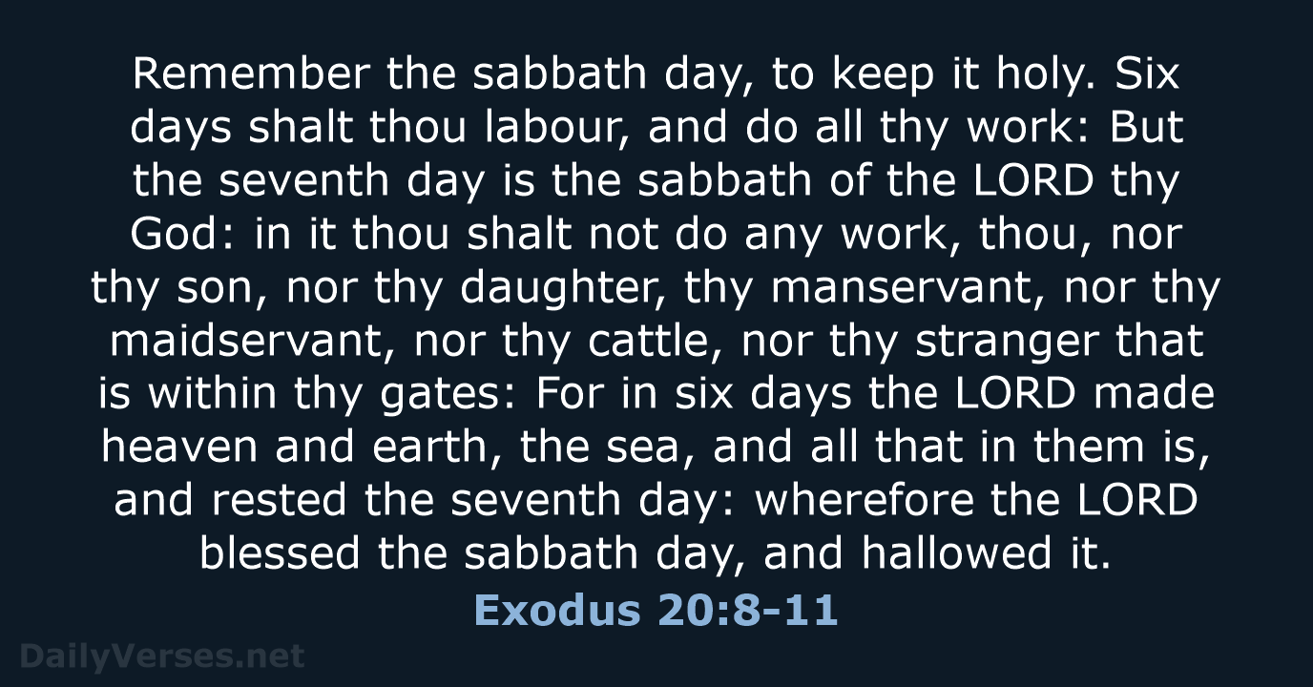

Slide 4
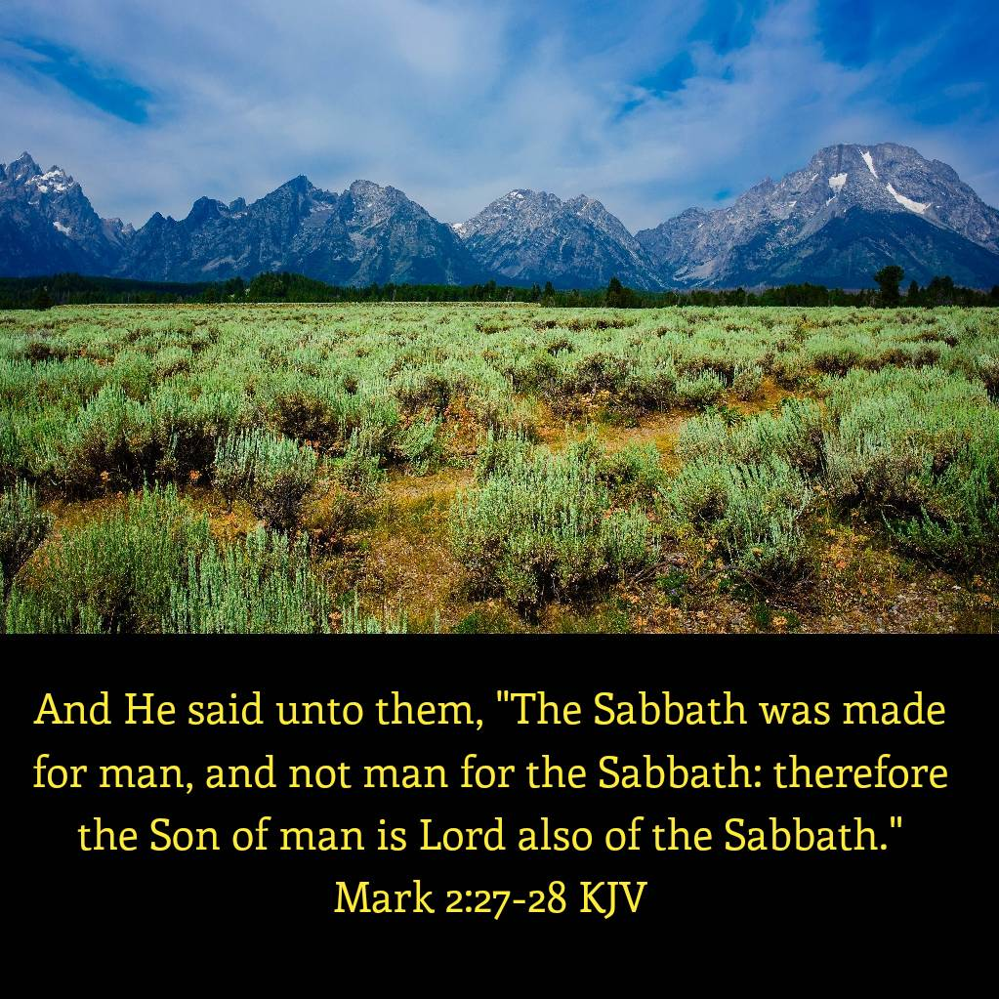

Slide 5

Opening Hymn
#442
How Sweet
Are the Tidings

Slide 6
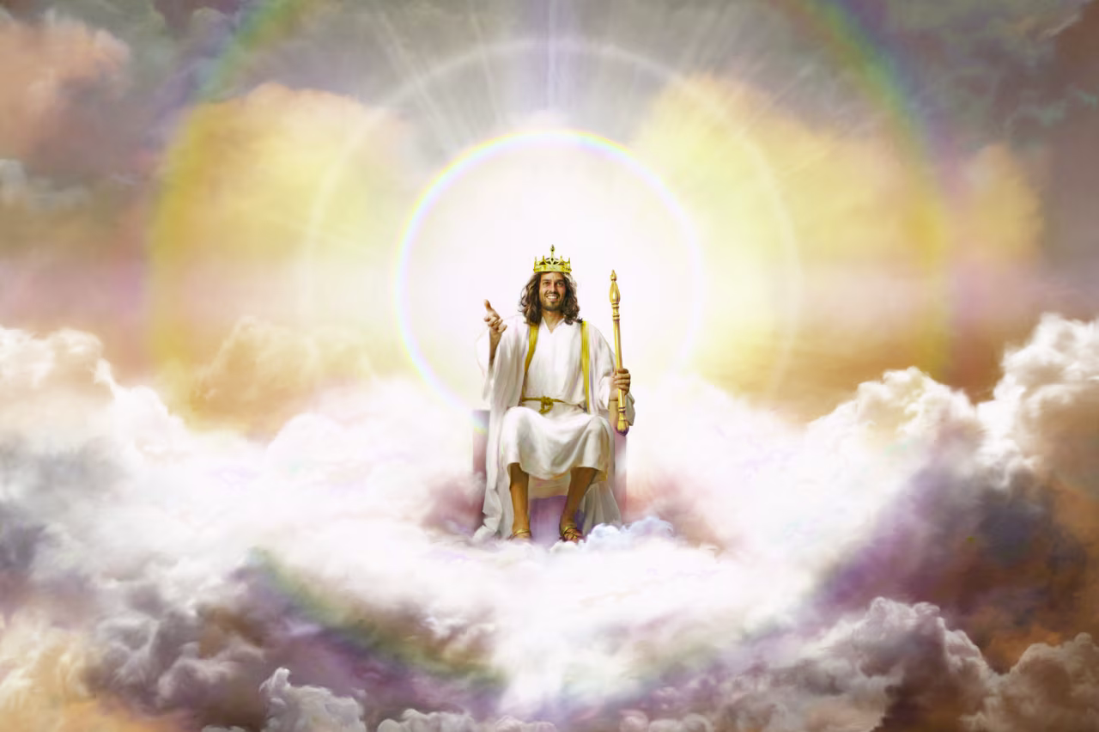

Slide 7
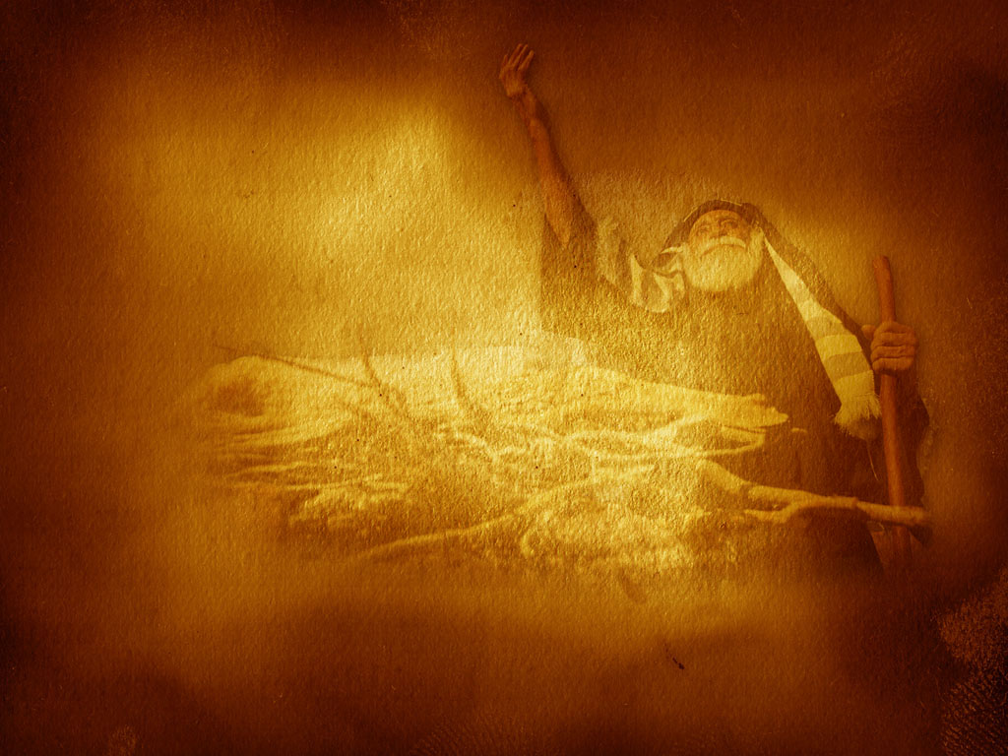
Scripture Reading
1 Corinthians
15:51-55

Slide 8
ETA
Alien Invasion

Slide 9
24 Death and Resurrection
The wages of sin is death. But God, who alone is immortal, will grant eternal life to His redeemed. Until that day death is an unconscious state for all people. . . .

Slide 10
24 Death and Resurrection
. . . .When Christ, who is our life, appears, the resurrected righteous and the living righteous will be glorified and caught up to meet their Lord. The second resurrection, the resurrection of the unrighteous, will take
place a thousand years later.

Slide 11
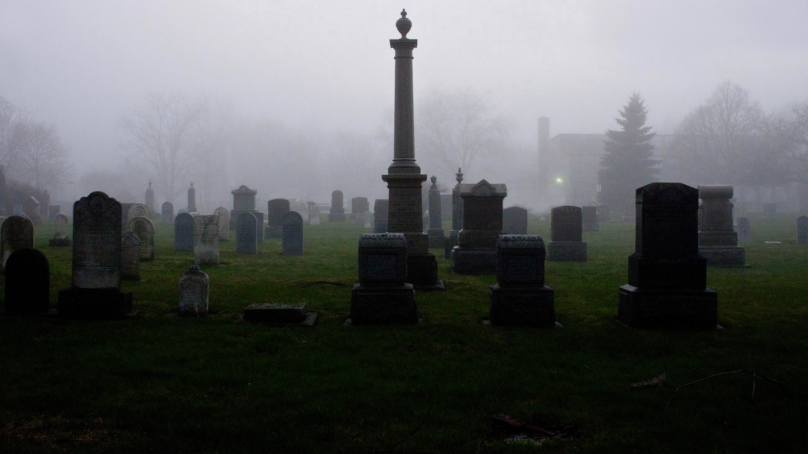
Are the Dead Really Dead
Death is the Opposite of Life

Slide 12
Genesis 2:7 KJV
And the LORD God formed man of the dust of the ground, and breathed into his nostrils the breath of life; and man became a living soul.

Slide 13
Ecclesiastes 12:7 GWN
Then the dust of mortals goes back to the ground as it was before, and the breath of life goes back to God who gave it.

Slide 14
Psalm 146:3 – 4 KJV
Put not your trust in princes, nor in the son of man, in whom there is no help. His breath goeth forth, he returneth to his earth; in that very day his thoughts perish.

Slide 15
Are the Dead Really Dead
Death is the Opposite of Life
Sin Brought Mortality not Immortality

Slide 16
Romans 6:23 KJV
For the wages of sin is death; but the gift of God is eternal life through Jesus Christ our Lord.

Slide 17
Ezekiel 18:4
"Behold, all souls are Mine; The soul of the father As well as the soul of the son is Mine; The soul who sins shall die

Slide 18
Genesis 3:4 KJV
And the serpent said unto the woman, Ye shall not surely die:

Slide 19
1 Timothy 6:15 NLT
For at just the right time Christ will be revealed from heaven by the blessed and only almighty God, the King of all kings and Lord of all lords.

Slide 20
1 Timothy 6:16 NIV
who alone is immortal and who lives in unapproachable light, whom no one has seen or can see. To him be honor and might forever. Amen.

Slide 21
Romans 2:7 NIV
To those who by persistence in doing good seek glory, honor and immortality, he will give eternal life.

Slide 22
Job 19:25 - 27
For I know that my Redeemer lives, And He shall stand at last on the earth; And after my skin is destroyed, this I know, That in my flesh I shall see God, Whom I shall see for myself, And my eyes shall behold, and not another. How my heart yearns within me!

Slide 23
Are the Dead Really Dead
Death is the Opposite of Life
Sin Brought Mortality not Immortality
No Consciousness in Death

Slide 24
Ecclesiastes 9:5 - 6, 10 KJV
For the living know that they shall die: but the dead know not any thing, neither have they any more a reward; for the memory of them is forgotten. Also their love, and their hatred, and their envy, is now perished; . . . .

Slide 25
Ecclesiastes 9:5 - 6, 10 KJV
. . . . neither have they any more a portion for ever in any thing that is done under the sun. . . . Whatsoever thy hand findeth to do, do it with thy might; for there is no work, nor device, nor knowledge, nor wisdom, in the grave, whither thou goest.

Slide 26
Psalm 115:17 NLT
The dead cannot sing praises to the LORD, for they have gone into the silence of the grave.

Slide 27
Psalm 6:5
For in death there is no remembrance of You; In the grave who will give You thanks?

Slide 28
Are the Dead Really Dead
Death is the Opposite of Life
Sin Brought Mortality not Immortality
No Consciousness in Death
Sleep is the Closest Illustration

Slide 29
John 11:11 – 14 NIV
After he had said this, he went on to tell them, "Our friend Lazarus has fallen asleep; but I am going there to wake him up." His disciples replied, "Lord, if he sleeps, he will get better.” . . . .

Slide 30
John 11:11 – 14 NIV
. . . . Jesus had been speaking of his death, but his disciples thought he meant natural sleep. So then he told them plainly, "Lazarus is dead,

Slide 31
1 Corinthians 15:51 – 54 KJV
Behold, I shew you a mystery; We shall not all sleep, but we shall all be changed, In a moment, in the twinkling of an eye, at the last trump: for the trumpet shall sound, and the dead shall be raised incorruptible, and we shall be changed. . . .

Slide 32
Are the Dead Really Dead
Death is the Opposite of Life
Sin Brought Mortality not Immortality
No Consciousness in Death
Sleep is the Closest Illustration
End-time Resurrection, not at Death

Slide 33
1 Corinthians 15:51 – 54 KJV
Behold, I shew you a mystery; We shall not all sleep, but we shall all be changed, In a moment, in the twinkling of an eye, at the last trump: for the trumpet shall sound, and the dead shall be raised incorruptible, and we shall be changed. . . .

Slide 34
1 Corinthians 15:51 – 54 KJV
. . . . For this corruptible must put on incorruption, and this mortal must put on immortality. So when this corrupt-tible shall have put on incorruption, and this mortal shall have put on immortality, then shall be brought to pass the saying that is written, Death is swallowed up in victory.

Slide 35
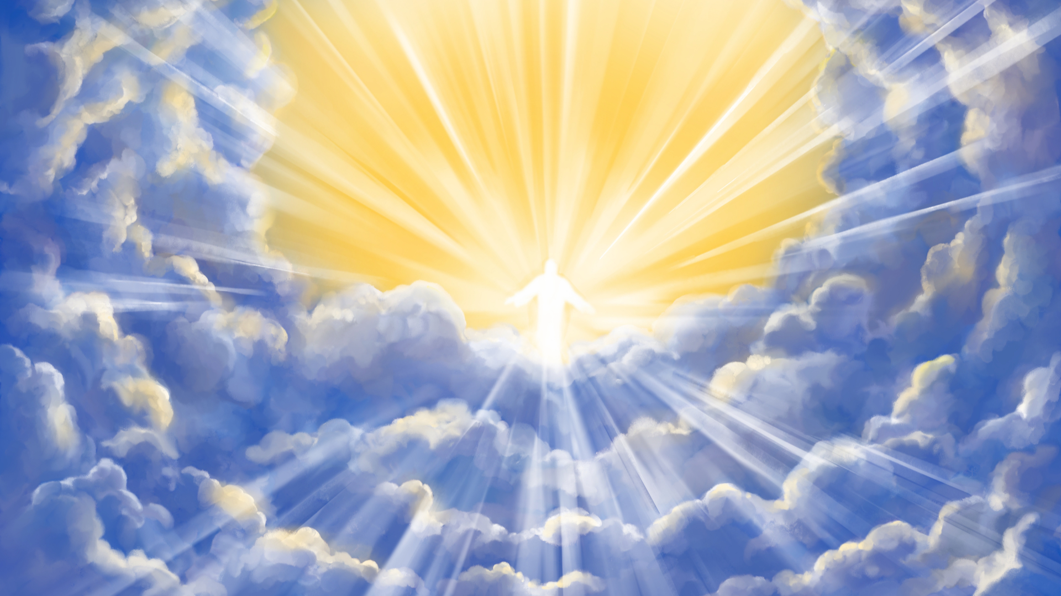
1 Thessalonians 4:13-17
But I would not have you to be ignor-ant, brethren, concerning them which are asleep, that ye sorrow not, even as others which have no hope. For if we believe that Jesus died and rose again, even so them also which sleep in Jesus will God bring with him. . . .

Slide 36
1 Thessalonians 4:13-17
. . . . For this we say unto you by the word of the Lord, that we which are alive and remain unto the coming of the Lord shall not prevent them which are asleep. For the Lord himself shall descend from heaven with a shout, with the voice of the archangel, and with the trump of God: . . .

Slide 37
1 Thessalonians 4:13-17
. . . . and the dead in Christ shall rise first: Then we which are alive and remain shall be caught up together with them in the clouds, to meet the Lord in the air: and so shall we ever be with the Lord.

Slide 38
John 5:28 – 29 NLT
Don't be so surprised! Indeed, the time is coming when all the dead in their graves will hear the voice of God's Son, and they will rise again. . . .

Slide 39
John 5:28 – 29 NLT
. . . . Those who have done good will rise to experience eternal life, and those who have continued in evil will rise to experience judgment.

Slide 40
2 Timothy 4:7 – 8 NLT
I have fought the good fight, I have finished the race, and I have remained faithful. And now the prize awaits me-- the crown of righteousness, which the Lord, the righteous Judge, will give me on the day of his return. . . .

Slide 41
2 Timothy 4:7 – 8 NLT
. . . . And the prize is not just for me but for all who eagerly look forward to his appearing.

Slide 42
Acts 2:34 KJV
For David is not ascended into the heavens: but he saith himself, The LORD said unto my Lord, Sit thou on my right hand,

Slide 43
Are the Dead Really Dead
Death is the Opposite of Life
Sin Brought Mortality not Immortality
No Consciousness in Death
Sleep is the Closest Illustration
End-time Resurrection, not at Death
All Mankind Wait for the Resurrection

Slide 44
Daniel 12:2, 13
And many of those who sleep in the dust of the earth shall awake, Some to everlasting life, Some to shame and everlasting contempt. . . . But you, go your way till the end; for you shall rest, and will arise to your inheritance at the end of the days."

Slide 45
John 5:28 – 29 NLT
Don't be so surprised! Indeed, the time is coming when all the dead in their graves will hear the voice of God's Son, and they will rise again. . . .

Slide 46
John 5:28 – 29 NLT
. . . . Those who have done good will rise to experience eternal life, and those who have continued in evil will rise to experience judgment.

Slide 47
Revelation 20:4 – 6 NLT
Then I saw thrones, and the people sitting on them had been given the authority to judge. And I saw the souls of those who had been beheaded for their testimony about Jesus and for proclaiming the word of God. . . .

Slide 48
Revelation 20:4 – 6 NLT
. . . . They had not worshiped the beast or his statue, nor accepted his mark on their forehead or their hands. They all came to life again, and they reigned with Christ for a thousand years. This is the first resurrection. . . .

Slide 49
Revelation 20:4 – 6 NLT
. . . . (The rest of the dead did not come back to life until the thousand years had ended.) Blessed and holy are those who share in the first resurrection. For them the second death holds no power, . . .

Slide 50
Revelation 20:4 – 6 NLT
. . . . but they will be priests of God and of Christ and will reign with him a thousand years.

Slide 51
Revelation 22:12
" And behold, I am coming quickly, and My reward is with Me, to give to every one according to his work.

Slide 52
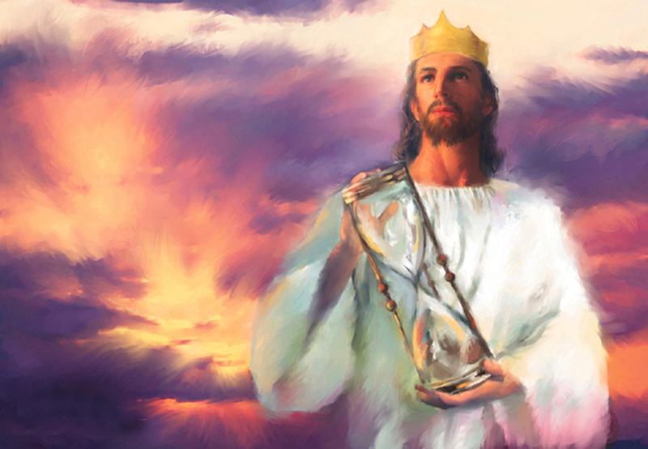

Slide 53
Scientism
Alien Invasion

Slide 55
Closing Hymn
#428
Sweet By and By

Slide 56
