Slide 1

RDO - Adobe Stock
Turn on Audacity & Screen Sharing

Slide 2


------------
Lufkin
Seventh-day
Adventist Church
RDO – Adobe Stock
a church where all are welcome
Notes:
To change picture, click on picture to bring up Shape Format tab, click Text Fill (not shape fill) then Picture and Insert Picture from File (on desktop or your computer).

Slide 3

How Great Thou Art
(Shane & Shane)
Dustin Smith | Jonny Robinson | Michael Farren | Rich Thompson
© 2016 CityAlight Music; Farren Love And War Publishing; Integrity's Alleluia! Music; Integrity's Praise! Music
Used with permission. CCLI License # 2833891
Milan – Adobe Stock

Slide 4
O Lord my God! When I in awesome wonder
Consider all the works Thy hands have made,
Verse 1 of 4

Slide 5
I see the stars, I hear the rolling thunder,
Thy pow'r thro'out the universe displayed,
Verse 1 of 4

Slide 6
Then sings my soul, my Savior God to Thee;
How great Thou art, how great Thou art!
Refrain 1 of 2

Slide 7
Then sings my soul, my Savior God to Thee;
How great Thou art, how great Thou art!
Refrain 2 of 2

Slide 8
And when I think that God, His Son not sparing,
Sent Him to die, I scarce can take it in;
Verse 3 of 4

Slide 9
That on the cross, my burden gladly bearing,
He bled and died to take away my sin;
Verse 3 of 4

Slide 10
Then sings my soul, my Savior God to Thee;
How great Thou art, how great Thou art!
Refrain 1 of 2

Slide 11
Then sings my soul, my Savior God to Thee;
How great Thou art, how great Thou art!
Refrain 2 of 2

Slide 12
When Christ shall come with shout of acclamation
And take me home, what joy shall fill my heart!
Verse 4 of 4

Slide 13
Then I shall bow in humble adoration
And there proclaim, my God, how great Thou art!
Verse 4 of 4

Slide 14
Then sings my soul, my Savior God to Thee;
How great Thou art, how great Thou art!
Refrain 1 of 2

Slide 15
Then sings my soul, my Savior God to Thee;
How great Thou art, how great Thou art!
Refrain 2 of 2

Slide 16
Then sings my soul, my Savior God to Thee;
How great Thou art, how great Thou art!
Refrain 1 of 2 Repeat

Slide 17
Then sings my soul, my Savior God to Thee;
How great Thou art, how great Thou art!
Refrain 2 of 2 Repeat

Slide 18
How great
Thou art,
How great
Thou art!
Ending
Milan – Adobe Stock

Slide 19
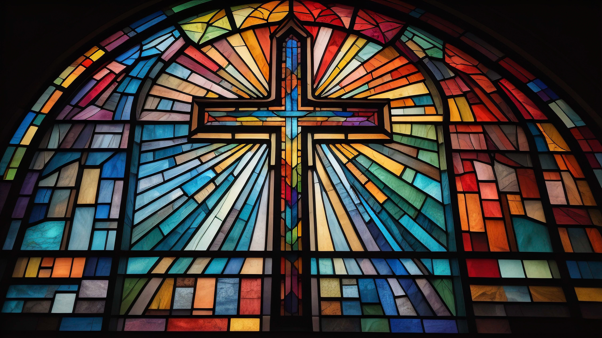
Christ our Hope in Life & Death
CCLI Song # 7147502
Jordan Kauflin | Keith Getty | Matt Boswell | Matt Papa | Matthew Merker
© 2020 Getty Music Hymns and Songs; Getty Music Publishing; Jordan Kauflin Music; Love Your Enemies Publishing; Matthew Merker Music; Messenger Hymns
Used with permission. CCLI License # 2833891
Jason Yonder – Adobe Stock

Slide 20
What is our hope in life and death
Christ alone, Christ alone
What is our only confidence
That our souls to Him belong
Verse 1 of 3

Slide 21
Who holds our days within His hand, What comes apart from His command, And what will keep us to the end, The love of Christ in which we stand
Verse 1 of 3

Slide 22
O sing hallelujah, Our hope springs eternal, O sing hallelujah, Now and ever we confess, Christ our hope in life and death
Chorus

Slide 23
What truth can calm the
troubled soul, God is good, God is
good, Where is His grace and
goodness known, In our great
Redeemer's blood
Verse 2 of 3

Slide 24
Who holds our faith when fears arise, Who stands above the stormy trial, Who sends the waves that bring us nigh, Unto the shore the rock of Christ
Verse 2 of 3

Slide 25
O sing hallelujah, Our hope springs eternal, O sing hallelujah, Now and ever we confess, Christ our hope in life and death
Chorus

Slide 26
Unto the grave what will we sing
Christ He lives, Christ He lives
And what reward will heaven bring, Everlasting life with Him
Verse 3 of 3

Slide 27
There we will rise to meet the Lord
Then sin and death will be destroyed, And we will feast in endless joy, When Christ is ours forevermore
Verse 3 of 3

Slide 28
O sing hallelujah, Our hope springs eternal, O sing hallelujah, Now and ever we confess, Christ our hope in life and death
Chorus

Slide 29
O sing hallelujah, Our hope springs eternal, O sing hallelujah, Now and ever we confess, Christ our hope in life and death
Chorus Repeat

Slide 30
Now and ever we confess, Christ our hope in life and death
Tag
Jason Yonder – Adobe Stock

Slide 31
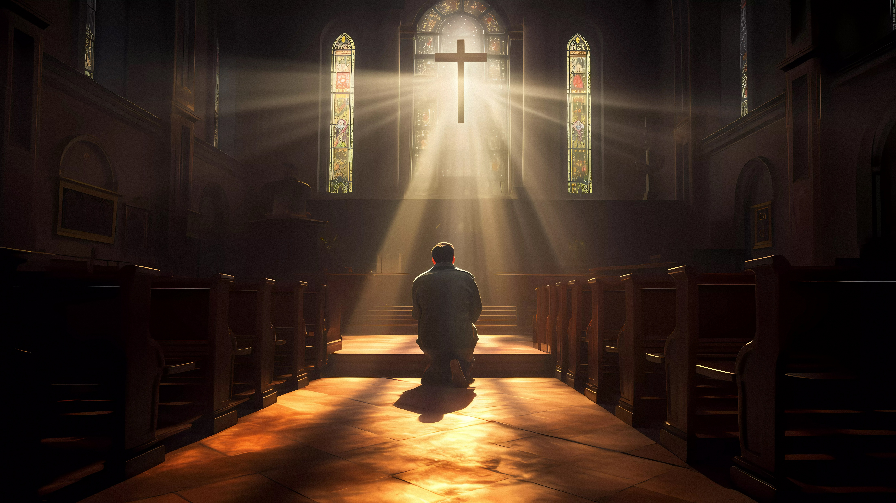
Christ is Mine Forevermore
CCLI Song # 7036096
Jonny Robinson | Rich Thompson
© 2016 CityAlight Music
Used with permission. CCLI License # 2833891
francescosgura – Adobe Stock

Slide 32
Mine are days that God has numbered, I was made to walk with Him, Yet I look for worldly treasure, And forsake the King of kings
Verse 1 of 3

Slide 33
But mine is hope in my Redeemer
Though I fall His love is sure
For Christ has paid for every failing
I am His forevermore
Chorus 1 of 4

Slide 34
Mine are tears in times of sorrow
Darkness not yet understood
Through the valley I must travel
Where I see no earthly good
Verse 2 of 3

Slide 35
But mine is peace that flows from heaven, And the strength in times
of need, I know my pain will not
be wasted, Christ completes His work in me
Chorus 2 of 4

Slide 36
Mine are days here as a stranger
Pilgrim on a narrow way
One with Christ I will encounter
Harm and hatred for His name
Verse 3 of 3

Slide 37
But mine is armour for this battle
Strong enough to last the war
And He has said He will deliver
Safely to the golden shore
Chorus 3 of 4

Slide 38
And mine are keys to Zion city
Where beside the King I walk
For there my heart has found its treasure, Christ is mine forevermore
Chorus 4 of 4

Slide 39
Come rejoice now O my soul
For His love is my reward
Fear is gone and hope is sure
Christ is mine forevermore
Bridge

Slide 40
Come rejoice now O my soul
For His love is my reward
Fear is gone and hope is sure
Christ is mine forevermore
Bridge - Second Repeat

Slide 41
Come rejoice now O my soul
For His love is my reward
Fear is gone and hope is sure
Christ is mine forevermore
Bridge - Third Repeat

Slide 42
And mine are keys to Zion city
Where beside the King I walk
For there my heart has found its treasure, Christ is mine forevermore
Chorus 4 of 4 Repeat

Slide 43
Christ is mine forevermore,
Christ is mine forevermore
Ending
francescosgura – Adobe Stock

Slide 44
------------
Lufkin
Seventh-day
Adventist Church
RDO – Adobe Stock
a church where all are welcome
Notes:
To change picture, click on picture to bring up Shape Format tab, click Text Fill (not shape fill) then Picture and Insert Picture from File (on desktop or your computer).

Slide 45

pamela_d_mcadams – Adobe Stock
Tuesday Zoom Bible Study - 6:30 pm - Elder Eddie Gray
Meeting ID: 813 8111 3439 Passcode: 218938
Notes:
Display on first Sabbath of each month or if Eddie is present.

Slide 46

Wednesday
Prayer & Bible Study
New Study Starting Soon
with Frances Carpenter
Wednesday at 7:00 PM
Romolo Tavani – Adobe Stock

Slide 47


Fellowship Meals for October
17 | No meal. Invite a friend home.
24 | Bring your favorite vegetarian dish.
31 | No meal. Invite a friend home.
Sign up at perfectpotluck.com
anaumenko - Adobe Stock

Slide 48
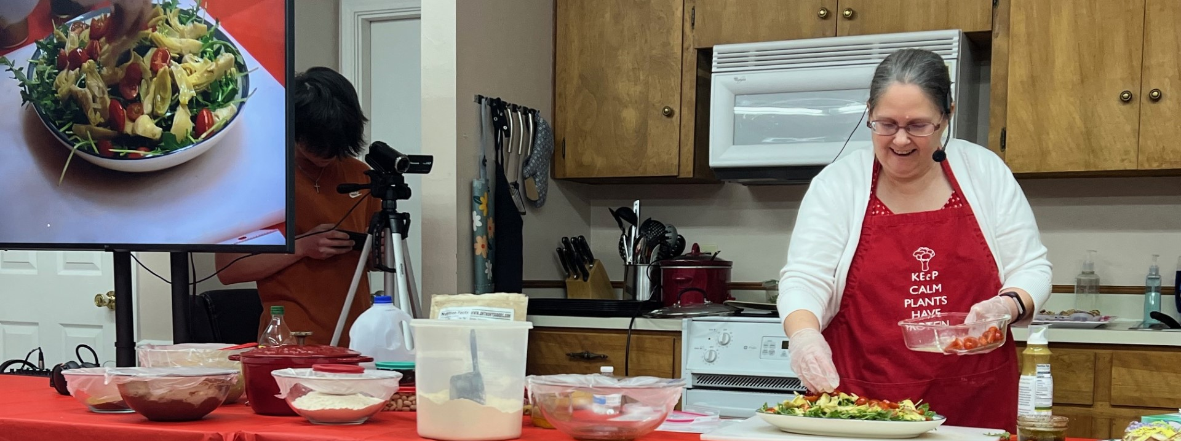
Free Community Wide
Plant-Powered Cooking Class
Next class November 9 at 6:30 pm, for more info call or text Frances at 541-908-3619
at Nacogdoches Church on November 1 at 3:30 pm

Slide 49

Ladies
Afternoon Tea
Sunday, October 25
3:00 – 4:30 PM
RSVP to Frances
541.908.3619
Pixel Matrix – Adobe Stock

Slide 50

Looking EASTWARD
Zoom Health Lectures
with Elder Ben Albin
The History of John Harvey Kellogg
November 12 at 6:00 PM
Meeting ID: 627 737 6775
Passcode: tn6JRW
Darya – Adobe Stock
Notes:
Need to update

Slide 51

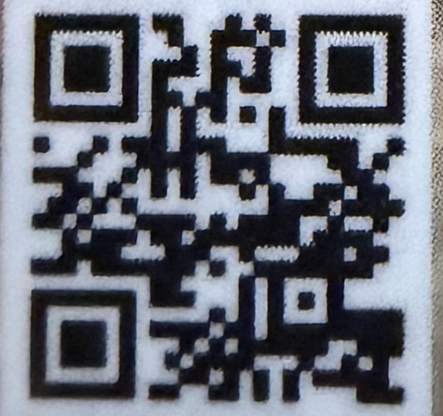
Cards are available in the foyer. Please pass them out to the community
lessons250.com

Slide 52
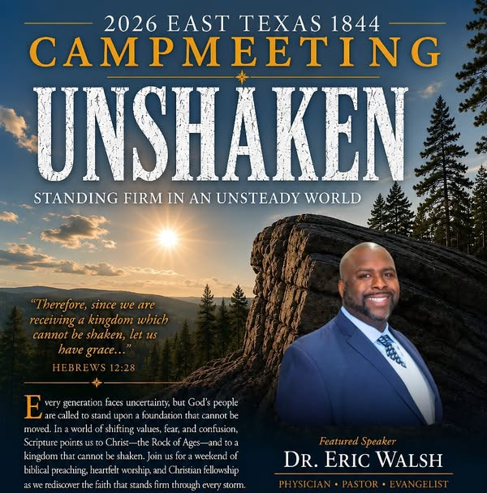
East Texas Camp Meeting
October
30-31
7723 FM 1793
Karnack, TX 75661
Pastor Sanford
936-488-9304

Slide 53
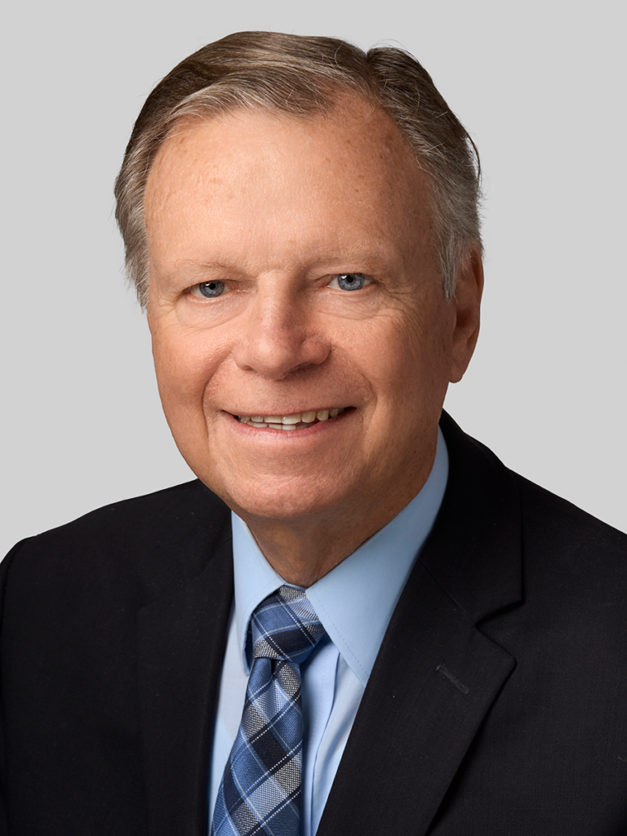

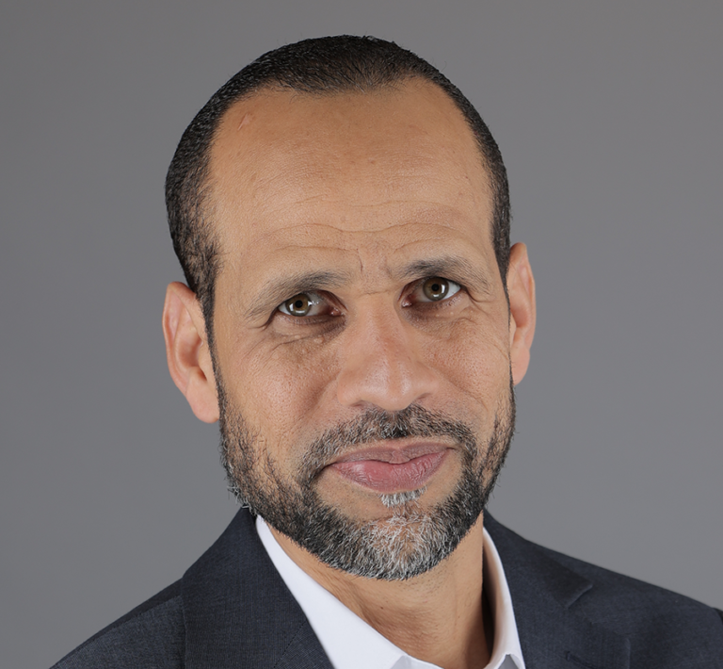
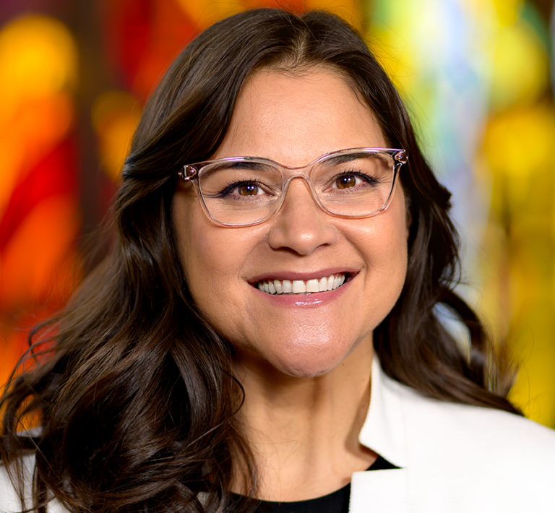

M E E T I N G
November 14 at Lake Whitney
Mark Finnley, Arnaldo Cruz, Yami Bazan
and the Heritage Singers

Slide 54
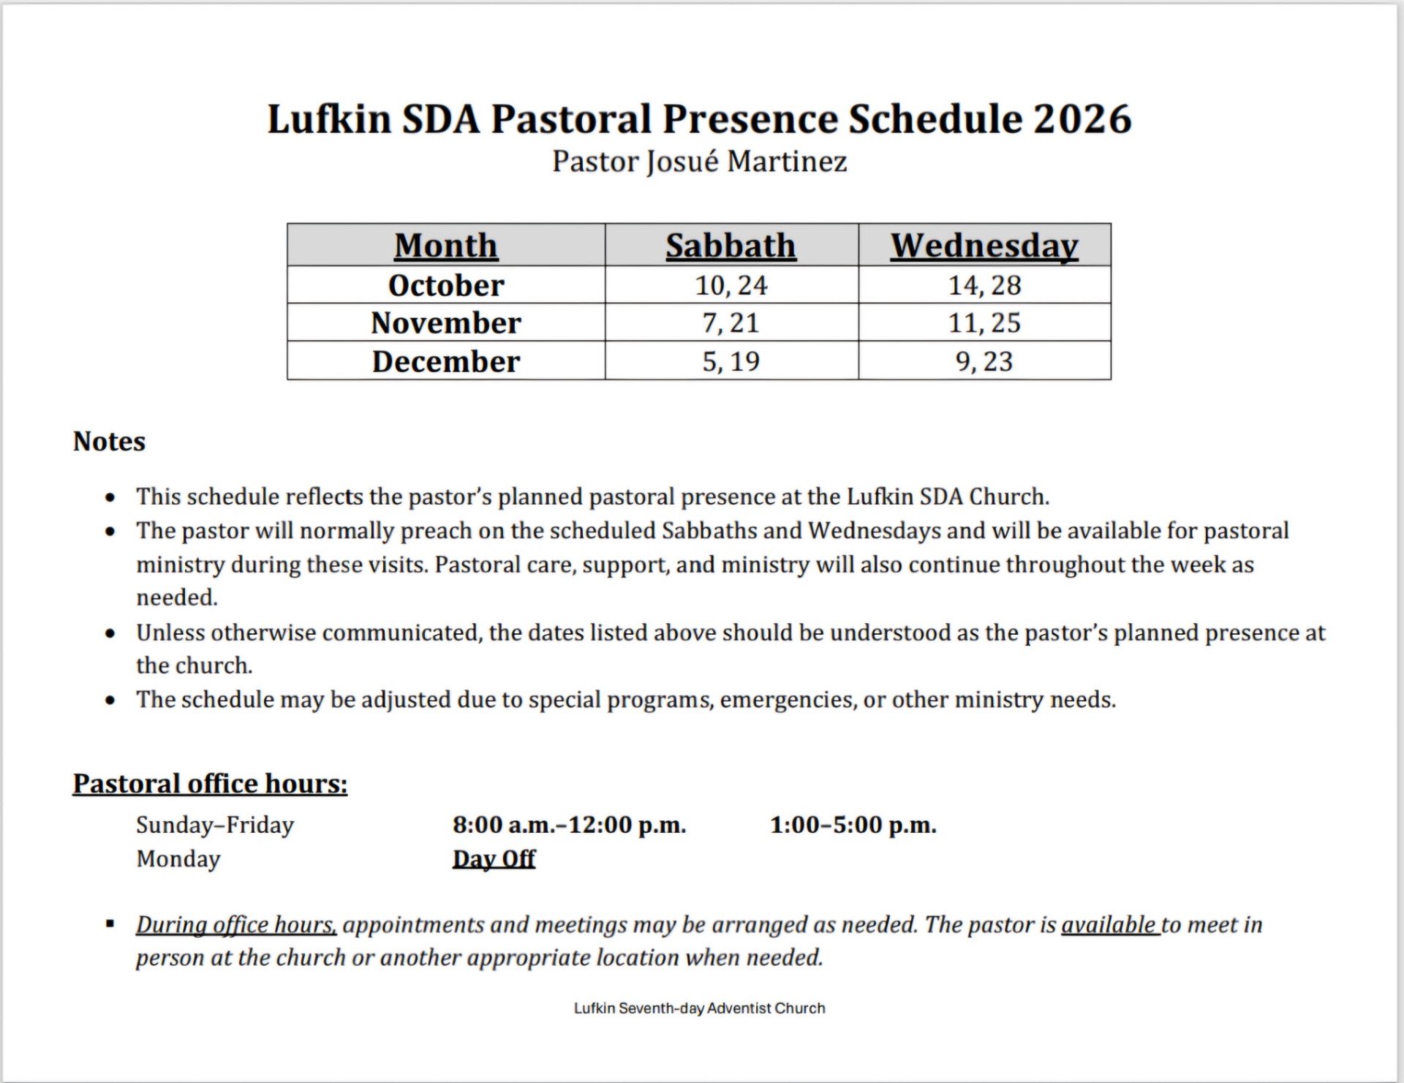

Slide 55

Invocation
Elder Jim Carpenter
Laura – Adobe Stock

Slide 56
Local Church Expenses
Monthly Budget Requirement
$3,217
Received For October
$356.00
Notes:
Click on the graph. A new tab will appear Chart Design. Click on it and then Edit Data and Edit Data (in the drop down). A little excel spreadsheet will appear. Update the amount under Total Funds Received and enter. X out and the graph should be updated.
Lastly update the amount on the slide.

Slide 57

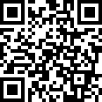
Notes:
The Local Church Budget goes for outreach, church ministries, utilities, repairs and maintenance, Sabbath School expenses, worship resources, insurance and more.

Slide 58

Praise &
Prayer
Hymn 684
Hear Our Prayer, O Lord
George Whelpton
Words: Public Domain; Music: Public Domain
Sound paused on Live Stream during Praise and Prayer.
Live Stream will continue in approximately 10 minutes.
Rawpixel - Shutterstock
Notes:
Prayer music removed. Daryl is not here.

Slide 59
Hear our prayer, O Lord,
Hear our prayer, O Lord;
Incline Thine ear to us,
And grant us Thy peace.
Amen.
Verse 1

Slide 60

Come Thy Fount
(Above All else/ Shane & Shane)
CCLI Song # 7029505
Robert Robinson | Shane Barnard
© 2013 Songs From Wellhouse
Used with permission. CCLI License # 2833891
Lexyat – Adobe Stock

Slide 61
Come thou Fount of every blessing Tune my heart to sing thy grace Streams of mercy never ceasing Call for songs of loudest praise
Verse 1 of 3

Slide 62
Teach me some melodious sonnet
Sung by flaming tongues above
Praise the mount I'm fixed upon it
Mount of Thy redeeming love
Verse 1 of 3

Slide 63
Here I raise my Ebenezer
Hither by Thy help I'm come
And I hope by Thy good pleasure
Safely to arrive at home
Verse 2 of 3

Slide 64
Jesus sought me when a stranger
Wand'ring from the fold of God
He to rescue me from danger
Interposed His precious blood
Verse 2 of 3

Slide 65
Oh to grace how great a debtor
Daily I'm constrained to be
Let Thy goodness like a fetter
Bind my wand'ring heart to Thee
Verse 3 of 3

Slide 66
Prone to wander Lord I feel it
Prone to leave the God I love
Here's my heart Lord take and seal it, Seal it for Thy courts above
Verse 3 of 3

Slide 67
All else I adore Your name
Above all else tune my heart to sing Your praise, Above all else I adore Your name, Above all else tune my heart to sing Your praise
Bridge

Slide 68
Above all else I adore Your name
Above all else tune my heart to sing Your praise, Above all else I adore Your name, Above all else tune my heart to sing Your praise
Bridge Repeat

Slide 69

The highest praise
The loudest praise
To the name above
every name
Tag
Lexyat – Adobe Stock

Slide 70
Prone to wander Lord I feel it
Prone to leave the God I love
Here's my heart Lord take and seal it, Seal it for Thy courts above
Ending (Verse 3 Repeat)

Slide 71

Children’s Offering
Offering collected will go to the
Trout Reach School Fund
Marie Hein – Shutterstock
Notes:
Trout Reach School Fund
2nd, 3rd, 4th Sabbath of the month

Slide 72
Children’s Offering
Offering collected will go to the
Youth Assistance Fund
Marie Hein – Shutterstock
Notes:
Youth Assistance Fund
1st and 5th Sabbath of the month

Slide 73

Children’s Story
Frances Carpenter
Youth Assistance Fund
1st and 5th Sabbath of the month

Slide 74
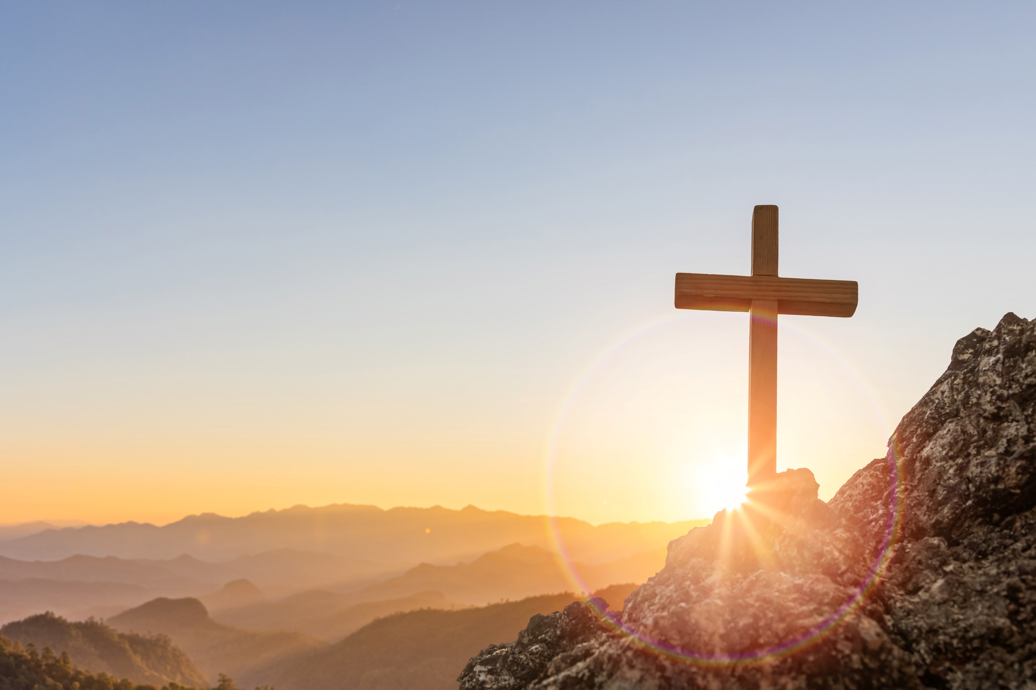
The Power of the Cross
CCLI Song # 4490766
Keith Getty | Stuart Townend
© 2005 Thankyou Music Ltd
Used with permission. CCLI License # 2833891
HTWE - Shutterstock

Slide 75
Oh to see the dawn of the darkest day
Christ on the road to Calvary
Tried by sinful men torn and beaten then, Nailed to a cross of wood
Verse 1 of 4

Slide 76
This the pow'r of the cross
Christ became sin for us
Took the blame bore the wrath
We stand forgiven at the cross
Chorus 1

Slide 77
Oh to see the pain written on Your face, Bearing the awesome weight of sin, Ev'ry bitter thought ev'ry evil deed
Crowning Your bloodstained brow
Verse 2 of 4

Slide 78
This the pow'r of the cross
Christ became sin for us
Took the blame bore the wrath
We stand forgiven at the cross
Chorus 1

Slide 79
Now the daylight flees now the ground beneath, Quakes as its Maker bows His head, Curtain torn in two dead are raised to life, Finished the vict'ry cry
Verse 3 of 4

Slide 80
This the pow'r of the cross
Christ became sin for us
Took the blame bore the wrath
We stand forgiven at the cross
Chorus 1

Slide 81
Oh to see my name written in the wounds, For through Your suff'ring I am free, Death is crushed to death life is mine to live, Won through Your selfless love
Verse 4 of 4

Slide 82
This the pow'r of the cross
Son of God slain for us
What a love what a cost
We stand forgiven
Chorus 2

Slide 83
What a love, what a cost. We stand
Forgiven at
the cross
Ending
HTWE - Shutterstock

Slide 84
Scripture Reading
Revelation 14:6-7 nkjv
⁶ Then I saw another angel flying in the midst of heaven,

Slide 85
having the everlasting gospel to preach to those who dwell on the earth — to every nation, tribe, tongue, and people — ⁷ saying with a loud voice, “Fear God and give glory

Slide 86
to Him, for the hour of His judgment has come; and worship Him who made heaven and earth, the sea and springs of water.”

Slide 87
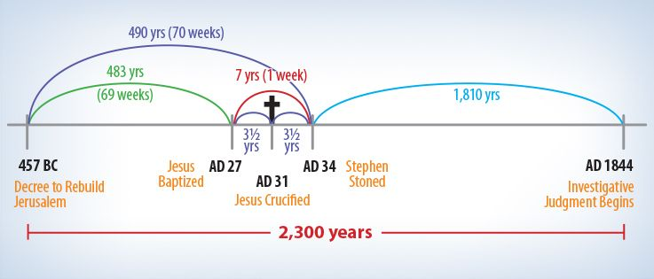
The Big Picture
Elder Jim Carpenter

Slide 88

Facing A Task Unfinished
(We Go to All the World)
CCLI Song # 7002026
Ed Cash | Fionán De Barra | Frank Houghton | Keith Getty | Kristyn Getty | Samuel Wesley
© 2015 Capitol CMG Paragon; Fionan De Barra Pub Designee; Getty Music Publishing; OMF International (UK)
Used with permission. CCLI License # 2833891
bemeve – Adobe Stock

Slide 89
Facing a task unfinished
That drives us to our knees
A need that undiminished
Rebukes our slothful ease
Verse 1 of 4

Slide 90
We who rejoice to know Thee
Renew before Thy throne
The solemn pledge we owe Thee
To go and make Thee known
Verse 1 of 4

Slide 91
Where other lords beside Thee
Hold their unhindered sway
Where forces that defied Thee
Defy Thee still today
Verse 2 of 4

Slide 92
With none to heed their crying
For life and love and light
Unnumbered souls are dying
And pass into the night
Verse 2 of 4

Slide 93
We go to all the world
With kingdom hope unfurled
No other name has power to save
But Jesus Christ the Lord
Chorus

Slide 94
We bear the torch that flaming
Fell from the hands of those
Who gave their lives proclaiming
That Jesus died and rose
Verse 3 of 4

Slide 95
Ours is the same commission
The same glad message ours
Fired by the same ambition
To Thee we yield our powers
Verse 3 of 4

Slide 96
We go to all the world
With kingdom hope unfurled
No other name has power to save
But Jesus Christ the Lord
Chorus

Slide 97
O Father who sustained them
O Spirit who inspired
Saviour whose love constrained them, To toil with zeal untired
Verse 4 of 4

Slide 98
From cowardice defend us
From lethargy awake
Forth on Thine errands send us
To labour for Thy sake
Verse 4 of 4

Slide 99
We go to all the world
With kingdom hope unfurled
No other name has power to save
But Jesus Christ the Lord
Chorus

Slide 100
We go to all the world
With kingdom hope unfurled
No other name has power to save
But Jesus Christ the Lord
Chorus Repeat

Slide 101
Benediction
Elder Jim Carpenter
Laura – Adobe Stock

