Slide 1

RDO - Adobe Stock
Turn on Audacity & Screen Sharing

Slide 2


------------
Lufkin
Seventh-day
Adventist Church
RDO – Adobe Stock
a church where all are welcome
Notes:
To change picture, click on picture to bring up Shape Format tab, click Text Fill (not shape fill) then Picture and Insert Picture from File (on desktop or your computer).

Slide 3

How Great is Our God
Chris Tomlin | Ed Cash | Jesse Reeves
© 2004 Rising Springs Music; Vamos Publishing; worshiptogether.com songs; Wondrously Made Songs
Used with permission. CCLI License # 2833891
Milan – Adobe Stock

Slide 4
The splendor of the King
Clothed in majesty
Let all the earth rejoice
All the earth rejoice
Verse 1 of 2

Slide 5
He wraps Himself in light
And darkness tries to hide
And trembles at His voice
And trembles at His voice
Verse 1 of 2

Slide 6
How great is our God, Sing
with me, How great is our God
And all will see how great
How great is our God
Chorus

Slide 7
And age to age He stands
And time is in His hands
Beginning and the End
Beginning and the End
Verse 2 of 2

Slide 8
The Godhead three in one
Father Spirit Son
The Lion and the Lamb
The Lion and the Lamb
Verse 2 of 2

Slide 9
How great is our God, Sing
with me, How great is our God
And all will see how great
How great is our God
Chorus

Slide 10
Name above all names
Worthy of all praise
My heart will sing
How great is our God
Bridge

Slide 11
Name above all names
Worthy of all praise
My heart will sing
How great is our God
Bridge Repeat

Slide 12
How great is our God, Sing
with me, How great is our God
And all will see how great
How great is our God
Chorus

Slide 13
How great is our God, Sing
with me, How great is our God
And all will see how great
How great is our God
Chorus Repeat (a cappella)

Slide 14
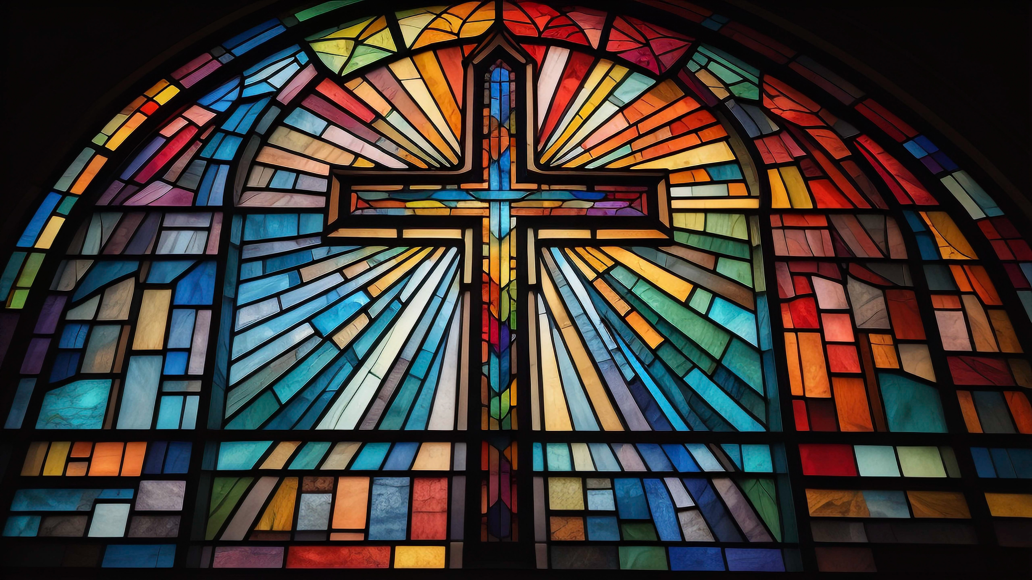
O For a Thousand Tongues to Sing
Carl Gotthelf Glaser | Charles Wesley | Chris Rice
Words: Public Domain; Music: Public Domain
Jason Yonder – Adobe Stock

Slide 15
O for a thousand tongues to sing
My great Redeemer’s praise,
The glories of my God and King,
The triumphs of His grace!
Verse 1 of 6

Slide 16
And if I had a thousand tongues
Still, I could never sing enough
Chorus

Slide 17
My gracious Master and my God,
Assist me to proclaim,
To spread through all the earth abroad, The honors of thy name.
Verse 2 of 6

Slide 18
And if I had a thousand tongues
Still, I could never sing enough
Chorus

Slide 19
Jesus! the name that charms our fears, That bids our sorrows cease;
’Tis music in the sinner’s ears,
’Tis life, and health, and peace.
Verse 3 of 6

Slide 20
And if I had a thousand tongues
Still, I could never sing enough
Chorus

Slide 21
He breaks the power of canceled sin, He sets the prisoner free;
His blood can make the foulest clean; His blood availed for me.
Verse 4 of 6

Slide 22
And if I had a thousand tongues
Still, I could never sing enough
Chorus

Slide 23
Hear Him, ye deaf; His praise, ye dumb, Your loosened tongues employ; Ye blind, behold your savior come, And leap, ye lame, for joy.
Verse 5 of 6

Slide 24
And if I had a thousand tongues
Still, I could never sing enough
Chorus

Slide 25
O for a thousand tongues to sing
My great Redeemer’s praise,
The glories of my God and King,
The triumphs of His grace!
Verse 6 of 6 (Verse 1 Repeat)

Slide 26
The glories of my God and King,
The triumphs of His grace!
Ending

Slide 27

Amazing Grace My Chains are Gone
Chris Tomlin Version
Chris Tomlin | John Newton | Louie Giglio
© 2006 Rising Springs Music; Vamos Publishing; worshiptogether.com songs
Used with permission. CCLI License # 2833891
forall - Adobe Stock

Slide 28
Amazing grace how sweet the sound, That saved a wretch like me, I once was lost but now I'm found, Was blind but now I see
Verse 1 of 4

Slide 29
'Twas grace that taught my heart to fear, And grace my fears relieved, How precious did that grace appear, The hour I first believed
Verse 2 of 4

Slide 30
My chains are gone I've been set free, My God my Savior has ransomed me, And like a flood His mercy rains, Unending love amazing grace
Chorus

Slide 31
The Lord has promised good to me
His word my hope secures
He will my shield and portion be
As long as life endures
Verse 3 of 4

Slide 32
My chains are gone I've been set free, My God my Savior has ransomed me, And like a flood His mercy rains, Unending love amazing grace
Chorus

Slide 33
The earth shall soon dissolve like snow, The sun forbear to shine
But God who called me here
below, Will be forever mine
Verse 4 of 4

Slide 34
Will be forever
mine
You are forever mine
Ending
forall - Adobe Stock

Slide 35

This is My Father’s World
Hymn 92
Franklin Lawrence Sheppard | Maltbie Davenport Babcock,
Words: Public Domain; Music: Public Domain
sudar – Adobe Stock

Slide 36
This is my Father’s world,
And to my listening ears, All nature sings, and round me rings, The music of the spheres.
Verse 1 of 3

Slide 37
This is my Father’s world:
I rest me in the thought, Of rocks and trees, of skies and seas; His hand the wonders wrought.
Verse 1 of 3

Slide 38
This is my Father’s world,
The birds their carols raise,
The morning light, the lily white,
Declare their Maker’s praise.
Verse 2 of 3

Slide 39
This is my Father’s world;
He shines in all that’s fair; In the rustling grass I hear Him pass, He speaks to me everywhere.
Verse 2 of 3

Slide 40
This is my Father’s world.
O let me ne’er forget, That though the wrong seems oft so strong, God is the Ruler yet.
Verse 3 of 3

Slide 41
This is my Father’s world;
Why should my heart be sad? The
Lord is King; Let the heavens ring!
God reigns; let the earth be glad!
Verse 3 of 3

Slide 42
------------
Lufkin
Seventh-day
Adventist Church
RDO – Adobe Stock
a church where all are welcome
Notes:
To change picture, click on picture to bring up Shape Format tab, click Text Fill (not shape fill) then Picture and Insert Picture from File (on desktop or your computer).

Slide 43

pamela_d_mcadams – Adobe Stock
Tuesday Zoom Bible Study - 6:30 pm - Elder Eddie Gray
Meeting ID: 813 8111 3439 Passcode: 218938
Notes:
Display on first Sabbath of each month or if Eddie is present.

Slide 44

Wednesday
Prayer & Bible Study
New Study Starting Soon
with Frances Carpenter
Wednesday at 7:00 PM
Romolo Tavani – Adobe Stock

Slide 45

Fellowship Meals for October
24 | Bring your favorite vegetarian dish.
31 | No meal. Invite a friend home.
Sign up at perfectpotluck.com
anaumenko - Adobe Stock

Slide 46
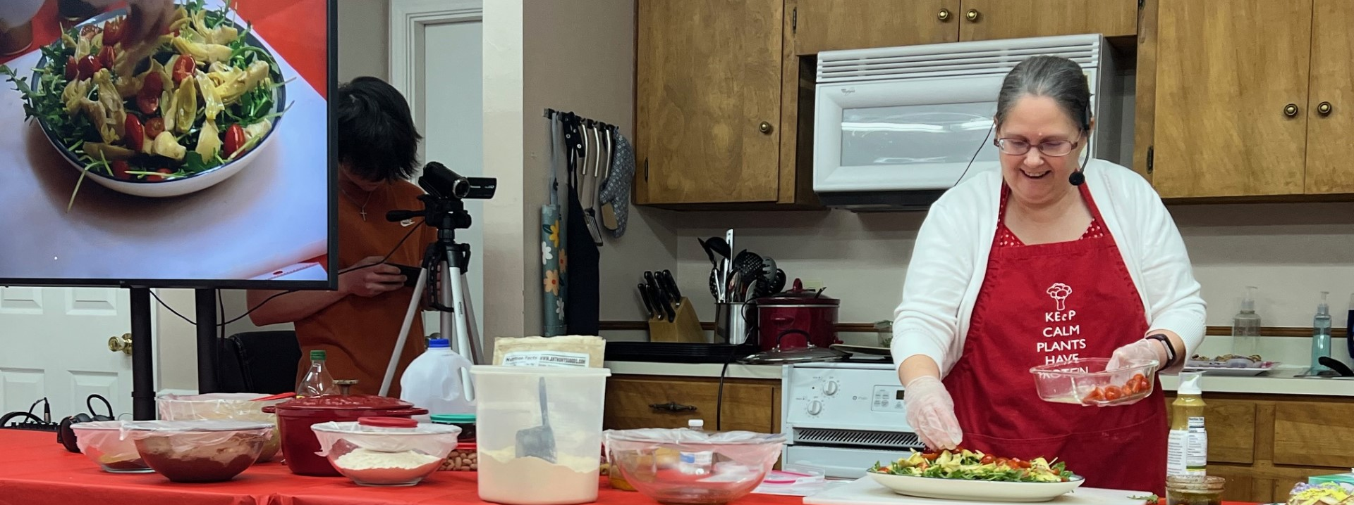
Free Community Wide
Plant-Powered Cooking Class
Next class November 9 at 6:30 pm, for more info call or text Frances at 541-908-3619
at Nacogdoches Church on November 1 at 3:30 pm

Slide 47

Ladies
Afternoon Tea
Sunday, October 25
3:00 – 4:30 PM
RSVP to Frances
541.908.3619
Pixel Matrix – Adobe Stock

Slide 48

Looking EASTWARD
Zoom Health Lectures
with Elder Ben Albin
The History of John Harvey Kellogg
November 12 at 6:00 PM
Meeting ID: 627 737 6775
Passcode: tn6JRW
Darya – Adobe Stock
Notes:
Need to update

Slide 49

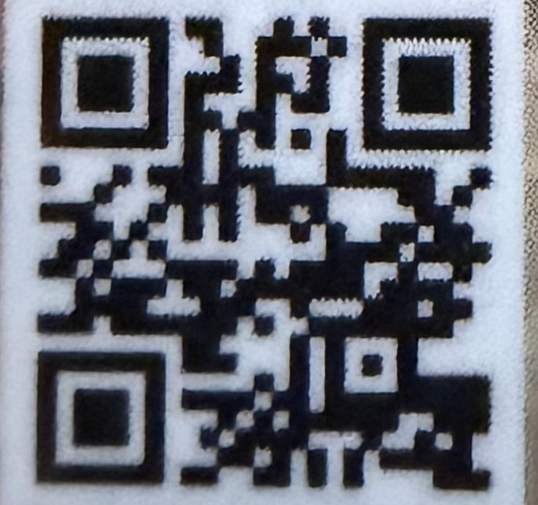
Cards are available in the foyer. Please pass them out to the community
lessons250.com

Slide 50
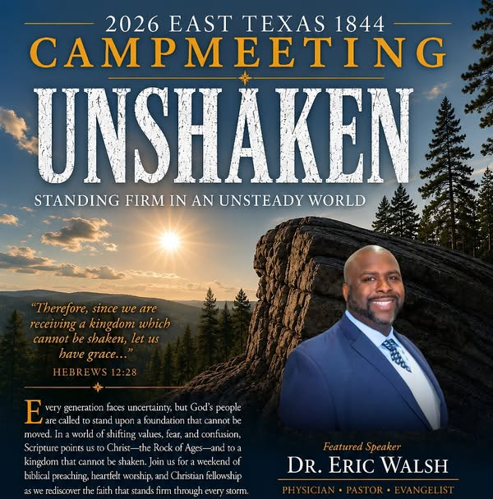
East Texas Camp Meeting
October
30-31
7723 FM 1793
Karnack, TX 75661
Pastor Sanford
936-488-9304

Slide 51
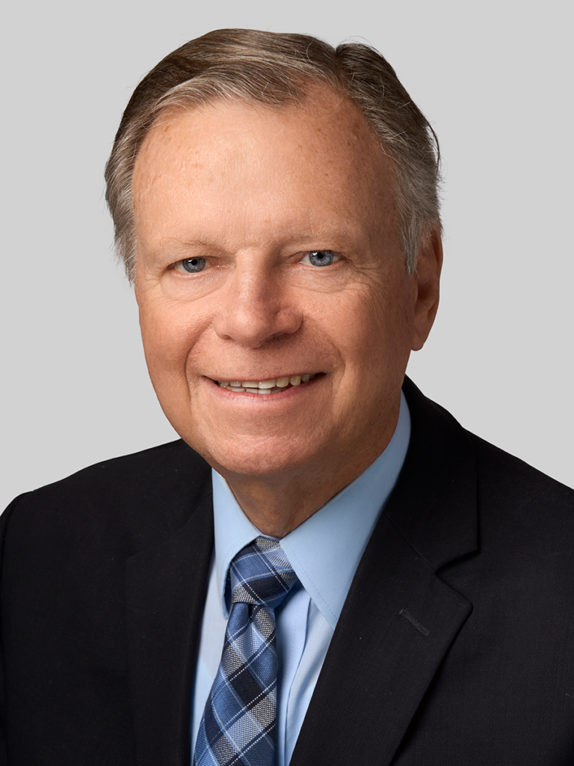

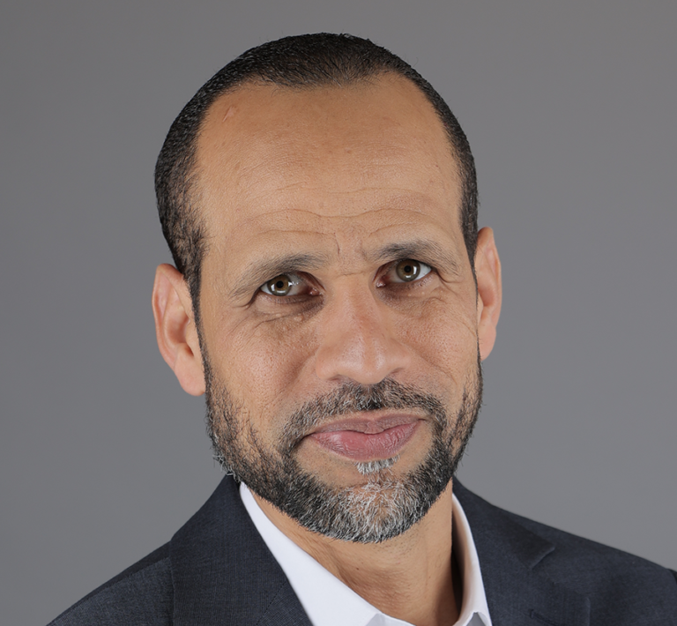
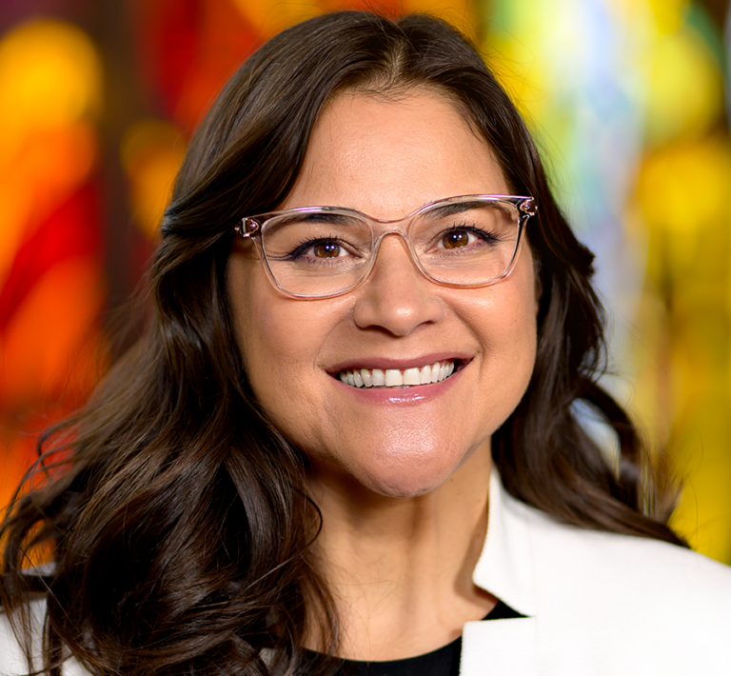

M E E T I N G
November 14 at Lake Whitney
Mark Finnley, Arnaldo Cruz, Yami Bazan
and the Heritage Singers

Slide 52
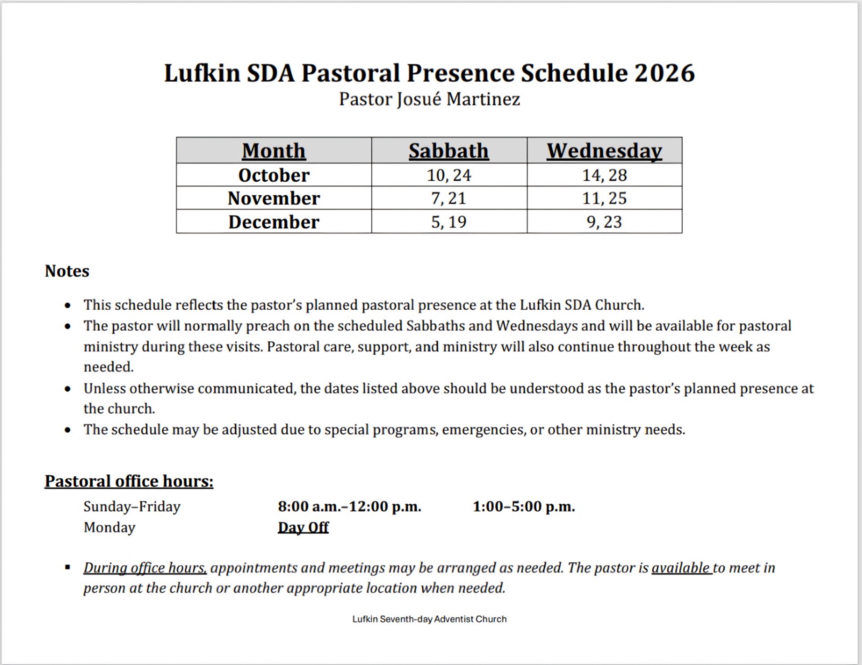

Slide 53

Invocation
Pastor Josue Martinez
Laura – Adobe Stock

Slide 54
Local Church Expenses
Monthly Budget Requirement
$3,217
Received For October
$356.00
Notes:
Click on the graph. A new tab will appear Chart Design. Click on it and then Edit Data and Edit Data (in the drop down). A little excel spreadsheet will appear. Update the amount under Total Funds Received and enter. X out and the graph should be updated.
Lastly update the amount on the slide.

Slide 55


Notes:
Texas Conference of Seventh-day Adventists is a sisterhood of local churches that helps each congregation within its boundaries to accomplish important objectives beyond the reach of any one church alone.
The Texas Vision offering benefits three areas within the Texas Conference of Seventh-day Adventists: worthy student funding for our academies (25%), Lake Whitney Ranch development (50%) and church or school building appropriations (25%).

Slide 56

Praise &
Prayer
Hymn 684
Hear Our Prayer, O Lord
George Whelpton
Words: Public Domain; Music: Public Domain
Sound paused on Live Stream during Praise and Prayer.
Live Stream will continue in approximately 10 minutes.
Rawpixel - Shutterstock
Notes:
Prayer music removed. Daryl is not here.

Slide 57
Hear our prayer, O Lord,
Hear our prayer, O Lord;
Incline Thine ear to us,
And grant us Thy peace.
Amen.
Verse 1

Slide 58
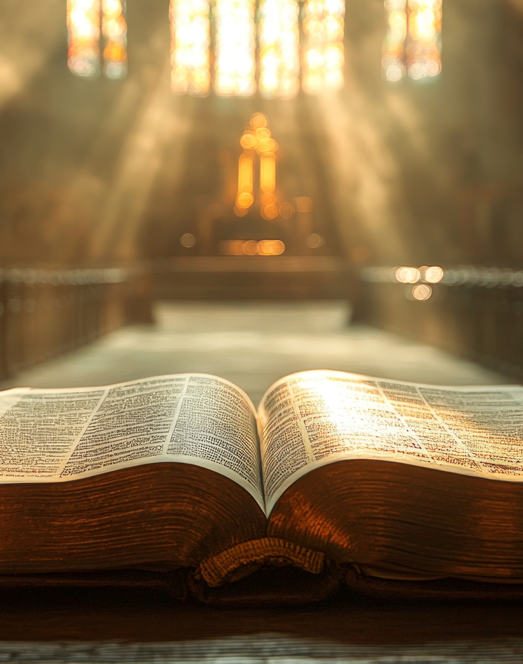
Draw Me Nearer
Hymn 306
Fanny J. Crosby | William H. Doane
Words: Public Domain; Music: Public Domain
Lexyat – Adobe Stock

Slide 59
I am Thine, O Lord, I have heard Thy voice, And it told Thy love to me; But I long to rise in the arms
of faith, And be closer drawn
to Thee.
Verse 1 of 3

Slide 60
Draw me nearer, nearer, blessed Lord, To the cross where Thou hast died; Draw me nearer, nearer, nearer, blessed Lord, To Thy precious, bleeding side.
Refrain

Slide 61
Consecrate me now to Thy service, Lord, By the power of grace divine;
May my soul look up with a steadfast hope And my will be lost in Thine.
Verse 2 of 3

Slide 62
Draw me nearer, nearer, blessed Lord, To the cross where Thou hast died; Draw me nearer, nearer, nearer, blessed Lord, To Thy precious, bleeding side.
Refrain

Slide 63
O the pure delight of a single hour
That before Thy throne I spend,
When I kneel in prayer, and with Thee, my God, I commune as friend with friend!
Verse 3 of 3

Slide 64
Draw me nearer, nearer, blessed Lord, To the cross where Thou hast died; Draw me nearer, nearer, nearer, blessed Lord, To Thy precious, bleeding side.
Refrain

Slide 65

Children’s Offering
Offering collected will go to the
Trout Reach School Fund
Marie Hein – Shutterstock
Notes:
Trout Reach School Fund
2nd, 3rd, 4th Sabbath of the month

Slide 66
Children’s Offering
Offering collected will go to the
Youth Assistance Fund
Marie Hein – Shutterstock
Notes:
Youth Assistance Fund
1st and 5th Sabbath of the month

Slide 67
Children’s Story
Alondra Hernanez
Marie Hein – Shutterstock
Youth Assistance Fund
1st and 5th Sabbath of the month

Slide 68
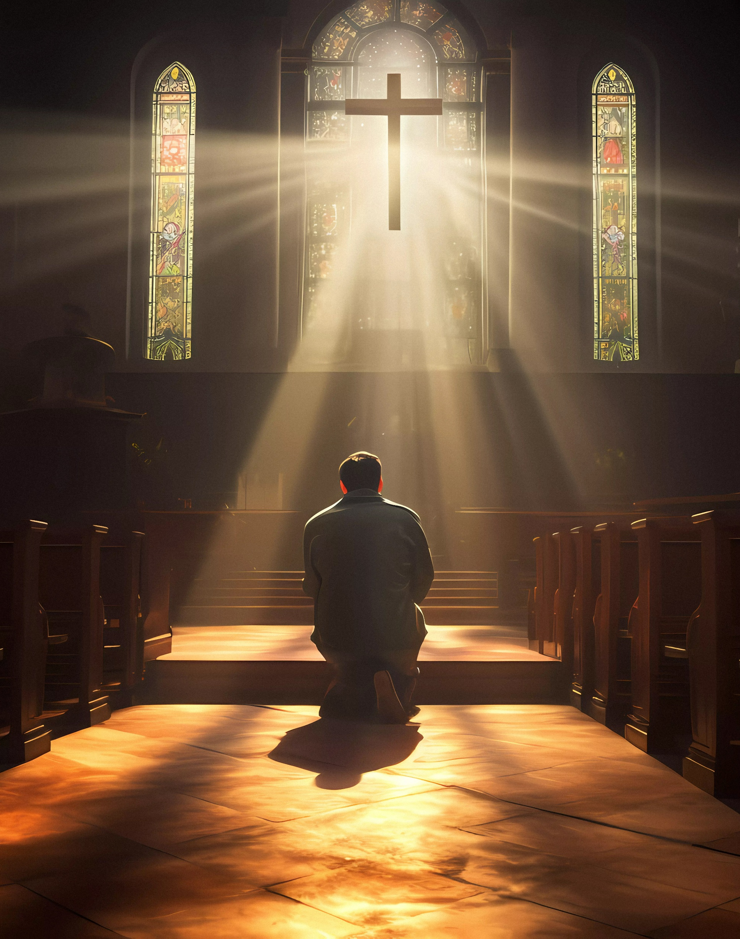
Sweet Hour of Prayer
Hymn 478
William Batchelder Bradbury | William W. Walford
Words: Public Domain; Music: Public Domain
francescosgura – Adobe Stock

Slide 69
Sweet hour of prayer, Sweet hour of prayer, That calls me from a world of care, And bids me, at my Father’s throne, Make all my wants and wishes known!
Verse 1 of 3

Slide 70
In seasons of distress and grief, My soul has often found relief, And oft escaped the tempters snare, By Thy return, Sweet hour of prayer.
Verse 1 of 3

Slide 71
Sweet hour of prayer! Sweet hour of prayer! Thy wings shall my petition bear, To Him whose truth and faithfulness, Engage the waiting soul to bless.
Verse 2 of 3

Slide 72
And since He bids me seek His face, Believe His word, and trust His grace, I’ll cast on Him my every care, And wait for Thee, Sweet hour of prayer.
Verse 2 of 3

Slide 73
Sweet hour of prayer! Sweet hour
of prayer! May I Thy consolation share, Till from Mount Pisgah’s lofty height I view my home and take my flight.
Verse 3 of 3

Slide 74
In my immortal flesh I’ll rise, To seize the everlasting prize. And shout while passing through the air, “Farewell, farewell, Sweet
hour of prayer!”
Verse 3 of 3

Slide 75
Scripture Reading
Jeremiah 29:12-13 nkjv
¹² Then you will call upon Me and go and pray to Me, and I will listen to you.

Slide 76
¹³ And you will seek Me and find Me, when you search for Me with all your heart.

Slide 77

A Healthy Church:
Growing Closer to God
Growing Through
Prayer
Pastor Josue Martinez
Iigun – Adobe Stock

Slide 78
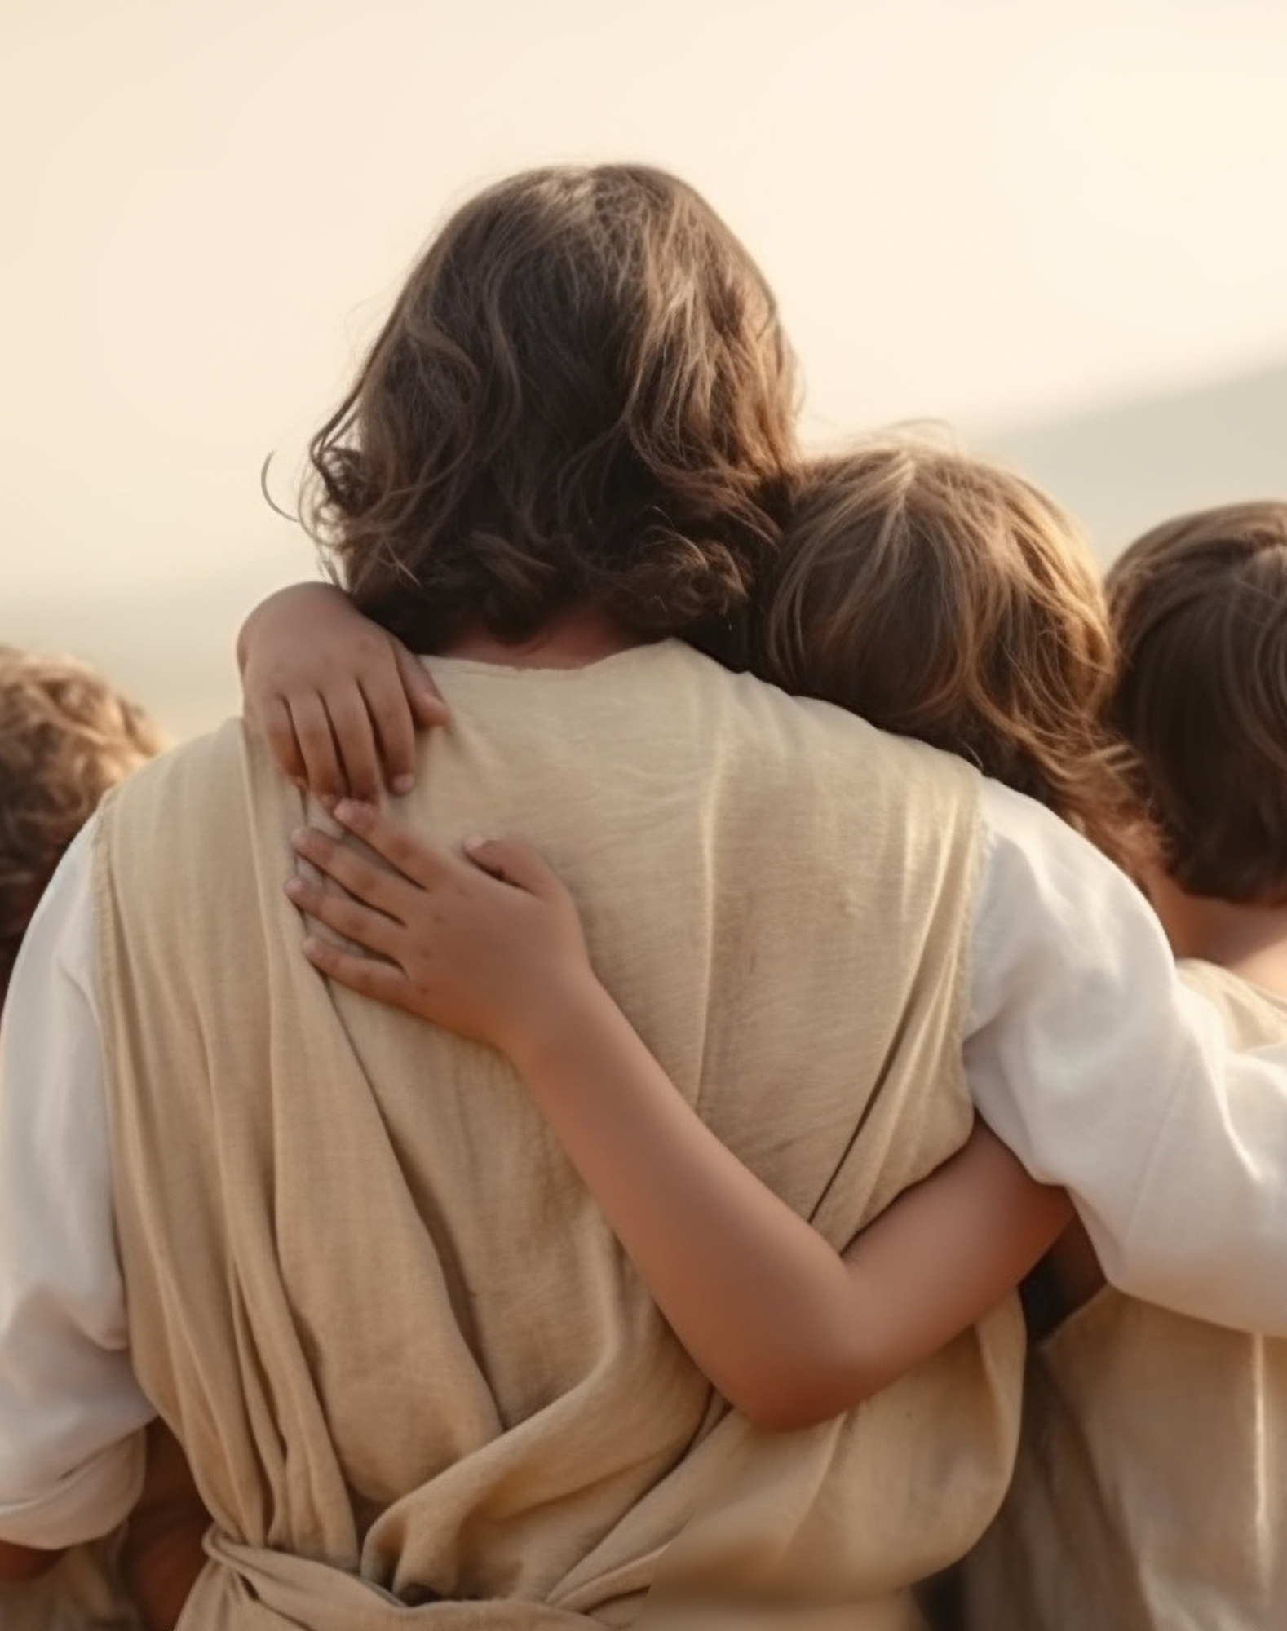
What a Friend We Have in Jesus
Hymn 499
Charles Crozat Converse | Joseph Medlicott Scriven
Words: Public Domain; Music: Public Domain
4kate – Adobe Stock

Slide 79
What a friend we have in Jesus,
All our sins and griefs to bear;
What a privilege to carry
Everything to God in prayer!
Verse 1 of 3

Slide 80
O what peace we often forfeit,
O what needless pain we bear,
All because we do not carry
Everything to God in prayer.
Verse 1 of 3

Slide 81
Have we trials and temptations?
Is there trouble anywhere?
We should never be discouraged;
Take it to the Lord in prayer!
Verse 2 of 3

Slide 82
Can we find a friend so faithful,
Who will all our sorrows share?
Jesus knows our every weakness;
Take it to the Lord in prayer!
Verse 2 of 3

Slide 83
Are we weak and heavy laden,
Cumbered with a load of care?
Precious Savior, still our refuge,
Take it to the Lord in prayer!
Verse 3 of 3

Slide 84
Do thy friends despise, forsake thee? Take it to the Lord in prayer!
In His arms He'll take and shield thee, Thou wilt find a solace there.
Verse 3 of 3

Slide 85
Benediction
Pastor Josue Martinez
Laura – Adobe Stock

