Slide 1
The Gift of Prophecy
Lesson 4
New Testament Prophets

Slide 2
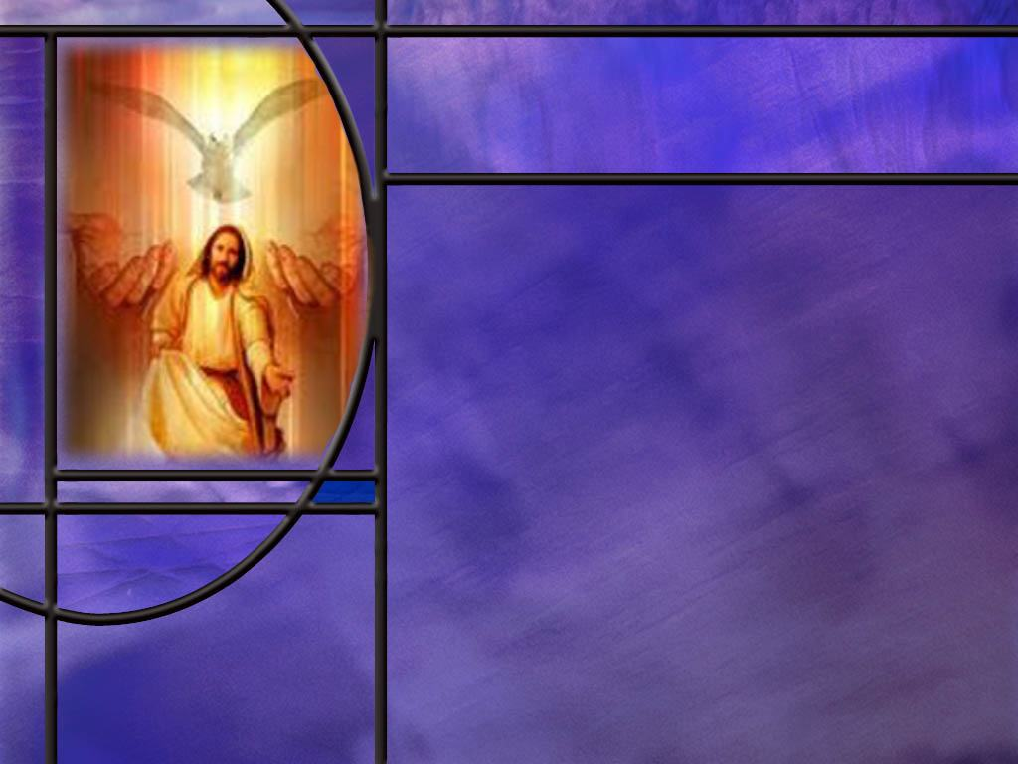
Memory Text
1 Corinthians 12:4-6 MKJV
There are diversities of gifts, but the same Spirit. ⁵ There are differences of ministries, but the same Lord. ⁶ And there are diversities of activities, but it is the same God who works all in all.
What do you notice about the divine names in these three verses?
What does Paul say here about spiritual gifts?
Notes:
B2:
1. There are three verses, three statements about spiritual gifts, and three divine names used.
2. First, we have the Spirit as in the Holy Spirit.
3. Then we have Lord as in the Lord Jesus Christ.
4. And finally, we have God as in God the Father.
5. So, this is one of many trinitarian texts found in the NT that mention all three divine Persons together.
6. Father, Son, and Holy Spirit are all working together in the distribution of Spiritual gifts.
B3:
1. First, he says there are diversities of gifts.
2. That means that the spiritual gifts are different for different people.
3. Not everyone has the same gift.
4. But all the gifts come from the same Spirit.
5. Next there are diversities of ministries.
6. These different gifts are given for the work of ministry.
7. Ministry builds up the church.
8. Paul gores on to say that they are given for the common good, the good of all the church.
9. While we all have the ministry of reconciliation, we can go about it in different ways.
10. Finally, there are many different activities in the church but the one divine God works it all together for good.
11. So, these are three parallel statements about the diversity of spiritual gifts, spiritual ministries, spiritual activities.
12. Yet there is one God who is in charge of it all: Father, Son, and Holy Spirit.
13. If your gift comes from God, then use it for His glory.
14. God graciously gives different gifts, calls forth different kinds of service, and works through people in different ways.
15. But Paul goes on to warn in this passage not to turn those differences into a ranking system.
16. You receive from the same Spirit, serve the same Lord, and depend on the same God.
17. What he has given each of you is intended to benefit the whole church—not to make one person feel superior or another feel unnecessary.”
18. So let us all use our gifts for the common good.

Slide 3
Overview
While the Prophets were God’s spokesmen in OT times, the apostles were His spokesmen in NT times. The gift of prophecy in NT times carries neither the authority nor the accuracy of the OT prophets. It is through the apostles and their close associates that the inspired words of the NT were written and are the means by which God speaks to us “by His Son.”
  Jesus as Prophet
  Other NT Prophets
  Apostolic Authority
  Summary

Slide 4
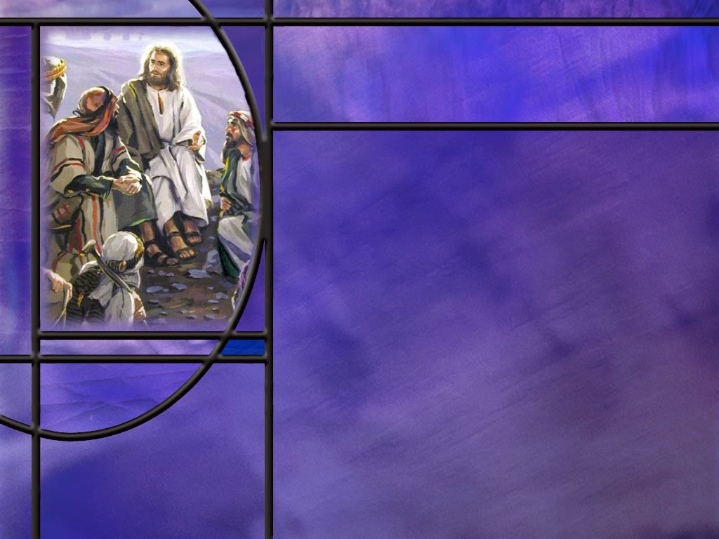
Jesus as Prophet
Which famous prophet predicted that a prophet like him would arise? (Deut 18:15,19)
How did Jesus fulfill Moses’ prediction? (Luke 24:27)
What famous predication did Jesus make that was fulfilled in 70 AD? (Matt 24:1-2,34)
How did Jesus inaugurate a new way of God speaking to His people? (Heb 1:1-2)
Notes:
B1:
[See notes on linked slide.]
B2:
[See notes on linked slide.]
B3:
[See notes on linked slide.]
B4:
[See notes on linked slide.]

Slide 5
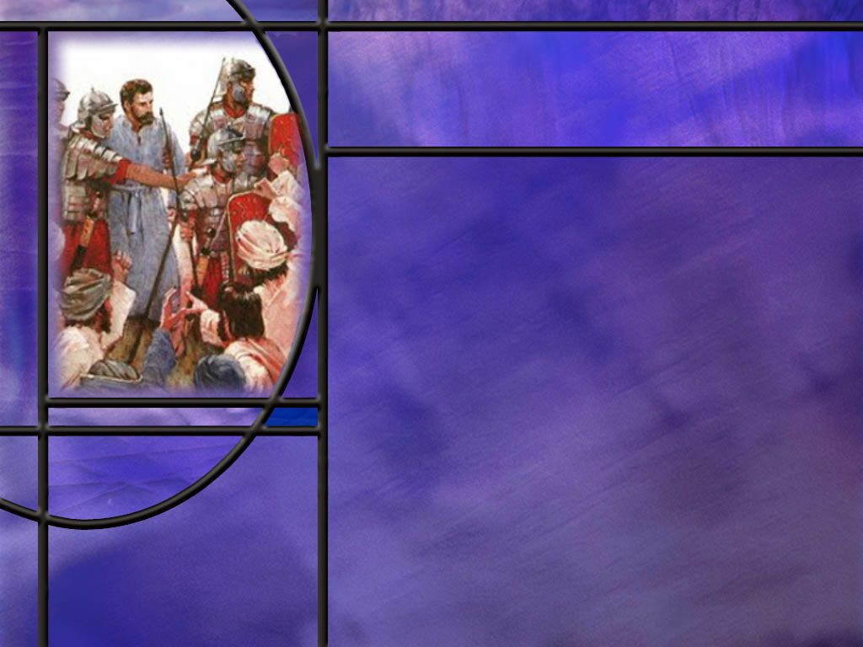
NT Prophets
What prophets are mentioned in the NT before the Day of Pentecost?
What NT prophets are mentioned in the early church after Pentecost? [Early Church Prophets]
What had Agabus prophesied would happen to Paul in Jerusalem? (Acts 21:11)
What actually happened? (Acts 21:30-33)
How should we approach NT prophecy if it is not always reliable? (1 Thes 5:19-20)
Notes:
B1:
1. We can look at two periods of time as recorded in the NT: Before Pentecost and After Pentecost.
2. Before Pentecost we have several prophets mentioned.
3. First is Zacharias, the father of John the Baptist.
4. Luke records his prophecy:
Luke 1:67-68, ESV – 67 And his father Zechariah was filled with the Holy Spirit and prophesied, saying, ⁶⁸ "Blessed be the Lord God of Israel, for he has visited and redeemed his people ...
5. And speaking of John the Baptist, he said:
Luke 1:76 76 ESV And you, child, will be called the prophet of the Most High; for you will go before the Lord to prepare his ways,
6. And we know from the gospel accounts that John the Baptist did just that.
Q1: Who did Jesus call a prophet?
1. John the Baptist.
2. Speaking to the people concerning John the Baptist, Jesus said:
Matthew 11:9 ESV – 9 What then did you go out to see? A prophet? Yes, I tell you, and more than a prophet.
3. In fact, He said there was no prophet greater than John because none had a greater message: “Behold the Lamb of God that takes away the sin of the world.”
4. John called people back to repentance and faithfulness to God and pointed them to Jesus.
Q2: Who were the two people who met Jesus at the temple when He was dedicated as an infant there?
1. We have Simeon and Anna.
2. Simeon made a prophecy concerning Jesus and Mary.
3. He said to Mary “a sword will pierce through your own soul also”
4. Anna is referred to in the next verse this way:
Luke 2:36 ESV – And there was a prophetess, Anna, the daughter of Phanuel, of the tribe of Asher. She was advanced in years,
5. She spent her days in the temple praying and fasting and Luke records she gave thanks to God for Jesus.
6. Finally, we have Jesus the Prophet whom we have already discussed..
B2:
[See notes on linked slide.]
B3:
[See notes on linked slide.]
B4:
[See notes on linked slide.]
B5:
[See notes on linked slide.]

Slide 6
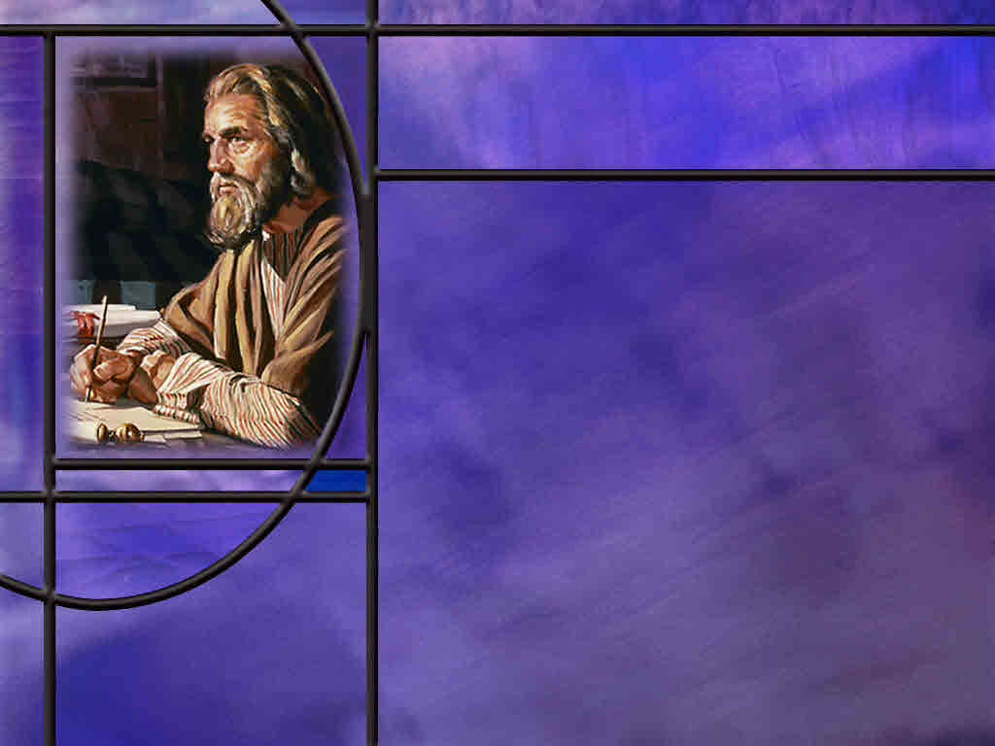
Apostolic Authority
How are we to test the NT gift of prophecy? (2 Peter 3:1-2)
How did Paul respond to the warning of Agabus not to go up to Jerusalem? (Acts 21:12-14)
Who exercised authority over the conduct of worship in the Corinthian church? (1 Cor 14:37-38)
How should we view the prophetic ministry of Ellen White, OT prophet or NT gift of prophecy?
Notes:
B1:
[See notes on linked slide.]
B2:
[See notes on linked slide.]
B3:
[See notes on linked slide.]
B4:
1. To me, it makes much mores sense to see Ellen White as having the NT gift of prophecy.
2. In my view, Ellen White dos not qualify as an OT prophet who spoke the very words of God with divine authority.
3. Instead, she spoke merely human words to do her best to convey to the church the thoughts that God had laid upon her heart.
4. That’s what the NT prophets did.
5. She did not say “Thus saith the Lord.” Rather she would say, “I was shown.”
6. She did not write scripture, but words that must be judged by Scripture.
7. She does not pass the test of an OT prophet, because not all of her prophecies came true.
8. One in particular that is very telling is the “food for worms” vision.
9. Based on the failure of this prophecy she would be considered a false prophet by the OT tests of a prophet.,
10. On the other hand, the NT gift of prophecy is more forgiving.
11. If Agabus can get a few details wrong and still be recognized as a NT prophet, so can EGW.
12. In this vein, we can sift her writings and hold fast what is good and discard what is not.
13. There is no question that her gift was instrumental in leading the young Adventist church.
14. Her council was invaluable in starting the publishing work, the educational work, the health reform work, the mission work, and in purchasing land and buildings that would prove a blessing in advancing the work.
15. I believe that she was instrumental in changing the Adventist church from non-trinitarian to trinitarian.
16. While she was not perfect, she has been a positive influence on the church and a blessing to many.
17. She was not an apostle, so her words may be inspiring, but are not inspired in the biblical sense of carrying divine authority.
18. We will be judged by the word of God, OT and NT, not by the writings of sister White.

Slide 7
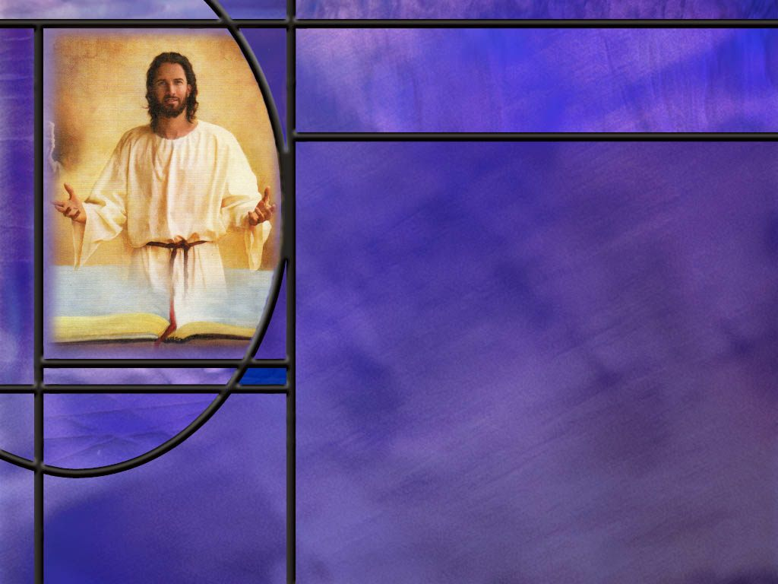
Summary
As we studied last week, OT prophets spoke the very words of God with a “Thus says the Lord.”
They spoke and wrote Scripture with divine authority as the “word of God.”
Prophets are also recognized in the NT: Zachariah, John the Baptist, Anna, and Jesus.
Jesus, being God the Son, would obviously speak the very words of God during His ministry.
His words were recorded through His inspired apostles in the gospels of the NT.
Jesus accurately predicted the fall of Jerusalem in 70 AD and will fulfill all the Messianic prophecies of the OT prophets.

Slide 8
Summary
Following the day of Pentecost, prophecy continued in the early church as the gift of prophecy prominently mentioned in lists of the gifts of the Spirit.
Several individuals are listed as prophets with this gift, most notably Agabus.
Agabus’ prophecy about Paul’s experience in Jerusalem got the general idea right, but the only two details he gave were wrong.
The Jews did not bind Paul’s hands, the Romans did; the Jews did not hand him over to the Romans, the Romans rescued him from the Jews who wanted to kill him.
Even so, Luke still recognizes Agabus as a prophet. It is reasonable to conclude that the NT gift of prophecy did not demand the same accuracy as OT prophets.

Slide 9
Summary
Paul’s instruction to the Thessalonians to test all prophecies and hold on to what is good indicates that the NT gift of prophecy may not always be reliable.
The authority of the OT prophets passed to the NT apostles. The former wrote the authoritative word of God in OT times; the latter wrote the authoritative Testimony of Jesus in NT times.
The apostles clearly exercised authority over those with the gift of prophecy in the early church.
EGW appears to fit the characteristics of having the NT gift of prophecy.
Thinking of prophecy in very simple terms of speaking up for God, will you ask Him to give you that gift this week?

Slide 11
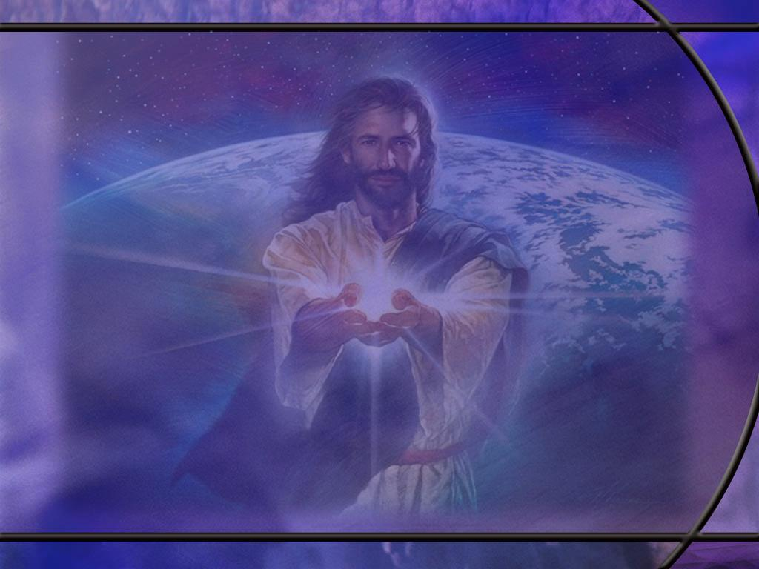
Deuteronomy 18:15, 19 ESV
“The LORD your God will raise up for you a prophet like me from among you, from your brothers--it is to him you shall listen-- ... ¹⁹ And whoever will not listen to my words that he shall speak in my name, I myself will require it of him. [R]
Notes:
Q1: Who is speaking these words?
1. In verse 15 we have Moses speaking.
2. And in verse 19 we have the Lord speaking to Moses and Moses recording the very words of God.
3. So here we have Moses predicting that God would raise up from the Hebrew people a prophet like himself.
4. This prophet will speak the Lord’s words in the Lord’s name.
5. And whoever does not listen to Him will be judged by the Lord.
6. Just as Moses spoke the words of God to the people, so would this future “Prophet.”
7. As Moses was God’s first spokesman to HIs people, so this future prophet would be God’s ultimate spokesman to His people.
8. This fits together with how the writer to the Hebrews opens his book:
Hebrews 1:1-2 KJV – God, who at sundry times and in divers manners spake in time past unto the fathers by the prophets, ² Hath in these last days spoken unto us by his Son, whom he hath appointed heir of all things, by whom also he made the worlds;
9. Here inspired scripture is saying that God is no longer speaking through the authority of prophets as in OT times.
10. In these last days God is speaking to us through His Son, the Lord Jesus Christ.
11. The NT is the testimony of Jesus.
12. It was written, not by prophets, but by the apostles who wrote the NT, through which Jesus speaks to us today.

Slide 12
Luke 24:27 KJV
And beginning at Moses and all the prophets, he expounded unto them in all the scriptures the things concerning himself. [R]
Notes:
Q1: Who is doing the expounding here?
1. This was Jesus on the road to Emaus.
2. All true prophecy finds its fulfillment in Christ.
3. We have the prophetic predictions of the OT that have either been fulfilled already in the life, death, and resurrection of Christ or will be fulfilled at His second coming.

Slide 13
Matthew 24:1-2, 34 ESV
Jesus left the temple and was going away, when his disciples came to point out to him the buildings of the temple. ² But he answered them, "You see all these, do you not? Truly, I say to you, there will not be left here one stone upon another that will not be thrown down." ... ³⁴ Truly, I say to you, this generation will not pass away until all these things take place. [R]
Notes:
Q1: When did Jesus make this prediction?
1. This was shortly before His crucifixion in 31 AD.
Q2: How long is a generation in biblical reckoning?
1. Typically, forty years.
2. That’s how long Israel wandered in the wilderness until the older generation died off.
Q3: When and how were the words of Jesus concerning the temple fulfilled?
1. In 70 AD, the Roman general Titus laid siege to Jerusalem in the spring of the year when it was full of people who had come to celebrate the Passover.
2. By August, the people were starving to death and fighting each other for scarce resources.
3. Josephus (a Jewish historian) records that one starving mother ate her baby.
4. The Jews refused to surrender, thinking that God would yet deliver His temple.
5. The Romans eventually set fire to the gold-plated walls of the temple and burned the city to the ground.
6. Josephus claims that 1.1 million people were killed during the siege, of which a majority were Jewish, and that 97,000 were captured and sold into slavery, some in Egypt.
7. His numbers are disputed by modern scholars, but virtually everyone in the city was either killed or enslaved.
8. Others estimate the Jewish losses at a quarter million.
9. The gold in the temple melted with the heat and ran into the cracks between the stones.
10. It is no wonder then that the stones were all removed by those looking for gold.
11. So within a generation, the words of Jesus were fulfilled.

Slide 14
Hebrews 1:1-2 ESV
Long ago, at many times and in many ways, God spoke to our fathers by the prophets, ² but in these last days he has spoken to us by his Son, whom he appointed the heir of all things, through whom also he created the world. [R]
Notes:
1. This was the memory text for our first lesson this quarter.
2. It says something very important about how God communicated with us in OT times and how he does it in NT times.
3. In OT times He used prophets to speak to His people.
4. They spoke what God told them to speak.
5. When they spoke on behalf of God, they were speaking the very words of God.
6. This was not thought inspiration, it was repeating what God told them to say.
7. But now in these last days, God is speaking to us by His Son.
8. In the OT times, the prophets wrote the scriptures.
Q1: Who was it that wrote the very words of God in the NT, the prophets or the apostles?
1. It was the apostles or their close associates that wrote, under inspiration, the authoritative words of God in the NT.
2. In times past, God used the OT prophets to speak His words.
3. But now, in NT times, He has spoken to us by His Son.
4. It is the NT that is the Testimony of Jesus.
5. The NT is the inspired words of the apostles of Jesus by which God records for us what Jesus said and did and what it means for us.
6. That does not mean that the gift of prophecy was absent in NT times.
7. But the NT gift of prophecy did not speak with the same power, accuracy, and authority as the OT prophets.
8. God was still using the gift to guide and comfort and correct His church.
9. But the NT Testimony of Jesus came through his apostles, not through others who may have had the prophetic gift.
10. All of the NT prophets were non-canonical prophets. They didn’t write Scripture.
11. It was the apostles who had divine authority to write the NT.

Slide 15
Early Church Prophets
Person or group | What the New Testament says | Scripture
Agabus | Predicted a widespread famine and later foretold that Paul would be bound and handed over to the Gentiles in Jerusalem. | Acts 11:27–28; 21:10–11
Judas, and Silas | Are explicitly called prophets. They encouraged and strengthened the believers through their words. | Acts 15:22, 32
Philip the evangelist’s four unmarried daughters | All four prophesied. Their names and the content of their prophecies are not recorded. | Acts 21:8–9

Slide 16
Early Church Prophets [R]
Person or group | What the New Testament says | Scripture
Barnabas, Simeon called Niger, Lucius of Cyrene, Manaen, and Saul—Paul | Are listed together among the “prophets and teachers” at Antioch. The passage does not specify which individuals belonged to which category, or whether some served in both roles. | Acts 13:1–3
Other unnamed prophets | A group of prophets traveled from Jerusalem to Antioch; Agabus was one of them. | Acts 11:27–28
Corinthian Prophets | Both men and women had the gift of prophecy & used it in worship. | 1 Cor. 14
Notes:
1. So this is the list of the early church prophets.
2. We should not be surprised that people had the gift of prophecy since this gift of the Spirit is prominently mentioned in the lists of the gifts of the Spirit.
3. The question we must face is how did this gift of prophecy function in the NT church and with what authority was it used.
4. For the most part, we have very little information on what these prophets said, and whether or not it came to pass.
5. It is likely that many of these prophets functioned as preachers of the word, taking what the Holy Spirit laid on their hearts and passing it along to the people.
6. The one prophet we have the most information on is Agabus, and there are only a few verses on him in Acts.
7. So we are going to take a brief look at Agabus and his prophecy.

Slide 17
Acts 21:11 (NKJV)
¹¹ When he [Agabus] had come to us, he took Paul’s belt, bound his own hands and feet, and said, “Thus says the Holy Spirit, ‘So shall the Jews at Jerusalem bind the man who owns this belt, and deliver him into the hands of the Gentiles.’ ” [R]
Notes:
Q1: Who was going to bind Paul?
1. The Jews.
Q2: After the Jews bound Paul, what were they going to do with him?
2. Hand him over to the Romans.
Q3: Is that what happened?
1. No. Not exactly.

Slide 18
Acts 21:30-33 (NKJV)
³⁰ And all the city was disturbed; and the people ran together, seized Paul, and dragged him out of the temple; and immediately the doors were shut. ³¹ Now as they were seeking to kill him, news came to the commander of the garrison that all Jerusalem was in an uproar. ³² He immediately took soldiers and centurions, and ran down to them. And when they saw the commander and the soldiers, they stopped beating Paul. ³³ Then the commander came near and took him, and commanded him to be bound with two chains; and he asked who he was and what he had done. [R]
Notes:
Q1: Who was it that bound Paul?
1. It was the Romans, not the Jews as Agabus had prophesied.
Q2: Did the Jews hand Paul over to the Romans as Agabus had prophesied?
1. No. The Romans rescued Paul from the Jews before they beat him to death.
Q3: Would that make Agabus a false prophet?
1. Agabus got the general idea right of a conflict that would involve Paul in Jerusalem.
2. But he gave only two details and both of them were wrong.
3. If judged by the OT tests of a prophet, Agabus would have to be categorized as a false prophet.
4. Luke doesn’t do that, and it is Luke that reports both the prophecy and the actual events.
5. So I think we see here a difference in OT and NT prophecy.
6. In the OT, the prophets spoke the very words of God with a “Thus saith the LORD.”
7. In the NT, the prophets spoke merely human words to report something that God brought to mind.
8. Perhaps Agabus received a vision of a mob in Jerusalem surrounding Paul and surmised that the Jews were going to bind him and hand him over to the Romans.
9. So he gets the general idea right but the details wrong.
10. Luke still seems to regard him as a true prophet in the NT sense of the gift of prophecy.

Slide 19
1 Thessalonians 5:19-21 (NIV)
¹⁹ Do not quench the Spirit. ²⁰ Do not treat prophecies with contempt ²¹ but test them all; hold on to what is good, [R]
Notes:
Q1: What should we do with NT prophecies?
1. Test them. Hold on to what is good; discard what is not.
2. For Agabus, we would hold on to the trouble he prophesied for Paul and discard the details of who bound him and handed him over.
3. You would never do that with an OT prophet.
4. The OT prophets spoke the very words of God: they were to be accepted not tested.
5. The NT prophets did not have the authority of the OT prophets.
6. It was the apostles that had the authority to speak for God.
7. That’s why Paul could disregard all the prophecies he had been bombarded with about trouble in Jerusalem.
8. Paul could also claim that the HS was leading him in his decision to go to Jerusalem even if it meant death.

Slide 20
2 Peter 3:1-2 ESV
This is now the second letter that I am writing to you, beloved. In both of them I am stirring up your sincere mind by way of reminder, ² that you should remember the predictions of the holy prophets and the commandment of the Lord and Savior through your apostles, [R]
Notes:
Q1: How was the early church to know the commandments and the doctrines of the Christian faith?
1. Here Peter says they should remember what the Holy Prophets said when the Lord spoke through them.
2. And they should remember what the Lord Jesus said as conveyed by His apostles.
3. Here we see again the authority of the prophets in OT times and the authority of the apostles in NT times.
4. Of course, Peter was writing as the NT was being developed.
5. It took until at least the end of the first century to get all of the NT together and have general agreement among the churches on the canonical books of the NT.
6. But it is clear from this text that the apostles of Jesus were His spokesmen with divine authority to convey the commandments and teachings of Jesus to the early church.
7. So NT prophecy would be judged by how it agrees with the writing and teaching of the apostles of Jesus.

Slide 21
Acts 21:12-14 ESV
When we heard this [the prophecy of Agabus], we and the people there urged him not to go up to Jerusalem. ¹³ Then Paul answered, "What are you doing, weeping and breaking my heart? For I am ready not only to be imprisoned but even to die in Jerusalem for the name of the Lord Jesus." ¹⁴ And since he would not be persuaded, we ceased and said, "Let the will of the Lord be done.“ [R]
Notes:
Q1: How did Paul regard the authority of the prophet Agabus?
1. Paul did not regard Agabus, a NT prophet, as having any authority over him.
2. Instead, Paul exercised his own judgment and went to Jerusalem anyway.
3. He did get into trouble there as Agabus predicted, but Paul was never ashamed of the gospel and would find opportunity to spread it in Rome, the very capitol of the empire.

Slide 22
1 Corinthians 14:37-38 ESV
If anyone thinks that he is a prophet, or spiritual, he should acknowledge that the things I am writing to you are a command of the Lord. ³⁸ If anyone does not recognize this, he is not recognized. [R]
Notes:
Q1: Who has authority over how worship is to be conducted in the Corinthian church?
1. While there were prophets in Corinth, it is the apostle Paul who has authority over them.
2. The words that he is writing to them on how their worship is to be conducted is “a command of the Lord.”
3. In the OT, prophets had authority over kings and priests; they stood in the place of God.
4. In the NT, apostles have authority over prophets.
5. Their words are the equivalent of “a command of the Lord.”
6. The NIV translates verse 39 as:
1 Corinthians 14:38 NIV – 38 But if anyone ignores this, they will themselves be ignored.
Q2: What was Paul’s command to the Corinthian prophets?
1. Specifically, to the prophets he said:
1 Corinthians 14:29-31 ESV – Let two or three prophets speak, and let the others weigh what is said. ³⁰ If a revelation is made to another sitting there, let the first be silent. ³¹ For you can all prophesy one by one, so that all may learn and all be encouraged,
2. Notice that what the prophets say is to be weighed or tested or sifted.
3. “Let two or three prophets speak and let the others weigh what is said.”
4. This goes right along with what he wrote to the Thessalonians:
1 Thessalonians 5:19-21 ESV – 19 Do not quench the Spirit. 20 Do not despise prophecies, ²¹ but test everything; hold fast what is good.

