Slide 1
The Gift of Prophecy
Lesson 3
Old Testament Prophets

Slide 2
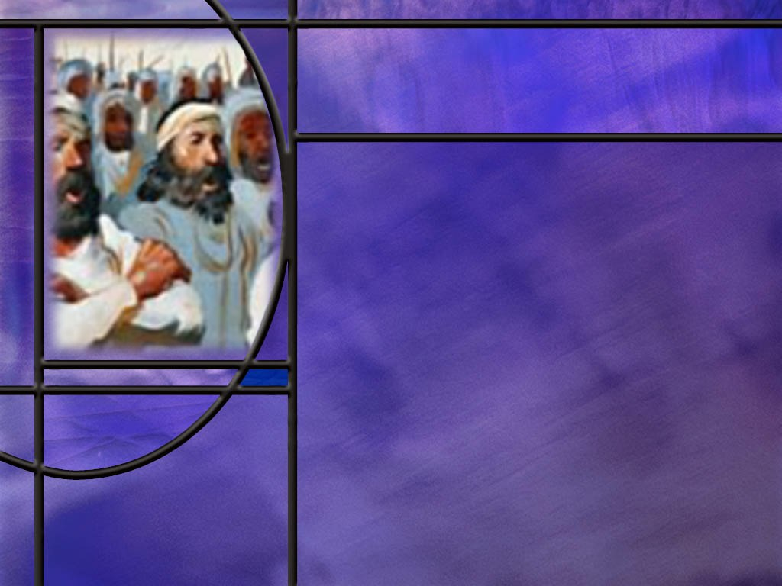
Memory Text
2 Chronicles 20:20 NKJV
Jehoshaphat stood and said, "Hear me, O Judah and you inhabitants of Jerusalem: Believe in the LORD your God, and you shall be established; believe His prophets, and you shall prosper.“
What difficulty did Jehoshaphat face as he spoke these words to the people of Judah?
What principles do we find in this text for success in facing our enemies?
Notes:
B2:
1. Jehoshaphat had received word that there was a vast army of enemies that were coming to fight against him.
2. So Jehoshaphat proclaimed a fast in all of Judah and the leaders of the people came to Jerusalem to seek the Lord together.
3. So they assembled at the temple and Jehoshaphat prayed a wonderful prayer, and he ended with these words:
2 Chronicles 20:12 ESV – O our God, will you not execute judgment on them? For we are powerless against this great horde that is coming against us. We do not know what to do, but our eyes are on you."
4. Well the Lord heard that prayer and sent a message through one of his prophets named Jahaziel.
5. And here is the message Jahaziel spoke to them:
2 Chronicles 20:15 ESV – And he said, "Listen, all Judah and inhabitants of Jerusalem and King Jehoshaphat: Thus says the LORD to you, 'Do not be afraid and do not be dismayed at this great horde, for the battle is not yours but God’s.”
6. The message continued:
2 Chronicles 20:17 ESV –You will not need to fight in this battle. Stand firm, hold your position, and see the salvation of the LORD on your behalf, O Judah and Jerusalem.' Do not be afraid and do not be dismayed. Tomorrow go out against them, and the LORD will be with you."
7. Well, you know the story:
8. The next morning, they went out to battle with the singers in the front ranks, and when they began to sing praises to the Lord, He sent an ambush against the enemy.
9. The enemy comprised three different countries in Edom and they turned on each other and wiped each other out.
10. What a wonderful story of the intervention of the Lord to save and deliver His people.
11. The only weapons they used were faith in God, fasting, prayer, and songs of praise to Him.
B3:
1. Have faith in the Lord your God.
2. Have faith in His prophets.
3. In the context of the times, the prophets were those who conveyed to the people the Word of God.
4. So we could paraphrase this verse by saying, “have faith in the Lord your God and in His word.”
5. There is a vast army arrayed against us.
6. Satan is leading his demonic hosts in his long war against God, and his objective is to hurt God by leading those whom God loves to perdition.
7. To be upheld in this battle and to be successful, we need to “have faith in the Lord our God and in His Word.”
8. In the end, there will be a group who remains faithful to God.
9. John describes them as keeping the commandments of God and the faith of Jesus.
10. Somebody is going to make up that faithful remnant, and it might as well be you, and it might as well be me.
11. Let’s resolve, whatever the difficulties we face to stand faithfully on the truth of God’s word.

Slide 3
Overview
Despite their flaws and weaknesses, God chose men and women in OT times to be His messengers to His people. They spoke on behalf of God with divine authority over kings and priests. What they wrote became the word of God and was recognized as divinely inspired Scripture.
  True and False
  OT Prophetic Authority
  Elijah and Us
  Summary

Slide 4
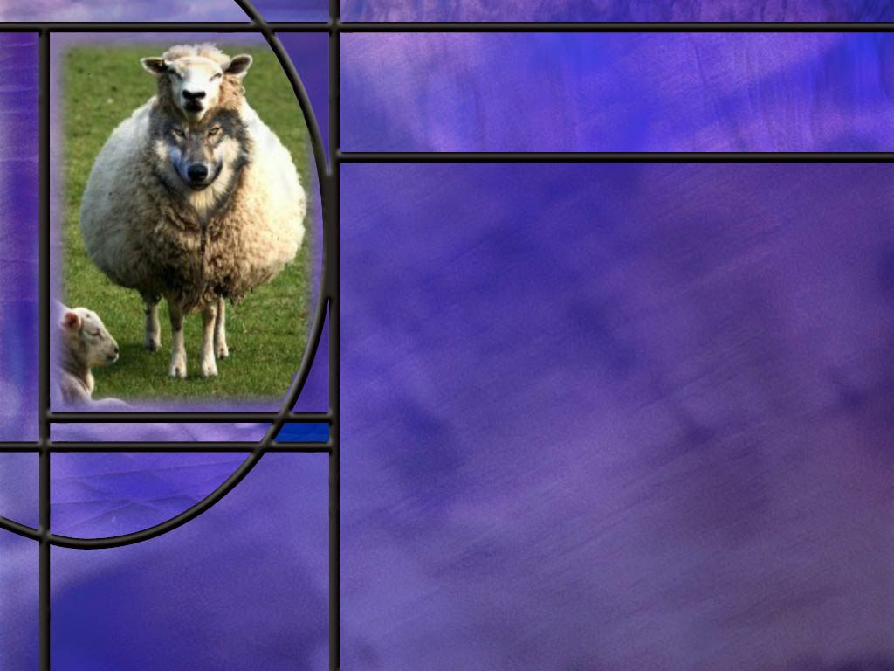
True and False
How were the OT prophets to be tested?
  Predictive Accuracy (Deut. 18:20-22)
  Leads People to the Lord (Deut 13:1-3)
  Correct Theology (Isa 8:19-20)
  Positive Fruit (Matt 7:15-20)
In OT times, what was tested, the prophet or the prophecies?
Was William Millar a false prophet?
Notes:
B1:
[See notes on linked slide.]
B2:
1. Here I believe we see a difference between the OT prophets and the NT gift of prophecy.
2. In the OT, it was the prophets that were tested.
3. They were either judged to be a prophet of God or a false prophet.
4. If they were accepted as a prophet of God, no one could disregard one of their prophecies and say, “That one was not from God.”
5. If they were a true prophet, everything they prophesied came from God as a message from Him.
6. The NT gift of prophecy seems to operate differently.
7. There the emphasis seems to be on testing the prophecies rather than the prophet.
8. Paul writes to the Thessalonians:
1 Thessalonians 5:19-21 ESV – Do not quench the Spirit. ²⁰ Do not despise prophecies, ²¹ but test everything; hold fast what is good.
9. When he was writing about prophecy in the Corinthian church, he wrote:
1 Corinthians 14:29 ESV – Let two or three prophets speak, and let the others weigh what is said.
10. This seems to be an evaluation of the prophecies given rather than saying these prophets were phonies.
11. We will see other distinctions between OT and NT prophets in future lessons.
12. In particular, NT prophets did not speak with the same authority as the OT prophets.
13. They were not speaking the very words of God but were doing their best to pass on to others what they believed God had laid upon their hearts.
14. We do not find those with the gift of prophecy in the NT saying “Thus says the Lord” and quoting His words.
15. What the OT prophet says, God says, and to disbelieve or disobey it is to disbelieve or disobey God Himself.
B3:
1. William Miller was the Baptist preacher in Low Hampton, NY that brought about the Second Great Awakening and revival in the 1830s and early 1840s. .
2. Based on his study of Daniel 8:14, he was convinced that Christ would come in 1843, later revised to October 22, 1844.
3. That day became known as the great disappointment as Jesus did not return as predicted.
4. It was out of that movement that the Seventh-day Adventist church originated.
5. The early Adventists were all followers of Miller and looked for Jesus to return on that date.
6. But William Miller never claimed to be a prophet.
7. He did not claim that God had told him the date of the return of Christ.
8. He was a Bible student and he came to that date through Bible study.
9. Adventists today still believe that Miller got the date right, but was wrong on the event.
10. Miller thought the cleansing of the sanctuary in Dan 8:14 was the cleansing of the earth when Jesus returned.
11. Today Adventists believe that the sanctuary to be cleansed was the heavenly sanctuary with the pre-advent judgment now going on in heaven.
12. Adventists don’t call Miller a false prophet; we say he was mistaken in the event he thought was at the end of the 2300-day prophecy of Daniel.
13. Many since Miller continue to predict the coming of Jesus, but all have failed.
14. The Bible says no man knows the day or the hour.

Slide 5
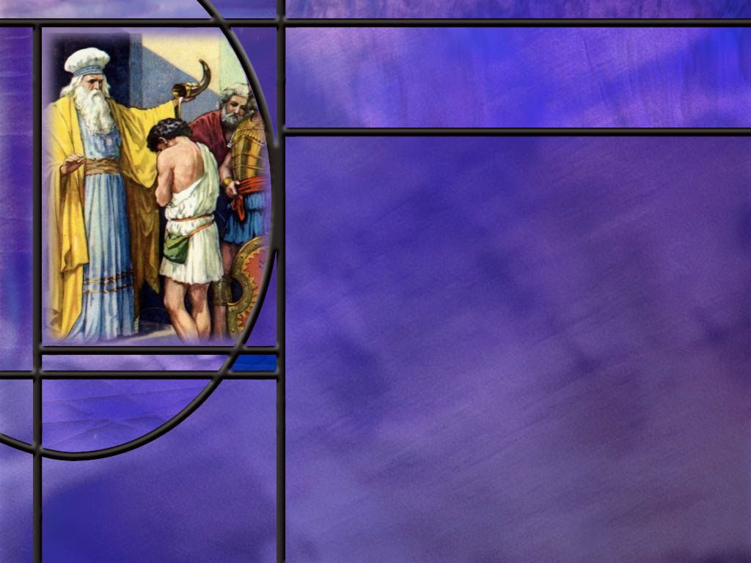
OT Prophetic Authority
What authority did the prophet Moses exert over the worship in the tabernacle and over Aaron and his sons? (Lev 8:10-13)
What authority did Samuel have over the kings of Israel? (1 Sam 8:21-22)
What authority did the writings of God’s true OT prophets have? (Ex 24:4,7)
What authority did Huldah the prophetess exhibit in her ministry? (2 Kings 22:13-16)
What are some expressions the OT prophets used to indicate they were speaking the very words of God? [link]
Notes:
B1:
[See notes on linked slide.]
B2:
[See notes on linked slide.]
B3:
[See notes on linked slide.]
B4:
[See notes on linked slide.]
B5:
[See notes on linked slide.]

Slide 6
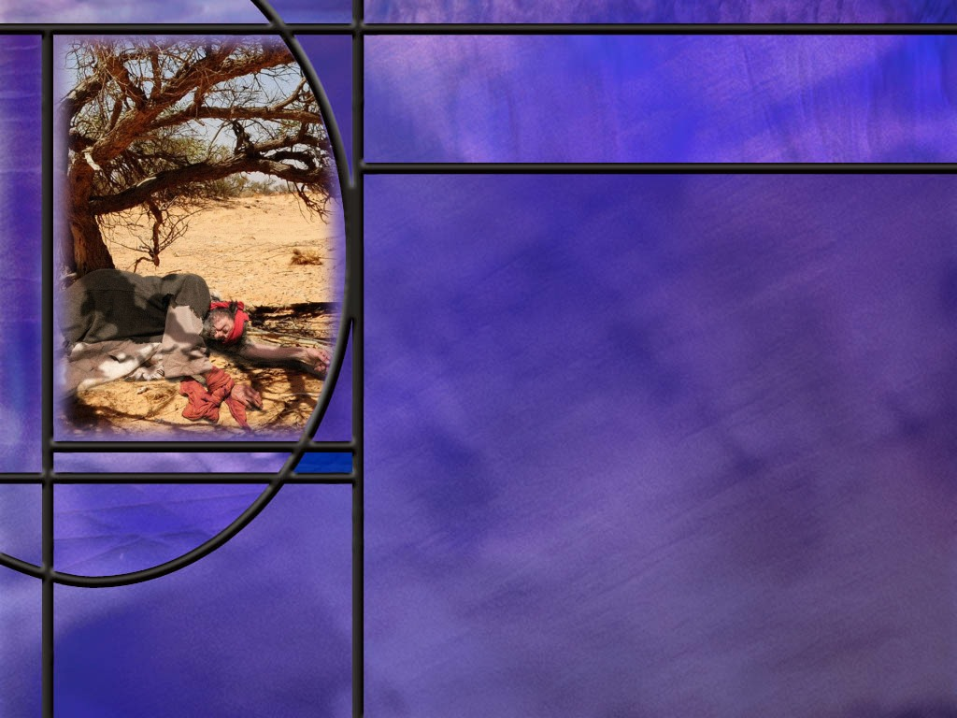
Elijah and Us
Wha does James tell us about Elijah? (James 5:17-18)
How did Jezebel increase the level of stress in Elijah’s life and how did Elijah respond? (1 Kings 19:1-4)
Notes:
B1:
[See notes on linked slide.]
B2:
[See notes on linked slide.]

Slide 7
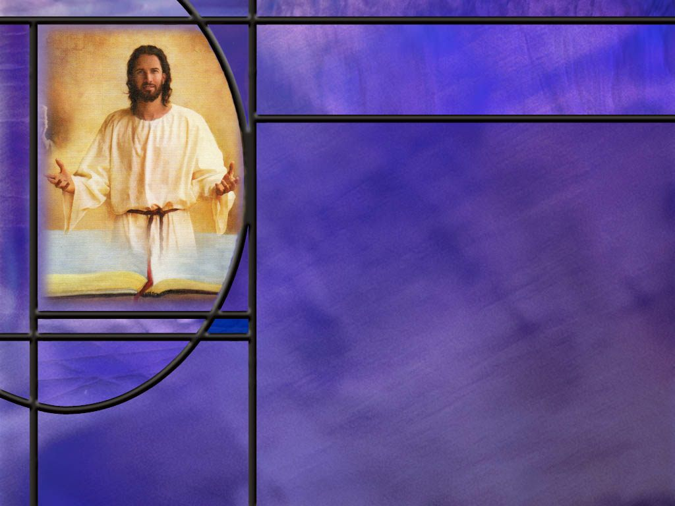
Summary
OT prophets were to be tested and judged as true or false.
Biblical tests included prophetic accuracy, leading people to love the Lord, agreement with other prophets accepted as true, and a life exhibiting good fruit.
The test of prophetic accuracy demanded no false prophecy, but sometimes this was difficult to apply because of distant prophetic dates or conditional prophecies.
If an OT prophet was judged to be a true prophet of God, his prophecies were not questioned or sifted but accepted as the word of God.
True prophets used many expressions such as “Thus says the Lord” to indicate they were speaking the very words of God.

Slide 8
Summary
OT prophets spoke with the authority of God Himself.
They had authority over priests and teachers and over kings and princes.
When their prophecies were written down they carried the same authority as God’s spoken word.
The OT prophets were God’s authoritative penmen to write Scripture that carried divine authority.
Women as well as men held prophetic office in OT times.
The prophetess Huldah was consulted by Josiah and his delegation when they read the book of Deuteronomy,
She confirmed in a message from the Lord that this book was God’s word.

Slide 9
Summary
While the biblical prophets were men and women of God, none was perfect.
Moses struck the rock twice in anger and was prevented from going into the Promised Land.
Elijah got so depressed he wanted to die under the broom tree.
The Bible does not cover up the flaws of its heroes, and that gives us encouragement that God can use us too in spite of our flaws.
In times of discouragement, we too can remember God’s goodness, His faithfulness, His promises, and know that He will ultimately deliver us.
Will you trust Him this week knowing “The battle is not yours but God’s?”

Slide 11
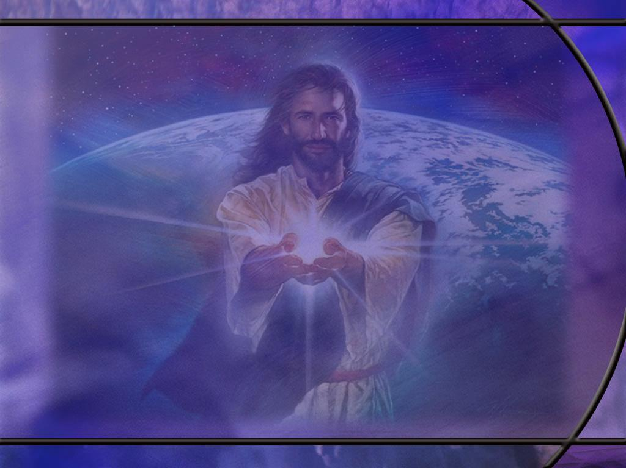
Deuteronomy 18:20-22 ESV
But the prophet who presumes to speak a word in my name that I have not commanded him to speak, or who speaks in the name of other gods, that same prophet shall die.' ²¹ And if you say in your heart, 'How may we know the word that the LORD has not spoken?'-- ²² when a prophet speaks in the name of the LORD, if the word does not come to pass or come true, that is a word that the LORD has not spoken; the prophet has spoken it presumptuously. You need not be afraid of him. [R]
Notes:
Q1: How does the Lord tell us here (through the prophet Moses) to identify a false prophet?
1. If someone speaks in the name of the LORD and what he says does not come to pass, he is a false prophet.
2. The Lord has not spoken through Him, because the Lord is not wrong.
3. Note that the test does not say the reverse: “If what the prophet says comes to pass, he is a true prophet.”
4. Some prophets may occasionally get something right by chance or occult connections like Jean Dixon and Joseph Smith.
So this is the test of prophetic accuracy:
Q2: How many failed prophecies do you need to make you a false prophet according to this test?
1. You only need one.
2. So in OT times, the test was very stringent.
3. You need to always be speaking the Lord’s word which never fails.
4. The prophets were not to speak presumptuously what they thought God might want them to say.
5. That could lead to errors in their prophetic ministry.
6. And, of course, if anyone spoke prophecy in the name of other gods, he was an obvious false prophet and worthy of death (verse 10)
Q3: What may make it difficult to apply this test?
1. First, not all predictions come true immediately.
2. In Daniel’s 70-week prophecy, it took 490 years for it all to be fulfilled.
3. Some of his other prophecies don’t get completely fulfilled until the time of the end and the establishment of the kingdom.
4. Daniel was long dead when most of his prophecies were fulfilled.
5. A second factor is conditional prophecy.
Q4: Was Jonah a false prophet in his prophecy against Nineveh?
1. He said “Forty days and Nineveh will be destroyed!”
2. Nineveh was not destroyed as he predicted.
3. Why not?
4. It was because the people repented and God relented of the destruction He was going to bring.
5. While Jonah didn’t state the condition explicitly, it was implied by the 40 days of probation that the city was given.
6. Certainly, the citizens took it as a probationary period to repent because that is what they did.
7. So Jonah’s prophecy was conditional as were many others in the OT.
8. We can see this clearly in Deuteronomy 28 where the prophet Moses predicted blessings for obedience and curses for disobedience.

Slide 12
Deuteronomy 13:1-3 ESV
"If a prophet or a dreamer of dreams arises among you and gives you a sign or a wonder, ² and the sign or wonder that he tells you comes to pass, and if he says, 'Let us go after other gods,' which you have not known, 'and let us serve them,' ³ you shall not listen to the words of that prophet or that dreamer of dreams. For the LORD your God is testing you, to know whether you love the LORD your God with all your heart and with all your soul. [R]
Notes:
Q1: What do these verses tell us about a false prophet?
1. A false prophet may have a sign or prediction come true, but if he tries to lead you to serve other gods he is a false prophet.
2. By contrast, a true prophet of God will not only give true prophecies, but will lead people to love God with all their hearts and souls.
3. The main function of a prophet is to lead people back to faithfulness to the true and living God.
4. Any prophet who leads us away from the God of Scripture is false.

Slide 13
Isaiah 8:19-20 NKJV
And when they say to you, "Seek those who are mediums and wizards, who whisper and mutter," should not a people seek their God? Should they seek the dead on behalf of the living? ²⁰ To the law and to the testimony! If they do not speak according to this word, it is because there is no light in them. [R]
Notes:
Q1: For whom do these mediums and wizards speak?
1. These are messengers of the devil, not of God.
2. When these false prophets claim they are speaking the words of your dead loved one, they are channeling the demons that are impersonating the dead.
3. By contrast, true prophets should always be faithful to the law of God and the testimony of the inspired prophets that have come before them.
4. In the OT we think of the “Law” as the first five books of the Bible, and the testimony as the remaining inspired writings.
5. Jesus referred to the OT as “the Scriptures,” “the Law,” “the Law and the Prophets,” and “the Law of Moses, the Prophets, and the Psalms.”
6. True prophets never contradict inspired scripture or the writings of other true prophets.

Slide 14
Matthew 7:15-20 NKJV
"Beware of false prophets, who come to you in sheep's clothing, but inwardly they are ravenous wolves. ¹⁶ "You will know them by their fruits. Do men gather grapes from thornbushes or figs from thistles? ¹⁷ "Even so, every good tree bears good fruit, but a bad tree bears bad fruit. ¹⁸ "A good tree cannot bear bad fruit, nor can a bad tree bear good fruit. ¹⁹ "Every tree that does not bear good fruit is cut down and thrown into the fire. ²⁰ "Therefore by their fruits you will know them. [R]
Notes:
Q1: How did Jesus say we should detect false prophets?
1. We should look at the fruits of their life.
2. A good tree bears good fruit.
3. A good prophet bears results that glorify God as bless others.
4. A good prophet has a positive influence on God’s people.
5. A good prophet brings people back to faithfulness to God and builds up the body of Christ.
6. A good prophet is faithful and obedient to the Lord, seeking to live a righteous life, honest, transparent, loving, humble, and virtuous.
7. A true prophet is filled with the Spirit exhibiting the fruit of the Spirit in his life.

Slide 15
Leviticus 8:10-13 ESV
Then Moses took the anointing oil and anointed the tabernacle and all that was in it, and consecrated them. ¹¹ And he sprinkled some of it on the altar seven times, and anointed the altar and all its utensils and the basin and its stand, to consecrate them. ¹² And he poured some of the anointing oil on Aaron's head and anointed him to consecrate him. ¹³ And Moses brought Aaron's sons and clothed them with coats and tied sashes around their waists and bound caps on them, as the LORD commanded Moses. [R]
Notes:
Q1: To whom did God communicate all the pattern for the tabernacle and its services?
1. God gave Moses the plans while he was on Mt. Sinai receiving the Ten Commandments.
Q2: Who was in charge of sanctifying the temple and all its components, even the high priest and his sons?
1. It is Moses again.
2. This shows Moses’ authority over the sanctuary ritual and over the High Priest and priests.
3. God set His OT prophets in a position of authority over the spiritual life of the Israelites.
4. When the people had a complaint they brought it to Moses, not to Aaron.
5. When Moses spoke on behalf of God, he was considered to be speaking the very words of God.
6. He would speak to God on behalf of the people and speak to the people on behalf of God.
7. When he spoke on God’s behalf, His words were considered to carry the authority of God Himself.

Slide 16
1 Samuel 8:21-22 ESV
And when Samuel had heard all the words of the people, he repeated them in the ears of the LORD. ²² And the LORD said to Samuel, "Obey their voice and make them a king." [R]
Notes:
Q1: Who had authority in Israel to set up a king or not to set up a king?
1. This authority was given to Samuel the prophet.
2. Without His approval and anointing of the king, there would have been no king in Israel.
3. Samuel didn’t want to do this, and he warned how the king would be a harder taskmaster than God, but the people wanted to be like the nations around them.
4. So God relented and Samuel anointed King Saul as the first king, and he also anointed his replacement, King David.
5. You remember how much respect David had for Saul as the Lord’s anointed.
6. He viewed Saul as having the Lord’s approval because the prophet anointed him king.
7. When the prophet was speaking for God, his word always trumped the authority of the king.
8. So we see that the OT prophets were God’s highest authority, higher than kings and priests.
9. God’s messengers, the OT prophets, carried the authority of God Himself.

Slide 17
Exodus 24:4, 7 ESV
And Moses wrote down all the words of the LORD. He rose early in the morning and built an altar at the foot of the mountain, and twelve pillars, according to the twelve tribes of Israel. ... 7 Then he took the Book of the Covenant and read it in the hearing of the people. And they said, "All that the LORD has spoken we will do, and we will be obedient.“ [R]
Notes:
Q1: When Moses wrote the words of the Lord in the book and read it, what did the people call the book?
1. They called it “all that the LORD has spoken.”
2. So, the written word of the Lord is the word that the Lord has spoken.
3. When we read the words that a prophet has written, it is still the same as the word of the Lord that was spoken.
4. The prophets were God’s penmen of the OT scriptures.
5. Here’s the progression:
6. God spoke.
7. The prophet received and delivered the message.
8. The message was sometimes written down.
9. The written message retained the same authority as God’s original speech.
10. That progression is especially visible in Moses, Samuel, Jeremiah, and Daniel.
11. The OT prophets had the authority to write the word of God.

Slide 18
2 Kings 22:13-16 ESV
"Go, inquire of the LORD for me, and for the people, and for all Judah, concerning the words of this book that has been found..." ¹⁴ So Hilkiah the priest, and [others] went to Huldah the prophetess, … and they talked with her. ¹⁵ And she said to them, "Thus says the LORD, the God of Israel: 'Tell the man who sent you to me [King Josiah], ¹⁶ Thus says the LORD, Behold, I will bring disaster upon this place and upon its inhabitants, all the words of the book [Deuteronomy] that the king of Judah has read. [R]
Notes:
Q1: Who has inquired to the prophetess Huldah?
1. It is King Josiah who has just heard the book of Deuteronomy read to him and he has rent his clothes.
2. He was convinced that they had not been keeping the commandments of God and they were in danger of getting the curses rather than the blessings.
3. So he sends a delegation headed by the priest to the prophetess Huldah to ask her what the word of the Lord says.
Q2: What is her reply when they ask her if this is from the Lord?
1. She says “Thus says the Lord.”
2. She is quoting what God tells her.
3. And God tells them that God will bring on Josiah’s people all the words of the book that Josiah has read.
4. So here God is telling Josiah that this is not some ordinary book, it is the word of the Lord that Moses wrote.
5. This again proves that the OT prophets were God’s authoritative penmen.
6. They wrote the Scriptures that convey the word of the Lord to us.
7. Huldah here is a true prophetess being faithful to pass along God’s message and to be faithful to His word.
8. She speaks with authority even to the king and his delegation.

Slide 19
OT Prophets Speaking the Word of God
Thus says the Lord
[so] Says the Lord / Declares the Lord
The word of the Lord came to…
The word of the Lord came to me, saying
The Lord said to me
Hear the word of the Lord
I have put my words in your mouth
As I live, I can only tell what the Lord tells me.
I will put my words in his mouth
You shall speak my words to them
The word of the Lord which he spoke to his servant the prophet. [R]

Slide 20
James 5:17-18 ESV
Elijah was a man with a nature like ours, and he prayed fervently that it might not rain, and for three years and six months it did not rain on the earth. ¹⁸ Then he prayed again, and heaven gave rain, and the earth bore its fruit. [R]
Notes:
Q1: What kind of nature did Elijah have?
1. James said he had a nature like ours.
Q2: What kins of nature do we have?
1. We have a fallen human nature that experiences innocent infirmities as well as sinful propensities.
2. Elijah was not a sinless man.
3. And perhaps he displayed physical and mental weaknesses like we do too.
4. So let’s take a look at one of his weaker moments as recorded in scripture.

Slide 21
1 Kings 19:1-4 ESV
Ahab told Jezebel all that Elijah had done, and how he had killed all the prophets with the sword. ² Then Jezebel sent a messenger to Elijah, saying, "So may the gods do to me and more also, if I do not make your life as the life of one of them by this time tomorrow." ³ Then he was afraid, and he arose and ran for his life and came to Beersheba, which belongs to Judah, and left his servant there. ⁴ But he himself went a day's journey into the wilderness and came and sat down under a broom tree. And he asked that he might die, saying, "It is enough; now, O LORD, take away my life, for I am no better than my fathers.“ [R]
Notes:
Q1: What makes his response so unexpected?
1. Heretofore, Elijah has been fearless.
2. He has seen and participated in the mighty miracles of God, including ravens that brought him food, the daily miracle of the flour and oil that didn’t run out, the raising from the dead of the son of the widow of Zarephath, the victory on Mt. Carmel.
3. He knows that God has a plan for his life and that God has used him in a mighty way to confront idolatry in the land.
4. Why would he not trust God to deliver him now?
5. Sometimes when we are under severe stress, we don’t seem to make rational decisions.
6. Elijah’s decision to run and his desire to die under the broom tree do not seem rational.
7. And perhaps God is letting us know here that mental and emotional fatigue and the depression that follows can happen to anyone, even those who are walking close to God.
Q2: What did the Lord do for Elijah in this depressed condition?
1. God did not abandon Elijah.
2. He sent an angel with bread and water to give him strength.
3. In fact, the angel provided two meals. And Elijah got plenty of rest.
4. After the second meal, the Bible says: “Strengthened by that food, he traveled forty days and forty nights until he reached Horeb, the mountain of God.”
5. So here are God’s remedies for Elijah: plenty of rest, good nutritious food and drink, and plenty of exercise.
6. And God led him on a 40-day journey to Mt. Horeb or Mt. Sinai.
7. Nutritious food and plenty of exercise can be part of God’s healing ministry for our depression as well.
8. There at the mountain of God, Elijah met the Lord and received His message.
9. Not in the wind or the earthquake or the fire, but in the still small voice.
10. God reminded Elijah that he was not alone, and his ministry was not a failure.
11. He told Him:
1 Kings 19:18 ESV – 18 Yet I will leave seven thousand in Israel, all the knees that have not bowed to Baal, and every mouth that has not kissed him."
12. So we too can be encouraged that God is in control and the battle is not ours but His.
Q3: What can we do to avoid allowing our current circumstances to bring us to a state of despair?
1. When we remember God’s leading in the past and His promises for the future, we should realize that we have nothing to fear.
2. Focus on God, His goodness, His power, His omnipotence, His love for us, and praise Him for all that He has done for us.
3. Focus on the future and what God has promised for us and praise Him that He will deliver us and make us a part of His eternal kingdom.
4. There is power in praise.
5. Where there is praise there cannot be despair and depression.
Illustration: Glenn Coon and how he fought off his depression.
Many years ago I remember a video presentation by Pastor Glenn Coon, the man who popularized the ABC’s of prayer.
He tells of a time when he became depressed and ended up in a mental hospital.
His depression began to lift when he began to thank God and praise Him for things.
It goes back to Phil 4:6-7
Philippians 4:6-7 NKJV - Be anxious for nothing, but in everything by prayer and supplication, with thanksgiving, let your requests be made known to God; ⁷ and the peace of God, which surpasses all understanding, will guard your hearts and minds through Christ Jesus.
Every day he would add to his list of praises: He thanked God for his toothbrush, then for his teeth, then for his jaw, then his whole head.
The more he praised God the more his depression lifted.
Before long his depression was gone.

