Slide 1
The Gift of Prophecy
Lesson 2
The Call of a Prophet

Slide 2
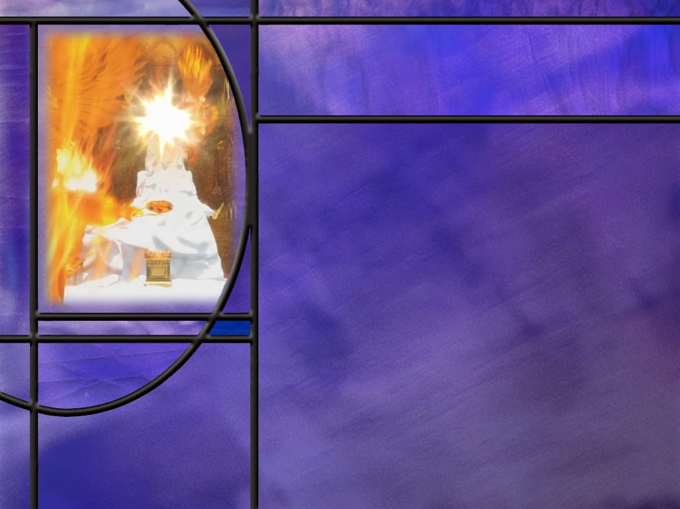
Memory Text
Isaiah 6:8 NKJV
Also I heard the voice of the Lord, saying: "Whom shall I send, And who will go for Us?" Then I said, "Here am I! Send me.“
What is unusual about the pronouns in the question the Lord asks?
What does the singular/plural pronoun usage imply about God?
How did Isaiah respond when he saw this magnificent vision of the LORD high and lifted up whose train filled the temple? (Isa 6:5)
Notes:
B2:
1. Whom shall I send and who will go for us?
2. These two questions are obviously parallel.
3. In the first God is singular and in the second He is plural.
B3:
1. It implies that God exist as three persons but one God.
2. This is one more place in scripture that we can see God referring to Himself in the plural.
Genesis 1:26 NKJV - Then God said, "Let Us make man in Our image, …“(us and our are plural)
3. And in the next verse:
Genesis 1:27 NKJV - So God created man in His own image; (his is singular)
4. When God confused the languages at Babel, He said,
Genesis 11:7 NKJV - "Come, let Us go down and there confuse their language,…
5. So Isaiah gives us one more instance where we see the godhead as plural rather than singular.
B4:
[See notes on linked slide.]

Slide 3
Overview
Since the Fall, the Curse, and the Flood, God as called certain individuals to be His spokesmen to His covenant people. Through these individuals, God has sent divine messages to instruct, correct, and encourage His chosen people and to bring glory to God as the One who is ultimately in control of human destiny.
  God’s First Prophetic Calls
  Isaiah and Daniel
  John the Baptist
  Summary

Slide 4
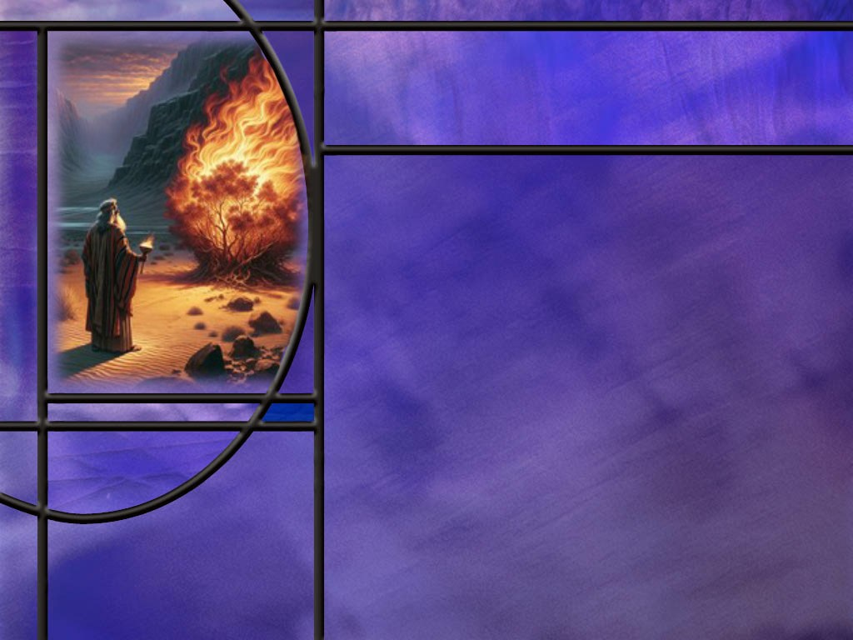
God’s First Prophetic Calls
Who is the first person in scripture referred to as a prophet? (Gen 20:7)
How did God call Abraham? (Gen 12:1; Heb 11:8)
Who was God’s first prophet to Israel and how was he called? (Ex 3:4,10)
How did Moses react to the prophetic ministry God had in mind for him? (Ex 4:1,10,13)
What were some of the highlights of Moses’ prophetic ministry? [Highlights]
What other OT prophets followed Moses? Who were the four major prophets? Were there any prophets that did not write Scripture?
Notes:
B1:
[See notes on linked slide.]
B2:
[See notes on linked slide.]
B3:
[See notes on linked slide.]
B4:
[See notes on linked slide.]
B5:
[See notes on linked slide.]
B6:
The four major prophets wrote fairly long books of Scripture.
They are in order, Isaiah, Jeremiah, Ezekiel, and Daniel.
There are 12 minor prophets that wrote smaller books.
Some very important prophets did not write any books, but their words and acts are recorded in Kings and Chronicles and other books.
These include Samuel, Elijah, Elisha, and the less well-known prophets Ahijah, Gad, and Nathan
There are also women prophets in OT times.
We have Mariam, the sister of Moses, Deborah, and Huldah.
These all were called to be spokespersons for God and to convey His words to Israel.

Slide 5
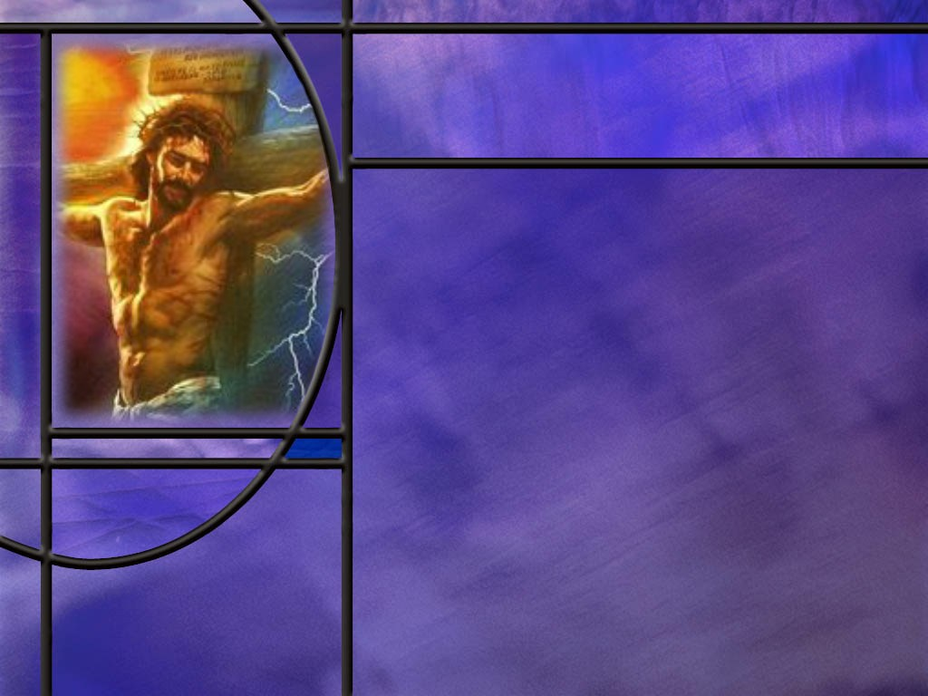
Isaiah and Daniel
Why is Isaiah called the gospel prophet?
What are some of the things that Isaiah predicts the Messiah would do for us? [Suffering Servant Song #4]
How did Philip use this chapter to preach the gospel? (Acts 8:32-35)
How did the kings of Babylon recognize the prophetic gift in Daniel? (Dan 2:47)
Notes:
B1:
1. No other prophet so clearly predicted the saving ministry of our Lord Jesus Christ.
2. Isaiah pictured the future Messiah as God’s “suffering Servant.”
3. God gave Isaiah five different poetic prophecies in which he describes the work of the suffering Servant.
4. The most explicit of these is Suffering Servant Song #4 which begins in Isaian 52:13 and goes through the end of Isaiah 53.
5. It provides a vivid description of One who would suffer and die for our sins but be raised again.
6. It is in this song that we find the plan of salvation , the gospel, laid out in clear and unmistakable terms.
B2:
[See notes on linked slide.]
B3:
[See notes on linked slide.]
B4:
[See notes on linked slide.]

Slide 6
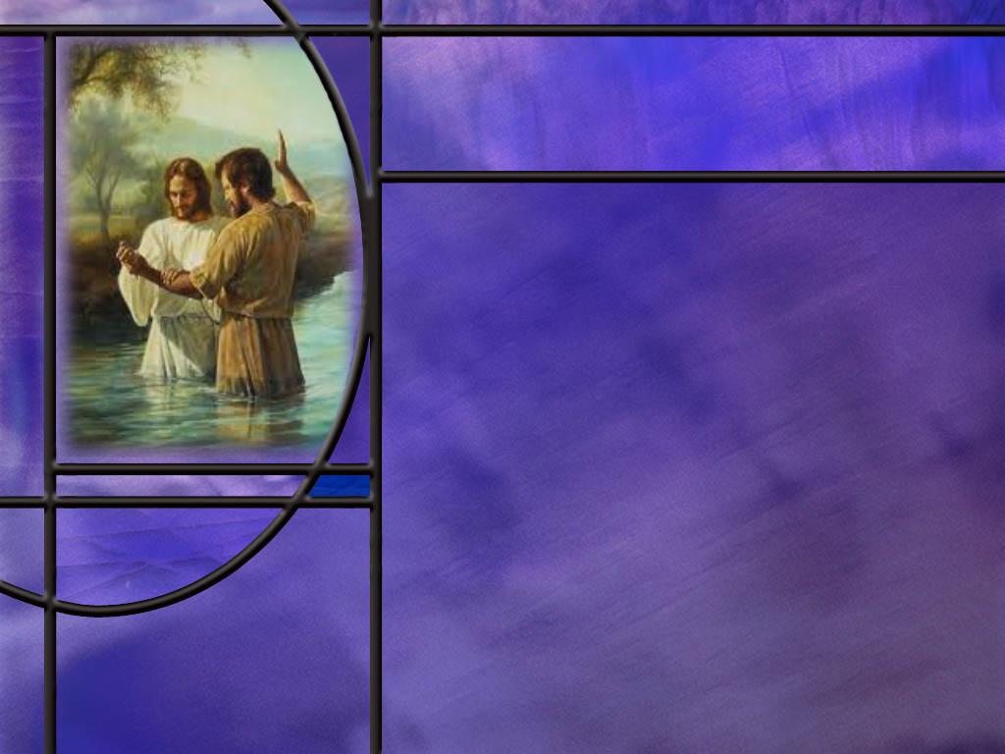
John the Baptist
What was the mission of John the Baptist? (Isa 40:3)
What did Jesus say about John the Baptist? (Matt 11:11)
What was the message that John the Baptist preached?
Notes:
B1:
[See notes on linked slide.]
B2:
[See notes on linked slide.]
B3:
Luke 3:3 NKJV – And he [John] went into all the region around the Jordan, preaching a baptism of repentance for the remission of sins,
1. So John was calling people to repent of their sins and come back to faithful obedience to God.
2. He was also pointing to Jesus as the Lamb of God.
John 1:29 NKJV – The next day John saw Jesus coming toward him, and said, "Behold! The Lamb of God who takes away the sin of the world!
3. Now Jesus had not yet died for our sins, so it may not have been clear how He was the Lamb of God.
4. But John had a two-fold message, repent and believe.
5. This is captured in Paul’s description of John’s ministry in:
Acts 19:4 NKJV – 4 Then Paul said, "John indeed baptized with a baptism of repentance, saying to the people that they should believe on Him who would come after him, that is, on Christ Jesus."
6. So here again we have a prophet calling people back to faithfulness to God and pointing them to Jesus.

Slide 7
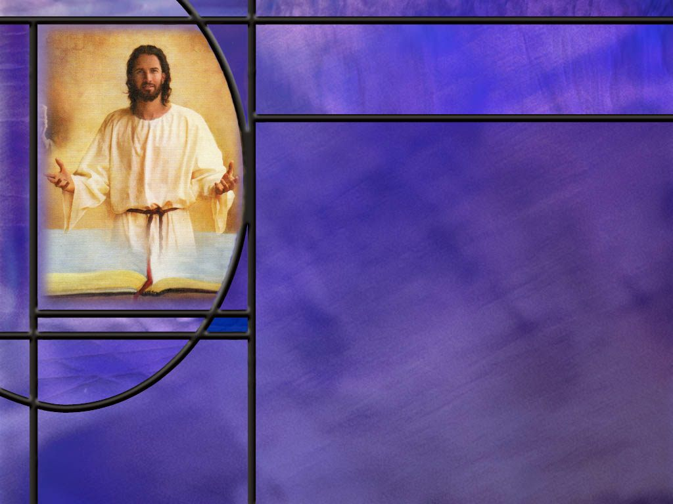
Summary
The first man named by God as a prophet is Abraham even in the midst of an event where Abraham is acting like anything but a prophet: lying to king Abimelech about his relationship to Sarah.
But the Bible does not cover up the flaws of its heroes. That gives us encouragement that God can use us too in spite of our failures and lapses of faith.
Abraham’s faith was demonstrated by his belief in God’s promises that led him to obey even to the point of offering his own son, Issac.
We too need the kind of faith that will trust and obey.
Moses, the first named prophet to Israel was called by God at the burning bush.

Slide 8
Summary
His response was to say he was unqualified and make excuses as to why he could not go. But when God had a provision for every excuse, Moses reluctantly accepted the call.
We can see ourselves in his reluctance. But God is just as able to make up for our deficiencies as for his.
Moses had many highlights in his prophetic ministry perhaps the most lasting of which is his writing of the first five books of the Bible.
Isaiah’s call to the prophetic ministry resulted in a cry of “Woe is me” until he was assured that his sins were forgiven, resulting in a response of “Here am I, send me.”

Slide 9
Summary
Isaiah’s prophetic songs of the suffering Servant are clearly messianic prophecies fulfilled by Jesus. Song #4 (Isaiah 53) is an amazingly clear description of what Jesus would do to provide for our salvation.
Daniel’s prophetic call was witnessed by kings of Babylon who were so impressed with Daniels God that they issued decrees praising Him.
John the Baptist was a uniquely privileged prophet who not only prepared the way for Jesus but identified him as the Messiah.
No prophet had a greater message.
Will you accept John’s witness and make time this week to “Behold the Lamb of God who takes away the sin of the world?”

Slide 11
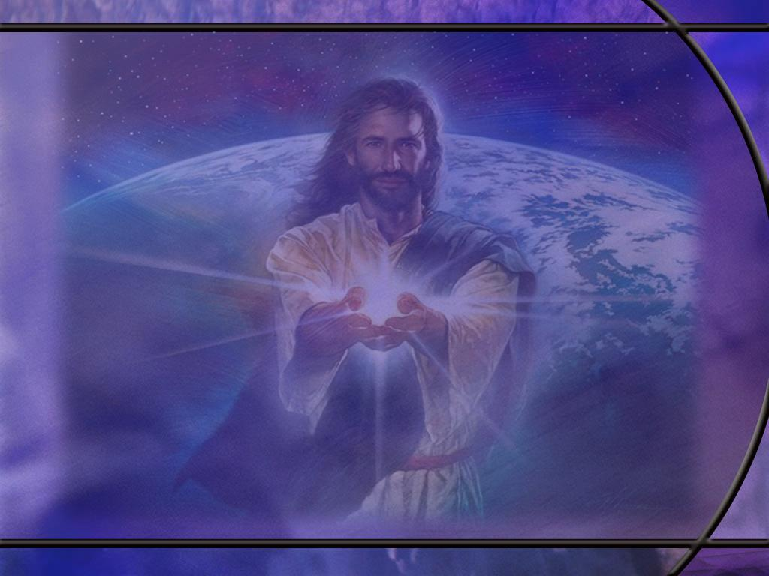
Isaiah 6:5 ESV
And I said: "Woe is me! For I am lost; for I am a man of unclean lips, and I dwell in the midst of a people of unclean lips; for my eyes have seen the King, the LORD of hosts!“ [R]
Notes:
Q1: Why did Isaiah respond to a vision of the Lord with “woe is me?”
1. The infinite holiness of God, His awesome power and glory, His hatred of sin, brings an awareness of our own unworthiness in His presence.
2. We see our inadequacies and sinfulness in contrast to His power and holiness.
3. Our only hope is the blood of Christ to forgive our sins and His righteousness to cover us.
4. The common belief was that no sinner could see God and live.
5. It was believed that God was a consuming fire to sin and sinners.
6. The Hebrew translated “I am lost” can also be translated cutoff, perish, destroy.
7. He thought that he would die as a sinner in the presence of a holy God.
8. This may come from Ex 33:20 where the Lord told Moses:
Exodus 33:20 ESV - "you cannot see my face, for man shall not see me and live."
9. What Isaiah needed was the assurance of the forgiveness of his sins.
10. When the angel touched his lips with a coal from the alter and announced he was forgiven, his response changed from “Woe is me” to “Here am I, send me.”
So too for us.
When we know that we are redeemed by the blood of the Lamb, we too can speak up for God.
Psalm 107:2 KJV – Let the redeemed of the LORD say so, whom he hath redeemed from the hand of the enemy;

Slide 12
Genesis 20:7 ESV
Now then, return the man's wife, for he is a prophet, so that he will pray for you, and you shall live. But if you do not return her, know that you shall surely die, you and all who are yours.“ [R]
Notes:
Q1: To whom does this refer and what is the context of the passage?
1. This refers to Abraham and the context is the second half-truth he told concerning Sarah.
2. This was after Sodom and Gomorrah were destroyed and Abraham and Sarah moved to Gerar where Abimelech was king.
3. You would think that Abraham would have learned his lesson in Egypt.
4. But this was the second time that he told the “half-truth” that Sarah was his sister.
5. She was his half-sister: same father, different mother.
6. But when you tell someone she is your sister rather than your wife, you have deceived them, and that’s a lie.
7. Abimelech took Sarah with the intention of marrying her until God spoke to him in a dream and told him Sarah was Abraham’s wife.
Q2: What was Abraham to do for Abimelech?
1. He was to pray for Abimelech.
2. This was the first of many times to follow when a prophet would intercede for the people.
3. We can particularly think of Moses in this role, interceding on behalf of his wayward people.
Q3: How does this fit into the prophetic function?
1. The primary role of a prophet is to bring people back to faithfulness to God.
2. Abimelech had unknowingly come close to committing adultery.
3. He was only too happy to give Sarah back and have Abraham pray for him.
Q4: Who needed prayer as much as Abimelech (maybe more)?
1. Abraham and Sarah.
2. Sarah apparently went along with this lie.
3. The king took her into his harem but had not touched her.
4. You wonder how Abraham could have placed her in such a vulnerable situation to protect his own skin.
5. This is the second time they did not trust God enough to protect them and made up a lie that almost got a lot of people killed.
Q5: What encouragement can we take from the fact that God still used Abraham in a mighty way despite his flaws and lapses of faith?
1. God can still use us too despite our flaws and lapses of faith.
2. Our faith can grow over time as Abraham’s did
3. His experience in almost offering Issac as a burnt offering took a tremendous amount of faith.
4. “God can still make straight lines with crooked sticks.”

Slide 13
Genesis 12:1 & Hebrews 11:8
Genesis 12:1 NIV – The LORD had said to Abram, "Go from your country, your people and your father's household to the land I will show you.
Hebrews 11:8 NIV – By faith Abraham, when called to go to a place he would later receive as his inheritance, obeyed and went, even though he did not know where he was going. [R]
Notes:
Q1: What did it take for Abraham to answer the call of God?
1. It took faith!
Q2: What is remarkable about Abraham’s faith in these verses?
1. When most people leave home, they know where they’re going, how to get there, and what to expect.
2. Abraham, it seems, had no idea where he was going, how to get there, or what to expect when he arrived.
3. He simply believed God’s promise and was obedient to God’s call.
4. He left his home and followed the Lord’s leading.
5. This meets the biblical definition of being faithful: to believe the promises of God.
6. His belief was not just intellectual assent to say yes to God’s promise.
7. His belief changed his entire life because it led to his obedience to follow God all the way.
8. That’s the kind of faith we need: a faith that results in leaving our comfort zone and following the Lord all the way in obedience to His call.

Slide 14
Exodus 3:4, 10 ESV
When the LORD saw that he turned aside to see, God called to him out of the bush, "Moses, Moses!" And he said, "Here I am." ... ¹⁰ Come, I will send you to Pharaoh that you may bring my people, the children of Israel, out of Egypt.“ [R]
Notes:
Q1: Where was Moses and what was he doing when he got the call to be a prophet for God?
1. Moses was in the land of Midian tending sheep for his father-in-law.
2. There, as he was tending sheep near Mt. Sinai, he saw a burning bush that was not consumed.
3. His first 40 years he had spent in Egypt, the next 40 years he spent tending sheep, and the last 40 years he spent shepherding the Children of Israel through the wilderness to the Promised Land.
4. So, he was already an elderly man at age 80.
5. His first response to God, recorded here, was “Here I am.”

Slide 15
Exodus 4:1, 10, 13 ESV
Then Moses answered, "But behold, they will not believe me or listen to my voice, for they will say, 'The LORD did not appear to you.'" ... ¹⁰ But Moses said to the LORD, "Oh, my Lord, I am not eloquent, either in the past or since you have spoken to your servant, but I am slow of speech and of tongue." ... ¹³ But he said, "Oh, my Lord, please send someone else." [R]
Notes:
Q1: What is Moses doing here?
1. He is making excuses about why he is unqualified to go speak God’s words to Pharaoh.
2. Even before we get to these excuses, right after God tells him what his mission will be, he replies:
Exodus 3:11 ESV – But Moses said to God, "Who am I that I should go to Pharaoh and bring the children of Israel out of Egypt?“
3. So, he feels unqualified to be God’s prophet; unqualified to approach Pharaoh.
4. This becomes a common theme among God’s prophets.
5. It is a valid concern.
6. Who can think they are actually qualified to be God’s spokesman?
7. The only prophet to be actually qualified was Jesus Christ Himself.
8. The same may be true of us.
9. God calls us to be His witnesses and speak up for Him.
10. We all have our excuses just like Moses.
11. But God’s wisdom and power can make up for our every deficiency.
12. We have the HS as our Helper to inspire us and bring to our remembrance what we should say.
13. God had an answer for every one of Moses’ excuses.
14. So the reluctant prophet accepted the call and headed for Egypt.

Slide 16
Highlights
Authored the first five books of the Bible.
His first encounter with the Lord at the burning bush.
Confronted Pharaoh with the 10 plagues.
Instituted Passover and led the Israelites out of Egypt and across the Red Sea.
Spent 80 days with the Lord on Mt. Sinai; received the Ten Commandments and instructions for building the tabernacle.
Interceded for His people after the golden calf apostasy and many times thereafter in the wilderness.
Spoke face-to-face with the Lord as with a friend.
Oversaw the construction of the tabernacle and followed God’s instructions for worship therein.
His warnings to the people of blessings for obedience and curses for disobedience. [R]
Notes:
1. I am sure there are many more we could add to this list.
2. God used him to work many miracles.
3. His warnings of the blessings and curses was a conditional prediction about the future.
4. But there is one famous prophecy that he made about a future Prophet.
5. It is found in:
Deuteronomy 18:15, 19 ESV –"The LORD your God will raise up for you a prophet like me from among you, from your brothers--it is to him you shall listen-- ... ¹⁹ And whoever will not listen to my words [the Lord speaking] that he shall speak in my name, I myself will require it of him.
6. We believe that this prophecy was fulfilled in the Lord Jesus Christ.
7. “In these last days, God has spoken to us by His Son.” (Heb 1:2)
8. It is by our relationship to Jesus that we will be judged.
Q1: As we look at Moses and his prophetic ministry, what was the major thrust of his ministry?
1. He was not primarily focused on predictions about future events.
2. Moses interceded with God to bridge the gap that sin had created.
3. Moses did not abandon his people to the separation that sin causes but sought to bring them back to God.
4. The main focus of a prophet’s work was to call people back to faithfulness to God.

Slide 17
Suffering Servant Song #4
Endure rejection and sorrow
Bear our griefs and carry our sorrows
Be wounded for our transgressions
Be crushed for our iniquities
Bear the punishment that brings us peace
Bring healing through His wounds
Carry the sins of us all
Submit to suffering without defending Himself
Be cut off from the land of the living for His people’s sins
Undergo death and burial despite His innocence
Make His life an offering for sin
Accomplish the Lord’s saving purpose
Justify many
Pour out His life unto death
Be numbered with transgressors
Bear the sin of many
Make intercession for transgressors
Be raised and lifted up and highly exalted (Isa 52:13) [R]
Notes:
1. This is an amazing description of what Jesus did for us.
2. He died for our sins, he was buried, and he rose again to intercede for us in the heavenly sanctuary.
3. Through His death for our sins we are justified, declared not guilty, and now have peace with God.
4. How can anyone read this chapter and not see what Jesus did to save us?
5. And yet the Jews are still waiting for a Messiah to save them.
6. Open your eyes my Jewish friends.
7. Jesus is your Messiah, and you can be saved only through Him!!

Slide 18
Acts 8:32, 34-35 ESV
Now the passage of the Scripture that he was reading was this: "Like a sheep he was led to the slaughter and like a lamb before its shearer is silent, so he opens not his mouth. ... ³⁴ And the eunuch said to Philip, "About whom, I ask you, does the prophet say this, about himself or about someone else?" ³⁵ Then Philip opened his mouth, and beginning with this Scripture he told him the good news about Jesus. [R]
Notes:
Q1: What passage of Scripture did the Ethiopian eunuch happen to be reading in his chariot?
1. It was Isaiah 53. What a set up!
2. Look how the Lord has arranged this Bible study.
3. He gets the eunuch there on time; He gets Philip there on time.
4. Just as they meet, the eunuch is reading one of the clearest OT passages on the work of the Messiah.
5. Philip asks if he understands it; the eunuch admits that he needs someone to help him.
6. The eunuch invites Philip up into the chariot.
7. Then he asks Philip to whom the scripture refers.
8. So Philip can use this OT scripture, which the eunuch believes, to point him to the fulfillment: Jesus Christ.
9. Undoubtedly this scripture was used time and again by Christian believers to point to Jesus Christ as the fulfillment of Isaiah’s prophecy.
10. Those who accept the OT should also accept the NT because it records the fulfillment ot the OT prophecies in Christ the Messiah.

Slide 19
Daniel 2:47 ESV
The king [Nebuchadnezzar] answered and said to Daniel, "Truly, your God is God of gods and Lord of kings, and a revealer of mysteries, for you have been able to reveal this mystery."
Notes:
Q1: What convinced Nebuchadnezzar that Daniel was a true prophet of the living God?
1. God gave Daniel the same dream as God had given to Nebuchadnezzar.
2. So Daniel was able to correctly describe the dream and give its interpretation.
3. Nebuchadnezzar would have been even more impressed if he were alive today and could see the fulfillment of this dream.
Q2: How has Nebuchadnezzar’s dream been fulfilled.
1. From the time of the dream, there were only four world ruling empires that affected God’s people and their promised land.
2. You will remember the different metals in the statue represented different world-ruling kingdoms.
3. The head of Gold, Babylon.
4. The arms and chest of silver was Medo-Persia.
5. The waist and thighs of bronze was Greece
6. The legs of iron were Rome
7. The feet of iron and clay: the divided Roman empire of Europe.
8. Many have tried to reunite the Roman empire but all have failed.
9. We believe we are living in the last days just before the stone cut out without hands strikes the image on the feet and blows away all the kingdoms of this world and ushers in the kingdom of God.
[Go to next slide.]

Slide 20
Daniel 6:25-26 ESV
Then King Darius wrote to all the peoples, nations, and languages that dwell in all the earth: "Peace be multiplied to you. ²⁶ I make a decree, that in all my royal dominion people are to tremble and fear before the God of Daniel, for he is the living God, enduring forever; his kingdom shall never be destroyed, and his dominion shall be to the end. [R]
Notes:
Q1: How did king Darius respond to God saving Daniel from the lions’ den?
1. He sends out a decree to all of his kingdom praising the God of Daniel.
2. No doubt, this good report was passed along to Cyrus who then made a decree that the Jews could return to their homes and rebuild the temple and the walls of Jerusalem and administer justice in their judicial system as vassal state of the empire.
3. Others in Babylon also recognized the “spirits of the gods” at work in Daniel’s life.
4. We see Daniel interceding in prayer for his people in chapter 9.
5. He is praying there for the restoration of the temple and the return of his people.
6. So, Daniel’s ministry gave glory to God and gave encouragement to all who would come later that God is ultimately in control of the destiny of mankind.
7. In the judgment scene in chapter 7, we can look forward to victory as the Son of Man receives the kingdom from His Father and shares it with those he has redeemed.

Slide 21
Isaiah 40:3 NKJV
The voice of one crying in the wilderness: "Prepare the way of the LORD; Make straight in the desert A highway for our God. [R]
Notes:
Q1: Who was to prepare the way for the Messiah?
1. It was John the Baptist.
2. Matthew, Mark, and Luke all declare that John the Baptist fulfilled this prophecy by Isaiah.
Q2: What can we say about Jesus from the names Isaiah uses here?
1. John was preparing the way for Jesus as the Messiah.
2. But Isaiah says he is preparing the way of the LORD in all caps.
3. When we see the word LORD in all caps it is the way the writers refer to Yahweh.
4. Since the name Yahweh was too holy to pronounce they represented God’s proper name with LORD.
5. Then at the end of the verse, John is to create a highway for our God.
6. This is one more place were we see the divinity of Jesus Christ.
7. He is both Yahweh and God.

Slide 22
Matthew 11:11 ESV
Truly, I say to you, among those born of women there has arisen no one greater than John the Baptist. Yet the one who is least in the kingdom of heaven is greater than he. [R]
Notes:
Q1: What made John the Baptist great among prophets?
1. John the Baptist was the greatest because of his unique role in God’s plan.
2. He was the prophet chosen to prepare the way for Jesus and personally identify Him as the Messiah.
3. There was no prophet that had a greater message than John.
4. Earlier prophets looked forward to Jesus.
5. John could point to him and say, “Look, the Lamb of God” (John 1:29).
6. He also had the extraordinary privilege of baptizing Jesus.
7. John was greatest because no earlier prophet had been given such an important part in announcing and introducing Jesus.
Q2: In what sense is the least in the kingdom greater than John?
1. The least in the kingdom enjoying the benefits of God’s grace and Christ’s sacrifice is greater than any looking forward to the kingdom in the sense that they have seen and are enjoying the blessings of God rather than looking forward to them.
2. John announces the arrival of the Messiah, but the believer knows the Messiah’s saving work.
3. John stands at the climax of the preparation for the Messiah, but the believer in the kingdom enjoys the salvation that the prophets anticipated.
4. John’s greatness comes from pointing directly to Jesus, and the least believer’s greater privilege comes from sharing in what Jesus accomplished.

