Slide 1
The Gift of Prophecy
Lesson 1
The Creator Speaks

Slide 2
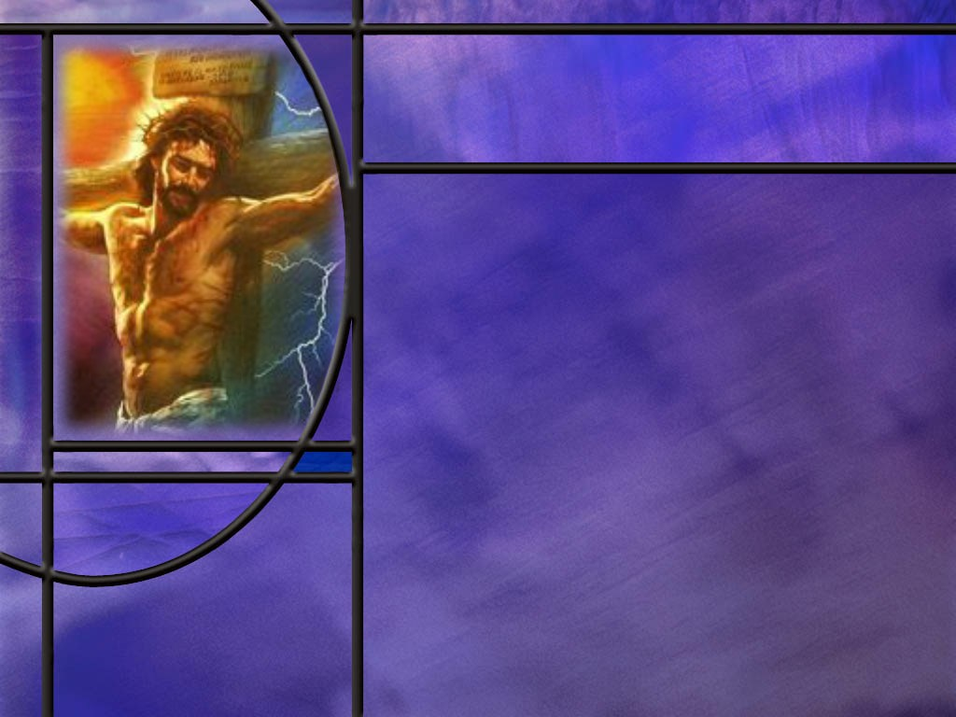
Memory Text
Hebrews 1:1-2 NKJV
God, who at various times and in various ways spoke in time past to the fathers by the prophets, ² has in these last days spoken to us by His Son, whom He has appointed heir of all things, through whom also He made the worlds.
What two periods of time do you see in this text?
Which method of speaking to us gave us a fuller revelation of God and His character?
What further information does this text give us about the Son of God?
Notes:
B2:
1. We have God speaking in time past, and we have God speaking in these last days.
2. So, what two periods of time are in view here?
3. Well the book of Hebrews is part of the NT, and so the writer of this book is referring to the time in which he lives and is writing as “these last days.”
4. He is living and writing in the beginning of the Messianic age inaugurated by the ministry of Jesus Christ.
5. So, the time past when God spoke to “the fathers by the prophets” were the OT times before Christ.
6. And now, since Christ has come, God is speaking to us through His Son.
B3:
1. When God wanted to give us an even fuller revelation of who He is and what He is like, He sent us His Son.
2. Jesus said to Philip:
John 14:9 NKJV –"Have I been with you so long, and yet you have not known Me, Philip? He who has seen Me has seen the Father; so how can you say, 'Show us the Father’?
3. Jesus is God’s clearest revelation of His own character to us.
4. The apostle John called Him the Word.
5. The Word was made flesh and dwelt among us. (John 1:14)
6. And here the author of Hebrews tells us that God’s ultimate word to us is revealed in Jesus.
7. Here the NT “testimony of Jesus” becomes an addition to the OT “word of God.”
6. The testimony of Jesus is the New Testament, inspired by the HS and written down by the apostles of Jesus or their near associates.
7. It becomes God final word of truth.
8. So now we have an even fuller test of truth.
9. Do you remember what Isaiah wrote about discovering truth?
Isaiah 8:20 KJV - To the law and to the testimony: if they speak not according to this word, it is because there is no light in them.
10. So now we can still have the law and the testimony as the twofold witness to truth, but the law would apply to the OT Scriptures and the testimony would apply to the NT writings as the Testimony of Jesus.
11. So if God is now speaking to us through His Son, then we ought to pay attention to Jesus.
12. We need to listen to Him, understand what He says, understand who He is, understand what He has done, and receive Him as our Savior our Lord our Friend.
13. In these last days since Jesus came, God speaks His love, His grace, His goodness, His forgiveness, His acceptance, His reconciliation, His covenant promises, and His salvation through His Son.
14. Are you thankful for Jesus this morning?
B4:
1. The writer of Hebrews here gives us additional information about Jesus.
2. Here we see that He is the active agent in creation of the physical universe.
3. The word translated here as “worlds” can also be translated as universe or cosmos.
4. This agrees with John’s description of Jesus as the Word.
John 1:3 KJV – All things were made by him; and without him was not any thing made that was made.
5. Not only is He the Son of God and the active agent in creation of the universe, but He has been appointed as the Heir of all things.
6. The heir is the one who inherits His Father’s wealth and royal position.
7. He will have authority and dominion over the entire physical creation.
8. He will be King of kings and Lord of lords.
9. And He will reign forever and ever.
10. At the end of the age, Christ inherits the universe and its dominion.
11. All things will be united I Him and subject to Him.

Slide 3
Overview
In God’s original creation of the earth, mankind was created in the image of God as a social being with the capacity for genuine love relationships. Sin brought a curse upon God’s good creation, and man could no longer communicate with God face-to-face. But God did not abandon us. He has used other ways to speak to us, most importantly by sending His Son to die for us.
  Face-to-Face
  Eden Lost
  God Still Speaks
  Summary

Slide 4
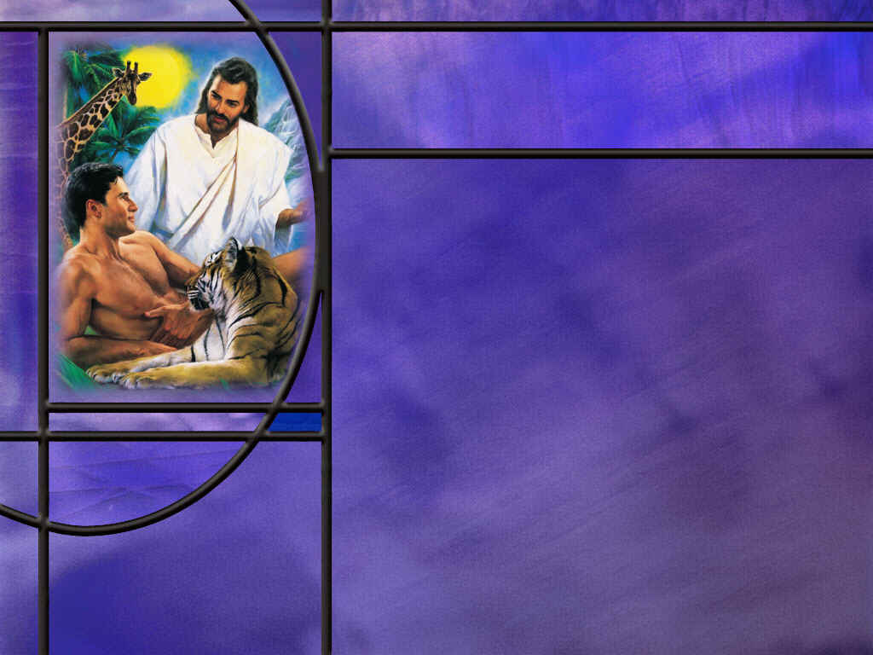
Face-to-Face
How does Genesis describe communication in Eden before sin? (Gen 1:28)
How does the creation of Eve indicate a physical presence of the Lord in Eden? (Gen 2:21-22)
How does Genesis describe Adam and Eve meeting and communing with the Lord? (Gen 3:8)
What specific warning did the Lord communicate to Adam and Eve about what not to eat? (Gen 2:16-17)
Notes:
B1:
[See notes on linked slide.]
B2:
[See notes on linked slide.]
B3:
[See notes on linked slide.]
B4:
[See notes on linked slide.]

Slide 5
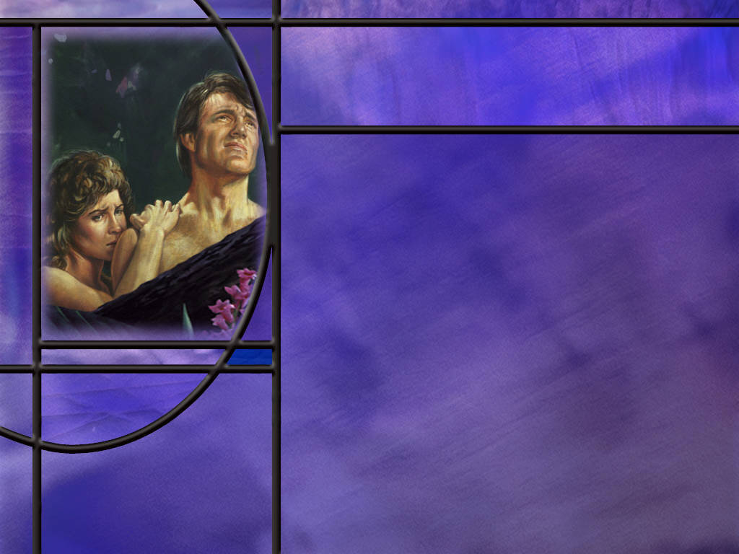
Eden Lost
What changes in God’s “very good” creation occurred because of the Curse?
How long will the curse last?
  And there shall be no more curse, (Rev 22:3a)
What promise of hope did the Lord give to Adam and Eve that the “seed of the woman” would reverse the curse? (Gen 3:15)
What remedy did God provide for Adam and Eve’s sin? (Gen 3:21)
Notes:
B1:
1. The brief account in Genesis gives us a few:
2. The serpent would crawl in the dust on its belly.
3. The woman’s pain in child bearing would be greatly increased.
4. She would be subject to the authority of her husband.
5. Thistles and thorns would proliferate.
6. Hard work would be required to live off the land.
7. Most important, the death God promised would take place for all things.
8. Beyond these specifics, there are many implied changes.
9. In nature, fangs and claws are now used to tear and eat the flesh of other animals.
10. Everyone born under the curse was born with a fallen nature with an inclination toward evil and a propensity for sin.
11. The whole creation groans looking for the day of redemption.
12. And, of course, Eden was lost. Adam and Eve were expelled from the beautiful garden, and an angel was sent to guard the way to the tree of life.-
13. This ended face-to-face communication with the Lord and times of fellowship and enjoying His personal presence with them.
14. It must have been as sad day to leave it all behind, especially the times of fellowship with their Creator.
B2:
1. Speaking of the New Jerusalem, John the Revelator writes:
Revelation 22:3 (NKJV)
³ And there shall be no more curse
2. After the second resurrection and the destruction of Satan, his angels, and the wicked, God will create new heavens and a new earth.
3. There we will dwell in righteousness and there will be no more curse. Hallelujah!!!
4. God’s plan is to restore us to a new Eden, a new heaven and new earth where we will once again be able to fellowship and worship our God face-to-face.
5. Here’s what John writes in Rev 22:3 - 4
Revelation 22:3-4 NKJV –And there shall be no more curse, but the throne of God and of the Lamb shall be in it [the New Jerusalem], and His servants shall serve Him. 4 They shall see His face, and His name shall be on their foreheads.
6. When the curse is lifted, we can see God face-to-face and the communication that Adam and Eve enjoyed in Eden will then be restored to all who are servants of the Lord.
B3:
[See notes on linked slide.]
B4:
[See notes on linked slide.]

Slide 6

God Still Speaks
What can we know about God from observing the natural world? (Rom 1:20)
How did God continue to speak to individuals and nations in OT times? (2 Peter 1:21)
How does God continue to speak to us today through His written word? (2 Tim 3:16-17)
Notes:
B1:
[See notes on linked slide.]
B2:
[See notes on linked slide.]
B3:
[See notes on linked slide.]

Slide 7
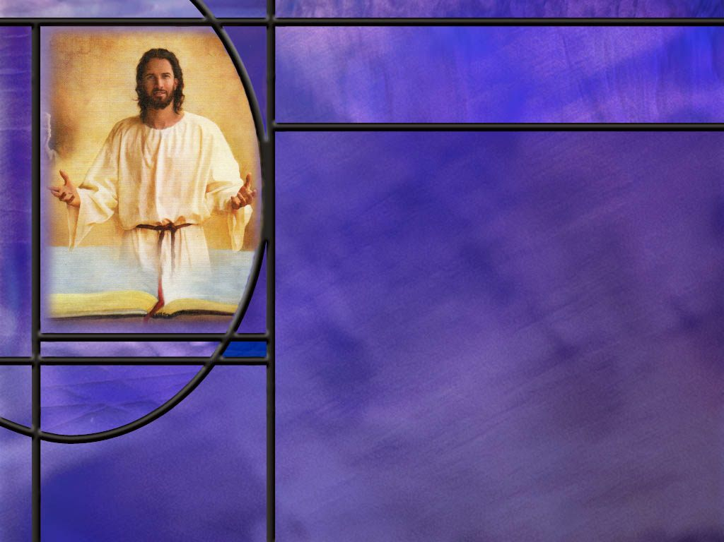
Summary
While the Genesis text does not say so explicitly, every indication seems to be that Adam and Eve spoke to the Lord God in Eden face-to-face.
It also seems reasonable to conclude that the Son has been God’s emissary to the human race from the very beginning and that, as the active agent in creation, it was the Son who created Eve and spoke with the first couple in Eden.
Adam and Eve enjoyed direct communication and fellowship with the Lord in the cool of the day as the Lord came to visit them.
As a test of loyalty and obedience, God warned them not to eat of the tree of the knowledge of good and evil lest they die.

Slide 8
Summary
Unfortunately, they used their freedom of choice to disobey God and bring the curse upon creation.
Their disobedience brought death upon themselves and all of creation; they were barred from Eden; and were no longer able to speak face-to-face with their Creator.
But God did not abandon them.
He introduced them to the sacrificial system to teach them the gospel of a Savior who would die for their sins, and He gave them the promise that the Seed of the woman would crush the serpent’s head.
On rare occasion in OT times, God the Son spoke face-to-face with mankind but with a veiled glory.

Slide 9
Summary
In OT times He spoke through prophets who were moved by the Holy Spirit to speak and write the words of God.
In these last days, God speaks His love, His grace, His goodness, His forgiveness, His acceptance, His reconciliation, His covenant promises, and His salvation through His Son.
Our clearest picture of the goodness of God is seen in Jesus who declared the love of God for us in that while we were yet sinners, Christ died for us.
God still speaks to us today through nature and through His word.
Are you listening and accepting His invitation to meet Him face-to-face in Eden restored?

Slide 11
Genesis 1:28 NKJV
Then God blessed them, and God said to them, "Be fruitful and multiply; fill the earth and subdue it; have dominion over the fish of the sea, over the birds of the air, and over every living thing that moves on the earth." [R]
Notes:
Q1: What is implied by the words in quotation here?
1. These would be the actual words that God spoke to them as a pair.
2. So the implication is that this was the Lord speaking directly to Adam and Eve.
3. They didn’t just hear a voice from heaven. There was an actual physical form there that they could see.
4. So we suppose, with good reason, I believe, that this was the Son of God who was the active agent in their creation speaking to them.
5. This is even clearer when we look at Genesis 2 and the account of the creation of Eve.

Slide 12
Genesis 2:21-22 NKJV
And the LORD God caused a deep sleep to fall on Adam, and he slept; and He took one of his ribs, and closed up the flesh in its place. ²² Then the rib which the LORD God had taken from man He made into a woman, and He brought her to the man. [R]
Notes:
Q1: What indication do we have here that the Lord is present physically with Adam and Eve?
1. Here we have the Lord performing an operation on the man.
2. He causes Adam to fall asleep, takes one of his ribs, and forms Eve.
3. Then the Lord brings Eve to Adam.
4. So, if we use a little sanctified imagination here, we can see the Lord introducing Adam to Eve and preforming a wedding ceremony to unite them together in marriage.
5. Then He gives them instructions for the honeymoon: “Be fruitful and multiply…”
Q2: How does verse 22 fit together with Jesus as the active agent in creation?
1. We know from the gospel of John that “all things were made by Him (the Word) and without Him was not anything made that was made.”
2. So it was the Son that created Eve and brought her to Adam.
3. We see all throughout the OT that God’s active agent in dealing with mankind was the preincarnate Son of God.
4. Paul writes to the Corinthians that the Rock that followed the Israelites in the wilderness was Christ.
5. It was the Son in the burning bush, and on Mt. Sinai where he was seen by 74 men.
6. It was the Son speaking to Moses as to a friend.
7. It was the Son appearing to Joshua as the captain of the Lord’s army.
8. It was the Son that appeared to Abraham and Isaac and wrestled with Jacob.
9. It was the Son that appeared to Manoah and his wife, the parents of Samson.
10. He is sometimes described as the angel of the Lord or as the Lord, Yahweh, directly.
11. For both Moses and Joshua, his divinity made the ground holy, and He told them to take off their shoes.
12. The Son has always been God’s active agent and His emissary to our fallen race.

Slide 13
Genesis 3:8 NKJV
And they heard the sound of the LORD God walking in the garden in the cool of the day, and Adam and his wife hid themselves from the presence of the LORD God among the trees of the garden. [R]
Notes:
Q1: What does this verse tell us about communication in the Garden?
1. What did they hear?
2. They heard the sound of the Lord walking in the garden.
3. This certainly implies that the Lord was in a physical form that made a sound when we walked along in the garden.
4. They were hiding from the presence of the Lord, so He must have been visible in a physical form that they could see.
5. This appears to be a common occurrence of a repeated meeting with the Son.
6. Apparently, He would come in the cool of the day to fellowship and commune with the first couple.
7. Following this verse, that comes just after they sinned, the Lord speaks to them directly.

Slide 14
Genesis 2:16-17 ESV
And the LORD God commanded the man, saying, "You may surely eat of every tree of the garden, ¹⁷ but of the tree of the knowledge of good and evil you shall not eat, for in the day that you eat of it you shall surely die." [R]
Notes:
Q1: What was to be the consequence of disobeying the commandment of God?
1. Death.
Q2: For such an important command with such devastating consequences, how could the Lord make sure they understood which tree He was talking about.?
1. The way the Lord could make sure there was no confusion about which tree he meant would be to take Adam to the tree and say “This is the tree.”
2. Again, this would imply a face-to-face communication with the Lord physically present.
Q3: Why didn’t Adam and Eve die in the very day that they ate the forbidden fruit?
1. The Hebrew doesn’t actually say that they would die on that very day.
2. “In the day” refers to the time of eating the fruit not the time of their death.
3. So the NLT translates it this way:
Genesis 2:16-17 NLT - 16 But the LORD God warned him, "You may freely eat the fruit of every tree in the garden-- 17 except the tree of the knowledge of good and evil. If you eat its fruit, you are sure to die.“
4. And indeed, when they ate the fruit, their doom was sealed.
5. Adam lived for 930 years but His death sentence was never in question.
5. When they lost access to the tree of life, death was inevitable.
Q3: What foundation or president did this set for the rest of Scripture?
1. From Genesis to Revelation, God’s truth does not change.
2. Sin is the transgression of God’s commandments and the wages of sins is death.
3. Ezekiel says it in the OT:
Ezekiel 18:20 ESV - The soul who sins shall die.
4. Paul says it in the NT:
Romans 6:23 KJV - For the wages of sin is death; but the gift of God is eternal life through Jesus Christ our Lord.
5. In fact, Paul goes back to the first sin in Eden to explain the origin of death.
Romans 5:12 KJV - Wherefore, as by one man (Adam) sin entered into the world, and death by sin; and so death passed upon all men, for that all have sinned:
6. The first mention in Scripture often sets the stage for truth that endures throughout Scripture.
Q4: What lesson should we take from the choice placed before our first parents?
1. We have a similar choice to make that leads to similar results.
2. Are we going to be faithful to God and acknowledge that He knows best?
3. Or are we going to rebel against Him and believe Satan’s lies instead.
4. Our choice will determine our destiny: immortality or eternal death.

Slide 15
Genesis 3:15 NIV
And I will put enmity between you and the woman, and between your offspring and hers; he will crush your head, and you will strike his heel." [R]
Notes:
Q1: Who is speaking to whom in this verse?
This is the Lord speaking to Satan in the form of the serpent in Eden.
Q2: What hope do you see in this promise?
1. This is the first hint we have of the gospel.
2. Although this is cryptic, there is coming a seed of the woman that will strike a deadly blow to the head of the devil.
3. In the cosmic conflict between Christ and Satan, Christ wins a decisive victory that defeats and destroys Satan (crushes his head).
4. This a peek at the end of the story.
5. There is a cosmic conflict, a great controversy, between Christ and Satan that begins in Genesis and ends in Revelation.
6. Satan is defeated; Christ wins.
7. And if you’re on Christ’s side, you win too.
8. It is ironic that the one making this promise is likely the Son of God who would come as the Messiah some 4,000 years later to endure the painful strike of crucifixion as He crushes the serpent’s head.
9. God’s plan from the very beginning was not to cast us off, but to send His Son to save us.
!0. As Peter describes Jesus in::
1 Peter 1:20 KJV - 20 Who verily was foreordained before the foundation of the world, but was manifest in these last times for you,
Q3: Who is the seed of the woman?
1. There is only one virgin birth in human history.
2. The incarnation of Jesus made Him the unique seed of the woman as He had no earthly father but was born by the power of the Holy Spirit making Him uniquely divine and human.
3. At the cross, it was Christ who sealed the doom of Satan and his kingdom by dying for our sins and rising again to provide for the forgiveness of our sins.

Slide 16
Genesis 3:21 NKJV
Also for Adam and his wife the LORD God made tunics of skin, and clothed them. [R]
Notes:
Q1: Where did God get the skins to make the coats?
1. God introduced the sacrificial system right after the first sin.
2. The coats of skin came from animal sacrifices that pointed forward to Christ the Redeemer.
3. John the beloved apostle writes this about Jesus:
1 John 2:2 (NIV)
² He is the atoning sacrifice for our sins, and not only for ours but also for the sins of the whole world.
4. God put into effect the everlasting covenant of salvation established from the foundation of the world.
5. God the Son would die for the sins of His own creatures.
6. And God the Father would accept His death in place of ours as the wages of our sin.
7. Because of the curse, we continue to die the first death, but because of Christ, those who trust Him will escape the second death.
1 Corinthians 15:22 (NKJV)
²² For as in Adam all die, even so in Christ all shall be made alive.

Slide 17
Romans 1:20 NIV
For since the creation of the world God's invisible qualities--his eternal power and divine nature--have been clearly seen, being understood from what has been made, so that people are without excuse. [R]
Notes:
Q1: What does Paul say demonstrated conclusively the divine nature and power of God?
1. He says it is the creation we see all around us.
2. The heavens that declare the glory of God.
3. The biosphere here on earth that contains the living things He created.
4. The beauty, design, and complexity of the natural world require a Creator.
5. Our Creator is a God of order, beauty, the infinite, the infinitesimal, the complex, the elegantly simple
6. Yes, our world is fallen, but it still declares the glory of the God who created it.
7. We can know without a doubt that the universe did not create itself.
8. The creation requires a Creator.
9. Those who deny that there is a Creator will be without excuse in the judgment.
Q2: What things of nature are most impressive to you in declaring the existence and power of God?
1. To me: the greatest evidence for a Creator is the specified complexity of biological organisms.
2. There is no possible way that the complex biochemical relations and reactions that make things live could have come about by chance.
3. This is the law of biogenesis: Life comes only from life, so the first life had to be created.
4. The incredible amount of information in the DNA that is present in every cell requires a creator.
5. Information does not arise by chance and random events.
6. It requires an intelligent source, which is God.
7. Here is the question that I posed to Perplexity AI:
8. What is the information content of a single human cell in terms of equivalent pages of the encyclopedia Britannica?
9. Answer:
A commonly repeated comparison says that the DNA in the nucleus of one human cell contains enough information to fill about 1 million encyclopedia pages—roughly 40 complete sets of the traditional 25,000-page, 23-volume Encyclopaedia Britannica*, or about 920 Britannica-sized volumes.
God the Creator put that much information in each one of your cells.
Amazing!!
God still speaks through creation.
Q3: What could you misunderstand about God looking only at nature?
1. We could misunderstand the character of God looking only at nature.
2. It is not clear from nature now that God is love.
3. The survival of the fittest is often accompanied by destruction of the weakest.
4. “Nature is red of fang and claw.”
5. We need to understand that nature as we see it is the result of sin and the curse.

Slide 18
2 Peter 1:21 ESV
For no prophecy was ever produced by the will of man, but men spoke from God as they were carried along by the Holy Spirit. [R]
Notes:
Q1: What should we note about the gift of prophecy from this verse?
1. God spoke through prophets in OT times.
2. We saw this in our memory text:
Hebrews 1:1 NKJV – God, who at various times and in various ways spoke in time past to the fathers by the prophets,
3. The messages that God sent through the prophets were not produced by the prophets themselves.
4. As Peter says here, no prophecy was ever produced by the will of man.
5. Instead, they spoke what God told them to speak under the power of the Holy Spirit.
6. They were speaking the very words of God, introducing their prophecies with words like “Thus saith the Lord…”
7. It was as though God was speaking through them.
8. And their words carried the authority of God Himself.
Q2: What does the word Prophet mean?
1. A prophet in the Bible is primarily a person whom God appoints to speak His message to others—God’s messenger or spokesperson.
2. A good illustration is in Ex 7:1-2 where God appointed Aaron to be Moses’ prophet, to speak Moses’ words to Pharaoh.
3. In the same way, a prophet speaks God’s words to the people.
Q3: What was the main task of a prophet?
1. The prophet’s main task was to speak for God, to tell people what God expected of them, to call them back to faithfulness to God or suffer the consequences of His judgments.
2. Some prophets did predict future events, but the main thrust of prophecy was calling people to be faithful and warning them of the consequences if they were not.

Slide 19
2 Timothy 3:16-17 NKJV
All Scripture is given by inspiration of God, and is profitable for doctrine, for reproof, for correction, for instruction in righteousness, ¹⁷ that the man of God may be complete, thoroughly equipped for every good work. [R]
Notes:
Q1: How is God speaking to us today?
1. God speaks to us today primarily through His word.
2. God has given us a sufficient revelation in Scripture to come to a saving knowledge of Him through faith in His Son, Jesus Christ.
3. In the verse just before this, Paul writes to Timothy,
2 Timothy 3:15 NKJV – and that from childhood you have known the Holy Scriptures, which are able to make you wise for salvation through faith which is in Christ Jesus.
4. The Scriptures, OT and NT, give us sufficient information to find salvation in Jesus Christ.
5. God’s ultimate word to us comes through His Son.
6. As our memory text says:
Hebrews 1:2 NKJV – 2 [God] has in these last days spoken to us by His Son,
7. It is in the NT that we find the Son’s words to us.
8. In fact, the NT is the testimony of Jesus or the witness of Jesus.
9. It is the inspired record written by His apostles or their close associates that tell us who Jesus was, how he became one of us, what he taught and how he healed, what He believed, how He died for our sins, rose again, ascended to heaven, intercedes for us as our High Priest, and how He will come again.
10. The NT defines the apostolic Christian faith once and for all delivered to the saints.
11. It is the faith of Jesus that He delivered to His church.
12. It is through Jesus that we understand the character of God.
13. It is by receiving Him and trusting His shed blood for the forgiveness of sins that we are saved.
14. It is in Him that all the promises of God are ministered to us.
2 Corinthians 1:20 NIV – For no matter how many promises God has made, they are "Yes" in Christ. And so through him the "Amen" is spoken by us to the glory of God.
15. How many are thankful this morning that God has spoken to us by His Son?

