Slide 1
First and Second Corinthians
Lesson 13
Grace, Love, and Fellowship

Slide 2
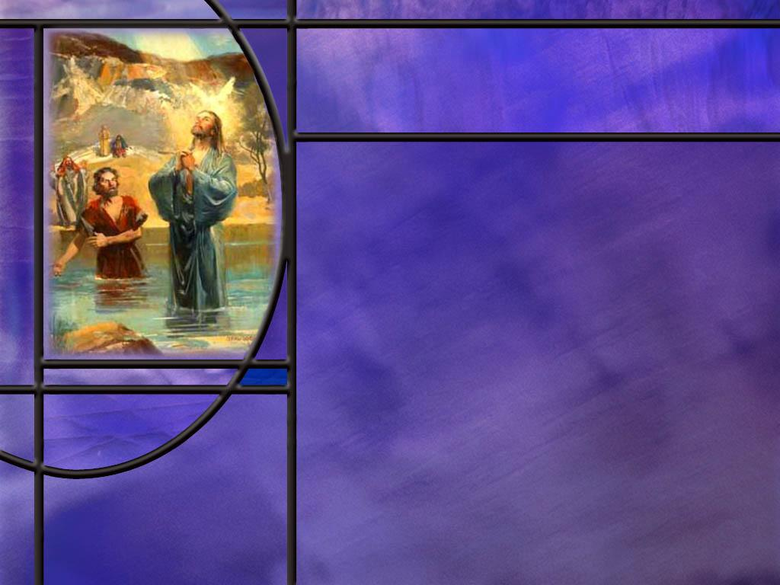
Memory Text
2 Corinthians 13:14 ESV
The grace of the Lord Jesus Christ and the love of God and the fellowship of the Holy Spirit be with you all.
What three Persons does Paul invoke in this closing verse of 2 Corinthians?
How is the grace, love, and fellowship appropriate to each of the respective persons in this benediction?
Which Person of the Godhead is easier or harder for you to visualize and why?
Notes:
B2:
1. Jesus Christ the Son, God the Father, and the Holy Spirit.
2. These ae the three divine persons that make up the Godhead.
3. Together they are often called the Trinity.
4. The word Trinity is not found in the Bible, but it is a theological term used to capture what the New Testament teaches.
5. This verse is one of several examples of the NT view of God.
6. Our one God is a plurality of three Divine persons: Father, Son, and Holy Spirit.
7. Here we have the HS inspiring Paul to put all three members of the Godhead together in his benediction.
8. This indicates that they are all part of the Godhead.
9. In our lesson today we will look at other texts that indicate that our God is a plurality rather than a singularity.
B3:
1. Grace is God’s unmerited favor toward mankind.
2. God’s grace is clearly manifested in our Lord Jesus Christ who stepped down from glory to become our sacrifice for sin.
3. As we studied two week ago, Paul wrote in:
2 Corinthians 8:9 ESV - 9 For you know the grace of our Lord Jesus Christ, that though he was rich, yet for your sake he became poor, so that you by his poverty might become rich.
4. The grace of the Lord Jesus Christ is the unmerited gift of forgiveness and eternal life through His shed blood.
5. What grace!
6. The love of God the Father is manifested in the giving of His Son to be our ransom from sin.
7. For God so loved the world that He gave…
8. The agape love of the Father acted to save us, not because we were worthy but because God is love.
9. What love!
10. The Holy Spirit is God dwelling in us and bringing us into communion and fellowship with the Godhead.
11. When God is in us, He is as close to us as we are to ourselves.
12. What fellowship!
B4:
1. The easiest Person of the Godhead to visualize is the Son.
2. That is because He “took the form of a servant and was made in the likeness of man.”
3. But even before His incarnation, it seems likely that the Son was God’s emissary to this fallen world.
4. All of the OT appearances of the LORD were likely carried out by the Son.
5. Paul wrote to the Corinthians about the wanderings of the Israelites in the wilderness saying,
Corinthians 10:4 (NKJV)
⁴ and all drank the same spiritual drink. For they drank of that spiritual Rock that followed them, and that Rock was Christ.
6. Sometimes referred to as the Angel of the LORD, sometimes as the LORD Himself, it was the Son who met with Moses on Mt. Sinai and wrote His law with His own finger.
7. It was the Son who spoke from the burning bush.
8. It was the Son who appeared to Joshua as the Captain of the Lord’s host.
9. It was the Son who spoke with Abraham and Elijah and others.
10. Moses records:
Exodus 24:9-10 (NKJV)
⁹ Then Moses went up, also Aaron, Nadab, and Abihu, and seventy of the elders of Israel, ¹⁰ and they saw the God of Israel.
11. Yet Jesus said:
John 6:46 (NKJV)
⁴⁶ Not that anyone has seen the Father, except He who is from God; He has seen the Father.
12. And John wrote in his gospel:
John 1:18New King James Version (NKJV)
¹⁸ No one has seen God [the Father] at any time. The only begotten Son, who is in the bosom of the Father, He has declared Him.
13. Paul wrote to Timothy:
1 Timothy 6:16 (NKJV)
¹⁶ [God] who alone has immortality, dwelling in unapproachable light, whom no man has seen or can see, to whom be honor and everlasting power. Amen.
14. So if people saw God in the OT, which person of the godhead did they see?
15. It was the Son rather than the Father.
16. So we can visualize God the Son who appears to us in human form.
17. At the other end of the spectrum we have the Holy Spirit who is invisible.
18. How do you visualize something that is invisible?
19. So we represent the HS with a dove, or with light, or with oil or some other physical thing.
20. But the Spirit is really like none of these: He is beyond our ability to visualize.
21. In the middle we have God the Father which we tend to visualize in human form because of His title, Father.
22. And since He is the Ancient of Days, we tend to visualize Him as a very old father.
23. But I wonder if we can really visualize the Father any better than the HS.
24. To the Samaritan woman at the well, Jesus declared that “God is Spirit and they that worship Him must worship Him in spirit and in truth.”
25. If God is Spirit, that means He doesn’t have a physical form that we can visualize, unless He wants to take such a form.
26. Paul wrote to Timothy this description of God:
1 Timothy 1:17New American Standard Bible (NASB)
¹⁷ Now to the King eternal, immortal, invisible, the only God, be honor and glory forever and ever. Amen.
27. There is no way to visualize someone who is invisible unless he takes on a physical form.
28. So we find our clearest understanding of God in Jesus Christ who became one of us and has been God’s active agent toward us even in OT times.

Slide 3
Overview
Paul ends his letter of 2 Corinthians with a clearly Trinitarian benediction affording us the opportunity to reflect on the nature of God as One God manifest in three Persons. This Christian understanding of God is most clearly reflected in the New Testament, particularly in the gospel of John.
  The Father
  The Son
  The Holy Spirit
  The Godhead
  Summary

Slide 4

The Father
What did Jesus tell the Samaritan woman about the nature of God the Father? (John 4:23-24)
How did Paul describe the nature of the Father? (1 Tim 1:17)
What are some of the things John tells us about the Father in His gospel? (John 3:16; 5:22; 16:23)
How does John’s gospel describe the connection between Father and Son? (John 1:18; 14:9; 10:30; 1:1)
Notes:
B1:
[See notes on linked slide.]
B2:
[See notes on linked slide.]
B3:
[See notes on linked slide.]
B4:
[See notes on linked slide.]

Slide 5
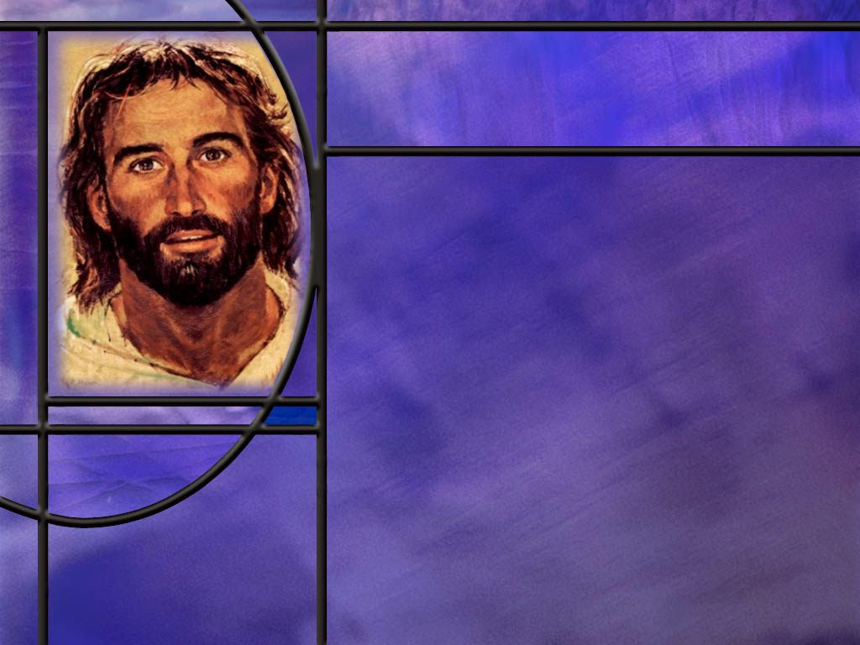
The Son
What indications do we have from John’s Gospel that Jesus was the divine Son of God?
  Creator (John 1:1-3)
  His Incarnation (John 1:14)
  Texts referring to Jesus as God (John 1:1, John 20:28)
  Exercises the prerogatives of God (John 6:40)
  Takes the names of God (John 8:58-59,)
  Claims unity with the Father (John 14:9, John 17:5)
  Received the worship of men (John 9:38)
Notes:
John 1:1-3 KJV - In the beginning was the Word, and the Word was with God, and the Word was God. ² The same was in the beginning with God. ³ All things were made by him; and without him was not any thing made that was made.
John 1:14 KJV - And the Word was made flesh, and dwelt among us, (and we beheld his glory, the glory as of the only begotten of the Father,) full of grace and truth.
John 20:28 KJV - And Thomas answered and said unto him, My Lord and my God.
John 6:40 ESV - For this is the will of my Father, that everyone who looks on the Son and believes in him should have eternal life, and I will raise him up on the last day.“
John 8:58-59 ESV - Jesus said to them, "Truly, truly, I say to you, before Abraham was, I am." ⁵⁹ So they picked up stones to throw at him, but Jesus hid himself and went out of the temple.
1. In addition to this Jesus uttered seven “I am” statements:
I am the bread of life.
I am the light of the world.
I am the door of the sheep.
I am the good shepherd.
I am the resurrection and the life.
I am the way, the truth, and the life.
I am the true vine.
John 14:9 ESV - Whoever has seen me has seen the Father.
John 17:5 ESV - And now, Father, glorify me in your own presence with the glory that I had with you before the world existed.
John 9:38 ESV - He said, "Lord, I believe," and he worshiped him. (Healing of the man born blind)
2. In addition to all of these texts we have all the signs and miracles Jesus did, the witness of John the Baptist, the witness of the Father and the Holy Spirit at His baptism, the witness of His disciples and Nicodemus, the witness of OT prophecies fulfilled by Jesus, and many more evidences.
3. Finally, we have the greatest evidence that Jesus is the divine Son of God: His resurrection from the dead.
4. The resurrection is God’s stamp of approval on all that Jesus said and did, and by it, the apostle Paul says, “Jesus Christ our Lord was declared to be the Son of God with power.”

Slide 6
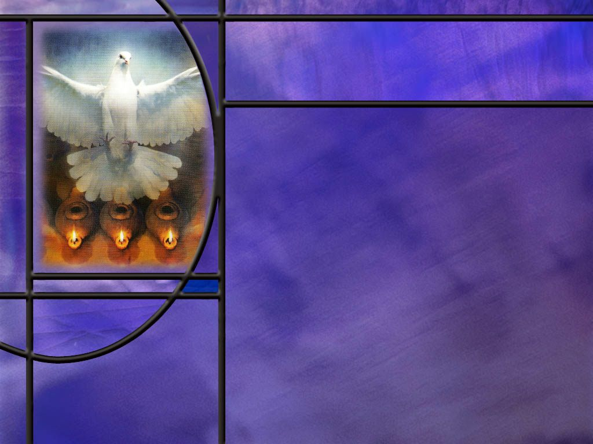
The Holy Spirit
How does Peter indicate the divinity of the Holy Spirit? (Acts 5:3-4)
How does Paul describe the location of the temple of God and how God dwells in His temple? (1 Cor 3:16; 6:19)
How does John describe the work of the Holy Spirit? (John 16: 13-14)
How did the Spirit of God resurrect Jesus from the dead, and how will that Spirit work in us? (Rom 8:11)
Notes:
B1:
[See notes on linked slide.]
B2:
[See notes on linked slide.]
B3:
[See notes on linked slide.]
B4:
[See notes on linked slide.]

Slide 7
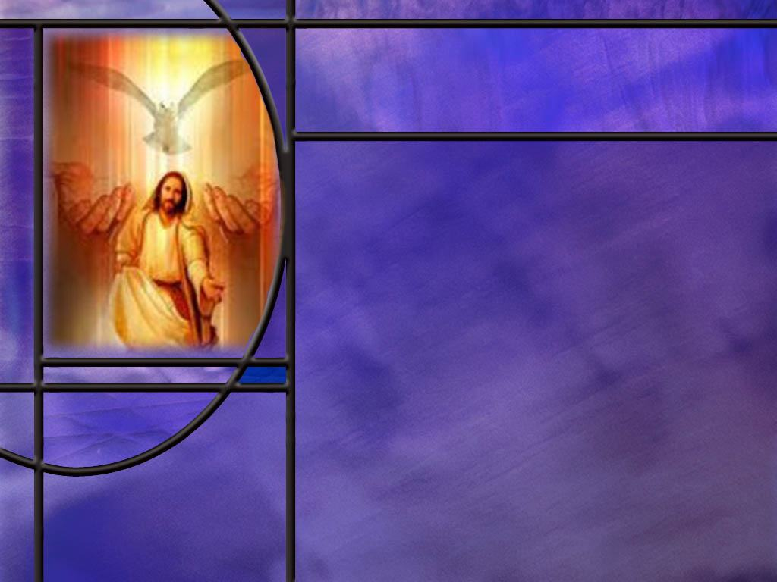
The Godhead
How can we describe what the Bible seems to teach about the nature of God? [Link]
What are some of the places in scripture where we see Father, Son, and Holy Spirit acting together?
What are some of the trinitarian texts that place the Father, Son, and Holy Spirit together in ministry?
Notes:
B1:
[See noes on linked slide.]
B2:
1. First; at creation.
Genesis 1:1-2 ESV - In the beginning, God created the heavens and the earth. ² … And the Spirit of God was hovering over the face of the waters.
2. We know from the NT in at least three places that Jesus, in His pre-incarnate form, was the active agent in creation. (John, Colossians, and Hebrews)
3. Second, at the incarnation.
Luke 1:35 ESV - 35 And the angel answered her, "The Holy Spirit will come upon you, and the power of the Most High will overshadow you; therefore the child to be born will be called holy--the Son of God.
4. Third at Christ’s Baptism:
Matthew 3:16-17 ESV - And when Jesus was baptized, immediately he went up from the water, and behold, the heavens were opened to him, and he saw the Spirit of God descending like a dove and coming to rest on him; ¹⁷ and behold, a voice from heaven said, "This is my beloved Son, with whom I am well pleased.“
5. Fourth, at the crucifixion and resurrection.
John records the Father speaking from heaven to Jesus before the crucifixion (John 12:28), and Paul describes Him as being raised by the power of the Holy Spirit on the resurrection morning (Rom 8:11).
B3:
[Read the following emphasizing the underlined words.]
2 Corinthians 13:14 (NKJV)
¹⁴ The grace of the Lord Jesus Christ, and the love of God, and the communion of the Holy Spirit be with you all. Amen.
Matthew 28:19 (NKJV)
¹⁹ Go therefore and make disciples of all the nations, baptizing them in the name of the Father and of the Son and of the Holy Spirit,
Luke 3:22 (NKJV)
²² And the Holy Spirit descended in bodily form like a dove upon Him [Jesus], and a voice came from heaven which said, “You are My beloved Son; in You I am well pleased.” [The Father speaking]
1 Peter 1:2 (NKJV)
² elect according to the foreknowledge of God the Father, in sanctification of the Spirit, for obedience and sprinkling of the blood of Jesus Christ: Grace to you and peace be multiplied.
Ephesians 4:4-6 (NKJV)
⁴ There is one body and one Spirit, just as you were called in one hope of your calling; ⁵ one Lord, one faith, one baptism; ⁶ one God and Father of all, who is above all, and through all, and in you all.
1 Corinthians 12:4-6 (NKIJV)
⁴ There are diversities of gifts, but the same Spirit. ⁵ There are differences of ministries, but the same Lord. ⁶ And there are diversities of activities, but it is the same God who works all in all.
Galatians 4:6 (NKJV)
⁶ And because you are sons, God has sent forth the Spirit of His Son into your hearts, crying out, “Abba, Father!”
2 Thessalonians 2:13-14 (NKJV)
¹³ But we are bound to give thanks to God always for you, brethren beloved by the Lord, because God from the beginning chose you for salvation through sanctification by the Spirit and belief in the truth, ¹⁴ to which He called you by our gospel, for the obtaining of the glory of our Lord Jesus Christ.
Titus 3:4-6 (NKJV)
⁴ But when the kindness and the love of God our Savior toward man appeared, ⁵ not by works of righteousness which we have done, but according to His mercy He saved us, through the washing of regeneration and renewing of the Holy Spirit, ⁶ whom He poured out on us abundantly through Jesus Christ our Savior,
1. These texts help us to see that God is a unity of three co-eternal persons.
2. We come to the idea of a triune godhead, not because it makes so much sense, but because the scriptures seem to teach it.
3. Even in the OT we can see a plurality in the Godhead.
4. In the creation account, God says:
Genesis 1:26 ESV - 26 Then God said, "Let us make man in our image, after our likeness…“
5. When Isaiah saw the vision of the Lord high and lifted up, the Seraphim repeated these words:
Isaiah 6:3, 8 KJV - 3 … Holy, holy, holy, is the LORD of hosts: the whole earth is full of his glory.
6. Why three “holies”? Could it be an indication of three divine persons comprising the Lord of hosts?
7. Then we have the question for Isaiah to consider:
Isa 6:8 KJV Also I heard the voice of the Lord, saying, Whom shall I send, and who will go for us? Then said I, Here am I; send me.
8. Here we find the Lord as both singular and plural: Whom shall I send (singular) and who will go for us (plural)?
9. So we grapple with Scripture to try to make sense of the nature of God.
10. Someday, God will make it plain:
1 Corinthians 13:12 KJV - For now we see through a glass, darkly; but then face to face: now I know in part; but then shall I know even as also I am known.

Slide 8
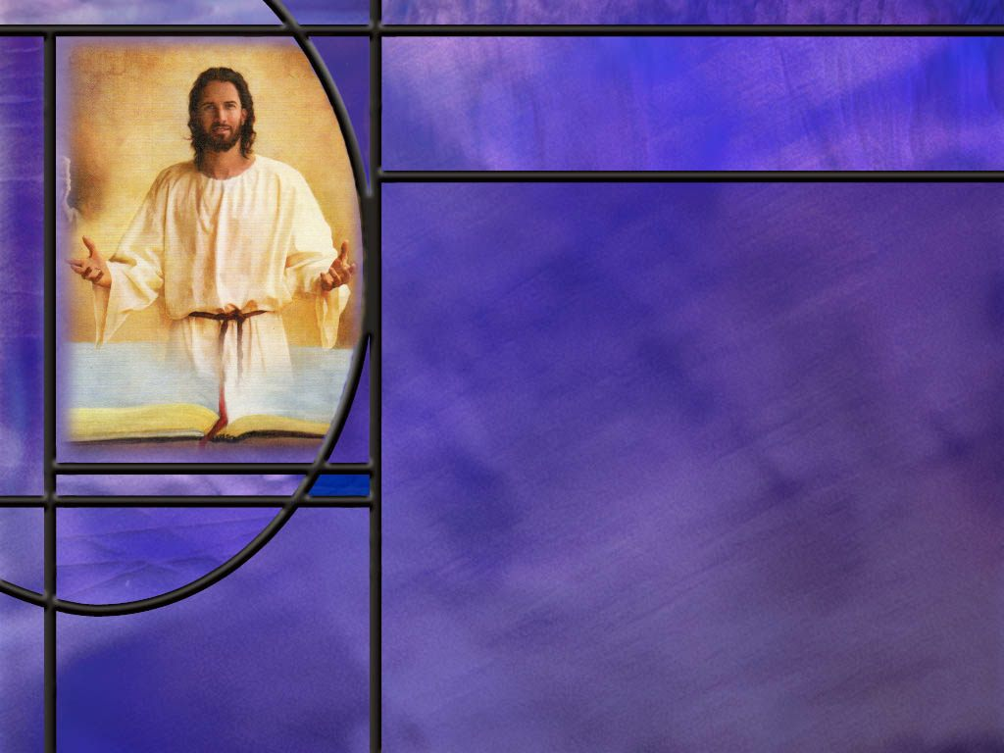
Summary
The Trinity is a uniquely Christian view of God that seeks to do justice to the inspired record of the NT.
The early Christians such as the apostles were confirmed monotheists that never spoke of Jesus as another god, but made a distinction between the Father and the Son as Jesus himself did, praying to His Father in heaven and urging His disciples to do so in His Name.
The gospel of John is foremost among the gospels in presenting Jesus as the Son of God and seeing in His life a revelation of the character, values, and mind of the Father.
Jesus declared, “I and my Father are one,” and “Anyone who has seen me has seen the Father.”

Slide 9
Summary
As in creation, so in salvation, Jesus took the functionally subordinate role of “active agent.”
The Father so loved the world that He sent His Son to save us; His Son so loved the world that He came and died for our sins.
John points to the divinity of Christ in many ways: His existence as God from the beginning, His work of creating all things, His incarnation to become God-man, His promise to resurrect the dead and give them eternal life, applying the names of God to Himself, receiving worship, signs and miracles, the witness of John the Baptist and many others, the witness of the Father and Holy Spirit at His baptism, and finally, His resurrection from the dead.

Slide 10
Summary
The NT record includes the Holy Spirit as the third person of the Godhead.
John presents Him as the Helper who comes from the Father as a replacement for Jesus to dwell in the hearts of believers and lead us into all truth.
The Holy Spirit does things that only persons do: helps, teaches, guides, intercedes in prayer, testifies, hears, speaks, glorifies Christ, and can be grieved.
Parallel wording in several NT texts indicate that the Holy Spirit is God, and many texts include the Holy Spirit in ministry along with the Father and Son.
Knowing that a full understanding of God is beyond our comprehension, will you stand today on what Scripture has revealed?

Slide 12
John 4:23-24 ESV
But the hour is coming, and is now here, when the true worshipers will worship the Father in spirit and truth, for the Father is seeking such people to worship him. ²⁴ God is spirit, and those who worship him must worship in spirit and truth." [R]
Notes:
Q1: What does this say about the nature of God the Father?
1. Here is Jesus telling us that God the Father is Spirit.
2. So this description would fit both the Father and the Holy Spirit.
Q2: What does it mean that God is spirit?
1. In Greek the word is “pneuma,” which can have a whole range of meanings.
2. Pneuma can be used to describe the wind or breath, it can be used of the Holy Spirit, it can be used to describe the animating power that gives life.
3. In reference to spiritual beings, such as angels, in can mean “a simple essence, devoid of all or at least all grosser matter, and possessed of the power of knowing, desiring, deciding, and acting.”
4. So there is a spiritual realm of existence inhabited by angels and demons, which are fallen angels.
5. These spiritual beings are non-physical but can move in to possess physical human beings.
6. Or, in the case of angels, they can take on physicality and appear in human form as we see in the angles at the tomb when Jesus rose.
7. When we say that God is spirit we are saying that His nature is non-physical, He is outside of time and space, He transcends the physical world and is independent of the physical universe He created.
8. God created all things in the physical universe; He created every atom that exists; so He must necessarily be independent of all the physical matter He created.
9. Because God belongs to the spiritual realm and not the physical, It is very difficult for us to understand His nature.
10. How does someone without a physical brain think, reason, understand, and remember?
11. How is He able to manipulate protons, electrons, and neutrons and create atoms and elements?
12. How can He be present everywhere in the physical realm at the same time?
13. So the very nature of God stretches our mind to the point where we simply have to take by faith God’s revelation of Himself in Scripture.

Slide 13
1 Timothy 1:17 KJV
Now unto the King eternal, immortal, invisible, the only wise God, be honor and glory for ever and ever. Amen. [R]
Notes:
Q1: What is the first thing Paul declares about God the Father?
1. First, He is eternal.
2. He had no beginning and He will have no end.
3. He is the self-existent, eternal God.
4. His life is underived and uncreated.
5. Second, He is immortal. He has always lived and He will always live.
6. Third, He is invisible. He cannot be seen.
7. This agrees with John’s description of God as spirit.
8. So it is no wonder that God’s second commandment prohibits making a likeness of him and worshipping it.
9. If you are invisible, no physical likeness can properly represent you.
10. Fourth, God is the only wise God, the only living God, the only God period.
11. And finally, God is the One who deserves to be praised for ever and ever.

Slide 14
John 3:16 KJV
For God so loved the world, that he gave his only begotten Son, that whosoever believeth in him should not perish, but have everlasting life.
Notes:
Q1: What does John 3:16 tell you about God the Father?
1. He we see a distinction in persons and rolls between the Father and the Son.
2. The Father so loved the world that He sent His only Son to die for our sins.
3. Jesus accepted His role of Redeemer and Savior and willing came to die for our sins.
4. So while the Father is the planner, the initiator, the supervisor, the sustainer, the Son is the One who subordinates himself to the Father and carries out the plan of salvation as the Redeemer.
5. The two are one in purpose, mind, and character, but they willingly take different rolls in achieving their goal.
[Go to next slide]

Slide 15
John 5:22 ESV
For the Father judges no one, but has given all judgment to the Son,
Notes:
Q1: Who has the right to judge the world and hold it accountable for sin?
1. If the Father has given that role to the Son, then it was originally the Father’s to give.
2. So again the Father is the source, the initiator, the supervisor, the overseer, and the Son is the active agent in the judgment.
3. The Father will agree with the judgment of the Son.
4. And it will be Jesus returning to save the redeemed and destroy the wicked.
5. Again, we see the oneness in purpose, mind and character but a distinction in rolls, responsibilities, and function.
[Go to next slide.]

Slide 16
John 16:23 ESV
Truly, truly, I say to you, whatever you ask of the Father in my name, he will give it to you. [R]
Notes:
Q1: What distinction do you see here between the Father’s role and the Son’s?
1. We are to pray to the Father in the name of the Son.
2. Jesus prayed to His Father in heaven.
3. He taught his disciples to pray: “Our Father which art in heaven…”
4. It is the Father who is the source of answered prayer.
5. Jesus serves as a model of the things for which we should pray.
6. To pray in the name of Jesus is to pray for the things that He would want in our lives.
7. To pray in His name is to pray as He would, if He were in our place.
8. And we know how Jesus prayed to His Father during His time of agony in the garden of Gethsemane.
9. Three times it was “not my will but thine be done.”
10. If that is the attitude that we bring to God in prayer, Jesus assures us that we will receive the right answer from our Father in heaven.

Slide 17
Father and Son
John 1:18 NIV - No one has ever seen God, but the one and only Son, who is himself God and is in closest relationship with the Father, has made him known.
John 14:9 NIV - Jesus answered: … Anyone who has seen me has seen the Father. How can you say, 'Show us the Father’?
John 10:30 NKJV - "I and My Father are one.“
John 1:1 NKJV - In the beginning was the Word, and the Word was with God, and the Word was God. [R]
Notes:
Q1: How can we know what God the Father is like?
1. We can look at God the Son.
2. John says that Jesus has made known to us the Father in heaven.
3. Jesus said when we look at Him and His character, we see the character of our Father in heaven.
4. He and His Father are one in character, mind, purpose, values, and goals.
5. The Father is God; the Son is God; they are not different God’s but the same God.
6. To make sense of the Biblical data, we must see God as a plurality not a singularity.
7. One God consisting of three Persons with different roles and responsibilities.
8. So in these last days, God has made it easy for us.
9. We can see what God is like by looking at Jesus and seeing what He is like.
10. The writer to the Hebrews begins his letter by emphasizing the witness of God’s son:
Hebrews 1:1-2 KJV - God, who at sundry times and in divers manners spake in time past unto the fathers by the prophets, ² Hath in these last days spoken unto us by his Son, whom he hath appointed heir of all things, by whom also he made the worlds;
11. In these last days, God is still speaking to us by His Son.
12. It is through Jesus that we see the goodness and grace of God.

Slide 18
Acts 5:3-4 ESV
But Peter said, "Ananias, why has Satan filled your heart to lie to the Holy Spirit and to keep back for yourself part of the proceeds of the land? ⁴ While it remained unsold, did it not remain your own? And after it was sold, was it not at your disposal? Why is it that you have contrived this deed in your heart? You have not lied to man but to God." [R]
Notes:
Q1: How would you reconcile the two underlined statements here?
1. Lying to the Holy Spirit is the same as lying to God.
2. Therefore, the Holy Spirit is God.
3. This is clear evidence for the divinity of the HS.

Slide 19
God’s Temple
1 Corinthians 3:16 ESV - Do you not know that you are God's temple and that God's Spirit dwells in you?
1 Corinthians 6:19 ESV - Or do you not know that your body is a temple of the Holy Spirit within you, whom you have from God? You are not your own, [R]
Notes:
Q1: What can we conclude from these two descriptions of our bodies as temples?
1. The first text says that our body is the temple of God.
2. The second text says that our body is the temple of the Holy Spirit.
3. What is the conclusion? (The Holy Spirit is God.)
Q2: What about the giver of Spiritual gifts? What did Paul say about that?
In 1 Cor 12:11 he writes:
1 Corinthians 12:11 ESV - All these are empowered by one and the same Spirit, who apportions to each one individually as he wills.
And in verse 28, it is God who appoints spiritual gifts:
1 Corinthians 12:28 ESV And God has appointed in the church first apostles, second prophets, third teachers, then miracles, then gifts of healing, helping, administrating, and various kinds of tongues.
Here again, God and the Holy Spirit are interchangeable.
That makes the Holy Spirit divine.

Slide 20
John 16:13-14 ESV
When the Spirit of truth comes, he will guide you into all the truth, for he will not speak on his own authority, but whatever he hears he will speak, and he will declare to you the things that are to come. ¹⁴ He will glorify me, for he will take what is mine and declare it to you. [R]
Notes:
Q1: What does the Holy Spirit do here that only a person can do?
1. He will guide us into all truth.
2. Only a person who knows the truth can guide others into the truth.
3. He hears, He speaks, He tells us of things to come.
4. Only a person can hear and speak and communicate information.
5. He glorifies Christ by declaring the gospel of the Lord Jesus Christ to us.
6. Only a person can declare the gospel of righteousness by faith.
7. So it is clear that if we take the Bible as it reads, the HS is not some impersonal force, but a divine being that is able to be our Helper and guide us into all truth.

Slide 21
Romans 8:11 ESV
If the Spirit of him who raised Jesus from the dead dwells in you, he who raised Christ Jesus from the dead will also give life to your mortal bodies through his Spirit who dwells in you. [R]
Notes:
Q1: In this text, who is it that raised Jesus and will raise you if you are in Him?
1. Here God uses the Holy Spirit to raise Jesus from the dead.
2. It will also be the Holy Spirit that dwells in us that raises us from the dead.
3. In Acts 17:31, for example, Paul preached in Athens that God raised Jesus from the dead.
4. What conclusion must we arrive at if God raised Jesus and the Holy Spirit raised Jesus? (The Holy Spirit is God.)

Slide 22
Seventh-day Adventists Believe…
There is one God: Father, Son, and Holy Spirit, a unity of three co-eternal Persons. God is immortal, all-powerful, all-knowing, above all, and ever present. He is infinite and beyond human comprehension, yet known through His self-revelation. He is forever worthy of worship, adoration, and service by the whole creation. [R] Fundamental Beliefs, 2
Notes:
1. Adventists believe in the trinitarian concept of the Godhead.
2. One God, three divine Persons, Father, Son, and Holy Spirit.
3. The book Seventh-day Adventists Believe goes on with this description:
While the Godhead is not one in person, God is one in purpose, mind, and character. The oneness does not obliterate the distinct personalities of the Father, the Son, and the Holy Spirit. Nor does the separateness of personalities within the Deity destroy the monotheistic thrust of Scripture that the Father, Son, and Holy Spirit are one God.
4. I know this concept is confusing to many, but it is the best we can do to makes sense of the NT Scriptures that we have looked at today.
5. The best analogy I can think of is a loving family that has different roles and responsibilities for each member, but is always in agreement on plans, purposes, goals, and methods, and who all share the same character.

