Slide 1
First and Second Corinthians
Lesson 12
Dealing with False Teachers

Slide 2

Memory Text
2 Corinthians 10:4 ESV
For the weapons of our warfare are not of the flesh but have divine power to destroy strongholds.
How would you characterize the warfare in which we are involved as Christians?
What weapons can we use in this spiritual conflict?
What are the weapons of our warfare able to do?
Notes:
B2:
1. We are not fighting a physical foe.
2. We cannot see our enemy directly or lay hands on him to wrestle him down.
3. In the 6th chapter of Ephesians, Paul describes our warfare:
Ephesians 6:12 KJV - For we wrestle not against flesh and blood, but against principalities, against powers, against the rulers of the darkness of this world, against spiritual wickedness in high places.
4. The NIV says our enemy is the spiritual forces of evil in the heavenly realms.
5. The NLT says our enemy is evil spirits in the heavenly places
6. We are not fighting a physical foe that is subject to physical warfare.
7. We are fighting a spiritual foe, Satan, a fallen angel and his hosts of demons.
8. And apparently they inhabit a spiritual dimension outside our physical universe, but they have the power to interact with the physical world.
9. They can tempt and afflict and possess and influence and communicate and harass the human race.
10. They can battle the forces of Christ and the hosts of good angels in conflicts unseen by the physical world.
11. They are the forces of evil in the long war against God that are attempting to sweep humanity into the abyss of eternal destruction.
12. While our loving God is continually offering us eternal life through a saving relationship with His Son.
13. This is the great cosmic conflict we call the Great Controversy.
14. And it is being fought over the souls of human beings.
B3:
1. Guns, missiles, and bombs will not work if we can’t see the enemy.
2. But Paul gives us a list of armor that we can put on to enable us to stand and allow the angelic forces to fight on our behalf.
3. The first weapon we can use is our own will power.
4. The first thing Paul tells us to do in this battle with evil is to stand.
5. Stand against the enemy and his temptations.
6. Face him head on as Jesus did with “It is written” on His lips.
7. Don’t give in; don’t give up; don’t lay down your weapons, don’t turn and run.
8. You’ve got a shield in front but no protection in the back.
9. He says: “Stand therefore having your loins girt about with truth.”
Belt of truth — Truth holds the rest of the armor together:
1. God’s truth stands in direct opposition to Satan’s lies and helps us to recognize his deceptions and counterfeits as soon as they arise.
2. Where do we find God’s truth? We find it in His word, and we stand on that truth refusing to believe Satan’s lies.
Breastplate of righteousness — This protects the heart and vital inner life through Christ’s righteousness credited to believers and through a life that practices what is right.
1. It helps us stand against guilt, accusation, compromise, and sinful habits.
Shoes of the gospel of peace — The good news of peace with God gives believers firm footing and readiness to go wherever God sends them.
1. Armed with the gospel of salvation that brings us peace with God, we can be ambassadors for Christ to reconcile others to God as well.
Shield of faith — Faith actively trusts God’s character, His promises, and His saving work when doubts, temptations, fears, and accusations come like “flaming arrows.”
1. It enables us to stand by extinguishing attacks that seek to set our thoughts, emotions, or desires on fire.
Helmet of salvation — Salvation guards the mind with confidence in what Christ has done, what He is doing, and the final deliverance He will bring.
1. It helps us resist despair, discouragement, and attacks on our assurance and hope.
Sword of the Spirit, which is the word of God — God’s Word is the one clearly offensive weapon in the list, used as the Spirit brings Scripture to mind and applies it truthfully.
1. It enables us to answer lies and temptation with God’s revealed truth, as Jesus did when tempted in the wilderness.
Prayer “at all times in the Spirit” — Prayer is not named as a separate piece of armor, but it is the continuing dependence that puts every part into action.
1. It keeps believers alert, connected to God’s strength, and concerned for fellow Christians who are also standing in the battle.
2. So we have spiritual weapons that can give us victory in this battle with spiritual forces.
3. You want victory in Jesus? Let’s stand in the battle, put on the whole armor of God, and claim the victory through Christ our redeemer.
B4:
1. Our weapons have divine power to destroy strongholds.
2. What do you think Paul means by that?
3. Think about the title of our lesson this week. (Dealing with False Teachers.)
4. Paul is saying that our weapons have the ability by their divine power to destroy the strongholds of the false teachers in Colossae.
5. God’s word, it’s truth, the gospel that brings salvation and changes lives, the faith in Christ that brings us righteousness instead of wallowing in sin, salvation instead of condemnation, the power of prayer to change us and our destiny: all of these contain divine power to destroy the strongholds of evil and error and false doctrines.
Isaiah 8:20 KJV - To the law and to the testimony: if they speak not according to this word, it is because there is no light in them.
6. We can be confident that the law and the testimony, the word of God, will expose whether or not there is light in a particular doctrine promoted as truth.

Slide 3
Overview
In chapters 10 – 13 of 2 Corinthians Paul defends his apostolic calling and authority against some in Corinth who were false teachers promoting themselves as superior apostles and preaching a different gospel rather than the apostolic message of the crucified and risen Jesus.
  Apostolic Boasting
  False Apostles
  Boasting as a Fool
  Summary

Slide 4
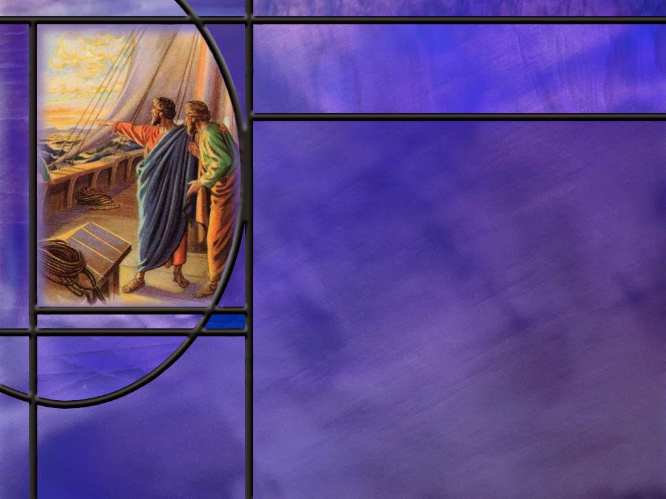
Apostolic Boasting
What kind of boasting is proper for an apostle of the Lord Jesus? (2 Cor 10:17)
What kind of boasting does it appear the false apostles were engaged in? (2 Cor 10:12)
What gave Paul the right to boast in the Lord in the church at Corinth? (2 Cor 10:13-15)
Whose commendation should carry the most influence for the church at Corinth? (2 Cor 10:18)
Notes:
B1:
[See notes on linked slide.]
B2:
[See notes on linked slide.]
B3:
[See notes on linked slide.]
B4:
[See notes on linked slide.]

Slide 5

False Apostles
What are some of the charges Paul makes against these false apostles?
  2 Cor 11:4
  2 Cor 11:13-15
  2 Cor 11:20
What boast of the apostle Paul cannot be matched by these false apostles? (2 Cor 11:7,10,12)
Notes:
B1:
[See notes on linked slide.]
B2:
[See notes on linked slide.]

Slide 6
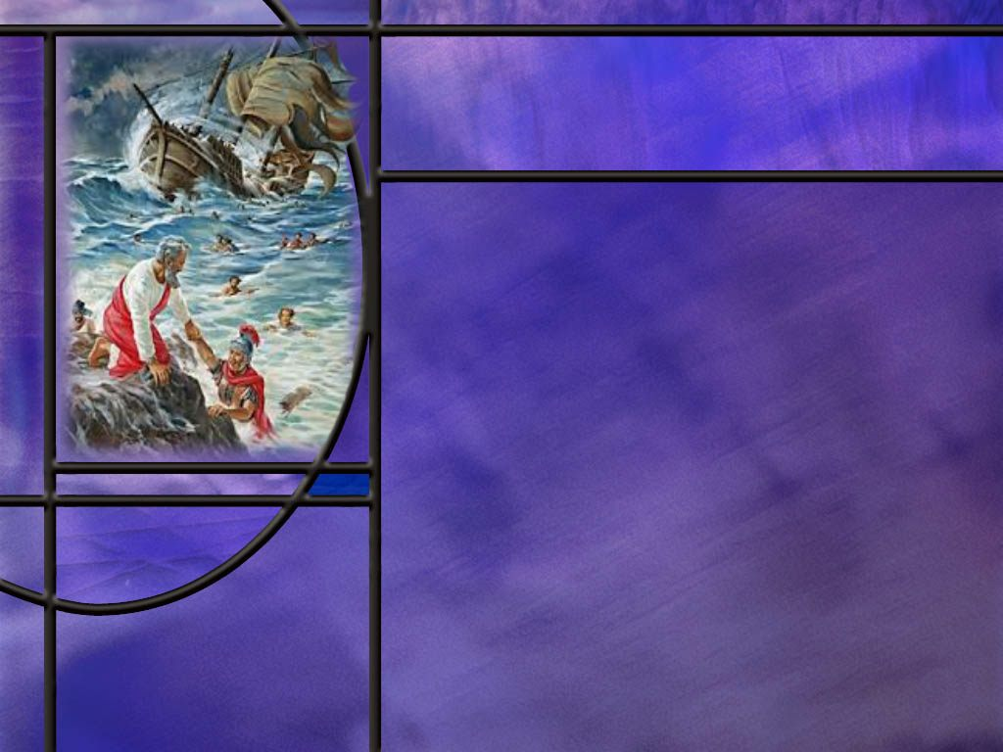
Boasting as a Fool
How does Paul ask for permission to counter the boasts of the false apostles? (2 Cor 11:1,16-18)
How does Paul compare himself to the false apostles? (2 Cor 11:22-23)
How does Paul finally reach the point of boasting in the Lord? (2 Cor 12:7-10)
Notes:
B1:
[See notes on linked slide.]
B2:
[See notes on linked slide.]
B3:
[See notes on linked slide.]

Slide 7
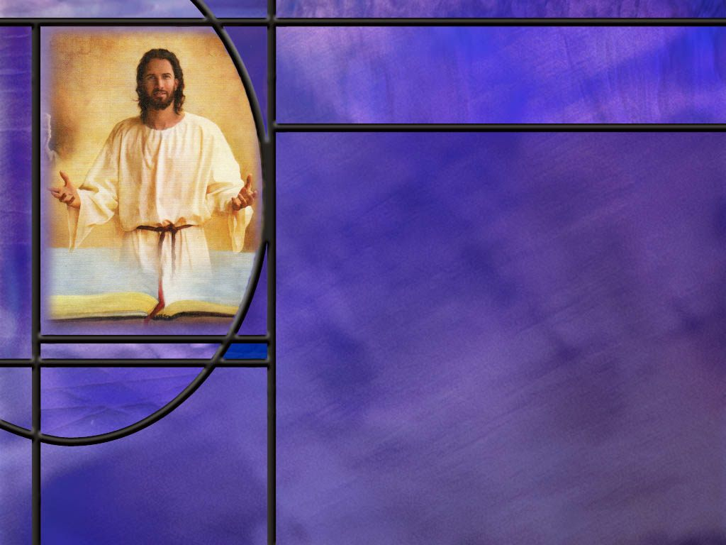
Summary
Paul reminds us that we are in a spiritual battle with the forces of evil in the heavenly realm, and our weapons in this battle have divine power to demolish strongholds of evil and error and bring captives of Satan to obedience to Christ.
For victory in this spiritual battle Paul encourages us to put on the whole armor of God: truth, righteousness, the gospel, faith, salvation, to take the word of God and activate it all with prayer at all times in the Spirit.
Paul has much to say about boasting in these chapters.
Those who fear the Lord should not be boasting about themselves but that they know the Lord and what He has done for them and through them.

Slide 8
Summary
Paul’s critique of the false apostles reveals that they were proclaiming a counterfeit Christianity marked by self-promotion, outward impressiveness, authoritarian control, a different Jesus, a different Holy Spirit, and a different gospel. These apostles were self-appointed servants of Satan appearing as angels of light.
They appear to be Jews that accepted the Christian message but were not fully grounded in the truth. Perhaps they were Judaizers from Jerusalem insisting on the importance of Jewish ritual observance.
Whatever their particular errors, Paul was willing to match His ministry against theirs.
Paul’s first boast was that he established the church in Corinth and that he presented the gospel there free of charge.

Slide 9
Summary
Since boasting is out of character for a Christian, Paul couched his boasting as that of a fool, but his boasting was for the protection of the church at Corinth.
While his Jewish credentials matched that of the false apostles, his service for Christ far exceeded anything that they could boast about.
Paul finally drops the pretext of boasting to admit that everything he has boasted about was because of the power of God.
He said: “I will boast of the things that show my weakness.”
God’s power was magnified in Paul’s weakness.
Will your boasting this week be about the Lord and what He has done for you?

Slide 11
2 Corinthians 10:17 ESV
"Let the one who boasts, boast in the Lord.“ [R]
Notes:
Q1: If we are going to boast about something, what should it be?
1. We should boast about what the Lord has done for us or through us.
2. All the glory should go back to God.
3. Our boast should not be about how great we are but about how great God is.
Q2: You will note that this verse is in quotation marks. Where do you think Paul is quoting this from?
1. If you think the OT Scriptures, you would be correct.
2. This is a famous quotation from Jeremiah 9:
Jeremiah 9:23-24 ESV - Thus says the LORD: "Let not the wise man boast in his wisdom, let not the mighty man boast in his might, let not the rich man boast in his riches, ²⁴ but let him who boasts boast in this, that he understands and knows me, that I am the LORD who practices steadfast love, justice, and righteousness in the earth. For in these things I delight, declares the LORD.“
3. So if we know the LORD and understand His working in us and through us, we will not boast in our own self-sufficiency but in His empowering grace.
4. In 1 Cor 4:7, Paul asks the rhetorical question:
1 Corinthians 4:7 ESV - What do you have that you did not receive? If then you received it, why do you boast as if you did not receive it?
5. From the Christian perspective, all that we have we have received from God who made us.
6. So don’t boast as if you did it all by yourself: give the glory to God!

Slide 12
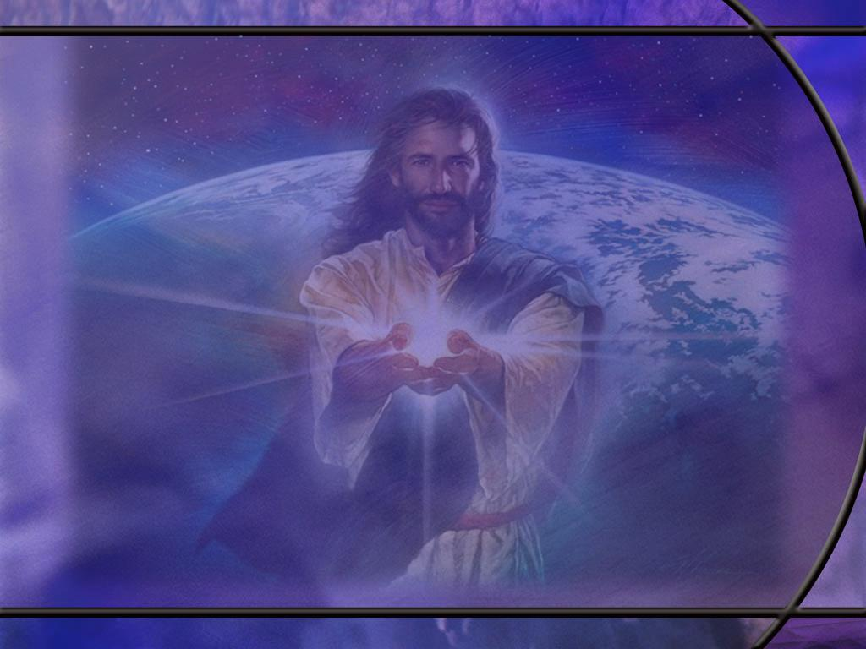
2 Corinthians 10:12 NLT
Oh, don't worry; we wouldn't dare say that we are as wonderful as these other men who tell you how important they are! But they are only comparing themselves with each other, using themselves as the standard of measurement. How ignorant! [R]
Notes:
Q1: How are the false teachers, described in this verse, boasting?
1. They are boasting about themselves, about how great they are, not about how the Lord is at work through their ministry.
2. They are comparing themselves with each other or with the apostle Paul.
3. Maybe they are eloquent speakers.
4. Maybe they can turn a Greek phrase better than the apostle Paul.
5. Maybe they have more educational credentials than him.
6. Apparently they are boasting about how they compare to other people, and so they commend themselves as superior and worthy of being followed.
Q2: What is going to happen to the church if these false apostles are successful in peddling their own influence to the Corinthians?
1. We will go right back to the early chapters of 1 Corinthians where the church was divided over their allegiance to certain ministers.
2. Some were following Peter, some were following Paul, some were following Apollos, some were following Christ.
3. And Paul’s plea was to drop the personality cliques and everyone be united in their love and appreciation for God who gives the increase.
4. Some servants plant, others water, but God is the source of your spiritual life.
5. It is Christ who died for you and saved you from your sins: follow Him.

Slide 13
2 Corinthians 10:13-15 ESV
But we will not boast beyond limits, but will boast only with regard to the area of influence God assigned to us, to reach even to you. ¹⁴ … For we were the first to come all the way to you with the gospel of Christ. ¹⁵ We do not boast beyond limit in the labors of others. But our hope is that as your faith increases, our area of influence among you may be greatly enlarged, [R]
Notes:
Q1: What gives Paul the right to boast about the church at Corinth?
1. It was him and his missionary team that established the church in Corinth.
2. He is not boasting about building on someone else’s labor.
3. If he were to boast, he would do so concerning the area of influence God assigned to him and his team.
4. Now along come these other men that call themselves superior apostles and seek to divide the church and counter the work that Paul has done.
5. Paul was a church planter; He wanted to lay a firm foundation.
6. And the foundation he laid was Jesus Christ.
1 Corinthians 3:11 KJV - For other foundation can no man lay than that is laid, which is Jesus Christ.
7. So Paul is rightly worried here that these false teachers will undo the hard work that God assigned for him to do.
8. And in verse 10 of Ch 10 he implies that it is hardly apostolic to boast about yourself in a location where you have not planted the seeds of the gospel.
2 Corinthians 10:16 ESV - so that we may preach the gospel in lands beyond you, without boasting of work already done in another's area of influence.

Slide 14
2 Corinthians 10:18 ESV
For it is not the one who commends himself who is approved, but the one whom the Lord commends. [R]
Notes:
Q1: Whose commendation carries more weight?
1. Of course, the Lord’s.
2. Anyone can boast about themselves.
3. But where is the proof of their effectiveness as an apostle?
4. Paul was never in doubt about his apostolic call on the road to Damascus.
5. And his effectiveness as a missionary and church planter was evidence that the Lord was using him to fulfill the gospel commission.
6. He will go on in the next few chapters to defend his apostolic ministry and show what a true apostle is willing to endure for the cause of Christ.

Slide 15
2 Corinthians 11:4 NLT
You happily put up with whatever anyone tells you, even if they preach a different Jesus than the one we preach, or a different kind of Spirit than the one you received, or a different kind of gospel than the one you believed.
Notes:
Q1: What can we glean from this verse about the false teachers in Corinth?
1. Well, these do not seem to be just minor peripheral issues about the Christian faith.
2. These ae fundamentals of the faith.
3. A different Jesus; a different Holy Spirit; a different gospel!
4. Unfortunately, Paul doesn’t go into detail on how their beliefs were off base.
5. But it wouldn’t be the last time people differed on these fundamentals.
6. Down through the ages people have denied the trinity, believing that the Son was a created being rather than being coeternal with the Father.
7. Even today, I know some Seventh-day Adventists who deny the personality and divinity of the Holy Spirit.
8. And what about the gospel? How many Christians know and believe the gospel of righteousness by faith in Christ?
9. How many still think their good works will save them?
10. When he wrote to the Galatians, Paul insisted that the gospel that he preached was absolutely essential.
Galatians 1:8 KJV - But though we, or an angel from heaven, preach any other gospel unto you than that which we have preached unto you, let him be accursed.
11. Instead of being scandalized by these fundamental departures from the faith, he says the Corinthians happily put up with it.
12. Let’s make sure we are discerning and willing to oppose error.
13. We do not want to just go along to get along.
14. Paul would later write these words to Timothy:
2 Timothy 4:3-4 KJV - 3 For the time will come when they will not endure sound doctrine; but after their own lusts shall they heap to themselves teachers, having itching ears; 4 And they shall turn away their ears from the truth, and shall be turned unto fables.
[Go to next slide]

Slide 16
2 Corinthians 11:13-15 KJV
For such are false apostles, deceitful workers, transforming themselves into the apostles of Christ. ¹⁴ And no marvel; for Satan himself is transformed into an angel of light. ¹⁵ Therefore it is no great thing if his ministers also be transformed as the ministers of righteousness; whose end shall be according to their works.
Notes:
Q1: What is Paul saying about the false teachers in this text?
1. This is a very devastating critique.
2. He calls them false apostles.
3. In other words, self-appointed rather than God-appointed.
4. They are deceivers and deceitful workers.
5. He calls them ministers of Satan who are masquerading as ministers of righteousness.
6. As Satan can transform himself into an angel of light, so have these deceitful workers who are ministers of Satan rather than ministers of Christ.
7. And Paul says they will be judged according to their works.
8. In other words, their works will be evaluated in the judgement as an indication of their faith.
Q2: How is Satan still transforming himself into an angel of light today?
1. Just this past week we celebrated the 25th anniversary of 9/11/2001 when Muslim terrorists hijacked planes to take down the World Trade Towers in NYC, damage the Pentagon in Washington, DC, and crash the fourth plane into a field in Shanksville, PA.
2. Three thousand of our fellow citizens were killed in this act of terror.
3. Do you think the devil had anything to do with that?
4. Do you think he appeared as an angel of light to the Muslim terrorists?
5. Here’s the lie: if you die as a martyr in holy jihad, Allah will reward you with a direct flight to heaven and 72 beautiful virgins for your eternal pleasure.
6. The devil is a liar and a murderer, and he is a master at making good look evil and evil look good.
It is likely that these terrorists were radicalized by some Muslim religious cleric appearing to them as an angel of light.
“Evil rarely looks evil until it accomplishes its goal; it gains entrance by appearing attractive, desirable, and perfectly legitimate.” (Klyne Snodgrass, Ephesians, 1996)
7. Satan masquerades as an angel of light to those caught up in the Muslim jihad.
8. By killing Christians and Jews, they think they are doing the will of Allah.
[Go to next slide]

Slide 17
2 Corinthians 11:20 NIV
In fact, you even put up with anyone who enslaves you or exploits you or takes advantage of you or puts on airs or slaps you in the face. [R]
Notes:
Q1: What kind of picture does this paint of the false teachers?
1. It paints a picture of a controlling personality.
2. We have seen this in certain aberrant Christian communities as well.
3. Perhaps the most notorious was the People’s Temple under the leadership of Jim Jones in Jonestown, Guyana where over 900 people died in a mass murder-suicide in 1978.
4. And even closer to home is David Koresh and the Branch Davidians of Waco Texas who were off-shoots of the SDA church.
5. Their Mt. Carmel compound was raided and sieged by the ATF and FBI and some 80 cult members died in the ensuing fire on April 19, 1993.
6. Here again we see Satan at work appearing as an angel of light to those trapped in these cults.
7. So Paul gives a devastating critique of these false teachers.
8. They were proclaiming a counterfeit Christianity: one that claimed Christ and spirituality, but was marked by self-promotion, outward impressiveness, authoritarian control, a different Jesus, a different Holy Spirit, and a different gospel rather than the apostolic message of the crucified and risen Jesus,

Slide 18
2 Corinthians 11:7, 10, 12 ESV
Or did I commit a sin in humbling myself so that you might be exalted, because I preached God's gospel to you free of charge? ... ¹⁰ As the truth of Christ is in me, this boasting of mine will not be silenced in the regions of Achaia. ... ¹² And what I am doing I will continue to do, in order to undermine the claim of those who would like to claim that, in their boasted mission, they work on the same terms as we do. [R]
Notes:
Q1: What is the one thing that Paul is willing to boast about in his work at Corinth?
1. He preached the gospel free of charge.
2. The false teachers cannot match that.
3. They’re expecting an income from the saints in Corinth.
4. But Paul wants everyone in the region of southern Greece (called Achia here) to know that he is not in it for the money.
5. He is a self-supporting missionary.
6. He doesn’t charge for preaching and teaching and writing letters and building up the church.
7. His claim is that his preaching the gospel free of charge is a mark of God’s power at work in his ministry.
8. He is not in it for the money, or even the food and shelter that he could rightfully claim.
9. He is in it for the love of Christ and the love of those to whom he preaches.
10. This undermines the claims of the false apostles that they are like Paul only better.

Slide 19
2 Corinthians 11:1, 16-18 ESV
I wish you would bear with me in a little foolishness. Do bear with me! ... ¹⁶ I repeat, let no one think me foolish. But even if you do, accept me as a fool, so that I too may boast a little. ¹⁷ What I am saying with this boastful confidence, I say not as the Lord would but as a fool. ¹⁸ Since many boast according to the flesh, I too will boast. [R]
Notes:
Q1: What is Paul saying in these verses?
1. He is presenting himself as a fool for boasting as a fool.
2. He is saying that boasting according to the flesh is out of character for a Christian.
3. In fact, he says that boasting is not what the Lord would do, but maybe what a fool would do.
4. So he is asking them to bear with his foolishness while he boasts a little.
5. Keep in mind that Paul’s reason for doing this is to protect them from false teachers.
6. So his boasting is not an ego trip, but has a purpose in building up the church and preventing its people from being led astray.
7. In the end we will see that Paul is really boasting in the Lord because of the power God has displayed in Paul’s ministry.

Slide 20
2 Corinthians 11:18, 22-23 ESV
Since many boast according to the flesh, I too will boast. ... ²² Are they Hebrews? So am I. Are they Israelites? So am I. Are they offspring of Abraham? So am I. ²³ Are they servants of Christ? I am a better one--I am talking like a madman--with far greater labors, far more imprisonments, with countless beatings, and often near death. [R]
Notes:
Q1: What do these first comparisons tell us about the false apostles?
1. Being a Hebrew, an Israelite, an offspring of Abraham identifies them as Jews who have accepted the Christian message.
2. They may have been Judaizers from Jerusalem who continued to insist the Gentiles follow Jewish ritual law, but Paul does not mention that here.
3. Although if they did, this would explain Paul’s criticism of their preaching another gospel, just like he did to the Judaizers in Galatia.
4. But Paul matches them one for one on their Jewish credentials.
Q2: when it comes to Christian service, how does Paul excel these false apostles?
1. Claiming to speak as a madman to show that his boasting is out of character,
2. He declares that his life as a servant of Christ, suffering for His cause, far exceeds theirs.
3. Paul goes on for the next five verses detailing all of the difficulties he has faced as a servant for Christ.
2 Corinthians 11: 24-28 ESV - Five times I received at the hands of the Jews the forty lashes less one. 25 Three times I was beaten with rods. Once I was stoned. Three times I was shipwrecked; a night and a day I was adrift at sea; 26 on frequent journeys, in danger from rivers, danger from robbers, danger from my own people, danger from Gentiles, danger in the city, danger in the wilderness, danger at sea, danger from false brothers; 27 in toil and hardship, through many a sleepless night, in hunger and thirst, often without food, in cold and exposure. 28 And, apart from other things, there is the daily pressure on me of my anxiety for all the churches.
4. So Paul is willing to compare his service as an apostle and a servant for Christ to that of any other apostle, confident that the false apostles will never match it.

Slide 21
2 Corinthians 12:7-10 ESV
So to keep me from becoming conceited because of the surpassing greatness of the revelations, a thorn was given me in the flesh, a messenger of Satan to harass me, to keep me from becoming conceited. ⁸ Three times I pleaded with the Lord about this, that it should leave me. ⁹ But he said to me, "My grace is sufficient for you, for my power is made perfect in weakness." Therefore I will boast all the more gladly of my weaknesses, so that the power of Christ may rest upon me. ¹⁰ For the sake of Christ, then, I am content with weaknesses, insults, hardships, persecutions, and calamities. For when I am weak, then I am strong. [R]
Notes:
Q1: How does Paul’s boasting then become boasting in the Lord?
1. Paul is not boasting about all that he has overcome in his own strength.
2. This is no ego trip for him.
3. He is boasting about how the power of God was manifest in delivering him from all the dangers he faced.
4. Back in chapter 11 after boasting about all that he had gone through in his service for Christ he says this in:
2 Corinthians 11:30 ESV - If I must boast, I will boast of the things that show my weakness.
5. In all the hardships he went through, it was not by his own strength that he prevailed.
6. His own personal weakness proclaimed the power of God to deliver him.
7. His thorn in the flesh kept him humble.
8. The weaker he was, the more powerful the hand of God in blessing his ministry.
9. So Paul ends his boasting by boasting of God’s power rather than his own.

