Slide 1
First and Second Corinthians
Lesson 9
Love-driven Ministry

Slide 2
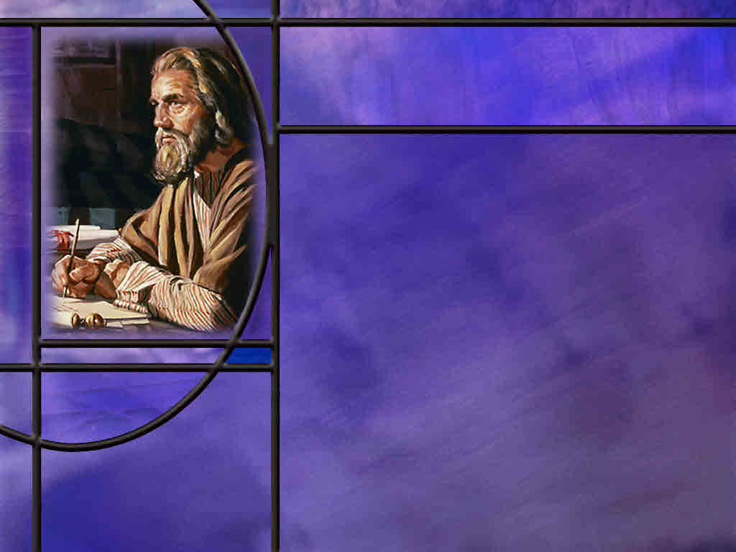
Memory Text
2 Corinthians 2:4 NKJV
For out of much affliction and anguish of heart I wrote to you, with many tears, not that you should be grieved, but that you might know the love which I have so abundantly for you.
How does Paul characterize his feelings as he last wrote to the church at Corinth?
How does Paul set an example for us as in times where we may need to enforce discipline in our homes?
Notes:
B2:
1. Well, if you read the context, it doesn’t seem like he was too happy with them.
2. He wrote a letter to them with much affliction and anguish of heart and many tears.
3. It was a letter that brought them grief.
4. Now some may be thinking that his previous letter must have been First Corinthians, but this is not the case.
5. In 1 Corinthians, Paul treated a number of issues in the church that needed correcting.
6. But the tone of 1 Corinthians would hardly qualify as a letter written in anguish of heart and with many tears.
7. So here it appears that Paul is referring to another letter written between first and second Corinthians, that has not been preserved.
8. It has become known as “the severe letter.”
9. And Paul refers to it several places in second Corinthians.
10. For example, he writes in:
2 Corinthians 7:8 NLT - I am not sorry that I sent that severe letter to you, though I was sorry at first, for I know it was painful to you for a little while.
11. So it appears that Paul had to correct a problem in the church at Corinth, and he wrote a severe letter to them that caused them pain and grief.
12. But Paul writes to them that he did it with anguish of heart and many tears.
B3:
1. Paul does not say that he wrote to them with frustration and anger and a desire to see them suffer for what they had done.
2. He wrote to them with anguish of heart and tears in his eyes.
3. His severe letter was written not to bring them grief but to restore them to fellowship.
4. His efforts were not a demonstration of anger but the evidence of his love for them.
5. Can we apply that in our own efforts at discipline?
6. When discipline and correction is needed, how much better to get beyond the anger and discipline in love.
7. The discipline needs to be directed at the behavior, not at the individual.
8. We love the individual, and because we do, we have to correct the behavior.
9. True love is interested in the long-range best interest of those we love.
10. We cannot ignore behaviors in the short term that will be destructive in the long term.
11. So we need to correct rebellion and defiance against authority when it raises its head in our homes.
12. Perhaps Paul was dealing with a similar problem in the Corinthian church.
13. But his willingness to face it head on and correct the problem was an act of agape love that sought the eternal best interest of the church.

Slide 3
Overview
Paul opens 2 Corinthians by praising God, who comforts believers in suffering so they can comfort others. He explains his hardships and delayed visit to Corinth, defending his sincerity. He rejoices that his severe letter has produced repentance and offers forgiveness to the offenders. He rejoices for triumph in Christ and the opportunity to be sincere followers spreading the aroma of His love.
  Reasons for Praise
  Letters and Visits
  Reconciliation and Triumph
  Summary

Slide 4
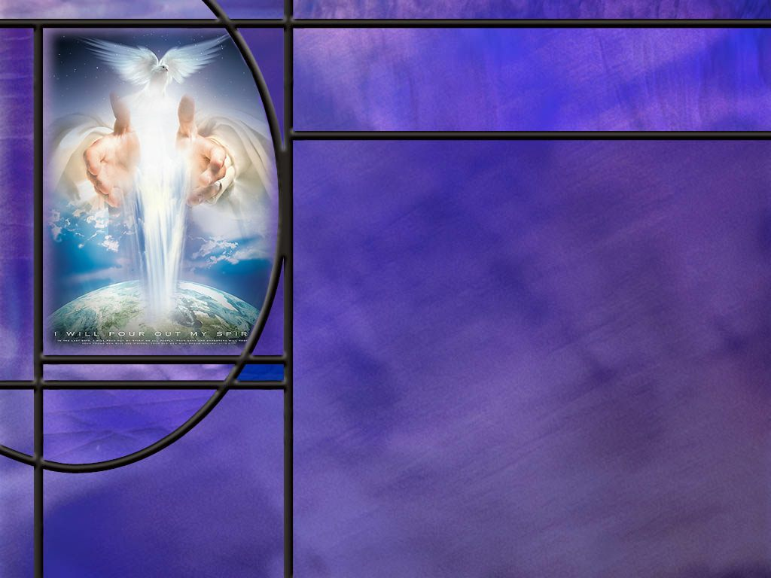
Reasons for Praise
How does Paul open his letter of 2 Cor? (2 Cor 1:1-2)
How does Paul feel about the comfort God provides for Christian believers? (2 Cor 1:3-5)
What dangers did Paul face in Asia that caused him to be thankful for God’s deliverance? (2 Cor 1:8-9)
Notes:
B1:
[See notes on linked slide.]
B2:
[See notes on linked slide.]
B3:
[See notes on linked slide.]

Slide 5
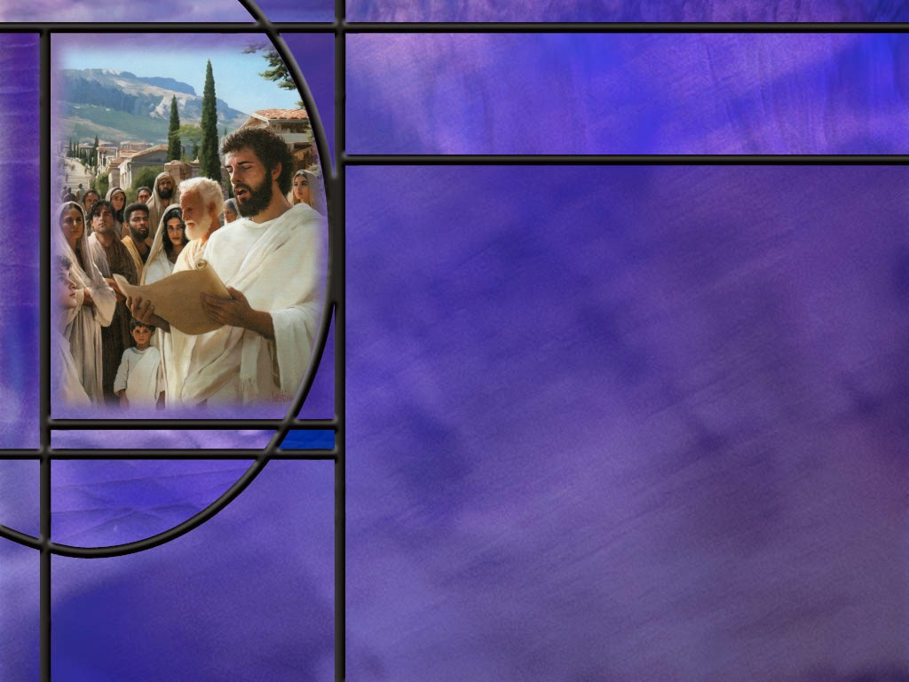
Visits and Letters
What were Paul’s original plans to visit Corinth a 2nd and 3rd time? (2 Cor 1:15-16)
What happened to change Paul’s original plans? (2 Cor 2:1-4)
What hint does Paul give us of the problem that was occurring at Corinth? (2 Cor 2:5-10)
How did Paul find out bout the repentance at Corinth? (2 Cor 2:12-13)
How can we summarize the visits and letters of the apostle Paul with the church at Corinth? [Summary]
Notes:
B1:
[See notes on linked slide.]
B2:
[See notes on linked slide.]
B3:
[See notes on linked slide.]
B4:
[See notes on linked slide.]
B5:
[See notes on linked slide.]

Slide 6

Reconciliation and Triumph
How does Paul respond to the reconciliation that has occurred in Corinth? (2 Cor 2:14)
What contrasting effects does the same aroma have on believers and non-believers? (2 Cor 2:15-16)
How does Paul contrast his ministry with that of others who may have ulterior motives? (2 Cor 2:17)
Notes:
B1:
[See notes on linked slide.]
B2:
[See notes on linked slide.]
B3:
[See notes on linked slide.]

Slide 7
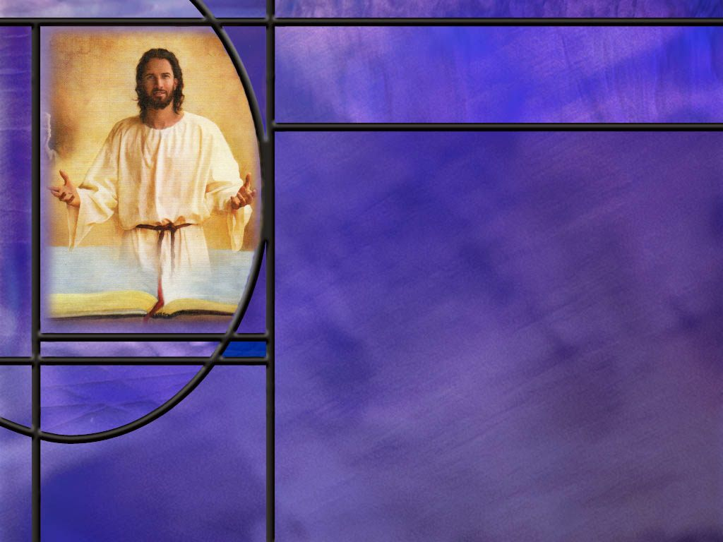
Summary
Paul begins 2 Corinthians by affirming, as he does in the majority of his epistles, his apostolic calling and authority.
He praises God as our merciful Father who is the source of all comfort.
God comforts us so that we can comfort others who are suffering.
It is reasonable to conclude that God’s comfort comes to us through the Holy Spirit who is our Comforter, Helper, Advocate, and Counselor.
The Holy Spirit is fulfilling God’s promise to never leave us or forsake us.
In the dangers Paul faced in Asia, he learned to rely only on God, confident that He is able to raise the dead, so not even death can separate us from His love.

Slide 8
Summary
After writing 1 Corinthians from Ephesus, Paul had to make a “painful visit” to Corinth, after which he returned to Ephesus and wrote them a “severe letter.”
Out of necessity, this changed his travel plans: he didn’t want to return to Corinth until he heard how they received his letter and whether those who opposed him in Corinth had repented.
After he met up with Titus in Macedonia and heard the report of their repentance in Corinth and their love for him, Paul called them to forgive and restore the ones who had opposed him earlier, and Paul assured them of his forgiveness for those who opposed him.
Here again Paul sets the example that church discipline should be restorative.

Slide 9
Summary
Paul ends chapter 2 by seeing himself as a captive in Christ’s triumphal victory procession, as Christ uses him to spread the aroma of the gospel everywhere.
The same gospel can be an aroma of both life and death.
For those who believe, it brings life because they receive Christ. For those who do not believe, it brings judgment and death.
Paul distinguishes his ministry for Christ from that of hucksters that peddle the word of God for profit: He speaks sincerely, as one sent by God and accountable before God in Christ.
Will you seek to be an aroma of life to those around you this week?

Slide 11
2 Corinthians 1:1-2 NLT
This letter is from Paul, chosen by the will of God to be an apostle of Christ Jesus, and from our brother Timothy. I am writing to God's church in Corinth and to all of his holy people throughout Greece. ² May God our Father and the Lord Jesus Christ give you grace and peace. [R]
Notes:
Q1: What important information does the apostle Paul always seem to give about himself as he begins his epistles?
1. In 9 out of his 13 epistles, Paul mentions that he is an apostle of Jesus Christ.
2. This provides his authority to speak on behalf of the Lord Jesus.
3. He wasn’t just a follower of Jesus.
4. He had seen the Lord Jesus on the road to Damascus and had been commissioned by Him to preach the Gospel.
5. And the gospel that he preached he received from Jesus Himself.
6. So He spoke and wrote with apostolic authority to write inspired Scripture.
7. We consider his letters to be God-breathed.
Q2: What blessing did he ask for the Corinthian church?
1. That they might receive grace and peace from God the Father and the Lord Jesus Christ.
2. Grace is God’s unmerited favor to mankind.
3. We see it most clearly in the gift of His Son to die for our sins.
4. We receive God’s grace by our faith, trusting in Jesus as a living Person for the forgiveness of our sins and eternal life with God.
5. When we have that saving faith we are justified, forgiven, declared righteous.
6. When we are justified, we are reconciled to God and have peace with Him.
7. Paul write it to the Romans in:
Romans 5:1 KJV - Therefore being justified by faith, we have peace with God through our Lord Jesus Christ:
8. This is the gospel of righteousness by faith that Paul preached.
9. We are saved by grace through faith.
10. May each of us also find peace with God through the grace that brings salvation in Jesus Christ.

Slide 12
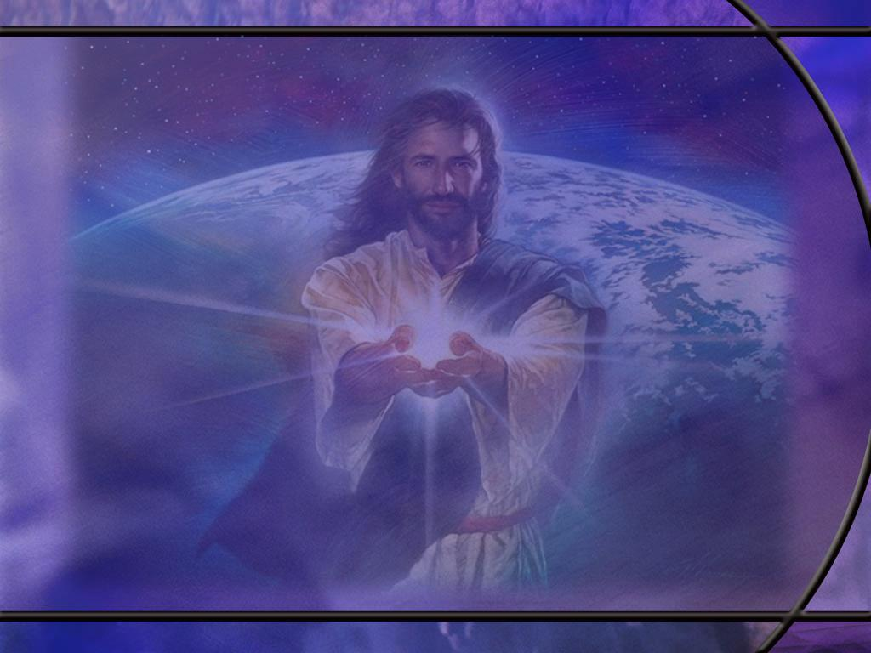
2 Corinthians 1:3-5 NLT
All praise to God, the Father of our Lord Jesus Christ. God is our merciful Father and the source of all comfort. ⁴ He comforts us in all our troubles so that we can comfort others. When they are troubled, we will be able to give them the same comfort God has given us. ⁵ For the more we suffer for Christ, the more God will shower us with his comfort through Christ. [R]
Notes:
Q1: For what reason does Paul praise God the Father here?
1. He praises God because He is the source of all comfort.
Q2: But even before Paul gets to the Father as the source of all comfort, what kind of a father is He?
1. Paul writes: “God is our merciful Father.”
2. Some think of the Father as the stern one in the Trinity.
3. He’s the God of the OT ready to bring condemnation on the sinner.
4. And Jesus has to plead His blood before the Father relents and forgives us.
5. But that is not a biblical view of God.
6. God the Father loved you so much He gave His only Son to die for your sins.
7. He is anxious to forgive and restore.
8. He is compassionate and merciful and willing to forgive with divine love for each of us.
9. Jesus said in:
John 16:27 NKJV - "for the Father Himself loves you, because you have loved Me, and have believed that I came forth from God.
10. So the Father is merciful, compassionate, and the source of comfort when we are in Christ.
Q3: When God brings us comfort, what does that empower us to do?
1. When God comforts us, that allows us to comfort others.
2. God allows us to go through difficulties to strengthen our faith and develop us into mature faithful Christians.
3. When God leads us through our trials, we can be a comfort to others who go through the same thing.
4. If we have had a problem getting Sabbath off as a day of rest from our employment, we can be a help to others who are going through the same thing.
5. If God has brought comfort to us in our conflict, He can bring the same to others who are trusting in Him.
6. So, as the song says, “Leave a well in the valley you go through.”
7. When others go through the same valley, they can be encouraged and comforted by our testimony of God’s grace, goodness, and comfort.
Q4: What promise does Paul end with here?
1. The more we suffer, the more God will bless us with His comfort.
2. God has promised to never leave us or forsake us.
3. And He keeps that promise by sending the HS to dwell in our hearts.
4. It is through the HS that God ministers His comfort to us.
5. In fact, the HS is called the Comforter!
6. Four times in the gospel of John, the HS is referred to as the Comforter in the KJV.
7. For example:
John 14:26 KJV - But the Comforter, which is the Holy Ghost, whom the Father will send in my name, he shall teach you all things, and bring all things to your remembrance, whatsoever I have said unto you.
8. The Greek is paraklētos.
9. So comforter is a valid translation as is helper or advocate or counselor.
10. The more we suffer, the more the HS is available to us to bring us comfort.

Slide 13
2 Corinthians 1:8-9 NLT
We think you ought to know, dear brothers and sisters, about the trouble we went through in the province of Asia. We were crushed and overwhelmed beyond our ability to endure, and we thought we would never live through it. ⁹ In fact, we expected to die. But as a result, we stopped relying on ourselves and learned to rely only on God, who raises the dead. [R]
Notes:
Q1: What problems did Paul encounter in Asia that were a mortal danger to him?
1. Paul doesn’t say, so we don’t know for sure.
2. But one incident that has been suggested is the riot in Ephesus during the time the Paul was ministering there.
3. You will recall that this was caused by Demetrius, a silversmith who accused Paul and his companions of ruining their business of making shrines to the goddess Diana.
4. They dragged two of Paul’s companions into the theater and for two hours shouted “Great is Diana of the Ephesians.”
5. Fortunately, cooler heads prevailed and no harm came to them.
6. One incident that would fit his description better would be when he was stoned at Lystra on his first missionary journey, dragged out of the city, and left for dead.
Q2: What did they learn from their self-reliance in trials?
1. They learned to rely only on God rather than themselves.
2. If we rely on God we cannot be defeated, because He can raise the dead.
3. If the worst happens and our enemies kill us, not even death can separate us from the love of God which is in Christ Jesus our Lord.

Slide 14
2 Corinthians 1:15-16 NLT
Since I was so sure of your understanding and trust, I wanted to give you a double blessing by visiting you twice-- first on my way to Macedonia and again when I returned from Macedonia. Then you could send me on my way to Judea. [R]
Notes:
Q1: What was Paul’s original plan to visit the Corinthian church?
1. He was in Ephesus when he wrote 1 Corinthians.
2. He planned to travel from there to Corinth, visit the church there in Greece, go north into Macedonia, collecting offerings for the poor at Jerusalem.
3. Then he would travel back south to Corinth and go back to Judea to deliver the offering collected to the Jerusalem church.
4. In 1 Cor 16:6-7 Paul says that when he comes to visit them he would like to stay the whole winter with them before going back to Judea.

Slide 15
2 Corinthians 2:1, 3-4 NLT
So I decided that I would not bring you grief with another painful visit. ... ³ That is why I wrote to you as I did, so that when I do come, I won't be grieved by the very ones who ought to give me the greatest joy. … ⁴ I wrote that letter in great anguish, with a troubled heart and many tears. I didn't want to grieve you, but I wanted to let you know how much love I have for you. [R]
Notes:
Q1: What kind of a visit did Paul have with the Corinthian church?
1. Verse 1 tells us that Paul had a “painful visit” with the church.
2. That’s why he decided to write his “severe letter” because he didn’t want to go there and have “another painful visit.”
3. So this painful visit came after Paul established the church there on his second missionary journey, and after he wrote 1 Corinthians from Ephesus on his third missionary journey.
4. Instead of going from Ephesus to Corinth to Macedonia back to Corinth as he had originally planned, Paul went form Ephesus to Corinth back to Ephesus and wrote them a severe letter.
5. This trip is not recorded in the book of Acts.

Slide 16
2 Corinthians 2:5-8, 10 NLT
I am not overstating it when I say that the man who caused all the trouble hurt all of you more than he hurt me. ⁶ Most of you opposed him, and that was punishment enough. ⁷ Now, however, it is time to forgive and comfort him. Otherwise he may be overcome by discouragement. ⁸ So I urge you now to reaffirm your love for him. ... ¹⁰ When you forgive this man, I forgive him, too. And when I forgive whatever needs to be forgiven, I do so with Christ's authority for your benefit, [R]
Notes:
Q1: What happened at Corinth to cause Paul to write his severe letter?
1. Apparently, there was a man or a leader of a group that opposed Paul and his ministry there.
2. Most of the people sided with Paul against this man.
3. Apparently, Paul has gotten word now that this man has repented and wants to acknowledge Paul’s ministry and authority as an apostle of Christ.
4. So Paul encourages the church to forgive him and restore him to fellowship.
5. Paul assures them that he forgives this man as well, with the authority of the Lord.
6. So Paul’s desire in church discipline is always restoration.
7. To the Galatians he wrote:
Galatians 6:1 KJV - Brethren, if a man be overtaken in a fault, ye which are spiritual, restore such an one in the spirit of meekness; considering thyself, lest thou also be tempted.
8. That should also be our objective in dealing with scandalous sins or disunity in the church.
9. We want to discipline in love and restore the erring brother or sister.

Slide 17
2 Corinthians 2:12-13 NLT
When I came to the city of Troas to preach the Good News of Christ, the Lord opened a door of opportunity for me. ¹³ But I had no peace of mind because my dear brother Titus hadn't yet arrived with a report from you. So I said good-bye and went on to Macedonia to find him. [R]
Notes:
Q1: How did Paul get the good report about the situation in Corinth after they received his severe letter?
1. Apparently, Titus had spent some time in Corinth before going north into Macedonia.
2. Paul was supposed to meet him in the port city of Troas, but when he didn’t show up, Paul traveled up to Macedonia and found him.
3. Titus’ good report of the situation in Corinth gave Paul great joy that everything was good, the opposition had repented and Paul could call for forgiveness and restoration.
4. Paul gives us more detail in 2 Cor 7
[Go to next slide.]

Slide 18
2 Corinthians 7:7-9 NLT
His presence [of Titus in Macedonia] was a joy, but so was the news he brought of the encouragement he received from you. When he told us how much you long to see me, and how sorry you are for what happened, and how loyal you are to me, I was filled with joy! ⁸ I am not sorry that I sent that severe letter to you, though I was sorry at first, for I know it was painful to you for a little while. ⁹ Now I am glad I sent it, not because it hurt you, but because the pain caused you to repent and change your ways. [R]

Slide 19
Summary of Visits and Letters - I
Founding visit (AD 50–52, Corinth) — Paul stayed 18 months, met Aquila and Priscilla, and was brought before the proconsul Gallio. This is the single fixed date in Pauline chronology, anchored by the Gallio Inscription at Delphi, which confirms Gallio held office in AD 51–52 (Wikipedia; Bible Archaeology Report).
Lost "previous letter" (AD ~52–54, probably Ephesus) — Written before 1 Corinthians; known only from 1 Cor 5:9, where Paul says he had "written to you in my letter not to associate with sexually immoral people".
Corinthian delegation and letter to Paul (AD ~54–55, Ephesus) Chloe's people reported factions; the Corinthians sent written questions via Stephanas, Fortunatus, and Achaicus (1 Cor 1:11; 7:1; 16:17).
Canonical 1 Corinthians (Spring AD ~55, Ephesus) — Paul ties it to Ephesus and "Pentecost" (1 Cor 16:8).
Notes:
Intro to this slide and the next:
1. Paul appears to have made three visits to Corinth and written at least four letters to the church there.
2. Only two of those letters survive in the New Testament: 1 Corinthians and 2 Corinthians.
3. The dates shown hee are approximate, and the exact ordering of the “painful visit” and “severe letter” is reconstructed from Paul’s own references in 2 Corinthians.

Slide 20
Summary of Visits and Letters - II
The "painful visit" (AD ~55–56, Corinth) — An emergency, unplanned visit never reported in Acts, but inferred from Paul's vow not to "come again in sorrow" (2 Cor 2:1) and his mention of an impending "third" visit, which requires a second one.
The "severe / tearful letter" (AD ~55–56, probably Ephesus) — Written "out of much affliction and anguish of heart and with many tears" (2 Cor 2:3–4), delivered by Titus. Now lost.
Titus's report (AD ~56, Macedonia) — Titus met Paul in Macedonia with news of the Corinthians' repentance (2 Cor 7:5–16).
Canonical 2 Corinthians (AD ~55–56, Macedonia) — Written after Titus's report, likely from Philippi.
Third and final visit (Winter AD 56–57, Corinth) — Three months in Greece (Acts 20:2–3); Romans likely written during this stay. [R]

Slide 21
2 Corinthians 2:14 NIV
But thanks be to God, who always leads us as captives in Christ's triumphal procession and uses us to spread the aroma of the knowledge of him everywhere. [R]
Notes:
Q1: What picture is Paul painting with this triumphal procession?
1. The background for this triumphal procession is the victory parades of Roman generals returning victorious from battle.
2. These often included:
The victorious commander, dressed in special triumphal clothing and riding in a chariot.
His troops and the visible spoils taken in battle.
Captured enemy leaders and prisoners, often chained and publicly humiliated.
Incense, flowers, sacrifices, music, crowds, and celebration throughout the route.
A final destination at the temple, where worship and sacrifice proclaimed that the victory had been granted by the gods—in Paul’s transformed image, by the true God.
3. So here Paul is seeing himself and his coworkers as captives in Christ’s triumphal procession.
4. Paul was once Christ’s enemy and persecuted the church.
5. But Christ overcame him on the Damascus road, not to destroy him, but to make him His servant and messenger.
6. Paul can therefore thank God for being Christ’s captive—wholly claimed, directed, and used by the victorious Lord.
7. Paul sees himself and his coworkers as spreading the aroma of the knowledge of Christ everywhere, perhaps taken from the incense and flowers scenting the air at the Roman victory processions.

Slide 22
2 Corinthians 2:15-16 NIV
For we are to God the pleasing aroma of Christ among those who are being saved and those who are perishing. ¹⁶ To the one we are an aroma that brings death; to the other, an aroma that brings life. And who is equal to such a task? [R]
Notes:
Q1: How does Paul describe the aroma of the knowledge of Christ?
1. To those who have rejected the gospel, it is an aroma that brings death.
2. To those who have accepted the gospel, it is an aroma that brings life.
3. The same gospel, the knowledge of Christ, does not change in itself.
4. Yet people respond differently to it.
5. For believers, it brings life because they receive Christ.
6. For those who reject Him, it testifies to judgment and death.
7. This explains Paul’s sober question: “Who is sufficient for these things?”
8. The gospel provides the great divide between those who receive eternal life and those who perish.

Slide 23
2 Corinthians 2:17 NIV
Unlike so many, we do not peddle the word of God for profit. On the contrary, in Christ we speak before God with sincerity, as those sent from God. [R]
Notes:
Q1: What can Paul point to as a distinguishing mark of his ministry?
1. Unlike many others, he does not preach the word of God for profit.
2. We saw this in 1 Cor 9 where Paul refused his right to support from the churches to which he ministered.
3. He worked to support himself so that he could present the gospel free of charge to all.
4. Unlike many televangelists today, Paul was not in it for the money.
5. He was in it for the love of Christ and for the love of the lost.
6. So Paul concludes this chapter declaring that he speaks before God as his witness, and he speaks with sincerity as one sent from God.
7. He has no ulterior motives; he is honest and sincere; he is transparent and open.
8. For Paul, being conquered by Christ is not a disgrace but liberation.
9. May we too find our highest calling in becoming servants of His and joining His triumphal procession to the Kingdom of God.

