Slide 1
First and Second Corinthians
Lesson 8
The Power of Christ’s Resurrection

Slide 2
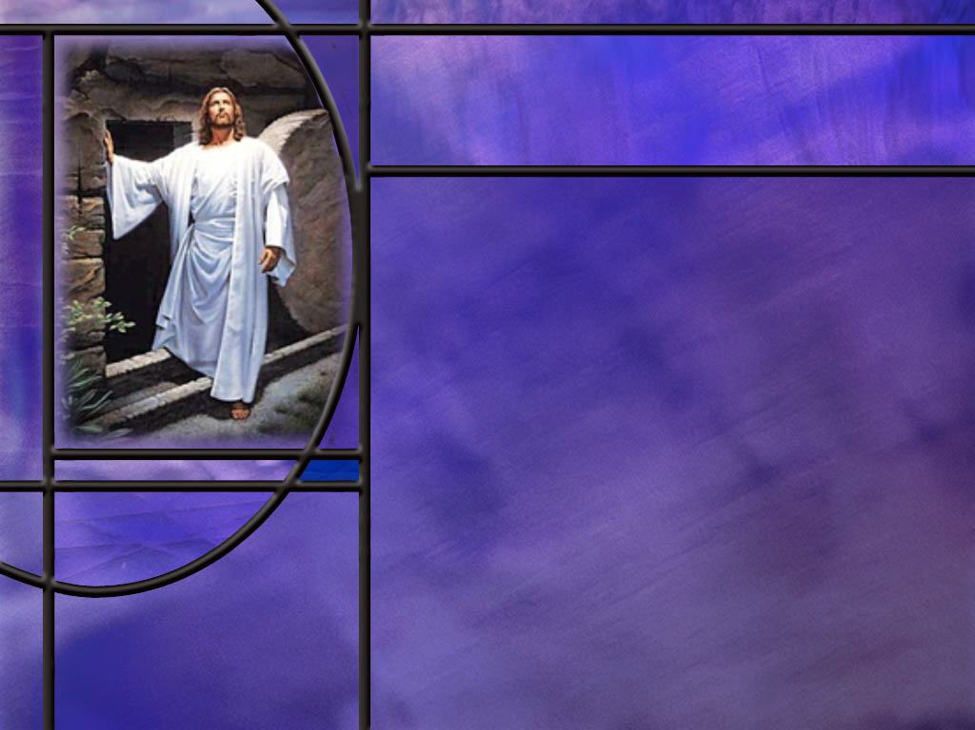
Memory Text
1 Corinthians 15:14, 17 NKJV
And if Christ is not risen, then our preaching is empty and your faith is also empty. ... ¹⁷ And if Christ is not risen, your faith is futile; you are still in your sins!
How important is the resurrection of Jesus Christ to the Christian faith?
If there is no resurrection, what would have happened to Jesus?
If the conscious souls or spirits of the dead go to heaven when the person dies, why do we even need a resurrection?
Notes:
B2:
1. According to what Paul writes in this chapter and elsewhere, the resurrection of Christ is absolutely essential to the Christian faith.
2. Without it, Paul declares that his preaching is empty and our faith in Christ is empty.
3. Other translations say it is vain, useless, or empty.
4. In verse 17 he says that if Christ is not risen, our faith if futile, we are yet in our sins.
5. Other translations say our faith is useless, worthless, futile, vain.
6. These are two different Greek words that Paul uses in verses 14 and 17 with a very similar meaning.
7. Paul is very clear in his teaching here that without the resurrection of Christ, the Christian faith is worthless.
B3:
1. He would not have risen; He would still be dead; His grave would be occupied.
2. Paul has nothing to say about an immortal soul or spirit by which He would survive the grave.
3. So Paul is clearly teaching here the biblical state of the dead.
4. Without the resurrection, Jesus would be dead: He would cease to exist.
5. And how can a dead savior save anybody?
6. We are awaiting the blessed hope of the soon return of our Savior to save us, to resurrect us, to give us immortality and eternal life.
7. If Jesus is dead, our faith in Him as our Savior is useless, worthless, futile.
B4:
1. We wouldn’t.
2. In fact, those who believe in the immortality of the soul do not even look forward to the resurrection.
3. They look forward to seeing Jesus was soon as they die.
4. At the funeral they’re saying, “She’s in a better place.” or “He’s looking down on us right now.” or “He’s in the arms of Jesus.”
5. But the immortality of the soul is a doctrine of the devil who is still pushing his first lie: “Ye shall not surely die.”
6. Paul gives no hint here of immortal souls that depart the body at death.
7. Everything depends on the resurrection of the dead and the translation of the living.
8. This mortal must put on immortality, not when we die, but when Jesus returns to save us.
9. If there is no resurrection then Jesus is dead.
10. And the Christian faith is worthless because a dead man can’t save anybody.

Slide 3
Overview
Paul proclaims that Christ died for our sins, was buried, and rose bodily, fulfilling Scripture. Paul presents the resurrection as the foundation of Christian faith and hope: believers will also be raised, receiving imperishable bodies when Christ returns. Therefore, Christians should stand firm, live faithfully, and labor confidently, knowing their work is not in vain.
  Resurrection and the Gospel
  Resurrection as Foundational
  Immortal Bodies
  Summary

Slide 4
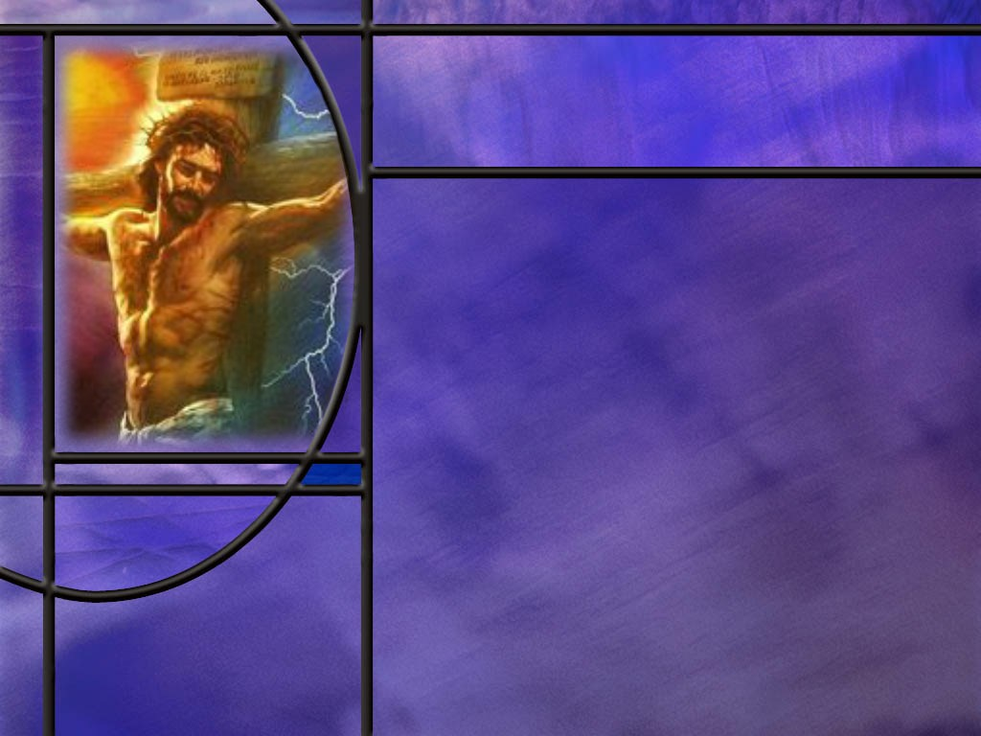
Resurrection and the Gospel
How does Paul define the gospel that saves? (1 Cor 15:1-4)
What is our living Savior doing for us now in the heavenly sanctuary? (Rom 4:24-25)
What eyewitness proof did Paul offer for the resurrection of Jesus? (1 Cor 15:5-8)
What other evidence can we cite for the truth of the resurrection of Jesus. [Quick Summary]
Notes:
B1:
[See notes on linked slide.]
B2:
[See notes on linked slide.]
B3:
[See notes on linked slide.]
B4:
[See notes on linked slide.]

Slide 5
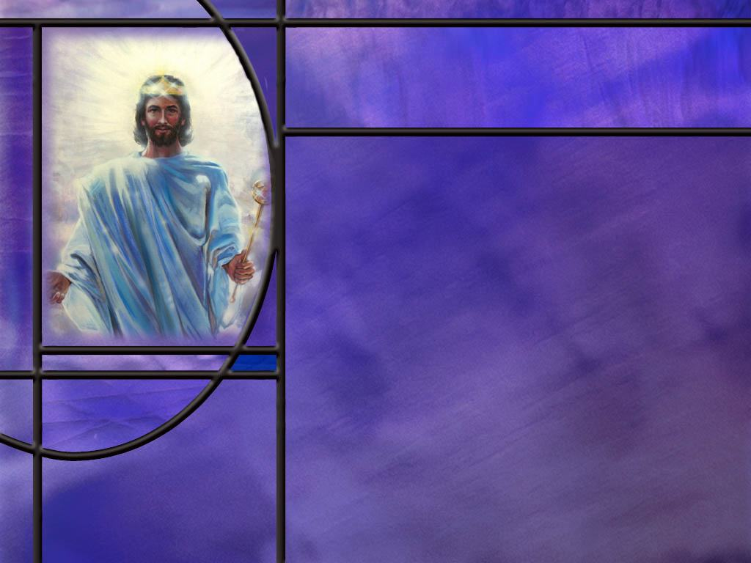
Resurrection as Foundational
What were some in Corinth saying about the resurrection? (1 Cor 15:12)
How essential is the resurrection of Jesus to the Christian faith? (1 Cor 15:14,16-19)
How did Christ succeed where Adam failed? (1 Cor 15:20-23)
How should we understand what Paul means by being baptized for the dead? (1 Cor 15:29)
Notes:
B1:

Slide 6
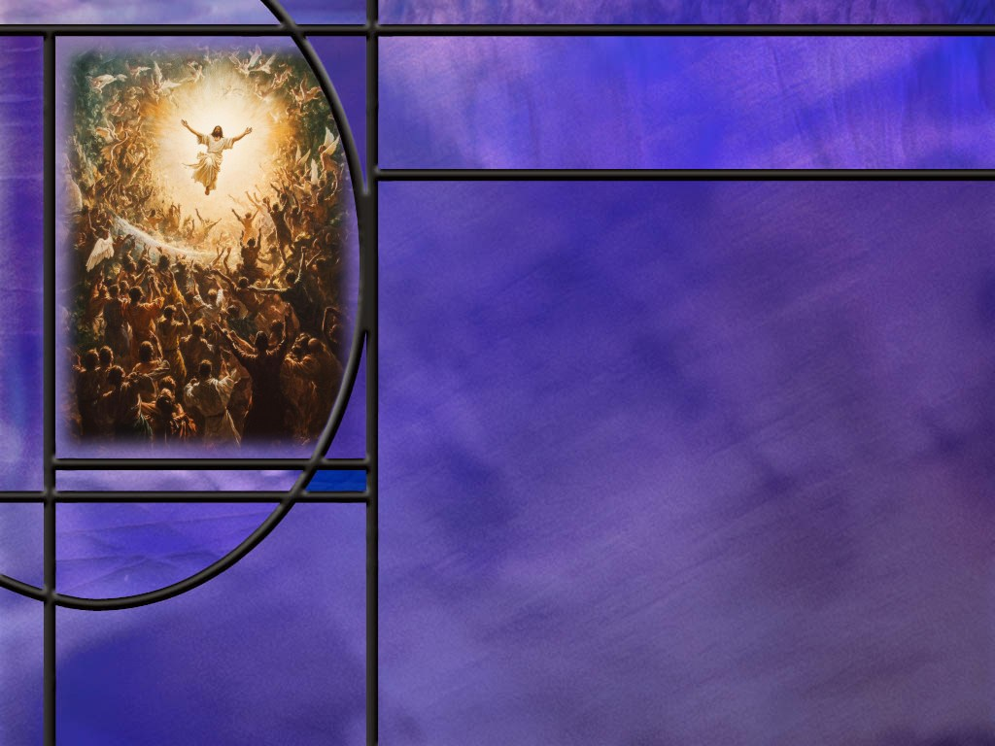
Immortal Bodies
How does Paul describe our resurrection bodies to the Corinthians? (1 Cor 15:42-44)
How did Paul describe the resurrection body to the Philippians? (Phil 3:20-21)
How long does it take to change from dust and ashes to a spiritual body ready to meet the Lord? (1 Cor 15:51-54)
How should we respond to God’s promise of immortality and victory over death? (1 Cor 15:55-58)
Notes:
B1:
[See notes on linked slide.]
B2:
[See notes on linked slide.]
B3:

Slide 7
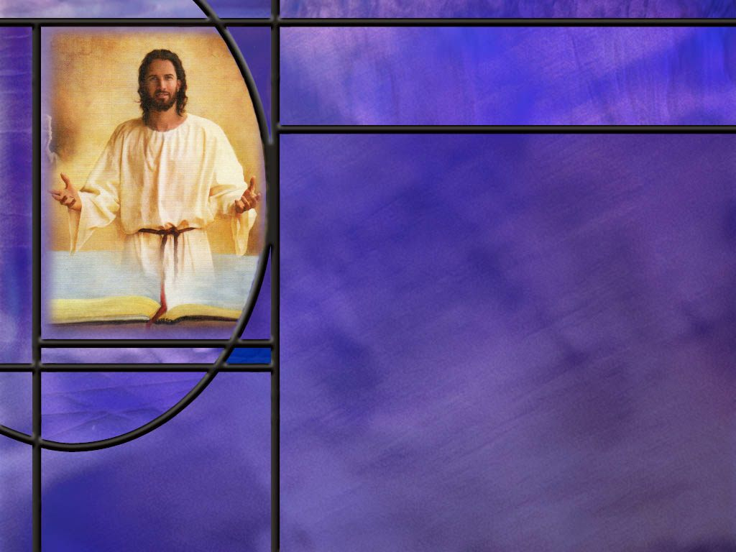
Summary
In the great resurrection chapter (1 Cor 15) Paul makes the argument that the resurrection of Christ is essential to the Christian faith.
The resurrection is part and parcel of the gospel that saves sinners: “Christ died for our sins … He was buried, and He rose again the third day according to the Scriptures.”
As evidence for the resurrection, Paul cites OT Scriptures and the many eyewitnesses that saw him alive after the crucifixion.
To these we could add many others including the moral character and historical accuracy of the apostles who wrote the NT gospels and epistles, their willingness to suffer and die for the truth of the resurrection, and the growth of the Christian church despite the persecution of both Jews and Romans to stamp it out.

Slide 8
Summary
Paul then confronts some in Corinth who denied a future resurrection of the dead.
He argues that Christ’s resurrection and the resurrection of believers cannot be separated.
If there is no resurrection, then Christ has not been raised; if Christ has not been raised, Christian preaching and faith are futile, believers remain in their sins, and those who died in Christ have perished.
Christianity would be reduced to false hope in a false Messiah.
But because Christ indeed rose from the dead, we have the promise that we too will be resurrected by Him. Christ’s resurrection is the first fruits; afterward they that are Christ's at his coming.
Only a living Savior can return in glory to save us.

Slide 9
Summary
Our new bodies in the resurrection will be like Christ’s body after His resurrection: they will be flesh and bones, immortal, glorious, powerful, a spiritual body rather than a natural body.
Perhaps this spiritual body will have access to the spiritual realm as Jesus did when he ascended to His Father in heaven and when He appeared to His disciples when the doors were closed.
Finally, Paul reveals a “mystery”: not all believers will die, but all will be changed in an instant at Christ’s return. Then Death will be swallowed up in victory through Jesus Christ.
Will you find time this week to abound in the work of the Lord knowing that your labor will not be in vain?

Slide 11
1 Corinthians 15:1-4 KJV
Moreover, brethren, I declare unto you the gospel which I preached unto you, which also ye have received, and wherein ye stand; ² By which also ye are saved, if ye keep in memory what I preached unto you, unless ye have believed in vain. ³ For I delivered unto you first of all that which I also received, how that Christ died for our sins according to the scriptures; ⁴ And that he was buried, and that he rose again the third day according to the scriptures: [R]
Notes:
Q1: What did Paul preach to the Corinthians?
1. The gospel.
Q2: When they received the gospel, believed it, and stood firm in it, what did it do for them?
1. It saved them.
2. There may be a lot of things we can call “good news,” but the gospel that Paul is talking about here is what saves us.
3. It is the good news of salvation in Jesus Christ.
4. Paul also takes a swipe here in verse two at the false doctrine of “once saved always saved.”
5. Notice the little word “IF.”
6. You are saved IF you keep in memory and hold fast to the gospel.
7. This is not once saved always saved regardless of your choice to stay saved.
8. If you apostatize and turn from the gospel, you have “believed in vain.”
Q3: What is the essence of the gospel that Paul delivered to them?
1. Three points:
2. Christ died for our sins, He was buried, and He rose again the third day.
3. And it all happened according to the prophecies of Scripture.
4. Note that the gospel includes both the death of Jesus for our sins and his resurrection.
5. His burial proved that He was dead physically; His dead body was laid in the tomb.
6. So the essence of the gospel is that our sins can be forgiven by laying them on Christ, who died for them.
7. But His death for our sins did not defeat Him, because He rose again and is a living Savior able to keep His promises of salvation for us.
8. So Paul begins this wonderful chapter on the resurrection by showing that the resurrection was part and parcel of the gospel that saves.
9. To the Romans he wrote this:
Romans 10:9 NKJV - if you confess with your mouth the Lord Jesus and believe in your heart that God has raised Him from the dead, you will be saved.
10. So believing in the resurrection of Jesus is an essential part of the gospel of salvation.
Q4: What evidence does Paul offer here for the truth of the gospel?
1. His evidence is “according to the Scriptures.”
2. He includes it for both his main points of the gospel: “He died for our sins according to the Scriptures” and “He rose again the third day according to the Scriptures.”
3. There is no question that Paul was well able to prove from the OT Scriptures that Jesus was the promised Messiah.
4. I am sure he would go back to Isa 53 to present the Suffering Servant as the prototype of the Messiah which Jesus fulfilled.
Isaiah 53:11 NLT - my righteous servant will make it possible for many to be counted righteous, for he will bear all their sins.
Psalm 16:10 NKJV - For You will not leave my soul in Sheol, Nor will You allow Your Holy One to see corruption.
5. It was Jeus Himself who opened to His apostles the OT Scriptures concerning Himself.
6. Remember on the road to Emmaus the Bible study He gave to the two disciples:
Luke 24:27 NKJV - And beginning at Moses and all the Prophets, He expounded to them in all the Scriptures the things concerning Himself.
7. Later that evening He presented the same thing to the apostles who were meeting behind closed doors.
8. After Jesus ate a piece of broiled fish, Luke records this:
Luke 24:45-47 ESV - 45 Then he opened their minds to understand the Scriptures, 46 and said to them, "Thus it is written, that the Christ should suffer and on the third day rise from the dead, 47 and that repentance for the forgiveness of sins should be proclaimed in his name to all nations, beginning from Jerusalem.
9. So the OT Scriptures declare the gospel of Christ’s death and resurrection.

Slide 12
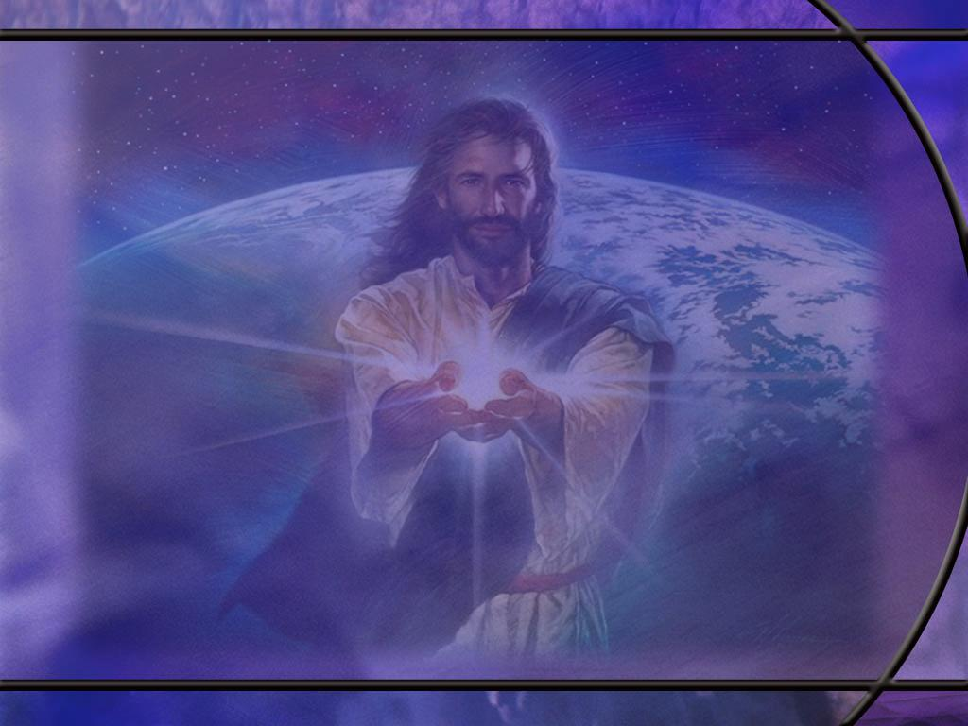
Romans 4:24-25 ESV
It [righteousness] will be counted to us who believe in him who raised from the dead Jesus our Lord, ²⁵ who was delivered up for our trespasses and raised for our justification. [R]
Notes:
Q1: What two elements of the gospel do you see here in verse 25?
1. We see here again the death of Jesus for our sins and His resurrection as the central elements of the gospel that brings us righteousness by faith.
2. Jesus was delivered up to death for our trespasses, and He was raised for our justification.
3. Jesus, our risen Savior, is interceding for us in the heavenly sanctuary to forgive our sins and declare us justified in the courts of heaven.
4. The resurrection is part and parcel of the gospel of salvation from sin.
5. Yes, His sacrifice is important: it provides atonement for our sins.
6. But we can’t be saved by a dead Savior.
7. It is the risen Jesus in the heavenly sanctuary that applies the benefits of His atonement to all those who come to Him in faith, trusting in His sacrifice for the forgiveness of their sins.
8. Praise God we have a living Savior who not only forgives our sins but is coming back to save us.

Slide 13
1 Corinthians 15:5-8 ESV
and that he appeared to Cephas, then to the twelve. ⁶ Then he appeared to more than five hundred brothers at one time, most of whom are still alive, though some have fallen asleep. ⁷ Then he appeared to James, then to all the apostles. ⁸ Last of all, as to one untimely born, he appeared also to me. [R]
Notes:
Q1: So how many eyewitnesses to the risen Christ do we have in this account?
1. Well over 500!
2. We have all of the apostles.
3. We have the women that followed Jesus and were the first witnesses of His resurrection.
4. We have the disciples on the road of Emmaus.
5. And this amazing gathering of over 500 brethren that see Him at one time.
6. Luke records in:
Acts 1:3 ESV - He presented himself alive to them after his suffering by many proofs, appearing to them during forty days and speaking about the kingdom of God.
7. So here we have a period of 40 days where Jesus met time and again with His followers, showing by many proofs that He was alive.

Slide 14
Quick Summary of Evidences for the Resurrection
The historical reliability of the gospels and epistles.
The eyewitness accounts of the resurrection.
The dramatic change in the courage of the disciples once they knew Christ was alive.
The inability of the Jews to stop the proclamation of the resurrection.
The willingness of the apostles to give their lives to spread the gospel. (No one is willing to die, for something they know is a lie).
The growth of Christianity despite the forces of persecution that have attempted to stop it. [R]

Slide 15
1 Corinthians 15:12 KJV
Now if Christ be preached that he rose from the dead, how say some among you that there is no resurrection of the dead? [R]
Notes:
Q1: What was the apostle Paul preaching in His presentation of the gospel?
1. He and other Christian apostles were preaching that Christ rose from the dead.
2. That is part and parcel of the gospel he just presented in verses 1-4.
Q2: What problem is Paul now addressing here in the Corinthian church?
1. Some were saying that there is no resurrection of the dead.
2. Apparently, some were holding to the Greek philosophical idea of the immortality of the soul, so why would you need to resurrect the body?
3. So Paul spends a whole chapter correcting this mistaken belief.
4. This was a serious problem, because those who denied the resurrection would be calling Paul a liar and would be bringing error into the church.
Q3: Was disbelief in the resurrection just a Gentile problem? Were there Jews that also disbelieved the resurrection?
1. Yes there were!
2. The Sadducees did not believe in the resurrection.
3. “That’s why they were sad, you see!”
4. They did not believe in a conscious existence after death.
5. They also accepted only the first five books of the OT written by Moses and did not believe in angels.

Slide 16
1 Corinthians 15:14, 16-19 ESV
And if Christ has not been raised, then our preaching is in vain and your faith is in vain. ... ¹⁶ For if the dead are not raised, not even Christ has been raised. ¹⁷ And if Christ has not been raised, your faith is futile and you are still in your sins. ¹⁸ Then those also who have fallen asleep in Christ have perished. ¹⁹ If in Christ we have hope in this life only, we are of all people most to be pitied. [R]
Notes:
Q1: What are the ramifications for us if Jesus did not rise from the dead?
1. Our preaching is futile.
2. Our faith is futile.
3. Our sins are not forgiven.
4. The dead saints perish.
5. We perish when we die.
6. Our hope will never be fulfilled.
7. We have wasted our lives.
8. The resurrection of Christ is essential to the Christian faith.
Q2: If Christ was not raised from the dead, what happens to all those who have trusted in Him for forgiveness?
1. They perish.
2. They are still in their sins.
3. There is no forgiveness, no justification, no salvation.
4. There is no resurrection, no eternal life.
5. Without the resurrection we have a dead savior who cannot save anyone.
Q3: What would we have to conclude about Jesus if He did not rise from the dead?
1. If Christ was not raised, He is a false messiah.
2. He predicted He would be raised the third day, and the sign that He gave to validate his ministry was the sign of Jonah.
Matthew 12:40 NKJV - 40 "For as Jonah was three days and three nights in the belly of the great fish, so will the Son of Man be three days and three nights in the heart of the earth.
3. It is the resurrection that declares Jesus to be all that He claimed to be.
4. Paul says as much in Rom 1:4
Romans 1:4 (NLT)
⁴ and he [Jesus Christ our Lord] was shown to be the Son of God when he was raised from the dead by the power of the Holy Spirit.
5. The resurrection was God’s stamp of approval on all that Jesus said and did.
6. The resurrection was the sign that His sacrifice was accepted by God to pay for our sins.
7. No resurrection, no forgiveness.
8. His sacrifice would have been in vain.
9. How can a dead Savior save anybody?
10. We need a living Savior to come back and save us from death through resurrection or translation.
Q4: If Christ did not rise, why are we to be pitied above all other people?
1. If Christ has not been raised, then we have spent our lifetime trusting in a false Messiah.
2. We have spent our time worshipping a phony.
3. We have spent our effort preaching a false gospel to make disciples of a false Messiah.
4. We have prayed to a dead man.
5. We have believed and lived by the Bible which cannot be true if Jesus is dead.
6. We have wasted our lives.
7. Everything depends on the resurrection of Christ.
8. Fortunately, it is one of the most firmly established facts of history.
9. Without the resurrection, there would be no Christian church and no Christian believers today.

Slide 17
1 Corinthians 15:20-23 ESV
But in fact Christ has been raised from the dead, the firstfruits of those who have fallen asleep. ²¹ For as by a man came death, by a man has come also the resurrection of the dead. ²² For as in Adam all die, so also in Christ shall all be made alive. ²³ But each in his own order: Christ the firstfruits, then at his coming those who belong to Christ. [R]
Notes:
Q1: What doers it mean that Jesus is the firstfruits of the resurrection?
1. The firstfruits implies more fruit to follow.
2. The resurrection of Jesus assures our resurrection to follow.
3. Because Christ was raised from the dead, He can raise us from the dead.
Q2: And when will that happen?
1. At His coming, He will raise those who belong to Him.
Q3: How does Paul contrast Adam and Christ?
1. All those who are in Adam die; all those who are in Christ are made alive.
2. Christ becomes the head of a new humanity called out by faith.
3. We all die the first death because of Adam; but we never die the second death because of Christ.
4. We see this same contrast in Rom 5:19
Romans 5:19 KJV - For as by one man's disobedience many were made sinners, so by the obedience of one shall many be made righteous.
5. Where Adam failed; Christ will succeed.
Q3: So how important is the resurrection of Jesus to you personally?
1. If He is not resurrected, there is no first fruits.
2. If there are no first fruits, there is no final harvest.
3. If He isn’t raised, He can’t come again to raise those who belong to Him.
4. But in fact, as verse 20 declares, Christ has been raised; the Bible is true; we can look forward to eternal life because He lives.
2 Corinthians 4:14 ESV - knowing that he who raised the Lord Jesus will raise us also with Jesus and bring us with you into his presence.

Slide 18
1 Corinthians 15:29 NKJV
Otherwise, what will they do who are baptized for the dead, if the dead do not rise at all? Why then are they baptized for the dead? [R]
Notes:
Q1: What does it mean to be baptized for the dead?
1. There are a few religious bodies that practice proxy baptism.
2. The most notable of these is the Church of Jesus Christ of Latter-day Saints also known as the Mormon church.
3. They teach that if someone dies without accepting Christ and being baptized, that a friend, usually a family member, can be baptized in their place.
4. Since they believe in the immortality of the soul, they teach that the dead person in the spirit world must affirm and accept Christ and the baptism as his own.
5. This, of course, is foolishness.
Hebrews 9:27 KJV - it is appointed unto men once to die, but after this the judgment:
6. There are no second chances after death.
7. Most Christians understand baptism for the dead as being baptized as a tribute to someone who has died, perhaps one who has been influential on your decision to be baptized.
8. Paul is arguing “Why be baptized as a tribute to a dead person if there is no resurrection. They will never know about it.”

Slide 19
1 Corinthians 15:42-44 ESV
So is it with the resurrection of the dead. What is sown is perishable; what is raised is imperishable. ⁴³ It is sown in dishonor; it is raised in glory. It is sown in weakness; it is raised in power. ⁴⁴ It is sown a natural body; it is raised a spiritual body. If there is a natural body, there is also a spiritual body. [R]
Notes:
Q1: What can we say about the change that occurs at the resurrection?
1. There is a wonderful positive change that occurs at the resurrection.
2. Paul is emphatic in this portion of scripture that the body that comes up in the first resurrection is not like the body that goes down.
3. It’s a new body, not like Adam’s earthly body but like Christ’s heavenly body.
4. The old body is perishable; the new one is immortal.
5. The old body was buried in dishonor; the new is raised in glory.
6. The old body was weak and falling apart; the new is raised in power.
7. The old body was natural, subject to decay and death; the new is raised as a spiritual body.
8. Now this spiritual body is not just a spirit with no physical properties.
9. It is still a physical body, but it has some spiritual qualities to it.
10. It is not a natural body but a spiritual body that apparently has access to both the physical and spiritual dimensions.
Q2: Are you looking forward to a new spiritual body?
1. It is imperishable; it is immortal; it will not get old and die; it won’t get cancer and heart disease and diabetes and all the other diseases that plague mankind.
2. No more head aches; no more colds; no more pneumonia; no more flu; no more fevers; no more old age; hallelujah!
Isaiah 40:31 (NKJV) - But those who wait on the Lord Shall renew their strength; They shall mount up with wings like eagles, They shall run and not be weary, They shall walk and not faint.

Slide 20
Philippians 3:20-21 NKJV
For our citizenship is in heaven, from which we also eagerly wait for the Savior, the Lord Jesus Christ, ²¹ who will transform our lowly body that it may be conformed to His glorious body, according to the working by which He is able even to subdue all things to Himself. [R]
Notes:
Q1: What happens to these bodies we now have when Jesus comes to save us?
1. The promise is that they will be changed to be like Christ’s glorious body.
2. Are you looking forward to that change? (Hallelujah!!)
3. No more death, old age, sickness, sorrow, or pain.
4. The KJV calls our present bodies “vile” in this text.
5. And the older we get the more we might agree with the KJV translation.
6. Paul writes something similar to the Corinthians:
1 Corinthians 15:49 ESV - Just as we have borne the image of the man of dust [Adam], we shall also bear the image of the man of heaven [Christ].
Q2: What kind of bodies can we look forward to if they are like the glorious body of Christ?
1. The Bible gives us some hints.
2. After the resurrection, what kind of body did Jesus have?
3. First His body was physical.
4. He said it was flesh and bones.
5. It could be touched and felt and it carried the scars of His crucifixion.
6. It was not a spiritual apparition like a ghost.
7. But He somehow had access to the spiritual realm into which He could move at His ascension.
8. And it may have been that access that allowed Him to appear to His disciples even though all the windows and doors were closed.
9. There is a natural body that we have, and there is a spiritual body which Christ had when He was raised.
10. So, we suppose a natural body is purely physical like our own, and a spiritual body is some new kind of a body with access to the spiritual realm.
11. That allows us access to the realm where heaven exists and where Christ has gone, perhaps in another dimension other than the dimensions in which our universe exists.
12. Our citizenship is in heaven, and it makes sense to me that we will have access to the heavenly dimension because that’s where Jesus is taking us.

Slide 21
1 Corinthians 15:51-54 ESV
Behold! I tell you a mystery. We shall not all sleep, but we shall all be changed, ⁵² in a moment, in the twinkling of an eye, at the last trumpet. For the trumpet will sound, and the dead will be raised imperishable, and we shall be changed. ⁵³ For this perishable body must put on the imperishable, and this mortal body must put on immortality. ⁵⁴ When the perishable puts on the imperishable, and the mortal puts on immortality, then shall come to pass the saying that is written: "Death is swallowed up in victory.“ [R]

Slide 22
1 Corinthians 15:51-54 NKJV
Behold, I tell you a mystery: We shall not all sleep, but we shall all be changed-- ⁵² in a moment, in the twinkling of an eye, at the last trumpet. For the trumpet will sound, and the dead will be raised incorruptible, and we shall be changed. ⁵³ For this corruptible must put on incorruption, and this mortal must put on immortality. ⁵⁴ So when this corruptible has put on incorruption, and this mortal has put on immortality, then shall be brought to pass the saying that is written: "Death is swallowed up in victory.“ [R]
Notes:
Q1: What is the mystery that Paul is dealing with in this passage?
1. It is the mystery of how we are changed from mortal to immortal.
2. The process is not something that we can understand: it is a miraculous change.
3. If we are living, we need to be translated.
4. If we are dead, we need to be resurrected.
5. In either case, we must put on immortality instead of mortality.
6. Mortality means we are subject to death.
7. Immortality means we are not.
8. If we have to put on immortality at the coming of Christ, it is absolutely clear that we do not have it now in the form of an immortal soul.
9. It is only through the resurrection and translation that death is swallowed up in victory.
Q2: How long does this change take?
1. A moment, a twinkling of the eye, less than a second.
2. People who believe in theistic evolution or progressive creation think that it took God 600 million years of trial and error through evolution to create the first man.
3. That’s not the God of the Bible.
4. God spoke and it was done.
5. In the resurrection and translation, all He needs to do is speak again and it will be done in the twinkling of an eye.

Slide 23
1 Corinthians 15:55-58 ESV
"O death, where is your victory? O death, where is your sting?" ⁵⁶ The sting of death is sin, and the power of sin is the law. ⁵⁷ But thanks be to God, who gives us the victory through our Lord Jesus Christ. ⁵⁸ Therefore, my beloved brothers, be steadfast, immovable, always abounding in the work of the Lord, knowing that in the Lord your labor is not in vain. [R]
Notes:
1. Paul quotes here from a couple of OT prophets to express his joy at the prospect of seeing death defeated.
2. When Jesus comes, death is swallowed up in victory.
Q1: How should we respond to the amazing promise that God will give immortality to those who are in Christ at His return.
1. First, we should be thankful.
2. God gives us victory over death through our Lord Jesus Christ.
3. Our hearts should overflow with gratitude for God’s love, mercy, grace and forgiveness that justifies us and saves us by faith in Christ.
4. Second, we should be confident in the promises of God.
5. We should be steadfast and immovable, always faithfully trusting the Lord, growing in grace, living for Jesus, surrendered to Him, and abounding in faithful service for Him.
6. Third, we should be confident that, when we are working for Jesus, our labor is not in vain.
7. Let’s pray that we may be wisely using the time we have left by giving ourselves more fully to the work of the Lord.
8. When I look back to my years of employment as a chemical engineer, I wonder how much of it is still relevant and useful today.
9. I think not much.
10. The only thing we can do that has eternal consequences is to be ambassadors for Christ and offer others the opportunity to be reconciled to God.

