Slide 1
First and Second Corinthians
Lesson 7
A Portrait of Love

Slide 2

Memory Text
1 Corinthians 13:13 NIV
And now these three remain: faith, hope and love. But the greatest of these is love.
What is faith and how do we get it?
What is hope, and how do we get it?
What is love and how do we get it?
What makes love greater than faith and hope?
Notes:
B1:
1. You will recall from our lesson last week that this great love chapter, 1 Cor. 13, is inserted by Paul between two chapters where he is teaching on Spiritual gifts.
2. He introduces this chapter by saying that he will now show the church the most excellent way to minister the gifts.
3. He begins this chapter by referring to some impressive spiritual gifts and saying if you are not ministering these gifts in love, they are worthless.
4. His reason for saying that appears to be a concern that the church in Corinth was not being edified and built up by the way they ministered their gifts.
5. Perhaps their gifts were being exercised in pride, rivalry, or a desire for recognition.
6. So Paul in this love chapter stresses the importance of love in using our spiritual gifts.
B2:
1. Faith can have a range of meanings and usages in Scripture.
2. So let’s think about three aspects of faith: saving faith, faith as a gift of the Spirit, and faith as a fruit of the Spirit.
3. How important is faith?
Hebrews 11:6 NIV - And without faith it is impossible to please God, because anyone who comes to him must believe that he exists and that he rewards those who earnestly seek him.
4. Here, faith is trusting the evidence that God exists, and earnestly seeking a relationship with Him.
5. It is trusting the evidence of creation and the evidence of revelation, believing the God of the Bible and trusting in Jesus His Son for the forgiveness of our sins and eternal life with God.
6. This is saving faith, the first and most important kind of faith.
7. For Christians, Paul shows how we get saving faith.
Romans 10:17 NLT - So faith comes from hearing, that is, hearing the Good News about Christ.
8. When we hear and believe the gospel of how Christ died for our sins, we choose to put our faith in Him, trust Him for forgiveness, and are justified and saved.
9. When we are justified, God then gives us the Holy Spirit, we are born again, and begin to live a new life for Christ.
10. Saving faith is neither a gift of the Spirit nor a fruit of the Spirit, it is our choice to trust Jesus as Savior and Lord.
11. We are held responsible for that choice in the judgment.
12. Once we receive the Holy Spirit at conversion, then He can produce the gift of faith and the fruit of faith in our lives.
13. It is interesting that faith is listed both as a gift of the Spirit in 1 Cor 12:9 and as a fruit of the Spirit in Gal 5:22.
14. As a fruit of the Spirit it is generally translated as “faithfulness” rather than faith.
15. The same Greek word (pistis) can be translated either as faith of faithfulness.
16. Faith, as a gift of the Spirit, is a particular Spirit-given capacity given to certain individuals for unusual confidence in God.
17. It is given for ministry in the church in a situation of need, danger, or seemingly impossible service.
18. Paul mentions it in Chapter 13 here with the words: “and if I have all faith, so as to remove mountains, but have not love, I am nothing.”
19. So, faith as a gift of the Spirit is a special capacity for trusting God to meet the needs of ministry for the body of Christ.
20. Faith as a fruit of the Spirit is the character quality of being faithful to Christ and His cause.
21. It is the character quality of being reliable, accountable, dependable, faithful, obedient, loyal, and surrendered to Jesus as Savior and Lord.
22. Every Christian should be growing in faithfulness as we grow in grace.
23. To summarize:
Saving faith: Our choice to trust in Christ as Savior and Lord.
Gift of faith: Holy Spirit’s gift to some for unusual confidence in God for ministry.
Fruit of Faith: Holy Spirit’s development of our character for faithfulness to Christ.
B3:
1. Christian hope can be defined as a confident reliance on the promises of God.
2. Hope is standing on the promises.
3. Faith trusts God and His word now.
4. Hope looks forward with confidence to what God has promised but has not yet fully revealed.
5. Paul, in his letter to Titus speaks of the blessed hope:
Titus 2:13-14 KJV - Looking for that blessed hope, and the glorious appearing of the great God and our Savior Jesus Christ; ¹⁴ Who gave himself for us, that he might redeem us from all iniquity, and purify unto himself a peculiar people, zealous of good works.
6. So we have the promise of Christ’s return in glory which is our blessed hope.
7. And the reason we can have confidence in His return is that He died to redeem us from all iniquity and purify unto Himself a peculiar people.
8. Based on His death and resurrection, we can have every confidence of His return to save us in His eternal kingdom.
9. Hope comes from realizing that God is trustworthy and His promises are true.
10. Peter writes that we have been born again to a living hope.
1 Peter 1:3 ESV - 3 Blessed be the God and Father of our Lord Jesus Christ! According to his great mercy, he has caused us to be born again to a living hope through the resurrection of Jesus Christ from the dead,
11. We have a living hope because we have a living Savior.
12. He has promised to come back and save us, and the resurrection is proof that He is alive and able to raise us up when He returns.
13. Hope is believing the promises of God because God has shown Himself to be trustworthy and true to His word.
14. So, is hope a gift of the Spirit, a fruit of the Spirit, or something else?
15. Hope is not listed in any of the lists of the gifts of the Spirit, nor is it specifically listed as a fruit.
16. But hope is a character quality that every true believer should have.
17. I believe it can be related to the fourth fruit of the Spirit which is patience or steadfast endurance.
18. Hope is standing with steadfast endurance on the word of God and believing His promises.
B4:
1. The Bible’s best definition of agape love is found in the chapter we study today.
2. It is not so much a feeling as acting it certain kind and caring ways toward others.
3. We can love our enemies without necessarily feeling warm affection for them.
4. We can pray for them and seek their good.
5. Agape love can be defined as acting in the eternal best interest of others regardless of how they respond.
6. The most famous verse in the Bible speaks of God’s love for us.
John 3:16 ESV - "For God so loved the world, that he gave his only Son, that whoever believes in him should not perish but have eternal life.
7. What did God’s agape love for the world compel Him to do?
8. It compelled Him to act in our eternal best interest by sending His son to die for our sins so that we could have eternal life.
9. Agape love is a settled, active commitment to act for another’s good—even when it costs something and even when the other person has not earned it.
10. That’s the kind of love the Father and Son have for us.
11. The apostle John writes:
1 John 4:19 ESV - We love because he first loved us.
12. Love comes from realizing what Christ has done to save us and loving Him because He first loved us.
13. And the apostle Paul writes that love is the first and foremost fruit of the Spirit in Gal 5:22.
14. Every Christian should be growing in this most important character quality as the Holy Spirit conforms us to the likeness of Jesus.
15. So, if we want to get the fruit of agape love, we need to trust in Jesus as our Savior and Lord, and pray for the Holy Spirit to make us more like Him each day.
B5:
1. Our present faith and hope find their fulfillment when Jesus returns, but love goes on forever and ever.
2. When we see Jesus, our faith becomes sight.
3. When the promises of God are fulfilled, our hopes are realized.
4. But love never ends. It endures for all eternity.
5. Love does not end in God’s kingdom; it is fully expressed there.
6. Faith receives Christ; hope awaits Christ; love becomes like Christ.
7. God is love, and His plan for us is to be His children who love Him with all our hearts through all eternity.
8. Faith and hope are means of becoming loving citizens of God’s eternal kingdom.

Slide 3
Overview
In our lesson this week, Paul seeks to correct the misuse of spiritual gifts at Corinth by insisting they be used in agape love. His description of agape love makes this chapter one of the most sublime in all of Scripture. His description of the “greater way” is not spiritual display but patient, humble, self-giving love that builds up the church.
  Describing Love
  Demonstrating Love
  Developing Love
  Summary

Slide 4

Defining Love
What description does Paul give us of agape love? (1 Cor 13:4-8a)
Notes:
B1:
[See notes on linked slide.]

Slide 5

Demonstrating Love
How did Jesus demonstrate the love described in 1 Corinthians 13?
  Love is patient
  Love is kind
  Love does not envy or boast
  Love is not arrogant or rude
  Love does not insist on its own way
  Love is not irritable or resentful
  Love rejoices not in evil but in the truth.
  Love bears all things & endures all tings.
  Love never ends
Where do we see the ultimate demonstration of the love of Christ?
Notes:
B1:
1. Jesus was patient:
1. Sometime we get frustrated with His disciples, but Jesus was patient with them.
2. After 3.5 years they are still arguing about who will be the greatest in the kingdom.
3. But Jesus patiently taught them and modeled agape love for them.
4. Jesus patiently bore with slow-learning disciples, doubters, crowds, and even opponents.
5. He repeatedly taught, corrected, restored, and did not abandon His followers when they failed.
6. Remember His patience with Peter before and after Peter’s denial.
2. Jesus was kind:
1. His compassion moved Him to minister the sick, the grieving, the hungry, the poor, children, lepers, and social outcasts. He touched the leper, welcomed children, fed the multitude, and wept with Mary and Martha at Lazarus’s tomb.
3. Jesus was humble:
1. Here is Jesus, the incarnate Son of God, Emmanuel, God with us, who came not to be served but to serve and give His life a ransom for many.
2. Paul wrote to the Philippians that He humbled himself and became obedient unto death even the death of the cross.
3. Though He possessed divine authority, Christ did not seek human applause or status.
4. He refused the path of worldly power and taught His disciples that true greatness is found in serving
4. Jesus was never arrogant or rude in dealing with others:
1. Jesus dealt with people with dignity—even those whom society despised.
2. His conversation with the Samaritan woman, His mercy toward the woman caught in adultery, and His willingness to associate with tax collectors and sinners reveal humility and good manners in leading others to a better life.
5. Jesus did not insist on His own way:
1. In Gethsemane, Jesus expressed the depth of His human anguish, yet surrendered fully: “Not my will, but thine, be done” (Luke 22:42).
2. His life was devoted to the Father’s will and humanity’s salvation.
6. Jesus was not irritable or resentful.
1. Jesus was slow to anger and kept no record of wrongs.
2. He did not keep a ledger of His disciples’ failures.
3. After the resurrection, He restored Peter rather than humiliating him.
4. On the cross He prayed, “Father, forgive them” (Luke 23:34).
5. His parable of the prodigal son portrayed the forgiveness of God and the joy of restoration for forgiven sinners.
7. Jesus never approved of evil but called sinners to repentance.
1. Jesus loved sinners without approving sin.
2. He forgave, healed, and received people, but also called them to repentance and new life.
8. Jesus was rejected by the Jews but proved to be God’s faithful suffering Messiah.
1. Christ bore rejection, misunderstanding, betrayal, mockery, injustice, and the cross.
2. He endured not because suffering itself was good, but because His love would not abandon the work of redemption.
9. Jesus still loves us today.
1. The resurrection shows that Christ’s love was not defeated by death.
2. He continues as the living Lord, interceding for His people and preparing for their final restoration.
10. So, we see in Jesus a perfect demonstration of the agape love described in 1 Cor 13.
B2:
1. Of course, the supreme demonstration of agape love is seen on Calvary.
2. There Christ took the sin of the world upon Himself and paid the ransom for us.
3. This is an amazing act of grace.
4. We deserved death.
5. He took our penalty that we night have life.
6. The apostle Paul wrote these words to the Romans:
Romans 5:8 NKJV - But God demonstrates His own love toward us, in that while we were still sinners, Christ died for us.
7. Jesus did not respond to evil with hatred, retaliation, or self-protection.
8. He gave Himself even for those who misunderstood, rejected, and crucified Him.
9. In that act, love was patient, kind, humble, forgiving, truthful, sacrificial, and enduring all at once.
10. At the cross, the very character of God is revealed: holy love that confronts sin, bears its consequence, and opens the way for reconciliation.

Slide 6

Developing Love
How can we receive the kind of agape love described in 1 Cor 13? (1 John 4:7-9)
How does the apostle Paul point to the work of the holy Spirit in developing agape love in the lives of Christian? (Rom 5:5, Gal 5:22-23)
What can we do to promote the development of a mature agape love for God and others?
Notes:
B1:
[See notes on linked slide.]
B2:
[See notes on linked slide.]
B3:
1. First, we need to recognize that agape love comes from God.
2. It is poured out in the hearts of believers when we trust Jesus for the forgiveness of our sins and receive the Holy Spirit.
3. Step one is having a living, growing, saving relationship with Jesus Christ.
4. Step two is seeking the infilling of the Holy Spirit each day.
5. Step three is abiding in Christ though regular prayer, meditating on the word, worship, obedience, gratitude, and surrender.
6. It also may be helpful to try to slow down our natural reaction to things and think about how Jesus would respond.
7. It is so easy to fly off the handle when something irritates you.
8. Fight the urge to snap back and be impulsive.
9. Visualize how Jesus would respond, and see if that would bring a better outcome.
10. Let’s do all we can to open our hearts to the love of God so that we can have peace and unity in our church and in our homes.

Slide 7
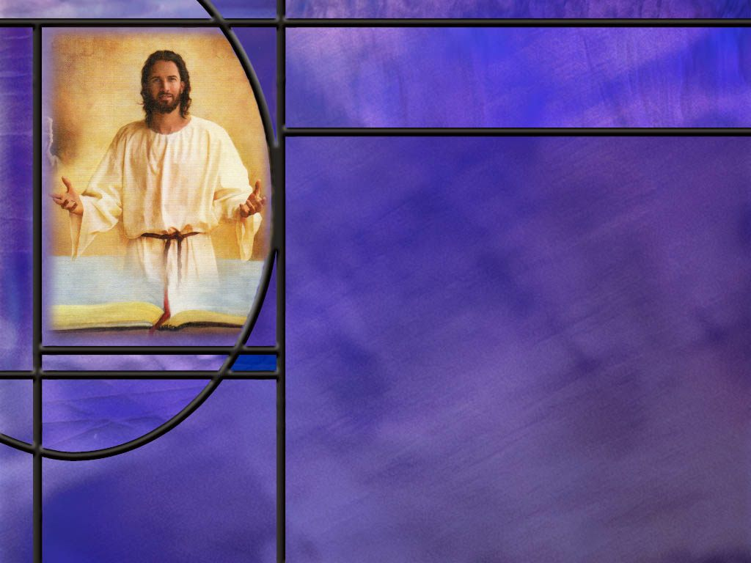
Summary
In 1 Corinthians 13, Paul teaches that love is the indispensable foundation of Christian life and ministry.
Paul writes that even the most impressive spiritual abilities—speaking eloquently, prophesying, possessing great knowledge, having extraordinary faith, giving away one’s possessions, or suffering for a cause—are worthless without love.
Paul then describes what genuine love looks like in practice. Love is patient and kind. It is not jealous, boastful, proud, rude, self-seeking, or easily angered. Love does not keep a record of wrongs and does not rejoice in evil; instead, it rejoices in truth. Love bears, believes, hopes, and endures through all things.

Slide 8
Summary
Agape love is action centered rather than feeling centered. It acts in the best interest of others.
It is a settled, active commitment to act for another’s good—even when it costs something and even when the other person has not earned it.
That kind of love was demonstrated by God in giving His Son to die for our sins.
In looking for a demonstration of agape love, Jesus appears to be the perfect fulfillment of Paul’s description of love.
The supreme demonstration of agape love is seen on Calvary where Christ took the sin of the world upon Himself and paid the ransom for us.

Slide 9
Summary
Agape love is not something we gin up on our own. It comes from God.
John writes that those who have agape love are born of God and know Him.
Paul writes that the love of God has been poured out in our hearts by the Holy Spirit who was given to us, and love is at the head of the list for the fruit of the Spirit.
If we want the kind of agape love that Paul describes, we need to be justified by trusting in Jesus for the forgiveness of our sins, be sanctified and born again by the Holy Spirit’s presence in our lives, and be growing in grace as the Spirit makes us more like Jesus.
Will you pray for the Holy Spirit to give you agape love, the greatest virtue of all?

Slide 11
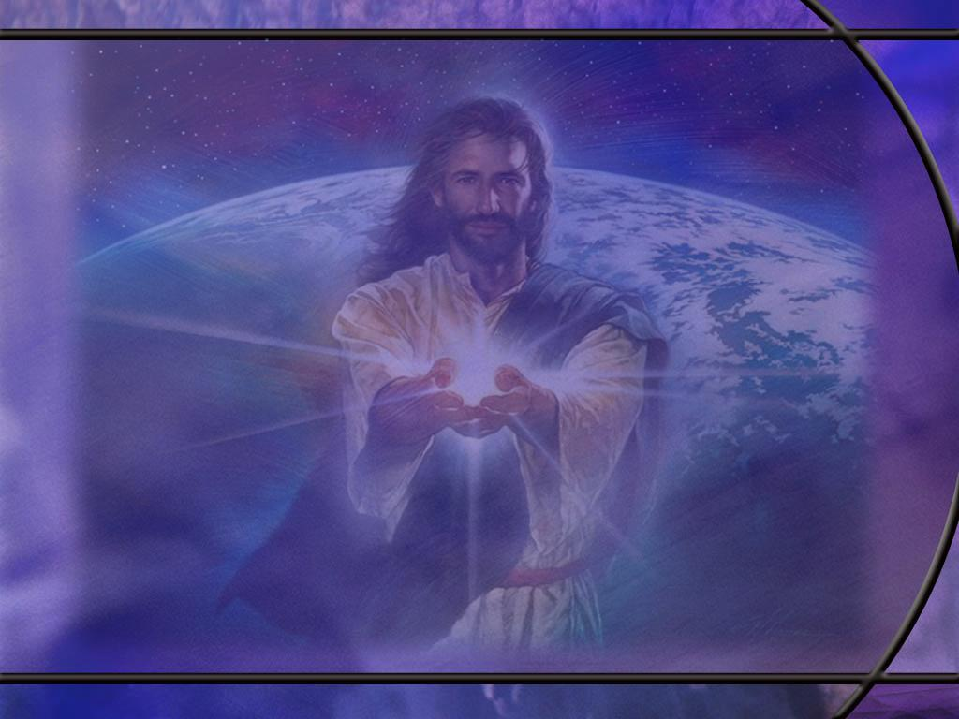
1 Corinthians 13:4-8a NIV
Love is patient, love is kind. It does not envy, it does not boast, it is not proud. ⁵ It does not dishonor others, it is not self-seeking, it is not easily angered, it keeps no record of wrongs. ⁶ Love does not delight in evil but rejoices with the truth. ⁷ It always protects, always trusts, always hopes, always perseveres. ⁸ Love never fails. [R]
Notes:
Q1: How many characteristics does the apostle give here of agape love?
1. I count 16 altogether.
2. Some are written as negative characteristics; others are positive traits of love.
3. So let’s list them in order showing just the characteristics that Paul mentions.
[Go to next slide.]

Slide 12
Characteristics of Love (NIV)
Love:
  Is patient
  Is kind
  Does not envy
  Does not boast
  Is not proud
  Is not rude
  Is not self-seeking
  Is not easily angered
  Keeps no record of wrongs
Love:
  Does not delight in evil
  Rejoices in the truth
  Always protects
  Always trusts
  Always hopes
  Always perseveres
  Never fails.
Notes:
1. So let’s work through this list and see if we can think of at least one synonym for each of these characteristics.
2. What is a synonym for patient? (tolerant, long suffering, slow to anger)
3. For kind? (nice, friendly, caring, helpful, warm, thoughtful)
4. For envy? (jealous, covetous, resentful)
5. For boast? (brag, show off)
6. For proud? (arrogant, conceited, smug)
7. For rude? (disrespectful, impolite, ill-mannered)
8. For self-seeking? (demands its own way, promotes self, my way or the highway)
9. For angered? (upset, enraged, provoked)
10. For record of wrongs? (past offenses, transgressions, trespasses, sins)
11. For evil? (sin, iniquity, transgression, rebellion, disobedience)
12. For truth? (God’s word, righteousness, Jesus, accuracy, honesty)
13. For protect? (defend, guard, shield)
14. For trust? (believes, gives the benefit of the doubt)
15. For hope? (optimistic, wishing the best future)
16. For perseveres? (Holds on, persist, endure)
17. For fail? (breaks down, gives out, gives up)
18. Our lesson goes back to the Greek and teases out the meaning from the Greek words that Paul uses for these characteristics of love.
Q1: Which of these characteristics do you find most difficult to implement in your own life?
1. Love is patient, not easily angered, keeps no record of wrongs.
2. As you look at this list, it is easy to conclude that we need divine help.
3. This kind of love is not natural.
4. Indeed, we need the Holy Spirit’s help to even come close.
[Go to next slide]

Slide 13
Characteristics of Love (NIV)
Negatives:
Love:
  Does not envy
  Does not boast
  Is not proud
  Is not rude
  Is not self-seeking
  Is not easily angered
  Keeps no record of wrongs
  Does not delight in evil
  Never fails
Positives:
Love:
  Is content
  Affirms others
  Is humble
  Is polite
  Seeks good of others
  Is slow to anger
  It forgives and forgets
  Delights in good
  Always continues. [R]
Notes:
1. We can take some of the negatives in Paul’s description of agape love and convert them to positives.
2. The positive characteristics are usually more difficult to put into practice than the negatives.
3. For example, it’s more difficult to be polite than it is not to be rude.
4. So we put 1 Cor 13 all in positive terms, as shown on the next slide.
[Go to next slide.]

Slide 14
Love in all Positives
“Love is patient, love is kind, it is content with what it has, it builds others up rather than self, it is humble, it is polite, it seeks the good of others, it is slow to anger, it forgives and forgets, it delights in good, it rejoices in the truth, it always protects, always trusts, always hopes, always perseveres, and always continues.” [R]
Notes:
1. Every aspect of agape love is an action word.
2. These are all verbs.
3. These are all ways we can choose to act toward other people.
4. They are all ways of treating others with care and kindness.
Q1: What would happen if we all treated each other like this in the church and in the home?
1. It would be a little like heaven on earth!
2. In fact, this is what we can look forward to in our heavenly home.
3. The Bible commentator William Barclay makes this comment on the description of agape love:
“Every one of [these] great Christian virtues depends on one thing – on the obliteration of self. So long as self is at the center of things, so long as our feelings, our prestige, are the only things that matter… oneness can never fully exist. It can only exist when we cease to make self the center of things and when we think more of others than we do of ourselves.”
4. So let’s strive to get the objects of our love in the right order.
5. Let’s remember the acronym JOY: J for Jesus, O for others, and Y for yourself.
6. You can find true Christian joy when you put Jesus first, others second, and yourself last.

Slide 15
1 John 4:7-9 ESV
Beloved, let us love one another, for love is from God, and whoever loves has been born of God and knows God. ⁸ Anyone who does not love does not know God, because God is love. ⁹ In this the love of God was made manifest among us, that God sent his only Son into the world, so that we might live through him. [R]
Notes:
Q1: Look at the first verse here. Where do we get agape love?
1. John writes here that agape love is from God.
2. It is not something that we get by gritting out teeth and trying harder.
3. He says whoever has agape love has been born of God and knows God.
4. He is talking about being born of the Spirit as Jesus told Nicodemus: “You must be born again.”
5. We must be born again and have a relationship with God in order to get agape love.
6. He goes on to say that God is love.
7. And if we don’t have love, it is because we do not know God.
8. He goes on to say that the reason he can say that God is love is that God has manifest His love for us by sending His only Son to die for our sins so that we can live through Him.
9. So, the first essential in receiving God’s agape love is to trust in Jesus for the forgiveness of our sins.
10. This results in our justification, being declared “not guilty” in the courts of heaven because our sins have been forgiven by the blood of Jesus.
11. And when we are justified, God sets us apart for a holy use, gives us the new birth by sending His holy Spirit into our hearts, gives us a new direction in life, and begins producing the agape love of God in our hearts.
Q2: What makes it possible for us to love according to 1 John 4:19?
1. You remember that famous verse:
1 John 4:19 ESV - We love [Him] … because he first loved us.
2. The Him is supplied by the translators in the KJV, so the verse more accurately says, “we love because He first loved us.”
3. So the implication of this verse is that Jesus first loved us and died for our sins.
4. When we hear and believe the gospel, we will love Him for what He has done for us and receive Him as our Savior and Lord.
5. Then our love for God and others will develop through the new birth and the work of the Holy Spirit to produce the agape love of God in our hearts.

Slide 16
Romans 5:5, Gal 5:22 (NKJV)
⁵ Now hope does not disappoint, because the love of God has been poured out in our hearts by the Holy Spirit who was given to us.
²² But the fruit of the Spirit is love, joy, peace, longsuffering, kindness, goodness, faithfulness, ²³ gentleness, self-control. Against such there is no law. [R]
Notes:
Q1: Where does divine agape love come from for the Christian?
1. It comes from the HS who was given to us.
2. The first and most important facet of the fruit of the Spirit is love.
3. The love of God, agape love, has been poured out in our hearts by the HS.
Q2: Rather than agape love, what kind of love is natural for us in our fallen sinful condition?
1. Our natural tendency is pride, self-love, selfish love, self-seeking love.
2. This was Lucifer’s problem, and our fallen condition reflects his self centeredness and rebellion.
3. Agape love is not natural for fallen human beings.
4. It is natural for God because God is love.
5. So our agape love has to come from God.
6. We get it through the indwelling Holy Spirit.
Q3: When was the Holy Spirit given to us?
1. When we trusted in Jesus as our Savior and Lord and asked Him to forgive our sins by His shed blood.
2. This is justification by faith that puts us “in Christ.”
3. Everyone that is justified is also sanctified and set apart for a holy use.
4. At that point God gives us the HS to perform a miracle in our lives.
5. We are born again by the Spirit of God.
6. Paul writes in 2 Cor 5:17
2 Corinthians 5:17 (NKJV)
¹⁷ Therefore, if anyone is in Christ, he is a new creation; old things have passed away; behold, all things have become new.

