Slide 1
First and Second Corinthians
Lesson 6
Spiritual Gifts

Slide 2

Memory Text
1 Corinthians 14:1 ESV
Pursue love, and earnestly desire the spiritual gifts, especially that you may prophesy.
Why does Paul begin chapter 14 with the words, “Pursue love.”
How should we regard spiritual gifts according to this verse?
Should we pray for spiritual gifts?
What is the gift of prophecy that we should especially desire?
Notes:
B1:
1. In chapters 12-14, Paul moves on to another issue in the Corinthian church raised by them in their letter to Paul, mentioned in 1 Cor 7:1
2. This new subject is introduced in 1 Cor 12:1 with these words:
1 Corinthians 12:1 ESV - Now concerning spiritual gifts, brothers, I do not want you to be uninformed.
3. So Paul goes on for three chapters to explain the proper use of spiritual gifts in the church.
4. There are two other passages in his epistles where he teaches on spiritual gifts: Roman 12:3-8 and Ephesians 4:11-16.
5. So, clearly, the three chapters that we study today are his most extensive treatment of the subject of spiritual gifts.
B2:
1. What has he just explained in chapter 13 of 1 Corinthians?
2. He has spent all of chapter 13 describing agape love and how important it is to properly ministering the spiritual gifts in the church.
3. Remember how he starts chapter 13?
1 Corinthians 13:1 ESV - If I speak in the tongues of men and of angels, but have not love, I am a noisy gong or a clanging cymbal.
4. We will come to that in our lesson today.
5. So it is appropriate that Paul emphasizes the importance of love as he moves on to chapter 14.
B3:
1. Paul tells us here to earnestly desire spiritual gifts.
2. Nobody should be sitting back saying , “I just want to be a pew warmer.”
3. “Pew warming” is not one of the spiritual gifts.
4. Too many in the church today are sitting on the premises instead of standing on the promises.
5. So Paul is saying look for ways to get involved in the ministry of the church.
6. Look for ways to be a blessing to others.
7. Desire a gift from the HS that will help to build up the church.
B4:
1. When we earnestly desire something that comes from God, what should we do?
2. Yes, it is appropriate to pray for spiritual gifts.
3. Spiritual gifts come from the Holy Spirit, and we need to pray daily for God’s Spirit to fill us.
4. But we must remember, that we can’t dictate to God what spiritual gifts we want to receive.
5. That is God’s choice not ours.
6. After listing a long list of spiritual gifts in 1 Cor 12, Paul writes this in verse 11:
1 Corinthians 12:11 ESV - All these are empowered by one and the same Spirit, who apportions to each one individually as he wills.
7. So, God is the one who decides on our spiritual gifts, and whatever they are, we must minister them in love.
8. So, our prayer for spiritual gifts should focus on praying for the Holy Spirit and on recognizing and ministering in love the gifts He gives.
B5:
1. In the context of this passage, prophecy seems to be more about preaching and exhortation than about making predictions of future events.
2. Roy Naden, Adventist pastor and writer, in his book Your Spiritual Gifts, Making the Great Discovery, defines the gift of prophecy as “speaking up for God.”
3. Speaking up for God is something we should all desire to do.
4. And God has given many of us the ability to do it.
5. So the gift of prophecy as most often used, particularly in the setting of worship in the early church, is to encourage, exhort, correct, and strengthen the believers.
6. Our lessons cites Judas and Silas as prophets in:
Acts 15:32 ESV - And Judas and Silas, who were themselves prophets, encouraged and strengthened the brothers with many words.
7. So it appears that believers with the NT gift of prophecy were like the local preachers in the church speaking to the congregation the things they believed God had revealed to them.
8. To the Thessalonians, Paul wrote:
1 Thessalonians 5:19-21 ESV - Do not quench the Spirit. ²⁰ Do not despise prophecies, ²¹ but test everything; hold fast what is good.
9. Of course we test the prophecies by the word of God.
10. The NT canon of Scripture was not fully developed for several decades after the church was established.
11. In fact, the gospel of John was not written until shortly before the turn of the century, say in the 90’s AD.
12. So they would have to test the prophesies by the OT Scriptures and by the NT developing testimony about Jesus in the Gospels, Acts, the epistles, and the teaching and writing of the apostles.
13. Today with the NT complete and accepted, we can speak up for God exhorting and encouraging believers from the divinely inspired words of Scripture, both OT and NT.

Slide 3
Overview
In our lesson this week, Paul teaches that the church is one body with many Spirit-given gifts, all intended to serve and strengthen others. Love must govern every gift. Therefore, worship should prioritize understandable, edifying speech—especially prophecy over uninterpreted tongues—and be conducted peacefully and orderly.
  Spiritual Gifts and Their Purpose
  Essential Key
  Prophecy vs. Tongues
  Summary

Slide 4

Spiritual Gifts and Their Purpose
How would you define Spiritual Gifts? [Link]
How does Paul describe the purpose of Spiritual Gifts? (Eph 4:11-13)
What spiritual gifts does Paul list for the Corinthian church? (1 Cor 12:8-11)
How is the church like a human body, and what does this have to do with the “different kinds of gifts” in the church?
How do these spiritual gifts group together and which may no longer be operating today? [Gift Clusters]
Notes:
B1:
[See notes on linked slide.]
B2:
[See notes on linked slide.]
B3:
[See notes on linked slide.]
B4:
1. The illustration is that Christians receive different kinds of gifts that are COMPLIMENTARY.
2. With different people having different gifts working together toward a common goal, the mission of the church can be accomplished more effectively than if everyone is trying to do the same thing.
3. The different organs and systems in the body aptly illustrate this truth.
4. The body functions properly only when each part is doing its assigned task.
5. The body needs the skeletal system, the muscular system, the nervous system, the digestive system, the circulatory system, the auditory system, the olfactory system, the visual system, the pulmonary system, the reproductive system, and each of these are composed of many different sub parts all of which are necessary to the proper functioning of the body.
6. If any one of these systems is missing or inoperative, the effect on the whole body can be devastating.
7. In the same way, the body of Christ works best when everyone does the job assigned by the HS.
8. There are other similar analogies that Paul could have chosen where everybody does a complimentary job that brings success to the whole.
9. These could include such things as a orchestra, a football team, a manufacturing business, and a military unit.
10. When coach Bill Belichick was with the New England Patriots, he had an expression that he often uses on his football players: “Do your job.”
11. The church works best when we all do our jobs.
B5:
[See notes on linked slide.]

Slide 5

Essential Key
What happens when spiritual gifts are exercised apart from love? (1 Cor 13:1-3)
What may have been the motive for exercising spiritual gifts in the Corinthian church?
What is the difference between the fruit of the Spirit and the gifts of the spirit? (Gal 5:22-23)
Notes:
B1:
[See notes on linked slide.]
B2:
1. Since love points us in the direction of others, it may have been that in Corinth, the gifts were being exercised in pride, rivalry, or a desire for recognition.
2. Paul therefore says that without love, even the most impressive ministry is spiritually empty: just noise, nothing, of no profit.
3. If we are doing the work to puff up ourselves rather than to build up others, our motivation is all wrong.
4. We need to minister in love so that others can be benefited and God can be glorified.
5. Knowledge spoken without love may become condescending.
6. A gift of leadership without love may become controlling.
7. Even truth must be communicated in a way that seeks the person’s restoration and spiritual good.
8. Love prevents spiritual gifts from becoming instruments of: pride and self-exaltation; jealousy of another person’s gift; disorder in worship.
9. Love prevents competition within the church that can lead to divisions and disunity.
B3:
[See notes on linked slide.]

Slide 6
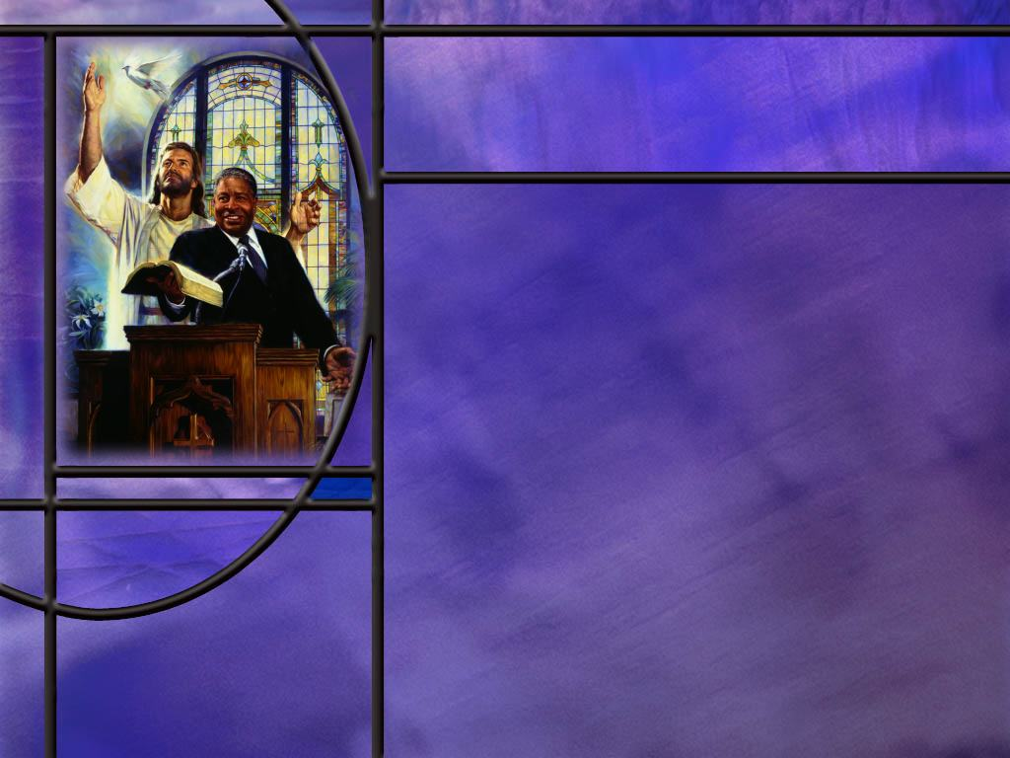
Prophecy vs. Tongues
What evidence do we have that speaking in tongues in the NT is speaking a real language? (Acts 2:4,8,11)
What may have been the problems with speaking in tongues in Corinth? (1 Cor 14)
What made prophecy in the church better than speaking in tongues? (1 Cor 14)
How does Paul make it clear that apostolic authority trumps the authority of the Corinthian prophets? (1 Cor 14:37-38)
How does the modern Pentecostal or charismatic “speaking in tongues” compare to the true gift described in Acts? [Link]
Notes:
B1:
[See notes on linked slide.]
B2:
[See notes on linked slide.]
B3:
[See notes on linked slide.]
B4:
[See notes on linked slide.]
B5:
[See notes on linked slide.]

Slide 7
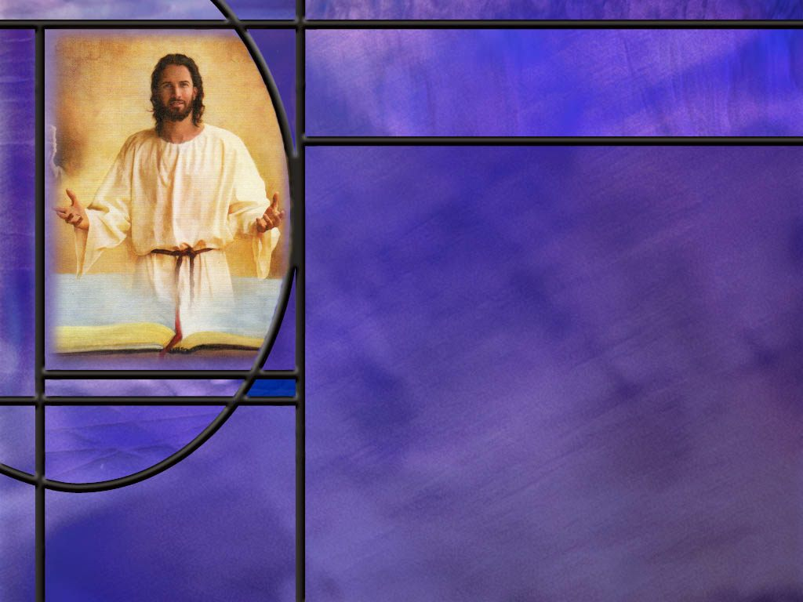
Summary
Spiritual gifts are special talents or abilities that the Holy Spirit gives to each believer to enable us to minister to others in nurture or outreach.
These gifts equip us for ministry, build up the Body, the church, bring us to Christian maturity, unify us in the faith, protect us from false doctrine, and help us grow up into Christ.
Since we have not yet reached the fulness of Christ, spiritual gifts are still needed in the body of Christ and will continue to be needed until Jesus returns.
While the gifts of the Spirit define roles, responsibilities, duties, and jobs within the church, the fruit of the Spirit defines nine different character qualities beginning with love, all of which are given to each believer.

Slide 8
Summary
However, some of the “sign gifts” seem to have ended with the apostolic era.
Without love, Paul insists that even the best gifts are of no value.
His emphasis on the importance of love in using our spiritual gifts indicates that we should be motivated by love and not by pride, rivalry, or a desire for recognition.
Love acts in the eternal best interest of others in the church so that the body can be unified and built up.
The Holy Spirit pours out the agape love of God in our hearts when we trust Jesus for the forgiveness of our sins.
The account of tongues at Pentecost indicates that speaking in tongues in the NT was speaking an actual language.

Slide 9
Summary
By contrast, the gibberish spoken in the modern Charismatic Movement has been extensively studied and shown to be counterfeit both in speaking and interpretation of tongues.
Paul’s overarching aim is that “all things be done for edification” and “decently and in order,” so that the church is built up and unbelievers can be convicted by clear, intelligible proclamation.
Hence, he prefers prophecy to speaking in tongues.
Will you seek the Lord in prayer this week to see if there is some spiritual gift that you could use for Him that would be effective in building up the Body of Christ?

Slide 11
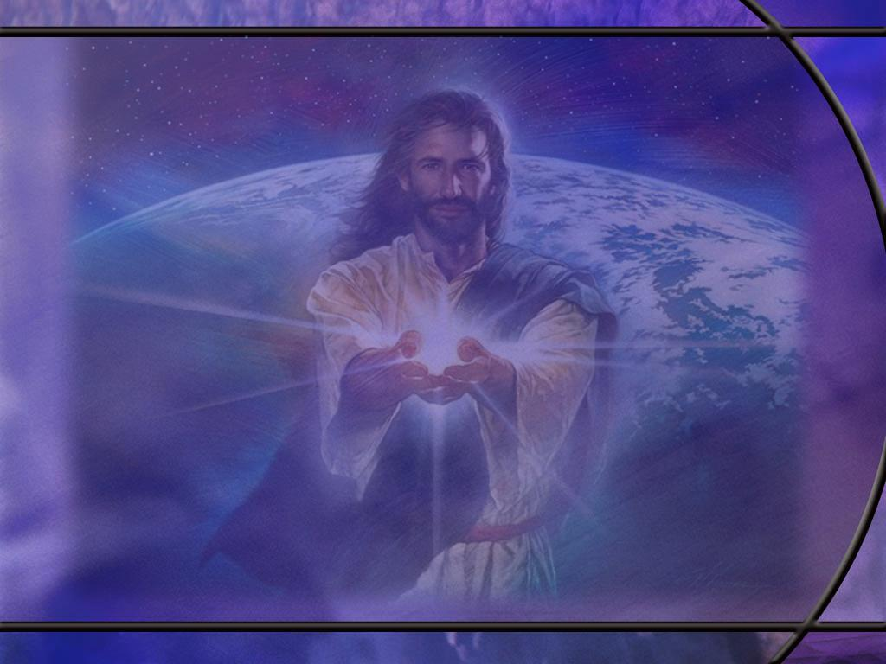
Definitions of Spiritual Gifts
“They are specific abilities given to Christians by the Holy Spirit so we can serve others in nurture and/or outreach.”
(Roy C. Naden Your Spiritual Gifts, Making the Great Discovery)
They are “a divinely ordained spiritual ability through which Christ enables His church to execute its task on earth.” (Michael Youssef, Gifts of the Spirit, Discovering Your Spiritual Gifts)
They are a God-given capacity through which the Holy [R]Spirit works in a believer to express Christ’s love and truth for the benefit of others. (Perplexity AI) [R]
Notes:
1. In all of these definitions it is clear that spiritual gifts are not for the benefit of the possessor of the gift but for the benefit of the church.

Slide 12
Ephesians 4:11-13 NIV
So Christ himself gave the apostles, the prophets, the evangelists, the pastors and teachers, ¹² to equip his people for works of service, so that the body of Christ may be built up ¹³ until we all reach unity in the faith and in the knowledge of the Son of God and become mature, attaining to the whole measure of the fullness of Christ. [R]
Notes:
Q1: What has God given us to bring us into unity?
1. He has given us leaders in the church with spiritual gifts to equip the saints for the work of ministry and for building up the body of Christ, the church.
2. Based on the word of God, written by the apostles and prophets, we should come to unity on the essentials of the faith.
Q2: What end goal does the Lord have in mind for those who are growing in grace?
1. The Lord wants us to grow up unto the measure of the stature of the fulness of Christ.
2. God’s plan and purpose for the redeemed is to become, in character, like Jesus His Son.
Q3: Has the church attained “to the measure of the stature of the fullness of Christ?”
We still have a long way to go.
Q4: So do we still need spiritual gifts?
1. Absolutely.
2. We will need them until the Lord comes again.
3. Now we can argue that some of these sign gifts have passed away with the apostles.
4. But we now have the NT which is the authoritative witness of the apostles to the life, death, resurrection and return of our Lord.
5. And as Jude says, we can earnestly contend for the faith which was once and for all delivered to the saints.
6. We come into unity around the word of God as our source of truth.

Slide 13
1 Corinthians 12:8-11 ESV
For to one is given through the Spirit the utterance of wisdom, and to another the utterance of knowledge according to the same Spirit, ⁹ to another faith by the same Spirit, to another gifts of healing by the one Spirit, ¹⁰ to another the working of miracles, to another prophecy, to another the ability to distinguish between spirits, to another various kinds of tongues, to another the interpretation of tongues. ¹¹ All these are empowered by one and the same Spirit, who apportions to each one individually as he wills. [R]
Notes:
Q1: How many gifts of the spirit does Paul list here? Let’s count them up.
1. Wisdom
2. Knowledge
3. Faith
4. Healing
5. Miracles
6. Prophecy
7. Discernment of spirits
8. Tongues
9. Interpretation of Tongues
If we look at Paul’s other passages on Spiritual Gifts, we can add more:
From Rom 12:3+ we can add
10. Preaching (Exhortation)
11. Teaching
12. Service
13. Giving
14. Leadership
15. Helps
From Eph 4:11, Paul lists some additional gifts:
16. Apostleship
17. Evangelism
18. Pastoring
Some other gifts we can glean from the NT are the gift of Martyrdom, which you exercise only once, and celibacy, which you have to exercise every day!
Q2: Are there other gifts of the Sirit that you can think of?
1. One that comes to my mind is the gift of music.
2. God has given wonderful talents of musical ability to many people who sing or play instruments to add to our worship service and build up the body of Christ.

Slide 14
Clusters of Gifts
Support Cluster: hospitality, support (helps, service, ministry), giving, compassion (mercy), intercession.
Counselor Cluster: insight (discernment), encouragement (exhortation), wisdom.
Teacher Cluster: knowledge, teaching
Shepherd/Evangelist Cluster: evangelism, shepherd (pastor) speaking up for God (prophecy) cross-cultural ministry.
Leader Cluster: leadership, administration
Sign Cluster: voluntary poverty, martyrdom, miracles, healing, exorcism, celibacy, tongues, and interpretation of tongues. [R]
Notes:
This grouping of spiritual gifts is according to Roy C. Naden Your Spiritual Gifts, Making the Great Discovery.
1. The sign gifts of miracles and healings were present in apostolic days, but do not seem to be present today.
2. Healing evangelists like Benny Hinn claim to have the gift of healing, but the evidence belies his claim.
3. The healings can all be explained by psychological manipulation to cure psychosomatic illnesses.
4. Sadly, parents bring their children in a wheelchair, and that’s the way they take them home.
5. If someone truly had the gift of healing, they would be constantly in demand at every hospital in the world.
6. The same is true of the gift of miracles, and tongues and interpretation of tongues.
7. The gift of apostleship applies strictly only to the 12, the apostle Paul, and perhaps others that had seen the risen Lord.
8. So we have no genuine apostles today.

Slide 15
1 Corinthians 13:1-3 ESV
If I speak in the tongues of men and of angels, but have not love, I am a noisy gong or a clanging cymbal. ² And if I have prophetic powers, and understand all mysteries and all knowledge, and if I have all faith, so as to remove mountains, but have not love, I am nothing. ³ If I give away all I have, and if I deliver up my body to be burned, but have not love, I gain nothing. [R]
Notes:
Q1: What spiritual gifts do you see in this passage?
1. First, the gift of tongues.
2. And not just human languages, but the language of angels too.
3. Then there is the gift of prophecy, the gifts of wisdom and knowledge, the gift of faith or faithfulness.
4. And finally, there is the gift of poverty, of giving, and of martyrdom.
Q2: What is the value of any of these gifts if they are exercised apart from love?
1. Paul says they are useless, worthless, nothing, just noise that accomplishes nothing.
2. Paul is going to go on in the remaining verses of chapter 13 to describe agape love and how it acts in the life of believers.
3. We will spend a whole lesson on that next week.
4. But for now, we just want to note love’s effect on spiritual gifts.

Slide 16
Galatians 5:22-23 ESV
But the fruit of the Spirit is love, joy, peace, patience, kindness, goodness, faithfulness, ²³ gentleness, self-control; against such things there is no law. [R]
Notes:
Q1: How do these differ from the gifts of the spirit?
1. The gifts of the Spirit are different abilities that God gives to individuals to enable them to carry out a particular role in ministry.
2. God gives different roles to different people.
3. Different people have different gifts as the HS decides.
4. The fruit of the spirit are character qualities that the Holy Spirit gives to every genuine believer.
5. Every Christian gets all the aspects of the fruit of the Spirit.
6. They may not all be evident all at once, but every aspect of the fruit should be growing in every Christian’s life.
Q2: Where do we get the agape love of God that is so important in ministering the particular gifts that the HS gives us?
1. We get agape love from the HS as the first and most important aspect of the fruit of the Spirit.
2. Paul emphasizes that in:
Romans 5:5 NKJV - Now hope does not disappoint, because the love of God has been poured out in our hearts by the Holy Spirit who was given to us.
3. When we received Jesus, the HS was given to us, and through the Spirit we were born again and the agape love of God began to grow in our hearts.
4. The HS’s work is to renew our minds and change us into the likeness of Christ.
5. That begins with pouring out the agape love of God in our hearts.
6. Every true believer has the HS and is growing in agape love.
7. So Paul is encouraging us to use that agape love to minister our spiritual gifts for the benefit of the church.

Slide 17
Acts 2:4, 8, 11 ESV
And they were all filled with the Holy Spirit and began to speak in other tongues as the Spirit gave them utterance. ... ⁸ And how is it that we hear, each of us in his own native language? ... ¹¹ we hear them telling in our own tongues the mighty works of God." [R]
Notes:
Q1: What can we conclude about the gift of tongues on the day of Pentecost?
1. The disciples were given a miraculous gift of being able to communicate the mighty works of God in languages that they had never studied and did not know.
2. These were actual languages that people who had gathered from many foreign countries understood.
3. They were all speaking foreign languages, but were unlearned men from Galilee.
4. The people were amazed, and well they should have been.
5. This miraculous sign was evidence that the Pentecost movement was of God.
6. It grabbed the people’s attention and assembled a vast crowd to hear Peter’s sermon.
7. The same Greek word for tongues is used in 1 Corinthian 14 as is used in Acts 2.
8. So we can conclude that the tongues spoken at Corinth were real languages.

Slide 18
1 Corinthians 14:2, 4, 9, 11, 13, 19, 23, 27-28 ESV
For one who speaks in a tongue speaks not to men but to God; for no one understands him, but he utters mysteries in the Spirit. ... 4 The one who speaks in a tongue builds up himself, but the one who prophesies builds up the church. ... 9 So with yourselves, if with your tongue you utter speech that is not intelligible, how will anyone know what is said? For you will be speaking into the air. ... 11 but if I do not know the meaning of the language, I will be a foreigner to the speaker and the speaker a foreigner to me. ... 13 Therefore, one who speaks in a tongue should pray that he may interpret. ...

Slide 19
1 Corinthians 14:2, 4, 9, 11, 13, 19, 23, 27-28 ESV
19 Nevertheless, in church I would rather speak five words with my mind in order to instruct others, than ten thousand words in a tongue. ... 23 If, therefore, the whole church comes together and all speak in tongues, and outsiders or unbelievers enter, will they not say that you are out of your minds? ... 27 If any speak in a tongue, let there be only two or at most three, and each in turn, and let someone interpret. 28 But if there is no one to interpret, let each of them keep silent in church and speak to himself and to God. [R]
Notes:
Q1: What is Paul’s concern in the situation he describes here?
1. So apparently, in Corinth, some people were speaking in the worship service in a foreign language which not many in the church understood.
2. Paul’s concern is that the great majority of those attending the worship service are not being edified because they don’t understand what is being said.
3. So he insists that no one speak in tongues unless there is an interpreter that can translate into the common language of the congregation, most likely Greek.
4. He sets the rule that only two or at most three foreign messages be given, that they should be in order, and each should be interpreted.
5. If there is no interpreter, then there should be no tongues.

Slide 20
1 Corinthians 14:3-5, 19 ESV
On the other hand, the one who prophesies speaks to people for their upbuilding and encouragement and consolation. 4 The one who speaks in a tongue builds up himself, but the one who prophesies builds up the church. 5 Now I want you all to speak in tongues, but even more to prophesy. The one who prophesies is greater than the one who speaks in tongues, unless someone interprets, so that the church may be built up. ... 19 Nevertheless, in church I would rather speak five words with my mind in order to instruct others, than ten thousand words in a tongue. [R]
Notes:
Q1: What is the advantage of speaking up for God to relay to others what you believe God has laid upon your heart?
1. If you do so in the language they understand, the church will be built up, encouraged, corrected, and strengthened.
2. Paul would rather speak five words that are understood than ten thousand that are not.
3. But please note that Paul indicates what is spoken by the prophets in Corinth needs to be evaluated.
1 Corinthians 14:29 ESV - 29 Let two or three prophets speak, and let the others weigh what is said.
4. So here we have something similar to what he said to the Thessalonians:
1 Thessalonians 5:20-21 ESV - Do not despise prophecies, ²¹ but test everything; hold fast what is good.
5. To the Corinthians he writes that those who hear the prophets should weigh what is said.
6. Does it agree with scripture? Does it agree with the apostles’ teaching?
7. If so, agree; if not, object!
8. So there may have been some discussion of ideas in the worship service in Corinth.
Q2: What is Paul’s aim for the worship service at Corinth?
1. Paul is aiming to make the worship service at Corinth something that unifies and edifies the church.
2. He writes:
1 Corinthians 14:33, 40 ESV - For God is not a God of confusion but of peace. As in all the churches of the saints, ... 40 But all things should be done decently and in order.
3. The implication is that there was confusion and disorder in the worship service.
4. People were jumping up and talking over each other.
5. There was no time for interpretations of what was said in a foreign language.
6. There may have been no thoughtful evaluations of what was said.
7. Too many people were trying to speak and disorder prevailed.
8. So in our church, we want our worship service to be done decently and in order.

Slide 21
1 Corinthians 14:37-38 ESV
If anyone thinks that he is a prophet, or spiritual, he should acknowledge that the things I am writing to you are a command of the Lord. ³⁸ If anyone does not recognize this, he is not recognized. [R]
Notes:
Q1: What is Paul saying here about His authority vs. the authority of the Corinthian prophets?
1. He is saying that, as an apostle, his writing to them on this matter is a command from the Lord.
2. In NT times, apostolic authority trumps prophetic authority.
3. The inspired word of God that we know as the NT is the testimony of Jesus from Jesus and about Jesus as written under inspiration by the apostles of Jesus.
4. So the authority of the OT prophets passed to the NT apostles.
5. Paul is saying here if you don’t recognize his apostolic authority, you undermine your own prophetic or spiritual authority.
6. The church should not recognize you as genuine.

Slide 22
Speaking in Tongues
Gerhard Hasel (1991)
Linguistic Studies
Prof Samarin of Univ. of Toronto’s Department of Linguistics, published, after more than a decade of careful research, a massive study of glossolalia from a linguistic perspective.
  He found it to be: “a meaningless but phonetically structured human utterance believed by the speaker to be a real language but bearing no systematic resemblance to any natural language, living or dead.”
Notes:
1. These are quotations from the book Speaking in Tongues, written by Gerhard Hasel.
2. He was a very famous professor at Andrews at the time of this writing. He is now dead.
3. This is a quote about detailed linguistic studies made on the modern phenomenon of so-called speaking in tongues, which is also called glossolalia.

Slide 23
Speaking in Tongues
Gerhard Hasel (1991)
Glossolalia in non-Christian religions
  L. Carlyle May shows that glossolalia in non-Christian religions is present in “Malaysia, Indonesia, Siberia, Arctic regions, China, Japan, Korea, Arabia, and Burma, among other places. It is also present extensively in African tribal religions.”
  Glossolalia is not restricted to Christians alone, but many other persons, among them priests, shamans, sorcerers and others of other major religions of the world, engage in glossolalia.

Slide 24
Speaking in Tongues
Gerhard Hasel (1991)
A learned behavior
  The fact that glossolalia can be learned, that it is even “taught” by Pentecostals and other charismatics, that it can be self-taught … is of utmost importance.
  How is it that a non-religious humanities scholar “taught himself” to engage in glossolalia and can continue to do so at will?

Slide 25
Speaking in Tongues
Gerhard Hasel (1991)
Doctrinal Disunity
  Is it not inconsistent that a movement which claims to be in direct contact with the Holy Spirit, to have all gifts such as prophecy, apostleship, and the word of knowledge, to communicate directly with God by tongues-speaking and other means, can at the same time include Roman Catholics, conservative and liberal Protestants, amillennialists, premillennialists, Calvinists, Armenians, those who deny the …inspiration of the Bible, and those who reject Christ’s vicarious atonement on the cross?

Slide 26
Speaking in Tongues
Gerhard Hasel (1991)
Interpretation of “tongues”
  In order to investigate the accuracy of these interpretations, we (Dr. John P. Kildahl) undertook to play a taped example of tongue-speech privately for several different interpreters of tongues. In no instance was there any similarity in the several interpretations. [R]

