Slide 1
First and Second Corinthians
Lesson 3
Unity in Christ

Slide 2

Memory Text
1 Corinthians 1:10 ESV
I appeal to you, brothers, by the name of our Lord Jesus Christ, that all of you agree, and that there be no divisions among you, but that you be united in the same mind and the same judgment.
What is Paul’s appeal here to the church at Corinth?
How does Paul’s appeal reflect Christ’s desire for His church?
How can we be united in the same mind and judgement?
Notes:
B2:
1. His appeal is for unity in the church.
2. He wants them to all be in agreement on the Christian faith.
3. He wants there to be no divisions and contentions in the church.
4. He wants them to be of the same mind and same judgment.
B3:
1. This is the same thing Jesus prayed for in His High Priestly Prayer in John 17 on the night of His betrayal.
2. After praying a beautiful prayer for the eleven disciples that remained faithful, he says:
John 17:20-21 ESV - "I do not ask for these only, but also for those who will believe in me through their word, ²¹ that they may all be one, just as you, Father, are in me, and I in you, that they also may be in us, so that the world may believe that you have sent me.
3. So Jesus prayed for unity among those who believed on Him, that we all may be one, Just as Jesus and the Father are one.
4. And His desire was that when the world sees the love and unity in the church, they would believe that Jesus was sent from God and that His way is God’s way.
5. So we have a special mission here, don’t we?
6. When people see conflict and divisions in the church, when they see criticisms and backbiting, they’re thinking: “Where is the love of Jesus these people claim to follow?”
7. Jesus wants to see love and unity in His church, not fighting and discord.
8. So, it makes sense that, in our memory text, Paul appeals to them in the name of our Lord Jesus Christ.
9. He is saying, based on all he knows about the character of Jesus, this is what Jesus would want.
B4:
1. Whose mind do we need to be united in?
2. We need to be united in the mind of Christ.
3. We will see this in our lesson today when we look at what Paul wrote to the Philippians.
4. “Let this mind be in you which was also in Christ Jesus.”
5. Where Jesus and the inspired word of God have spoken, we need to be in agreement with Him and the word.
6. Where inspiration has not spoken, we need to seek the wisdom and guidance of the HS to humbly agree on a consensus position.
7. In the church, we need to live by the motto:
8. In essentials: unity; in non-essentials, liberty; in all things, charity.
9. We need to be united on the essentials of the Christian faith based on the inspiration of the Bible.
10. We follow the Protestant principle: The Bible and the Bible only is our rule of faith and practice.
11. For non-essentials, we can allow people to have their own opinion.
12. Some Adventist are vegetarian; others eat meat.
13. Some eat three meals a day; others eat only two.
14. Some prefer a red carpet for the sanctuary; others prefer blue.
15. Divisions often occur when we insist on our own opinions on minor issues.
16. Majoring in minors is a sure way to produce divisions in the church.
17. In all things we should exhibit charity, which is the word the KJV uses to translate agape love.
18. Agape love acts in the eternal best interest of others, regardless of how they respond.
19. The more love, the more unity in the church.

Slide 3
Overview
In our lesson today, Paul deals with the problem of divisions and cliques in the Corinthian church. He points the people back to Jesus as the central focus of our faith and encourages them to follow the servant leadership of Jesus and his apostles.
  Personality Cliques
  Apostolic calling
  Paul’s Formula for Unity
  Summary

Slide 4
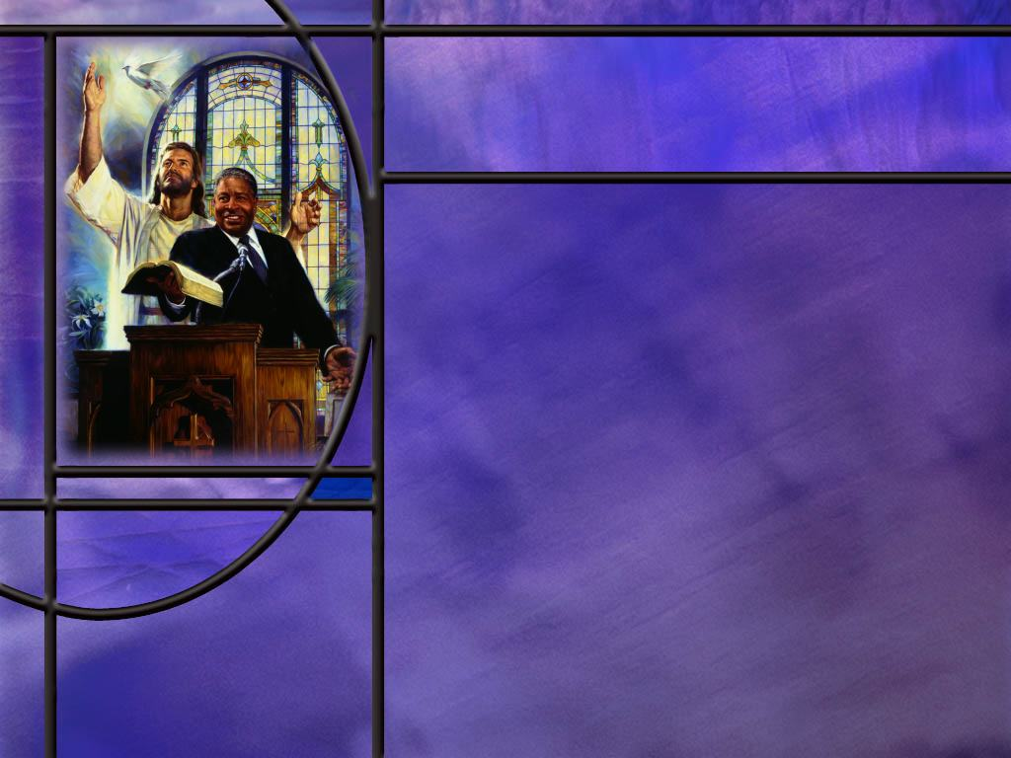
Personality Cliques
How did Paul find out about divisions in the church at Corinth and what was causing them? (1 Cor 1:11-12)
After introducing the problem, where does Paul take his response? (for 30 verses)
After focusing on Jesus, who else does He present as imparting divine wisdom? (1 Cor 2:9-10,12,14,16)
As Paul returns to the personality cliques in chapter 3, what does he say about human personalities? (1 Cor 3:5-7)
What is Paul’s conclusion on this matter? (1 Cor 3:21-23)
Notes:
B1:
[See notes on linked slide.]
B2:
1. This is interesting.
2. Paul introduces the problem in 1 Cor 1:10-17, and he does not get back to it until chapter 3, 30 verses later!
3. In between we have Paul’s presentation of Jesus as the wisdom and power of God.
4. This was our study last week entitled “The Message of the Cross.”
5. As we studied last week, the message of the cross is the gospel of salvation by grace through faith.
6. It is the good news about what Christ has done to save sinners by dying for their sins and offering them justification, sanctification and glorification by faith in Him.
7. He says that Jesus Christ is the manifestation of the power and wisdom of God.
8. It is in Christ that sinners can be forgiven and saved, showing God’s power.
9. It is in Christ that God’s wisdom is shown in devising a plan to defeat sin, humble human pride, and reconcile sinners to Himself.
10. So, the gospel of salvation in Christ becomes the center of the Christian faith.
11. The message of the cross is the message that unites us as Christians.
12. It makes us fall in love with Jesus as our Savior and Lord.
13. I unites us in a fellowship that is destined for eternity together in God’s kingdom.
14. So, in answer to divisions in the Church, Paul holds up the cross as his argument for unity.
B3:
[See notes on linked slide.]
B4:
[See notes on linked slide.]
B5:
[See notes on linked slide.]

Slide 5
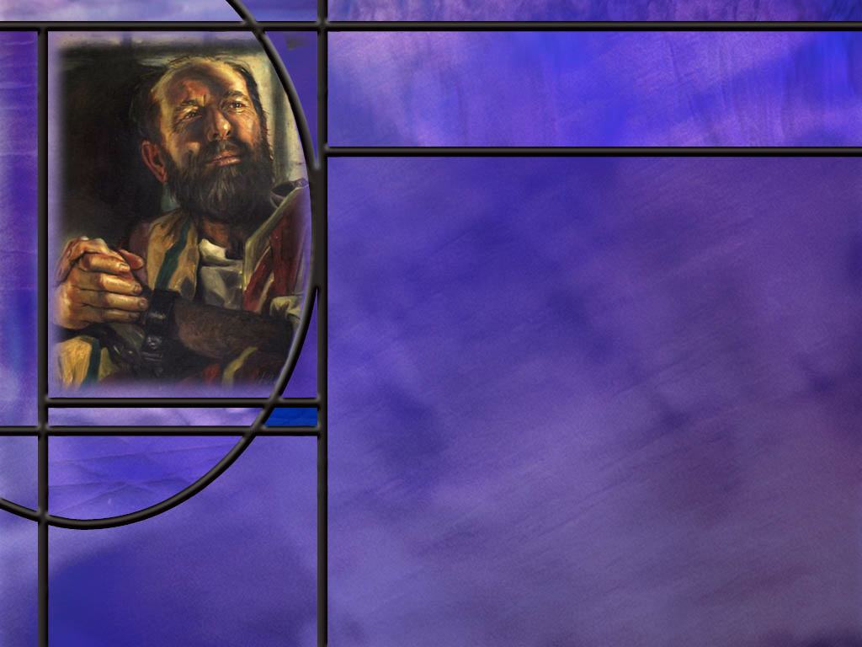
Apostolic Calling
How does Paul see his role as an apostle of Christ? (1 Cor 4:1-2)
How does Paul urge the Corinthians to see him simply as the recipient of spiritual gifts? (1 Cor 4:6-7)
How does Paul describe the apostle’s lot in life that seems to make them objects of scorn rather than heroes. (1 Cor 4:9-11)
Notes:
B1:
[See notes on linked slide.]
B2:
[See notes on linked slide.]
B3:
[See notes on linked slide.]

Slide 6

Paul’s Formula for Unity
What Christian virtues should come from knowing Jesus? (Phil 2:1-2)
What is Paul’s remedy for the disunity that may have persisted at Philippi? (Phil 2:3-4)
What is Paul’s ultimate remedy for pride, conceit, and disunity? (Phil 2:5)
Notes:
B1:
[See notes on linked slide.]
B2:
[See notes on linked slide.]
B3:
[See notes on linked slide.]

Slide 7
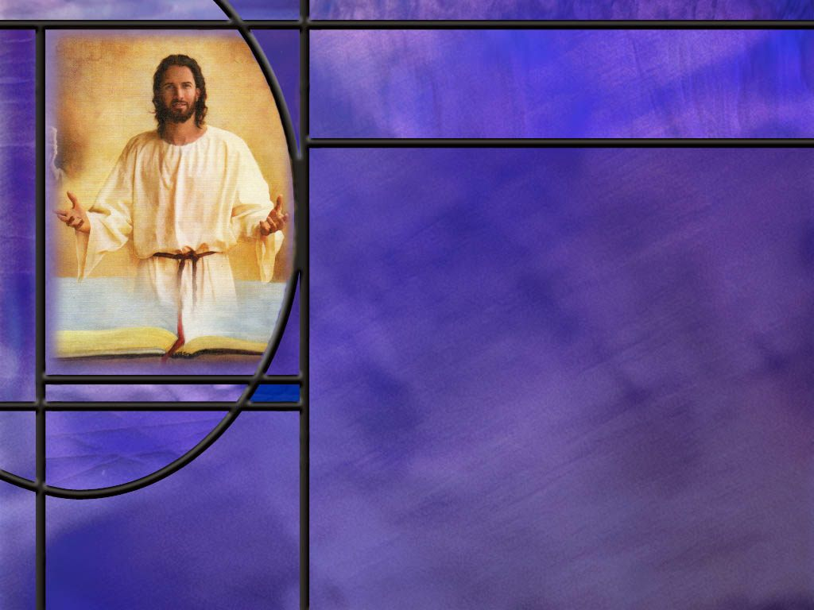
Summary
Paul’s desire for the churches to which he wrote was to see love and unity between believers.
This desire reflects that of Jesus who prayed that we may all be one as He and the Father are one so that the world may believe.
The church in Corinth was plagued by division and quarreling over personality cliques following Peter, Paul, or Apollos, rather than being united in following Christ.
After introducing the problem, Paul presents the message of the cross as the power of God to save sinners and the wisdom of God to devise the plan of salvation. The Holy Spirit is the divine agent who reveals to us who are Christ’s the deep tings of God.

Slide 8
Summary
Paul points out that apostles are simply servants of Christ using the gifts God has given them. What do we have that we have not received?
One plants, another waters but God gives the increase. Therefore, he insists, the glory should go to God.
If we are in Christ, we have all things that really matter in the end. Salvation is by God’s grace, so there is no need to boast in men.
Paul presented a bleak picture of the life of an apostle. There were no worldly perks in such a life, but this was evidence that their love for Christ and His truth was genuine. They were not in it for worldly gain, power, or prestige, and success in their weakness would bring more glory to God.

Slide 9
Summary
In Paul’s letter to the Philippian church, he calls for humility rather than pride and considering the interests of others rather than self.
His final appeal is to “let this mind be in you which was also in Christ Jesus.”
Though He was God, Jesus humbled himself, became human, became a servant and died on the cross for our sins.
If Jesus can humble Himself to such a degree, how much more should those who follow Him be willing to humble themselves and promote love and unity in the church.
Knowing today who Jesus is and what He has done to save you, will you ask the Holy Spirit to form the character of Christ in you and make you an agent of love and unity?

Slide 11
1 Corinthians 1:11-12 ESV
For it has been reported to me by Chloe's people that there is quarreling among you, my brothers. ¹² What I mean is that each one of you says, "I follow Paul," or "I follow Apollos," or "I follow Cephas [Peter]," or "I follow Christ." [R]
Notes:
1. Cephas is the Aramaic name for Peter.
Q1: What can we infer about Chloe from this text?
1. First of all, Chloe is a woman’s name.
2. Second, she would have to be well known in the Corinthian church, because Paul assumes everybody would know her.
3. Third, she had a family, one or more of which had reported to the apostle that there were divisions in the church.
4. This is the only mention of her in the Bible.
5. She was likely a prominent, influential Christian woman or a house-church leader in Corinth.
6. It is interesting that Paul protects the confidentiality of his informants but gives enough information to confirm that there is a well-known problem.
Q2: What was going on in the church?
1. There was quarreling among the baptized church members.
2. People had formed cliques around personalities in the early church.
3. Paul doesn’t say exactly what the divisions were about.
4. All of these leaders should have been preaching the same doctrines.
5. Paul goes on to say he is glad he did not baptize many in Corinth, so it is likely that they had formed cliques depending on who had baptized them.
Q3: Which of these four groups got it right?
1. Those who said, “I follow Christ.”
2. We should not put any human being in Christ’s place.
3. We are all disciples of Jesus Christ.
4. It doesn’t matter who baptized us; it’s to Jesus that we all belong.
5. We’re united in Christ, not divided by who baptizes us.
6. In the very next verse, Paul asks some rhetorical questions:
1 Corinthians 1:13 (NKJV)
¹³ Is Christ divided? Was Paul crucified for you? Or were you baptized in the name of Paul?
7. We are unified by what Christ did on the cross for us, and we are baptized into His name as a sign that He has forgiven our sins and is our Savior.
8. So Paul is encouraging everyone here to follow Christ, not the one who baptized you.

Slide 12
1 Corinthians 2:9-10, 12, 14, 16 ESV
But, as it is written, "What no eye has seen, nor ear heard, nor the heart of man imagined, what God has prepared for those who love him"-- ¹⁰ these things God has revealed to us through the Spirit. For the Spirit searches everything, even the depths of God. ... ¹² Now we have received not the spirit of the world, but the Spirit who is from God, that we might understand the things freely given us by God. ... ¹⁴ The natural person does not accept the things of the Spirit of God, for they are folly to him, and he is not able to understand them because they are spiritually discerned. ... ¹⁶ "For who has understood the mind of the Lord so as to instruct him?" But we have the mind of Christ. [R]
Notes:
Q1: How does God impart divine wisdom to those who have received Christ?
1. Here Paul argues that it is the work of the Holy Spirit that leads us into the divine truth of God.
2. Jesus said,
John 16:13 ESV - When the Spirit of truth comes, he will guide you into all the truth, for he will not speak on his own authority, but whatever he hears he will speak, and he will declare to you the things that are to come.
3. Here Paul argues that the Holy Spirit reveals to believers the deep things of God.
4. True divine wisdom comes from the HS, not from the wisdom of this world.
1 Corinthians 2:14 KJV - But the natural man receiveth not the things of the Spirit of God: for they are foolishness unto him: neither can he know them, because they are spiritually discerned.
5. The pagan philosophers of Greece and Rome look at Christianity and call it foolishness.
6. But those who have received the Holy Spirit see God’s wisdom in the plan of salvation.
7. Paul ends the chapter with a rhetorical question: Who has understood the mind of the Lord so as to instruct him?
8. The obvious answer is that the mind of God is far beyond human reasoning to understand.
9. No human can instruct the Lord!
10. Then he ends the chapter with this declaration: “But we have the mind of Christ.”
Q2: What do you think Paul means by those words?
1. When we come to Christ and are justified by faith, He gives us the Holy Spirit.
2. The Spirit produces the new birth and gives us a new direction in life.
3. Our worldview is changed from trying to please ourselves to trying to please God.
4. Instead of running after sin we are running away from it.
5. The word of God and the commandments of God makes sense, and the Spirit leads us into conformity with the divine will.
6. As we fall in love with Jesus, we will keep his commandments and grow in His likeness.
7. The Spirit writes God’s law in our hearts and puts it in our minds and we delight to do God’s will.
8. The process of sanctification is a process of “having the mind of Christ.”
9. Through the Holy Spirit, believers are given a share in Christ’s own outlook, values, and understanding of God’s wisdom, especially as revealed in the cross.
10. Paul is assuring the church that, in contrast to the world’s wisdom, they already share in Christ’s own way of seeing and valuing things through the Spirit.
11. This is particularly seen in their recognition that the crucified Messiah is the true wisdom and power of God.

Slide 13
1 Corinthians 3:5-7 ESV
What then is Apollos? What is Paul? Servants through whom you believed, as the Lord assigned to each. ⁶ I planted, Apollos watered, but God gave the growth. ⁷ So neither he who plants nor he who waters is anything, but only God who gives the growth. [R]
Notes:
Q1: To whom does Paul point as the source of growth in the Christian life?
1. His argument is that is is God who produces growth in the Christian life.
2. The Holy Spirit convicts us of sin and of the need of righteousness and of judgment to come.
3. The Holy Spirit reveals Jesus as the only solution to the sin problem that has separated us from God.
4. It is through the enlightenment of the HS that our hearts are drawn to Christ who suffered and died for us.
5. Coming to Christ and growing in Christ are possible only through God’s mercy and grace.
6. So Paul’s argument is don’t glory in the human servants who pointed you to Jesus.
7. Glory in the God who saved you by His mercy and grace and impressed His truth on your heart.
Q2: What analogy does Paul use here for becoming a mature Christian?
1. He is using the analogy of a seed growing.
2. Yes, it is essential that someone plant the seed.
3. Yes it is essential that someone water the seed.
4. But without a viable seed that God has created, the planting and watering would be in vain.
5. God has created within every seed a genetic code that directs the growth of the seed into a mature plant that bears fruit.
6. Without that genetic code and the properties God has placed within the seed to respond to water, nutrients, light, air, temperature, etc. the seed would never germinate and grow.
7. Paul’s analogy is that the planting and watering are impossibly simple compared with the work of the Holy Spirit to germinate and grow mature Christians.
8. So, the glory should go to God for His love, mercy, grace, and forgiveness, not so much to the messengers who brought the good news.
Q3: How can Paul’s teaching here relieve us from the stress of needing to convert people?
1. We don’t need to worry about making converts.
2. That’s not our job.
3. We can leave that to the Holy Spirit.
4. But let us be faithful in planting and watering and trust God with the results.

Slide 14
1 Corinthians 3:21-23 ESV
So let no one boast in men. For all things are yours, ²² whether Paul or Apollos or Cephas or the world or life or death or the present or the future--all are yours, ²³ and you are Christ's, and Christ is God's. [R]
Notes:
Q1: How does Paul start his conclusion here?
1. “Let no one boast in men.”
2. If you are boasting in a man, even a minister of the gospel, you have set your sights far too narrow.
3. If you are in Christ, all things are yours!!
4. Don’t limit yourself to one man.
5. Paul, Apollos and Cephas are all your ministers and servants given to minister in the church.
6. The whole world is yours because the meek will inherit the earth.
7. This will be our eternal home if we are in Christ.
8. Life is ours: eternal life in Christ.
9. Death is only a short rest before Jesus comes to wake us to eternal life.
10. The present and the future are ours too because we belong to Christ and Christ belongs to God.
11. This is reminiscent of the end of Romans 8 where nothing can separate us from the love of God which is in Christ Jesus our Lord.
12. The true defining mark of the believer is belonging to Christ, not attachment to a particular human leader or style of ministry.
13. Paul is saying here: Stop shrinking your horizons down to your favorite person.
14. In Christ you already have everything you truly need, because you belong to Him, and He belongs to God.

Slide 15
1 Corinthians 4:1-2 ESV
This is how one should regard us, as servants of Christ and stewards of the mysteries of God. ² Moreover, it is required of stewards that they be found faithful. [R]
Notes:
Q1: How does Paul view himself and other minister of the gospel here?
1. They should be regarded as servants of Christ.
2. They are not to be exalted or worshipped like royalty.
3. They are mere servants of the Lord.
4. They are not some great philosophers that have arrived at truth from their own wisdom.
5. They are stewards, managers of divine revelations.
6. What they preach and teach are not from their own surmising.
7. They are merely caretakers of God’s truth and they must be judged faithful by God.

Slide 16
1 Corinthians 4:6-7 ESV
I have applied all these things to myself and Apollos for your benefit, brothers, that you may learn by us not to go beyond what is written, that none of you may be puffed up in favor of one against another. ⁷ For who sees anything different in you? What do you have that you did not receive? If then you received it, why do you boast as if you did not receive it? [R]
Notes:
Q1: What is Paul’s argument here in verse 7 that takes away reasons for boasting in human leaders?
1. He is saying here that the apostles are just using their spiritual gifts like everyone else in the church.
2. What do you have that you have not received from God?
3. Everyone’s spiritual gifts come from God, so there is no room to boast for any Christian as though they have done it on their own.
4. Every “good gift” comes from God, so there is no room for self-exaltation, only for boasting in the Lord.
5. Their pride shows they have forgotten that they are receivers, not originators, of all their spiritual advantages.

Slide 17
1 Corinthians 4:9-11, 13 ESV
For I think that God has exhibited us apostles as last of all, like men sentenced to death, because we have become a spectacle to the world, to angels, and to men. ¹⁰ We are fools for Christ's sake, … ¹¹ To the present hour we hunger and thirst, we are poorly dressed and buffeted and homeless, ... ¹³ We have become, and are still, like the scum of the world, the refuse of all things. [R]
Notes:
Q1: Why such a bleak picture of the apostolic lifestyle?
1. Perhaps the Corinthian Christians have the wrong idea about what it means to be an apostle.
2. There are no worldly perks to attract someone to be an apostle.
3. In fact, their bleak existence would give them every incentive to find another line of work.
4. But their reward in the end was worth all the deprivation they were enduring at the present time.
5. They were faithful to their calling despite their deprivations.
6. And this was God’s intentions: none of the apostles were in it for the money, the fame, social status, the praise of men.
7. They were in it for the love of Christ and the rewards He promised to those who love Him.
8. The success of their efforts brought glory to God not to themselves.
9. So here Paul is intentionally taking some of the luster off of what it means to be an apostle in order to correct the thinking of the Corinthians that have placed them on a pedestal rather than seeing them as servants of Christ.

Slide 18
Philippians 2:1-2 NLT
Is there any encouragement from belonging to Christ? Any comfort from his love? Any fellowship together in the Spirit? Are your hearts tender and compassionate? ² Then make me truly happy by agreeing wholeheartedly with each other, loving one another, and working together with one mind and purpose. [R]
Notes:
Q1: What is Paul asking here in verse 1?
1. He is asking if belonging to Christ has made any difference in their life?
2. Is there any benefit from belonging to Christ?
3. Has His love brought you any comfort and hope and assurance?
4. Is the Holy Spirit at work in your hearts?
5. Has the Spirit made your hearts tender toward each other and compassionate?
6. If you are growing in grace and the Spirit is softening your heart then I have a favor to ask…
Q2: What favor does Paul ask in verse 2?
1. He asks them to make him happy by agreeing together as brethren in the church.
2. He wants them to love each other and work together with one mind and purpose.
Q3: What do you think may have been the problem in the Philippian church?
1. Apparently, there was contention and disunity.
2. They were not united in love.
3. There was pride and self-centeredness, people thinking “It’s my way or the highway.”
4. Paul addresses a lack of love, a lack of unity, a lack of cooperation because of personal ambition, pride, and self-exaltation.
5. Perhaps the lack of unity in Philippi is more relevant to our churches today than the personality cliques in Corinth.
6. So we need to listen to Paul’s advice here.

Slide 19
Philippians 2:3-4 NIV
Do nothing out of selfish ambition or vain conceit. Rather, in humility value others above yourselves, ⁴ not looking to your own interests but each of you to the interests of the others. [R]
Notes:
Q1: For unity in the church, what two characteristics do we need to avoid and what do we need to have?
1. We need to avoid selfish ambition and vain conceit.
2. We need to have humility and love for others.
Q2: How would you describe selfish ambition?
1. It would be an attitude to make a name for yourself, to promote yourself, to make yourself number one, to be a person that others look up to and compliment and respect.
2. Selfish ambition goes along with pride, seeking glory for yourself instead of giving glory to God.
3. This was the original sin of Lucifer in heaven: pride and self exaltation, seeking the worship that belonged only to God.
4. In Galatians 5:20, Paul list selfish ambition along with a host of other sins, including witchcraft and idolatry!
Q3: How would you describe “vain conceit.”
1. This is again related to pride.
2. Conceit is thinking of yourself as better than others.
3. Google’s AI defines it this way:
an empty, inflated, and excessive pride or self-importance, often based on a false sense of superiority in looks, achievements, or abilities, leading to self-centered actions and a desire for hollow recognition rather than genuine worth or God's glory.
Q4: What remedy does Paul recommend for the pride that brings disunity?
1. He recommends humility instead of pride.
2. Rather than thinking you are better than others, value others above yourself!
3. Don’t just think of your own interests, think about the interests of others.
4. Don’t think about what the church can do for you , but what you can do for them.
5. The Bible warn us against pride.
6. Peter writes this:
1 Peter 5:5-6 KJV - 5 … Yea, all of you be subject one to another, and be clothed with humility: for God resisteth the proud, and giveth grace to the humble. 6 Humble yourselves therefore under the mighty hand of God, that he may exalt you in due time:

Slide 20
Philippians 2:5 NKJV
Let this mind be in you which was also in Christ Jesus, [R]
Notes:
Q1: What does it mean to you to let the mind of Jesus be in you?
1. This is a call to be an imitator of the Lord Jesus Christ.
2. To make Him our example in everything.
3. Seek to emulate the way He would act.
4. To ask what would Jesus do, and then do it!
Q2: How can we get the mind of Jesus. How can our minds become more like His in character?
1. This is the work of the Holy Spirit.
2. When we receive Jesus as our Savior and Lord, He forgives our sins, gives us His righteousness and saves us.
3. At the same time, He gives us the Holy Spirit to give us the new birth and a new direction in life.
4. The Holy Spirit pours out the agape love of God in our hearts and gives us the fruit of the Spirit to conform us to the likeness of Christ.
5. Paul writes in Rom 8:29 that God “predestined us to be conformed to the image of His Son.”
6. God’s desire for every Christian is to become more like Jesus in character.
7. And 2 Cor 3:18 tells us that, as we behold Jesus and His character, the HS changes us into His likeness.
2 Corinthians 3:18 NKJV - 18 But we all, with unveiled face, beholding as in a mirror the glory of the Lord, are being transformed into the same image from glory to glory, just as by the Spirit of the Lord.
8. To get the mind of Jesus we need to behold His character in the Word of God and pray for the HS to conform us to His likeness in character.
9. Pray for the fruit of the Spirit to grow, especially the agape love of God.
10. The fruit of the Spirit is a description of the character of Jesus: love, joy, peace, patience, kindness, goodness, faithfulness, gentleness, and self-control.
11. This fruit does away with selfish ambition and vain conceit and replaces them with agape love that acts in the eternal best interest of others rather than self.
12. A spirit-filled church will be a church that is unified on the fundamentals of the faith and is living in love for one another.
13. In the verses following verse 5, Paul goes on to describe the condescension of Jesus.
14. Though He was God, He humbled Himself taking our humanity upon His divinity.
15. Coming, not as royalty, but as a servant to seek and save that which was lost.
16. He humbled himself and became obedient unto death.
17. Dying the most humiliating death possible on a cross.
18. If Jesus, the Son of God, can so humble Himself, how much more should we be willing to follow His example and humble ourselves.

