Slide 1
First and Second Corinthians
Lesson 1
Paul’s Ministry in Corinth

Slide 2

Memory Text
Acts 18:9-10 RSV
One night the Lord said to Paul in a vision, “"Do not be afraid, but speak and do not be silent; for I am with you, and no one will lay a hand on you to harm you, for there are many in this city who are my people.“
How do you think Paul felt after having this vision?
What similar promise did the Lord make to all who would be His disciples in the great commission?
Knowing that the Lord is also with us, how can we approach opportunities to minister for Him?
Notes:
B2:
1. Perhaps encouraged, safe, accepted, empowered, protected by God almighty.
2. Here is Jesus, his Lord and Savior, encouraging Paul with a promise to be with him and protect him.
3. He had just been to Thessalonica and Berea.
4. In both places the Jews had organized to run him out of town.
5. Perhaps he was wondering if the same would happen in Corinth.
6. But with this encouraging word from the Lord, Paul was able to settle in and minister in Corinth for a year and a half.
B3:
1. These are his final words as recorded in the book of Matthew.
2. “and lo, I am with you always, even to the end of the age.” (Matt 28:20b)
3. So even though Jesus ascended to heaven, He has sent the Holy Spirit to be our Helper, our Comforter, our Councilor, our Guide, to be the divine representative of Jesus.
4. It is by His Spirit that Jesus can be present with every believer at the same time, in every location all over the world.
5. So we can claim this promise of Jesus that “I am with you.”
6. We also have His promise in:
Hebrews 13:5-6 NKJV - …For He Himself has said, "I will never leave you nor forsake you." ⁶ So we may boldly say: "The LORD is my helper; I will not fear. What can man do to me?“
7. So in this vision, Jesus is renewing His promise to Paul to be with him and protect him.
B4:
1. We too can follow the Lord’s instructions to the apostle Paul:
2. “Do not be afraid, but speak and do not be silent.”
3. We have a testimony to share about what the Lord has done for us.
4. We have been redeemed by the blood of the Lamb, our sins have been forgiven, we have been born again and adopted into the family of God.
5. Nobody can contradict your testimony about what Jesus has done for you.
6. We are sinners, saved by grace, and promised eternal life because of what Chrit has done for us.
7. There is a wonderful little verse in:
Psalm 107:2 KJV - Let the redeemed of the LORD say so, whom he hath redeemed from the hand of the enemy;
8. We have been redeemed from the hand of the enemy.
9. So let’s not be afraid to “say so.”

Slide 3
Overview
First and second Corinthians are letters written by the apostle Paul to the church of Corinth. In the first, Paul deals with problems in the church and questions that church members raised for him to answer. In the second, Paul seeks to establish his credentials as a worthy minister of the gospel. Our lesson this week sets the stage for understanding his ministry to the Corinthian church.
  Paul’s Identity and Authority
  Missionary Church Planter
  Prolific Letter Writer
  Summary

Slide 4
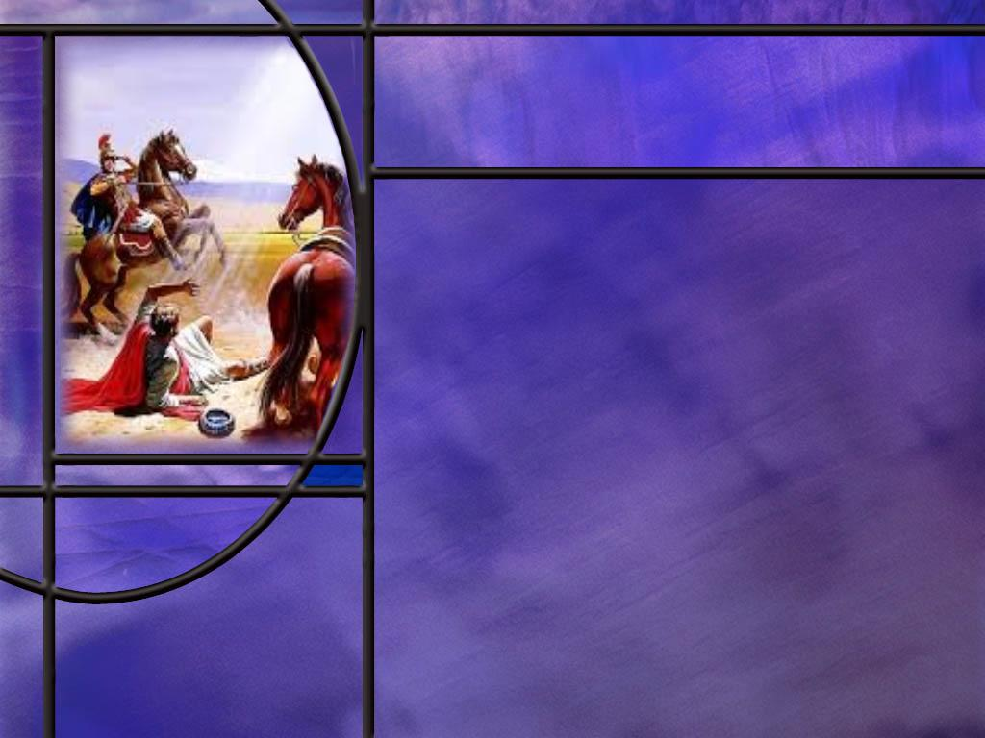
Paul’s Identity and Authority
How did Paul identify himself in his greetings to the Corinthian church? (1 Cor 1:1, 2 Cor 1:1)
How does Paul include himself with the other apostles as he describes the eyewitnesses of the resurrection? (1 Cor 15:5-8)
Why was it important for Paul to establish the fact that he was an apostle of Jesus Christ?
What was Paul’s claim about his understanding of the gospel? (Gal 1:11-12)
Notes:
B1:
[See notes on linked slide.]
B2:
[See notes on linked slide.]
B3:
1. The Greek “apostolos” (ap-os'-tol-os) means a delegate, a messenger, one sent forth with orders.
2. The twelve apostles were the ones that spent time learning from Jesus.
3. They witnessed His teaching, His healing, His love, His compassion, His character.
4. They witnessed His crucifixion and His resurrection and His ascension.
5. They received the fullness of the Holy Spirit on the day of Pentecost and became His witnesses in Jerusalem, and in all Judea and Samaria, and to the ends of the earth.
6. The apostles were instrumental in writhing the gospels, early church history, the epistles and Revelation.
7. They were the witnesses of Jesus as they bore their inspired testimony of Jesus in the books of the NT.
8. They were commissioned by Jesus to spread the gospel of salvation by grace through faith to all the world.
9. So the apostles had the authority from Christ Himself to establish the true Christian faith.
10. Paul, in taking the title of apostle of Jesus Christ, claimed the authority to preach and teach as one sent by Jesus Himself.
11. This gave him the authority to preach and defend the true gospel of righteousness by faith and to correct the churches to live the true Christian life that pleased and honored the Lord.
12. Even though he was not a disciple of Christ during His earthly ministry, being an apostle identified Paul with the 12 who were eyewitnesses of the crucifixion and the resurrection and received the outpouring of the Holy Spirit.
B4:
[See notes on linked slide.]

Slide 5
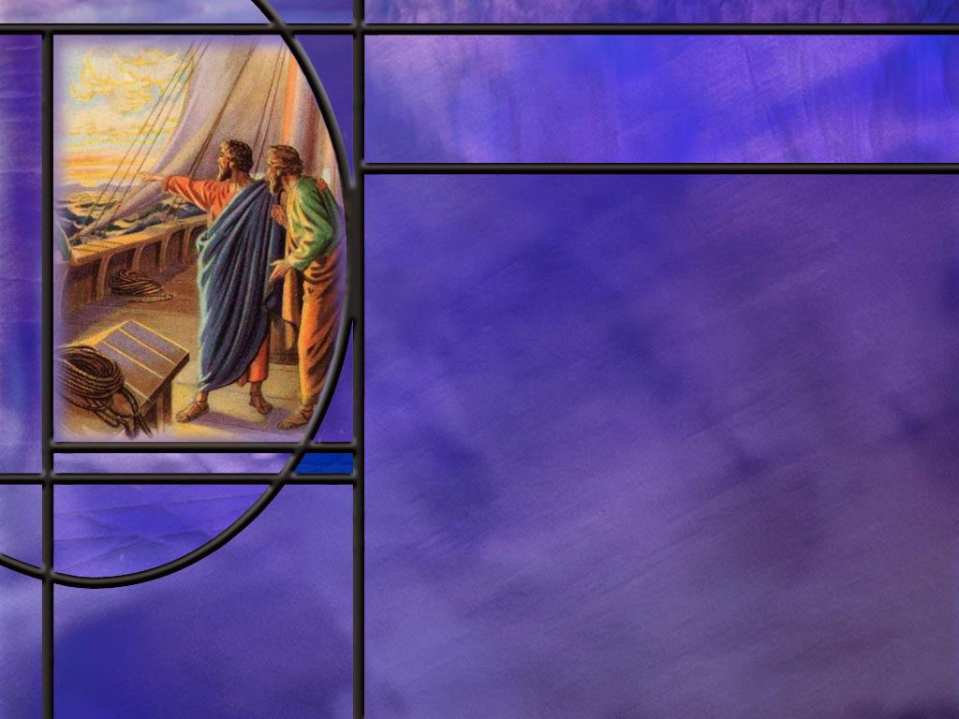
Missionary Church Planter
Where did the apostle Paul journey to establish new Christian churches? [Maps]
What was the culture like in Corinth when Paul arrived there in about 50 AD? [Culture]
How did Paul begin his ministry in Corinth? (Acts 18:1-6)
What happened when Paul left the synagogue and started a church next door? (Acts 18:7-8)
What problems did the apostle Paul address in first Corinthians? [Problems]
Notes:
B1:
[See notes on linked slide.]
B2:
[See notes on linked slide.]
B3:
[See notes on linked slide.]
B4:
[See notes on linked slide.]
B5:
[See notes on linked slide.]

Slide 6
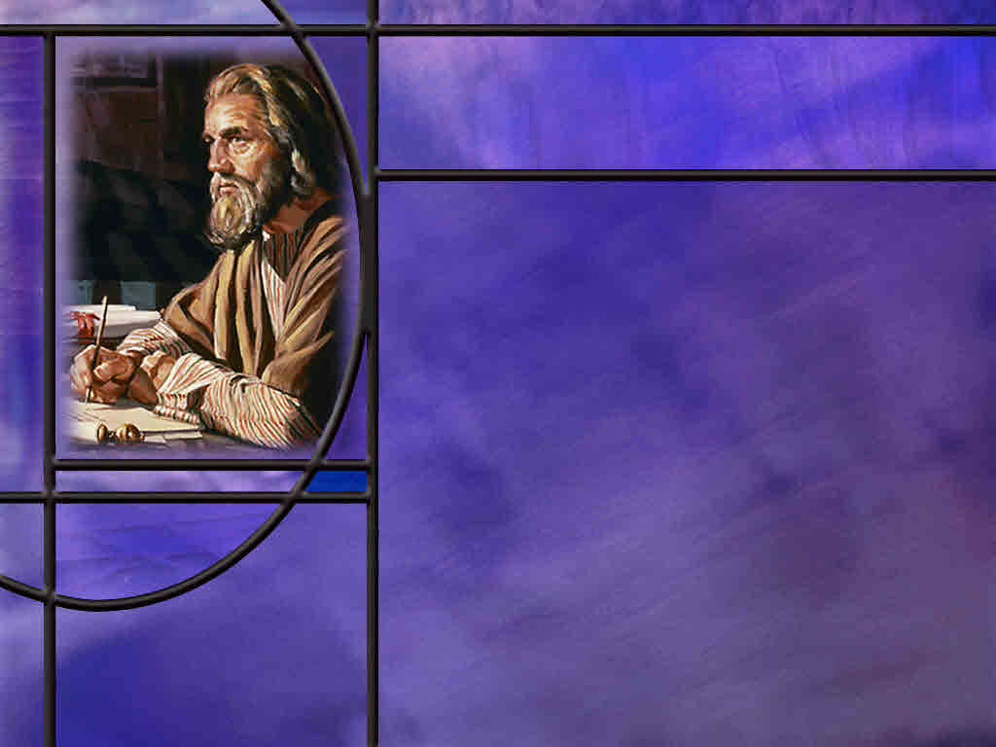
Prolific Letter Writer
How many letters of Paul appear in the New Testament?
How many letters did Paul write to the Corinthians? (1 Cor 5:9)
What letter did the Corinthians write to Paul? (1 Cor 7:1)
Notes:
B1:
1. There are 13 letters of Paul in the NT.
2. This excludes Hebrews which some attribute to the apostle Paul but others do not.
3. His letters make up nearly half of the 27 books of the NT.
4. He is responsible for writing 23.5% of the words of the NT, second only to Luke.
5. These letters are full of inspired theology and practical guidance for living the Christian life.
B2:
[See notes on linked slide.]
B3:
[See notes on linked slide.]

Slide 7

Summary
The apostle Paul consistently presented himself in his letters as an apostle of the Lord Jesus Christ
Although he was not one of the twelve, he identified with them as having seen the Lord and having been commissioned and sent to proclaim the Gospel, particularly to the Gentiles.
In writing to the Galatians, he declared that his understanding of the gospel did not come from man but by direct revelation from Jesus Christ Himself.
Paul’s gospel was righteousness by faith: we are saved by God’s grace in sending His Son to die for our sins, and we receive His grace by faith trusting in Jesus for the forgiveness of our sins and eternal life with God.

Slide 8
Summary
As an apostle, Paul had the authority to defend the faith and correct the church in theology and practice.
From 44 to 58 AD, Paul led three missionary journeys to Asia Minor and into Greece.
He established at least eight churches in various cities and encouraged others through his letters.
In Corinth, he began in the synagogue to preach Christ as the Messiah, but when opposition arose, he moved to a house next door and baptized the synagogue leader and his family. Many were then added to the church.
Corinth was a large city near Athens, a crossroads for commerce, trade, and travel

Slide 9
Summary
Its Greek and Roman culture was rife with idolatry and immorality including temple prostitutes in the temple of Aphrodite.
It is little wonder that the church had problems in such an environment.
In 1 Corinthians Paul deals with divisions in the church, lawsuits between believers, sexuality immorality in the church, marriage and divorce, sexual relations, food offered to idols, spiritual gifts in public worship, and doubts about the resurrection.
Much of His inspired council can be applied to us and our churches today.
As you study these letters this quarter, will you listen with an open heart to what the Spirit says to you?

Slide 11
1 & 2 Corinthians 1:1 ESV
1 Corinthians 1:1 ESV Paul, called by the will of God to be an apostle of Christ Jesus, and our brother Sosthenes,
2 Corinthians 1:1 ESV - 1 Paul, an apostle of Christ Jesus by the will of God, and Timothy our brother, To the church of God that is at Corinth, with all the saints who are in the whole of Achaia: [R]
Notes:
Q1: What does Paul emphasize here in his greetings to the church at Corinth?
1. He emphasizes that he is an apostle of Christ Jesus by the will of God.
2. He is not a self-proclaimed apostle.
3. He has been called to be an apostle by God Himself.
4. Three times in the book of Acts, Luke records Paul recounting the story of his call to apostleship on the road to Damascus.
5. There he saw Jesus in vision.
6. There he was confronted with the fact that he was persecuting Jesus the living Messiah.
7. He was given the commission of preaching Christ to both Jew and Gentile.
8. After three days of blindness, he received his sight and was baptized and became the leading missionary of the early church.
9. His apostleship was clearly the will of God.
Q2: Who are Sosthenes and Timothy mentioned by name in these greetings?
1. These were co-workers with Paul.
2. They may have been his scribes who actually wrote down what Paul dictated to them.
3. But, Paul is clearly the author of these two books.
4. If they were simply co-workers instead of scribes, Paul may have included them as approving the letters he wrote as Christian witnesses known to the church at Corinth.
5. In OT law, truth was established by two or three witnesses.

Slide 12
1 Corinthians 15:5-8 NKJV
and that He was seen by Cephas, then by the twelve. ⁶ After that He was seen by over five hundred brethren at once, of whom the greater part remain to the present, but some have fallen asleep. ⁷ After that He was seen by James, then by all the apostles. ⁸ Then last of all He was seen by me also, as by one born out of due time. [R]
Notes:
Q1: So how many eyewitnesses to the risen Christ do we have in this account?
1. Well over 500!
2. We have all of the apostles.
3. We have the women that followed Jesus and were the first witnesses of His resurrection.
4. We have the disciples on the road of Emmaus.
5. And this amazing gathering of over 500 brethren that see Him at one time.
6. Luke records in:
Acts 1:3 ESV - He presented himself alive to them after his suffering by many proofs, appearing to them during forty days and speaking about the kingdom of God.
7. So here we have a period of 40 days where Jesus met time and again with His followers, showing by many proofs that He was alive.
8. We also have the Messianic prophecies that prove that Jesus was the Messiah.
9. And one of these prophecies says:
Psalm 16:10 (NKJV)
¹⁰ For You will not leave my soul in Sheol [the grave], Nor will You allow Your Holy One to see corruption.
10. This text was used by Peter on the day of Pentecost as OT support for the resurrection of Jesus.
11. And finally, we have the witness of the apostle Paul of seeing the resurrected Jesus on the road to Damascus, hearing His voice, and surrendering his life to Him.

Slide 13
Galatians 1:11-12 NIV
I want you to know, brothers and sisters, that the gospel I preached is not of human origin. ¹² I did not receive it from any man, nor was I taught it; rather, I received it by revelation from Jesus Christ. [R]
Notes:
Q1: Where did the apostle Paul get the gospel that he preached?
1. He got it from Jesus.
2. He didn’t get it from Peter, James, or John.
3. He didn’t get it from some other apostle or from other men.
4. He got the gospel through direct revelations from the Lord Jesus Christ.
5. So we can be sure that Paul’s gospel of salvation by grace through faith is the true gospel revealed to him by Jesus Christ.
Q2: Where and when do you suppose that Paul received this revelation?
1. Paul encountered the risen Lord on the road to Damascus.
2. In the brief account in Acts 9:3-6, it doesn’t seem like Paul and the Lord had much of a discussion about his message or his mission.
3. But when Paul recounts his conversion story before King Herod Agrippa, here’s what he remembers Jesus saying unto him:
Acts 26:16-18 (NKJV)
¹⁶ But rise and stand on your feet; for I have appeared to you for this purpose, to make you a minister and a witness both of the things which you have seen and of the things which I will yet reveal to you. ¹⁷ I will deliver you from the Jewish people, as well as from the Gentiles, to whom I now send you, ¹⁸ to open their eyes, in order to turn them from darkness to light, and from the power of Satan to God, that they may receive forgiveness of sins and an inheritance among those who are sanctified by faith in Me.’
4. So here on the road to Damascus, Jesus tells Paul he is sent to open the eyes of the Gentiles. That was his mission.
5. And what is his message to the Gentiles?
6. “That they may receive forgiveness of sins and an inheritance among those who are sanctified [or made holy] by faith in Jesus Christ.”
7. This is righteousness by faith. That was his message.
8. So here in Paul’s own words in testimony before King Herod Agrippa, we see that Jesus gave Paul his mission as an apostle and He gave him his message of righteousness by faith.
9. This came during the revelation of Jesus to Paul on the road to Damascus.
10. In the rest of Galatians 1 (verses 13-24) we have Paul’s chronology of the time following his conversion.
11. He went to Arabia and returned to Damascus.
12. After 3 years he went up to Jerusalem and met with Peter and James, the brother of Jesus.
13. He then went to Syria, presumably to the church at Antioch, and Cilicia where his home town of Tarsus was located.
14. The impression he gives here is that he knew what to preach without consulting the apostles and learning from them.

Slide 14
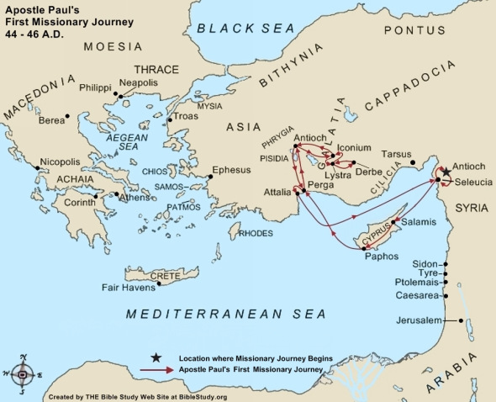
Notes:
1. Paul’s church planting and strengthening of churches took place in three major missionary journeys.
2. This map shows his travels on his first missionary journey.
3. On this journey, Paul took with him Barnabas, John Mark, and possibly Luke.
4. Their home base of operation is the church at Antioch in Syria.
5. The first missionary journey was to the island of Cyprus and the region of Galatia in Asia Minor (today, Turkey).
6. On Paul’s first missionary journey, he established churches in Pisidian Antioch, Iconium, Lystra, and Derbe.
7. We want to compare this with the second missionary journey in the next slide.

Slide 15
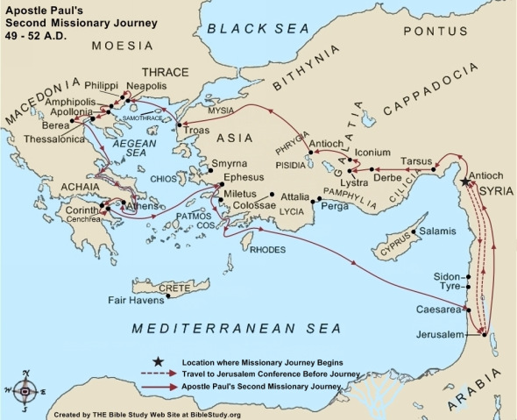
[R]
Notes:
1. You can see the second missionary journey is much more extensive than the first.
2. The red lines show the missionary journey of Paul and Silas; Luke is with them and they pick up Timothy in Lystra.
3. Paul and his team go west first to his home town of Tarsus.
4. Paul then visits and strengthens the four churches he established in Galatia on his first missionary journey.
5. From Pisidian Antioch, Paul wants to go south then north but the HS prevents him.
6. At Troas he sees a vision of a man in Macedonia saying “come over and help us.”
7. So the gospel goes across the Aegean Sea to the land of the Greeks.
8. This is he first entrance of the gospel into the continent of Europe.
9. Macedonia and Achia are today a part of Greece.
10. On this second missionary journey, Paul and his team establish four new churches in the cities of Phillipi, Thessalonica, Berea, and finally in Corinth.
11. They also make a stop at Ephesus on the way home.

Slide 16
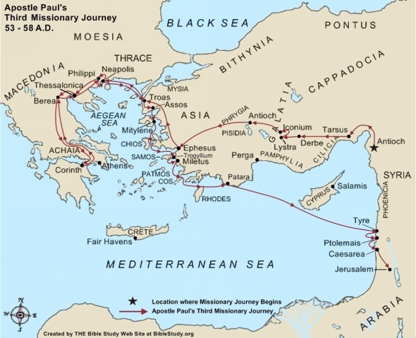
[R]
Notes:
1. This is a map of Paul’s third missionary journey, beginning in Antioch in Syria and ending in Jerusalem.
2. On this trip, Paul mainly visits the churches he has established previously.
3. But on this trip, he spends almost three years in Ephesus, establishing the church there and in the surrounding regions.
4. When we studied the book of Colossians, it seems that the church in Colossae, and perhaps in the neighboring cities of Hierapolis and Laodicea, were started by Epaphras.
5. He is mentioned in:
Colossians 1:7 NIV - You learned it [the Gospel] from Epaphras, our dear fellow servant, who is a faithful minister of Christ on our behalf,
6. So perhaps it was in Ephesus that Paul and Epaphras met and became fellow workers.
7. It was from Ephesus that Paul wrote the letter of 1 Corinthians in about 55 AD.
8. Second Corinthians was written about a year later in 56 AD sometime after he left Ephesus on his trip back home.

Slide 17
Corinthian Culture
Population: estimated as 250,000 free people + as many as 400,000 slaves.
Commerce: crossroads for traders and travelers, two harbors one east one west, trade and commerce center.
Culture: typical Greek culture, placed a high value on wisdom and philosophy.
Religion: had at least 12 temples dedicated to idols. Most infamous was dedicated to Aphrodite, the goddess of love, worshipers practiced religious prostitution; Jews had established a synagogue.
Immorality: center for open and unbridled immorality, one source claims 1,000 temple prostitutes for Aphrodite. [R]
Notes:
1. In fact the immorality in Corinth was so well known that a term in Greek “to Corinthianize” came to mean to practice sexual immorality.
2. In such a setting, it is no wonder the church was plagued by problems.
[Source, NIV study Bible Introduction to 1 Corinthians.]

Slide 18
Acts 18:1, 4-6 NIV
After this, Paul left Athens and went to Corinth. ... ⁴ Every Sabbath he reasoned in the synagogue, trying to persuade Jews and Greeks. ⁵ When Silas and Timothy came from Macedonia, Paul devoted himself exclusively to preaching, testifying to the Jews that Jesus was the Messiah. ⁶ But when they opposed Paul and became abusive, he shook out his clothes in protest and said to them, "Your blood be on your own heads! I am innocent of it. From now on I will go to the Gentiles." [R]
Notes:
Q1: Where did Paul begin with the preaching of the gospel?
1. He began with the Jews.
2. They had the OT Scriptures with all of the Messianic prophecies.
3. They had the time prophecy of Daniel 9 that had just been fulfilled in Jesus.
4. God placed His stamp of approval on Jesus by raising Him from the dead.
5. What more did they need to prove that Jesus was indeed the Messiah?
6. But once again here in Corinth, the Jews refused to yield to the gospel that Paul preached.
7. When it became too contentious, Paul shook off the dust, so to speak, and turned to the Gentiles.
Q2: Is there a lesson here for us?
1. There are some people who cannot be reached by arguments from Scripture.
2. They simply disbelieve the Bible as a whole or our interpretation of it.
3. There are times when we will have to react to their adamant refusal to believe as Paul did here.
4. If they reject the pardon God offers them through Christ, they will be responsible for their own demise.
5. We can always take a step back and pray for them, asking the HS to open their eyes to the truth.
6. And we can live in Christian love toward them in spite of their decision to reject Christ.

Slide 19
Acts 18:7-8 NIV
Then Paul left the synagogue and went next door to the house of Titius Justus, a worshiper of God. ⁸ Crispus, the synagogue leader, and his entire household believed in the Lord; and many of the Corinthians who heard Paul believed and were baptized. [R]
Notes:
Q1: So here Paul is going to the Gentiles, but who is it that is among his first converts?
1. It is Crispus, the synagogue leader!
2. So here we have a prominent Jew who accepts Jesus as the Messiah.
3. No doubt he would be thrown out of the synagogue.
4. But he and his family seem to form the foundation of the new Christian church in Titus Justus’ house.
5. Then many of the Corinthians who were Gentiles heard Paul and believed and were baptized.
6. Right after this we have our memory verse where God says “there are many in this city who are my people.”
7. The book of Acts goes on to tell us that Paul stayed in Corinth building the church for a year and a half.
8. We have the fulfillment of God’s promise to protect Paul.
9. The Jews here did not run him out of town like in previous cities.

Slide 20
Problems in 1 Corinthians
Divisions in the Church (1:10-4:21)
Law Suits and Immorality in the church (Ch 5-6)
Instructions on Marriage and Divorce (Ch 7)
Instruction on Food offered to Idols (8:1-11:1)
Instruction on Public Worship (11:2-14:40)
Instruction on the Resurrection ( Ch 15) [R]
Notes:
1. So here we see that the entire book is taken up addressing problems in the church that have been reported to Paul or answering questions raised by people in the church on various aspects of the Christian life.
2. We can look forward to learning from Paul’s inspired council on these issues how we should live in the light of the gospel.

Slide 21
1 Corinthians 5:9 NIV
I wrote to you in my letter not to associate with sexually immoral people-- [R]
Notes:
Q1: To what letter is Paul referring to here.
1. This is first Corinthians, but Paul is referring to a previous letter that he wrote to them.
2. This letter has not been preserved and so is considered a lost letter.
3. But that’s ok.
4. Perhaps God did not see fit to include it in the cannon of scripture.
5. So Paul wrote at least three letters to the Corinthians.
6. He may also have written another letter that is referred to in 2 Corinthians.
2 Corinthians 7:8-9 NIV - 8 Even if I caused you sorrow by my letter, I do not regret it. Though I did regret it--I see that my letter hurt you, but only for a little while-- 9 yet now I am happy, not because you were made sorry, but because your sorrow led you to repentance. For you became sorrowful as God intended and so were not harmed in any way by us.
7. So this may refer to a severe letter that Paulk sent between first and second Corinthians.
8. So, Paul may have written 3 or 4 letters to the Corinthians.

Slide 22
1 Corinthians 7:1 ESV
Now concerning the matters about which you wrote: "It is good for a man not to have sexual relations with a woman." [R]
Notes:
Q1: Who raised this question?
1. Here it is clear tha the Corinthian church wrote a letter to the apostle Paul asking questions about various beliefs and practices, asking for his guidance.
2. Paul spends the rest of the book from chapter 7 through chapter 15, answering the questions that they raised.
3. So here we see two-way communication between Paul and the church.
4. It would be nice to see their letter and see how they framed the questions, but we get some idea of the questions by Paul’s answers.
5. For example, when we get to the resurrection in chapter 15, Paul writes:
1 Corinthians 15:12 KJV - Now if Christ be preached that he rose from the dead, how say some among you that there is no resurrection of the dead?
6. The issue was that some were saying there is no resurrection of the dead.
7. Paul spends a whole chapter dealing with that problem.

