Slide 1
Growing in a Relationship with God
Lesson 11
Setbacks

Slide 2
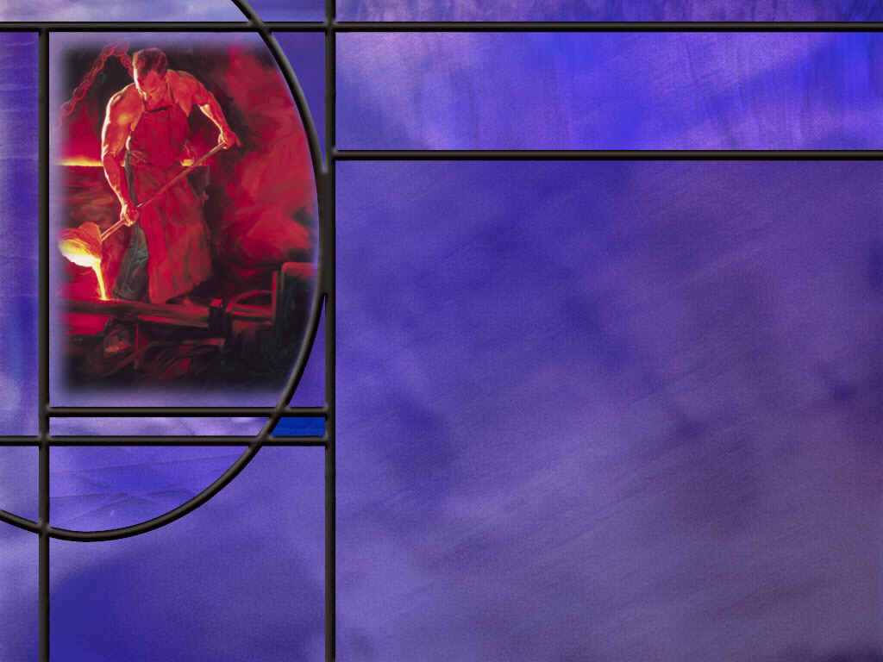
Memory Text
Romans 5:3-5 NKJV
And not only that, but we also glory in tribulations, knowing that tribulation produces perseverance; ⁴ and perseverance, character; and character, hope. ⁵ Now hope does not disappoint, because the love of God has been poured out in our hearts by the Holy Spirit who was given to us.
Not only what?
What do we do in tribulation?
What does tribulation do for the faithful Christian?
What is biblical hope?
What is the evidence of a saving relationship with Christ that gives us hope?
Notes:
B1:
1. Let’s begin at the beginning of these three verses and see if we can understand the logic of Paul’s argument here.
2. Let’s begin with the very first phrase, because Paul is referring here to what he has said in verses 1 and 2.
B2:
1. Verses 1 and 2 set the context for verses 3 – 5.
2. Here’s what they say:
Romans 5:1-2 NKJV - Therefore, having been justified by faith, we have peace with God through our Lord Jesus Christ, ² through whom also we have access by faith into this grace in which we stand, and rejoice in hope of the glory of God.
3. So here Paul is including himself with other believers in Rome who have been justified by faith.
4. And when you have been justified by faith, your sins are forgiven and Christ’s righteousness is placed to your account.
5. You are in a saving relationship with the Lord Jesus that brings you peace and acceptance with God.
6. In Christ, you are standing in grace because of His righteousness and can rejoice in hope of the glory of God.
7. And the glory of God for which we hope is eternal life with our Lord in His eternal kingdom.
8. So, all of that is included in this little phrase, “and not only that.”
B3:
1. Paul says, “We also glory in tribulation.”
2. And I say, “We do?!”
3. Maybe we should, but it is not easy to do.
4. It takes a divine perspective to be thankful for tribulations.
5. But Paul is saying that there is value in tribulations.
6. James says something very similar in his epistle:
James 1:2-4 NKJV - My brethren, count it all joy when you fall into various trials, ³ knowing that the testing of your faith produces patience. ⁴ But let patience have its perfect work, that you may be perfect and complete, lacking nothing.
7. Suffering has a purpose in God’s hands.
B4:
1. Faith is like a muscle: It needs to be exercised in order to stay strong.
2. If your faith is never challenged, it gets weak and flabby.
3. There is a saying: “Whatever doesn’t kill you makes you stronger.”
4. That’s true of our faith: whatever doesn’t kill it, makes it stronger.
5. The Lord does not send us trials that we cannot bear.
6. Paul wrote this famous verse to the Philippians:
Philippians 4:13 NKJV - I can do all things through Christ who strengthens me.
7. And if you look at the context of this verse what he is really saying is I can endure all things that Christ allows me to go through.
8. God will not test us above what we are able to bear.
9. If God allows us to pass through trials and tribulations, He will go through them with us, because He has promised never to leave us or forsake us. (Heb 13:5)
10. As we hang on to the Lord in difficult times, our faith grows stronger.
11. Tribulations produce perseverance; perseverance produces character, and character produces hope.
12. Faithfulness is one of the character traits that comes as part of the fruit of the Spirit.
13. The more our faith perseveres under trial, the more we are proven to have the character trait of faithfulness of a mature Christian.
B5:
1. Biblical hope is not wishful thinking.
2. It is not like saying, “I hope it doesn’t rain tomorrow.”
3. Biblical hope is a confident expectation of the future based on the promises of God.
4. We can hope in the glory of God because God has promised us eternal life in His Kingdom when we are justified by faith in Christ.
B6:
1. Here at the end of these verses, Paul gives us some evidence that we can look for to make sure our hope in Christ will not be disappointed.
2. He says that the Holy Spirit was given to us.
3. This goes back to verse 1 where he speaks of being justified by faith.
4. All those who are justified by faith are set apart for a holy use and are given the Holy Spirit.
5. The Holy Spirit produces in us the New Birth as we are born again and begin to grow in grace.
6. It is the HS that pours out the agape love of God in our hearts.
7. Agape love is the first character trait of the fruit of the Spirit: love, joy, peace, patience…
8. Paul here is saying that this agape love that we receive from the Holy Spirit is evidence that our justification is valid and that our hope in Christ will not be disappointed.
9. Jesus also pointed to agape love as the evidence that would mark us as His disciples.
John 13:35 KJV - By this shall all men know that ye are my disciples, if ye have love one to another.
10. In 2 Cor 1:22, Paul points to the HS as God’s seal on us guaranteeing our hope.
2 Corinthians 1:22 ESV - [God] has also put his seal on us and given us his Spirit in our hearts as a guarantee.
11. So let’s summarize Paul’s logic here:
12. Trials and tribulation allow God to build a mature, strong faith in His people.
13. Endurance under testing produces character, and character produces hope.
14. Christian hope is not wishful thinking, but a confident expectation.
15. Our hope in Christ will not be disappointed if we see the work of the Holy Spirit in our lives producing agape love and the other fruit of the Spirit.

Slide 3
Overview
Growing in a relationship with God will be challenged, at times, by trials and tribulations which lead us to question God’s goodness. In those times, we need to stand on the truth of Scripture and believe the promises of God, confident that He is able to work all things together for good for those who love Him.
  The Suffering of Job
  The Trials of Paul
  The Grace of Jesus
  Summary

Slide 4
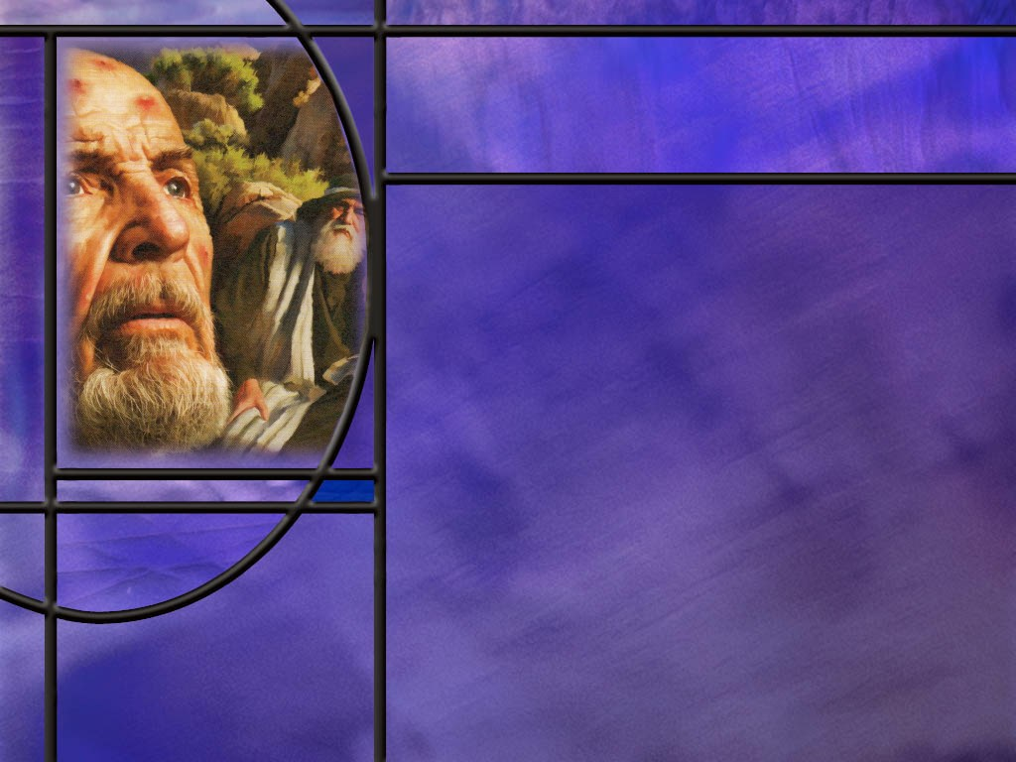
The Suffering of Job
After calamity struck Job and his household, what does Job have to say about the day on which he was born? (Job 3:1,10,11)
How does Job describe the resurrection to which he looks forward? (Job 19:25-27)
When God finally speaks to Job out of the whirlwind, what is the subject of the rhetorical questions that he asks Job? (Job 38:4-7)
How does Job finally respond to the display of God’s mighty acts? (Job 42:1,2,6)
What lesson is there for us in Job’s experience?
Notes:
B1:
[See notes on linked slide.]
B2:
[See notes on linked slide.]
B3:
[See notes on linked slide.]
B4:
[See notes on linked slide.]
B5:
1. Our hope is built on the knowledge that God is omnipotent.
2. His plans and purpose for His creation will not be thwarted.
3. His character is holy and He will do what is right.
4. We may not know what the future holds, but we know WHO holds the future.
Many things about tomorrow, I don’t seem to understand,
But I know Who holds tomorrow, and I know who holds my hand.
5. That’s Christian hope!

Slide 5
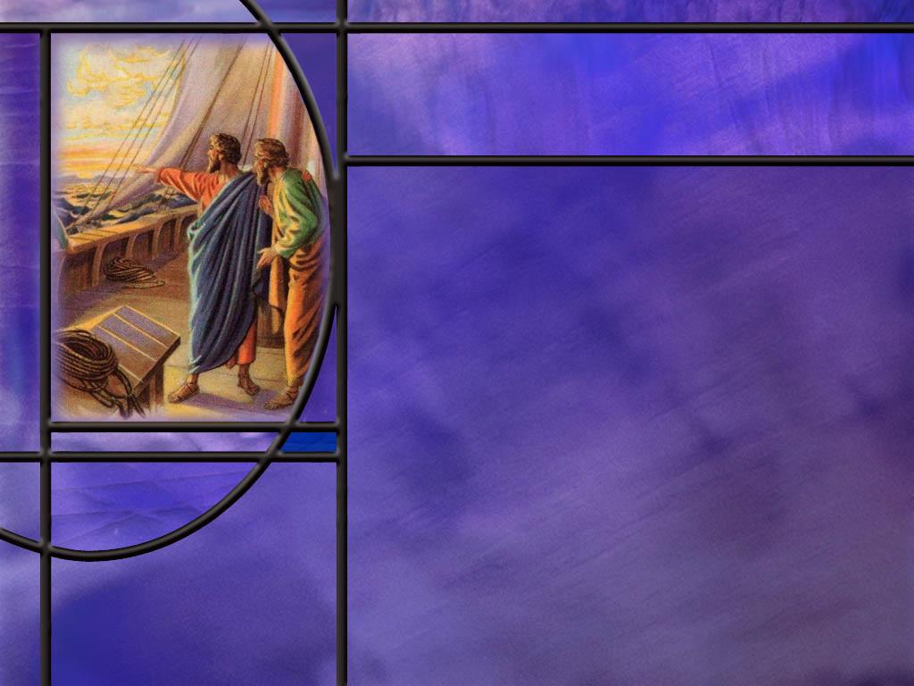
The Trials of Paul
How did the apostle Paul recount the difficulties he faced in spreading the Gospel as he wrote to the Corinthian church? (2 Cor 11:23-27)
What assurances do we have that the trials we face will not defeat us? (2 Cor 4:8-9; Rom 8:35)
How did Paul respond when the Lord did not answer his prayer to remo9e his “thorn in the flesh?” (2 Cor 12:9-10)
What blessings have come to us as a result of Paul’s two imprisonments in Rome?
Notes:
B1:
[See notes on linked slide.]
B2:
[See notes on linked slide.]
B3:
[See notes on linked slide.]
B4:
1. Imprisonment gave him the time and opportunity to write five books of the New Testament.
2. These books have been an immeasurable blessing to Christians around the world for nearly 2,000 years.
3. During his first imprisonment under house arrest, Paul wrote: Ephesians, Philippians, Colossians, and Philemon.
4. During his second imprisonment in Rome, likely in a dungeon awaiting execution, he wrote 2 Timothy.
5. So we have five wonderful epistles that are a result of his imprisonment.
6. Indeed, as Paul wrote to the Romans:
Romans 8:28 NKJV - And we know that all things work together for good to those who love God, to those who are the called according to His purpose.

Slide 6
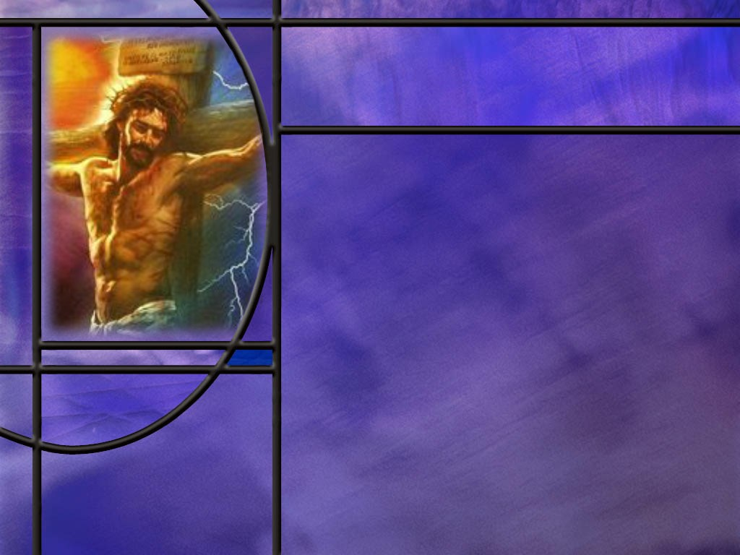
The Grace of Jesus
What was the key element that brought healing in the ministry of Jesus? (Matt 9:20-22)
For whom did Christ suffer and die? (Isa 53:5-6)
What helped Jesus to endure the shame and suffering of the Cross? (Heb 12:2)
Notes:
B1:
[See notes on linked slide.]
B2:
[See notes on linked slide.]
B3:
[See notes on linked slide.]

Slide 7
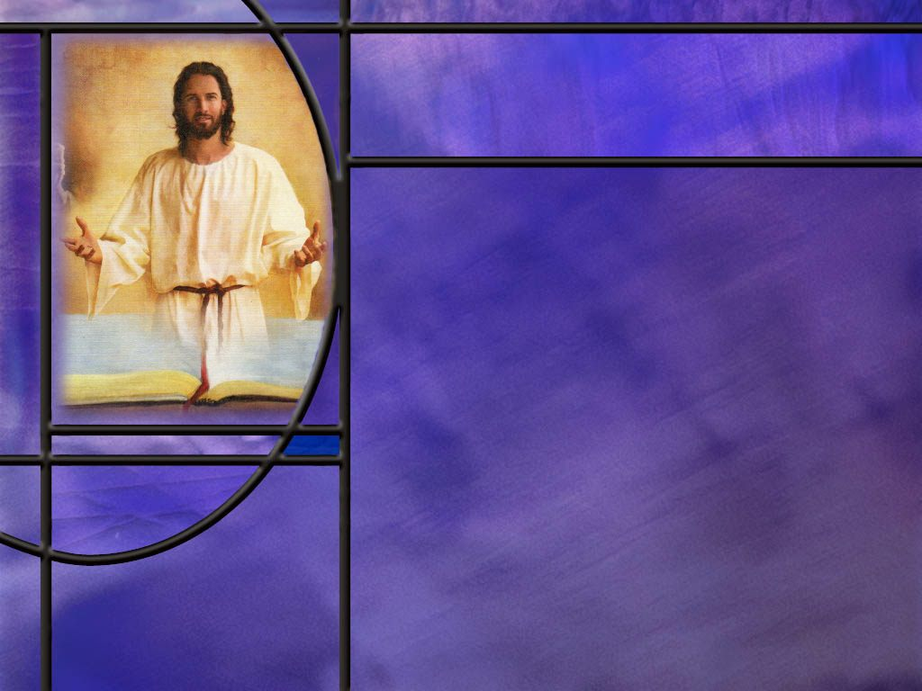
Summary
Both Paul and James encourage Christians to be thankful and rejoice in trials and tribulations knowing that God uses them to strengthen our faith, develop our character, and give us hope.
Biblical hope is not wishful thinking but a confident expectation based on the promises of God.
Evidence that our hope in Christ will not be disappointed is provided by the gift of the Holy Spirit, given to all who are justified to give us the new birth, pour out the agape love of God in our hearts, and produce the fruit of the Spirit in our lives.
Trials and tribulations are a part of every Christian’s experience. Jesus said, “In the world ye shall have tribulation: but be of good cheer; I have overcome the world.”

Slide 8
Summary
The Bible is honest about the trials and tribulations of its heroes.
With Job, God was focused on answering the question of Who to trust rather than why Job was suffering
In the end, Job acknowledged the omnipotence of God and accepted what God allowed to happen.
We too have hope for the future if we trust the omnipotent God who holds the future and is able to resurrect those who love Him.
Paul endured many trials for the sake of Jesus but he was content in every situation whether with much or little. He suffered the loss of all things for the sake of Jesus but considered them rubbish that he might win Christ and be found in Him, not having his own righteousness but a righteousness that comes from God by faith.

Slide 9
Summary
Despite his trials and thorn in the flesh, Paul was always positive and encouraging, looking beyond the troubles to the eternal joy that awaits the redeemed.
Jesus’ ministry of physical healing for those who came to Him in faith is a model of His saving grace also received by faith.
His suffering and death on the cross were an act of grace as the sinless Soin of God took our sin and paid its penalty for us.
For the joy that was set before Him, Jesus endured the cross despising the shame.
Will you follow His example this leek, enduring whatever trials He allows to strengthen your faith, confident in the hope of eternal life and the joy that will be ours in His Kingdom?

Slide 11
Job 3:1, 10-11 NLT
At last Job spoke, and he cursed the day of his birth. ... ¹⁰ Curse that day for failing to shut my mother's womb, for letting me be born to see all this trouble. ¹¹ "Why wasn't I born dead? Why didn't I die as I came from the womb? [R]
Notes:
Q1: Have you ever wished you had never been born?
1. You really have to get pretty low to wish you had never been born.
2. Most of us cling to life as our most precious possession.
3. But it is likely that we all know somebody who has acted on a death wish and has committed suicide.
4. There seems to be an epidemic of suicides among our teenage population and returning veterans.
5. Somehow, life seems too painful to go on.
6. Do you remember that wonderful classic, “It’s a Wonderful Life” starring Jimmy Stewart as George Bailey?
7. When Clarence, the angel, found George at the end of his rope, he heard George say, “I wish I’d never been born.”
8. And Clarence used that to show George how different and how much sadder life would have been for all his family and friends if he had never been born.
9. Eventually George saw the light and said, “I want to live again.”
10. For most people, even a difficult life is better than no life.
Q2: What was the advice of Job’s wife during his time of suffering?
Job 2:9 NLT - His wife said to him, "Are you still trying to maintain your integrity? Curse God and die."
1. So everyone, Job, his wife, his friends all think that this is God directly punishing Job when it is really Satan who is inflicting the suffering on him.
2. But Job does maintain his integrity.
3. His response to his affliction comes in:
Job 13:15 NKJV - Though He slay me, yet will I trust Him.
4. Even though Job couldn’t see behind the scenes to his role in this GC between Christ and Satan, he knew enough to know that he had no hope other than God.
5. I like the way the NLT puts this verse:
Job 13:15 NLT - God might kill me, but I have no other hope.

Slide 12
Job 19:25-27 NIV
I know that my redeemer lives, and that in the end he will stand on the earth. ²⁶ And after my skin has been destroyed, yet in my flesh I will see God; ²⁷ I myself will see him with my own eyes--I, and not another. How my heart yearns within me! [R]
Notes:
1. Many believe that Moses wrote the book of Job even before he wrote the first five books of the Bible.
2. That makes it perhaps the oldest book in the Bible.
3. So from perhaps the earliest of all books, the Bible gives a wonderful description of the resurrection.
Q1: What did Job know about his Redeemer?
1. He lives and will stand on the earth at the end of earth’s history.
2. Our resurrection depends on a Redeemer who is immortal, who has been victorious over death and lives forevermore.
3. This could be none other than Jesus, who paid the death penalty for our sins and is able to redeem us from the second death.
Q2: When will the resurrection occur?
1. “In the end.”
2. Other translations say:
“at the latter day” (KJV)
“at last” (NKJV)
3. These are all ways to refer to the time of the end when Jesus comes.
Q3: What does Job say about how he will be raised? Will he be immaterial like a ghost or physical like us?
1. He says that after his skin has been destroyed by decay, yet in his flesh he will see God.
2. So he is pointing forward to a resurrection of the body.
3. He will have eyes to see.
4. And he will be able to see God and dwell in His presence without being destroyed.
Q4: What assurance does Job give us that the real person gets resurrected, not some cheap imitation?
1. I myself will see Him with my own eyes, I and not another.
2. When we die, the breath of life, or spirit, returns to God who gave it.
3. The breath of life or spirit is the life force or spark of life that God originally gave to Adam.
4. The Hebrew for spirit (ruach) can also be translated as “mind.”
5. It is translated as mind 5 times in the OT.
6. So the breath of life that returns to God, I believe, includes the content of our mind that is then saved in the “books” of heaven.
7. When God creates a body for us in the resurrection, our omnipotent and omniscient God downloads the content of our mind into the new body to make us the same person with the same experiences, information, character, and personality.
Q5: Are you yearning for the resurrection like Job?
1. Anybody sick and tired of being sick and tired?
2. The older we get, the more precious the promise of a new body becomes.
3. Paul pointed forward to our hope in Jesus:
Philippians 3:21 KJV - Who shall change our vile body, that it may be fashioned like unto his glorious body, according to the working whereby he is able even to subdue all things unto himself.
4. Resurrection by our blessed Redeemer is the ultimate solution to the trials and tribulations of this life.
5. Like Job, let’s hang on to the end, confident in the power of our God to give us eternal life in His kingdom.
6. No matter what the Lord allows to come our way, it will be worth it in the end.
7. Remember Paul’s words in:
Romans 8:18 ESV - For I consider that the sufferings of this present time are not worth comparing with the glory that is to be revealed to us.
8. Hang on, my friend. Jesus is coming!

Slide 13
Job 38:4-7 NIV
"Where were you when I laid the earth's foundation? Tell me, if you understand. ⁵ Who marked off its dimensions? Surely you know! Who stretched a measuring line across it? ⁶ On what were its footings set, or who laid its cornerstone-- ⁷ while the morning stars sang together and all the angels shouted for joy? [R]
Notes:
Q1: What is the subject of God’s questioning of Job?
1. God is questioning Job about creation and his knowledge of it.
Q2: How would we fare in a conversation with God about our understanding of nature?
1. Maybe we would do a little better than Job on his questions.
2. Hundreds of years of scientific investigation has yielded a great deal of knowledge about nature and how it operates.
3. But God could come up with a whole new series of questions that we would be totally unable to answer.
4. The more we learn, the more we realize how much we don’t know.
5. All of the scientific research going on today is designed to answer questions about nature that we don’t know the answers to.
6. And there is no end in sight to scientific research and inquiry.
Q3: What point do you think God was making in asking Job these questions?
1. These rhetorical questions that Job could not answer were designed to get Job to think and consider the creation that he saw all around him.
2. The Psalmist later would write:
Psalm 19:1King James Version (KJV)
The heavens declare the glory of God; and the firmament sheweth his handywork.
3. The things of creation that we see all around us declare the omnipotence of the God who made it all.
4. Paul would write to the Romans that creation clearly displays the power and godhead of our God and those who ignore the testimony of creation are without excuse.
Romans 1:20 (NIV)
²⁰ For since the creation of the world God’s invisible qualities—his eternal power and divine nature—have been clearly seen, being understood from what has been made, so that people are without excuse.
5. God seems to be ignoring Job’s question of “Why am I suffering?”
6. Instead, He is answering the question of “Who is able to deliver me?”
7. Which question is more important?
8. Obviously, to God, the Who question is more important than the Why question.
9. Now God does not ignore the why question for us: He gives us the answer to “why” in the first two chapters of Job and in the third chapter of Genesis where we read about the fall and the curse.
10. But the more important thing than knowing “why” is knowing the One who is able to deliver us.

Slide 14
Job 42:1-2, 6 NIV
Then Job replied to the LORD: ² "I know that you can do all things; no purpose of yours can be thwarted. ... ⁶ Therefore I despise myself and repent in dust and ashes.“ [R]
Notes:
Q1: How does Job respond to the creative power and intelligence of God?
1. He responds in humility.
2. “God resists the proud but gives grace to the humble.” (1 Peter 5:5)
3. Yes we want to be friends with God, but we should never lose that sense of awe and respect and reverence we have when we come to Him.
4. God is holy, unique, distinctive from everything else we have ever known.
5. Our approach should be to allow God to teach us His ways and lead us in His paths.
6. We have plenty to learn.
7. Job’s response is to acknowledge the omnipotence of God and to accept what God allows to happen.

Slide 15
2 Corinthians 11:23-27 (NIV)
²³ Are they servants of Christ? (I am out of my mind to talk like this.) I am more. I have worked much harder, been in prison more frequently, been flogged more severely, and been exposed to death again and again. ²⁴ Five times I received from the Jews the forty lashes minus one. ²⁵ Three times I was beaten with rods, once I was pelted with stones, three times I was shipwrecked, I spent a night and a day in the open sea, ²⁶ I have been constantly on the move. I have been in danger from rivers, in danger from bandits, in danger from my fellow Jews, in danger from Gentiles; in danger in the city, in danger in the country, in danger at sea; and in danger from false believers. ²⁷ I have labored and toiled and have often gone without sleep; I have known hunger and thirst and have often gone without food; I have been cold and naked. [R]
Notes:
Q1: And after all of this, how did his life end?
1. Nero accused the Christians of setting fire to Rome.
2. Paul was swept up in the arrests and executed by Nero’s command, by having his head chopped off.
3. As a Roman citizen, he would have been spared the far more excruciating death of crucifixion.
4. He was probably executed around 67 AD outside the walls of Rome.
Q2: When you look at this list of persecutions and trials that Paul endured, what comes to mind about your own trials.
1. By comparison, nothing to speak of.
2. What do we suffer for the cause of Christ? Too little to mention.
3. There are people who do suffer for their faith in Jesus in other countries.
4. We can think today particularly of Nigeria where terrorist Muslims have killed thousands of Christians.
5. This has recently come to the attention of our government who has carried out a strike against the terrorists this past Christmas day.
6. But here in our culture with a constitution that guarantees freedom of religion, Christians may be subject to ridicule by the anti-Christian left, but nothing like the brutal persecution in countries like Nigeria, China, No. Korea, Pakistan, Iran, Sudan, Yemen, Afghanistan, Somalia, and others.
7. Christianity is actually the most persecuted religion in the world.
Q3: How did Paul start out on a religious path that was much different that what he describes here?
1. Paul had not intentionally started out on such a harrowing life experience.
2. He calls himself a Hebrew of the Hebrews.
3. He was of the tribe of Benjamin, educated at the feet of one of great rabbis of the day, Gamaliel.
4. He was a strict Pharisee, very zealous for the law.
5. And far from being persecuted, he was the persecutor that was chasing down Christians and arresting them throwing them in prison, and holding the coats of those who stoned Stephen.
6. He seemed destined for fame, respect, and a life of relative ease.
Q4: What happened to change his direction in life?
1. He met the resurrected Lord on the road to Damascus.
2. That one meeting changed everything.
3. Everything he had valued before, his respect, his influence, his honor, his position, his education, his income, his career, became rubbish, garbage, dung.
4. He willingly lost it for a life of danger and deprivation.
5. Why? Because he had found the Pearl of Great Price: something far more valuable than anything he could have ever hoped for.
6. He found that Jesus was the Messiah who died for his sins.
7. He found that true saving righteousness does not come from works of the law but by faith in Jesus Christ for the forgiveness of sins.
8. He dedicated his life to proclaiming the gospel of salvation by grace through faith.
9. He was willing to endure whatever it took to complete his mission for Jesus.
10. O that we would be as faithful as he to complete the great commission the Lord has given to us.

Slide 16
Assurance in Difficult Times
2 Corinthians 4:8-9 KJV - We are troubled on every side, yet not distressed; we are perplexed, but not in despair; ⁹ Persecuted, but not forsaken; cast down, but not destroyed;
Romans 8:35, 37 KJV - Who shall separate us from the love of Christ? shall tribulation, or distress, or persecution, or famine, or nakedness, or peril, or sword? ... ³⁷ Nay, in all these things we are more than conquerors through him that loved us. [R]
Notes:
Q1: What assurance does Paul give us that there is no ultimate defeat for those who are Christs?
1. When we are in Christ, we are more than conquerors.
2. We may get knocked down, but we are not knocked out.
3. What ever doesn’t kill us makes us stronger.
4. Even death cannot separate us from the love of God.
5. Listen to how Paul finishes Romans 8:
Romans 8:35, 37-39 KJV - For I am persuaded, that neither death, nor life, nor angels, nor principalities, nor powers, nor things present, nor things to come, ³⁹ Nor height, nor depth, nor any other creature, shall be able to separate us from the love of God, which is in Christ Jesus our Lord.
6. When we are in Christ, we are always victorious.
7. The only thing that can separate us from Him is our choice to reject Him.

Slide 17
2 Corinthians 12:9-10 (NIV)
⁹ But he said to me, “My grace is sufficient for you, for my power is made perfect in weakness.” Therefore I will boast all the more gladly about my weaknesses, so that Christ’s power may rest on me. ¹⁰ That is why, for Christ’s sake, I delight in weaknesses, in insults, in hardships, in persecutions, in difficulties. For when I am weak, then I am strong. [R]
Notes:
Q1: What is Paul saying here?
1. He is willing to accept his thorn in the flesh as a weakness that keeps him humble.
2. The weaker the vessel the more glory goes to God by using it.
3. We see this in many other individuals as well that refuse to allow their weaknesses or disabilities get them down.
4. Fanny Crosby, blind from infancy, became a prolific hymnwriter.
5. Joni Erickson Tata, a quadriplegic from a teenage diving accident, does beautiful paintings by holding the brush in her teeth, is a beautiful singer and has a vibrant wheelchair ministry.
6. Nick Vujicic, was born without arms or legs and is a successful Christian pastor and motivational speaker.
7. Here’s a video of Nick speaking to an audience. It's a miracle of God for a limbless man to be His hands and feet! #nickvujicic #limblesspreacher.
Video file is too big to post. Go to YouTube and find link.
[Play video next slide.]

Slide 18

Nick Vujicic
Notes:
1. I don’t know what Paul’s thorn in the flesh was, but we have seen Nick’s.
2. What a powerful message when God speaks through him.
3. Life dealt him a lemon, he made lemonade.
4. The more we allow God to use us in our weakness, the better He looks.

Slide 19
Matthew 9:20-22 NKJV
And suddenly, a woman who had a flow of blood for twelve years came from behind and touched the hem of His garment. ²¹ For she said to herself, "If only I may touch His garment, I shall be made well." ²² But Jesus turned around, and when He saw her He said, "Be of good cheer, daughter; your faith has made you well." And the woman was made well from that hour. [R]
Notes:
Q1: What was it that made this woman well.
1. Jesus said, your faith has made you well.
2. This was common in the healing ministry of Jesus.
3. It was faith in Jesus the healer that brought physical healing.
4. When we studied the book of Mark, we noted that physical healing was a metaphor for spiritual healing.
5. Healing in the gospel accounts is a metaphor for salvation.
6. Healing from physical disease reminds us of our need for healing from sin.
7. In fact, to save and to heal are often the same word in Greek.
8. The Greek word for save is “sozo.” (sode’-zo).
9. For example:
Matthew 1:21 ESV - She will bear a son, and you shall call his name Jesus, for he will save his people from their sins."
10. The word for “save” in that verse is “sozo.”
11. Then we come to:
Matthew 9:21 ESV - for she said to herself, "If I only touch his garment, I will be made well.
12. The Greek for “be made well” or “be healed” is the same Greek word, “Sozo.”
13. So the healing ministry of Jesus can be seen as a metaphor or a model of the saving ministry that Jesus wants to do in the life of the lost.
14. All through the gospels, people are healed by their faith in Jesus the Healer.
15. In the same way, after He died for our sins, people are saved by their faith in Jesus the Savior.
16. Jesus never turned away anyone who came to Him in faith for healing.
17. So, He never turns away anyone who comes to Him in faith for salvation.
18. Every physical healing of Jesus taught righteousness by faith in Him.
19. And the greater act of grace is the salvation by faith that gives us eternal life rather than a physical healing that makes life easier for a few more years.

Slide 20
Isaiah 53:5-6 ESV
But he was pierced for our transgressions; he was crushed for our iniquities; upon him was the chastisement that brought us peace, and with his wounds we are healed. ⁶ All we like sheep have gone astray; we have turned--every one--to his own way; and the LORD has laid on him the iniquity of us all. [R]
Notes:
1. This passage goes on to give a detailed picture of Christ taking our sins, suffering for them, and finally dying for them that we might be forgiven.
2. Verse 11 says:
Isaiah 53:11 NIV - After he has suffered, he will see the light of life and be satisfied; by the knowledge of Him my righteous servant will justify many, and he will bear their iniquities.
3. Psalm 22 gives another graphic picture of Christ dying on the cross and the suffering He went through there for us.
4. These prophetic descriptions of the suffering of Christ were fulfilled in the NT record that describes the crucifixion of Jesus.
5. The gospel accounts simply say that they crucified Him, but we know from Thomas’ statement of doubt that Jesus was actually nailed to the cross.
6. He said:
John 20:25 ESV - "Unless I see in his hands the mark of the nails, and place my finger into the mark of the nails, and place my hand into his side, I will never believe.“
7. Peter describes His suffering for us in:
1 Peter 2:24 ESV - He himself bore our sins in his body on the tree, that we might die to sin and live to righteousness. By his wounds you have been healed.
8. In addition to the physical pain He endured for us, there was the mental anguish of becoming sin for us and experiencing the separation from His Father that our sins caused.
9. This was all of grace.
10. We deserved eternal death.
11. He took our punishment so we could have eternal life.

Slide 21
Hebrews 12:2 ESV
looking to Jesus, the founder and perfecter of our faith, who for the joy that was set before him endured the cross, despising the shame, and is seated at the right hand of the throne of God. [R]
Notes:
Q1: What was it that allowed Jesus to endure the cross.
1. It was “the joy that was set before Him.”
2. The cross was excruciating pain.
3. There is no indication of Jesus rejoicing as He was being put to death.
4. The joy was not the present pain but the future victory.
5. Jesus looked forward to the redemption and restoration of the universe.
6. He looked forward to the defeat of sin and Satan.
7. He looked forward to being reunited in glory with His Father.
8. He looked forward to a loving relationship with the saints throughout eternity in a world made new where righteousness dwells.
9. So too for us.
10. No matter how difficult our circumstances, we can rejoice “in the Lord” knowing that He has secured a glorious future for us.

