Slide 1
Growing in a Relationship with God
Lesson 10
Repentance and Forgiveness

Slide 2
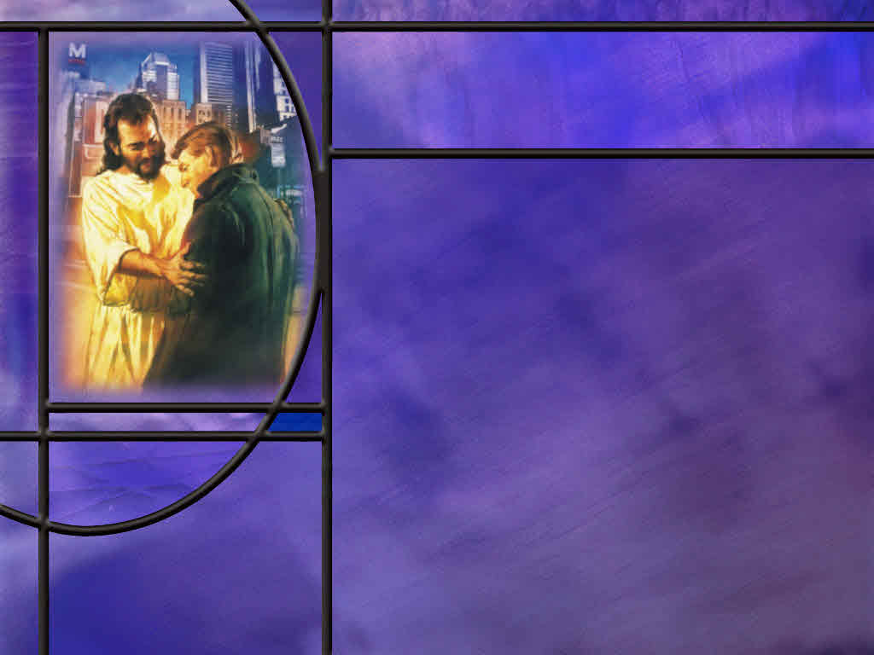
Memory Text
1 John 1:9 NKJV
If we confess our sins, He is faithful and just to forgive us our sins and to cleanse us from all unrighteousness.
What do we need to do to have our sins forgiven?
Who is the “we” to which this promise is made?
Who is the “He” that does the forgiving?
What does forgiveness do for us?
Notes:
B2:
1. We need to confess our sins.
2. This is the explicit condition of the promise: we need to confess our sins.
3. If we confess, God will forgive; if we don’t confess, God will not forgive.
4. So that condition could put us in some difficulty.
5. What if we don’t remember a sin that we have committed or are unaware that we have committed a sin?
6. How can we confess a sin of which we are unaware?
7. It is the Holy Spirit’s job to convict us of sin.
8. So when we have confessed all the sins for which we have a specific conviction, we can ask the Lord to forgive us for all the other sins we may have committed.
9. We want to hold nothing back and allow the Lord to forgive it all.
B3:
1. The writer, the apostle John, includes himself in the “we” of this promise.
2. He is writing to Christians that are walking in the light as Jesus is in the light.
3. So the implication is that the promise is made to born-again believers in the Lord Jesus Christ.
4. And, of course, this makes sense, because it is only through the blood of Christ that our sins can be forgiven by God.
5. Just two verses earlier John writes:
1 John 1:7 ESV - But if we walk in the light, as he is in the light, we have fellowship with one another, and the blood of Jesus his Son cleanses us from all sin.
6. So implicit in the context is that this promise is for those who have received Jesus as their Savior and Lord and are trusting in Him as a living Person for the forgiveness of their sins and for eternal life with God.
B4:
1. It is obvious that the “He” of this verse is God.
2. It is only God that can forgive sins.
3. Jesus in the heavenly sanctuary pleads His shed blood for our forgiveness and the Father forgives us for Christ’s sake.
4. Do you remember the paralytic that was let down through the roof?
5. In healing him, Jesus said, “Thy sins are forgiven thee.”
6. And the scribes and Pharisees reasoned, “Who can forgive sins but God alone?”
7. They considered a human claiming to forgive sins blasphemy.
8. And Indeed, they were correct.
9. They just didn’t recognize Jesus as the divine Son of God, Emmanuel, God with us.
10. In the Bible, all prayers for forgiveness are directed to God.
11. But apparently not so in the RC Church.
12. They have a human priest to which confession is made, and he prescribes the penance to be done and then this priest says, “Ego te absolve” which, in Latin, means “I absolve you.”
13. This is still blasphemy!
14. No man has the right to absolve any person from sin.
15. We confess our sins to God alone, who alone is able to forgive.
B5:
1. When our sins are laid on Jesus and His righteousness is laid on us, we are saved.
2. In legal terms, we are justified. Just-as-if-I had never sinned.
3. Our sins are cast into the depths of the sea.
4. They are removed as far from us as the east is from the west.
5. We are declared not guilty and adopted into the family of God as sons and daughters.
6. And if we continue in our relationship with Jesus as our sin-bearer and our Savior, we will be given eternal life when He returns.

Slide 3
Overview
Growing in a relationship with God will require us to be honest about our sins and shortcomings, heed the promptings of the Holy Spirit, and often kneel at the feet of Jesus in humble confession and repentance, seeking forgiveness, restoration, and power to overcome.
  Confession and Repentance
  David’s Prayer
  God of Forgiveness
  Summary

Slide 4
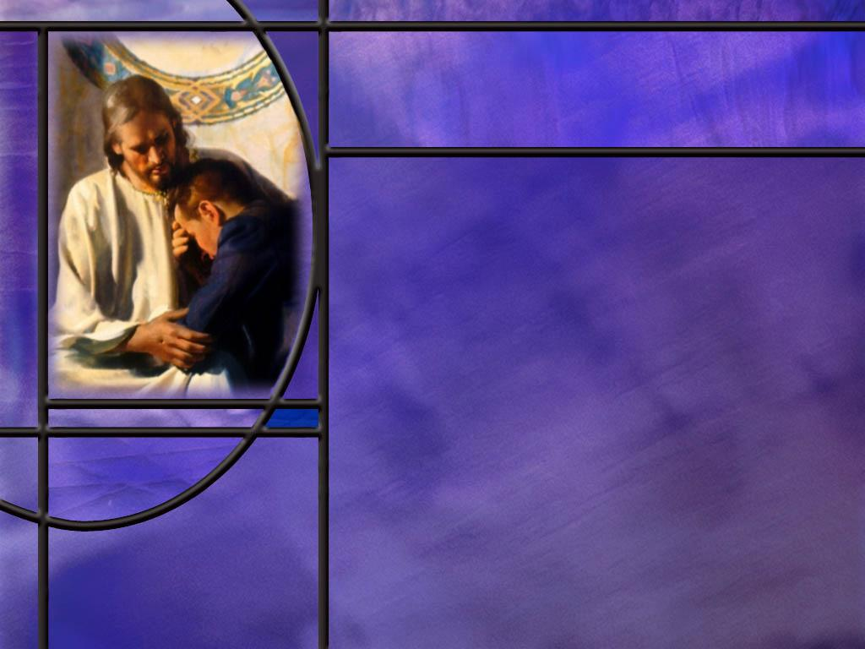
Confession and Repentance
What does it mean to confess your sins? (Prov 28:13)
How does the Greek of the NT help us to understand confession? (1 John 1:9)
What does it mean to repent? (Acts 2:37-38)
How should we differentiate between confession and repentance?
Notes:
B1:
[See notes on linked slide.]
B2:
[See notes on linked slide.]
B3:
[See notes on linked slide.]
B4:
1. There is a temptation to say the confession of sin is acknowledging that you have sinned and repentance is being sorry for your sin and desiring to change.
2. While that may be true in the abstract, I think Biblical confession includes sorrow for sin as well.
3. Let’s go back to our memory text: “If we confess our sins, He is faithful and just to forgive us our sins and to cleanse us from all unrighteousness.”
4. Confession is to say the same thing about our sin as God says about it.
5. What does God say about our sin?
6. He says, we need to admit it; we need to be sorry for it; we need to ask forgiveness for it, and we need to desire to leave it behind.
7. If we do, we are assured by 1 John 1:9 that God will forgive us.
8. So confession includes repentance and the desire to change.
9. It is not just the admission of guilt without a desire to change or be forgiven for our sins.
10. How about repentance? Does that include the confession of sin?
11. Absolutely!
12. When we turn around on the road of life, we come to Jesus and confess our sins, tell Him we’re sorry, and ask Him to forgive us by His shed blood.
13. So biblically, confession involves repentance, and repentance involves confession.
14. Here’s where I see a difference.
15. Repentance is the change in mind that brings us to Christ for salvation.
16. It makes us new creatures in Christ that are born again, living for Him, and bound for the Kingdom.
17. Confession is our response to sin after we have been born again and are trying to live for Jesus.
18. Every time we sin, we don’t need to be born again and have a change in direction in life.
19. We are still on the path to the kingdom; we have just messed up and need to be forgiven.
16. We just need to pick up the soap and stay in the shower.
17. But if we apostatize, turn our back on Jesus, and return to the world to wallow in sin, then we have changed directions in life.
18. We then need to repent, turn back to Jesus, and find forgiveness and salvation in Him again.
19. Does that make sense?
20. Let’s take an example:
21. Suppose I lose my temper and raise my voice with angry words to my wife.
22. Have I turned my back on Jesus, or have I just failed to live up to His law of love?
23. I still love Jesus, but I have failed to live up to His law of love.
24. God puts me in time out till the HS convicts me and I confess my sin and ask for forgiveness.
25. Since I still love Jesus, I will be sorry for my sin and seek to restore my fellowship with Him as soon as conviction comes.
[See notes on linked slide.]
B5:
[See notes on linked slide.]

Slide 5
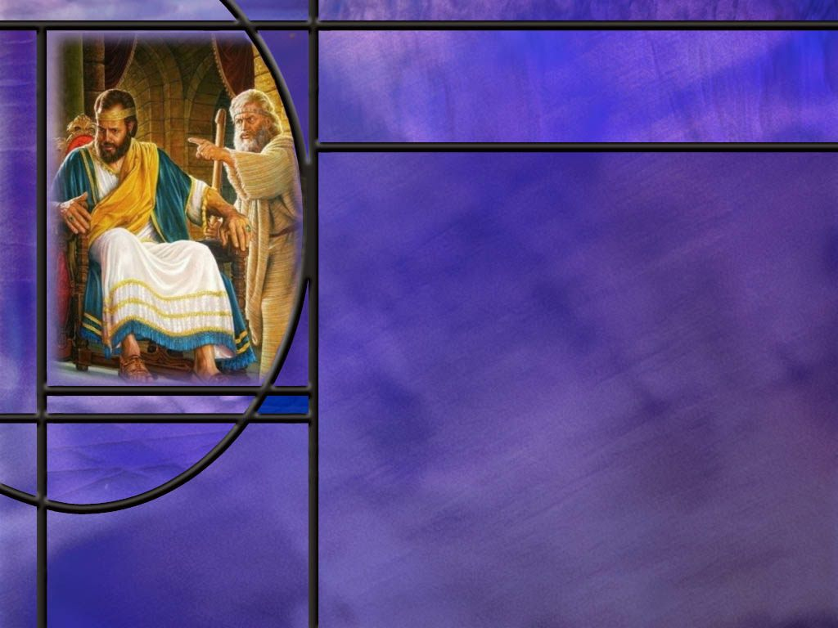
David’s Prayer
What was the cry of David’s heart when the Holy Spirit convicted him of sin? (Ps 51:1-2,7,10)
What does David write about sacrifices in Ps 51:16-17?
How many of the Ten Commandments did David break in his affair with Bathsheba?
What offense was uppermost in David’s mind as he came to God for forgiveness? (Ps 51:4)
Why do you think God inspired David to write Psalm 51?
Notes:
B1:
[See notes on linked slide.]
B2:
[See notes on linked slide.]
B3:
1. No. 6: Thou shalt not kill (He sent Uriah to the front lines w/o support to be killed in battle). No. 7 Thou shalt not commit adultery (He did). No. 8 Thou shalt not steal. (He stole Uriah’s wife). No. 9 Thou shalt not bear false witness. (He tried to perpetuate a lie that the child born to Bathsheba would be Uriah’s rather than David’s). No. 10 Thou shalt not covet thy neighbor’s wife (That’s where the whole sordid affair began).
2. Basically, the whole second table of the Law was broken in this affair.
B4:
[See notes on linked slide.]
B5:
1. This psalm teaches us what it means to repent of our sin and confess it to God and ask for His forgiveness.
2. Here David bears his soul and shows us true repentance.
3. This psalm can serve as a model for our own repentance and plea for forgiveness when we sin.
4. In this prayer we see both confession of sin and heartfelt repentance for sin.
5. So we can raise the question: was this a sin of apostasy or not?
6. It was certainly a lot more than getting angry with his wife or cutting corners on the Sabbath.
7. It took persistent and prolonged rebellion against God to carry out all the twists and turns in the plot.
8. So, I think that David is treating it as a time of apostasy from God.
9. He sees himself in danger of losing God’s Holy Spirit.
10. He writes in:
Psalm 51:11-12 NKJV Do not cast me away from Your presence, And do not take Your Holy Spirit from me. ¹² Restore to me the joy of Your salvation,
11. I think for most of us, if we committed these sins, we would consider ourselves to have fallen so far away from Jesus that we would feel the need to repent and be re-baptized to recommit our lives to the Lord.

Slide 6
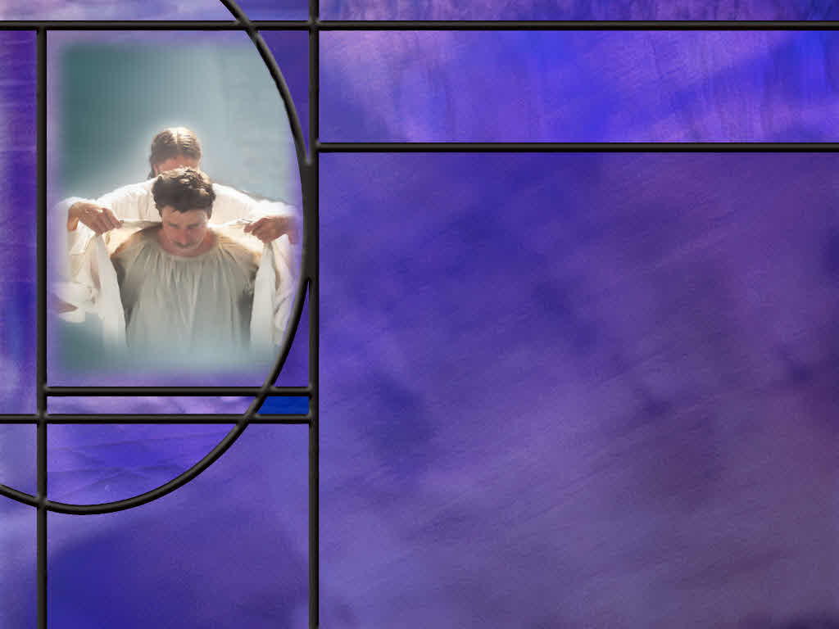
God of Forgiveness
How did the Lord reveal His glory and His name to Moses when he went back up on Mt. Sinai? (Ex 34:5-7)
In Jesus’ parable of the wedding feast, who came in to look over the dinner guests and what did He find? (Matt 22:11-12)
What happened to the man without a wedding garment? (Matt 22:13)
What is Jesus’ punchline? (Matt 22:14)
Notes:
B1:
[See notes on linked slide.]
B2:
[See notes on linked slide.]
B3:
[See notes on linked slide.]
B4:
[See notes on linked slide.]

Slide 7
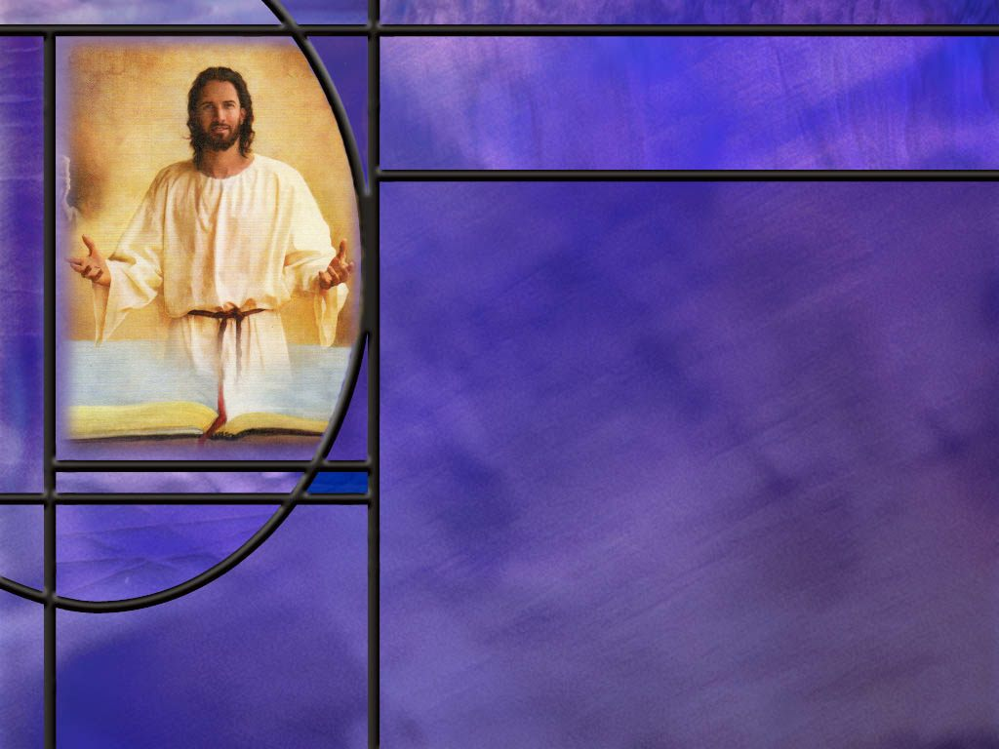
Summary
Growing in a relationship with God will require us to be honest about our sins and shortcomings, heed the promptings of the Holy Spirit, and often kneel at the feet of Jesus in humble confession and repentance, seeking forgiveness, restoration, and power to overcome.
Confession and repentance are two closely related words that lead to the forgiveness of sin provided we have received Jesus as our Savior and Lord.
The NT word for confession means to say the same thing about our sin as God does, and the NT word for repentance means to change one’s mind and think differently.
Biblical confession is acknowledging our sin with sorrow and contrition and a desire to change.

Slide 8
Summary
Repentance is a U-turn on the road of life from a mindset that rejects Christ to one that accepts Him.
Repentance may be used to refer more specifically to the change that brings us to Christ for justification and the new birth, while confession may be used more specifically to maintain our fellowship with Christ as we are trying to live for Him.
In Psalm 51, David bares his soul before the Lord, with a beautiful prayer of confession and repentance, asking for forgiveness and restoration so that he might again experience the joy of the Lord and the power of the Spirit in his life.
This can be a model prayer for us as we acknowledge our sin and ask for forgiveness.

Slide 9
Summary
If God can forgive David for his sins, He can also forgive us for ours.
God’s revelation of His character to Moses shows He is loving, merciful, gracious, patient, and forgiving to the thousandth generation of those who love Him.
The punchline of the wedding feast parable is “many are called, but few are chosen.”
The few that are chosen are the ones that accept the invitation, have their sins forgiven by the blood of Jesus, and are covered in the judgment by His robe of righteousness.
You have been invited to the marriage supper of the Lamb. Will you put on the wedding garment that Jesus so lovingly has provided for you?

Slide 11
Proverbs 28:13 NKJV
He who covers his sins will not prosper, But whoever confesses and forsakes them will have mercy. [R]
Notes:
Q1: What can we get from this proverb about what it means to confess our sins?
1. This is Hebrew poetry in which the writer is using parallelisms.
2. This is an antithetical or contrasting parallelism where the first line says one thing and the second line says the opposite.
3. This gives us two opportunities to understand what the verse says.
4. The second line says whoever confesses his sin and forsakes them will have mercy.
5. The first line gives us the opposite of that: whoever covers his sin will not prosper.
6. So covering your sin is the opposite of confessing your sin.
7. Covering your sin is hiding your sin, pretending that it does not exist, refusing to acknowledge it and admit that you have done it.
8. So confession is the opposite of covering.
9. Confession is admitting your sin, acknowledging that you are guilty of it, and doing so with a desire to forsake it and be free of it.

Slide 12
1 John 1:9 ESV
If we confess our sins, he is faithful and just to forgive us our sins and to cleanse us from all unrighteousness. [R]
Notes:
1. This is our memory text which we have already discussed in detail.
2. But here we want to look at the Greek word for “confess” to see what light it sheds on the meaning of the word.
3. The Greek word for confess is homologeō (hom-ol-og-eh’-o).
4. It is a compound word consisting of two parts: homo and logeo.
5. Homo means the same, and logeo means so say.
6. So homologeo means to says the same as another, to agree.
7. When it comes to confessing sin, homologeo means to agree with God and say the same thing about our sin that He says about it.
8. So a common definition of confess is “to admit or declare one's self guilty of what one is accused of.”
9. So confession of sin is acknowledging your sin, admitting that you are guilty, agreeing with God that you need forgiveness, and asking to be forgiven.

Slide 13
Acts 2:37-38 ESV
Now when they heard this they were cut to the heart, and said to Peter and the rest of the apostles, "Brothers, what shall we do?" ³⁸ And Peter said to them, "Repent and be baptized every one of you in the name of Jesus Christ for the forgiveness of your sins, and you will receive the gift of the Holy Spirit. [R]
Notes:
Q1: When these people were convicted on the day of Pentecost that Jesus was the Messiah, what did Peter tell them to do?
1. Repent and be baptized.
2. The Greek word used for repent here is: metanoeō (met-an-aw-eh’-o)
3. It literally means to change one’s mind, to think differently.
4. “Repentance involves a turning with contrition from sin to God; the repentant sinner is in the proper condition to accept … divine forgiveness.“ (FFBruce).
5. Repentance involves a U-turn on the road of life.
6. It is a change of mindset from rejecting Christ to accepting Him.
7. It is a change of living for self to living for Jesus.
8. It is a change from running after sin to running away from sin.
9. It is a change of mind that leads to sorrow for sin and a desire to live for Jesus.
10. It is a change of mind that leads to receiving Jesus as Savior and Lord, confessing our sinful past, asking for forgiveness, being baptized, and receiving the Holy spirit and the new birth.

Slide 14
Psalm 51:1-2, 7, 10 ESV
Have mercy on me, O God, according to your steadfast love; according to your abundant mercy blot out my transgressions. 2 Wash me thoroughly from my iniquity, and cleanse me from my sin! ... 7 Purge me with hyssop, and I shall be clean; wash me, and I shall be whiter than snow. ... 10 Create in me a clean heart, O God, and renew a right spirit within me. [R]
Notes:
Q1: Who wrote Psalm 51, and why did he write it?
1. Many of the psalms have an introductory note identifying the author and the occasion for which the psalm was written.
2. Psalm 51 has this note before verse 1: “To the Chief musician. A Psalm of David when Nathan the prophet went to him after he had gone in to Bathsheba.”
3. This is David’s Psalm of repentance for his sins on this particular occasion.
Q2. On what character traits of God does David rely as he approaches God for forgiveness?
1. He knows he can call on God for mercy because of two things: God’s steadfast love (the Hebrew word “hesed”) and God’s abundant mercy or compassion.
Q3: What words does David use to describe his sin in verses 1 and 2?
1. v.1 Blot out my transgressions.
2. v.2 wash me from my iniquity.
3. v.2 cleanse me from my sin.
4. These are the three commonly used OT words to refer to the totality of sin.
5. These same words were used by the Lord in describing His forgiveness to Moses:
Exodus 34:7 ESV - keeping steadfast love for thousands, forgiving iniquity and transgression and sin,
6. Transgression is rebellion against God: deliberately choosing disobedience.
7. Iniquity is the inner twistedness, our fallenness, our propensity to disobey.
8. Sin is missing the mark and failing to live up to God’s law and His will.
9. So David is here praying for a complete cleansing.
Q4: Why does David ask to be purged with hyssop?
1. It could be a reference to the sacrificial blood.
2. At the Passover, the angel instructed the Israelites to use hyssop to apply the blood of the Passover lamb to the doorposts of their homes.
3. That Passover lamb would point to Jesus the Lamb of God who takes away the sins of the world.
4. So here it appears that David understood the principle of Substitutionary Atonement.
5. The blood of the Substitute purged the sins of the guilty sinner.

Slide 15
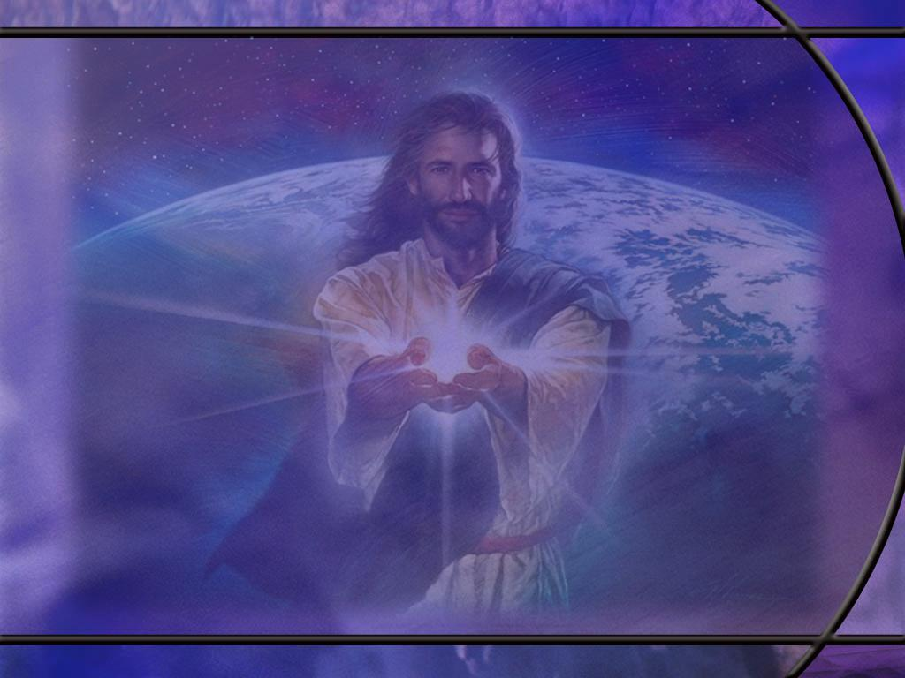
Psalm 51:16-17 ESV
For you will not delight in sacrifice, or I would give it; you will not be pleased with a burnt offering. ¹⁷ The sacrifices of God are a broken spirit; a broken and contrite heart, O God, you will not despise. [R]
Notes:
Q1: What kind of sacrifice is God looking for when we have sinned?
1. He is looking for an attitude of humility, of repentance, of confession, of admission of guilt.
2. He is looking for sorrow for sin and a broken heart because we broke the heart of God.
3. He is looking for a longing desire to be forgiven and restored to fellowship.
4. Refusal to confess our sins places us in danger of grieving the Holy Spirit.
5. God is looking for a contrite heart that longs to be restored through forgiveness.
6. Rituals and external forms won’t cut it with God who looks not on the outward appearance but on the heart.
7. God desires not forms and rituals but loving relationship and devotion.
8. As Jesus said to the woman at the well.
John 4:24 ESV - God is spirit, and those who worship him must worship in spirit and truth.“
Q2: What does David recognize about the blood of bulls and goats?
1. David was rich enough to offer hundreds of sacrifices at the temple.
2. But he recognized that the blood of bulls and goats do not take away sin.
3. The sacrifices that God is looking for when we sin are a broken spirit and a contrite heart.
4. He is looking for us to acknowledge our sin, take responsibility for it, confess it, and ask for forgiveness.
(In fact, there is indication that the sanctuary service was only for unintentional sins, not premeditated sins of rebellion and intentional disobedience.)
5. The sanctuary was a teaching tool teaching the truth that God will deal with sin through the principle of “substitutionary atonement.”
6. The sacrifices pointed forward to the Lamb of God who really would atone for sin.
7. But true forgiveness comes from repentance, confession, and faith in the love and grace and goodness of God to forgive.

Slide 16
Psalm 51:4 NKJV
Against You, You only, have I sinned, And done this evil in Your sight--That You may be found just when You speak, And blameless when You judge. [R]
Notes:
Q1: Is it true that David had sinned only against God? Who else did he sin against?
1. He sinned against Uriah whose wife he stole and with whom he committed adultery.
2. He sinned against Uriah even more by having him murdered.
4. He sinned against Bathsheba by causing her to commit adultery.
5. He sinned against his lawful wives by committing adultery on them.
6. He sinned against the baby that was born causing his death.
7. He sinned against his family who became sexually dysfunctional.
8. He sinned against the nation by setting an ungodly example for them.
Q2: So, what is David saying here as he comes to God seeking forgiveness?
1. He is saying that all the other people fade away from view when he thinks of how he has sinned against the holy God that he loves.
2. Every sin is ultimately against God, and He is the highest authority offended.
3. Only God can forgive sin and restore our relationship with Him.
4. So, while I am sure David recognized that his sin has affected many people, here he recognizes that it was first and foremost a revolt against God’s holy authority and an offense that only God can finally forgive.

Slide 17
Exodus 34:5-7 ESV
The LORD descended in the cloud and stood with him there, and proclaimed the name of the LORD. ⁶ The LORD passed before him and proclaimed, "The LORD, the LORD, a God merciful and gracious, slow to anger, and abounding in steadfast love and faithfulness, ⁷ keeping steadfast love for thousands, forgiving iniquity and transgression and sin, but who will by no means clear the guilty, visiting the iniquity of the fathers on the children and the children's children, to the third and the fourth generation.“ [R]
Notes:
1. Moses asked to see the glory of God and the LORD showed Moses His character.
2. Notice that the Lord says His name twice connecting His name to the character traits that follow.
3. When we think of Yahweh, we should associate His character traits with His name.
4. And when we think of the glory of God, we should go back to this passage to remember the character traits that show the kind of God that He is.
5. He is loving, merciful, gracious, patient, faithful, forgiving, and just.
6. In verse 7 where it says “keeping steadfast love for thousands,” the footnote says “Or to the thousandth generation.”
7. Moses actually spells it out more fully in:
Deuteronomy 7:9 ESV - 9 Know therefore that the LORD your God is God, the faithful God who keeps covenant and steadfast love with those who love him and keep his commandments, to a thousand generations,
Q1: What does God do here to meet the greatest need of our fallen race?
1. Because He is a good God, loving, merciful, and gracious, He has found a way to forgive our sins.
2. That is our greatest need.
3. For those who repent and confess their sins, trusting in the grace of God to provide a Substitute, there is forgiveness.
4. He casts our sin into the depth of the sea and removes it from us as far as the east is from the west.
5. In reality, He lays our sins on Jesus who paid the just penalty at calvary.
6. God is love; but He is also just.
7. He will not ignore sin, but punish it.
8. We can either repent and confess our sins, in which case Christ takes our punishment.
9. Or we can refuse the pardon of God, in which case we take our own punishment.
10. So God’s wrath against wickedness and sin becomes an act of love for the redeemed.
11. There is no other way to rid the world of sin and Satan and lift the curse that we have lived under for so long.
Q2: How should we understand the last part of this text where God visits the iniquity of the fathers on the children?
1. Sin has consequences and those consequences can be felt for generations.
2. The environment that we surround ourselves with can be a stumbling block to our family and friends.
3. It is clear from Ezekiel that God does not punish our children for our sins.
Ezekiel 18:20 KJV - The soul that sinneth, it shall die. The son shall not bear the iniquity of the father, neither shall the father bear the iniquity of the son: the righteousness of the righteous shall be upon him, and the wickedness of the wicked shall be upon him.
4. So, the Lord is not being unjust to the children of sinful men.
5. He is simply saying that sinful living has a tendency to perpetuate itself naturally for generations.
6. In Hebrew thought, what the Lord does not prevent, He is seen as actively causing.
7. So here if God does not prevent the iniquity of the fathers from passing to the next generation, He can be spoken of as “visiting the iniquity of the Fathers on the children.”

Slide 18
Matthew 22:11-12 ESV
"But when the king came in to look at the guests, he saw there a man who had no wedding garment. ¹² And he said to him, 'Friend, how did you get in here without a wedding garment?' And he was speechless. [R]
Notes:
Q1: What did the king do before he executed judgment on the man?
1. He had an investigation.
2. There was an investigative judgment about why he had no wedding garment.
Q2: What defense did the man have?
1. He had none. He was speechless.
2. This indicates that the wedding garment was provided by the host.
3. He couldn’t say he wasn’t offered a wedding garment.
4. Apparently, he refused the wedding garment thinking his own clothes were good enough.

Slide 19
Matthew 22:13 ESV
Then the king said to the attendants, 'Bind him hand and foot and cast him into the outer darkness. In that place there will be weeping and gnashing of teeth.’ [R]
Notes:
Q1: What was the result of showing up at the wedding feast without a wedding garment?
1. Outer darkness.
2. Weeping and gnashing of teeth.
3. This man was removed and missed out on the marriage supper.

Slide 20
Matthew 22:14 ESV
“For many are called, but few are chosen.“ [R]
Notes:
Q1: How should we understand the punchline of this parable?
1. Well, the first part is pretty easy: many are called.
2. In the parable, everyone they found on the roads was invited to the wedding feast.
3. Both good and bad were invited, perhaps representing both Jew and Gentile.
4. It doesn’t say they all came, but enough of them came to fill the wedding hall.
5. So God calls everyone: whosoever will, to come to Jesus and be saved.
Q2: Now who are the few that are chosen?
1. The few that are chosen are the ones who come to the wedding feast and put on the wedding garment that is provided for them.
2. These are the ones who have trusted in Jesus to forgive their sins and place His righteousness to their account.
3. The wedding garment is the righteousness of Christ.
4. So the few that are chosen are the ones that have chosen Jesus.
5. The text does NOT mean that God calls many, but He only chooses a few to be saved.
6. That’s predestination.
7. God invites all to be saved, but saves only the elect who choose to receive Jesus as their Savior.
8. The real choosing that matters is done, not by God, but by those who are saved.
9. In other words, God chooses to save only those who have chosen Jesus as their Savior, have their sins forgiven, and are clothed in His righteousness.
10. Does that make sense?
Q3: What does this parable say about the judgment of those who profess to be Christians?
1. There will be a judgment of those who have accepted the invitation to see if they are clothed in the righteousness of Christ.
2. Those clothed in their own righteousness will be cast out.
3. But the good news is that the righteousness of Christ is offered to us as a gift.
4. It is free to all who believe.
5. All those who are justified by faith have exchanged their filthy rags for the spotless robe of Christ’s righteousness.
6. If you want to attend the marriage supper of the Lamb, you need to have on the robe of Christ’s righteousness.
7. How many are thankful for righteousness by faith?

