Slide 1
Growing in a Relationship with God
Lesson 9
Sin, Gospel, and the Law

Slide 2
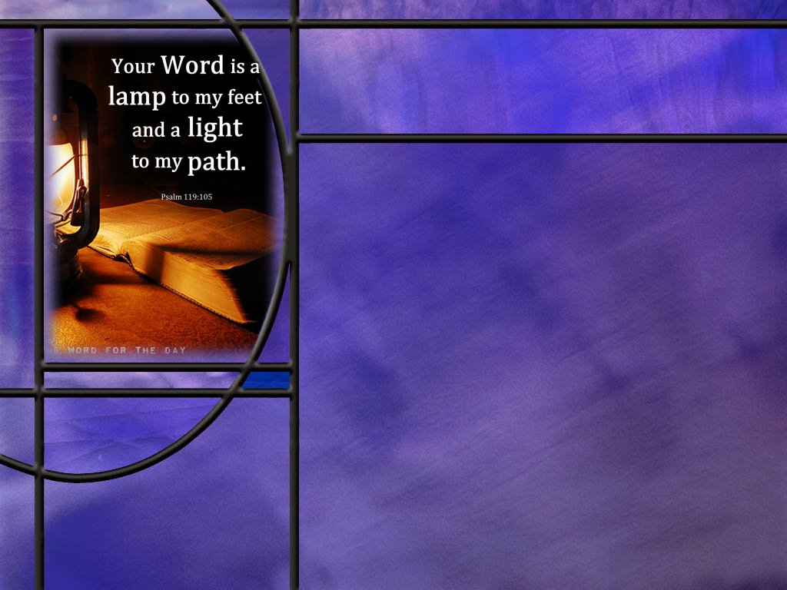
Memory Text
Psalm 119:93-94 NKJV
I will never forget Your precepts, For by them You have given me life. ⁹⁴ I am Yours, save me; For I have sought Your precepts.
What is the general subject of Psalm 119?
What are the “precepts” of God?
What does the psalmist promise to do with the precepts of God.
How can the precepts of God save us and give us life?
Notes:
B2:
1. Psalm 119 is all about the law of God, the word of God, the commandments of God
2. The title given for Psalm 119 in the KJV is “Meditations and Prayers Relating to the Law of God.”
3. Psalm 119 is the longest chapter in the Bible with 176 verses.
4. It is referred to as an acrostic poem where each new stanza of eight verses begins with the next successive letter of the Hebrew alphabet having 22 letters in all. (22 x 8 = 176 verses total)
5. It uses at least eight different words in Hebrew to describe God’s word or His law.
6. These are commonly translated into English as: law, testimonies, precepts, statutes, commandments, judgments (or ordinances), word, and promises (or sayings).
7. What verses of Psalm 119 do you know by heart?
8. How about:
Psalm 119:11 KJV - Thy word have I hid in mine heart, that I might not sin against thee.
Psalm 119:105 KJV - Thy word is a lamp unto my feet, and a light unto my path.
Psalm 119:165 KJV - Great peace have they which love thy law: and nothing shall offend them.
B3:
1. How would you describe the precepts of God?
2. When we think of precepts of God, the synonym that comes to my mind is principles: “God’s principles for proper living.”
3. Webster define precept as: “a command or principle intended especially as a general rule of action.”
4. Perplexity AI gives this helpful definition:
“In Psalm 119, precepts means God’s specific instructions or appointed rules for how His people should live. The idea is not just general wisdom, but concrete guidance to be obeyed.”
B4:
1. He promises to never forget them.
2. Is that a promise that we need to make too?
3. To do that, where do we need to have God’s law?
4. It needs to be written in our hearts and put into our minds.
5. We need to know, memorize, and remember the principles and instructions of God’s word.
6. This is what is to occur in the New Covenant of faith in Jesus Christ and the Holy Spirit’s work in our lives.
Hebrews 8:10 KJV - For this is the covenant that I will make with the house of Israel after those days, saith the Lord; I will put my laws into their mind, and write them in their hearts: and I will be to them a God, and they shall be to me a people:
B5:
1. Here we can think of the precepts about which the psalmist writes as not just the commandments of God but of all the principles for right living revealed in the word of God.
2. Paul wrote to Timothy saying:
2 Timothy 3:15 KJV - And that from a child thou hast known the holy scriptures, which are able to make thee wise unto salvation through faith which is in Christ Jesus.
3. It is the holy Scriptures which are able to lead us unto salvation.
4. And it is in the Scriptures that we find the principle that the just shall live by faith.
5. Or, as some translations put it: “the one who, by faith, is just (or justified) shall live.”
6. So justification by grace through faith was available to the psalmist just as it is available to us today.
7. There is a key phrase in our memory text that reveals the psalmist’s grasp of salvation by grace through faith.
8. Look at how he begins verse 94: “I am yours, save me.”
9. Here he doesn’t plead his obedience to the law as the basis of his salvation.
10. Instead, he pleads his relationship with the Lord: “I am yours.”
11. He is surrendered in love and trust to the God who alone can save.
12. His acceptance of the precepts of the Lord is evidence of his relationship with the Lord.
13. But the salvation comes by God’s grace through the psalmist’s faith which leads to a relationship of love and trust.

Slide 3
Overview
Growing in a relationship with God requires us to accept the precepts of His law, which enable us to live in fellowship with Him, and to avoid the consequences of sin which separates us from Him. God’s remedy for sin is the blood of Jesus which cleanses us from its penalty and the Holy Spirit which delivers us from its power as we live in love for our Lord.
  The Law of God
  The Consequences of Sin
  The Remedy for Sin
  Summary

Slide 4
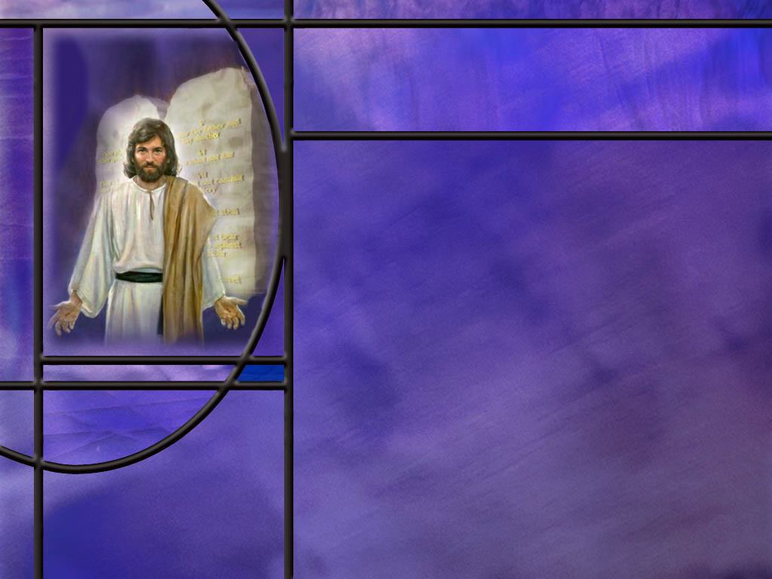
The Law of God
How does Moses describe the Law and why God gave it to us? (Deut 6:24; 10:13)
How did David describe the law of God? (Ps 19:7-11)
What did Jesus say about the permanence of God’s law? (Matt 5:17-18)
How did Jesus expand and summarize the Law? (Matt 22:37-40)
How did Moses describe how to love the Lord with all our hearts? (Deut 10:12-13)
Notes:
B1:
[See notes on linked slide.]
B2:
[See notes on linked slide.]
B3:
[See notes on linked slide.]
B4:
[See notes on linked slide.]
B5:
[See notes on linked slide.]

Slide 5

The Consequences of Sin
How does the Bible define sin? [Definitions of Sin]
What does sin do to our relationship with God? (Isa 59:2)
What did Jesus say about maintaining our friendship with Him? (John 15:10,14)
Once we have trusted Christ as our Savior, what does sin do to our status as children of God?
Notes:
B1:
[See notes on linked slide.]
B2:
[See notes on linked slide.]
B3:
[See notes on linked slide.]
B4:
1. When we trust Christ as our Savior we are adopted into the family of God.
2. John 1:12 tells us:
John 1:12 KJV - But as many as received him, to them gave he power to become the sons of God, even to them that believe on his name:
3. And Paul writes in:
Galatians 4:4-6 KJV - 4 But when the fulness of the time was come, God sent forth his Son, made of a woman, made under the law, 5 To redeem them that were under the law, that we might receive the adoption of sons. 6 And because ye are sons, God hath sent forth the Spirit of his Son into your hearts, crying, Abba, Father.
4. So when we come to Christ, we are adopted into the family of God as redeemed sons and daughters of God.
5. We are His children.
6. What happens to that status when we sin?
7. Does God kick us out of the family, or does He just put us in time out?
8. Well, it depends on how serious the sin is.
9. There is such a thing as apostasy where we turn our back on Christ and deny Him as our personal Savior and Lord, and we go back to the world and wallow in sin.
10. When that happens, we do lose our status as children of God.
11. That doesn’t mean we can’t come back at a later point in our life, in repentance and be baptized again and be forgiven.
12. But if we die in a condition of apostasy, we are lost.
13. But that is not the usual case for a born-again Christian that falls into sin.
14. Instead of turning our back on Christ, we turn toward Him in confession and repentance.
15. Sin does break our fellowship with God but not our saving relationship with Him.
16. He puts us in time out until the HS convicts us of sin, and we confess our sins and are forgiven, and the fellowship is restored.
17. Now the devil will try to convince you that when you sin, you are a hopeless sinner.
18. He’ll be telling you, “If you drop the soap, you gotta get out of the shower.”
19. Don’t believe him: stay in the shower, pick up the soap, and let the Lord Jesus make you clean.

Slide 6
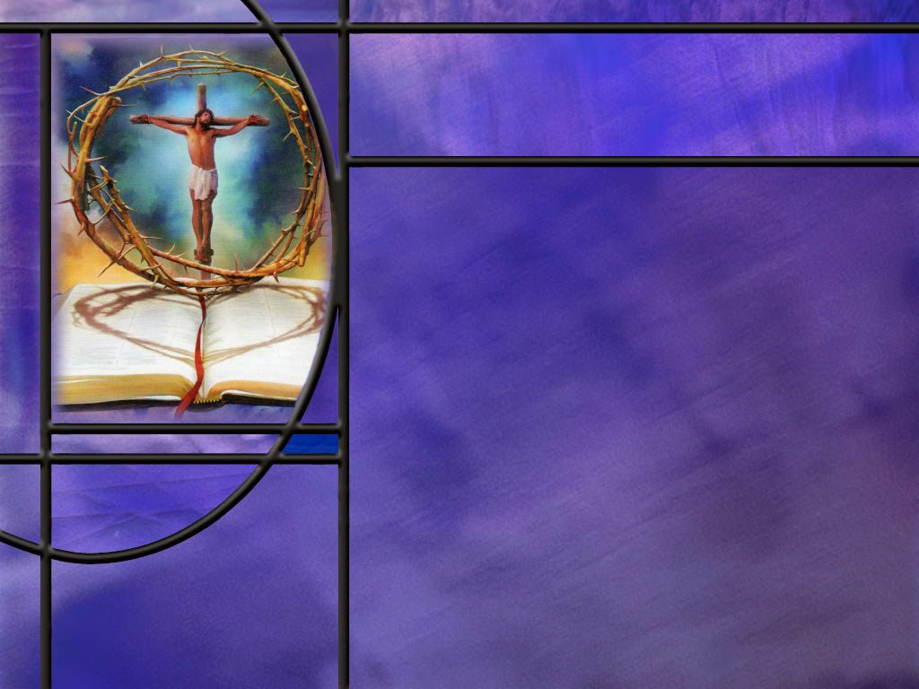
The Remedy for sin
What is God’s remedy for sin? (1 John 1:7)
How do we apprehend God’s remedy for sin? (1 John 1:9)
What can Jesus do for us that the law is powerless to do? (Gal 2:16)
While faith in Christ delivers us from the penalty of sin (eternal death), what delivers us from the power of sin in our daily lives?
If we are not saved by keeping the law, why keep it?
Notes:
B1:
[See notes on linked slide.]
B2:
[See notes on linked slide.]
B3:
[See notes on linked slide.]
B4:
1. In short, this is the work of the Holy Spirit.
2. Justification comes through faith in Jesus Christ for the forgiveness of our sins.
3. Everyone who is justified is given the Holy Spirit to begin the process of growing in grace and becoming more like Jesus.
4. When we are justified, we are born again by the Holy Spirit.
5. Jesus told Nicodemus, you must be born again.
John 3:5-6 NKJV - 5 Jesus answered, "Most assuredly, I say to you, unless one is born of water and the Spirit, he cannot enter the kingdom of God. 6 "That which is born of the flesh is flesh, and that which is born of the Spirit is spirit.
6. So the Holy Spirit gives us a new direction in life, a new spiritual birth.
7. He makes us new Creations with a new world view.
8. Instead of chasing after sin we are now running away from it.
9. Paul describes it this way in 2 Cor 5:17
2 Corinthians 5:17 NKJV - Therefore, if anyone is in Christ, he is a new creation; old things have passed away; behold, all things have become new.
10. The Holy Spirit produces the fruit of the Spirit in our lives which give us character traits like Jesus: love, joy, peace, patience, kindness, goodness, faithfulness, gentleness, and self-control. (Gal 5:22-23)
11. As we behold Jesus we are changed into His likeness even as by the Spirit of the Lord. (2 Cor 3:18)
12. The Holy Spirit pours out the agape love of God in our hearts. (Rom 5:5)
13. Through the HS, God writes His law on our hearts and puts it in our minds. (Heb 8:10)
14. As we grow in love for God and love for others, we will naturally obey God’s law written in our hearts.
15. Jesus said:
John 14:15 ESV - "If you love me, you will keep my commandments.”
16. With the HS giving us agape love, the power of sin will continue to diminish and we will find joy in keeping God’s commandments.
1 John 5:3 ESV - For this is the love of God, that we keep his commandments. And his commandments are not burdensome.
B5:
1. First of all, keeping the law is for our own good.
2. The law is a hedge to protect us.
3. Stay out of trouble, stay out of jail, stay out of court, stay away from revenge, by keeping the law.
4. Life is always better when we obey the law of God.
5. Second, we keep the law to bring glory to God.
6. As God’s people, we make God look good when we obey His commandments and receive His blessings.
Matthew 5:16 (NKJV)
¹⁶ Let your light so shine before men, that they may see your good works and glorify your Father in heaven.
7. Third, we obey the commandments of God to express our love for Him.
8. Jesus said:
John 15:14 (NKJV)
¹⁴ You are My friends if you do whatever I command you.
9. Want to be friends with Jesus? Keep His commandments.

Slide 7
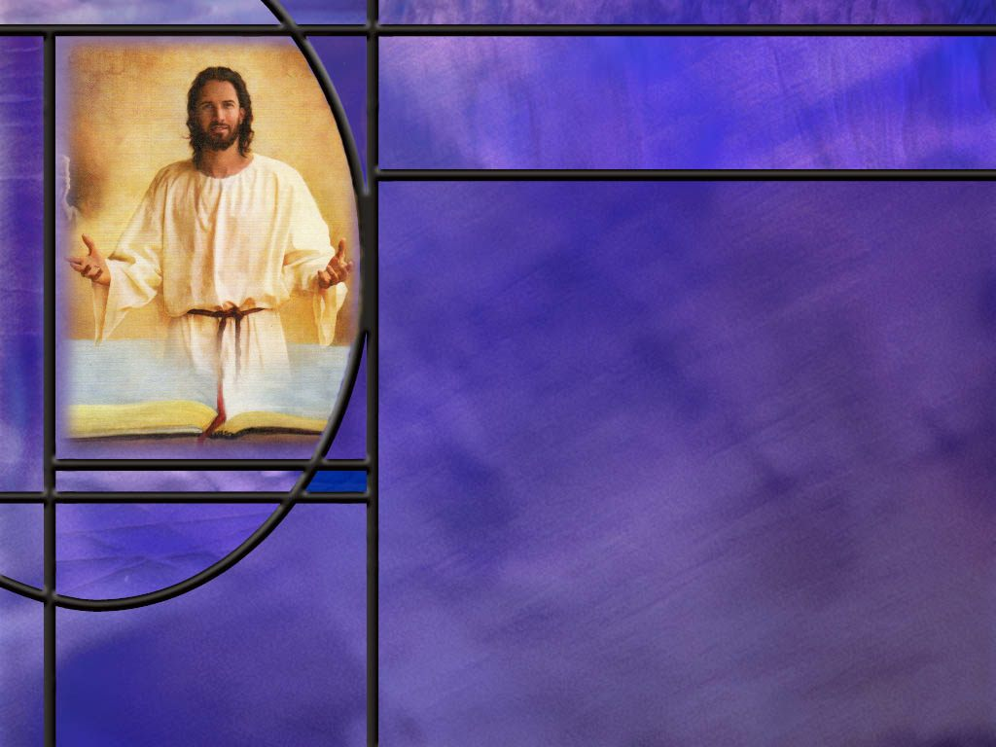
Summary
Many of the psalms paint a wonderful picture of the blessings that come from keeping the law of God.
David describes God’s law as perfect, sure, right, pure, clean, true and righteous.
Moses declared that God’s law was given for our good always. It was to be a hedge of protection from the evil that offends God, hurts others, and destroys us.
Jesus declared the permanence of God’s law that is as enduring as the character of God.
Jesus summarized the Law in the two greatest commandments: supreme love to God and love for others. This principle of agape love sets a higher standard of behavior than the Ten Commandments.

Slide 8
Summary
While the Bible has several definitions of sin, it is often seen as disobedience to the law of God.
Sin separates us from God and breaks our fellowship with Him.
We can abide in Jesus by keeping His commandments, but when we disobey, we break our friendship with Him.
Those who have trusted Christ as Savior and Lord have been adopted into His family and are children of God.
If they fall into sin, God does not kick them out of His family, but allows the Holy Spirit to convict them of sin and lead them to repentance. However, apostasy can occur if someone turns his back on Jesus and returns to the world, giving up on God.

Slide 9
Summary
God’s remedy for sin is found in the everlasting gospel of salvation by grace through faith.
Grace is God’s part, giving His Son Jesus to die for our sins; faith is our part, receiving Him as our Savior and Lord and trusting His shed blood for our forgiveness.
When God forgives us in Christ, we are declared justified, and we are saved from the penalty of sin, eternal death.
God then gives us the Holy Spirit to deliver us from the power of sin and make us new creations that are growing in character to be more like Jesus and living for Him.
Will you take advantage this week of the blessings promised for obedience to God’s law of love?

Slide 11
Deuteronomy 6:24; 10:13 NKJV
'And the LORD commanded us to observe all these statutes, to fear the LORD our God, for our good always, that He might preserve us alive, as it is this day.
"and to keep the commandments of the LORD and His statutes which I command you today for your good?
Notes:
Q1: What do these verses say about the commandments of God and why He gave them?
1. The commandments were given to us for our good!
2. God is not trying to restrict our freedom.
3. He is trying to prevent us from ruining our lives.
4. God’s law is a hedge about us to protect us from the consequences of destructive behavior.
5. His law tells us how to live a life that pleases Him and blesses others.
[Go to next slide.]

Slide 12
Joshua 1:8 NKJV
"This Book of the Law shall not depart from your mouth, but you shall meditate in it day and night, that you may observe to do according to all that is written in it. For then you will make your way prosperous, and then you will have good success.” [R]
Notes:
Q1: What is the promise of this verse?
1. There is a blessing in obedience to the law of God.
2. If you are obedient to the law of God you will prosper and have good success.
3. There are natural blessings that accrue from obeying the commandments of God.

Slide 13
Psalm 19:7-11 ESV
The law of the LORD is perfect, reviving the soul; the testimony of the LORD is sure, making wise the simple; 8 the precepts of the LORD are right, rejoicing the heart; the commandment of the LORD is pure, enlightening the eyes; 9 the fear of the LORD is clean, enduring forever; the rules of the LORD are true, and righteous altogether. 10 More to be desired are they than gold, even much fine gold; sweeter also than honey and drippings of the honeycomb. 11 Moreover, by them is your servant warned; in keeping them there is great reward. [R]
Notes:
Q1: Let’s review again all the adjectives David uses in this psalm to describe the law of God.
1. God’s law is perfect, it is sure, it is right, it is pure, it is clean, it is totally true and righteous.
Q2: And what is God’s law able to do for us:
1. It revives our soul, it makes us wise, it rejoices our hearts, it enlightens our eyes, it endures forever.
2. It warns us from evil and brings great reward in obedience.
3. No wonder David describes God’s law as being more precious than gold and sweeter than honey.

Slide 14
Matthew 5:17-18 KJV
Think not that I am come to destroy the law, or the prophets: I am not come to destroy, but to fulfil. ¹⁸ For verily I say unto you, Till heaven and earth pass, one jot or one tittle shall in no wise pass from the law, till all be fulfilled. [R]
Notes:
Q1: What law do you think Jesus was talking about here? Was it just the 10 commandment law or something bigger?
1. The fact that He refers to the Law or the Prophets indicates that He is considering more than just the 10 commandments.
2. The Law and the Prophets was one of the ways the Jews referred to the OT.
3. In some cases they would refer to it as the Law, the Prophets, and the Psalms.
4. The Hebrew Bible is titled The Law, the Prophets, and the Writings.
5. In Luke 24, after Jesus met with His disciples following the resurrection, He told them
Luke 24:44 KJV - …These are the words which I spake unto you, while I was yet with you, that all things must be fulfilled, which were written in the law of Moses, and in the prophets, and in the psalms, concerning me.
6. So Law and Prophets here is code for all of the OT scriptures.
7. Have heaven and earth passed?
8. Then we can be sure that the word of God stands firm.
9. Jesus said in:
Matthew 24:35 NIV - Heaven and earth will pass away, but my words will never pass away.
Q2: How did God indicate the permanence of the covenant law?
1. He wrote it with His own finger on tables of stone.
2. This was not thought inspiration or verbal dictation.
3. It was divine inscription. God wrote it Himself.
4. It has to be exactly what He wanted to write.
5. And He did it twice.
Q3: What assurance does this text give us that the fourth commandment cannot be changed?
1. We can depend on he words of Jesus.
2. It is interesting that the word “seventh” in Hebrew contains two jots and one tittle.
3. The jot is a yod, the smallest letter in the Hebrew alphabet.
4. A tittle is just a little line that makes one letter different from another like the difference between a C and a G in English.
5. While the Little Horn power would think to change times and laws, he never has changed God’s law and he never will.

Slide 15
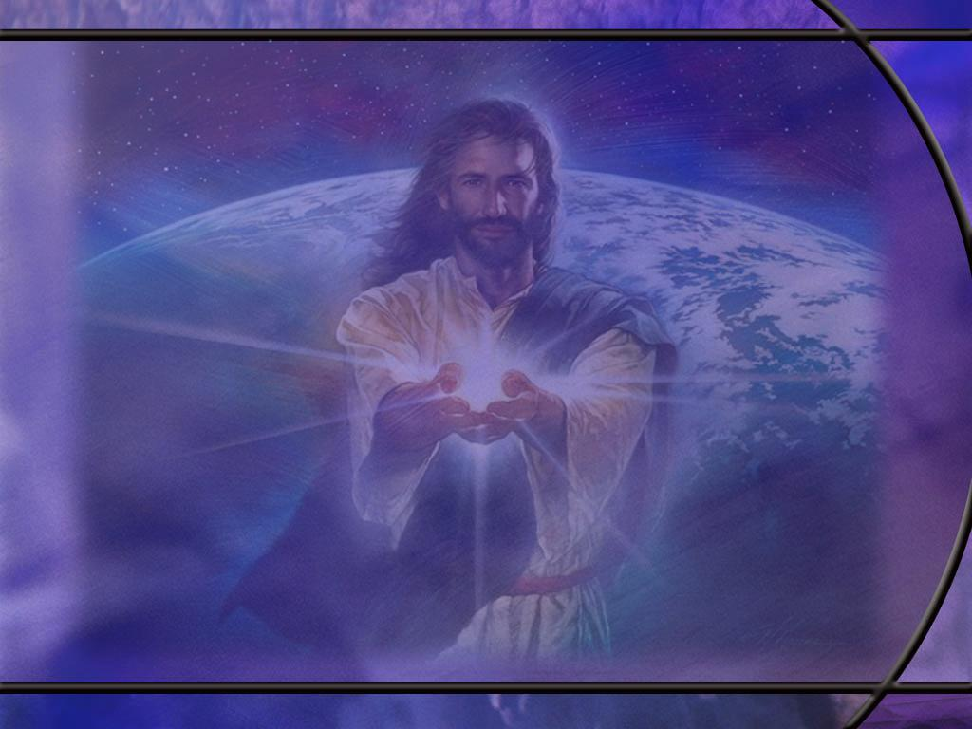
Matthew 22:37-40 NKJV
Jesus said to him, "'You shall love the LORD your God with all your heart, with all your soul, and with all your mind.' ³⁸ "This is the first and great commandment. ³⁹ "And the second is like it: 'You shall love your neighbor as yourself.' ⁴⁰ "On these two commandments hang all the Law and the Prophets." [R]
Notes:
Q1: Is this something new that Jesus made up or can we find these words in the OT?
1. These are quotes from the OT Scriptures.
2. The first comes from Deut 6:5
Deuteronomy 6:5 NKJV - "You shall love the LORD your God with all your heart, with all your soul, and with all your strength.
3. The second is from Lev. 19:18.
Q2: How much of the OT Scriptures hang on these two laws?
1. These laws of love are foundational to all of the Law and Prophets, which is code for OT Scriptures.
2. They are certainly a good summary of the 10 commandments.
3. The commandment to love the Lord covers the first four commandments, and the command to love others cover the last 6 commandments.
Q3: Does the commandment to love set a higher standard of behavior than the literal Ten Commandments?
1. Yes, I believe that it does.
2. If we love God and love others, we will certainly keep all of the 10 commandments.
3. The Ten Commandments actually set a minimum standard for how we should treat God and others.
4. If we fall below this minimum, it is sin.
5. God’s ultimate standard of behavior is to love the Lord our God with all our heart, soul, mind, and strength and to love our neighbor as ourself.
6. That should be our goal as Christians.
7. But failing that, the moral law of Ten Commandments gives us a minimum standard of love.
8. We may not be able to love our neighbor as ourself, but don’t murder him, don’t commit adultery with his wife, don’t steal his property or covet his goods, don’t lie to him or about him.
9. When we fall below the minimum standard of the Ten Commandments, we have fallen into sin.

Slide 16
Deuteronomy 10:12-13 NKJV
"And now, Israel, what does the LORD your God require of you, but to fear the LORD your God, to walk in all His ways and to love Him, to serve the LORD your God with all your heart and with all your soul, ¹³ "and to keep the commandments of the LORD and His statutes which I command you today for your good? [R]
Notes:
Q1: What are some of the key words that Moses uses here to expand on what it means to Love the Lord?
1. Fear the Lord.
2. That doesn’t mean to be terrified of Him but to stand in awe of Him, to treat Him with reverence, respect, praise, adoration, and obedience.
3. Walk in all His ways.
4. This again involves obedience to the will of God.
5. Love Him and serve Him with all your heart.
6. Keep His commandments and statutes.
7. In short, loving the Lord involves more that professing an affectionate feeling for God.
8. It involves living in obedience to Him, serving Him, doing His will, treating Him with reverence, respect, and submission.

Slide 17
Definitions of Sin
1 John 3:4 KJV - Whosoever committeth sin transgresseth also the law: for sin is the transgression of the law.
James 4:17 KJV - Therefore to him that knoweth to do good, and doeth it not, to him it is sin.
Romans 14:23 NIV - … and everything that does not come from faith is sin.
1 John 5:17 KJV - All unrighteousness is sin. [R]
Notes:
1. First, sin is disobedience to the law of God.
2. Second, sin is failing to do the good we know we should do (sins of omission).
3. Third, this definition of sin is given in the context of violating your conscience for the sake of others. Failure to remain faithful to God and His word is sin.
4. Fourth, all unrighteousness or wrong doing is sin.
5. And where do we find God’s definition of right and wrong? (It is found in His word, primarily His commandments.)
6. Paul writes in:
Romans 3:20 KJV - Therefore by the deeds of the law there shall no flesh be justified in his sight: for by the law is the knowledge of sin.
7. The law of God points out sin in our lives, but it is powerless to forgive those sins.
8. While these definitions are helpful, there is something more to sin that the broken law of God.
10. Our sin not only breaks God’s law, it breaks His heart.
11. We may think of sin as hurting only others, but it ultimately hurts God.
12. In his prayer of confession David prayed these words: “Against thee, thee only, have I sinned and done this evil in thy sight.”
13. Of course, David’s sin affected Bathsheba, Uriah, the baby, his lawful wives, his family, the whole country of Israel.
14. But what was uppermost in David’s mind is that his sin had broken God’s heart.

Slide 18
Isaiah 59:2 KJV
But your iniquities have separated between you and your God, and your sins have hid his face from you, that he will not hear. [R]
Notes:
Q1: What does sin do to our relationship with God?
1. Sin separates us from God.
2. It breaks our fellowship with Him.
Amos 3:3 KJV - Can two walk together, except they be agreed?
3. We abide in Christ by obeying His commandments.
4. He told His disciples:
John 15:10 KJV - If ye keep my commandments, ye shall abide in my love; even as I have kept my Father's commandments, and abide in his love.
5. If we don’t keep His commandments, our sins separate us from Him, and we need to follow the conviction of the HS, confess our sins, repent, and resume our fellowship with the Lord.
6. God is a holy God, and He abhors sin.
7. In fact, the Bible presents God as a consuming fire to all that offends.
8. We see that clearly at the return of our Lord when the wicked are destroyed by the brightness of His coming. (2 Thes 2:8)
2 Thessalonians 1:9 KJV - 9 Who [The wicked at His coming] shall be punished with everlasting destruction from the presence of the Lord, and from the glory of his power;

Slide 19
John 15:10, 14 ESV
If you keep my commandments, you will abide in my love, just as I have kept my Father's commandments and abide in his love. ... ¹⁴ You are my friends if you do what I command you. [R]
Notes:
Q1: What is the key to abiding in the love of Jesus?
1. The key to abiding in the love of Jesus is obeying His commandments.
2. Sin destroys our fellowship with God.
3. Obeying all the commandments because we love Jesus keeps us in fellowship with our Lord through the HS.
John 15:14 (ESV)
¹⁴ You are My friends if you do what I command you.
4. The flip side of that is that if we break the commandments, that breaks our friendship with the Lord.
5. So, to keep abiding in the love of Jesus we need to keep obeying the commandments.
6. That means we need to keep living in love toward God and others.
7. Paul writes to the Corinthians:
1 Corinthians 16:14 NKJV - Let all that you do be done with love.
8. And to the Romans he writes.
Romans 13:10 ESV - Love does no wrong to a neighbor; therefore, love is the fulfilling of the law.
9. We abide in Jesus by obeying His commandments to love.
10. Disobeying His commandments is sin, and that breaks our fellowship and our friendship with Jesus.

Slide 20
1 John 1:7 NKJV
- …the blood of Jesus Christ his Son cleanses us from all sin. [R]
Notes:
Q1: What does the blood of Jesus represent in this verse?
1. It represents the blood that He shed on Calvary for the forgiveness of our sins.
2. It represents the sinless life that He sacrificed to pay the wages of sin for us.
3. When we trust in His blood for our forgiveness, our sins are laid on Him when we repent and confess them.
4. His death is accepted by the Father as the payment for our sins.
5. When we are cleansed from all sin, we are justified: “just-as-if-I” had not sinned.
6. This brings us into a right relationship with God where we are declared righteous.
7. This is salvation by grace through faith.
8. Grace is God’s part: giving His Son Jesus to die for our sins.
9. Faith is our part: receiving Jesus as our Savior and Lord and trusting in His blood for forgiveness.
10. As Paul writes in:
2 Corinthians 5:21 NKJV - For He made Him who knew no sin to be sin for us, that we might become the righteousness of God in Him.
11. This is what Luther called the great exchange: Jesus took our sins and gave us His righteousness.

Slide 21
1 John 1:9 NKJV
If we confess our sins, He is faithful and just to forgive us our sins and to cleanse us from all unrighteousness. [R]
Notes:
Q1: How do we need to deal with our sin in order to be justified and declared righteous?
We need to confess our sins and repent of them.
The one who forgives us is the one whose blood cleanses us from all sin in the two verses just before this one.
So we need to come to Jesus, receive Him as the Son of God and our Savior from sin, and trust in His death and resurrection for the forgiveness of our sins.
And the promise of this verse is that He will forgive us and cleanse us from all unrighteousness.
This is the work of Jesus in the heavenly sanctuary, applying the atoning blood which He shed to sinners who come to Him in faith and repentance.
When Jesus forgives us, we are declared justified in the courts of heaven, our names are written in the Lamb’s Book of Life, and we are saved.
Saved by God’s grace in sending Jesus to save us, and our faith in receiving Jesus as our personal Savior and Lord.

Slide 22
Galatians 2:16 NKJV
knowing that a man is not justified by the works of the law but by faith in Jesus Christ, even we have believed in Christ Jesus, that we might be justified by faith in Christ and not by the works of the law; for by the works of the law no flesh shall be justified. [R]
Notes:
Q1: What is the only way to be justified and declared righteous?
1. Paul considers two ways here: one of which works and the other does not.
2. We are justified by faith in the Lord Jesus Christ, trusting in His shed blood for the forgiveness of our sins and eternal life with God.
3. The law has no power to forgive our sins.
4. The law points out sin.
5. Paul wrote to the Romans:
Romans 7:7 NKJV - …I would not have known sin except through the law. For I would not have known covetousness unless the law had said, "You shall not covet."
6. The law is like a mirror that shows us we are sinners.
7. But the law cannot forgive sins, only the blood of Jesus can.

