Slide 1
Growing in a Relationship with God
Lesson 8
Having Faith

Slide 2
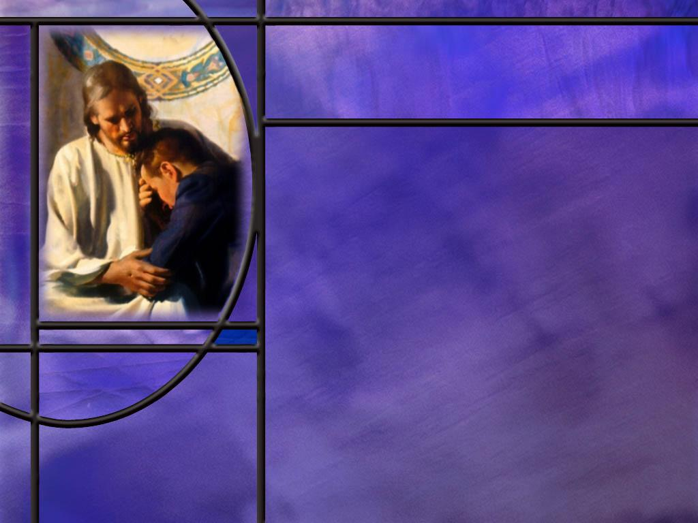
Memory Text
Hebrews 11:1 NLT
Faith shows the reality of what we hope for; it is the evidence of things we cannot see.
How would you put this definition of faith in your own words?
Is faith a leap into the dark or a step into the light? Explain.
Why does Heb 11:6 say that “without faith it is impossible to please God?”
Is this faith reasonable or unreasonable?
Notes:
B2:
1. Here are some other translations of Heb 11:1
2. Now faith is confidence in what we hope for and assurance about what we do not see. (NIV)
3. Now faith is the assurance of things hoped for, the conviction of things not seen. (RSV)
4. Faith goes beyond believing in what we can touch and see.
5. It is faith that makes unseen spiritual things as real as physical things we can see and touch.
6. Faith extrapolates what we can be sure of to a confidence in a greater unseen reality.
7. Faith is trusting God and being sure He will do what He promised, even when you cannot see it yet.
B3:
1. Atheists and humanists accuse Christians of believing in things they cannot prove by empirical evidence.
2. They claim that faith is a leap into the dark, just hoping something is true without actual proof.
3. I prefer to think of faith as an extrapolation from what we do know to what we don’t.
4. Extrapolation is a word that describes following an existing trend.
5. If you have a data set over a limited range of the variables, you fit a trend line to the data you have and use it to extrapolate to a range where you have no data.
6. Faith goes beyond the empirical data, but never contrary to it.
B4:
1. Because it takes faith to believe in God.
2. Here’s what the full verse says:
Hebrews 11:6 (NIV)
⁶ And without faith it is impossible to please God, because anyone who comes to him must believe that he exists and that he rewards those who earnestly seek him
3. We can’t discover God or verify His existence with our five senses.
4. We can’t literally see Him, touch Him, or hear Him.
5. So it takes faith to believe that He exists.
6. Anyone that denies the existence of God cannot know Him or love Him or obey Him or please Him.
B5:
1. Christians claim that it is very reasonable based on the evidence of creation.
2. Faith in God is a reasonable extrapolation of the evidence we have all around us.
3. The laws of science demand a supernatural creation.
4. The law of cause and effect says that anything that had a beginning had a cause that’s greater than the effect.
5. The cause of creation must be eternal (without beginning), spaceless (not limited by space), immaterial (not limited to matter), extraordinarily intelligent, and extremely powerful. That’s God.
6. The first law of thermodynamics says mass and energy can neither be created nor destroyed by natural processes, so creation must have been supernatural.
7. The second law of thermodynamics says that the universe naturally runs down, becomes disordered and cools off, so something supernatural must have organized it and heated it up in the beginning.
8. The law of biogenesis says that life comes only from life, so the first life forms must have been created supernaturally.
9. In fact, the only reasonable explanation for the creation we see is that it is the work of a supernatural Creator we cannot see.
10. Don’t let these atheistic evolutionists bamboozle you: all the really good scientific evidence is on the side of creation, not evolution.
11. A second branch of empirical evidence that supports our faith in the unseen is the fulfillment of Bible prophecy.
12. God tells us in advance in His Word what He is going to do and then He acts to bring it about.
13. Fulfilled prophecy tells us that God is in control of human history and the Bible is His word.
14. One of my favorite prophecies is the 70-week prophecy of Daniel 9 which predicts the exact time of the baptism of Jesus, His death on the cross for our sins, and the time of the gospel going to the Gentile world.
15. Scores of OT messianic prophecies were fulfilled in the life, death, and resurrection of Jesus.
16. Prophecies about cities, and nations, kingdoms have been amazingly fulfilled.
17. We can extrapolate this record of fulfilled promises to be confident in the eventual fulfillment of all the promises of God.
18. Faith is not a leap into the dark but a step into the light.

Slide 3
Overview
Without faith it is impossible to have a relationship with God. Our lesson this week focuses on understanding faith, what it is, how we get it, and how it grows.
  Saving Faith
  A Measure of Faith
  Faith of Jesus
  Summary

Slide 4
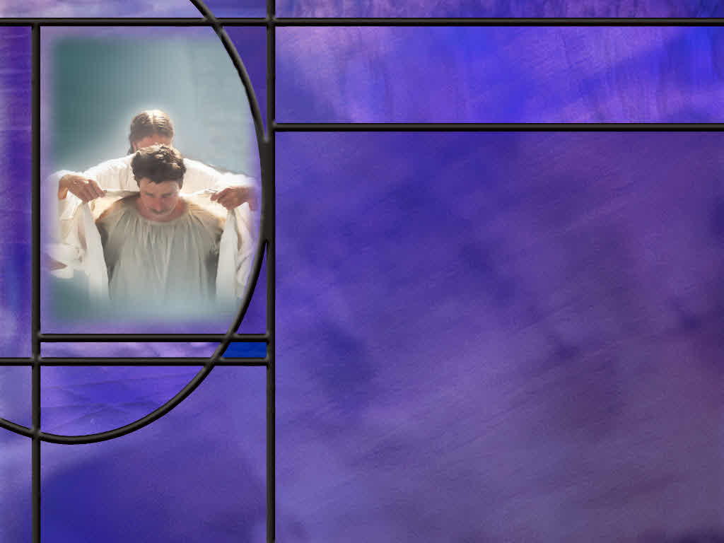
Saving Faith
How does John’s gospel describe how we can have eternal life? (John 1:11-13)
What is the relationship between belief and faith?
What is saving faith? How would you define it as it relates to faith in God?
How do we get saving faith? (Rom 10:17)
Does the Bible say that saving faith is a gift of God? (Eph 2:8-9)
Notes:
B1:
[See notes on linked slide.]
B2:
1. If we look at these two words in English, many people see a difference.
2. Faith is defined as belief and trust and loyalty to God.
3. Belief is often seen as simply accepting certain facts as true.
4. So James can write that the devils believe and tremble.
5. But they don’t trust God and are not loyal to Him.
6. But if we look at the dictionary definition of belief, it is similar to the definition of faith: a state of mind in which trust or confidence is placed in some person or thing
7. So we can have different shades of meaning of faith and belief.
8. In the Greek, they are quite similar.
9. Faith is a noun and believe is a verb, but they both come from the same root in Greek.
10. The Geek for faith is pistis (pis'-tis); the Greek for believe is pisteuō (pist-yoo’-o)
11. Strong’s definition for pisteuo is to have faith in a person or thing.
12. John appears to use “believe in Jesus” the same way Paul uses “have faith in Jesus.”
13. So in Biblical usage, these two forms of describing a relationship with Jesus are essentially the same.
B3:
1. My favorite definition of saving faith is from Wayne Grudem in his book Systematic Theology.
“Saving faith is trust in Jesus Christ as a living Person for forgiveness of sins and for eternal life with God.”
2. We can also use the word “Faith” as an acronym for a definition: Forsaking All, I Take Him.
3. Here’s a definition for the SDA Bible commentary
“a confidence of heart and mind in God and His ways that lead one to act in accordance with His … will.” (SDA Bible Dictionary p 360).
4. We can go back to the Bible definition from Hebrews 11:1
Hebrews 11:1 ESV - Now faith is the assurance of things hoped for, the conviction of things not seen.
5. This is not a complete definition but served the purposes of introducing the great hall of faith chapter in Hebrews 11.
6. The things hoped for are the things God has promised.
7. So we can paraphrase this definition by saying: Faith is a firm persuasion and expectation, that God will perform all he has promised to us in Christ.
8. Martin Weber defines faith as follows.
“Faith is simply the willingness to exchange what the world offers for what God offers us in Christ.” (Who’s Got the Truth, p 171)
B4:
[See notes on linked slide]
B5:
[See notes on linked slide.]

Slide 5

A Measure of Faith
What is the context of Paul writing that God has given to every man a measure of faith? (Rom 12:3)
What did Jesus tell the Pharisees about looking for extra-biblical signs? (Matt 12:38-40)
How can our faith and trust in the Lord Jesus grow? (Mark 9:24)
Notes:
B1:
[See notes on linked slide.]
B2:
[See notes on linked slide.]
B3:
[See notes on linked slide.]

Slide 6
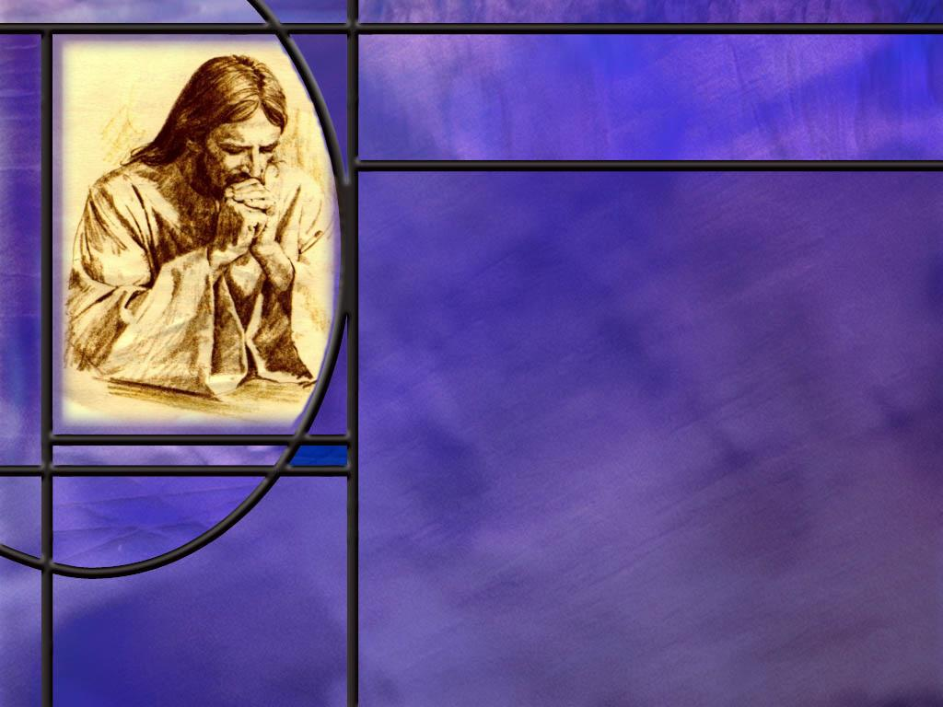
The Faith of Jesus
How does John describe those who avoid the mark of the beast and the worship of his image? (Rev 14:12)
What does the New Testament say about keeping the faith of Jesus? (2 Tim 4:7, Acts 6:7, Jude 1:3)
Notes:
B1:
[See notes on linked slide.]
B2:
[See notes on linked slide.]

Slide 7

Summary
Without faith it is impossible to please God.
Faith extrapolates what we can be sure of to a confidence in a greater unseen reality.
Faith goes beyond the empirical evidence we see but not counter to it.
At least two branches of empirical evidence support the Christian faith: creation and fulfilled prophecy.
Saving faith is trusting in Jesus as a living Person for the forgiveness of our sins and eternal life with God.
Romans 10:17 declares that saving faith comes by hearing, understanding and accepting the gospel of what Christ did to save us.

Slide 8
Summary
When we hear the gospel and the Holy Spirit convicts us of sin and the need of a Savior, we can exercise our freedom of choice to trust Jesus as Savior and Lord.
Eph 2:8-9 teaches that salvation comes by grace (God’s part) through faith (our part). It is clear from the Greek that it is not the faith that is the gift of God but the salvation by grace.
While God deals to each man a measure of faith, this is best understood in the context of the work of the Holy Spirit on those who have already been saved: the fruit of the Spirit brings faithfulness in the exercise of our spiritual gifts.
Our faith can continue to grow as we look to Jesus, our trustworthy Savor and Lord.

Slide 9
Summary
Rev 14:12 points to the saints who have steadfast endurance and avoid the mark of the beast by keeping the commandments of God and the faith of Jesus.
The faith of Jesus is best understood as the apostolic faith, the body of doctrines and teachings that Jesus once and for all delivered to the saints.
This faith is defined in the inspired NT writings of the apostles and focuses primarily on the everlasting gospel of salvation by grace through faith that results in justification, sanctification, and glorification.
Will you stand with that remnant this week and walk in the light that shines on your path from the Law of God and the Testimony of Jesus?

Slide 11
John 1:11-13 ESV
He came to his own, and his own people did not receive him. ¹² But to all who did receive him, who believed in his name, he gave the right to become children of God, ¹³ who were born, not of blood nor of the will of the flesh nor of the will of man, but of God. [R]
Notes:
Q1: How do these verses expand on the concept of believing in Jesus?
1. In verse 11 we see the rejection of Jesus by the religious leaders, the scribes, the Pharisees, the Sadducees.
2. They did not believe that Jesus was who He claimed to be and they did not believe in Him; they crucified Him.
3. But there were others who did receive Him.
4. These John describes as those who believed in His name.
5. To this group He gave the right to become children of God.
6. And they were born from above by the Spirit of God.
7. So here, the key to being saved appears to be to receive Jesus for who He says He is, the Messiah, the Son of God, and believe in His name.
Q2: What does it mean to believe in His name?
1. His name is a representation of all that Jesus is.
2. The words "his name" refers to everything he is, everything he's done, indeed, everything about him.
3. It means you accept, as the truth, the full gospel message of the doing and dying of Jesus.
4. You receive Him as your Savior and Lord and trust in His blood for the forgiveness of your sins.
Q3: How does John summarize Jesus’ message to Nicodemus? (John 3:16)
John 3:16 KJV - For God so loved the world, that he gave his only begotten Son, that whosoever believeth in him should not perish, but have everlasting life.
1. Here is the gospel in a nutshell.
2. Here we see the grace of God in giving His only Son to die for our sins.
3. And here we see the faith of the one who is saved, who believes in Him.
4. That one receives everlasting life instead of perishing.
5. In understanding this verse, it is important to see the context.
6. The whosoever that believeth in Him, believes in Him as the sacrifice for their sins.
7. In the two verses just before John 3:16. Jesus said to Nicodemus:
John 3:14-15 KJV - And as Moses lifted up the serpent in the wilderness, even so must the Son of man be lifted up: ¹⁵ That whosoever believeth in him should not perish, but have eternal life.
8. So the believing in Jesus of John 3:16 is believing that He was lifted up on the cross to die for our sins.
9. And trusting Him for the forgiveness of our sins is what gives us eternal life instead of eternal death.

Slide 12
Saving Faith
Romans 10:17 KJV - So then faith cometh by hearing, and hearing by the word of God.
Romans 10:17 NLT - So faith comes from hearing, that is, hearing the Good News about Christ. [R]
Notes:
1. If you look at the Greek, the verse ends with Christos not Theos.
2. So I would take the NLT as more accurate in this case.
3. And it makes sense: Saving faith in Christ comes from hearing the gospel about how Christ died for our sins, was buried and rose again the third day.
4. When we trust the Word of God as the source of truth and hear the gospel of what Christ has done to save us, we can put our trust in Him for the forgiveness of our sins and be justified by faith.
Q1: What are some of the ways you exercise faith in non-spiritual things? What are some things you trust without full understanding, proof, or assurance?
1. We exercise faith all the time in everyday things.
2. We get on an elevator and take it to the 35th floor having faith that the cable won’t break and drop us to the sub basement.
3. We have faith that the plane we get on will fly us to our destination without crashing.
4. We have faith when we drive along a two-lane road at 50 mph that the drivers coming in the opposite direction will stay in their own lane; we trust these complete strangers with our lives!
5. We have faith in a doctor who writes a prescription that we can’t read that is filled by a pharmacist that we don’t know with a chemical we can’t pronounce, and we go home and take it faithfully.
6. We have faith when we get on a roller coaster that it will not jump the tracks and take us to our death.
7. We do all these things and many others because we see evidence that they are safe.
8. While there may be occasional mishaps, the vast majority of people who do these things do them successfully.
9. We decide the benefits are worth the risk and we step out in faith.
Q2: How do we use a similar process to come to faith in Christ?
1. Faith in Christ comes the same way.
2. We see the evidence that the word of God is true.
3. The word of God gives us the gospel of what Jesus has done so that we can be forgiven and have eternal life.
4. We see that we are sinners and that only Christ can save us.
5. We decide that the benefits are worth the risk and trust in Him to save us.
6. This is not a miraculous transaction.
7. Paul says that faith comes by hearing the gospel.
8. He does not say that faith is a miraculous gift that God has to give us before we can believe.
9. This does not deny the work of the HS in convicting us of sin and our need of a Savior.
10. But Satan is also at work telling us it would be too much to give up to be a follower of Christ.
11. In the end, it comes down to our own free choice of whether or not to trust in Jesus as our Savior and Lord.

Slide 13
Ephesians 2:8-9 NKJV
For by grace you have been saved through faith, and that [tauto] not of yourselves; it is the gift of God, ⁹ not of works, lest anyone should boast.
Notes:
1. In the introduction of our lesson this week, the author writes, “ Faith is a gift from God,” and cites Eph 2:8-9 as the text that proves it.
2. As we will see, this is not what the text says.
3. There is a danger in believing this.
4. If faith is a gift from God, then only those to whom God gives saving faith can be saved.
5. This gets back to the Calvinist idea that God predestines some to be saved and others to be lost.
6. To the elect He gives saving faith, and to the others, He does not.
Q1: What are the two means by which we are saved according to verse 8?
1. We are saved by grace through faith.
2. Grace is God’s part; faith is our part.
3. God sends His Son to die for our sins (that’s grace); we receive Him as our savior from sin (that’s faith).
4. Grace is God’s act in saving sinners; faith is our act in receiving His grace.
Q2: How is this text misunderstood by many who want to claim that saving faith is the gift of God?
1. They understand the word “that” (underlined in the text above) as referring to faith rather than to salvation as a gift of God.
2. How do we know that this is incorrect?
3. We can tell from the gender of the nouns.
4. In Greek, the word “faith” is feminine gender while the word “that” is neuter.
5. So the word “that” cannot refer back to faith.
6. It must refer back to the salvation that comes by grace.
7. And that is confirmed by verse 9.
8. To say that faith is not a result of works is nonsense.
9. But to say that salvation is not a result of works is to say what Paul always says.
10. Remember the Philippian jailer was told to “believe on the Lord Jesus Christ.”
11. That was his part in order to receive the grace of God.
12. They didn’t tell him to pray for the gift of saving faith.
13. Here is what FF Bruce says on this verse:
[Go to next slide.]

Slide 14

Authoritative Quotation on Eph 2:8-9
“The fact that the demonstrative pronoun ‘that’ in neuter in Greek (tauto) whereas ‘faith’ is a feminine noun (pistis), combines with other considerations to suggest that it is the whole concept of salvation by grace through faith that is described as the gift of God. This incidentally, was Calvin’s interpretation.”
F.F. Bruce in The Epistle to the Ephesians, p 51-52
Notes:
[Go to next slide.]

Slide 15
Ephesians 2:8-9 (KJV)
⁸ For by grace (God’s part: His unmerited favor toward us in sending His Son to die for our sins) are ye saved through faith (our part: trusting in Christ for forgiveness of sins) ; and that (salvation by grace through faith is) not of yourselves: it is the gift of God: ⁹ Not of works (salvation is not of works), lest any man should boast (about being saved by his works). [R]
Notes:
1. Based on what we have learned from the Greek grammar, we can parse this text with comments that explain each phrase.
2. Let’s read through it again with parenthetical comments.

Slide 16
Romans 12:3 NKJV
For I say, through the grace given to me, to everyone who is among you, not to think of himself more highly than he ought to think, but to think soberly, as God has dealt to each one a measure of faith. [R]
Notes:
Q1: Is this measure of faith, saving faith?
1. This is Paul’s introduction to a section in Romans 12 on the use of Spiritual gifts.
2. He is writing to Christians here who have the Holy Spirit and have been given spiritual gifts.
3. That means they are already saved: they have “saving faith.”
4. We don’t get the Holy Spirit and spiritual gifts unless we have been saved by the blood of Jesus.
5. So Paul is talking here about how to use the spiritual gifts they have been given by the Holy spirit.
6. It is interesting that the Greek word for faith, pistis (pis’-tis) can be translated either as faith or faithfulness depending on the context.
7. When we come to the fruit of the Spirit in Gal 5:22-23, there the seventh aspect of the fruit of the Spirit is pistis, the Greek word for faith, and is translated in most versions as “faithfulness.”
8. So you need saving faith to come to Jesus and receive the Holy Spirit.
9. And as the Spirit works to change your life, He makes you more faithful, more reliable, more dependable in your service for Christ.
10. So I would argue that here in Rom 12:3, the phrase “measure of faith” would be better translated as “measure of faithfulness.”
11. As the Holy Spirit gives us a measure of faithfulness through the fruit of the Spirit, we are to use it to minister effectively with our gifts of the Spirit.
12. So Paul is encouraging the believers to minister their gifts in the body with humility and faithfulness, being dependable, accountable, reliable, to the measure they have been enabled by the Holy Spirit.
13. Does that make sense?

Slide 17
Matthew 12:38-40 NKJV
Then some of the scribes and Pharisees answered, saying, "Teacher, we want to see a sign from You." ³⁹ But He answered and said to them, "An evil and adulterous generation seeks after a sign, and no sign will be given to it except the sign of the prophet Jonah. ⁴⁰ "For as Jonah was three days and three nights in the belly of the great fish, so will the Son of Man be three days and three nights in the heart of the earth. [R]
Notes:
Q1: What signs did the scribes and Pharisees have already?
1. They had all the signs and miracles that Jesus was doing every day as He healed the sick and cast out demons and cleansed the Lepers and opened blind eyes, and raised he dead.
2. Nicodemus had no problem seeing the signs.
3. He said to Jesus:
John 3:2 NKJV - …"Rabbi, we know that You are a teacher come from God; for no one can do these signs that You do unless God is with him."
4. It was not that Jesus had not performed many wonderful signs, it was that they refused to believe.
5. They were asking for a performative miracle to wow the audience, something like Satan’s temptation in the wilderness of casting himself down from the pinnacle of the temple and being caught by angels.
6. Jesus wasn’t into performing miracles for show.
7. He was into meeting needs that were real.
8. In addition to all the signs they had during Jesus’ ministry, they had the signs of scripture.
19. Jesus said to them:
John 5:39 NKJV - "You search the Scriptures, for in them you think you have eternal life; and these are they which testify of Me.
Q2: What was the sign of Jonah?
1. I was the sign of the resurrection.
2. The resurrection validated all that Jesus said and did.
3. It validated Him as the Son of God.
4. It put God’s stamp of approval on His ministry and on His sacrifice for sin.
5. Paul writes in:
Romans 1:3-4 NKJV - Jesus Christ our Lord … was … declared to be the Son of God with power according to the Spirit of holiness, by the resurrection from the dead.
6. It is the resurrection that established the truth of the Christian faith.
7. Without it, there would by no Christian church, there would be no NT, our faith would be empty and useless, and we would all perish in our sins.
8. But Luke records in
Acts 6:7 NKJV - Then the word of God spread, and the number of the disciples multiplied greatly in Jerusalem, and a great many of the priests were obedient to the faith.
9. The empty grave is an enduring testimony to the truth of the Christian faith.

Slide 18
Mark 9:24 NKJV
Immediately the father of the child cried out and said with tears, "Lord, I believe; help my unbelief!" [R]
Notes:
Q1: Is this a prayer that we, too, need to pray?
1. Yes indeed!
2. We always want our faith to be growing stronger, not weaker.
3. Luke records the disciples of Jesus as saying to Him, “Increase our faith.” (Luke 17:5)
4. So faith is not static it continues to grow.
Q2: How did Jesus answer the prayer of this father, whose son was demon possessed?
1. In the very next verse, Jesus casts out the unclean spirit.
Q3: How do you think that affected the father’s faith?
1. No doubt he want from that place rejoicing, saying, “Look what Jesus did for my son!”
2. His faith was strengthened by looking to Jesus and seeing His healing power at work.
Q4: How does the Lord strengthen our faith?
1. Our faith is strengthened when we behold Jesus in the word of God and see His power to heal, forgive, and save.
2. The more we see and know of Jesus, the more we will see how trustworthy He is.
3. The more we love Him and trust Him, the stronger our faith will become.
4. We want our faith to become so strong we will never turn our back on our Savior and Lord.
5. Hebrews 12:1 imagines the Christian life as a race, and we are to run that race by:
Hebrews 12:2 NKJV - 2 looking unto Jesus, the author and finisher of our faith,
6. He is the author of our faith in the sense that our race to the heavenly goal began when we put our faith in Him.
7. He is the finisher of our faith in that our faith will still be placed in Him at the end of the race.
8. The more we keep our eyes on Him the more we will want to fall into His arms at the finish line.

Slide 19
Revelation 14:12 KJV
Here is the patience of the saints: here are they that keep the commandments of God, and the faith of Jesus.
Greek Interlinear, Nestle text:
“Here is the endurance of the saints, the ones keeping the commandments of God and the faith of Jesus.” (Rev 14:12) [R]
Notes:
[Delay click on second bullet]
1. I believe that this verse can actually be considered the concluding statement of the third angel.
2. It draws the contrast between those who worship the beast and his image and those who do not.
Q1: What kind of patience do these saints have?
1. This is not just that ability to put up with annoyances.
2. The Greek word used here is hupomone which is best translated steadfast endurance.
3. These saints hold onto their faith in Jesus despite the times of severe tribulation they go through.
4. They are ostracized, marginalized, persecuted, prevented from buying and selling, and placed under a death decree.
5. But they are loyal to Jesus and to His gospel and to the word of God no matter what the circumstances.
6. They are willing to die for the One who died for them.
Q2: What two characteristics do these saints have that makes them loyal to the truth of God?
1. They keep the commandments of God and the faith of Jesus.
Q3: Do these saints “keep the faith of Jesus” or do they “have the faith of Jesus?”
1. What does the text say?
2. As given in the KJV, NKJV, the RSV, and NASB (footnote) they keep the faith of Jesus.
3. Some of the more modern translations say:
They maintain their faith in Jesus (NLT)
They remain faithful to Jesus (NIV)
4. So let’s take a look at the Greek: [Click second bullet]
5. So the best literal translation we have of this verse is that the saints “keep the faith of Jesus.”
6. This would call into question translations that would make this verse say the saints “have the faith of Jesus” or “have faith like Jesus” or even “have faith in Jesus.”
7. Nor does it say they keep their faith in Jesus, but they keep the faith of Jesus.
8. So let’s try to make sense out of what the text actually says.
9. I want to spend a little time on this because of some of the statements on Thursday’s lesson in the quarterly where the author paraphrases the text as : “keeping the commandments and having the faith of Jesus.”
10. Then she goes on to explain that having the faith of Jesus means to have Jesus abiding in us and thus His faith in our hearts.
11. I don’t know what it means to have Jesus’ faith in our hearts.
12. I think there’s a lot of confusion among Adventist about what this text actually means.

Slide 20
Keeping the Faith of Jesus
2 Timothy 4:7 KJV - I have fought a good fight, I have finished my course, I have kept the faith:
Acts 6:7 KJV - 7 And the word of God increased; and the number of the disciples multiplied in Jerusalem greatly; and a great company of the priests were obedient to the faith.
Jude 1:3 NKJV - 3 Beloved, …I found it necessary to write to you exhorting you to contend earnestly for the faith which was once for all delivered to the saints.
Notes:
1. Here we have three verses where “the faith” is kept.
2. The apostle Paul, looked back over his life and said he has kept the faith.
3. What was “the faith” he kept? It was the faith of Jesus.
4. It was the NT teachings of Jesus that centered in the gospel: that Christ died for our sins, was buried, and rose again the third day according to the Scriptures. (1 Cor 15:1-4)
5. It was the gospel of salvation by grace through faith in the Lord Jesus Christ.
1. Many of the priests were obedient to “the faith,” meaning they kept it.
2. It was the same NT faith that Christ delivered to His church, the gospel of righteousness by faith, of justification and sanctification and glorification.
1. Jude encourages the saints in his letter to earnestly contend for “the faith” that was once and for all delivered to the saints.
2. And who delivered that faith? (It was the Lord Jesus Christ.)
3. The faith of Jesus is simply the doctrines or teaching of the apostolic church which they received from Jesus.
4. First and foremost, the doctrine of salvation by grace through faith.
5. Let me now share two quotes from Adventist theologians on the next two slides.
[Go to next slide.]

Slide 21
Hans LaRondelle
The remnant people not only keep God’s commandments but also keep the “faith of Jesus” (Rev 14:12). This faith of Jesus which His followers “keep” is not simply their subjective faith in Jesus but the objective faith or teachings of Jesus, which the apostles taught and kept faithfully, Jude, the brother of James, urged the church “to contend for the faith that was once for all entrusted to the saints.” (Light for the Last Days, p 182-183)
Notes:
1. Hans LaRondelle was a professor at Andrews University Seminary for many years.
2. This is from one of several books he wrote on end time events.
[Go to next slide.]

Slide 22
William G. Johnsson
They keep the faith of Jesus. This expression does not mean that the people of God have faith in Jesus (although they do), because the faith of Jesus is something they keep. “The faith” probably refers to the Christian tradition, the body of teachings that center in Jesus….When God’s loyal followers keep the faith of Jesus they remain true to basic Christianity – they “keep the faith.” (Symposium on Revelation Book 2 p 38-39) [R]
Notes:
1. William G. Johnsson was for many years editor of the Adventist Review.
2. He has published many books and articles and contributed to the DARCOM (Daniel and Revelation Committee) Symposium on Revelation – Book 2.
3. We find this theme of the two witnesses throughout the book of Revelation.
4. In chapter 1 John is exiled to Patmos because of “the word of God and the testimony of Jesus.”
5. In chapter 6 the saints figuratively under the alter are there because of “the word of God, and for the testimony which they held” on to.
6. In Rev 12 the remnant “keep the commandments of God and have the testimony of Jesus.”
7. And in Rev 14 the saints “keep the commandments of God and the faith of Jesus.”
8. These texts are all saying the same thing: God’s people are always true to Scripture.
Isaiah 8:20 NKJV - To the law and to the testimony! If they do not speak according to this word, it is because there is no light in them.
9. The word of God or the commandments of God refer to the OT, and the testimony of Jesus or the faith of Jesus refer to the NT.
10. And in Revelation 11 we have the two witnesses that are caught up to heaven that we have identified as the OT and the NT.
11. This is the hallmark of God’s true remnant people in the Christian age: they keep the word of God as found in the OT and the NT.
12. The Bible and the Bible only is their rule of faith and practice.
13. If you want to avoid the mark of the beast, keep the faith: live by the word of God, OT and NT.

