Slide 1
Growing in a Relationship with God
Lesson 7
Practical Prayer

Slide 2
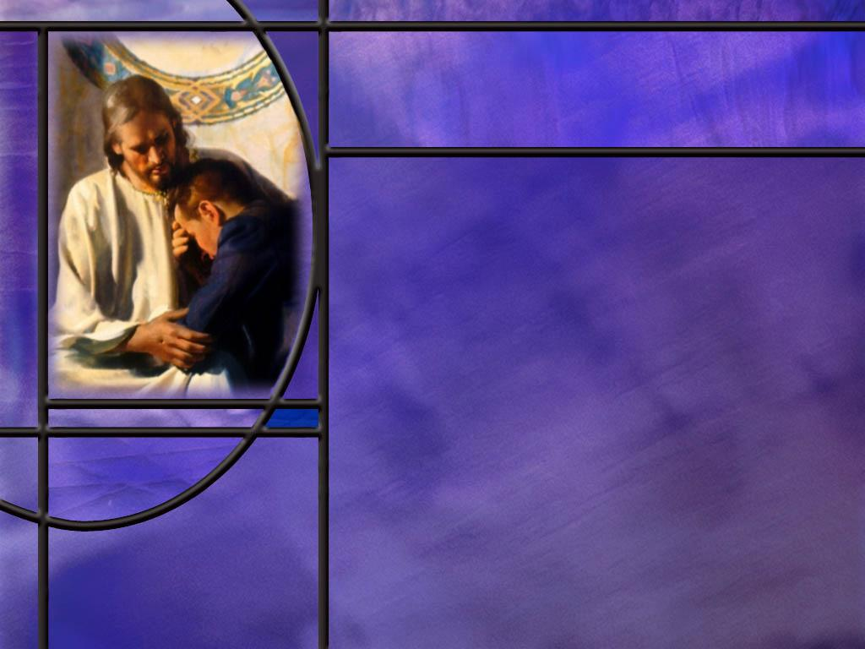
Memory Text
Psalm 62:8 NKJV
Trust in Him at all times, you people; Pour out your heart before Him; God is a refuge for us.
What is a refuge?
How can we make God our refuge?
In addition to faith, what key does the psalmist give us for dwelling secure in God as our refuge?
Notes:
B2:
1. A refuge is a place where you can find safety and comfort.
2. It is place where we can find protection from danger, hardship, or trouble.
3. If a tornado is headed our way we look for a place to “take refuge.”
4. It is a place where we will be safe in the midst of the storm.
B3:
1. Let’s go back to the beginning of our verse, What does it say?
2. Trust in Him at all times.
3. We make God our refuge through faith and trust in Him.
4. Not just in the good times; not just in the bad times; but at all times.
5. God is looking for people who have a living faith that consistently trusts in the power and promises of the almighty God we serve.
6. It is by faith that we enter into a saving relationship with Christ.
7. Paul writes in Eph 2:8&9:
Ephesians 2:8-9 ESV - For by grace you have been saved through faith. And this is not your own doing; it is the gift of God, ⁹ not a result of works, so that no one may boast.
8. We are saved by God’s grace that we receive by faith.
9. Grace is God’s unmerited favor in sending His Son Jesus to die for our sins.
10. Faith is receiving Christ as our Savior and trusting His blood for the forgiveness of our sins.
11. And when we are saved by grace through faith, God has become our refuge.
12. Are we safe in that refuge? (Absolutely!!)
13. The apostle Paul was persuaded of our safety there as he closed the 8th chapter of Romans.
Romans 8:35, 37-39 KJV - Who shall separate us from the love of Christ? shall tribulation, or distress, or persecution, or famine, or nakedness, or peril, or sword? ... ³⁷ Nay, in all these things we are more than conquerors through him that loved us. ³⁸ For I am persuaded, that neither death, nor life, nor angels, nor principalities, nor powers, nor things present, nor things to come, ³⁹ Nor height, nor depth, nor any other creature, shall be able to separate us from the love of God, which is in Christ Jesus our Lord.
14. Hallelujah!!!
15. Thank you Lord Jesus!
16. God is a refuge for us!
17. Nothing can separate us from His love when we are in Christ.
18. We are in the ark of safety!
19. We are bound for the kingdom, and even death cannot stand in our way.
20. Are you thankful for Jesus today?
B4:
1. Here in the middle of this verse we have the key to abiding in the refuge of God.
2. “Pour out your heart before Him.”
3. What does that mean to you?
4. How do we pour out our heart before God?
5. It means taking time to talk to God, to be honest and open with Him, to confess our sins and shortcomings and plead for His forgiveness.
6. We might as well be honest with God because He knows us from the inside out.
7. All things ae naked and open to His eyes.
8. But more than that this phrase carries the idea of friendship.
9. You might have a really good friend that you would pour out your heart to.
10. And that’s what God wants to become for you.
11. He wants to be your BFF that you go to with every burden, every joy, all the ups and downs of life; He wants to share them with you.
12. He wants to have a love relationship with you as Savior, Lord, and Friend.
13. Let’s make the time and take the effort to pour out our heart before Him in prayer, praise, and thanksgiving as we abide securely in the refuge of His love and power.

Slide 3
Overview
Growing in a relationship with God depends on having a vibrant prayer life that is open and honest with God and spends time communing with Him. This week we look at what the Bible teaches on prayer, it’s power to change lives, and how Jesus used prayer and taught its value.
  The Power of Prayer
  Intercessory Prayer
  Jesus and Prayer
  Common Questions on Prayer
  Summary

Slide 4
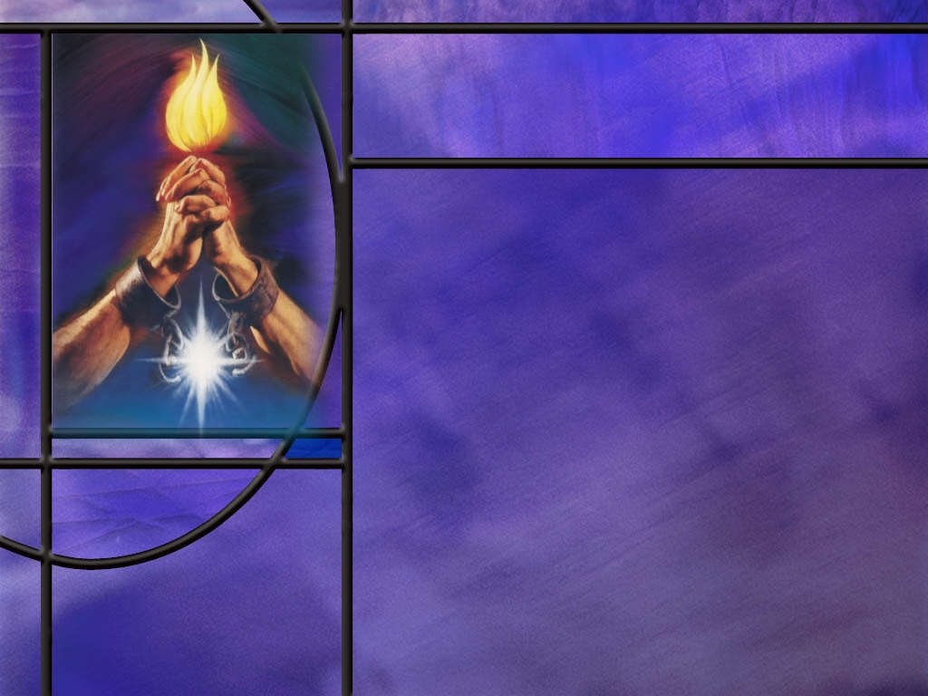
The Power of Prayer
How would you define prayer?
What did Jesus say would happen when we ask in faithful prayer? (Luke 11:9-10)
How did prayer change Hezekiah’s life? (Isa 38:1-5)
Whose testimony do we have in this account that Hezekiah’s prayer made a difference?
If prayer changes things, what glimpse of the nature of God does this give you?
Notes:
B1:
1. Probably the definition that we have heard most often is that “prayer is the opening of the heart to God as to a friend.” (Steps to Christ p 93)
2. We usually think of prayer as talking to God, but a better definition is that “Prayer is simply communication with God.”
3. We can communicate with God through spoken words, written words, thoughts, meditation, or song.
4. Some of the most beautiful prayers are written prayers because we can take the time to compose and refine them.
5. Prayer can be as simple as a God-ward thought. Or it can be a whole series of thoughts as we focus on God and put ourselves in His presence and care.
6. Hymns and songs can be prayers.
7. “I Surrender All” is a prayer hymn. “All to thee my blessed Savior, I surrender all.”
8. “Have Thine Own Way Lord” is a prayer. “Just as I Am” is another. There are many. What a beautiful way to pray: sing a hymn to the Lord.
B2:
[See notes on linked slide.]
B3:
[See notes on linked slide.]
B4:
1. This is Isaiah’s testimony of what God said and did.
2. This is not an ambiguous account of how somebody prayed and something happened that he thought was an answer.
3. If we pray for healing and healing comes, some will say the healing would have come anyway, with or without the prayer.
4. But in this case, we have God’s own word to Hezekiah that he was going to die and not recover.
5. Then after he prays, God says that because of his prayer he will not die but live 15 more years.
6. This is a very clear answer to prayer.
B5:
1. This indicates to me that God does not fix all the details of the future but allows room for our free choices including our choice to pray and our choice to receive Jesus as our Savior.
2. This indicates that God works with an open future rather than a closed one.
3. He does not predetermine the future in all its detail by predestination, nor is the future fixed by His perfect foreknowledge of it.
4. Rather He is acting in history to work out his plans for His creation while at the same time allowing his creatures to make free choices that also determine the future in their sphere of influence.
5. While no one can thwart the plans of God and cause His prophecies to fail, we can still make free choices that determine our own destiny.
6. God can always work around our choices.
7. This means that God experiences the future in time as we do.
8. All heaven, including God, rejoices over one sinner that repents.
9. Our choices add information to the mind of God.
10. It says also that God did not foreordain all the tragedies of life.
11. The holocaust was not part of the divine plan: Accidents, disease, and death are a result of sin, Satan, the curse, and the wrong choices we make.
12. God goes through the tragedies of life with us and promises to work all things together for good if we love Him.
13. Our choice to pray has an effect on God.
14. It adds something to His experience that would not be there if we chose not to pray.
15. So God can remain sympathetic and loving to us as the future unfolds and He experiences it with us.
16. God experiences our choices when we make them, not in eternity past.

Slide 5
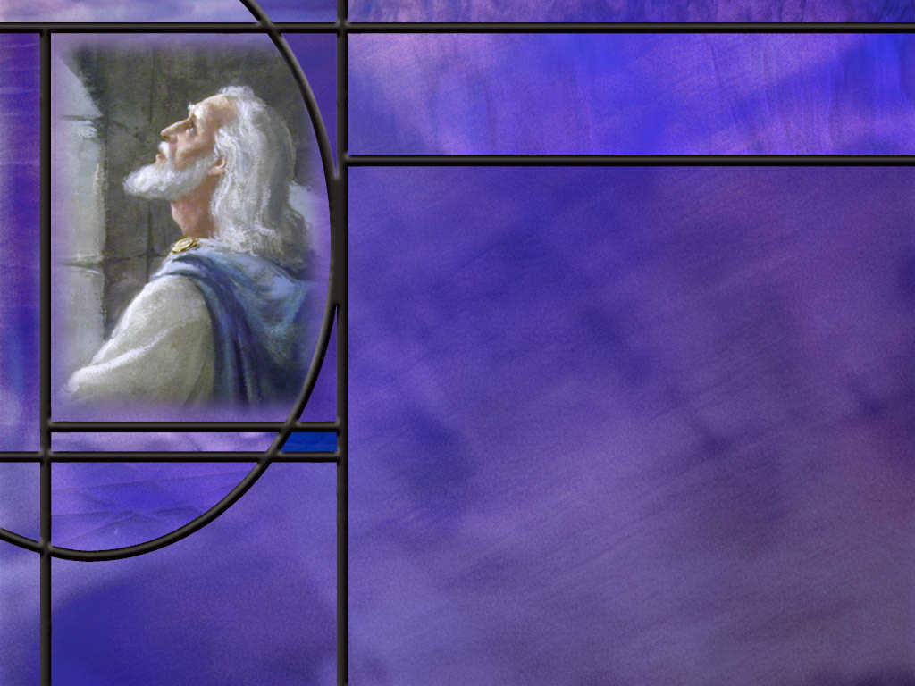
Intercessory Prayer
What can we learn about intercessory prayer from Daniel 9?
What are some of the groups of people with which we can identify in intercessory prayer?
How many of these groups are included in your prayer time?
Notes:
B1:
[See notes on linked slide.]
B2:
1. Our immediate family.
2. Our extended family including brothers and sisters, aunts, uncles, cousins, and in-laws.
3. Our church family.
4. Our district church family: Haverhill, Amesbury, and Lowell.
5. Our conference church family.
6. The NAD and GC church family.
7. Our workplace community, our school communities.
8. The neighborhood in which we live.
9. Our state and our country with our elected and appointed government leaders.
10. Our prayer list of those with health issues in our community of faith.
B3:
1. Our intercessory prayer can be like ripples when we drop a pebble into a pool of water.
2. Our closest “ripple group” is our family beginning with our spouse and children.
3. Then we go out, our next ripple group is our grandchildren and our extended family.
4. From there we can go to our church family our church school, our conference, the Advent movement.
5. The next ripple group would be our neighbors, our community, our work colleagues.
6. Next our country and duly elected government officials and leaders.
7. Finally we would remember that we are part of the human family and the gospel is to go to all the world for a witness before Jesus comes again.

Slide 6
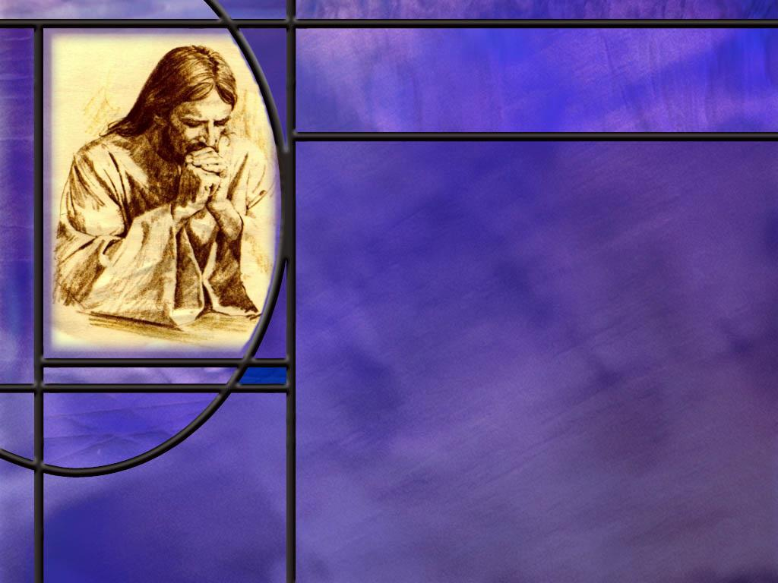
Jesus and Prayer
How would you describe the prayer life of Jesus? *
What should we take away from the prayer life of Jesus?
What did Jesus teach about prayers for show? (Matt 6:5-6)
What did Jesus teach about repetitious prayer? (Matt 6:7-8)
In giving the disciples (and us) the Lord’s prayer how do you think Jesus expected us to use it? [Lord’s Prayer]*
Notes:
B1: Was prayer important to Him?
1. The gospels clearly present Jesus as a man of prayer.
2. There were two complimentary aspects of Jesus’ prayer life: isolated intimacy and constant communion.
3. He spent time alone with His Father sharing a deep intimacy of focused prayer.
4. But He also had a constant communion with His Father that was a moment-by-moment abiding in His presence.
5. Let’s look at some of the texts that describe these two aspects of Jesus’ prayer life.
[Click link to two slides.]
B2:
1. Go and do likewise!
2. If Jesus, the sinless Son of God needed to pray, how much more do we.
3. If He took time for isolated intimacy with His Father how much more should we.
4. If He was living life in constant communion with His Father, how much more should we.
5. Jesus sets the biblical example for us.
6. So let’s find that solitary place where we can pour out our heart to God.
7. And let’s be aware of God’s presence with us each moment of the day so we can stay in constant communion with Him.
8. If Jesus made prayer a priority in His life, how much more do we need to do the same.
B3:
[See notes on linked slide.]
B4:
[See notes on linked slide.]
B5:
1. I don’t have a problem praying the Lord’s prayer verbatim.
2. In fact, that is the way we get all of our kids to pray when we open and close Sabbath.
3. But I think it was more likely that the Lord was giving His disciples an outline for the kinds of things they could pray about.
4. They could use each phrase of the Lord’s prayer as the main point of an outline and fill in additional related points in prayer.
5. So let’s have a look at how that could play out.
[Click link]
[See notes on linked slide.]

Slide 7

Common Questions on Prayer
Why do some prayers seem unanswered?
Does prayer actually change the future?
What are some categories that should be included in Christian prayer? [Categories]
Is there a right way to pray?
What does it mean to pray in the name of Jesus? (John 16:23)
Notes:
B1:
1. The Bible points to God answering according to His wisdom, timing, and purposes rather than always giving the answer in the way or time we expect.
2. At times we can pray for things that are not in line with the will of God.
1 John 5:14 KJV - And this is the confidence that we have in him, that, if we ask any thing according to his will, he heareth us:
3. Even if it is God’s will, there are certain prayers that may not get answered.
4. We can pray for the salvation of a loved one, but God will not override our loved one’s freedom of choice.
5. God will have all men to be saved, but not all men choose to be saved.
6. Even Jesus had His prayer for deliverance denied by the Father.
Mark 14:36 KJV - And he said, Abba, Father, all things are possible unto thee; take away this cup from me: nevertheless not what I will, but what thou wilt.
7. Three times Jesus asked, but, if the Father had delivered Jesus from His hour of death all of us sinners would perish.
8. It was God’s will to lay on Him the iniquity of us all.
9. So, we need to pray according to the will of God, and, even then, God may be constrained by other factors to say no to our prayer.
10. There may be certain rules of engagement in the GC that limit God in the use of miraculous intervention to deliver us from disease and death.
11. Many in the early church were martyred for their faith, but God did not intervene to miraculously deliver them.
12. God is loving and compassionate, but we still all die the first death according to the curse for Adam’s sin.
B2:
1. If you’re a Calvinist that believes every detail of the future has been fixed by predestination in eternity past, then the answer is no.
2. For a Calvinist, prayer may help you accept the future but it doesn’t change it.
3. However, if you believe that God has planned the outline of the future but not fixed all its details, then the answer is Yes, prayer changes things.
4. We can look at Hezekiah’s prayer.
5. If he had chosen not to pray, he would have died.
6. Because he prayed, God gave him 15 additional years of life.
7. Prayer definitely changed things for Hezekiah.
8. But even more than Hezekiah, prayer determines our own destiny.
9. Without prayer we end up with eternal death.
10. With prayer, receiving Jesus as our Savior, confessing our sin, building a personal relationship with Him as Savior, Lord and Friend, we end up with eternal life.
11. Prayer changes you; it changes your character; it changes your status before God; it changes your future; it changes your destiny.
B3:
[See notes on linked slide]
B4:
1. There may be preferred ways to pray, but the Bible provides a wide latitude on acceptable prayer.
2. It is wrong to pray to idols or any other being except the true and living God.
3. It is wrong to pray to Mary and the “saints.”
4. It is wrong to pray hypocritical prayers for show, or repetitious prayers.
5. But beyond these, there are many acceptable ways to pray.
6. We may say it is preferred to kneel in prayer as a sign of respect and submission and devotion to God.
7. It may be preferred to pray with our eyes closed to avoid distractions as we pray.
8. It may be preferred to pray with our hands folded or palms up to indicate a willingness to receive from God.
9. But the Bible certainly doesn’t restrict us to these ways of praying.
10. We can pray standing, sitting, walking, running, or driving.
11. We can pray with our eyes open, which I hope is the case when we’re driving.
12. We can bow our heads or look up to heaven.
13. We can pray at any time and in any place.
14. We can pray silently in our head, in a whisper, in an audible voice, or in a song.
15. We can pray in private devotions or public gatherings.
16. We can pray for ourselves or for others.
17. As long as we are sincere and humble our prayers are acceptable to God.
B5:
[See notes on linked slide.]

Slide 8

Summary
Prayer is the amazing privilege of communicating with God, in word, in thought, in song, in the Spirit, allowing us to know Him more intimately, love Him more deeply, and release His power more fully in our lives and the lives of those for whom we pray.
Prayer is absolutely essential for Christians. Without prayer it is impossible to come to Christ, nor long remain with Christ if we neglect it.
There is power in prayer. Prayer changes things. God does things in response to prayer that otherwise would not be done.
The power of prayer is clearly seen in God’s answer to Hezekiah’s prayer, in response to which God added to his life 15 years.

Slide 9
Summary
In his prayer of intercession, Daniel identifies himself with those for whom he is interceding, confessing their sins as his own, and seeking God’s glory through his request for their restoration.
We too have “ripple groups” of which we are a part and can seek to bring glory to God through answered prayer on their behalf.
The prayer life of Jesus was characterized by two complimentary aspects: Isolated Intimacy and Constant Communion.
If Jesus needed this type of prayer life, how much more do we.
Satan would like nothing better than to keep us too busy to pray intimately and too preoccupied to pray constantly.

Slide 10
Summary
Because of the Fall, the Curse, and the rules of engagement of the continuing Cosmic Conflict, prayers requesting physical miracles are answered only rarely.
However, God will always answer our prayer of confession and meet our most important need: the forgiveness of our sins through the blood of Jesus Christ our Lord.
Prayer changes us; our character; our status before God; our future; our destiny.
There may be preferred ways to pray, but any prayer offered to the living God in sincerity and humility will be accepted.
Having found refuge in God though faith in Christ, will you pour out your heart to Him in prayer this week, confident that nothing can separate you from His love.

Slide 12
Luke 11:9-10 NKJV
"So I say to you, ask, and it will be given to you; seek, and you will find; knock, and it will be opened to you. ¹⁰ "For everyone who asks receives, and he who seeks finds, and to him who knocks it will be opened. [R]
Notes:
Q1: What do these verses say to you about prayer?
1. These verses tell us that prayer changes things.
2. Things happen in response to prayer that would not happen without it.
3. Ask and it will be given unto you; don’t ask and it won’t be given to you.
4. Seek and you will find; don’t seek and you won’t find.
5. Knock and the door will be opened; don’t knock and it won’t be opened.
6. This tells me that the future is not completely fixed, either by predestination or by God’s exhaustive foreknowledge of it.
7. The future is determined at least to some extent by our choices and by our prayers.
8. God can respond to our choices and decisions. He can hear our prayers and take action on them.
9. Every sinner who prays the sinner’s prayer, receives Jesus , and repents of his sins is justified and sanctified, and if faithful will be glorified.
10. Prayer changes us from sinners to saints.
11. One of the clearest examples in the Bible is Hezekiah’s prayer.

Slide 13
Isa 38:1-5 (NKJV)
¹ In those days Hezekiah was sick and near death. And Isaiah the prophet, the son of Amoz, went to him and said to him, “Thus says the Lord: ‘Set your house in order, for you shall die and not live.’”
² Then Hezekiah turned his face toward the wall, and prayed to the Lord, ³ and said, “Remember now, O Lord, I pray, how I have walked before You in truth and with a loyal heart, and have done what is good in Your sight.” And Hezekiah wept bitterly.
⁴ And the word of the Lord came to Isaiah, saying, ⁵ “Go and tell Hezekiah, ‘Thus says the Lord, the God of David your father: “I have heard your prayer, I have seen your tears; surely I will add to your days fifteen years. [R]
Notes:
Q1: Did prayer change things for Hezekiah?
1. “The earnest prayer of a righteous person has great power and produces wonderful results.” (James 5:16 NLT)
2. Here we have the account of an earnest prayer by a righteous king that had great power and produced wonderful results in his life.
3. Hezekiah wept bitterly as he pleaded with the Lord.
4. He reminded God of how he tried to follow God and do what was right.
5. His prayer had power to get the Lord to intervene and give him 15 more years of life instead of death.

Slide 14
Dan 9:4-6 (NIV)
⁴ I prayed to the Lord my God and confessed:
“Lord, the great and awesome God, who keeps his covenant of love with those who love him and keep his commandments, ⁵ we have sinned and done wrong. We have been wicked and have rebelled; we have turned away from your commands and laws. ⁶ We have not listened to your servants the prophets, who spoke in your name to our kings, our princes and our ancestors, and to all the people of the land…
¹⁹ Lord, listen! Lord, forgive! Lord, hear and act! For your sake, my God, do not delay, because your city and your people bear your Name.” [R]
Notes:
Q1: What form of personal pronoun does Daniel use over and over again as he opens his prayer?
1. He uses the first person plural, “we.”
2. He includes himself with the people for whom he is praying.
3. Daniel recognizes himself as a sinner even though it was not his sins that brought judgment upon the Jews.
4. He identifies with his people and includes himself in their sin, rebellion, and disobedience.
Q2: As he closes his prayer in verse 19, for whom is he concerned?
1. His concern is for God’s glory, for God’s city Jerusalem, for His people Israel that bear His name.
2. He wants to see the shame of captivity lifted from God’s people so that God will look good.
Q3: To what extent will Daniel himself benefit from the answer to his prayer for restoration of Jerusalem and Judah?
1. Daniel is an old man at this point.
2. There is no record of Daniel returning with Jews under Cyrus’ decree in 538 BC.
3. He is content to stay in Babylon.
4. Daniel will benefit little from the restoration of the Jews to Jerusalem.
5. But that is not his concern. His concern is God’s name and God’s glory.
Q4: What is the focus of Intercessory Prayer?
1. Intercessory prayer focuses on others rather than self.
2. In Daniel’s prayer, he identifies himself with the Jewish nation and confesses their sins as including himself.
3. He prays for the restoration of Jerusalem and the Jewish nation.
4. He is concerned for his people and for the glory of God whose name they bear.
5. When God’s people are disgraced, God’s name is disgraced.

Slide 15
The Prayer Life of Jesus:
Isolated Intimacy
Now in the morning, having risen a long while before daylight, He went out and departed to a solitary place; and there He prayed. (Mark 1:35)
And when He had sent the multitudes away, He went up on the mountain by Himself to pray. Now when evening came, He was alone there. (Matt 14:23)
So He Himself often withdrew into the wilderness and prayed. (Luke 5:16)
Now it came to pass in those days that He went out to the mountain to pray, and continued all night in prayer to God. (Luke 6:12)
Notes:
1. Do you get the picture here?
2. Jesus spent time, lots of time, alone in focused, intimate prayer with His Father in heaven.
3. He found a place where there were no distractions or interruptions.
4. And He poured out His heart in prayer.
5. This was one side of His prayer life: Isolated Intimacy.
[Go to next slide.]

Slide 16
The Prayer Life of Jesus:
Continual Communion
And yet if I do judge, My judgment is true; for I am not alone, but I am with the Father who sent Me. (John 8:16)
Indeed the hour is coming, yes, has now come, that you will be scattered, each to his own, and will leave Me alone. And yet I am not alone, because the Father is with Me. (John 16:32)
And He who sent Me is with Me. The Father has not left Me alone, for I always do those things that please Him.” (John 8:29) [R]
Notes:
1. Do you get the picture here?
2. Jesus was never alone until He hung on the cross.
3. His Father was always there. They were constant companions.
4. Every decision Jesus was talking over with His Father, and He would do only what pleased His Father in heaven.
5. Now God has promised us that He will never leave us or forsake us. (Heb 13:5)
6. He wants us to pray to Him continually without ceasing, giving thanks in everything, worrying about nothing but praying about everything.

Slide 17
Matthew 6:5-6 ESV
"And when you pray, you must not be like the hypocrites. For they love to stand and pray in the synagogues and at the street corners, that they may be seen by others. Truly, I say to you, they have received their reward. ⁶ But when you pray, go into your room and shut the door and pray to your Father who is in secret. And your Father who sees in secret will reward you. [R]
Notes:
Q1: What is the point that Jesus is making here?
1. Prayer is not to be used as a public display of piety.
2. Prayer is not to call attention to ourselves and display our praying abilities.
3. While there is a place for sincere public prayer, it should be to lead others in corporate prayer, not to call attention to self.
4. Jesus is saying that our true prayer life is to be in the isolated intimacy of our inner room with the door closed.
5. This is where we can pour out our heart to God in humility and surrender and connect with Him as Savior, Lord, and Friend.
6. This is what Jesus did.
7. He did occasionally pray in public like at the tomb of Lazarus.
8. But His true prayer life was carried out in secret in solitary places.
Q2: What similar thought did Jesus convey in His story about the Pharisee and tax collector that went up to the temple to pray?
1. The Pharisee’s prayer was all about himself and how good he was.
2. He was proud of his righteousness; he had no sins to confess.
3. The tax collector bowed his head in shame and cried out “God be merciful to me a sinner.”
4. The one who went down to his house justified and forgiven was the one who confessed his sins and asked for mercy.

Slide 18
Matthew 6:7-8 KJV
But when ye pray, use not vain repetitions, as the heathen do: for they think that they shall be heard for their much speaking. ⁸ Be not ye therefore like unto them: for your Father knoweth what things ye have need of, before ye ask him. [R]
Notes:
Q1: What warning did Jesus give here about repetitious prayers?
1. Don’t just speak the same words over and over as though the more you say them the more God will listen.
2. God hears and knows the first time we pray, and knows everything that we know even before we pray.
Q2: Would praying the rosary fall into this category?
1. I think it would.
2. Not only is it vain repetition, but it is praying to a woman who is dead and buried and cannot hear a single thing you say.
3. This is blasphemy, making an idol of the virgin Mary.
4. If a Catholic prays the full rosary, they say 53 Hail Mary’s and 6 Our Father’s.
5. It is a ratio of like 9 to 1.
6. Nine times as many prayers to Mary as to God.
Q3: What about our own prayers? If you pray daily, do you find yourself falling into a rut of praying the same words every day?
1. It is very easy, for me at least, to fall into this habit.
2. Many days, I feel like I could just say, “Same as yesterday!!”
3. It is hard to be sincere and original in our prayers.
4. It is much easier to fall into a routine of praying for the same things with the same words each day.
5. So maybe we need to think of ways to shake up our prayer life.
Q4: Do you have the same problem and how have you dealt with it?
1. Perhaps taking time to listen instead of speaking so much.
2. Ask the HS to guide your thoughts for things to pray about.
3. Or ask the HS to simply intercede for us in that for which we should pray.
Romans 8:26 KJV - …for we know not what we should pray for as we ought: but the Spirit itself maketh intercession for us with groanings which cannot be uttered.

Slide 19
The Lord’s Prayer as Outline
Our Father which art in heaven, hallowed be thy name: Give adoration and praise to God for who He is and what He has done: Creator, Redeemer, Sustainer, Restorer, Protector, Father, Friend.
Thy kingdom come, Thy will be done or earth as it is in heaven: Ask that the kingdom of grace may be established in your heart and the hearts of those you care about, and that the kingdom of glory would soon triumph and be established on earth.
Give us this day our daily bread: Ask God to supply all your needs in every area of your life, physical, spiritual, emotional, mental, social, and financial.
Forgive us our debts as we forgive our debtors: Bring your sins before God in confession and repentance and plead the precious blood of Jesus for forgiveness.
Lead us not into temptation but deliver us from evil: Pray for the Holy Spirit to fill you that you may walk in the Spirit and not in the flesh, growing in the likeness of Jesus each day.
For thine is the kingdom and the power and the glory forever, Amen: End by praising God in confidence of the hope we have in Christ and the assurance we have that nothing can separate us from His love. [R]
Notes:
1. Note the order of the Lord’s prayer.
2. We put God first, praise and adore Him first, seek His kingdom and His will first.
3. Seek ye first what? The kingdom of God and His righteousness…
4. Our requests are second to the glory we seek for Him.
5. Andrew Murray has this to say about this order:
First, Thy name, Thy kingdom, Thy will; then, give us, forgive us, lead us, deliver us. The lesson is of more importance than we think. In true worship the Father must be first, must be all. The sooner I learn to forget myself in the desire that HE may be glorified, the richer will be the blessing that prayer will bring to myself."

Slide 20
Elements of Christian Prayer [R]
The Three P’s
  Praise
  Pardon
  Petition
ACTS
  Adoration
  Confession
  Thanksgiving
  Supplication
Adoration & Praise
Thanksgiving
Confession
Petition (for us)
Intercession (others)
Surrender & Praise

Slide 21
John 16:23 ESV
Truly, truly, I say to you, whatever you ask of the Father in my name, he will give it to you. [R]
Notes:
Q1: What distinction do you see here between the Father’s role and the Son’s?
1. We are to pray to the Father in the name of the Son.
2. Jesus prayed to His Father in heaven.
3. He taught his disciples to pray: “Our Father which art in heaven…”
4. It is the Father who is considered the source of answered prayer.
5. Now I believe that is a preference: I don’t think it is wrong to pray to Jesus or to the Holy Spirit; they are all God, three in one.
6. But Jesus serves as a model of the things for which we should pray.
7. To pray in the name of Jesus is to pray for the things that He would want in our lives.
8. To pray in His name is to pray as He would, if He were in our place.
9. And we know how Jesus prayed to His Father during His time of agony in the garden of Gethsemane.
10. Three times it was “not my will but thine be done.”
11. If that is the attitude that we bring to God in prayer, Jesus assures us that we will receive the right answer from our Father in heaven.

