Slide 1
Growing in a Relationship with God
Lesson 6
Prayer Warriors

Slide 2
Memory Text
Psalm 116:1-2 NKJV
I love the LORD, because He has heard My voice and my supplications. ² Because He has inclined His ear to me, Therefore I will call upon Him as long as I live.
What reason does the psalmist give here for loving the Lord?
What part does prayer play in delivering us from death?
How do we feel toward the Lord when He has delivered us from eternal death?
How long will the love engendered by answered prayer continue?
Notes:
B2:
1. Because the Lord has heard his prayer.
2. And the implication is that the Lord has not only heard his prayer but also answered it.
3 He goes on in this psalm to give thanks and praise to God for delivering him.
4. In verse 8 he says:
Psalm 116:8 NLT - 8 He has saved me from death, my eyes from tears, my feet from stumbling.
5. The whole psalm in the NKJV is entitled: “Thanksgiving for Deliverance from Death.”
B3:
1. There may be times when God intervenes to spare our lives in difficult circumstances.
2. He can send an angel to deliver us as He did for Daniel in the lion’s den.
3. But we are all subject to the first death that eventually overtakes us in this life.
4. The only two that we know of who escaped it are Enoch and Elijah.
5. It is not the first death that we need to fear, but the second.
6. For those in Christ, the first death is but a moment of “sleep” until Jesus comes and calls us back to life.
7. So, how do we get “in Christ” and abide in Him?
8. What part does prayer play in delivering us from the second death?
9. Prayer is absolutely essential in coming to Christ and abiding in Christ.
10. We need to pray in order to ask Jesus to come into our heart and be our Savior and Lord.
11. We need to pray in order to confess our sins and tell the Lord we’re sorry and ask Him to forgive us.
12. We need to pray in order to express our faith in Jesus and surrender to Him.
13. We need to pray for the Holy Spirit to change us into His likeness.
14. We need to pray to build a loving, saving, relationship with Jesus that will make us friends for eternity.
15. Prayer is essential for delivering us from eternal death.
B4:
1. Just like the psalmist, we love the Lord.
2. John explains it very simply in 1 John 4:19
1 John 4:19 NKJV - We love Him because He first loved us.
3. When we hear the gospel and understand it and receive Jesus as our Savior and Lord, we fall in love with Him because of His great love and grace for us.
4. Our prayer for salvation results in a relationship of love with our Savior.
B5:
1. The psalmist ends with a promise to continue this love relationship through prayer for as long as he has breath to do so.
2. That doesn’t mean that God is going to answer every prayer.
3. Even for things that are within His will, God cannot always give us the answer we want.
4. It is His will that all men be saved and come to a knowledge of the truth.
5. But He will not override the free will of those who choose to reject His love and grace.
6. But we can know, that for ourselves, He has answered our most important cry for mercy.
1 John 1:9 NKJV - If we confess our sins, He is faithful and just to forgive us our sins and to cleanse us from all unrighteousness.
7. He is able to save to the uttermost those who come to Him in faith.
8. Our prayer for justification by faith is answered by His promise of eternal life in His kingdom.
9. And our response to that answer should be a life-long relationship of love.
10. In this text, the psalmist loves the Lord because God heard his cry for mercy, and that personal experience leads to a lifelong commitment to keep calling on God.
11. So too for us.
12. God’s listening creates love, and love keeps praying.
13. Let us be grateful to the God who has saved us by His grace, and continue to call on Him in prayer for as long as we have breath.

Slide 3
Overview
Growing in a relationship with God depends on having a vibrant prayer life that is open and honest with God and spends time communing with Him. This week we look at biblical examples of prayer in the lives of Daniel, Enoch, and Moses.
  Daniel and Prayer
  Enoch and Prayer
  Moses and Prayer
  Summary
Notes:
1. You may note that the most important person, Jesus, is missing from this list.
2. But our quarterly devotes two weeks to prayer, and we will consider the prayer life of Jesus next week.

Slide 4
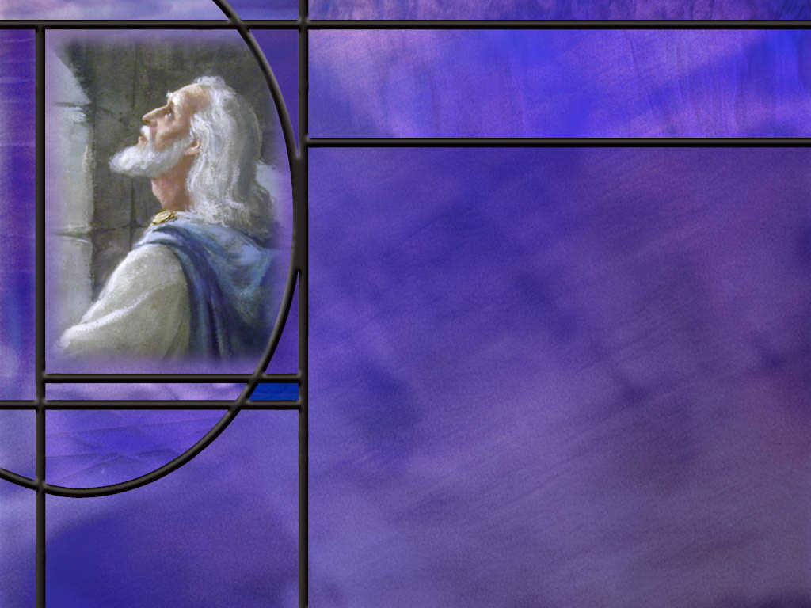
Daniel and Prayer
How did Daniel respond when the king placed him and the other wise men under a death decree? (Dan 2:17-18)
How did God answer Daniel’s prayer? (Dan 2:19)
What decree was Darius encouraged to sign into law? (Dan 6:7)
How did Daniel change his prayer life in light of the new decree? (Dan 6:10)
What can we take away from our brief study of Daniel’s prayer life?
Notes:
B1:
[See notes on linked slide.]
B2:
[See notes on linked slide.]
B3:
[See notes on linked slide.]
B4:
[See notes on linked slide.]
B5:
1. Daniel understood the importance of Prayer, especially when facing difficult times.
2. Daniel understood the importance of praying with others to multiply the power of prayer.
3. Daniel was thankful for answered prayer.
4. Daniel formed the habit of prayer, praying three times a day on his knees.
5. Daniel was faithful in prayer regardless of the consequences.
6. He was willing to die rather than give the appearance that he was following the decree to pray to a false god, the king.
7. We will see some other aspects of Daniel’s prayer life in our study next week.
8. For now, we can see that Daniel enjoyed a vibrant prayer life, and that can explain how he maintained such a Godly influence under several Babylonian and Persian kings.

Slide 5
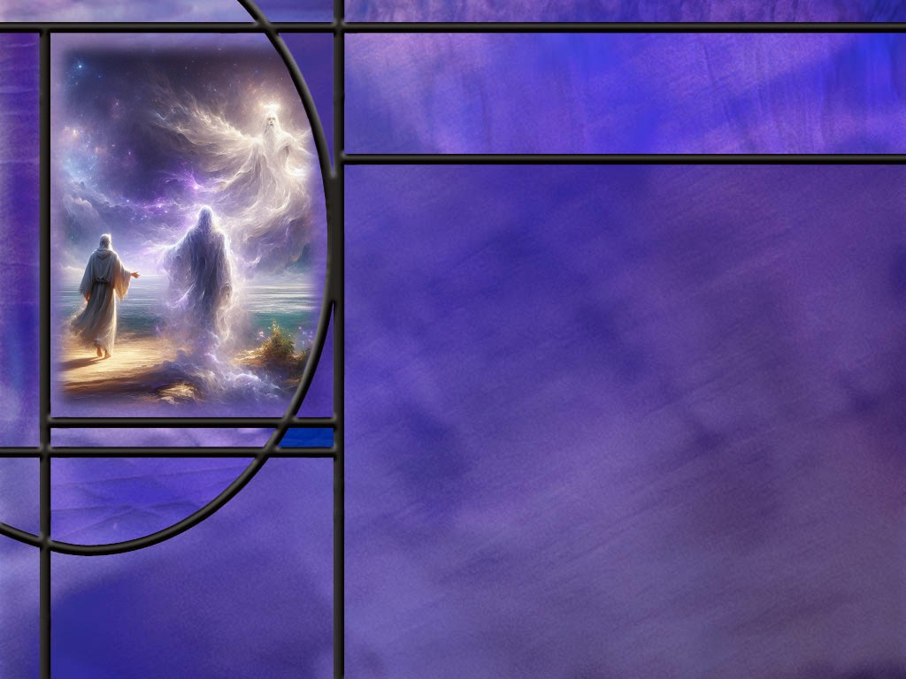
Enoch and Prayer
What little do we know about Enoch? (Gen 5:21-24)
How do you visualize prayer being involved in walking with God?
How can we form the habit of walking with God? [Brother Lawrence]
Notes:
B1:
[See notes on linked slide.]
B2:
1. We can think of walking with God as having a two-way conversation with Him as we live life together.
2. We speak to God in prayer as we whisper our thoughts to Him.
3. And He speaks to us through the impressions that the Holy Spirit places in our hearts and minds.
4. Perhaps we can see Paul’s description of walking with God as he writes to the Thessalonians:
1 Thessalonians 5:16-18 KJV - 16 Rejoice evermore. 17 Pray without ceasing. 18 In every thing give thanks: for this is the will of God in Christ Jesus concerning you.
5. Rejoice always!
6. Joy is one facet of the fruit of the Spirit.
7. If we are filled with the Spirit as we walk with the Lord, there should be a smile on our face and joy in our hearts.
8. In prayer we can express our joy in living in the presence of God.
9. The psalmist writes:
Psalm 16:11 KJV - …in thy presence is fulness of joy; at thy right hand there are pleasures for evermore.
10. Pray without ceasing!
11. How do we do that?
12. We live in an attitude of prayer.
13. We keep turning our hearts toward God in surrender, looking to Him to guide out path, seeking His will, asking Him what to do next, offering ourselves to His service, working as if we were working for Him.
14. In everything give thanks!
15. Here again, prayer is essential.
16. Think of him as we do each little task in life.
17. Give Him thanks for all we encounter, asking for wisdom to solve each problem, and thanking Him for the successes come.
18. Living such a life dedicated to walking with God is easier said than done.
19. This walking with God has been described as practicing the presence of God.
20. It is being aware that God’s Spirit is with us and engaging Him in two-way conversation.
B3:
[See notes on linked slide.]

Slide 6
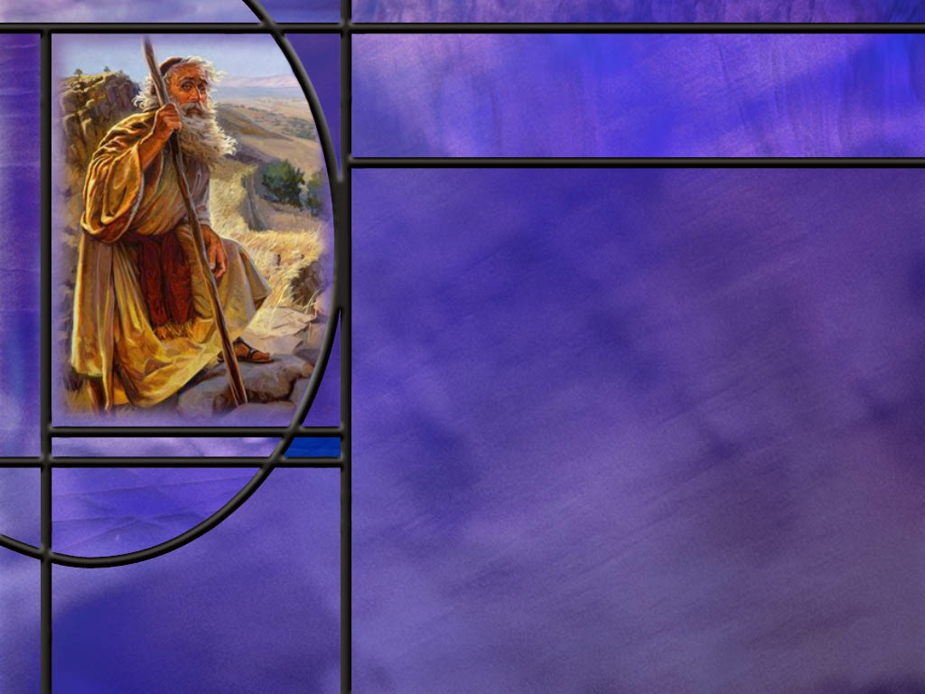
Moses and Prayer
What two long working conversations did Moses have with the Lord?
How does the Bible describe Moses’ relationship to the Lord? (Ex 33:9,11)
What selfless offer did Moses make after the people had sinned in worshipping the golden calf? (Ex 32:31-32)
What can we take away from our brief study of Moses’s prayer life?
Notes:
B1:
1. There were two times that Moses spent 40 days and 40 nights on Mt. Sinai receiving commandments and instruction from the Lord.
2. Ex 24:18 describes 40 days for the first tables of stone that he broke, and Ex 34:28 describes the second 40 days for the second tables of stone.
3. So here we get the impression that Moses is in direct communication with the Lord.
4. He speaks to the Lord, and the Lord speaks to him in an audible voice.
5. We see this all the way through the Exodus and the wanderings in the wilderness.
6. It begins at the burning bush where the Lord speaks, and Moses hears and responds.
7. It ends on Mt. Nebo where the Lord speaks to him one final time and shows him the promised land before he dies.
B2:
[See notes on linked slide.]
B3:
[See notes on linked slide.]
B4:
1. Moses spent quality time with God in prayer.
2. He became friends with the Lord, and communicated with Him in direct intimate conversation as with a friend.
3. He was always interceding for his wayward people, asking God to forgive them for their sinful ways, to remember His covenant promises, and to relent in His anger against them.
4. He was bold and persistent in his prayers, arguing for God’s glory to be displayed in His treatment of the erring.
5. Moses’ prayer life was transforming.
6. Over time, the reluctant shepherd became a steady leader and a deeper friend of God through repeated communion with Him.
7. The same is true for us.
8. The more time we spend with the Lord, the more we will grow to love Him.
9. And the more we love Him, the more we will want to spend time with Him.

Slide 7

Summary
Growing in a relationship with God depends on having a vibrant prayer life that is open and honest with God and spends time communing with Him.
Prayer changes things, beginning with us. It is impossible to become a Christian or stay a Christian without prayer.
For those who have used the privilege of prayer to receive Jesus as Savior and Lord, be justified by faith in Him, and have the promise of eternal life with God, our most important prayer has been and will continue to be answered.
God’s gracious answer to our greatest need, deliverance from eternal death, engenders a response of love for Him and a desire to call on Him as long was we live.

Slide 8
Summary
Daniel was a man of prayer. When facing a death decree from the king, he called a prayer meeting with other believers.
When their prayers were answered, he prayed a beautiful prayer of thanksgiving.
He was faithful in prayer, praying three times a day on his knees.
He was willing to die rather than give the appearance that he was following the decree to pray to a false god, the king.
The Bible records that Enoch walked with God and was not.
Walking with God implies having an ongoing conversation with Him: We share our thoughts with Him in prayer, and He speaks to us through the impressions and guidance of the Holy Spirit.

Slide 9
Summary
Walking with God has been described as practicing the presence of God: forming the habit of being aware of God’s presence and doing all we do as a gift of love to Him.
Moses had an amazing relationship with the Lord in which they spoke to one another as friend to friend.
Moses is noted for his great intercessory prayers for God’s wayward people, reminding God to remember his covenant and display His glory by forgiving them.
His example challenges us to pray for those in our lives who may be difficult to love.
Seeing the importance of prayer for these three heroes of faith, will you seek to follow their example in your prayer life this week, talking to God as to a friend ?

Slide 11
Daniel 2:17-18 (NIV)
¹⁷ Then Daniel returned to his house and explained the matter to his friends Hananiah, Mishael and Azariah. ¹⁸ He urged them to plead for mercy from the God of heaven concerning this mystery, so that he and his friends might not be executed with the rest of the wise men of Babylon. [R]
Notes:
Q1: Where did Daniel go when he got into difficult times.
1. He took it to the Lord in prayer.
2. But he didn’t go alone. He took his three friends with him.
3. They had a prayer meeting.
4. We can only imagine the earnestness of their prayers.
5. Their lives all depended on an answer from God.
6. The wise men were correct is telling Nebuchadnezzar, that no human being was able to do what the king requested.
7. But Daniel knew that with God all things are possible.
Q2: How about us? Where do we go when times get difficult?
1. We would do well to follow Daniel’s example.
2. Share our burdens with Christian friends, call a prayer meeting, and take it to the Lord in prayer.

Slide 12
Daniel 2:19 (NIV)
¹⁹ During the night the mystery was revealed to Daniel in a vision. Then Daniel praised the God of heaven… [R]
Notes:
1. Following this verse comes the beginning of Daniel’s wonderful prayer of praise to God.
2. Here we see God’s answer to Daniel’s prayer meeting.
3. Daniel receives a vision from God giving him the same view as Nebuchadnezzar saw in his dream and also giving the interpretation.
4. Does God hear and answer prayer? Absolutely.
Q1: How did God know the dream and interpretation aside from being able to read the sub-conscience mind of Nebuchadnezzar?
1. Who gave Nebuchadnezzar the dream?
2. So God knew the dream because He planted it in Nebuchadnezzar’s mind.
3. And the interpretation was God’s plan for the history of the world from Nebuchadnezzar’s day to the end of the age.

Slide 13
Daniel 6:7 (NIV)
⁷ The royal administrators, prefects, satraps, advisers and governors have all agreed that the king should issue an edict and enforce the decree that anyone who prays to any god or human being during the next thirty days, except to you, Your Majesty, shall be thrown into the lions’ den. [R]
Notes:
Q1: What lie do the conspirators tell the king in this verse?
1. “All the government officials have agreed.”
2. Certainly Daniel would not have agreed to this decree.
3. And it is quite likely that all 120 Satraps had not agreed either.
4. It is probably the other governors beside Daniel had concocted this conspiracy.
Q2: Wouldn’t this be a strange request considering the fact that neither the Babylonians nor the Persians consider their kings divine?
1. The Nabonidus Chronicle gives us some insight into this situation.
2. The Nabonidus Chronicle is a historical account of the events of Nabonidus’ reign written on clay tablets in cuneiform text.
3. It tells of how Nabonidus planned to protect the city of Babylon from the Medo-Persian invasion.
4. He sent representatives to the major cities of Babylon and brought all the images of their gods to the city of Babylon.
5. He wanted all the gods on his side and he thought they would be obliged to defend the city if that’s where they were.
6. After the defeat of Babylon, the Persians returned these gods to their cities to be put back in their temples there.
7. It took four months for this to be completed according to the Chronicle.
8. This could have caused confusion in the pagan religions of the land, and maybe the idea was floated that during this time of confusion, everybody should pray to the king instead of to their missing idols.
Q3: What was to be the punishment for violating this decree?
1. Death in the lions’ den.
2. This was a death decree.

Slide 14
Daniel 6:10 (NIV)
¹⁰ Now when Daniel learned that the decree had been published, he went home to his upstairs room where the windows opened toward Jerusalem. Three times a day he got down on his knees and prayed, giving thanks to his God, just as he had done before. [R]
Notes:
Q1: Any change in his prayer life?
1. No change.
Q2: How long do you think Daniel had been praying three times a day facing toward the temple in Jerusalem?
1. We know that Daniel was taken to Babylon in 605 BC.
2. We know that Babylon fell to the Medes and Persians on October 12, 539 BC
3. If this happened shortly after, Daniel would have spent 66 years in Babylon.
4. If he was deported at age 18, he would be 84 years old by now.
5. Do you think his prayer life had become a habit after 66 years?
6. The habit of prayer is definitely a good thing.
Q3: What could he have done to avoid the lions den?
1. Close the window. Just close the window.
2. How many of us pray with the windows open?
3. We follow Jesus’ instruction:
Matthew 6:6 (NKJV)
⁶ But you, when you pray, go into your room, and when you have shut your door, pray to your Father who is in the secret place; and your Father who sees in secret will reward you openly.
Q4: Why didn’t he just close the window?
1. Daniel did not want to give the impression that he was going along with the decree.
2. To do so would have given the appearance of evil.
3. He had been seen praying in full view toward Jerusalem every day.
4. To close the windows now would be to give the impression that he was not praying as before.
5. It was Daniel’s statement of faithfulness and obedience to God to continue to pray as he always had.
6. There was also scriptural support for praying toward the temple in Jerusalem.
7. When Solomon dedicated the temple, his prayer included several times that he asked God to hear the prayer that was offered toward the temple in Jerusalem.
8. Here is a verse that would be especially relevant to Daniel:
1 Kings 8:48-49 (NIV)
⁴⁸ and if they turn back to you with all their heart and soul in the land of their enemies who took them captive, and pray to you toward the land you gave their ancestors, toward the city you have chosen and the temple I have built for your Name; ⁴⁹ then from heaven, your dwelling place, hear their prayer and their plea, and uphold their cause.
9. So here we see Daniel following that instruction allowing no barriers between him and the place where the temple formerly stood.
10. What about us? Should we pray toward the temple in Jerusalem?
11. God’s house and dwelling place is no longer in Jerusalem.
12. His dwelling place is in our hearts where His Holy Spirit dwells.
1 Corinthians 6:19-20 NIV - Do you not know that your bodies are temples of the Holy Spirit, who is in you, whom you have received from God? You are not your own; you were bought at a price. Therefore honor God with your bodies.
Q4: How would you react to a law prohibiting prayer?
1. I would ignore it completely and pray all the more.
2. Prayer does not need to be visible or audible.
3. We can pray anytime, any place, in any position.

Slide 15
Genesis 5:21-24 ESV
When Enoch had lived 65 years, he fathered Methuselah. ²² Enoch walked with God after he fathered Methuselah 300 years and had other sons and daughters. ²³ Thus all the days of Enoch were 365 years. ²⁴ Enoch walked with God, and he was not, for God took him. [R]
Notes:
Q1: How long did Enoch walk with God?
1. At least 300 years.
2. Enoch walked with God and God took him.
Q2: When the Bible describes Enoch walking with God, what does that mean?
1. It means that they were friends: They had a close personal relationship with each other.
2. Amos asked the question:
Amos 3:3 (NKJV)
³ Can two walk together, unless they are agreed?
3. Enoch agreed with God.
4. Their friendship became so strong that God translated Him after 300 years of friendship.
5. Wouldn’t that be a nice way to lay down the burdens of this life: just walk off with the Lord into heaven?
Q3: This brings us to the question: Who was the oldest man who ever lived?
1. Many will answer that it was Enoch’s son Methuselah.
2. He lived to age 969.
3. But think about it for a moment: Methuselah was the oldest man that ever died.
4. His father, Enoch, is still living.
5. So now, Enoch has to be the oldest man who ever lived.
6. He lived 365 years on earth and some 5,000 years so far in heaven.

Slide 16

The Practice of the Presence of God
Brother Lawrence
That our sanctification did not depend upon changing our works, but in doing that for God’s sake which we commonly do for our own.
That the most excellent method he had found of going to God was that of doing our common business without any view of pleasing men, and (as far as we are capable) purely for the love of God.
“I am come to a state wherein it would be as difficult for me not to think of God as it was at first to accustom myself to it.” [R]
Notes:
Bro Lawrence was a 17th century monk.
Q1: Do you see the change in perspective here? [Bullet 1]
1. Don’t change your job, in your own mind, change your boss!
2. Do it for the Lord, not for some human overlord.
3. Dedicate your work to Jesus.
4. Let His HS guide your as your work.
5. Commune with Him as you do the job.
Q2: Once we change our perspective to work for Jesus, what should motivate our work? [Bullet 2]
1. If we are working for Jesus, our work will be motivated by love for Him.
2. We are not working for a paycheck, although that will come; we are working for our Lord and Savior who has forgiven our sins, adopted us into His family, and given us an eternal inheritance with Him.
3. Paul wrote to the Corinthians:
1 Cor 16:13: Let all your things be done with love.
4. Let your work be an expressions of your love for God.
5. This goes right along with what Paul wrote to the Colossians:
Colossians 3:23 ESV - Whatever you do, work heartily, as for the Lord and not for men,
Q3: Does this sound like a good place to end up? [Bullet 3]
1. We form the habit of thinking of God as always present with us.
2. Is that true? (Absolutely.)
3. We are the temples of His HS.
4. We can talk to God all the time and know that He is always with us because the HS is in us.
5. And the HS intercedes for us with our Savior in heaven.
6. The more we practice the presence of God the easier it becomes to pray without ceasing and include Him in all of our life’s activities.
Q4: Do you think we can become an annoyance to God by constantly sharing our life with Him?
1. He is the one who invites us to come and find our rest in Him.
2. Jesus says in:
Matthew 11:28-30 KJV Come unto me, all ye that labor and are heavy laden, and I will give you rest. ²⁹ Take my yoke upon you, and learn of me; for I am meek and lowly in heart: and ye shall find rest unto your souls. ³⁰ For my yoke is easy, and my burden is light.
3. He wants to be yoked together with each one of us to share the ups and downs of life.
4. As we are yoked together, we walk together with Him as friends and coworkers.
5. Peter invites us to
1 Peter 5:7 KJV - 7 Cast[ing] all your care upon him; for he careth for you.
6. We will not weary God with our constant turning to Him in love and surrender, giving Him thanks and praise, and seeking His guidance.

Slide 17
Exodus 33:9, 11 ESV
When Moses entered the tent, the pillar of cloud would descend and stand at the entrance of the tent, and the LORD would speak with Moses. ... ¹¹ Thus the LORD used to speak to Moses face to face, as a man speaks to his friend. [R]
Notes:
Q1: Should we understand from this that Moses saw God’s face?
1. Most understand this face-to-face speaking as indicating direct, intimate communication.
2. After all, the Lord is still in the cloud when He speaks to Moses.
3. Later on in this same chapter the Lord says:
Exodus 33:20 ESV "you cannot see my face, for man shall not see me and live.“
4. The point is that Moses spoke to God the way we would speak to a friend.
5. It was a two-way conversation where Moses both spoke and heard the Lord speak to him.
Q2: What can we learn about prayer from this description of Moses’ experience?
1. Prayer involves not only speaking but listening.
2. Moses heard audible words from the Lord.
3. We are not usually so fortunate, although others describe times when the Lord has spoken audibly to them.
4. We are usually left listening for impressions from the Holy Spirit, perhaps reminding us of Scripture or impressing us with the will of the Lord.
5. For me, prayer is pretty much me doing all of the talking.
6. Based on Moses’ prayer life, I would do well spending more time being still and listening.

Slide 18
Exodus 32:31-32 ESV
So Moses returned to the LORD and said, "Alas, this people has sinned a great sin. They have made for themselves gods of gold. ³² But now, if you will forgive their sin--but if not, please blot me out of your book that you have written." [R]
Notes:
Q1: What is Moses offering for the forgiveness of his people in this verse?
1. He offers to be blotted out of the book of life.
2. That is an amazing offer!
3. He seems to be offering His life as an atonement for their sins.
4. In this regard, he is a type of Christ who died that we might live.
5. Such love for his erring people marks him as a type of the Good Shepherd who lays down His life for the sheep.
6. Now, Moses is asking the impossible.
7. His death is insufficient to atone for his own sins let alone the sins of others.
8. God refuses his offer because there is only One whose blood is of sufficient value to atone for sin: Jesus Christ, the Son of God.
9. As our Creator, He can redeem us by bearing our sin and paying its penalty.
10. There is another way we can understand this verse.
11. It begins by saying, “if you will forgive their sin…”
12. And the answer to that implied question is: Yes, God will forgive the sins of all those who repent and confess, and receive God’s forgiveness by grace through faith in the Substitute.
13. And the second part of the verse is: if not, if you don’t forgive, if you can’t forgive, then I too need to be blotted out of your book of life since I am a sinner too.
14. So maybe Moses is saying here, if you can forgive me, you can forgive them too.
15. Afterall, Moses was guilty of murder, which was also part of the Ten Commandment covenant law.

