Slide 1
Growing in a Relationship with God
Lesson 5
How to Study the Bible

Slide 2
Memory Text
Isaiah 55:11 NKJV
So shall My word be that goes forth from My mouth; It shall not return to Me void, But it shall accomplish what I please, And it shall prosper in the thing for which I sent it.
What is the promise of this verse?
What evidence do we have that the word of God accomplishes what He desires?
Where do we find the words that God has spoken to us?
How is Jesus, the Word made flesh, a fulfillment of this promise?
Notes:
B2:
1. This is God speaking through the prophet Isaiah.
2. And He is promising us that when God speaks, things will happen according to what He says.
3. He promises us that His word will not come back empty.
4. It won’t just be an echo that accomplishes nothing.
5. It will accomplish what God has planned.
6. It will accomplish the purpose for which He has spoken it.
7. The NIV puts it in these words:
Isaiah 55:11 NIV so is my word that goes out from my mouth: It will not return to me empty, but will accomplish what I desire and achieve the purpose for which I sent it.
B3:
1. The Bible describes creation as the result of the spoken word of God.
2. On day one, how did God create light?
Genesis 1:3 KJV - And God said, Let there be light: and there was light.
3. God’s word expresses His will, His pleasure, His plan and brings into being what He says should exist.
4. When God said, “let there be light,” there was light.
5. It is the same with all the other days of creation.
6. The psalmist described the creation in these words:
Psalm 33:6, 9 KJV - ⁶ By the word of the LORD were the heavens made; and all the host of them by the breath of his mouth. ... ⁹ For he spake, and it was done; he commanded, and it stood fast.
7. When God speaks, things happen.
8. The entire created universe declares the glory of God, and testifies to His creative power.
9. In addition to creation, we have a second line of evidence that God’s word brings about that which He desires: Fulfilled prophecy.
10. God speaks and tells us what will happen; then he acts in the affairs of men to bring it about.
11. Isaiah describes it in these words:
Isaiah 46:9-11 NKJV - 9 … I am God, and there is none like Me, 10 Declaring the end from the beginning, And from ancient times things that are not yet done, Saying, 'My counsel shall stand, And I will do all My pleasure,' 11 Calling a bird of prey from the east, The man who executes My counsel, from a far country. Indeed, I have spoken it; I will also bring it to pass. I have purposed it; I will also do it.
12. God speaks the prophetic word through his prophets, then He acts in the affairs of men to bring it to pass.
13. God’s prophetic word will not return to Him void. It will accomplish all that He pleases!
B4:
1. We find them in Scripture, both OT and NT.
2. Not only has the word of God created us, the word of God provides us with His plan to recreate us and restore us.
3. That plan is centered in the gospel of the Lord Jesus Christ.
4. We find in Scripture the story of redemption from Eden lost to Eden restored.
5. The everlasting covenant, unfolds through history until God finally speaks through His Son.
Hebrews 1:1-2 KJV - ¹ God, who at sundry times and in divers manners spake in time past unto the fathers by the prophets, ² Hath in these last days spoken unto us by his Son, whom he hath appointed heir of all things, by whom also he made the worlds.
6. God’s ultimate word of love and grace has been spoken through His Son.
1 John 5:12 KJV - He that hath the Son hath life; and he that hath not the Son of God hath not life.
7. We find God’s ultimate power to save and recreate us, in Jesus Christ, the Word made flesh
B5:
1. The promise of this verse is that the Word of God will not return to Him void.
2. Think of Jesus as the Word of God sent out to a world of lost sinners.
3. Did He accomplish the thing for which He was sent, or did He return to the Father void and empty?
4. God placed His stamp of approval on all Jesus said and did by raising Him from the dead.
5. He returned to heaven triumphant and victorious.
6. His sacrifice was sufficient to forgive every sin of every human being from Adam to the last sinner.
7. He led captivity captive.
8. He defeated the devil and rose in victory over death and the grave.
9. He won the victory at the cross for all those who would receive Him by faith and trust in His blood to cover their sins.
10. Where Adam failed, Christ succeeded.
1 Corinthians 15:22 KJV - 22 For as in Adam all die, even so in Christ shall all be made alive.
11. As our High Priest in heaven, Jesus is in the process of adding saints to His kingdom, saving to the uttermost all those that come unto Him by faith.
12. And someday soon when the full number of the saints are added to the kingdom of Grace, Jesus will return to establish the kingdom of Glory.
13. Jesus has not returned to His Father empty handed or void, but in victory, certain to accomplish God’s plan and purpose in sending Him forth.

Slide 3
Overview
Growing in a relationship with God depends on receiving His word, understanding His word, submitting to His word, walking in the truth of His word, and growing to love the living Word, Jesus our Lord. This will take effort and discipline to form proper habits of meditating on the Word.
  Choosing to Listen
  Feeding the Soul
  Walking in Light
  Summary

Slide 4

Choosing to Listen
How important is the Word of God to success in life? (2 Timothy 3:15)
What were the Holy Scriptures that Timothy had to lead Him to salvation? (John 5:39)
What did the apostle Paul write to the Romans about coming to saving faith? (Rom 10:17)
What part does the word of God play in abiding in Jesus? (John 15:10)
Notes:
B1:
[See notes on linked slide.]
B2:
[See notes on linked slide.]
B3:
[See notes on linked slide.]
B4:
[See notes on linked slide.]

Slide 5
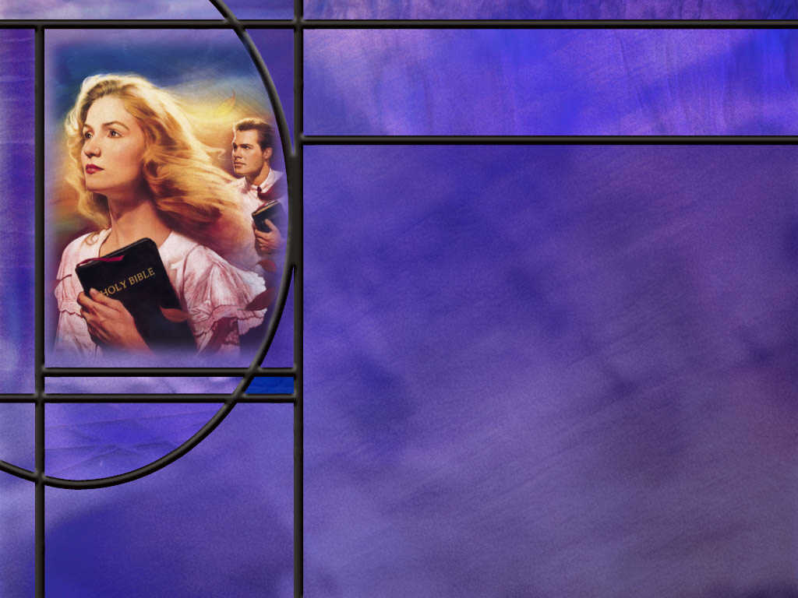
Feeding the Soul
How can we make time in our busy schedule to study the Bible? (Josh 24:15)
What are some practical ideas we can follow for making daily Bible study a habit? [Link]
What tools have you found helpful in studying the Bible?
What are some of the ways you have found to study the Bible? What Bible study plans have you used?
Notes:
B1:
[See notes on linked slide.]
B2:
[See notes on linked slide.]
B3:
1. First, I love to study the Bible on my computer.
2. There are wonderful Bible resources and commentaries online.
3. Right now, I am using Blue Letter Bible which is a free website, although they do ask for a free-will donation every now and then.
4. You can click on their tools to find an interlinear with the original Hebrew and Greek, Strong’s concordance to find the meanings of the original words, parallel Bible translations, commentaries of all kinds.
5. It is so helpful in preparing the SS lessons.
6. The SDA Bible commentary is always helpful with commentary on every verse of the Bible.
7. I also find the Andrews Bible Commentary useful for a broader overview of scripture and help with difficult passages.
8. More recently I have been using the free version of Perplexity AI which, I have found, does a very good job of coming up with the meaning and application of the text.
9. You can even ask for commentary from an SDA perspective and it will do an excellent job of providing it.
B4:
1. How many have read the Bible through at least once?
2. This can give us an overview of scripture.
3. Some variations may be to read the Bible chronologically, or to read it in a paraphrase or different translation.
4. I would like to get Eugene Peterson’s “The Message” for my next complete read.
5. We can focus on the NT as a whole which is the Testimony of Jesus, or pick out a particular book of the Bible to study.
6. We can do a study on the parables, or the Sermon on the mount, or just the beatitudes.
7. We can do a topical study of all the Bible says on a particular topic: the Sabbath, the state of the dead, the second coming of Jesus, Bible health principles.
8. We can study the Bible to answer a particular question that someone has raised and that we are trying to answer.
9. In this type of study, it is helpful to write out what we find in a letter or report in order to have all the information organized in a logical way and share it with the person who raised the question.
10. We can do the SS lesson that has a Bible study for each day of the week.
11. That is a great way to get started in forming the habit of daily study.
12. In our video sermon last week, Pastor Randy Roberts recommended the “Anthony Hopkins method of Bible study.”
13. This he took from an interview with Hopkins, who Randy thought was an outstanding actor.
14. In order to assume the character in the role he was playing, Hopkins would read the script through 100 or 200 times, imagining how to emulate his character until he became the character he imagined.
15. What would happen to us if we read through a book of the Bible 100 times?
16. Would it have an effect on our character?
17. There are so many ways we can study the Bible.
18. But to get started we need a plan so we are not wasting time trying to figure out what to read each day.
19. Make a plan and see it through.
[See notes on linked slide.]
B4:
[See notes on linked slide.]

Slide 6
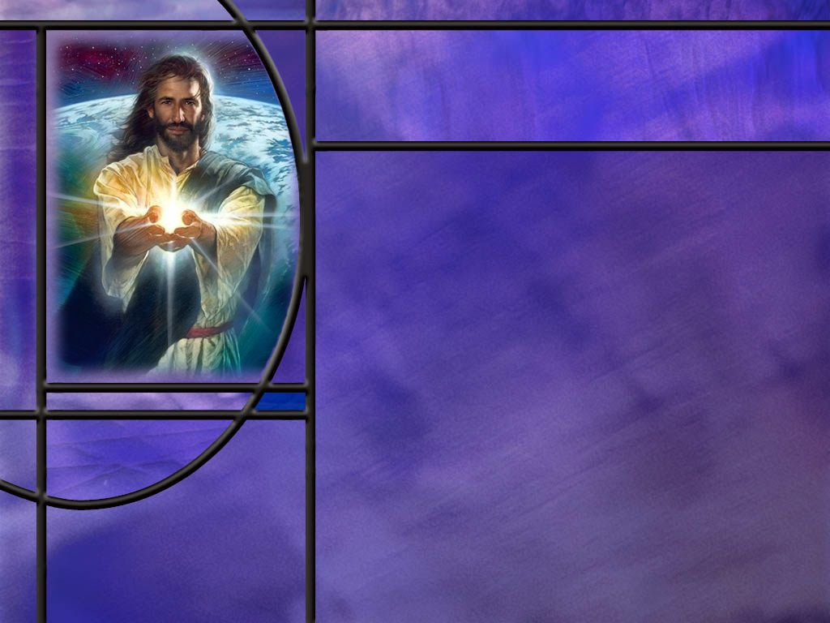
Walking in Light
What are some of the advantages of memorizing Scripture? (Ps 119:11)
How well did Jesus know scripture?
What has been your experience with memorizing scripture?
What challenge does Paul leave for us as students of the Word? (2 Tim 2:15)
Notes:
B1:
1. First, memorizing God’s word helps us to know it so we can live by it.
2. Second, we can share it with others without having to look it up.
3. Third, we can bring it to mind and meditate on it whenever the need arises.
4. Fourth, we can use it to resist temptation like Jesus did: “It is written.”
5. Fifth, it helps us in our Bible study to bring other texts to bear on a passage we are studying.
6. Sixth, memorizing key important texts will help us develop sound doctrine and enable us to defend the faith.
B2:
1. It is clear that Jesus had memorized scripture.
2. During His ministry, there is never any indication that He needed to pull out a scroll to find a passage.
3. In the wilderness of temptation, He knew just the right texts from Deuteronomy to counter Satan’s temptations.
4. Three times: “It is written.”
5. And then quotations from Deut 8:13, 6:16, and 6:13
6. On the road to Emmaus, He “expounded unto them in all the scriptures the things concerning himself.”
7. So clearly, Jesus had memorized all the OT messianic prophecies.
B3:
1. I know that you guys have memorized Scripture: I start a verse and you’re all finishing it.
2. Thy word is a lamp unto my feet…
3. How do you get Scripture to stick in your minds?
4. It’s not easy for me; it takes work and lots of repetition.
5. The best time to memorize scripture is when you’re young.
6. Our great-grand kids in Adventist school have to memorize one Bible text per week starting in first grade.
7. They can do it without fail.
8. The older you get, the harder it gets.
9. The texts you memorize as a kid seem to stay with you better than the ones you memorize more recently.
[Tell about BMA Camp (Bible Memory Association) and trying to memorize the book of John.]
10. Before I retired, I had a 35-minute drive to work in the morning.
11. Much of that time I worked on memorizing NT scripture.
12. I memorized the Sermon on the Mount in Matthew 5-7 and the Olivette Discourse in Matt 24.
13. I memorized lots of verses from the epistles and tried to memorize Rev 12-17.
14. It took a lot of repetition to try to keep all these things memorized, but it was a real blessing to have these things fixed in my heart.
15. I feel like I need to spend more time on memorization as I am starting to forget, particularly the references where these verses are found.

Slide 7
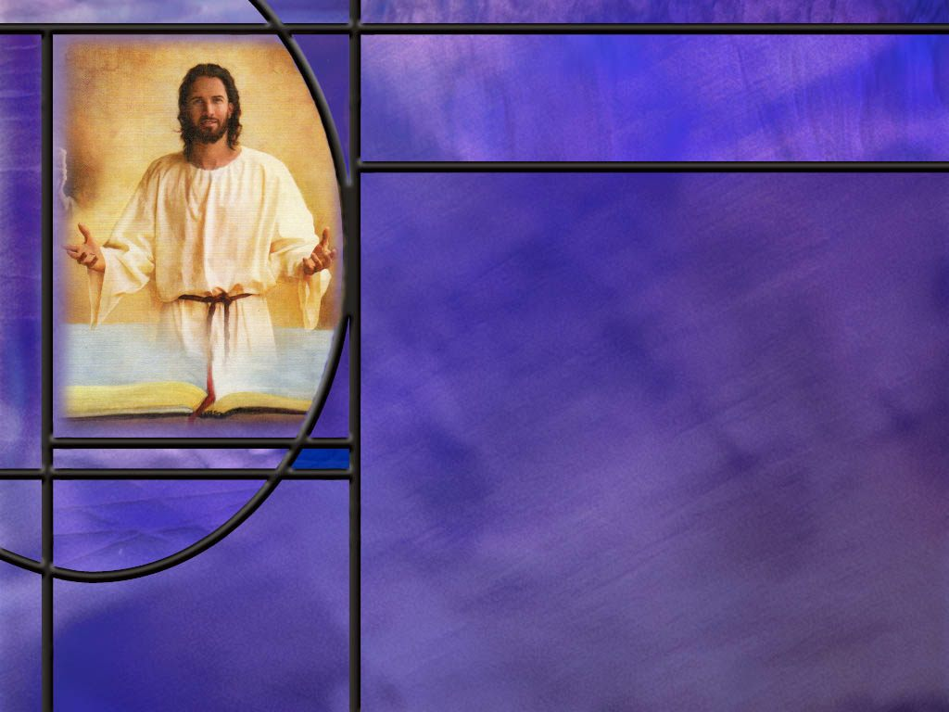
Summary
A knowledge of the Bible is foundational to growing in a relationship with God.
Aside from the general revelation of nature, everything we know about God, creation, the fall, the plan of redemption, the forgiveness of sins, life everlasting and so much more is found in the pages of the Bible.
There is power in God’s word: power to create the universe, and power to create in us a new heart.
The Scriptures are able to lead us to salvation by faith in Christ. This alone will bring success in life.
Saving faith comes by hearing the good news about Christ and choosing to trust Him for the forgiveness of our sins.

Slide 8
Summary
Our belief of the gospel is predicated on the trustworthiness of God’s word.
Fortunately, God has given us ample evidence for trusting the written word as well as the Word made flesh.
In order to hear God speak to us through His word, we must become diligent students of it.
We must choose to make it a priority to spend time in the word.
We can form the habit of daily Bible study by choosing an appropriate time and place, starting small (5-10 minutes), selecting a plan, beginning and ending with prayer, meditating on what the Word says, what it means, and how it applies to our lives, and writing a take-away from our study.

Slide 9
Summary
Computer and phone apps have opened up many excellent tools for Bible study. Commentaries, interlinears, concordances, parallel translations, and AI now make Bible study a breeze.
Bible study plans include reading the whole Bible, just the NT, a book of the Bible, a Bible topic, an important section of Scripture, and the SS lesson.
There is great value in memorizing Scripture. It helps us to know it, live by it, share it, meditate on it, resist temptation by it, and defend the faith with it.
As an Adventist who claims to be a person of the Book, will you make Bible study a priority this week so that you can rightly handle the word of truth?

Slide 11
2 Timothy 3:15 NKJV
and that from childhood you have known the Holy Scriptures, which are able to make you wise for salvation through faith which is in Christ Jesus. [R]
Notes:
Q1: What are the Holy Scriptures able to do for us?
1. They give us the wisdom and knowledge we need to find salvation.
2. They lead us to faith in Christ Jesus.
3. They are able to lead us from eternal death to eternal life; from the lake of fire to God’s eternal kingdom.
Q2: How would you define success in life?
1. Would you say that finding salvation in Jesus Christ is a good definition of success? (Absolutely!)
2. In the end, nothing else matters.
3. You can go into any bookstore and find hundreds of self-help books that promise success in finance or business or health or fitness.
4. But what does it profit a man if he gain the whole world and lose his own soul?
5. In the end, it comes down to our relationship with the Lord Jesus Christ that determines success of failure in life.
6. Let’s recall the words of the apostle John who wrote:
1 John 5:11-12 NKJV - And this is the testimony: that God has given us eternal life, and this life is in His Son. ¹² He who has the Son has life; he who does not have the Son of God does not have life.
Q3: How do we “have the Son?”
1. It’s kind of like we have a wife or a husband.
2. We have a life-long, loving, faith relationship with Jesus where He is our Savior, Lord, and Friend.
3. So the word of God is able to lead us there.
4. The written word leads us to the living Word, Jesus.

Slide 12
John 5:39 NKJV
"You search the Scriptures, for in them you think you have eternal life; and these are they which testify of Me. [R]
Notes:
Q1: When the NT refers to the Scriptures, to what is it usually referring?
1. Usually to the OT.
2. It took nearly a century for the NT to be collected and accepted as the inspired testimony of Jesus, inspired by the HS, and written down by the apostles.
3. But even the types and shadows of the OT are sufficient to lead us to salvation.
4. If we search the OT Scriptures diligently, Jesus says we will find Him there.
5. Remember His Bible study on the road to Emmaus?
Luke 24:27 KJV - And beginning at Moses and all the prophets, he expounded unto them in all the scriptures the things concerning himself.
6. It is only in the Scriptures that we can learn the truth about God.
7. The Scriptures tell us where we come from, why we are here, and where we are going.
8. The Scriptures make it plain that we are sinners and that the wages of sin is death.
9. The Scriptures proclaim the good news that sinners can be saved by substitutionary atonement.
10. The Scriptures declare the love of God for lost sinners and His amazing grace in providing a way to be forgiven and saved.
11. In the Scriptures, we read that God has laid the iniquity of us all on His suffering Servant.
12. The OT saints were saved by faith in the coming Redeemer.
13. The whole sanctuary service pointed forward to the blood of Jesus who would bear our sins and provide forgiveness.
14. They didn’t know His name, but if they trusted in the grace of God to provide forgiveness of their sins, through confession and repentance, they were saved by faith in the blood that Jesus would shed.
15. The OT scriptures were sufficient to lead sinners to righteousness by faith as evidenced by the Heroes of faith in Hebrews 11.
16. But now that we have the NT as well, the truth of who Jesus is and what He has done to save us is so abundantly clear that we have no excuse for missing it or ignoring it.

Slide 13
Romans 10:17
Romans 10:17 NKJV - So then faith comes by hearing, and hearing by the word of God.
Romans 10:17 NIV - Consequently, faith comes from hearing the message, and the message is heard through the word about Christ.
Romans 10:17 NLT - So faith comes from hearing, that is, hearing the Good News about Christ. [R]
Notes:
Q1: For those of us living in the age of the Christian church, where does saving faith come from?
1. It comes from hearing the good news about Christ and what He did to save us from our sins.
2. If you look at the Greek, the ending word of this verse is not Theos (God) but Christos (Christ).
3. Therefore, the more modern translations give a better rendering of the original.
4. Saving faith comes by hearing the good news that Christ died for our sins and trusting Him for forgiveness of sins and eternal life with God.
5. But before we decide to hear and receive the good news about Christ, we have to believe that the testimony of the apostles and NT eyewitnesses are reliable.
Q2: Is the NT reliable? What evidence can we cite?
1. Well, we covered this in last week’s lesson where we talked about the uniqueness of the Bible.
2. In the NT, we have much the same evidence: its unity points to its inspiration by God, its historical accuracy points to careful attention to detail, its careful transmission and wealth of early manuscripts testify to its accuracy in translation, its prophetic fulfillment, especially in the Messianic prophecies, demonstrate that God is in control of NT events, and its ability to change lives shows that its truth is living and powerful.
3. But I think we can add something more for the veracity of the NT.
4. We have the testimony of the apostle Paul and the other apostles who had nothing to gain and everything to lose, if they were trying to perpetrate a false gospel by claiming Jesus rose from the dead if he did not.
5. None of them got rich, all of them except one got martyred.
6. They were eyewitnesses, and they sincerely believed what they wrote and taught.
7. People are unlikely to endure imprisonment, beatings, exile, and death for something they know they invented.
8. People will die for the truth, but not for something they know is a lie.
9. So you can believe the Bible, especially the inspired eyewitnesses of the NT.

Slide 14
John 15:10 NKJV
"If you keep My commandments, you will abide in My love, just as I have kept My Father's commandments and abide in His love. [R]
Notes:
Q1: Where do we find Christ’s commandments, and see how He lived in obedience to His Father’s commandments?
1. It is in the word of God that we learn the commandments of God.
2. Jesus always did the will of His Father.
3. Even facing death on a cross for the sins of the world He prayed, “not my will but thine be done.”
4. So we abide in the love of Jesus by obeying the commandments of Scripture and learning the will of God and doing it.
5. You may remember we noted this progression as we studied John 15.
6. We abide by obeying Jesus.
7. We obey by loving Jesus. (If you love me, you will keep my commandments Jn 14:15)
8. We love Jesus by knowing Him.
9. And we know Him by beholding Him in Scripture.
10. So to abide in Jesus, we need to begin by coming to know Him more and more fully from our time in the word of God.
11. And the promise is that if we abide in Him we will bear much fruit and bring glory to God.
Q2: What did Jesus say happens to us if we don’t abide in Him?
1. Like the branches that are not connected to the vine we wither up and are burned in the fire.
2. To quote Jesus:
John 15:6 ESV - If anyone does not abide in me, he is thrown away like a branch and withers; and the branches are gathered, thrown into the fire, and burned.
3. That’s a fate that none of us wants to face.
4. So let’s make the right choice when it comes to being open to the word of God.

Slide 15
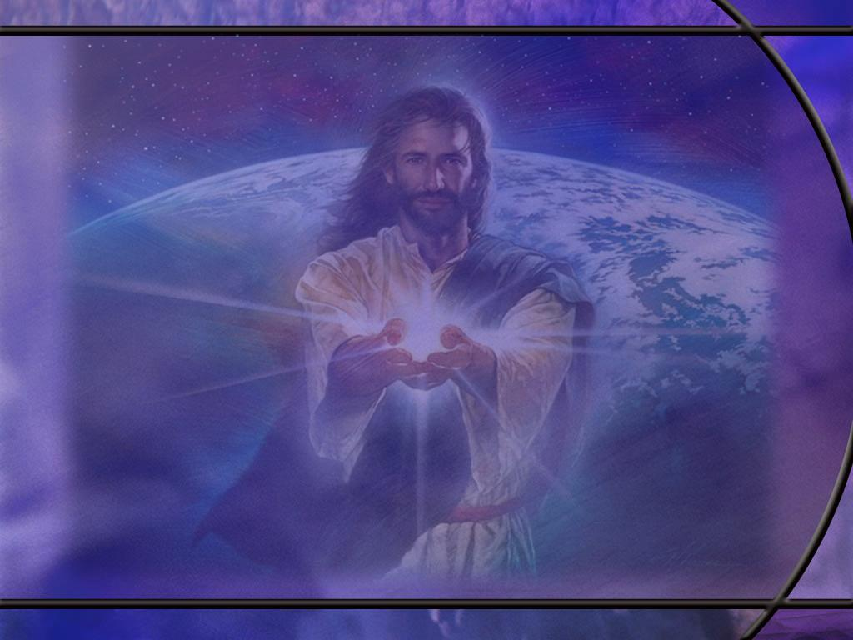
Joshua 24:15 ESV
And if it is evil in your eyes to serve the LORD, choose this day whom you will serve, whether the gods your fathers served in the region beyond the River, or the gods of the Amorites in whose land you dwell. But as for me and my house, we will serve the LORD.“ [R]
Notes:
Q1: What choice do you need to make about daily Bible study?
1. We need to begin by making a choice.
2. Is this something the Lord wants you to do?
3. If your answer to that is yes, then let’s do our best to make a start.
4. I know we all have busy schedules.
5. But we need to set priorities on what is important and what is not.
6. I like what President Eisenhower is quoted as saying:
“What is important is seldom urgent, and what is urgent is seldom important.”
7. So don’t let the urgent rob you of the important.
8. The devil would like to keep you so busy you will be tempted to postpone this important meeting with God and His word.
9. Richard Foster writes, “ In contemporary society our Adversary majors in three things, noise, hurry, and crowds. If he can keep us engaged in “muchness’ and “manyness” he will rest satisfied.”
10. He then quotes Carl Jung as once remarking, “ Hurry is not of the Devil; it is the Devil.”
11. But we can choose to be still and know that God is God.
12. We can choose to make time for Him and make it a habit.

Slide 16
Starting the Journey
Choose a set time you can keep each day.
Find a consistent quiet place; no phone.
Start small: maybe 5 to 10 minutes.
Have a Bible reading plan.
Pray for the Holy Spirit’s guidance.
Read a paragraph or two.
Think about what it says, what it means, and how it applies to you. (Meditate on the Word)
Write down the main idea of the passage.
Pray that God will use His word to guide your life today. [R]
Notes:
Q1: Is there anything that you think we should add or subtract from this start up list? Any comments or discussion on what you have found valuable in forming the habit of Bible study?
In studying a passage, it may be helpful to fix in your mind and be able to write down the main idea of the passage.
Haddon Robinson, in his book Biblical Preaching, teaches that the idea consists of only two parts: the subject and the compliment.
The subject is what the Bible author is talking about.
And the compliment is what the Bible author is saying about his subject.
The subject should be defined as precisely as possible, taking into account the context of the passage.
Together these form the idea that the Bible author is trying to convey.
When the main idea becomes clear by study and prayer, write it down and see how it may apply to you.

Slide 17
Psalm 119:11 KJV
Thy word have I hid in mine heart, that I might not sin against thee. [R]
Notes:
Q1: How does memorizing Scripture help us to be obedient to the will of God?
1. The word of God expresses the will of God.
2. Memorizing key portions of the word helps us to remember it and apply it.
3. We can’t do the will of God unless we know the will of God.
4. And when we memorize the Word we can know it, recall it, meditate on it, and apply it.
Q2: How many think they could name off the 10 commandments in order?
1. If you can, you’re way ahead of the general public.
2. In a recent survey, only 14% of those asked could name all 10 commandments.
3. Less than 60% knew that “Thou shalt not kill” was one of the 10 commandments.
4. Try it on one of your non-Christian friends.
5. Ask them to name the 10 commandments and see how many they come up with.
[Read notes under B1 on return to summarize.]

Slide 18
2 Timothy 2:15 ESV
Do your best to present yourself to God as one approved, a worker who has no need to be ashamed, rightly handling the word of truth. [R]
Notes:
Q1: Why is it important to rightly handle the word of truth?
1. As Seventh-day Adventists, we claim to be the “people of the Book.”
2. We believe we are rightly handling the word of truth while many other churches have compromised on the word of truth.
3. We need to know what we believe and why we believe it.
4. As Peter writes in:
1 Peter 3:15 KJV - … be ready always to give an answer to every man that asketh you a reason of the hope that is in you with meekness and fear:
5. The devil is in the business of promoting counterfeit religion, mixing truth and error so people have a form of religion without its power to save.
6. We must know the genuine so well that we can spot the counterfeit instantaneously.
7. And when the counterfeit arises, we need to defeat it with the truth.
8. We can only rightly handle the word of truth if we know it for ourselves, and that will take effort, perseverance, submission, and guidance of the Holy Spirit as we study and meditate on the Word of God.

