Slide 1
Growing in a Relationship with God
Lesson 1
Reality Check

Slide 2
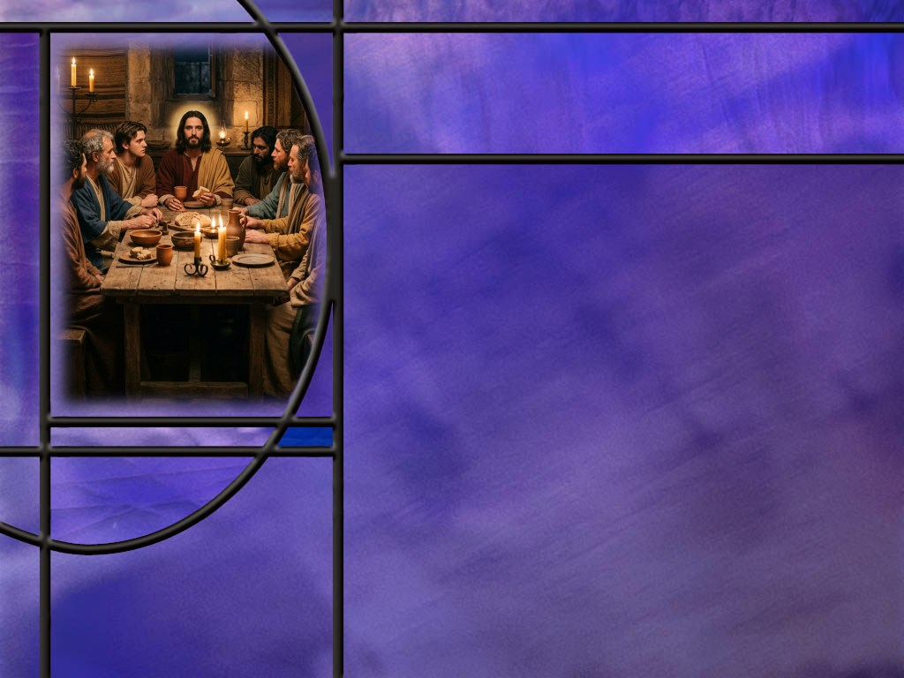
Memory Text
John 15:9 NKJV
"As the Father loved Me, I also have loved you; abide in My love.”
When did Jesus say these words to His disciples?
To what kind of love does Jesus compare His love for His disciples?
What important command does Jesus give us here?
What key does Jesus give us in the next verse on how to abide in His love? (John 15:10)
Notes:
B2:
1. It appears that John 15 occurs during the Passover meal that Jesus shared with His disciples on the night He was betrayed.
2. In John 12 we have the triumphal Entry into Jerusalem.
3. In John 13 we have the Passover and Jesus washing the disciple’s feet.
4. In John 14 we have Jesus telling His disciples that He is going back to the Father, but He will come again.
5. In John 15 we have the vine and the branches, from which our memory text is taken.
6. In John 16 we have the promise of the Holy Spirit.
7. In John 17 we have the Lord’s prayer for Himself, His disciples, and for us.
8. And in John 18 we have His betrayal and arrest in Gethsemane.
9. So apparently John took copious notes on the words of Jesus at that last Passover meal and the events that surrounded it.
B3:
1. Jesus compares His love for His disciples to the Father’s love for Him.
2. This is divine agape love, a selfless love that acts in the eternal best interest of the one who is loved.
3. Love is God’s greatest relational attribute.
4. The apostle John declares in 1 John 4:8 that “God is love.”
5. Both the Father and the Son have loved us with that divine agape love that was willing to have the Son of God die an excruciating death for our sins.
6. The Father gave His Son; the Son gave His life.
7. Both went through the agony of Calvary so that sin and evil and death might be defeated, and that we would all have a chance to find redemption.
B4:
1. He tells us to abide in his love.
2. What does it mean to abide?
3. Stay, remain, continue in a love relationship with Jesus.
B5:
[See notes on linked slide.]

Slide 3
Overview
Our lesson this week begins with a reality check on our spiritual condition: do we have a lukewarm problem and how do we find the cure? Jesus calls us to be fruitful disciples and gives us the keys to find joy in our relationship with Him.
  Lukewarm Laodicea
  Vine and Branches
  Walking Together
  Summary

Slide 4

Lukewarm Laodicea
What do we know about the city of Laodicea?
What epoch of history does Laodicea represent?
How does Jesus assess the Laodicean condition (Rev 3:15-16)?
How did Jesus use the characteristics of the city of Laodicea to point out the church’s deficiencies? (Rev 3:17-18)
Where does Jesus picture himself standing in His invitation to the Laodicean church? (Rev 3:20)
What does Jesus want to do for you if you let Him into your heart?
Notes:
B1:
1. It was founded in the 3rd century BC by Antiochus, who named the city after his wife, Laodice.
2. It was situated on a major crossroads, and it enjoyed great prosperity
3. With the aid of its large banking community, the city was able to refuse aid from Rome after its devastation by an earthquake in AD 60.
4. Laodicea was known for its black wool industry, as well as the manufacture of an eye salve called collyrium, both clearly alluded to in Revelation 3:18.
5. Its self-sufficiency was compromised only by its limited water supply, so that water provided by hot springs had to be brought some distance by aqueduct, arriving lukewarm.
6. The city was eventually abandoned, its extensive ruins known in Turkish as Eski Hissar, or “old castle.”
B2:
1. There seven letters to the seven churches in Rev 2 and 3.
2. Many scholars see these churches as representing different periods of church history from John’s day to the second coming of Jesus.
3. They start with Ephesus, the apostolic and post apostolic church and end with Laodicea, the last day church.
4. So the message to Laodicea is directly applicable to our church that is anticipating the soon return of Jesus.
5. So we need to examine ourselves this morning to see if we fit the description that Jesus gives here of the church living in the end times.
B3:
[See notes on linked slide]
B4:
[See notes on linked slide.]
B5:
[See notes on linked slide.]
B6:
1. Jesus wants to have a loving, life-changing relationship with you.
2. This is the key to solving every problem that faces every church.
3. He wants to come in and dine with you.
4. That speaks of friendship, communion, conversation, spending time together, growing to know each other, being at peace, enjoying life and sharing it together.
5. The more we love Him, the more we will obey Him and trust in Him.
6. Let’s open our hearts to Him, invite Him in to be our Savior and Lord, and grow in love for Him each day.
7. We can regain our first love and keep it growing; we can be on fire for Jesus instead of being only lukewarm, and we can claim all the promises that Jesus makes to those who overcome.
8. What promise does Jesus make to those in the Laodicean church that leave lukewarmness behind and invite Jesus into their hearts?
Revelation 3:21 NKJV - "To him who overcomes I will grant to sit with Me on My throne, as I also overcame and sat down with My Father on His throne.
9. Jesus wants to sit right next to you on His throne!!
10. Let’s be done with the lukewarmness of a casual relationship with Jesus and make our love for Him our highest priority.
11. What do you say?

Slide 5

Vine and Branches
What metaphor does Jesus use in John 15 to depict our relationship to Him? (John 15:4-5)
How did Jesus say we bring glory to God and show that we are His disciples? (John 15:8)
What is the secret to abiding in Jesus? (John 15:10,14)
What is the secret to obeying Jesus? (John 14:15)
What is the secret to loving Jesus? (John 15:13-15)
Notes:
B1:
[See notes on linked slide.]
B2:
[See notes on linked slide.]
B3:
[See notes on linked slide.]
B4:
[See notes on linked slide.]
B5:
[See notes on linked slide.]

Slide 6
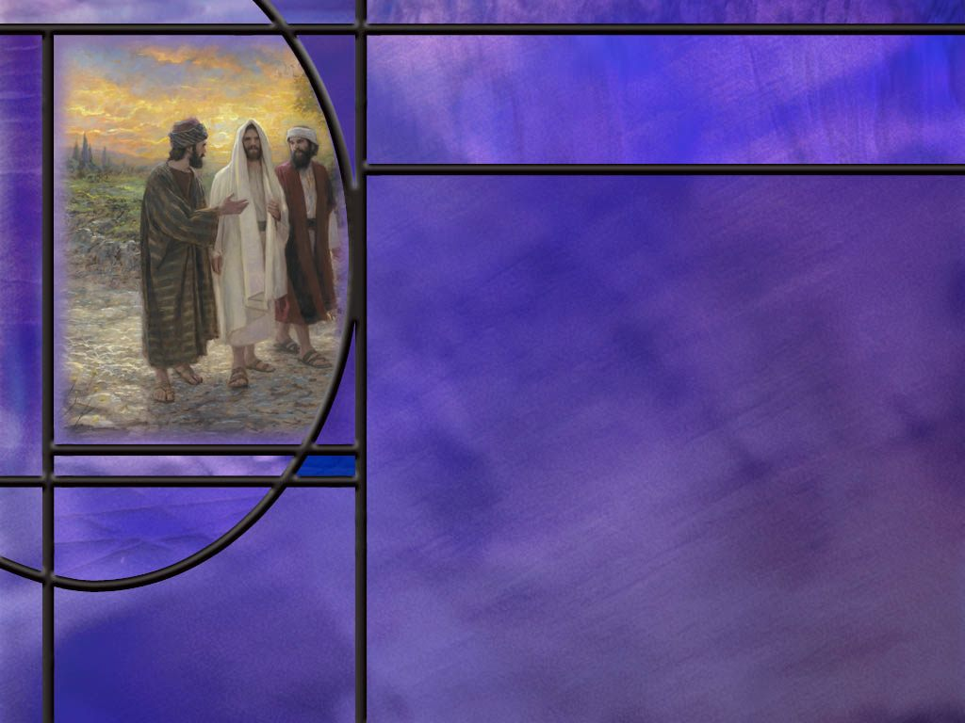
Walking Together
What does it mean to walk with God?
Is it possible to walk closely with God?
  Enoch — Genesis 5:24,
  Noah — Genesis 6:9,
  Abraham — Genesis 17:1,
  Moses — Exodus 33:11,
  Job -- Job 1:1,
  David — Acts 13:22.
Notes:
B1:
1. “Walking with God” means living in close fellowship, trust, and obedience to Him.
2. It is a term that describes a companionship with God as with a close friend.
3. Those who walk with God have formed the habit of thinking of Him in the simple daily tasks of living and opening their heart to His presence with them.
B2:
Genesis 5:24 ESV - Enoch walked with God, and he was not, for God took him.
Genesis 6:9 ESV - Noah was a righteous man, blameless in his generation. Noah walked with God.
Genesis 17:1-2 ESV - 1 When Abram was ninety-nine years old the LORD appeared to Abram and said to him, "I am God Almighty; walk before me, and be blameless, 2 that I may make my covenant between me and you, and may multiply you greatly.“
Exodus 33:11 ESV - 11 Thus the LORD used to speak to Moses face to face, as a man speaks to his friend.
Job 1:1 ESV - There was a man in the land of Uz whose name was Job, and that man was blameless and upright, one who feared God and turned away from evil.
Acts 13:22 ESV - And when he had removed him [Saul], he raised up David to be their king, of whom he testified and said, 'I have found in David the son of Jesse a man after my heart, who will do all my will.’
1. These ae biblical examples of those who have walked with God and have had a close personal relationship with Him.
2. If they can do it, we can do it too.
3. That is the kind of relationship God wants to have with all of us.

Slide 7

Summary
As we begin our study this quarter of Growing in a Relationship with God, it is prudent to examine our current relationship with God and see where improvements may be needed.
As Adventists, we believe we are living in the final days before the return of Jesus often correlated with Christ’s message to the church at Laodicea.
To what extent does the lukewarm Laodicean church characterize our own relationship to the Lord?
Are we half-hearted Christians with divided loyalties, one foot in the kingdom and one in the world, name on the church books but not in the Book of Life, born of the flesh but not really born again, thinking we are rich when the Lord sees us in spiritual poverty?
Notes:
too-khee-kos’

Slide 8
Summary
The Lord has a remedy for the lukewarm Christian: the gold of genuine faith, the white raiment of Christ’s righteousness, and the eyesalve of the Holy Spirit.
Jesus pictures himself standing, knocking, hoping you will hear His voice and open the door of your heart.
He promises to come in to be your Savior, Lord, and Friend and to apply the remedies your need to be a victorious conqueror that is faithful to Jesus to the end.
To such He promises to sit next to Him on His throne.
On the night of His betrayal, Jesus spoke to His disciples about the vine and the branches. He stressed the need for us, the branches, to abide in Him, the vine.

Slide 9
Summary
In this passage, He gave several keys for living the Christian life:
  To bear much good fruit, we must abide in Him.
  To abide in Him, we must obey Him and His commandments to love.
  To obey Him willingly we must fall in love with Him as a Friend.
  To love Him we must know Him and what He did to save us.
Knowing that there is room for your relationship with God to grow, will you seek to walk with God each day, asking for the Holy Spirit to fill you and keep you knowing, loving, obeying, and abiding in Jesus?

Slide 11
John 15:10 NKJV
"If you keep My commandments, you will abide in My love, just as I have kept My Father's commandments and abide in His love. [R]
Notes:
Q1: What is the key that Jesus gives us here to abiding in His love?
1. The key to abiding is obeying.
2. The key to remaining in a love relationship with Jesus is to obey Him.
3. We must keep His commandments to remain in His love.
4. Here we see Jesus setting the example by keeping His Father’s commandments and remaining in His love.
Q2: Is there any difference between the commandments of Jesus and the commandments of the Father?
1. No! All God’s commandments are based on the one great principle of love, and the two directions of love: toward God and toward others.
2. When Jesus summarized the commandments of God for the lawyer who asked which was the greatest commandment, He actually quoted laws from Deut 6:5 and Lev 19:18.
Deuteronomy 6:5 NKJV - 5 "You shall love the LORD your God with all your heart, with all your soul, and with all your strength.
Leviticus 19:18 NKJV - 18 …you shall love your neighbor as yourself:
3. Father and Son are in total and complete agreement on the commandments of God and how we should live in obedience to all the will of God.
Q3: How do we express our love for Jesus?
1. What did Jesus say back just one chapter in John 14:15?
John 14:15 ESV - "If you love me, you will keep my commandments.”
2. And in his first epistle, John writes this:
1 John 5:3 ESV - For this is the love of God, that we keep his commandments. And his commandments are not burdensome.
3. We keep His commandments as an expression of love to the One who has saved us.
4. And when love is our motivation, keeping the commandments is a joy rather than a chore.

Slide 12
Revelation 3:15-16 (NKJV)
¹⁵ “I know your works, that you are neither cold nor hot. I could wish you were cold or hot. ¹⁶ So then, because you are lukewarm, and neither cold nor hot, I will vomit you out of My mouth. [R]
Notes:
Q1: What reaction does Jesus have to their lukewarm quality?
1. It makes Him want to puke.
Q2: What does He prefer to lukewarm?
1. Either cold or hot.
2. Isn’t that our preference as well?
3. People drink iced coffee or hot coffee, but lukewarm coffee is not preferred by anyone I know.
4. For coffee, my preference is just the smell. I don’t like the taste either hot or cold.
Q3: Why would Jesus prefer someone to be cold toward Him rather than lukewarm?
1. The one who is cold knows his condition; the one lukewarm thinks he’s hot enough
2. The one who is cold can be convinced he’s lost; the one lukewarm thinks he’s saved.
Q4: How would you describe someone who is lukewarm toward Christ?
1. One who claims to be a Christian but is not a true disciple.
2. One who holds back from full surrender.
3. One who is Christian in name only but has not been born again.
4. One who thinks that a half-hearted commitment to Christ is sufficient.
5. One who has only a form of godliness.
Q5: How would you describe someone who is “on fire” for Jesus?
1. Willing to endure persecution for Christ,
2. Live in total allegiance to His lordship,
3. Understand and keep all His teachings,
4. Give evidence of agape love through Him,
5. Bear fruit by creating other disciples.

Slide 13
Revelation 3:17-18 (KJV)
¹⁷ Because thou sayest, I am rich, and increased with goods, and have need of nothing; and knowest not that thou art wretched, and miserable, and poor, and blind, and naked: ¹⁸ I counsel thee to buy of me gold tried in the fire, that thou mayest be rich; and white raiment, that thou mayest be clothed, and that the shame of thy nakedness do not appear; and anoint thine eyes with eyesalve, that thou mayest see. [R]
Notes:
Q1: How did Laodicea see itself?
1. Rich and increased with goods and in need of nothing.
2. They saw themselves as doing just fine.
Q2: How did Jesus see them?
1. Wretched, miserable, poor, blind, and naked.
2. They were proud of their riches; He saw them in spiritual poverty.
3. They were proud of their black-wool cloth industry; He saw them as spiritually naked.
4. They were proud of their eye salve; He saw them as spiritually blind.
Q3: What remedy does Jesus prescribe for them?
1. Gold tried in the fire that they may be truly rich.
2. White raiment that they may be clothed.
3. Eye salve that they may see.
4. Do you see how this dovetails with the claims to fame of the city?
5. They were famous for their banking (gold), their black wool (rather than white raiment), and their eye salve.
Q4: What do you think is symbolized by the Gold, white raiment, and eyesalve prescribed by Jesus for the Laodicean church?
1. Most commentators agree that the gold tried in the fire represents genuine faith in Jesus.
1 Peter 1:7 (NIV)
⁷ These [trials] have come so that the proven genuineness of your faith—of greater worth than gold, which perishes even though refined by fire—may result in praise, glory and honor when Jesus Christ is revealed.
2. The trials in life refine our faith like fire refines gold.
3. What does white raiment represent?
4. It represents the righteousness of Christ in which we must be clothed.
Revelation 7:14 (NIV)
¹⁴ … And he said, “These are they who have come out of the great tribulation; they have washed their robes and made them white in the blood of the Lamb.
5. From Jesus’ parable of the wedding feast, everyone at the marriage of the Lamb must have on a wedding garment provided by God.
6. That garment represents the righteousness of Christ imputed to our account.
7. How about the eye salve?
8. Jesus specifies anointing our eyes with eye salve.
9. Anointing usually refers to oil which is a symbol of the Holy Spirit.
Acts 10:38 (NKJV)
³⁸ how God anointed Jesus of Nazareth with the Holy Spirit and with power, who went about doing good and healing all who were oppressed by the devil, for God was with Him.
10. So Jesus’ prescription for the Laodicean church is to be anointed by the HS.
11. This will open their eyes to the truth of God’s word and allow them to see their real condition.

Slide 14
Revelation 3:20 (NKJV)
²⁰ Behold, I stand at the door and knock. If anyone hears My voice and opens the door, I will come in to him and dine with him, and he with Me. [R]
Notes:
Q1: What is the door on which Jesus is knocking?
1. We think of it as the door of our hearts.
2. It is actually a choice that we make to love Jesus and allow Him to be our Savior or not.
3. Jesus is asking us to say yes to Him and open the door of our hearts to Him.
Q2: What else is Jesus doing besides knocking?
1. He’s saying something.
2. We need to hear his voice and listen to what He is saying.
3. How do we hear the voice of Jesus?
4. We hear it through the word of God and the testimony of Jesus: the holy scriptures.
5. It is in the word of God that we come to understand the gospel of righteousness by faith.
Romans 10:17 (NLT)
¹⁷ So faith comes from hearing, that is, hearing the Good News about Christ.
6. When the HS gives us a true understanding of the gospel, we will recognize our need for Christ.
7. We must then make the choice of whether or not to invite Him into our hearts to be our Savior and Lord.

Slide 15

John 15:4-5 NKJV
“Abide in Me, and I in you. As the branch cannot bear fruit of itself, unless it abides in the vine, neither can you, unless you abide in Me. ⁵ "I am the vine, you are the branches. He who abides in Me, and I in him, bears much fruit; for without Me you can do nothing. [R]
Notes:
Q1: How much good fruit can we bear without Jesus?
1. None!
Q2: How much good fruit can we bear if we abide in Him?
1. Much!
2. The secret of fruit bearing is abiding in Jesus.
Q3: What kind of a connection do we, the branches, need to Him, the vine?
1. It needs to be a constant connection, not one that is here today and gone tomorrow.
2. To abide in Him means to stay connected to Him in a constant living, loving relationship.
3. So Jesus is here speaking of a relationship in which we abide in Christ and He abides in us.
4. This speaks of a continual awareness of the presence of God as we live moment by moment.
5. It is being in an attitude of surrender, praying and sharing our life with Jesus through His indwelling HS.
6. It is putting into practice Paul’s challenge to the Thessalonians:
1 Thessalonians 5:16-18 ESV - 16 Rejoice always, 17 pray without ceasing, 18 give thanks in all circumstances; for this is the will of God in Christ Jesus for you.
Q4: What does it mean to bear fruit?
1. We can think of a couple of possibilities.
2. First, when we have a living relationship with Christ, we bear the fruit of the Spirit.
3. The Holy Spirit is like the sap that flows into the branches and produces the fruit of the spirit: love, joy, peace, patience, kindness, goodness, faithfulness, gentleness, and self-control.
4. All of the fruit should be growing in Christians that have a constant connection with Jesus and are abiding in Him.
5. Second, we can bear fruit in sharing the love of Jesus with others and bringing them to be disciples too.
6. As born-again Christians, we have been given the ministry of reconciliation as ambassadors for Christ, calling everyone to be reconciled to God.
7. Bearing good fruit is becoming more like Jesus in the way we live.
8. In this metaphor, the only way we can do that is to abide in Him.
9. And when we do that, the promise of this verse is that we will become more like Him in character.
Q5: What part does the Holy Spirit play in abiding in Jesus?
1. It is through the HS that we abide in Jesus and He abides in us.
2. The HS is Christ’s representative, the Helper that Jesus sent as His replacement.
3. It is through the HS that we speak to Jesus and He speaks to us.
4. Abiding in Jesus is inviting Jesus to come into our hearts and walk with us.
5. And Jesus does that by sending the HS as His representative to dwell in us.
6. When we think of Jesus present with us moment by moment, it is the HS that is present in His place.
7. Christ can live His life in us through the presence of the HS if we allow Him to have control.

Slide 16
John 15:8 ESV
By this my Father is glorified, that you bear much fruit and so prove to be my disciples. [R]
Notes:
Q1: What proves that we are disciples and followers of Jesus?
1. Is there any good fruit in our lives?
2. Jesus said,
Matthew 7:19-20 KJV - Every tree that bringeth not forth good fruit is hewn down, and cast into the fire. 20 Wherefore by their fruits ye shall know them.
3. A good tree brings forth good fruit; a corrupt tree brings forth evil fruit.
4. When we bear good fruit, we bring glory to God and make Him look good.
5. And this is evidence that we are disciples, students, followers, of Jesus.
6. Bringing glory to God is the aim of every true Christian.
7. Paul wrote:
1 Corinthians 10:31 KJV - Whether therefore ye eat, or drink, or whatsoever ye do, do all to the glory of God.
8. And God is glorified when we bear much fruit.

Slide 17
John 15:4-6 ESV
Abide in me, and I in you. As the branch cannot bear fruit by itself, unless it abides in the vine, neither can you, unless you abide in me. ⁵ I am the vine; you are the branches. Whoever abides in me and I in him, he it is that bears much fruit, for apart from me you can do nothing. ⁶ If anyone does not abide in me he is thrown away like a branch and withers; and the branches are gathered, thrown into the fire, and burned. [R]
Notes:
Q1: What is the key to bearing good fruit to the glory of God and showing we are disciples of Jesus?
1. The key to fruit bearing is abiding in Jesus.
2. It is through the HS that we abide in Jesus and He abides in us.
3. The HS is Christ’s representative.
4. It is through the HS that we speak to Jesus and He speaks to us.
5. Abiding in Jesus is inviting Jesus to come into our hearts and walk with us.
6. And Jesus does that by sending the HS as His representative to dwell in us.
7. When we think of Jesus present with us moment by moment, it is the HS that is present in His place.
8. Christ can live His life in us through the presence of the HS if we allow Him to have control.
Q2: What does it mean to abide?
1. It means to stay, to dwell, to remain, to tarry, not to depart.
2. So Jesus is here speaking of a relationship in which we abide in Christ and He abides in us.
3. This speaks of a continual awareness of the presence of God as we live moment by moment.
4. It is being in an attitude of surrender, praying and sharing our life with Jesus through His indwelling HS.
5. It is putting into practice Paul’s challenge to the Thessalonians:
1 Thessalonians 5:16-18 ESV - 16 Rejoice always, 17 pray without ceasing, 18 give thanks in all circumstances; for this is the will of God in Christ Jesus for you.

Slide 18
John 15:10, 14 ESV
If you keep my commandments, you will abide in my love, just as I have kept my Father's commandments and abide in his love. ... ¹⁴ You are my friends if you do what I command you. [R]
Notes:
Q1: What is the key to abiding in the love of Jesus?
1. The key to abiding in the love of Jesus is obeying His commandments.
2. Sin destroys our fellowship with God.
3. Obeying all the commandments because we love Jesus keeps us in fellowship with our Lord through the HS.
John 15:14 (ESV)
¹⁴ You are My friends if you do what I command you.
4. The flip side of that is that if we break the commandments, that breaks our friendship with the Lord.
5. So, to keep abiding in the love of Jesus we need to keep obeying the commandments.
6. That means we need to keep living in love toward God and others.
7. Paul writes to the Corinthians:
1 Corinthians 16:14 NKJV - Let all that you do be done with love.
8. And to the Romans he writes.
Romans 13:10 ESV - Love does no wrong to a neighbor; therefore, love is the fulfilling of the law.
9. So here is the progression so far:
10. We bear fruit by abiding in Jesus.
11. We abide in Jesus by obeying His commandments to love.
12. Let’s find the next secret on how to obey.

Slide 19
John 14:15 ESV
John 14:15 ESV - "If you love me, you will keep my commandments. [R]
Notes:
Q1: What is the key to obeying Jesus’ commandments?
1. Remember what Jesus said in:
John 14:15 ESV - 15 "If you love me, you will keep my commandments.
2. That’s a promise!!
3. If we love Jesus we will seek to keep His commandments.
4. Love is the motivation that makes obedience possible.

Slide 20
John 15:13-15 ESV
Greater love has no one than this, that someone lay down his life for his friends. ¹⁴ You are my friends if you do what I command you. ¹⁵ No longer do I call you servants, for the servant does not know what his master is doing; but I have called you friends, for all that I have heard from my Father I have made known to you. [R]
Notes:
Q1: What is the key to loving Jesus?
1. The key to loving Jesus is to know Him as a friend.
2. The Lord doesn’t treat us as servants. He treats us as friends.
3. We can have no greater friend than Jesus.
4. No one loves us more than Jesus.
5. He laid down His life for us.
6. How many friends do you know that would lay down their life for you?
7. Only Jesus.
8. He has not only called us friends, He has proven that His friendship is genuine.
9. His friendship is far more valuable than the friendship of any other.
10. He took the death that was ours that we might have the life that was His.
11. Because of Jesus, our sins can be forgiven, and we can inherit eternal life as a child of God!
12. John would write in his first epistle:
1 John 4:19 KJV - We love him, because he first loved us.
13. To know Him is to love Him.
14. In any friendship, the key to building a loving relationship is to spend quality time together.
15. So with Jesus, to be His friend, we need to spend time with Him.
16. And the best way to do that is to share our life with Him moment by moment, doing for Him what we would normally do for ourselves.
17. Being aware of His presence through the HS, living with joy in our hearts, a prayer on our lips, and thanksgiving on our tongues.
18. So here is he progression of this beautiful metaphor of abiding in Christ.
19. To bear much good fruit, we must abide in Him.
20. To abide in Him, we must obey Him and His commandments to love.
21. To obey Him willingly we must fall in love with Him as a Friend.
22. To love Him we must know Him and what He did to save us.
23. And to know Him, we must hear the gospel truth about Him that leads us to saving faith.
Romans 10:17 NLT - So faith comes from hearing, that is, hearing the Good News about Christ.

