Slide 1
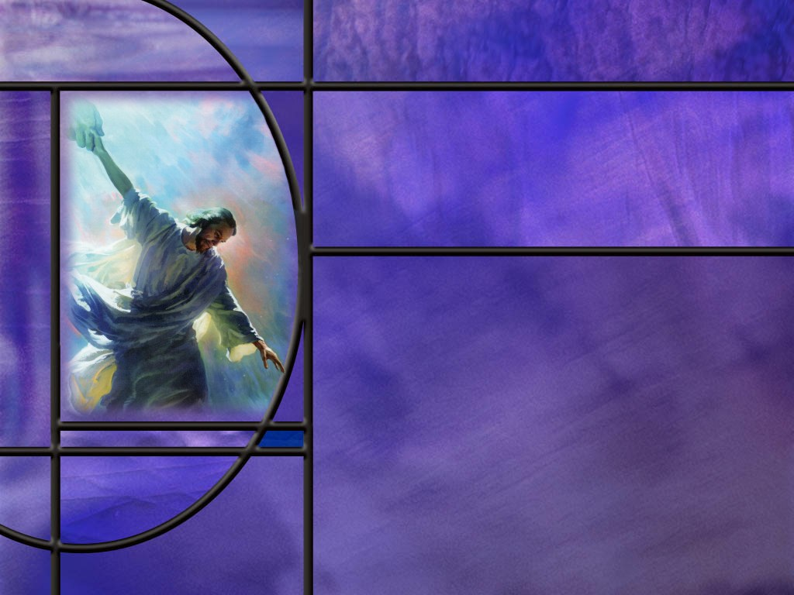
Uniting Heaven and Earth: Christ in Philippians and Colossians
Lesson 13
Standing in All the Will of God

Slide 2
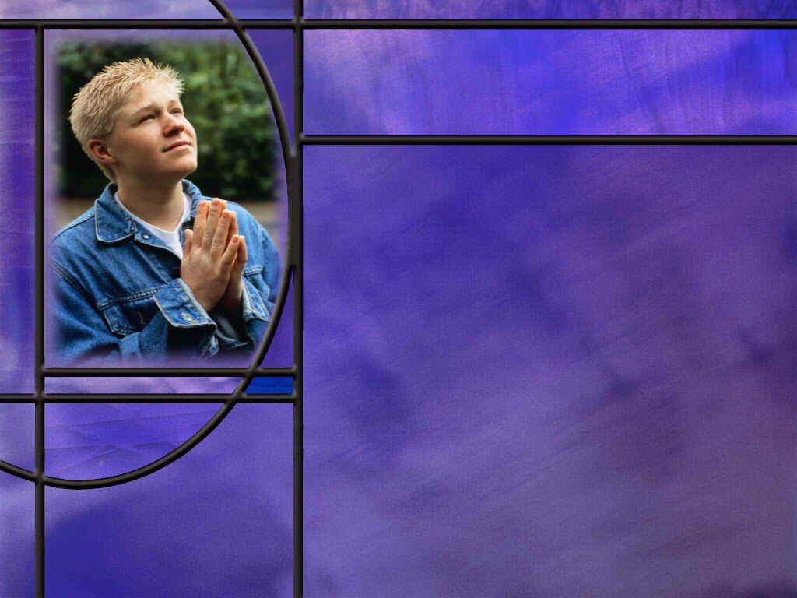
Memory Text
1 Thessalonians 5:18 NKJV
In everything give thanks; for this is the will of God in Christ Jesus for you.
What two short verses does Paul write before our memory text?
What makes it difficult to put these short commands into practice?
What is the difference between giving thanks “in everything” and giving thanks “for everything?”
What did Paul and Silas do when they were beaten and imprisoned in Philippi?
How did God respond to this prayer and praise session?
Notes:
B2:
1. Beginning in 1 Thes 5:16:
1 Thessalonians 5:16-18 NKJV - Rejoice always, ¹⁷ pray without ceasing, ¹⁸ in everything give thanks; for this is the will of God in Christ Jesus for you.
B3:
1. If we take these commands literally, they would occupy 100% of our time and effort.
2. Rejoice always, pray always, give thanks always.
3. How would we get anything else done in life?
4. When could we take time to eat and sleep and talk and study and teach and do a hundred other things that active people do every day?
5. So, what is Paul saying here in these three short verses?
6. He is calling Christians to cultivate a mindset or an attitude toward living for Jesus.
7. Considering the gospel and what Christ has done to redeem us, considering the great and precious promises that are ours in Christ, considering what the Holy Spirit is doing in us, our lives should reflect an attitude of joy thanksgiving, and praise.
8. Because of Christ, we have every reason to rejoice, to stay connected with our Lord in prayer, and be thankful for what He has done and is doing to save us.
9. So, Paul is here describing the attitudes that should be exhibited in the spirit-led Christian life.
10. Our default response to life should be rejoicing, praying, and giving thanks, not complaining and blaming God for what we are going through.
B4:
1. Let’s take the difficult situation where someone is diagnosed with terminal cancer.
2. Should such a person thank God “for cancer?” (No!)
3. We don’t have to give thanks for cancer, knowing that it is an evil intrusion upon God’s prefect creation.
4. We don’t have to thank God for the pain and death it will cause.
5. But how can we thank God “in cancer?”
6. We can thank Him that our “life is hid with Christ in God.” (Col 3:3)
7. We can thank Him that Jesus is coming back to give us immortality and eternal life.
8. We can thank Him that He will change our vile body that it may be fashioned like unto His glorious body.
9. We can thank Him for the promise that there is nothing in all creation (even death itself) that can separate us from the love of God which is in Christ Jesus our Lord.
10. We can be thankful that the cancer will be gone when He wakes us in the resurrection.
11. Paul makes this comparison in:
Romans 8:18 KJV - For I reckon that the sufferings of this present time are not worthy to be compared with the glory which shall be revealed in us.
12. Even in our weakness and infirmity, we can be thankful for the kingdom that is coming where sorrow, pain, death, and mourning will be gone forever.
B5:
1. Were they sitting in prison complaining about how God let them down?
2. No! They were leading the song service in prison at midnight.
3. They were praising God by singing hymns and praying.
4. The other prisoners were a captive audience, literally.
B6:
1. He sent a very selective “earthquake.”
2. Usually the ground shakes, the building falls down, and everyone is killed.
3. In this case, the foundations of the prison shook, all the doors were unlocked, and all the prisoners’ chains fell off.
4. So this was no ordinary earthquake.
5. This was the power of God at work with selective targeting.
6. There is still power in praise today.
7. Let us follow Paul’s council in our memory text this week.
8. Let us develop the attitude of rejoicing, prayer, thanksgiving, and praise.
9. This is God’s will for you!

Slide 3
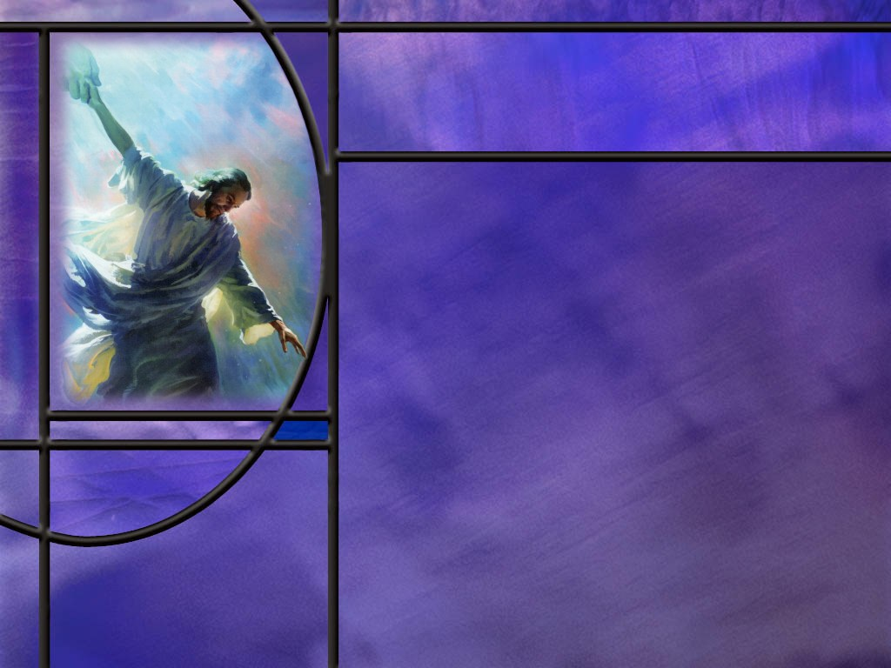
Overview
Paul’s closing words in his letter to the Colossians mention a number of co-workers that will deliver his epistle and make sure the gospel work continues in the Colossae region. His commendation of these workers helps to establish their credentials as workers who can be trusted.
  Fellow Workers
  Trusted Ministers
  Final Blessings
  Summary

Slide 4
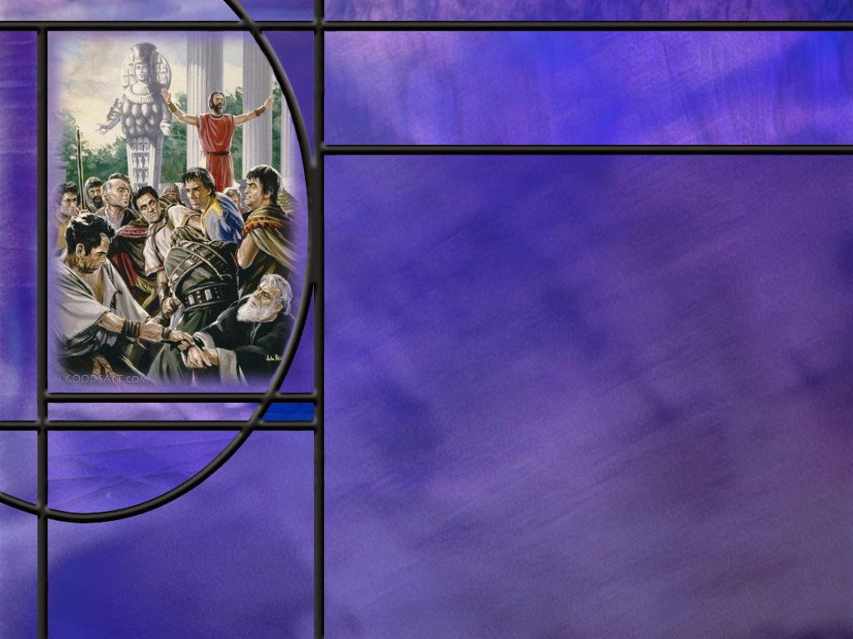
Fellow Workers
Who are the first co-workers Paul mentions in his closing and what about them does he commend? (Col 4:7-9)
What do we know about Paul’s fellow prisoner, Aristarchus? (Col 4:10)
What gospel workers with a Jewish background were an encouragement to Paul in Rome? (Col 4:10-11)
Notes:
B1:
[See notes on linked slide.]
B2:
[See notes on linked slide.]
B3:
[See notes on linked slide.]

Slide 5
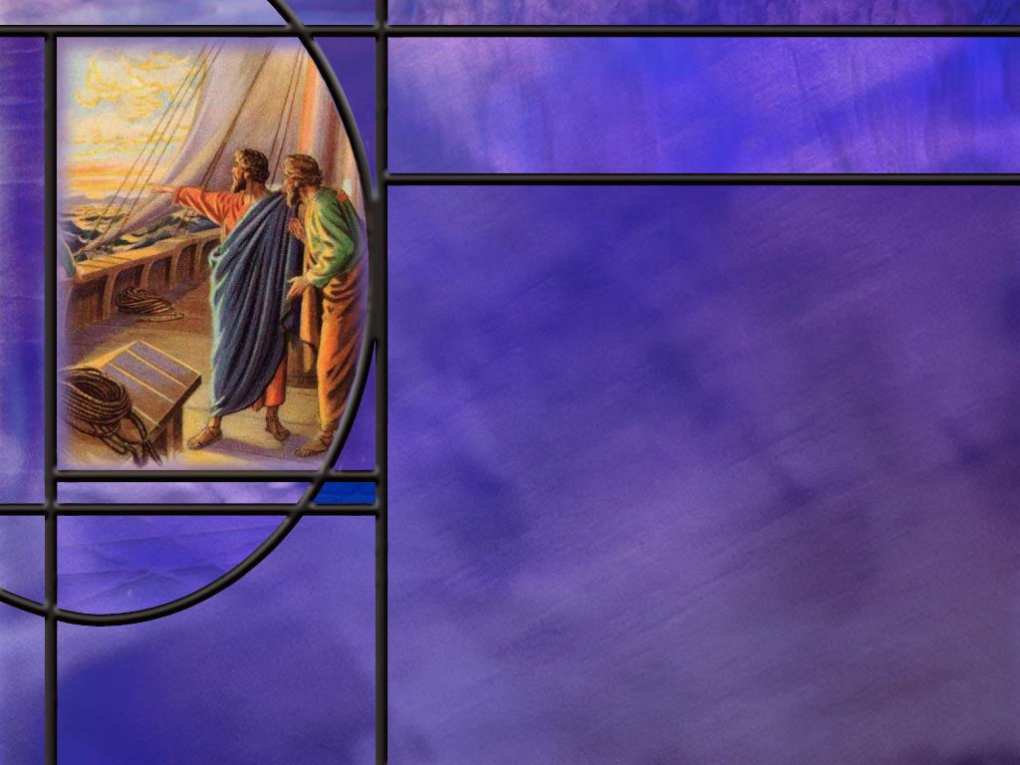
Trusted Ministers
Who was Epaphras and with what churches was he affiliated? (Col 4:12-13)
Who else does Paul include in his list of fellow workers? (Col 4:14-15)
What does Paul say about a letter from Laodicea? (Col 4:16)
Notes:
B1:
[See notes on linked slide.]
B2:
[See notes on linked slide.]
B3:
[See notes on linked slide.]

Slide 6
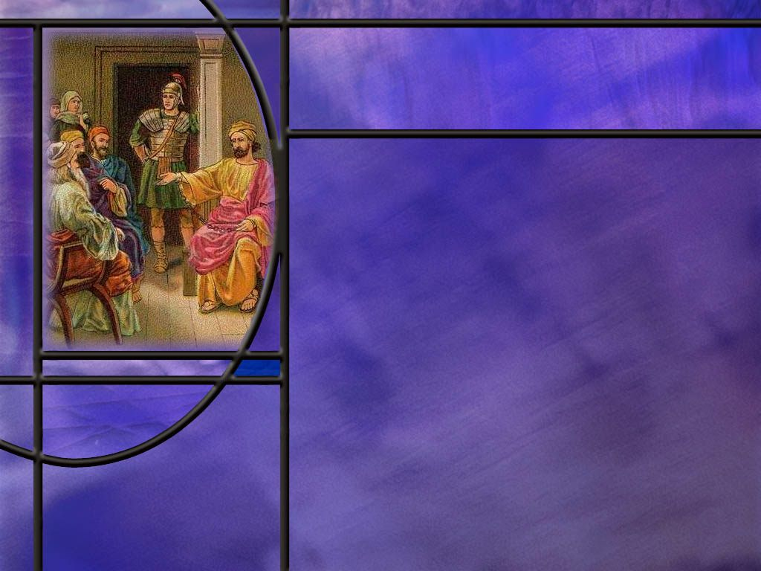
Final Blessing
How does Paul end this epistle? (Col 4:17-18)
Is Paul looking for sympathy when he reminds them of his chains?
What word does Paul use to both open and close this epistle? (Col 1:2; 4:18)
Notes:
B1:
[See notes on linked slide.]
B2:
1. I don’t think he is looking for sympathy from his readers.
2. Rather he is pointing to his chains as a badge of authority to speak for Christ.
3. It is as though he is saying:
“This is not a letter from someone who does not know what the service of Christ means, or someone who is asking others to do what he is not prepared to do himself. It is a letter from one who has himself suffered and sacrificed for Christ. My only right to speak is that I too have carried the cross of Christ.” [Quoted in William Barclay’s Commentary on Colossians.]
B3:
[See notes on linked slide.]

Slide 7
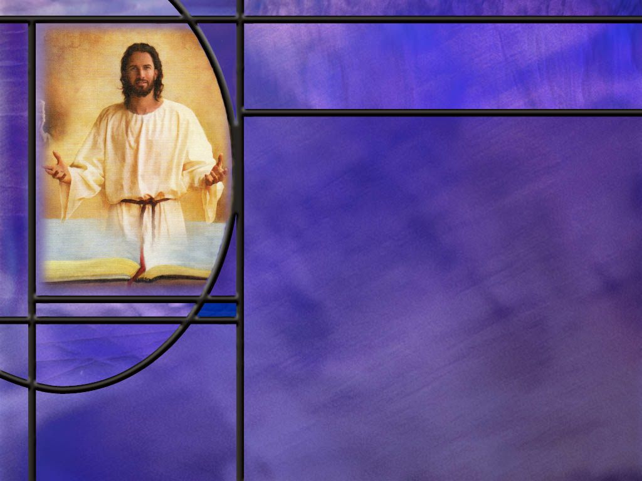
Summary
In closing his epistle to the Colossians, Paul names and commends a number of fellow workers that are faithful ministers and fellow servants of the Lord.
His commendation of these workers helps to establish their credentials as workers who can be trusted to teach and preach the truth.
Paul sends Tychicus and Onesimus as his envoys to deliver the letter to the Colossian church and make sure it is read. They are also charged with giving an oral report on everything going on with Paul in Rome.
Aristarchus is a fellow prisoner with Paul in Rome, who has been through some close calls with the apostle and has been a faithful traveling companion.
Notes:
too-khee-kos’

Slide 8
Summary
Aristarchus, along with john Mark and Justus are mentioned as Jewish believers in Jesus that are an encouragement to Paul.
Epaphras was a Colossian leader responsible for establishing the church there and possibly in Hierapolis and Laodicea as well. He is commended by Paul for laboring in prayer for his churches.
Paul also mentions the beloved physician, Luke, who remained faithful in serving with Paul to the end of his life.
At this time, Demas was still with Paul but later abandoned him, being attracted to the things of this world.
Paul instructed his letter to the Colossians to also be read in Laodicea, and the letter from Laodicea to be read at Colossae.

Slide 9
Summary
This may indicate other letters from Paul that may have been lost or providentially excluded from the NT Canon.
Paul’s encouragement of Archippus to fulfill the ministry he has received reminds us that those who are new creatures in Christ have received the ministry of reconciliation. We are ambassadors for Christ seeking to reconcile sinners to God.
Paul ends his letter to the Colossians with the same word he used to open it: grace. It is grace that makes Christianity unique. We are saved, not by the performance of religious duties, but by God’s grace in sending Christ to die for our sins so we can be forgiven and receive eternal life.
Will you reach out your hand of faith to receive His grace again today?

Slide 11
Colossians 4:7-9 ESV
Tychicus will tell you all about my activities. He is a beloved brother and faithful minister and fellow servant in the Lord. ⁸ I have sent him to you for this very purpose, that you may know how we are and that he may encourage your hearts, ⁹ and with him Onesimus, our faithful and beloved brother, who is one of you. They will tell you of everything that has taken place here. [R]
Notes:
Q1: Who is at the head of the list of Paul’s co-workers?
1. The proper Greek pronunciation of this man’s name is too-khee-kos’
2. Paul describes him as a beloved brother and faithful minister and fellow servant.
3. Based on this commendation, the churches to which he ministers can have confidence that he is preaching and teaching the truth as it is in Jesus.
4. Paul has warned them in this letter about false teachers.
5. Tychicus (too-khee-kos’) is a truth teacher.
6. He is also mentioned in Ephesians:
Ephesians 6:21 ESV - So that you also may know how I am and what I am doing, Tychicus the beloved brother and faithful minister in the Lord will tell you everything.
Q2: What task does Paul give to Tychicus (too-khee-kos’)?
1. Both to the Ephesians and Colossians, Tychicus (too-khee-kos’) is to give the churches a report on all that is going on with the apostle Paul.
2. The letters that Paul wrote dealt with problems of faith and conduct in the churches rather than all the personal details he could have included.
3. So Tychicus (too-khee-kos’) was to fill the people in on all the details of Paul’s house arrest in Rome and how he was able to function there and witness for Jesus among Caesar’s household.
4. Tychicus (too-khee-kos’) was the personal envoy from Paul and as such would carry the letter to Colossae and make sure it was read in the churches of Asia Minor.
Q3: Who else is mentioned here along with Tychicus (too-khee-kos’)?
1. We have Onesimus, the run-away slave that we have encountered before.
2. Here Paul says that Onesimus is one of the Colossian Christians (one of you).
3. Instead of calling him a run-away slave, Paul calls him a faithful and beloved brother.
4. Apparently, Onesimus found his way to Rome, encountered Paul, received Jesus as his Savior and Lord, and now Paul is sending him back home to minister there.
5. Perhaps Onesimus is carrying the letter Paul wrote to Philemon, Onesiums’ former owner, asking him to receive Onesimus as a new brother in the Lord.
6. The prison epistles of Paul are: Ephesians, Philippians, Colossians, and Philemon, written while under house arrest in Rome at his first imprisonment there.

Slide 12
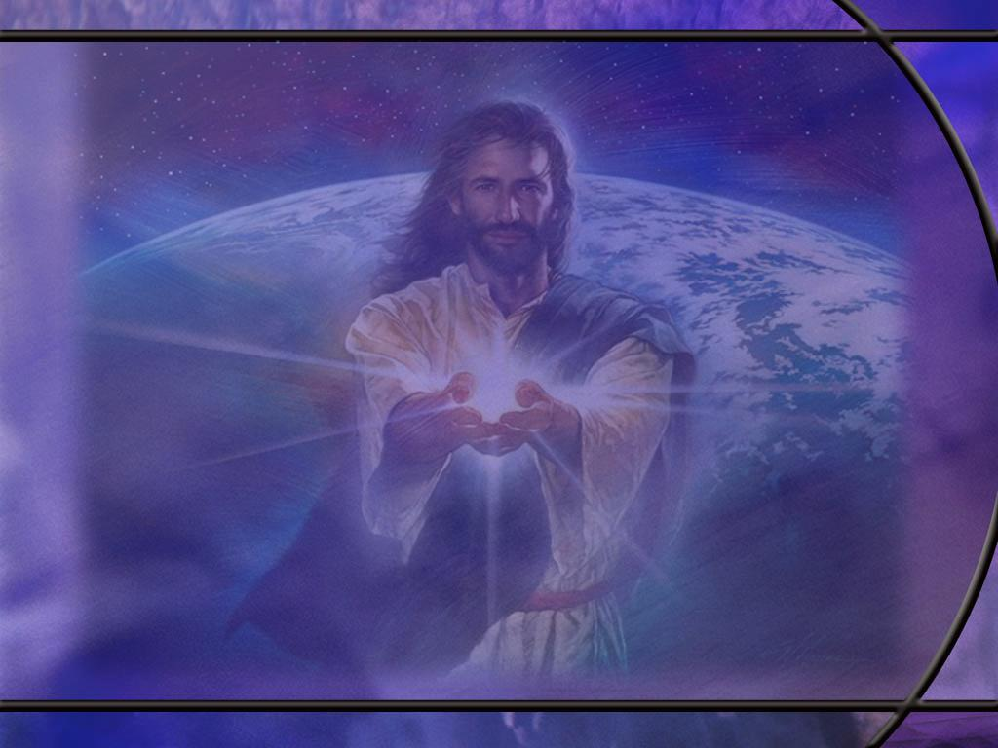
Colossians 4:10 ESV
Aristarchus my fellow prisoner greets you, and Mark the cousin of Barnabas (concerning whom you have received instructions--if he comes to you, welcome him), [R]
Notes:
Q1: Who is Aristarchus according to this verse?
1. Paul calls him a fellow prisoner.
2. Apparently, he is under house arrest along with the apostle.
Q2: What does the book of acts tell us about Aristarchus?
[See next slide]

Slide 13
Acts 19:28-29 ESV
Acts 19:28-29 ESV When they heard this they were enraged and were crying out, "Great is Artemis of the Ephesians!" ²⁹ So the city was filled with the confusion, and they rushed together into the theater, dragging with them Gaius and Aristarchus, Macedonians who were Paul's companions in travel.
Acts 27:1-2 ESV - And when it was decided that we should sail for Italy, they delivered Paul and some other prisoners to a centurion of the Augustan Cohort named Julius. ² And embarking in a ship of Adramyttium, which was about to sail to the ports along the coast of Asia, we put to sea, accompanied by Aristarchus, a Macedonian from Thessalonica. [R]
Notes:
1. Here we have two references from the book of Acts that mention Aristarchus.
2. He was a Macedonian from Thessalonica and a traveling companion of Paul.
3. He was swept up in the riot at Ephesus over Paul’s preaching that the idols made of metal were not real gods.
4. Eventually the rioters calmed down after a few hours and no harm came to Aristarchus, Gaius, or Paul.
5. The second reference is when Paul sailed for Rome with some other prisoners.
6. This is after Paul appealed to Caesar.
7. Luke records that Aristarchus was with them.
8. It is unclear how or when Aristarchus became a fellow prisoner of the apostle.
9. But t looks like he was a faithful friend even when Paul was in some of his most difficult times.

Slide 14
Colossians 4:10-11 ESV
Aristarchus my fellow prisoner greets you, and Mark the cousin of Barnabas (concerning whom you have received instructions--if he comes to you, welcome him), ¹¹ and Jesus who is called Justus. These are the only men of the circumcision among my fellow workers for the kingdom of God, and they have been a comfort to me. [R]
Notes:
Q1: What do we know about Mark the cousin of Barnabas?
1. This is the young man who wrote the gospel of Mark.
2. He is also know as John Mark who left Paul and Barnabas on Paul’s first missionary journey.
3. They had taken Mark to be their secretary, but when the going got tough, Mark quit and returned home.
4. This caused a great dispute between Paul and Barnabas for the second missionary journey.
5. Barnabas wanted to give him a second chance, but Paul refused to take a quitter.
6. As a result, Barnabas took Mark and Paul took Silas.
7. It was not until much later in his ministry that Paul found Mark useful.
8. Just in case there were some in Colossae that still had questions about Mark and Paul, Paul instructs them to welcome him.
9. In his last epistle, Pul has this to say about Mark:
2 Timothy 4:11 ESV - 11 Luke alone is with me. Get Mark and bring him with you, for he is very useful to me for ministry.
10. These are instruction to Timothy during Paul’s second imprisonment in Rome when he was locked in a dungeon and eventually beheaded.
Q2: What does Paul note about these three men, Aristarchus, Mark, and Justus?
1. He notes that these gospel workers for the kingdom of God are the only Jewish believers among his co-workers.
2. Apparently, all the others were of Gentile background.
3. So, Paul found comfort in these three faithful workers who recognized Jesus of Nazareth as their Messiah.
4. The majority of his contemporary Jews rejected the gospel, which broke Paul’s heart.

Slide 15
Colossians 4:12-13 ESV
Epaphras, who is one of you, a servant of Christ Jesus, greets you, always struggling on your behalf in his prayers, that you may stand mature and fully assured in all the will of God. ¹³ For I bear him witness that he has worked hard for you and for those in Laodicea and in Hierapolis. [R]
Notes:
Q1: According to this text, what was the home church of Epaphras?
1. Writing to the Colossians, Paul called him “one of you.”
2. So, Epaphras was a Colossian.
3. In Col 1:7, Paul says that the Colossian church heard the gospel from Epaphras:
Colossians 1:7 ESV - 7 just as you learned it [the Gospel] from Epaphras our beloved fellow servant. He is a faithful minister of Christ on your behalf.
4. Apparently Epaphras, not Paul, raised up the church as Colossae.
Q2: What witness does Paul bear about how Epaphras cares for the Colossian church?
1. His witness is that Epaphras struggles in prayer on behalf of the church.
2. He is lifting them up in prayer that they will stand mature in all the will of God.
3. Is there an example for us here? (Yes)
4. We need to lift one another up in prayer that we might grow to maturity in our relationship with Christ and stand mature in all the will of God.
Q3: What other churches has Epaphras worked to establish?
1. Two other churches: Laodicea and Hierapolis.
2. Let’s look at a map so see the location of these churches.
[See map on next slide.]

Slide 16
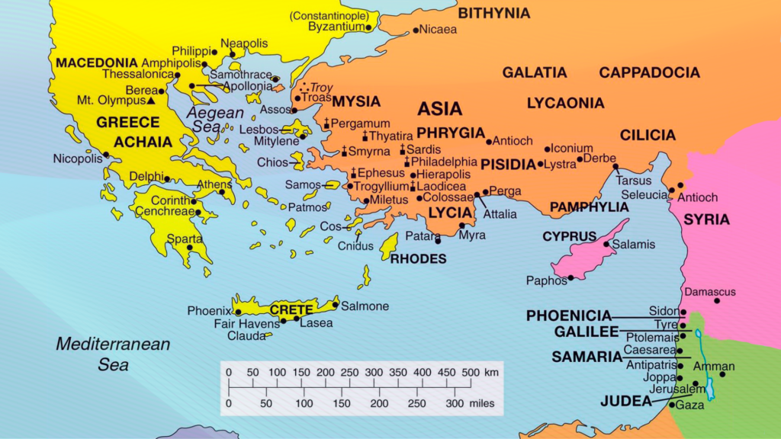
Map of Asia Minor
[R]
Notes:
[Use magnifying glass to blow up area of seven churches in Asia Minor.]
1. Here we can see the seven churches of Revelation 2 and 3.
2. In order, they make a loop around the important cities of Asia Minor.
3. They start with Ephesus and end with Laodicea.
4. Hierapolis is between Philadelphia and Laodicea, and Colossae is just south of Laodicea.
5. These churches are all close enough that Epaphras could have been the Overseer or Bishop for them all.

Slide 17
Colossians 4:14-15 ESV
Luke the beloved physician greets you, as does Demas. ¹⁵ Give my greetings to the brothers at Laodicea, and to Nympha and the church in her house. [R]
Notes:
Q1: What does Paul call Luke here?
1. “The beloved Physician.”
2. What a blessing Luke was to the apostle Paul and to the church.
3. He wrote the gospel of Luke and the book of Acts.
4. He was an inspired writer who brought the life of Christ and the history of the early church to life.
5. What a blessing he has been to us all!
6. And you wonder what lucrative practice he may have given up for the sake of Christ and the gospel and his care for the apostle Paul.
7. In Paul’s last letter, 2 Timothy, faithful Luke was still with him.
8. Here he pleads with Timothy to come before winter:
2 Timothy 4:9-11 NKJV - 9 Be diligent to come to me quickly; 10 for Demas has forsaken me, having loved this present world, and has departed for Thessalonica--Crescens for Galatia, Titus for Dalmatia. 11 Only Luke is with me. Get Mark and bring him with you, for he is useful to me for ministry.
9. In Paul’s second imprisonment he was possibly in the Mamertine prison.
10. He wanted Timothy to bring his cloak and parchments for writing.
Q2: What happened to Demas?
1. Well, during his first imprisonment here in our text, Paul sends greetings from Demas to the Colossian church.
2. But by his second imprisonment, Paul says that Demas has forsaken him, having loved this present world.
3. So this could be a case of apostasy from the faith for one of Paul’s close workers.
4. Here Paul also greets the believers at the church in Laodicea and the church that meets at Nympha’s house.
5. In the early church, homes and churches were identical.
6. It is still true today, that every Christian home should also be a place of worship.

Slide 18
Colossians 4:16 ESV
And when this letter has been read among you, have it also read in the church of the Laodiceans; and see that you also read the letter from Laodicea. [R]
Notes:
Q1: What do you think Paul means by the letter from Laodicea?
1. Could this be a letter from Paul to the Laodicean church that has been lost and not included in the Canon of Scripture?
2. This is quite possible.
3. Paul may have written more than the 13 epistles we have in our Bibles.
4. But that’s ok that some writings may be missing.
5. The fact that God has not preserved every letter Paul ever wrote reminds us that inspiration attaches to what God brought into and kept within the canon, not to every historical document an apostle may have penned.
6. It is also clear from this verse that Paul expected his letters to be read in various churches.
7. Before the completion of the NT, this was all that the early church had of the gospel truth that would become the faith of Jesus or His testimony as recorded by His apostles.
8. So, these letters must have been very precious to the churches as they made copies and kept circulating them around to each other.

Slide 19
Colossians 4:17-18 ESV
And say to Archippus, "See that you fulfill the ministry that you have received in the Lord." ¹⁸ I, Paul, write this greeting with my own hand. Remember my chains. Grace be with you. [R]
Notes:
Q1: How can we be like Archippus here? Have we received a ministry?
1. If you have received Christ you have a ministry.
2. Listen to what Paul writes to the Corinthians:
2 Corinthians 5:17-20 KJV - Therefore if any man be in Christ, he is a new creature: old things are passed away; behold, all things are become new. 18 And all things are of God, who hath reconciled us to himself by Jesus Christ, and hath given to us the ministry of reconciliation; 19 To wit, that God was in Christ, reconciling the world unto himself, not imputing their trespasses unto them; and hath committed unto us the word of reconciliation. 20 Now then we are ambassadors for Christ, as though God did beseech you by us: we pray you in Christ's stead, be ye reconciled to God.
3. If you are a born-again Christian, you have received a ministry.
4. It is the ministry or reconciliation.
5. You are an ambassador for Christ, calling the lost to be reconciled to God.
6. So let’s obey Paul’s charge to Archippus.
7. “See to it that you fulfill the ministry that you have received in the Lord.”
Q2: How does Paul end this letter to the Colossian Church.
1. He writes a greeting with his own hand.
2. We know that Paul used secretaries to write his epistles.
3. We know from Rom 16:22 that Tertius wrote the epistle to the Romans as Paul dictated it.
4. It was Paul’s custom to write, at the end of the letter, a few words of greeting in his own handwriting.
5. In one of his epistles he comments on how big he writes, perhaps because of poor vision which could have been his thorn in the flesh.
6. He writes simply: Remember my chains. Grace be with you.

Slide 20
From Grace to Grace
Colossians 1:2 KJV - To the saints and faithful brethren in Christ which are at Colosse: Grace be unto you, …
Colossians 4:18 KJV - The salutation by the hand of me Paul. Remember my bonds. Grace be with you. Amen. [R]
Notes:
Q1: What do you think Paul is saying by this greeting and closing?
1. This is typical Paul.
2. He is overwhelmed by the grace of God.
3. Marvelous grace, amazing grace, saving grace, transforming grace.
4. God loves us so much that He gave us His Son.
5. This grace comes specifically through the person and work of Jesus Christ, whose righteousness and saving work are given as a “free gift” to guilty sinners.
6. Paul wrote in:
2 Corinthians 8:9 KJV - 9 For ye know the grace of our Lord Jesus Christ, that, though he was rich, yet for your sakes he became poor, that ye through his poverty might be rich.
7. Paul never tired of commending to others the grace of God which had saved him.
8. Even though he saw himself as the chief of sinners for persecuting the Lord and His church, if God’s grace could save him, it could save anyone.
9. Grace is the thing that separates Christianity from every other religion in the world.
10. Christianity teaches that we are reconciled to God entirely by His grace—a free, undeserved gift in Christ—rather than by our moral or religious performance.
11. Grace is God doing for us what we could never do for ourselves, forgiving our sins and placing the righteousness of Christ to our account.
12. What makes Christianity unique? “It’s grace.”
13. We are saved by grace alone (God’s part) through faith alone (our part) in Christ alone (the only Savior).

