Slide 1

Uniting Heaven and Earth: Christ in Philippians and Colossians
Lesson 12
Living with Each Other
Notes:
Comment on the title:
To live above with those we love,
O that will be glory,
But to live below with those we know,
Now that’s a different story!”

Slide 2
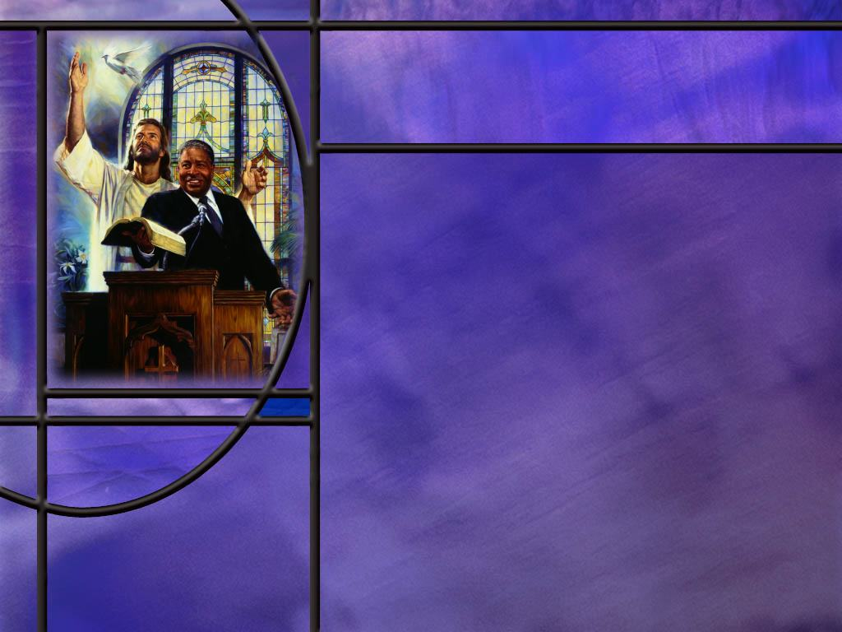
Memory Text
Colossians 4:6 NKJV
Let your speech always be with grace, seasoned with salt, that you may know how you ought to answer each one.
Remember from our lesson last week, what kind of speech did Paul say Christians must put off? (Col 3:8-9)
What is the first thing that should characterize a Christians’ speech?
What does Paul mean by saying our speech should be “seasoned with salt?”
Notes:
B2:
[See notes on linked slide.]
B3:
1. Grace.
2. Let your speech always be with grace.
3. What do you think it means to speak with grace?
4. When we think of God’s grace, we often define it as “God’s unmerited favor toward mankind.”
5. Grace is the goodness of God toward us who are undeserving sinners.
6. When we speak with grace, our intent should be to reflect the grace we have received from God to others.
7. The ultimate goal of speaking with grace is to have others find the saving grace of God as well.
8. So when we recall the grace of God toward us, our speech should reflect God’s grace, His goodness, His mercy, His patience, His forgiveness, and His love as we speak with others.
9. Our speech will be truthful, yet gentle.
10. It will be pure rather than corrupt.
11. It will encourage and build others up rather than tear them down.
12. It will focus on God’s solutions rather than on human complaints.
B4:
1. Well he is not talking about “salty speech” as we sometimes use the term for the way a sea Captain or Sailors might talk.
2. Paul seems to be saying that we should flavor our speech to make it appealing to our hearers.
3. We need to connect with people in a way that is best suited for them, and this will require different flavors of speech or different approaches for different people.
4. The NLT renders this verse:
Colossians 4:6 NLT - Let your conversation be gracious and attractive so that you will have the right response for everyone.
5. So the “seasoned with salt” makes our speech attractive to those to whom we are speaking.
6. We might summarize this verse as follows.
7. Let the mercy and kindness God has shown you in Christ govern every word, so that your speech is truthful yet gentle, pure rather than corrupt, helpful rather than destructive, and wisely adapted to the person before you, with an aim to point them toward God’s saving grace.

Slide 3

Overview
In our lesson this week, Paul sets forth rules for Christian living in daily relationships between husbands and wives, parents and children, and slaves and masters. He encourages balance and reciprocity based on love and respect and what would be pleasing to the Lord to bring about cooperation and success. He also provides instruction on prayer and effective speech for witnessing.
  Husband - Wife
  Parent - Child
  Master - Slave
  Prayer and speech
  Summary

Slide 4

Husband - Wife
What rules does Paul give for husbands and wives to develop a successful working relationship? (Col 3:18-19)
In writing to the Ephesians, how does Paul introduce the wife’s responsibility for developing the ideal husband-wife relationship? (Eph 5:22-24)
How does Paul introduce the husband’s responsibility for developing the ideal husband-wife relationship? (Eph 5:25-27)
Notes:
B1:
[See notes on linked slide.]
B2:
[See notes on linked slide.]
B3:
[See notes on linked slide.]

Slide 5

Parent - Child
What rules does Paul give for governing the parent child relationship in the home? (Col 3:20-21)
In writing to the Ephesians, how does Paul describe the rules that the children should follow in the home? (Eph 6:1-3)
In the Ephesian passage, what does Paul add to his rules for parents? (Eph 6:4)
Notes:
B1:
[See notes on linked slide.]
B2:
[See notes on linked slide.]
B3:
[See notes on linked slide.]

Slide 6

Master - Slave
How does Paul address the responsibilities of Christian slaves in the home? (Col 3:22-25)
What is Paul’s instruction to masters in this passage? (Col 4:1)
How would you apply Paul’s instructions to slaves to yourself even though you are not a slave?
Notes:
B1:
[See notes on linked slide.]
B2:
[See notes on linked slide.]
B3:
1. While Paul gives these instructions for slaves in the ancient world, we can apply them to ourselves as employees in the modern world.
2. First, we would do well to work for our employers as though we were working for Christ.
3. We may not love our employers, but we certainly love Christ.
4. And if we work for someone we love, work becomes a pleasure rather than a chore.
5. Second, as Christians we should be faithful at our jobs even though the boss is not watching.
6. When we work for Christ, the Lord’s eyes behold the actions and omissions that earthly bosses cannot see.
7. Third, Christian employees should work wholeheartedly, as if working for the Lord, not just their boss.
8. And finally in this passage, Christians are not to fret if their work does not receive the recognition from their boss that they expect.
9. Know that the justice of God, who see all and knows all, will prevail in the end.

Slide 7

Prayer and Speech
What instructions does the apostle give the Colossians about prayer? (Col 4:2-4)
What final advice does Paul have for living among unbelievers? (Col 4:5-6)
Notes:
B1:
[See notes on linked slide.]
B2:
[See notes on linked slide.]

Slide 8
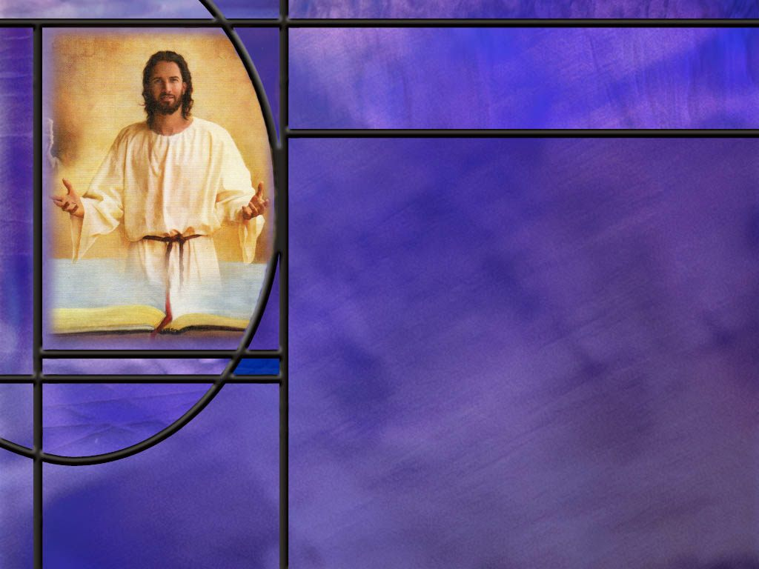
Summary
In Col 3 and Eph 5, Paul presents God’s ideal for peace and unity in Christian homes: looking at three relationships that involve headship and submission: husband-wife, parent-child, and master-slave.
This principle does not imply superiority or inferiority but defines different roles for husband and wife, parent and child, employer and employee that are complimentary and lead to peace, unity, and success.
Jesus himself, while claiming equality with the Father, took a subordinate role in order to carry out the plan of salvation for us.
There are many examples of human activities using the principle of headship-submission to achieve success where a more egalitarian approach would bring chaos and failure. Examples include sports, businesses, government, military, etc.

Slide 9
Summary
In the ideal Christian family, wives are to submit to their husbands in the home as the church submits to Christ, and husbands are to love their wives as Christ loved His church.
Children are to obey their parents in the Lord in everything, and parents are to bring them up in the nurture and admonition of the Lord.
Fathers are warned not to exasperate or provoke their children to anger lest they be discouraged.
Slaves are to work for their masters as if they were working for their Lord in heaven and masters are to treat their slaves with fairness and justice.

Slide 10
Summary
Paul’s instruction to slaves and masters is still relevant in the workplace where we should do our jobs, whether great or small, as if we were working for the Lord we love.
Paul reminds us to be devoted to prayer, being alert and thankful, praying for open doors to clearly share the gospel.
In relation to unbelievers, we are encouraged to live wisely making the most of our opportunities to reach them with the gospel, speaking in ways that will connect with them and build bridges that will enable them to experience the grace of Christ.
Will you pray this week for the Lord to open doors of opportunity for you to share the love of Jesus and give you wisdom to be a bridge builder to those that need to be saved?

Slide 12
Colossians 3:8-9 ESV
But now you must put them all away: anger, wrath, malice, slander, and obscene talk from your mouth. 9 Do not lie to one another, seeing that you have put off the old self with its practices [R]
Notes:
1. When we come to Christ, there should be a change in the way we speak.
2. These are the kinds of things that should be put off from the way we speak.
3. No lying! Christians must always speak the truth, being honest and trustworthy.
4. The devil is the father of lies; Jesus is the way, the truth, and the life.
5. If we are to properly represent Christ, we must get rid of all of worldly ways that formerly characterized our speech: anger, wrath, malice, slander, obscene talk.
6. So let’s go back to our memory text to see what should replace these practices.

Slide 13
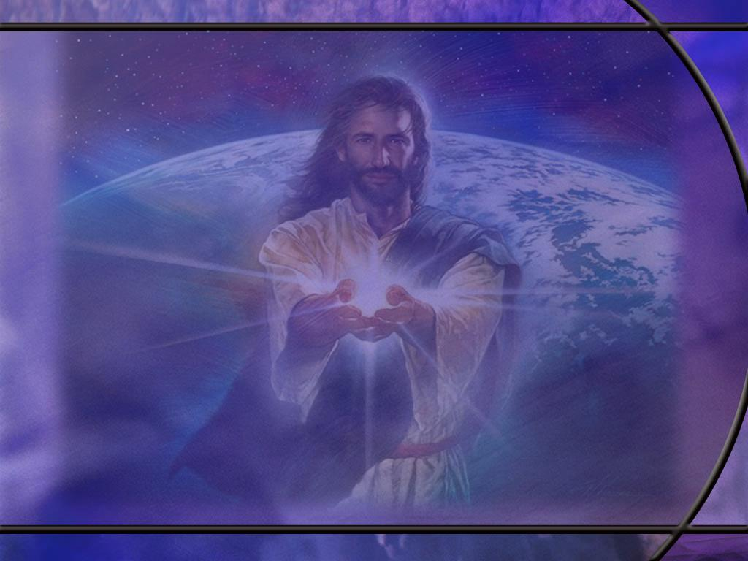
Colossians 3:18-19 ESV
Wives, submit to your husbands, as is fitting in the Lord. ¹⁹ Husbands, love your wives, and do not be harsh with them. [R]
Notes:
Q1: What rule does Paul set down for wives?
1. Submit to your husbands as it is fitting in the Lord.
2. And, of course, submission indicates respect for the husband as the head of the home, and a willingness to let him serve in that position.
3. This avoids a fight for supremacy between husband and wife.
4. God’s plan is that both accept their God-ordained functions in the home and cooperate in helping the home succeed.
5. This does not mean that wives are less important than husbands or of less value to God or to the home.
6. In many ways, the role of wife and mother is essential.
7. It just means that they carry out their important roles in the home under the loving headship of their husbands.
Q2: What condition does Paul place on this rule for wives?
1. The condition Paul gives here is that her submission is as it is fitting in the Lord.
2. Paul is not here saying that a wife must be submissive without regard to what her husband might ask her to do.
3. Both husband and wife have, as their ultimate authority in the home, the Lord, Jesus Christ.
4. So the wife needs to be submissive to her husband in maters where they are both submissive to Christ.
5. But if the husband is asking the wife to do something that she feels is displeasing to the Lord, this gives her an out.
6. She needs to remain faithful to Jesus rather than her husband where there is a conflict between the two.
7. But in a marriage where both husband and wife are Christians, this would be rare.
8. Both should agree on biblical morality and truth.
Q3: What rule does Paul lay down for husbands?
1. Love your wives and do not be harsh with them.
2. This rule should make it a lot easier for the wives to be submissive to their husbands.
3. Women need love; men need respect.
4. Isn’t it natural when two people fall in love, that the woman wants to be swept up in the strong arms of her man?
5. Can’t think of any man who dreams of falling in love and being swept up in the strong arms of his woman!!
6. There are differences in the sexes that help define our different roles in the home.
7. God’s ideal is for the man to be the provider and protector for his wife and family.
8. God’s ideal for the woman is to be the nurturer and supporter of the family.
9. Families work best when we seek to put in place God’s ideal.
Q4: What would be the opposite of being harsh with your wife?
1. Being kind, tenderhearted, forgiving, and patient.
2. So here husbands are to love their wives and treat them with love and compassion.
3. To a Christian man that does that, a Christian wife should have no problem submitting so that they can both carry out their complimentary roles in the home.

Slide 14
Ephesians 5:22-24 ESV
Wives, submit to your own husbands, as to the Lord. ²³ For the husband is the head of the wife even as Christ is the head of the church, his body, and is himself its Savior. ²⁴ Now as the church submits to Christ, so also wives should submit in everything to their husbands. [R]
Notes:
Q1: Who submits to whom in this text?
1. The wife submits to her own husband.
2. She doesn’t have to submit to anybody else’s husband, only to her own.
3. So the assumption here is that each wife has one husband and each husband has one wife.
4. We can go back to Paul’s requirements for elder in his council to Timothy:
1 Timothy 3:2 KJV - 2 A bishop then must be blameless, the husband of one wife, vigilant, sober, of good behavior, given to hospitality, apt to teach;
5. This is the NT ideal.
Q2: What reason does Paul give here for the submission of the wife to her husband?
1. Because the husband is head of the wife just like Christ is the head of the church.
2. And as we are all subject to the headship of Christ in the church, so in the home, the wife should be subject to the headship of her husband.
3. So here Paul uses the model of the relationship of Christ to His church to argue for the same relationship between husbands and wives.
4. Paul could have gone back to the order of creation or he could have gone to Genesis 3:16.
5. There, one aspect of the curse as a result of sin is given in these words:
Genesis 3:16 ESV - To the woman he said, "I will surely multiply your pain in childbearing; in pain you shall bring forth children. Your desire shall be contrary to your husband, but he shall rule over you."
6. Instead, Paul looks at how the church is subject to Christ, its head, and encourages wives to show the same respect to their husbands.

Slide 15
Ephesians 5:25-27 ESV
Husbands, love your wives, as Christ loved the church and gave himself up for her, ²⁶ that he might sanctify her, having cleansed her by the washing of water with the word, ²⁷ so that he might present the church to himself in splendor, without spot or wrinkle or any such thing, that she might be holy and without blemish. [R]
Notes:
Q1: How should husbands love their wives?
1. Love them as Christ loved the church and gave himself for her.
2. This is agape love.
3. This is an other-centered love.
4. This acting in another’s eternal best interest without regard to how they respond.
Q2: What words does Paul use to describe Christ’s love for the church in this passage?
1. First, he says the Christ gave Himself up for her.
2. He sacrificed himself for her benefit.
3. So Christ’s love was a sacrificial love.
4. He died that we might be forgiven and have eternal life.
5. That’s justification.
6. Second, Christ’s love for the church was a purifying love.
7. Look at all the terms for purity he uses here.
8. Those He justifies He also sanctifies and sets them apart for a holy use.
9. We have been cleansed of sin, washed with water, perhaps referring to baptism or to the “washing of regeneration, and renewing of the Holy Ghost;” (Titus 3:5)
10. We are without spot or wrinkle or any such thing, holy and without blemish!
11. This speaks of the righteousness of Christ that we receive by grace through faith.
12. Paul writes in:
Philippians 3:9 ESV - and be found in him, not having a righteousness of my own that comes from the law, but that which comes through faith in Christ, the righteousness from God that depends on faith.
Q3: If husbands love their wives with a sacrificial love and a purifying love, how do you think the wives will respond?
1. Wives will respond like we respond to what Christ has done for us.
2. We love Him because He first loved us.
3. We submit to His lordship in our lives and seek to live in obedience to Him.
4. So the godly wife will also willingly submit to her loving husband.
Q4: How might feminists today view God’s plan for the home.
1. Now the feminists today will take umbrage at the Bible and claim that it is part of the patriarchy that needs to be condemned in order to free women.
2. But God’s plan for the home does not enslave women to men.
3. This is loving headship and willing submission.
4. Even Jesus, while claiming equality with His Father, took a subordinate position to become one of us and die for our sins in order to redeem us.
5. So no one is saying that the position of headship is valued more by God.
6. God values both men and women the same, but assigns them different roles.
7. We see this all the time in other walks of life.
8. In football, the quarterback calls the plays.
9. When they get in the huddle, they don’t take turns calling the next play or they don’t take a vote on which play to run next.
10. The quarterback calls the play, and all the other players do their part to make it work. All are essential but only one calls the plays.
11. In an orchestra, there is only one conductor, everyone else follows his lead and plays their part. The musicians are just as essential as the conductor.
12. In the military, there is a well-defined chain of command that leads to a successful outcome.
13. In business there are bosses and workers that compliment each other to make the business succeed. Both are essential.

Slide 16
Colossians 3:20-21 ESV
Children, obey your parents in everything, for this pleases the Lord. ²¹ Fathers, do not provoke your children, lest they become discouraged. [R]
Notes:
Q1: What is Paul’s rules for children?
1. Obey your parents in everything.
2. Here we have another case of headship and submission.
3. Parents are the heads of their children.
4. The children need to be submissive to the headship of their parents.
Q2: Does Paul give the kids a little wiggle room here when he says “for this pleases the Lord?”
1. What if the parent is asking the kid to do something that displeases the Lord?
2. Of course, obedience to a parent that disobeys the Lord would not be pleasing to the Lord.
3. So we again see the caveat that this applies to godly parents who would not lead their children disobey the Lord.
Q3: What additional burden does the Lord place upon fathers concerning their children?
1. They should not provoke their children lest they become discouraged.
2. Children are a wonderful gift from God that we need to cherish and develop.
3. Certainly, discipline is necessary, but it should be applied in such a way as to discourage bad behavior, not defeat the child.
4. It should break their will but not their spirit.
5. Equally important to discouraging bad behavior is the encouraging of good behavior.
6. We need not only to apply the rod at times but to apply the reward for good behavior.

Slide 17
Ephesians 6:1-3 ESV
Children, obey your parents in the Lord, for this is right. ² "Honor your father and mother" (this is the first commandment with a promise), ³ "that it may go well with you and that you may live long in the land.“ [R]
Notes:
Q1: Why does Paul instruct children to obey their parents?
1. Very simple: it is right to obey.
2. He doesn’t go into some long justification.
3. It is simply the right thing to do, and Christians should do what is right.
Q2: What does Paul quote to prove it is right?
1. He quotes the 5th commandment.
2. Here in the first commandment that deals with human relationships, God declares what is right in the parent-child relationship.
Q3: Who determines what is right and wrong?
1. God does.
2. He has given us his law, and He wrote this law with His own finger on tables of stone.
3. People today think they can determine what is right and wrong for themselves.
4. They are in for a rude awakening on the day of judgment.
5. They will be judged on the law of God, not on what they think.
6. There’s no “my truth” and “your truth.”
7. There’s just God’s truth; If God’s says it’s right: end of argument.
8. Paul had no problem quoting the OT Scriptures and no problem quoting the law as still in effect for Christians.
9. This is one of many instances where he quotes one of the ten commandments.

Slide 18
Ephesians 6:4 ESV
Fathers, do not provoke your children to anger, but bring them up in the discipline and instruction of the Lord. [R]
Notes:
Q1: What is the negative command of this verse?
1. Do not provoke your children to anger.
2. In the parallel passage in Col 3:21, Paul gives a reason:
3. So you don’t discourage them.
4. The NIV translates these verses as:
Ephesians 6:4 NIV - Fathers, do not exasperate your children;
Colossians 3:21 NIV - Fathers, do not embitter your children, or they will become discouraged.
5. So, discipline should seek to break the will of the disobedient child but not his spirit.
6. Don’t beat a child down until he has no self worth and looses his desire to achieve great things.
Q2: What is the positive command of this verse?
1. We are to bring our children up in the discipline and instruction of the Lord.
2. The NIV says: “the training and instruction of the Lord.”
3. The NLT says: “the discipline and instruction that comes from the Lord.”
4. In other words, we should bring them up to know the Lord, to love the Lord, and to obey the Lord.
5. A good relationship with the Lord will result in obedience.
John 14:15 (NKJV) “If you love Me, you will keep My commandments.” (margin, NU text)
6. This we should see as our most important work: bringing our children up to know the Lord Jesus, to love and obey Him and be saved in His kingdom.

Slide 19
Colossians 3:22-25 NIV
Slaves, obey your earthly masters in everything; and do it, not only when their eye is on you and to curry their favor, but with sincerity of heart and reverence for the Lord. ²³ Whatever you do, work at it with all your heart, as working for the Lord, not for human masters, ²⁴ since you know that you will receive an inheritance from the Lord as a reward. It is the Lord Christ you are serving. ²⁵ Anyone who does wrong will be repaid for their wrongs, and there is no favoritism. [R]
Notes:
Q1: How are slaves or servants to obey their earthly masters?
1. Slaves are to obey their masters in everything.
2. They are to do it not just when their master is watching to impress him.
3. They are to obey in sincerity of heart and reverence for the Lord.
4. Whatever they do, they are to do it with all their heart as though they were doing it for Christ.
5. They should see themselves as working for the Lord Jesus himself rather than an earthly master.
6. And they can count on an eternal inheritance if they are in Christ.
7. They don’t need to plan vengeance for wrongs they receive, because God will bring justice upon the wicked.
Q2: What escape does Christianity offer the slave?
1. First, Christianity offered the slave a different type of master if that master is a Christian.
2. A Christian master that follows the golden rule could make life a lot more enjoyable for a slave.
3. Second, Christianity offered the slave redemption in Christ and the promise of eternal life in glory.
4. This is ultimate freedom.
John 8:36 KJV - If the Son therefore shall make you free, ye shall be free indeed.
5. We can recall how Paul sent the runaway slave Onesimus back to his master Philemon.
6. Paul’s letter to Philemon asked this Christian man to accept back his former slave as a new brother in Christ.
7. We have every reason to believe that Philemon did that and freed his former slave.
8. And I wouldn’t be surprised is that happened many other times as the gospel spread through the Roman world.

Slide 20
Colossians 4:1 NIV
Masters, provide your slaves with what is right and fair, because you know that you also have a Master in heaven. [R]
Notes:
Q1: How should Christian masters treat their slaves?
1. Provide your slaves with what is right and fair.
2. The NLT rays:
Colossians 4:1 NLT - Masters, be just and fair to your slaves. Remember that you also have a Master--in heaven.
3. Paul is calling masters to treat their slaves in a way that is just and proper.
4. Note that Paul doesn’t tell the masters to free their slaves, but to treat them well, knowing that their Master in heaven is watching.
Q2: Does this text mean God approves slavery?
1. No.
2. Slavery was a fact of life for most of Bible history including the slavery of God’s chosen people in Egypt.
3. Christianity does not offer any of us the escape from our circumstances.
4. The call of Christ is not a call to rebel against social institutions and injustices.
5. It is a call to find freedom in Christ.
6. It is a call to find victory in the worst of circumstances whether or not they change.
7. However, on a personal level, we should always be loving, kind, and just.
8. That means that we will not participate in any activity that brings injustice to others.

Slide 21
Colossians 4:2-4 NIV
Devote yourselves to prayer, being watchful and thankful. ³ And pray for us, too, that God may open a door for our message, so that we may proclaim the mystery of Christ, for which I am in chains. 4 Pray that I may proclaim it clearly, as I should. [R]
Notes:
Q1: What advice does Paul give on prayer here?
1. First, he calls us to devote ourselves to prayer.
2. We should not ignore prayer but devote ourselves to it.
3. That means taking time each day for focused prayer, where we can enter our solitary place and spend intimate, uninterrupted time with God in prayer.
4. Paul was a man of prayer, and he was always praying for all the saints and all the churches.
5. As he lived, he was always in an attitude of prayer, anxious to share all that he did with his Lord in heaven.
6. We can see the same emphasis on prayer in the life of Jesus where He spent solitary hours in isolated intimacy with His heavenly Father.
7. But as He then lived out His life among others, He stayed connected with His Father, who was always with Him in constant communion.
8. So Paul and Jesus call us to live lives devoted to prayer: both isolated intimacy and constant communion.
Q2: What else should mark our prayer life besides devotion?
1. The two Paul mentions here in verse 2 is watchfulness and thankfulness.
2. We are to be watchful or alert.
3. It is easy to fall into a routine in prayer and end up just repeating the same thing over day after day.
4. Be alert. Use your brain. Shake things up. Get out of the rut and try a new approach.
5. Pray through the Ten Commandments; pray through the Lord’s prayer as an outline.
6. Then be thankful.
7. Express your appreciation for what God has done for you.
1 Thessalonians 5:18 NKJV - 18 in everything give thanks; for this is the will of God in Christ Jesus for you.
Q3: What can we learn from Paul’s prayer requests here?
1. Paul’s greatest desire was to see the gospel preached and souls saved.
2. That should be the great desire of our heart as well.
3. We can ask God to open a door for us to enable us to share the love of Jesus with our family, friends, coworkers or neighbors.
4. We can also ask the Lord for clarity of speech to make the gospel message plain when we have opportunity to share it.

Slide 22
Colossians 4:5-6 NLT
Live wisely among those who are not believers, and make the most of every opportunity. ⁶ Let your conversation be gracious and attractive so that you will have the right response for everyone. [R]
Notes:
Q1: How should we be interacting with those who are not believers?
1. We should be looking for means and opportunities to bring them to Christ.
2. We should keep the channels of communication open.
3. We are not to shun unbelievers but treat them with respect and love.
4. After all, we were once where they are now.
5. We need to be ambassadors for Christ so that they too can be reconciled to God.
6. We should speak graciously with them tuning our speech to appeal to them.
7. Our words should be wisely adapted to the person to whom we are speaking, with an aim to point them toward God’s saving grace.
8. Paul put it a little differently to the Corinthians, but I think his intent was the same.
9. In 1 Cor 9:20 Paul says that when he was with the Jews he became as a Jew to win the Jews; when he was with the Gentiles he became as a Gentile to win the Gentiles. When he was with the weak he became as the weak that he might win the weak.
1 Corinthians 9:22 KJV - … I am made all things to all men, that I might by all means save some.
10. Paul identified with people where they were in order to bring them to Christ.
11. I think he is telling us to do something similar in these verses.
12. Do you best to build bridges rather than barriers so that people can come to Jesus and be saved.

