Slide 1
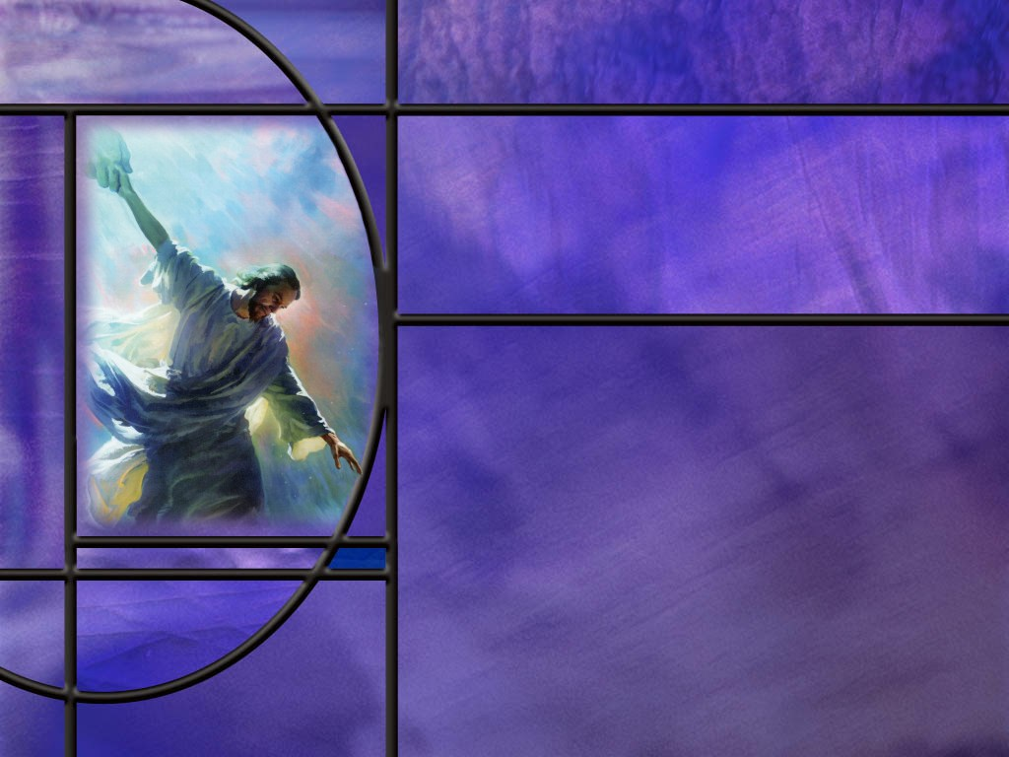
Uniting Heaven and Earth: Christ in Philippians and Colossians
Lesson 6
Confidence Only in Christ

Slide 2
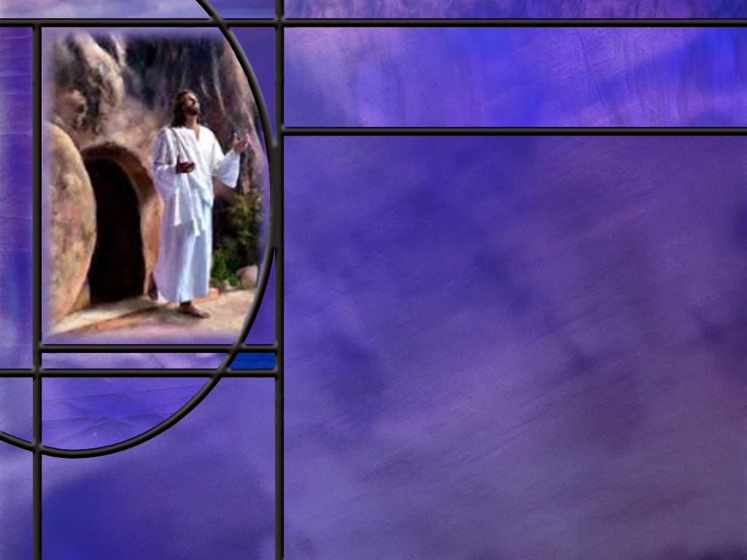
Memory Text
Philippians 3:10-11 NKJV
“That I may know Him and the power of His resurrection, and the fellowship of His sufferings, being conformed to His death, ¹¹ if, by any means, I may attain to the resurrection from the dead.
What is the first thing Paul wants to do in this text?
What effect does the power of Christ’s resurrection have on us?
How does Paul view his own sufferings here?
What was Paul’s final desire in this text?
Notes:
B2:
1. He wants to know Christ.
2. This is the essence of what it means to be a Christian.
3. To know Christ, to know His grace, His love, His forgiveness, His goodness, His mercy and compassion and faithfulness.
4. To know Him is to love Him and to come to trust in Him as our Savior and Lord.
5. O that we may each follow Paul in this desire to know Jesus.
6. Not just to know about Him, but to know Him as our personal Savior and Lord and Friend.
7. Knowing, loving, trusting, surrendering to Jesus makes all the difference in our destiny.
1 John 5:12 NKJV - He who has the Son has life [eternal life]; he who does not have the Son of God does not have life.
8. We “have the Son” by having a loving, saving, faithful relationship with Him.
B3:
1. Paul wanted to know or experience the power of Christ’s resurrection.
2. We worship a living Savor who is able to empower us to live a new life in Christ.
3. Paul speaks of this in Romans 6 where he talks about the change the Holy Spirit makes in us when we are buried in baptism and raised to walk in newness of life.
Romans 6:4 NKJV - Therefore we were buried with Him through baptism into death, that just as Christ was raised from the dead by the glory of the Father, even so we also should walk in newness of life.
4. So the old man dies and is buried, and the new man is raised, born again by the Spirit of God, to live a new life in Christ.
5. The same power that raised Christ from the dead raises us to a new spiritual life in Him.
6. And the fact the God raised Jesus from the dead assures us that the same power will raise us from the dead as well.
2 Corinthians 4:14 NKJV - knowing that He who raised up the Lord Jesus will also raise us up with Jesus, and will present us with you.
B4:
1. He views them as bringing him fellowship with Jesus.
2. If Jesus, the innocent Son of God, was willing to suffer and die for our sins, we should be willing to bear the trials, tribulations, and persecutions He allows us to go through.
3. Paul saw all his difficulties, persecutions, and afflictions as a way of identifying with Christ and growing their friendship.
4. In chapter 4 of this same epistle, Paul writes this:
Philippians 4:13 NKJV - I can do all things through Christ who strengthens me.
5. In the context of that verse, he is saying, “I can endure all things through Christ who strengthens me.”
6. Paul looked at all his sufferings as bringing him fellowship with Jesus and conforming him to the kind of death that Jesus died.
7. Jesus was innocent, but put to death by the guilty.
8. Like Jesus, Paul saw himself as innocent, but on the path to die a similar death at the hands of the guilty.
B5:
1. His final desire in this verse is to attain to the resurrection of the dead.
2. He wants to be raised in the resurrection when Christ returns.
3. He wants to suffer like Christ, die like Christ, and be raised like Christ.
4. There is no hint here of any immortal souls going to heaven at death.
5. Paul’s hope is in the resurrection, not in an immortal soul.
6. We can think back to chapter 1 of Philippians where Paul says that to depart this life and be with Christ is far better for him.
7. Based on everything else he wrote on the subject, we have to understand that statement as expressing a desire to lay down the burdens of this life, giving glory to God in the way that he dies for his faith, and looking forward to the resurrection when Christ returns.
8. Hebrews 11:35 speaks of “a better resurrection” for those who endured persecution and suffering and martyrdom for their faith.
9. And perhaps Paul is thinking that he will attain a better resurrection by suffering for Christ and dying for Him.

Slide 3
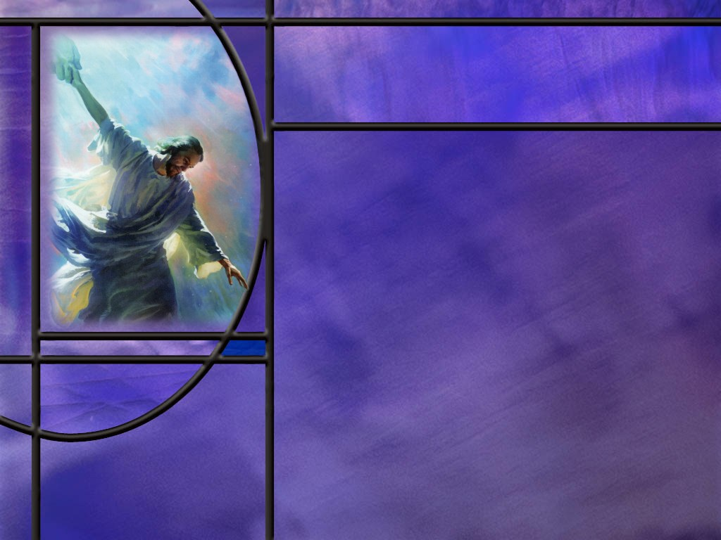
Overview
In our lesson this week, Paul warns the Philippians about false teachers that pervert the gospel of righteousness by faith. He points to faith in Christ alone as the source of the righteousness that saves. He calls them to follow his example and focus on the goal of eternal life.
  Joys and Warnings
  Rubish and Righteousness
  One Focus
  Summary

Slide 4
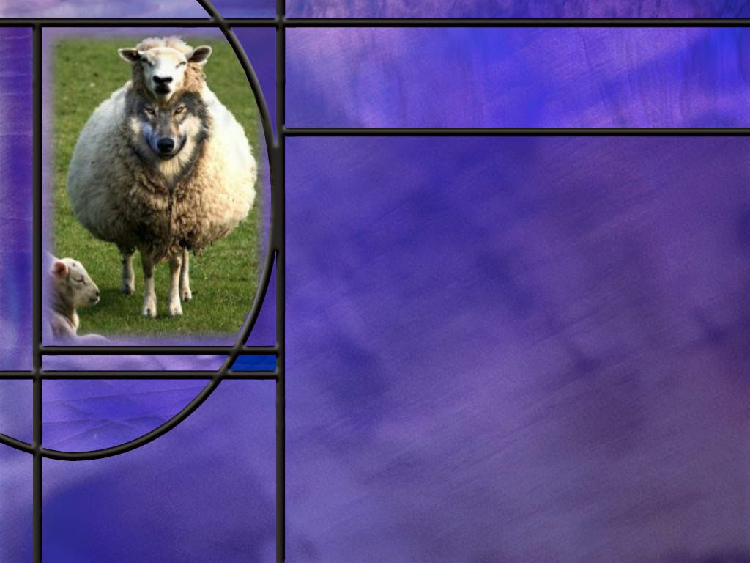
Joys and Warnings
How does Paul begin his warning to the Philippian church? (Phil 3:1)
How does Paul describe the false teachers who would pervert the gospel? (Phil 3:2-3)
How would Paul qualify to boast in the flesh if he were still a Pharisee? (Phil 3:4-6)
Notes:
B1:
[See notes on linked slide.]
B2:
[See notes on linked slide.]
B3:
[See notes on linked slide.]

Slide 5
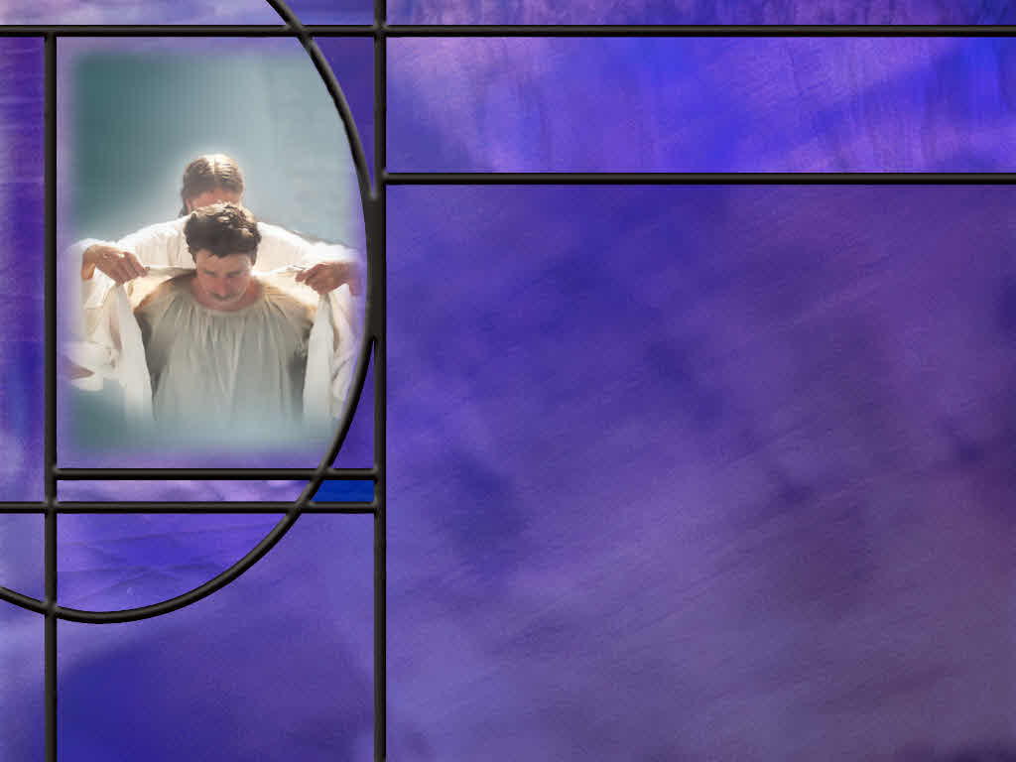
Rubish and Righteousness
What value does the apostle place on his Jewish qualification once he has come to know Christ? (Phil 3:7-8)
What can Christ do for us that the law cannot? (Phil 3:8c-9)
What did gaining Christ and being found in Him do for the apostle Paul? (Phil 3:10-11)
Notes:
B1:
[See notes on linked slide.]
B2:
[See notes on linked slide.]
B3:
[See notes on linked slide.]

Slide 6

One Focus
What limitations does the good apostle admit when considering fully experiencing the love of Christ? (Phil 3:12)
What is Paul’s one focus as he considers the surpassing value of knowing Jesus Christ as his Savior and Lord? (Phil 3:13-14)
Notes:
B1:
[See notes on linked slide.]
B2:
[See notes on linked slide.]

Slide 7

Summary
Paul warned the church to beware of the Judaizers and legalists that were teaching that circumcision was necessary for salvation.
Their legalistic approach caused Paul to recall his own legalism, trusting in his heritage, education, dedication, and strict obedience to the law to find acceptance with God.
His encounter with the risen Christ on the road to Damascus changed all of that.
Finding Christ and the truth of righteousness by faith, he turned from his former legalistic religion, lost everything he had worked for, and considered it rubbish compared to the surpassing value of knowing Jesus as Savior and Lord.

Slide 8
Summary
Paul draws a contrast between two types of righteousness: his own righteousness that comes from the law, and the righteousness that comes from God by faith.
It is only the perfect righteousness of God that brings salvation. When we ae justified by trusting Jesus for the forgiveness of our sins, His blood cleanses us from all sin and we are reckoned to be as righteous as Christ. This is imputed righteousness.
There is also an imparted righteousness that we have as we walk in the Spirit and obey the commandments. But this righteousness cannot save because it is always tainted by sin. Our good works done while walking in the Spirit cannot cancel our sin committed in the flesh.

Slide 9
Summary
Righteousness by faith produced in Paul a deep desire to know Christ in a more intimate way, to find fellowship with Him in suffering, to be conformed to His death, and to be raised to life as He was.
It appears that Paul saw an advantage of a better resurrection by identifying as a martyr with Christ in His suffering and death. That would explain his view of how death could be gain for him.
Aware that he had not yet attained all that there was to know and experience in a relationship with Christ, he likened the Christian life to a race where he had his eyes firmly fixed on the goal.
Will you pray this week that God will keep you focused on the important things in life, and that you will finish the race as Paul did?

Slide 11

Philippians 3:1 NIV
Further, my brothers and sisters, rejoice in the Lord! It is no trouble for me to write the same things to you again, and it is a safeguard for you. [R]
Notes:
Q1: For what does Paul first appeal in this passage?
1. He calls them to rejoice in the Lord.
2. We think of Joy as one facet of the fruit of the Spirit.
3. And rejoicing in the Lord is evidence of the presence of the Spirit in the hearts of the believers.
4. The Holy Spirit brings unity as He impresses us with the truth and convicts us of sin.
5. Jesus said:
John 16:13 NKJV - "However, when He, the Spirit of truth, has come, He will guide you into all truth;
6. When the church is the temple of the Holy Spirit, we are unified in our understanding of the truth as it is in Jesus.
7. We are unified on the gospel and the fundamentals of the apostolic faith.
8. A unified church is a joyful church that can rejoice in the Lord.
Q2: What do you think Paul may be referring to when he says he is writing the same things to them again?
1. This probably doesn’t refer to a previous letter.
2. More likely it is referring to the same things he taught them when he was there in person to establish the church.
3. In the following verses he is warning them about false teacher, the Judaizers that continually followed Paul and tried to pervert the gospel.
4. It was a common theme in Paul’s writing, and no doubt in his preaching, to warn against the false teachers.
5. So Paul doesn’t mind repeating himself in these warnings, and it is to safeguard them from being led astray by false teachers.

Slide 12
Philippians 3:2-3 NKJV
Beware of dogs, beware of evil workers, beware of the mutilation! ³ For we are the circumcision, who worship God in the Spirit, rejoice in Christ Jesus, and have no confidence in the flesh, [R]
Notes:
Q1: Who do you think Paul has in mind here as false teachers?
1. He calls them dogs, evil workers, and the mutilation!
2. His mention of circumcision in the very next verse indicates that this was the focus of these false teachers.
3. These were Jews that were teaching that faith in Christ was not enough.
4. To be a Christian you had to become a Jewish proselyte first and be circumcised.
5. This was a major problem in the early church, and it seems that these Judaizers followed Paul wherever he went.
6. The whole book of Galatians was written to combat these false teachers.
7. This was the major subject at the Jerusalem council in Acts 15:
Acts 15:1 NKJV - And certain men came down from Judea and taught the brethren, "Unless you are circumcised according to the custom of Moses, you cannot be saved."
8. And, of course, the Jerusalem council agreed with Peter and Paul that the church should not require circumcision or other Jewish customs for salvation.
9. The apostolic gospel was salvation by grace alone through faith alone in Christ alone, nothing else being necessary.
10. So Paul warns them against dogs, referring to the false teachers as unclean animals that would attack whatever was defenseless.
11. He warns them against evil workers, implying that the false teachers were focused on works rather than faith.
12. And he warns them against “the mutilation” rather than their common title, “the circumcision.”
Q2: In what sense does he refer in verse three to the Christians as “the circumcision?”
1. For Paul, true circumcision is not of the flesh but of the heart and of the spirit.
2. Paul writes this to the Romans:
Romans 2:28-29 ESV - For no one is a Jew who is merely one outwardly, nor is circumcision outward and physical. ²⁹ But a Jew is one inwardly, and circumcision is a matter of the heart, by the Spirit, not by the letter. His praise is not from man but from God.
3. Being circumcised of heart means to remove our stubborn resistance to God.
4. It produces an inner change where a person’s hard, stubborn, sinful attitudes are cut away so they can love, trust, and obey God sincerely from within.
5. It is what we today call being born again, or being born of the Spirit.
6. It is a result of trusting Christ and being justified and filled with the Holy Spirit.
7. Circumcision of the heart is the work of the Holy Spirit.
8. So in verse 3, those who are circumcised of heart worship God in the Spirit, rejoice in their salvation in Christ Jesus, and put their confidence in the work of the Spirit in their lives, not in some outward change in their flesh.
9. Contrary to circumcision of the flesh, circumcision of the heart applies both to men and to women.

Slide 13
Philippians 3:4-6 ESV
though I myself have reason for confidence in the flesh also. If anyone else thinks he has reason for confidence in the flesh, I have more: ⁵ circumcised on the eighth day, of the people of Israel, of the tribe of Benjamin, a Hebrew of Hebrews; as to the law, a Pharisee; ⁶ as to zeal, a persecutor of the church; as to righteousness under the law, blameless. [R]
Notes:
Q1: How does Paul compare himself to the ideal that Jewish tradition would hold up as a man worthy of salvation?
1. He had all the credentials of the ideal Jew.
2. If anyone could brag about his standing as an ideal religious Jew, it was Paul.
3. He had all the qualifications.
4. Full blooded Hebrew, a Jew of the tribe of Benjamin, a Pharisee, a persecutor of those who dared depart from Jewish tradition.
5. Blameless in his appearance to himself and fellow Jews at keeping the laws and traditions in the prescribed way.
6. If anyone had reason to trust the flesh for acceptance with God it was him.
7. Here Paul sets the stage for a rude awakening as to his true condition before a holy God.

Slide 14
Philippians 3:7-8 ESV
But whatever gain I had, I counted as loss for the sake of Christ. ⁸ Indeed, I count everything as loss because of the surpassing worth of knowing Christ Jesus my Lord. For his sake I have suffered the loss of all things and count them as rubbish, in order that I may gain Christ. [R]
Notes:
Q1: Once Paul met Christ, how does he value his Jewish qualifications as one worthy of acceptance with God?
1. Whatever gain he had because of his Jewish heritage, because of his education under the great Rabbi Gamaliel, because of his position in Jewish society as a Pharisee, because of his zealous persecution of “heretics,” because of his fastidious keeping of the laws and traditions of the Jews…
2. He considered it all a loss.
3. It not only became worthless in procuring acceptance with God, it became a hindrance.
4. His religious fervor blinded him to his need for Christ.
5. He thought he was fighting for God; in fact, he was fighting against Him.
6. He was trusting in his own righteousness for acceptance with God.
7. In fact, his own righteousness was still filthy rags.
8. Works of the law cannot forgive our sins; only the blood of Jesus can do that.
Q2: To what does he compare all the things he was trusting in for salvation?
1. He compares them to garbage in this translation.
2. In other translations, rubbish or dung,
3. The Greek word (Skoo’-ba-lon) can mean any refuse, such as the excrement of animals, offscourings, rubbish, dregs, things worthless and detestable,
Q3: What has made all that he used to trust in so worthless?
1. He has found the pearl of great Price.
2. He has now found the surpassing worth of knowing Christ Jesus.
3. Compared to knowing Christ everything else trusted for religious gain is rubbish.
4. Everything else is useless compared to gaining Christ and the salvation He can bring.
5. Looking back, Paul admits that he has lost everything for the sake of Christ, everything that he had worked to become in the Jewish religion.
6. But compared to gaining Christ, it is all rubbish, garbage, dung.

Slide 15
Philippians 3:8c-9 ESV
that I may gain Christ ⁹ and be found in him, not having a righteousness of my own that comes from the law, but that which comes through faith in Christ, the righteousness from God that depends on faith. [R]
Notes:
Q1: What two types of righteousness does Paul contrast here?
1. The first is a righteousness of his own that comes from keeping the law.
2. The second is a righteousness that comes from God through faith in Christ.
Q2: Which of these two is more important to the apostle Paul?
1. The second; the righteousness that comes from God by faith.
2. The righteousness that comes from God is the perfect righteousness of Christ that saves sinners.
3. This is imputed righteousness that is placed to our account when we trust Jesus as our Savior and Lord.
4. It is also called “positional righteousness” because it places us in the position of being saved.
5. Positional righteousness is what Christ does for us.
6. This is what Luther called the great exchange described in:
2 Corinthians 5:21 NKJV - For He made Him who knew no sin to be sin for us, that we might become the righteousness of God in Him.
7. God lays our sins on Jesus, who pays their penalty, and lays His righteousness on us when we trust in Him.
8. The righteousness from God is the righteousness that saves.
Q3: Now is our own righteousness unimportant?
1. Paul is not saying that here.
2. He is just saying that our own righteousness that comes from obeying the commandments cannot save us.
3. In Romans, Paul writes this:
Romans 8:4 NKJV - that the righteous requirement of the law might be fulfilled in us who do not walk according to the flesh but according to the Spirit.
4. Paul calls the law holy, and the commandment holy and just and good. (Rom 7:12)
5. The righteousness of Rom 8:4 is a “practical righteousness.”
6. It is what the Holy Spirit does in us.
7. When we walk in the Spirit, we live in obedience to the law of God and keep His commandments.
8. This is also called “imparted righteousness.”
Q4: What do each of these types of righteousness do for us?
1. We have imputed and imparted; we have positional and practical; we have the righteousness of Christ and our own righteousness.
2. It is the imputed, positional, righteousness of Christ that saves us.
3. It is the imparted, practical, righteousness produced in us by the HS that brings glory to God.
4. Our own personal righteousness is never good enough to save us; only the perfect righteousness of Christ can do that.
5. The reason our personal righteousness cannot save us is that the good that we do by walking in the Spirit does not cancel out the bad that we have done when we have walked in the flesh.
6. So our own personal righteousness is always tainted with transgression, sin and iniquity.
7. It is only by coming to Christ and trusting His blood for the forgiveness of our sins that we can be justified and declared righteous.
8. And that righteousness is imputed rather than imparted.
9. Does that make sense?

Slide 16
Philippians 3:10-11 NKJV
that I may know Him and the power of His resurrection, and the fellowship of His sufferings, being conformed to His death, ¹¹ if, by any means, I may attain to the resurrection from the dead. [R]
Notes:
1. This is our memory text that we discussed in some detail as our introduction.
2. Having found Christ and a saving relationship with Him, Paul is determined to follow Him all the way.
3. He is living a new life in the power of the resurrection.
4. He finds fellowship with Christ in his own suffering.
5. He is willing to die for the faith as an innocent victim like Christ.
6. He has confidence now in the resurrection of the dead.
7. If God’s divine power raised up Christ, we can have confidence that Christ was God’s Son, the Messiah, and that His sacrifice for our sins was acceptable to His Father in heaven.
8. The resurrection was God’s stamp of approval on all that Jesus said and did.
Q1: How do we attain to the resurrection of the dead?
1. Hold on to Jesus. Know Him, love Him; serve Him.
2. Receive Him as Savior and Lord.
3. Trust in His shed blood for the forgiveness of sin and a righteousness that saves.
4. Pray for the Holy Spirit to make us like Him.
5. Walk in the Spirit and grow in grace.
6. Stand on the promises of God till we see them all fulfilled.
7. Believe and be saved by grace through faith.

Slide 17
Philippians 3:12 NIV
Not that I have already obtained all this, or have already arrived at my goal, but I press on to take hold of that for which Christ Jesus took hold of me. [R]
Notes:
Q1: What limitations does the apostle Paul admit to here?
1. He admits that he has not reached his goal, but he is still running the race.
2. He is still learning what it means to know Christ fully and experience the power of His resurrection life and His fellowship in suffering.
3. And, of course, he has not yet attained to the resurrection of the dead.
4. He is still running the race like we are, and looking forward to taking hold of the prize at the end.
5. It is interesting that he looks back to how he got into this race and sees the start as the point when Christ Jesus took hold of him on the road to Damascus.
6. We too can look back in our lives and see the times that we started the race or restarted it, maybe multiple times.
7. We can all be thankful for the gospel of what Jesus did on the cross to even make such a race possible.
8. And by loving us, to appeal to our hearts to get into the race and arrive at the goal.

Slide 18
Philippians 3:13-14 NIV
Brothers and sisters, I do not consider myself yet to have taken hold of it. But one thing I do: Forgetting what is behind and straining toward what is ahead, ¹⁴ I press on toward the goal to win the prize for which God has called me heavenward in Christ Jesus. [R]
Notes:
Q1: What is Paul doing in this passage?
1. He is running a race.
2. Here Paul is using this race as a metaphor for living the Christian life.
3. The finish line is in heaven.
4. God the Father has called us into this race by His gracious gift of His Son to die for our sins.
5. God calls us heavenward by His love and grace manifested in Jesus Christ our Lord.
Q2: And what is the prize?
1. It is eternal life with the godhead and with the redeemed of all ages.
2. It is being adopted into the family of God.
3. It is eternal friendship and love and joy and peace centered in Jesus our Redeemer.
Q3: How does Paul intend to reach the finish line in this race?
1. He’s going to focus his life on just one thing.
2. Just like a runner in a race that is totally focused on the finish line.
3. He’s not looking back behind him to see whose catching up.
4. He’s not looking to the side to see supporters or distractors.
5. His life is focused on ONE thing: reaching the goal for the prize.
Q4: Are we as focused as the apostle Paul describes himself in this passage?
1. It is good to be reminded of the important things in life.
2. As we consider this passage, let’s resolve to get our priorities in order.
3. Nothing is more important than reaching the finish line and winning the prize of eternal life in the heavenly Kingdom.
4. When I look at myself, I see my love of ease, of entertainment, of leisure, of pleasure.
5. I look at all the things that occupy my time and attention.
6. They are things that I think I need to do, but they are not really important in the long run.
7. President Eisenhower once said: “The important is seldom urgent and the urgent is seldom important.”
8. Let us pray that we will have the wisdom, like the apostle Paul, to focus on the important rather than the urgent.
9. May we each press toward the goal for the prize that God offers us in Christ Jesus.

Slide 19
Outline of Philippians
I. Greeting (1:1-2)
II. Thanksgiving and prayer (1:3-11)
III. Paul’s personal Circumstances (1:12-26)
IV. Exhortations (1:27-2:18)
  A. Living a worthy life (1:27-30)
  B. Being a Servant like Jesus (2:1-18)
V. Fellow Servants in the Gospel (2:19-30)
  A. Timothy (2:19-24)
  B. Epaphroditus (2:25-30)
VI. Warnings (3:1-4:1)
  A. Against legalists (3:1-16)
  B. Against lawlessness (3:17-4:1)
VII. Final exhortations, Thanks, and Conclusions (4:2-23)
Notes:
Not used in this lesson.

