Slide 1

Uniting Heaven and Earth: Christ in Philippians and Colossians
Lesson 4
Unity through Humility

Slide 2

Memory Text
Philippians 2:2 (ESV)
“Fulfill my joy by being like-minded, having the same love, being of one accord, of one mind.
What is it that would bring joy to the apostle’s heart?
Who else emphasized unity and love among His disciples?
What did He say about love and unity, and when did He say it? (John 13:35, 17:20-21)
Notes:
B2:
1. Paul tells the Philippians that his joy would be complete if they had unity and love among them.
2. Being of the same mind or being like-minded means to be in agreement on the essentials of the faith.
3. Having the same love means to love one another as they love themselves.
4. Being of one accord and one mind means to be united in purpose and work together.
B3:
1. Jesus.
B4:
[See notes on linked slide.]

Slide 3

Overview
While unity within Christendom has been illusive, Paul’s call for unity within the local apostolic church can be achieved through the work of the Holy Spirit producing humility in our lives and giving us the mind of Jesus, who is the ultimate example of love, humility, and condescension.
  Christian Unity
  Paul’s Formula for Unity
  Incomparable Condescension
  Summary

Slide 4
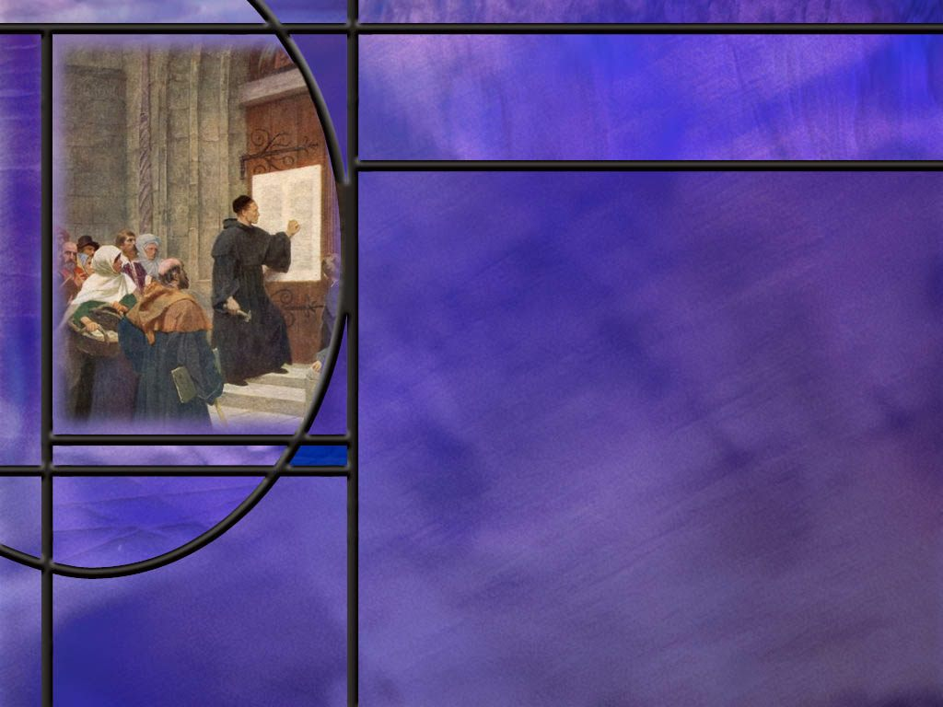
Christian Unity
Read 1 Cor 1:10
How well do you think Jesus’ prayer for unity and Paul’s call for unity are reflected in the churches that claim to be Christian today?
Why is Christianity so fractured?
What are some of the issues that divide Christian?
Within our own church, what principles should we follow to maintain unity without demanding uniformity?
Notes:
B1:
[See notes on linked slide.]
B2:
1. There are three major divides in Christendom: Eastern Orthodox, Roman Catholic, and Protestant.
2. Within each of these there are many subdivisions, groups, and views: e.g., conservative and liberal, doctrinal or existential, biblical or traditional.
3. The Protestant church is fractured into hundreds if not thousands of denominations and independent churches.
4. Christians are divided, not unified.
5. The ecumenical movement has been a colossal failure.
6. Mainline denominations are shrinking while independent non-denominational churches are increasing.
7. Fortunately, the SDA church is still one of the fastest growing churches in the world.
B3:
1. Apparently there is something more important than unity to most Christians.
2. Most of us would rather be right than be unified with error.
3. Jesus said, “But in vain they do worship me, teaching for doctrines the commandments of men.” (Matt 15:9)
4. In the book of Revelation the most solemn warning is given against those who imbibe the wine of Babylon.
5. God calls His people out of Babylon and into the remnant that keep the commandments of God and the faith of Jesus.
6. I don’t know about you, but I want to believe what is true, not what is popular.
7. That’s why I am a SDA. I believe the doctrines of this church are closer to the Bible than any other denomination I have been able to find.
8. I am not inclined to give up any truth for the sake of unity.
9. I want to be unified with the apostolic church.
10. I want my faith to be the faith once delivered unto the saints.
11. This is “the faith” for which Jude tells us we should “earnestly contend.”
B4:
1. Some of the issues that divide Protestant churches are:
a. Infant baptism vs. believer’s baptism
b. Sprinkling vs. immersion
c. Emphasis on speaking in “tongues” and miracles
d. Sabbath vs. Sunday
e. Dietary restrictions vs. eating anything
f. Predestination vs. free will
g. Creation vs. theistic evolution or progressive creation
h. Eschatology (preterism, futurism, historicism, pre-millennial, post-millennial, amillennial)
i. Communion (how often, real wine, leavened or unleavened bread)
j. The state of the dead and the nature of man (eternal torment, resurrection vs. immortal soul)
2. Issues dividing Protestant from RC are many:
a. The gospel (by faith alone or by faith plus works)
b. Earthly vs. heavenly priesthood (confession to a priest rather than confession to Jesus)
c. Sacraments vs. faith
d. Mary vs. Christ as Mediator
e. Prayers to Mary and the Saints
f. Tradition vs. the Bible
g. Papal infallibility vs. Biblical infallibility
h. Idolatry in veneration of images and relics
i. Worship of a man (the pope) instead of God
j. For Adventists, Sabbath vs. Sunday sacredness declared by Rome.
B5:
1. Along with other Protestants, we claim that the Bible and the Bible only is our rule of faith and practice.
2. But the fact of the matter is that no two people will always be exactly agreed on every point of biblical interpretation.
3. So we must allow some diversity of opinion on the non-essentials of the faith.
4. The principle we should follow is:
In essentials: unity
In non-essentials: liberty
In all things: charity.
5. But what are the essentials that we should all be unified on?
6. When we come to Galatians, we find that Paul was unwilling to compromise in any way on the Gospel. (Gal 1:8)
7. Righteousness comes by faith and not by works.
8. This is the one great essential of biblical Christianity: salvation in Christ.
9. For Adventists, the other pillars of the church have been: the Sabbath, the Second Coming (along with an historical understanding of prophecy), the Sanctuary, and the State of the Dead. (5 S’s)
10. In addition, I believe we, along with other Christians, can recite the Apostles Creed which gives many additional essentials of the Christian faith.
11. As Adventists, I think the best we can hope for is unity within the remnant church.
12. Even there, we face tremendous challenges, but we have made tremendous progress.
13. Let’s keep the Reformation going until we get all the way back to the apostolic faith once and for all delivered unto the saints.
14. This is the faith of Jesus that we are called to keep at the end of the third angel’s message:
Revelation 14:12 KJV - Here is the patience of the saints: here are they that keep the commandments of God, and the faith of Jesus.

Slide 5
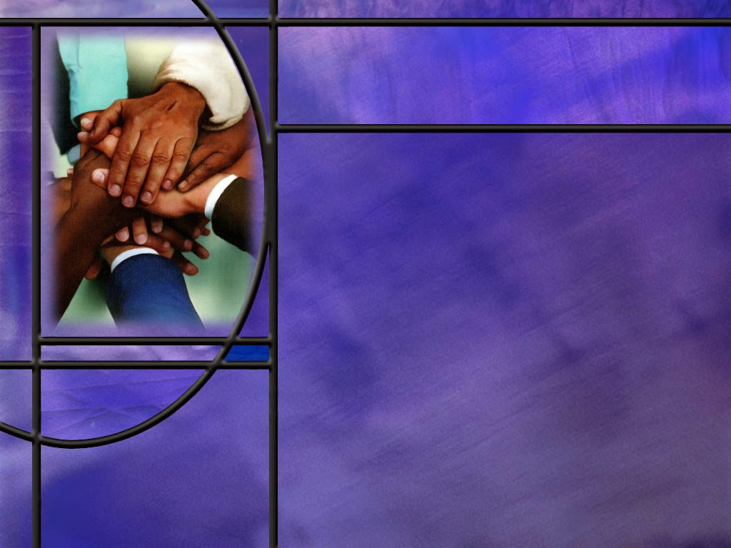
Paul’s Formula for Unity
What Christian virtues should come from knowing Jesus? (Phil 2:1-2)
What is Paul’s remedy for the disunity that may have persisted at Philippi? (Phil 2:3-4)
What is Paul’s ultimate remedy for pride, conceit, and disunity? (Phil 2:5)
Notes:
B1:
[See notes on linked slide.]
B2:
[See notes on linked slide.]
B3:
[See notes on linked slide.]

Slide 6
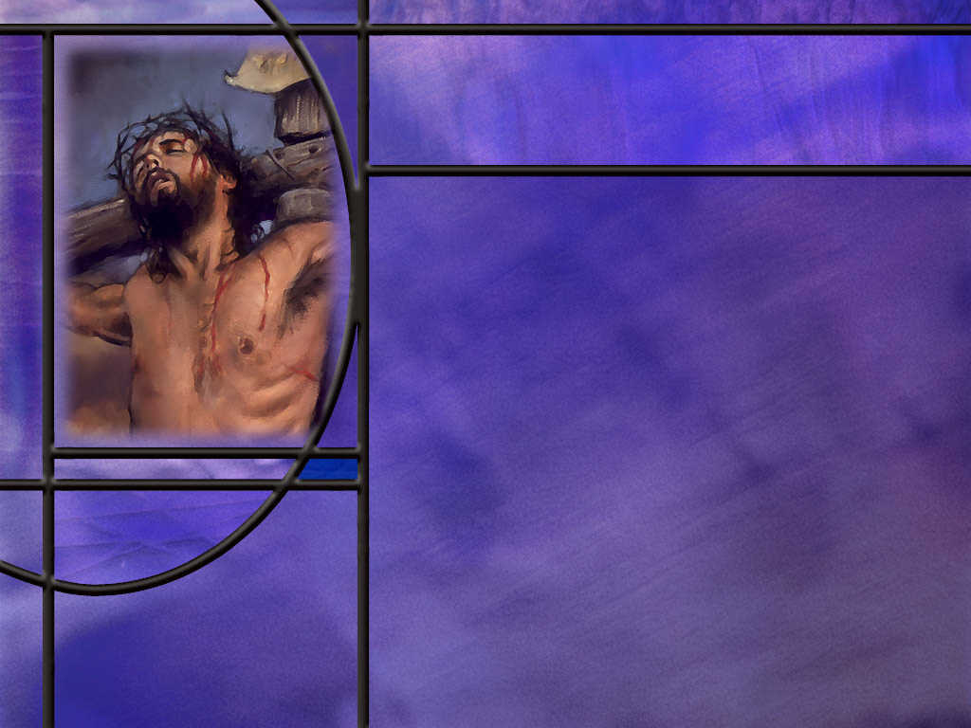
Incomparable Condescension
How did the apostle Paul describe the incomparable condescension of Jesus in the incarnation? (Phil 2:5-8)
How does Paul go on to describe His incomparable exaltation? (Phil 2:9-11)
Notes:
B1:
[See notes on linked slide.]
B2:
[See notes on linked slide.]

Slide 7

Summary
On the night of His betrayal, Jesus told His disciples that their love for one another would mark them as His disciples and He prayed for unity in His church.
The apostle Paul echoed these themes in several of his epistles including Philippians.
Unfortunately, much of Christendom has departed from the faith once and for all delivered unto the saints.
As Adventists our hope is to continue the Reformation to recover the apostolic faith of Jesus and come to unity in our churches on the fundamentals of that faith.
Paul begins his teaching on unity by asking if belonging to Christ and knowing His love and having the Holy Spirit has made a difference in their lives.

Slide 8
Summary
Assuming that it has, he asks a favor: He wants them to bring him joy by “loving one another, and working together with one mind and purpose.”
Rather than creating division through selfish ambition and vain conceit, Paul calls for humility rather than pride and considering the interests of others rather than self.
His final appeal is to “let this mind be in you which was also in Christ Jesus.”
It is the work of the Holy Spirit to transform our characters and make them more like that of Jesus. As we grow in grace, the fruit of the Spirit produces Christian virtues in us, particularly agape love which is other-centered and unifying.

Slide 9
Summary
Paul waxes eloquent on the condescension of Jesus: Though He was God, he humbled himself, became human, became a servant and died on the cross for our sins.
If Jesus can humble Himself to such a degree, how much more should those who follow Him be willing to humble themselves and promote love and unity in the church.
But Paul doesn’t end with the condescension of Jesus but with His exaltation and a name that is above every other name.
He sees a day in the future when every knee shall bow and every tongue confess that Jesus Christ is Lord.
Knowing today who Jesus is and what He has done to save you, will you ask the Holy Spirit to form the character of Christ in you and make you an agent of love and unity?

Slide 11

John 13:35;17:20-21 (NIV)
³⁵ By this everyone will know that you are my disciples, if you love one another.”
²⁰ “My prayer is not for them alone. I pray also for those who will believe in me through their message, ²¹ that all of them may be one, Father, just as you are in me and I am in you. May they also be in us so that the world may believe that you have sent me. [R]
Notes:
Q1: What is the context of these words of Jesus and this prayer for His disciples?
1. These words and this prayer were spoken by Jesus as he was about to be betrayed and crucified the next day.
2. As He was about to leave His disciples, love and unity among them were uppermost in His mind.
3. John 13 records Jesus washing the Disciples feet on the night on which He was betrayed
4. John 17 is Jesus’ prayer just after the Last Supper before He leaves for the Garden of Gethsemane where Judas betrays Him.
With all that was happening on His mind, Jesus prays for love and unity among His disciples.
Q2: Why was love and unity so important to Him?
1. He tells us: Love and unity would be the sign to the world that God (who is love) had sent Jesus, and love was to be the hallmark of His true disciples.
2. A church filled with arguments, divisions, disputes, cliques, and gossip cannot properly represent the God of love and His message of love.
3. The Hallmark of Christianity is love and unity.
4. How different form the Muslim terrorists whose Hallmark is “death to the infidels!”
5. Love between His followers is the sign Jesus gives us here of being His true disciples.
6. So how are we doing?
7. Do we have some love cooking here in the Haverhill SDA Church?
8. Let us each be praying daily for the Holy Spirit to do His work to give us the fruit of the Spirit beginning with love, to bring love and unity to our church family.

Slide 12
1 Corinthians 1:10 (NKJV)
¹⁰ Now I plead with you, brethren, by the name of our Lord Jesus Christ, that you all speak the same thing, and that there be no divisions among you, but that you be perfectly joined together in the same mind and in the same judgment. [R]
Notes:
Q1: What is Paul’s plea to the Corinthians in this verse?
1. Once again Paul is here calling for unity in the church.
2. This theme is repeated in many of his epistles: most notable in Romans 14-15, 1 Corinthians 1, Philippians 2 and 4, Ephesians 4.
3. He wants to see no divisions and everyone in agreement.
4. He wants everyone to get along.
5. This doesn’t mean that everyone is going to agree on all the details of the Christian faith.
6. He starts Romans 14 with these words:
Romans 14:1 NIV - 1 Accept the one whose faith is weak, without quarreling over disputable matters.
7. Disputable matters are things like diet, and fast days, and festivals, and rituals where the word of God is not explicit.
8. Some are weak; some are strong; we are growing at different rates; don’t be a stumbling block for someone else.
9. But on the fundamentals of the gospel and the Christian faith: agree and get along!

Slide 13
Philippians 2:1-2 NLT
Is there any encouragement from belonging to Christ? Any comfort from his love? Any fellowship together in the Spirit? Are your hearts tender and compassionate? ² Then make me truly happy by agreeing wholeheartedly with each other, loving one another, and working together with one mind and purpose. [R]
Notes:
Q1: What is Paul asking here in verse 1?
1. He is asking if belonging to Christ has made any difference in their life?
2. Is there any benefit from belonging to Christ?
3. Has His love brought you any comfort and hope and assurance?
4. Is the Holy Spirit at work in your hearts?
5. Has the Spirit made your hearts tender toward each other and compassionate?
6. If you are growing in grace and the Spirit is softening your heart then I have a favor to ask…
Q2: What favor does Paul ask in verse 2?
1. He asks them to make him happy by agreeing together as brethren in the church.
2. He wants them to love each other and work together with one mind and purpose.
Q3: What do you think may have been the problem in the Philippian church?
1. Apparently, there was contention and disunity.
2. They were not united in love.
3. There was pride and self-centeredness, people thinking “It’s my way or the highway.”
4. Paul addresses a lack of love, a lack of unity, a lack of cooperation because of personal ambition, pride, and self-exaltation.

Slide 14
Philippians 2:3-4 NIV
Do nothing out of selfish ambition or vain conceit. Rather, in humility value others above yourselves, ⁴ not looking to your own interests but each of you to the interests of the others. [R]
Notes:
Q1: For unity in the church, what two characteristics do we need to avoid and what do we need to have?
1. We need to avoid selfish ambition and vain conceit.
Q2: How would you describe selfish ambition?
1. It would be an attitude to make a name for yourself, to promote yourself, to make yourself number one, to be a person that others look up to and compliment and respect.
2. Selfish ambition goes along with pride, seeking glory for yourself instead of giving glory to God.
3. This was the original sin of Lucifer in heaven: pride and self exaltation, seeking the worship that belonged only to God.
4. In Galatians 5:20, Paul list selfish ambition along with a host of other sins, including witchcraft and idolatry!
Q3: How would you describe “vain conceit.”
1. This is again related to pride.
2. Conceit is thinking of yourself as better than others.
3. Google’s AI defines it this way:
an empty, inflated, and excessive pride or self-importance, often based on a false sense of superiority in looks, achievements, or abilities, leading to self-centered actions and a desire for hollow recognition rather than genuine worth or God's glory.
Q4: What remedy does Paul recommend for the pride that brings disunity?
1. He recommends humility instead of pride.
2. Rather than thinking you are better than others, value others above yourself!
3. Don’t just think of your own interests, think about the interests of others.
4. Don’t think about what the church can do for you , but what you can do for them.
5. The Bible warn us against pride.
6. Peter writes this:
1 Peter 5:5-6 KJV - 5 … Yea, all of you be subject one to another, and be clothed with humility: for God resisteth the proud, and giveth grace to the humble. 6 Humble yourselves therefore under the mighty hand of God, that he may exalt you in due time:

Slide 15
Philippians 2:5 NKJV
Let this mind be in you which was also in Christ Jesus, [R]
Notes:
Q1: What does it mean to you to let the mind of Jesus be in you?
1. This is a call to be an imitator of the Lord Jesus Christ.
2. To make Him our example in everything.
3. Seek to emulate the way He would act.
4. To ask what would Jesus do, and then do it!
Q2: How can we get the mind of Jesus. How can our minds become more like His in character?
1. This is the work of the Holy Spirit.
2. When we receive Jesus as our Savior and Lord, He forgives our sins, gives us His righteousness and saves us.
3. At the same time, He gives us the Holy Spirit to give us the new birth and a new direction in life.
4. The Holy Spirit pours out the agape love of God in our hearts and gives us the fruit of the Spirit to conform us to the likeness of Christ.
5. Paul writes in Rom 8:29 that God “predestined us to be conformed to the image of His Son.”
6. God’s desire for every Christian is to become more like Jesus in character.
7. And 2 Cor 3:18 tells us that, as we behold Jesus and His character, the HS changes us into His likeness.
2 Corinthians 3:18 NKJV - 18 But we all, with unveiled face, beholding as in a mirror the glory of the Lord, are being transformed into the same image from glory to glory, just as by the Spirit of the Lord.
8. To get the mind of Jesus we need to behold His character in the Word of God and pray for the HS to conform us to His likeness in character.
9. Pray for the fruit of the Spirit to grow, especially the agape love of God.
10. The fruit of the Spirit is a description of the character of Jesus: love, joy, peace, patience, kindness, goodness, faithfulness, gentleness, and self-control.
11. This fruit does away with selfish ambition and vain conceit and replaces them with agape love that acts in the eternal best interest of others rather than self.
12. A spirit-filled church will be a church that is unified on the fundamentals of the faith and is living in love for one another.

Slide 16
Philippians 2:5-8 KJV
Let this mind be in you, which was also in Christ Jesus: ⁶ Who, being in the form of God, thought it not robbery to be equal with God: ⁷ But made himself of no reputation, and took upon him the form of a servant, and was made in the likeness of men: ⁸ And being found in fashion as a man, he humbled himself, and became obedient unto death, even the death of the cross. [R]
Notes:
1. This is, in many ways, the greatest passage that the apostle Paul ever wrote about Jesus.
2. Here in these verses he unpacks who Jesus is and what He has done for us.
Q1: What does verse 6 tell us about Jesus?
1. It tells us that Jesus was in the form of God before He took on the form of mankind.
2. The Greek word for “form” here is morphē (mor-fa’)
3. It means the essential form which never alters.
4. This is a clear statement of the divinity of Christ before the incarnation.
5. His essential being was in essence, God or divine.
6. The Greek for robbery here can also mean “a thing to be seized upon or to be held fast, retained.”
7. Jesus did not consider equality with God something to be held on to if it meant that we should perish.
8. This clearly says that Jesus, in divine essence, was equal to God the Father, although subordinate to him in function.
9. Although He was God, He humbled himself to die for us!
10. As Paul says in:
2 Corinthians 8:9 NKJV - For you know the grace of our Lord Jesus Christ, that though He was rich, yet for your sakes He became poor, that you through His poverty might become rich.
11. In this passage, Paul expands on that thought of how Christ stepped down from glory to become a slave, a bondservant, who would die for us.
12. This is the incarnation.
13. This is amazing grace.
14. God the Son trades His throne for a manger and a cross.
15. He leaves the holiness of heaven for our sin-polluted world.
16. He leaves the adoration of angels for rejection, ridicule, and crucifixion by His own creatures.
Q1: What was Jesus willing to do to pay for our sins?
1. Crucifixion was the most humiliating and excruciatingly painful way to die.
2. People would beg for death that was long in coming.
3. But Jesus humbled himself to take on the worst punishment His enemies could inflict.
4. And the greatest punishment was not the physical pain but the mental anguish of our sin that separated Him from His Father.
5. We should not dwell too long on the Jews or the Romans that carried out the execution.
6. It is our sins that hung Him there. We are the guilty ones.
Those nails were mine, Those nails were mine,
By my sins I swung the hammer, Pierced those hands of love divine.
Those nails of shame, my sins acclaim,
But by His death I have forgiveness, Praise His name.
Q2: What argument is Paul making here for unity in the Philippian church?
1. He says, “Look at Jesus and how He humbled himself.”
2. He is God and He humbled himself to become a man, a servant, a slave.
3. And if that wasn’t enough, he died a criminal’s death for our sins by the most excruciatingly painful and humiliating method the Romans could devise.
4. If He can humble Himself to that extent, you, as his disciple, can humble yourself in following Him.
5. Get rid of your selfish ambition and vain conceit and treat each other like Jesus would: in love, compassion, forgiveness, humility, and grace.

Slide 17
Philippians 2:9-11 KJV
Wherefore God also hath highly exalted him, and given him a name which is above every name: 10 That at the name of Jesus every knee should bow, of things in heaven, and things in earth, and things under the earth; 11 And that every tongue should confess that Jesus Christ is Lord, to the glory of God the Father. [R]
Notes:
Q1: How did the Father respond to the unblemished sacrifice of Jesus?
1. First, the Father, through the power of the HS, raised Him from the dead.
2. This was God’s stamp of approval on all that Jesus said and did.
3. This is how the Father declared Jesus to be His Son and our Savior.
Romans 1:3-4 KJV - 3 … Jesus Christ our Lord, … 4 …[was] declared to be the Son of God with power, according to the Spirit of holiness, by the resurrection from the dead:
Q2: And what did the Father do for Jesus after the resurrection?
1. He exalted Him to the highest heaven, and gave Him a name which is above every name.
2. He is now seated at the right hand of God the Father in the position of power and authority.
3. Jesus is really the Greek spelling for the Hebrew name Joshua, or Yehoshua, which means Yahweh saves or Yahweh is salvation.
Q3: When will every knee bow and every tongue confess that Jesus Christ is Lord to the glory of God the Father?
1. Perhaps we can think of several possibilities:
2. First is at the second coming of Jesus.
3. The righteous dead are raised, the righteous living are translated and we are caught up together to meet the Lord in the air.
4. At that time the wicked living are destroyed by the brightness of His coming.
5. Since the only knees that are able to bow and the only tongues that are able to confess Jesus as Lord are the righteous around the throne of Jesus, that could be the time.
6. This neglects the good angels in heaven and the fallen angels and Satan on earth.
7. But, one could argue that angels, as non-corporeal beings, do not have physical knees and tongues, so this scenario could still be valid.
8. A second possibility is at the great White Throne Judgment of Rev 20.
9. There after the resurrection of the wicked of all ages, the wicked will be judged and destroyed in the lake of fire.
10. It is possible that, before their destruction, they will realize their mistake in rejecting Jesus and bow in recognition of the fact that He is who he says.
11. However, to me, this is a forced obedience: they may bow the knee but they cannot truthfully confess that Jesus Christ is their Lord to the glory of God.
12. There is no indication in the description of the destruction of the wicked in Revelation that they have had a change in heart.
13. In fact, Revelation describes them as trying to surround the New Jerusalem and take it by force when fire comes down out of heaven from God and destroys them.
14. A third possibility is that this prediction will be fulfilled in the kingdom of God where only the righteous dwell.
15. Sinners, Satan, and the fallen angels will have been destroyed.
16. Heaven and earth will be united in Christ.
17. And on the earth made new, from one Sabbath to the next, we will come to worship our King of kings and Lord of lords.
18. I like this scenario the best:
19. Then every knee shall bow and every tongue confess that Jesus Christ is Lord to the glory of God the Father.

Slide 18
Outline of Philippians
I. Greeting (1:1-2)
II. Thanksgiving and prayer (1:3-11)
III. Paul’s personal Circumstances (1:12-26)
IV. Exhortations (1:27-2:18)
  A. Living a worthy life (1:27-30)
  B. Being a Servant like Jesus (2:1-18)
V. Fellow Servants in the Gospel (2:19-30)
  A. Timothy (2:19-24)
  B. Epaphroditus (2:25-30)
VI. Warnings (3:1-4:1)
  A. Against legalists (3:1-16)
  B. Against lawlessness (3:17-4:1)
VII. Final exhortations, Thanks, and Conclusions (4:2-23)
Notes:
Not used in this lesson.

