Slide 1
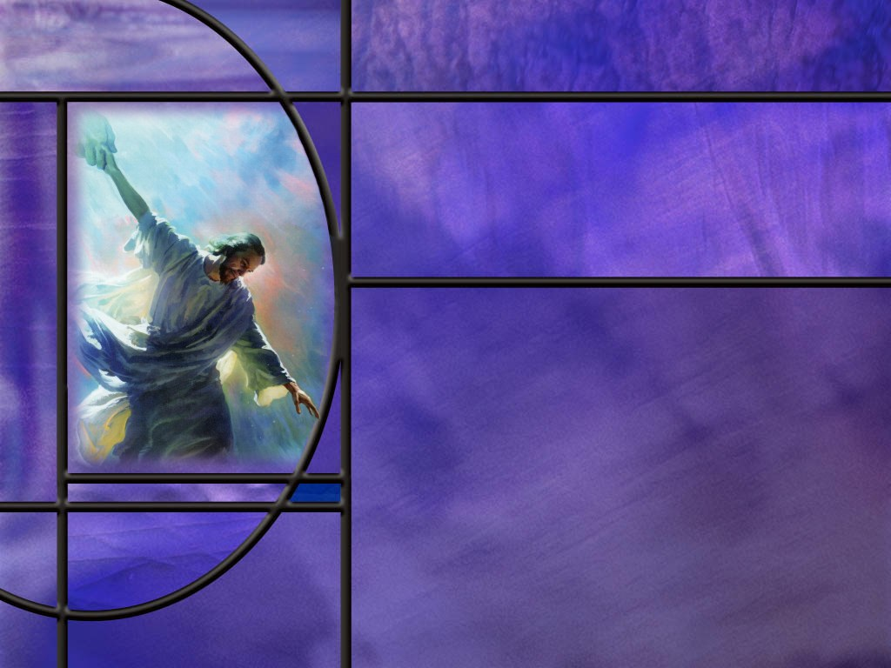
Uniting Heaven and Earth: Christ in Philippians and Colossians
Lesson 1
Persecuted but Not Forsaken

Slide 2
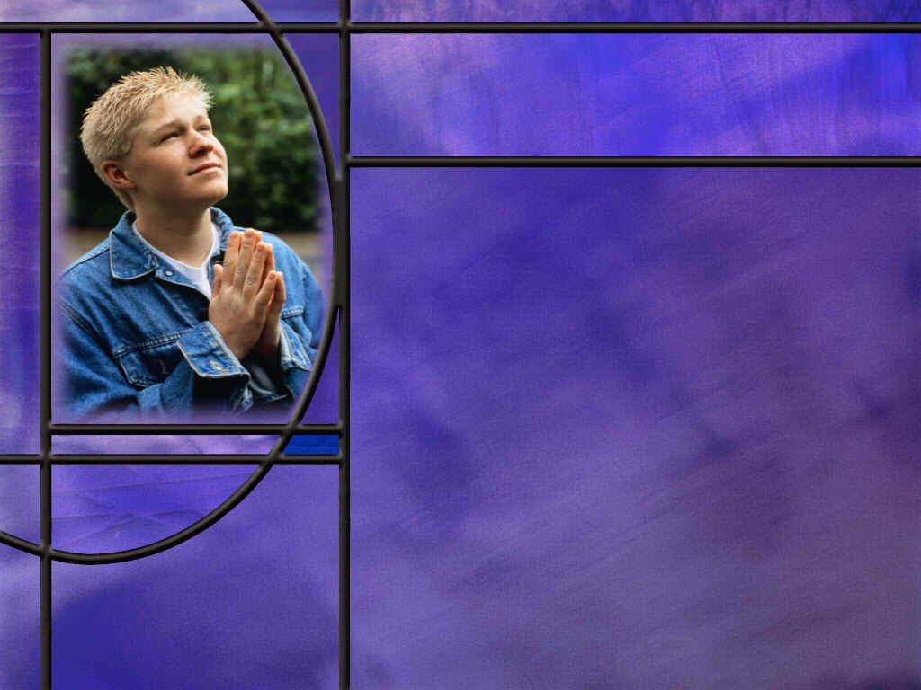
Memory Text
Philippians 4:4 NKJV
Rejoice in the Lord always. Again I will say, rejoice!
What is the one word in this text that makes it difficult to put into practice?
Let’s say someone close to you, perhaps a child, dies. Would you mourn or rejoice?
What phrase in our memory text puts a “qualifier” on rejoicing always?
What was it that allowed Jesus to endure the cross and despise its shame? (Heb 12:2)
Notes:
B2:
1. Rejoice how often??
2. Always!!
3. Is anybody in the habit of doing that?
4. We can rejoice some of the time.
5. We can rejoice when things go well.
6. We can eat, drink, and be merry.
7. We can rejoice when our needs are met, when we have peace and prosperity, when our relationships are clicking, when we’re all getting along, when the blessings keep coming, when we’re agreeing with Christian friends, when we’re worshiping God, when we’re meditating on the word, or singing a hymn or spiritual song.
8. There’s lots of times when we can rejoice, but always?
9. But there’s also times when we’re discouraged, or depressed, or sad, or frustrated, or angry, or hurt, or afraid, or feel alone and forsaken.
10. Should we rejoice in the difficult times as well? (It says always!)
B3:
1. Wouldn’t we all mourn?
2. Solomon, in the book of Ecclesiastes writes:
Eccl 3:4 (KJV) [There is] a time to weep, and a time to laugh; a time to mourn, and a time to dance;
3. Even Jesus at the tomb of Lazarus wept in mourning.
4. He mourned the loss of His friend knowing full well that He was going to resurrect him.
5. Job did nothing to rejoice at the great calamity that came upon him.
6. He sat in an ash heap questioning why God had abandoned him.
7. He wished he had never been born.
8. How should we reconcile this with Paul’s command to rejoice always?
B4:
1. “in the Lord.”
2. Does that put a little different focus on “rejoice always?”
3. Even in our mourning we can rejoice that there is one who has overcome death and offers us eternal life through the resurrection.
4. Even though we are sad at losing a loved one to death, we can rejoice in the Lord that He will one day wipe away all tears from our eyes.
5. We can find comfort in the promises of God, knowing that there is nothing that can separate us from His love.
6. As Paul wrote to the Romans:
Romans 8:18 KJV - 18 For I reckon that the sufferings of this present time are not worthy to be compared with the glory which shall be revealed in us.
7. We can rejoice in the Lord that He is in control and can work all things together for good.
8. Rejoicing in the Lord focuses on the future promises of God and the joy of the blessings of God that will be ours in Christ.
9. Even as we mourn in the present, we can rejoice for what God has promised us in the future.
10. Jesus said: “Blessed are they that mourn for they shall be comforted.”
11. The rejoicing that Paul is talking about in our memory text is the joy of knowing our future is secure in Christ, regardless of what happens in the present.
B5:
[See notes on linked slide.]

Slide 3
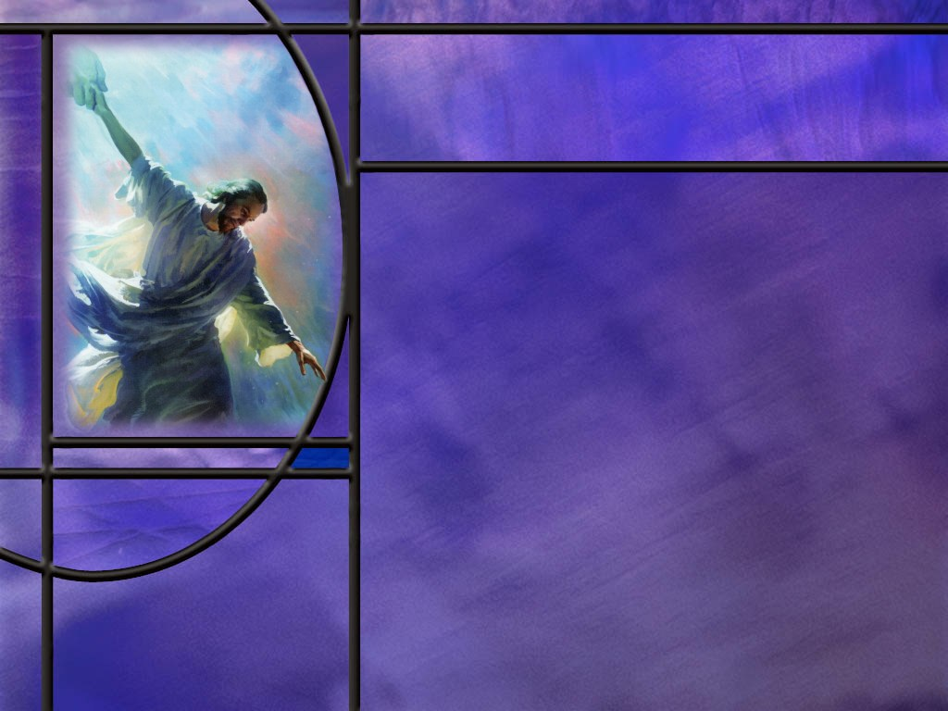
Overview
Our lesson this week introduces us to Paul’s epistles to the Philippians and Colossians. Paul suffered much in proclaiming the Gospel, and it was from prison that he wrote both of these letters. The book of Acts gives us the historical account of the beginnings of these two churches and Paul’s love and care for them.
  Knocked Down but Not Knocked Out
  Church at Philippi
  Church at Colossae
  Outline of Philippians
  Summary

Slide 4
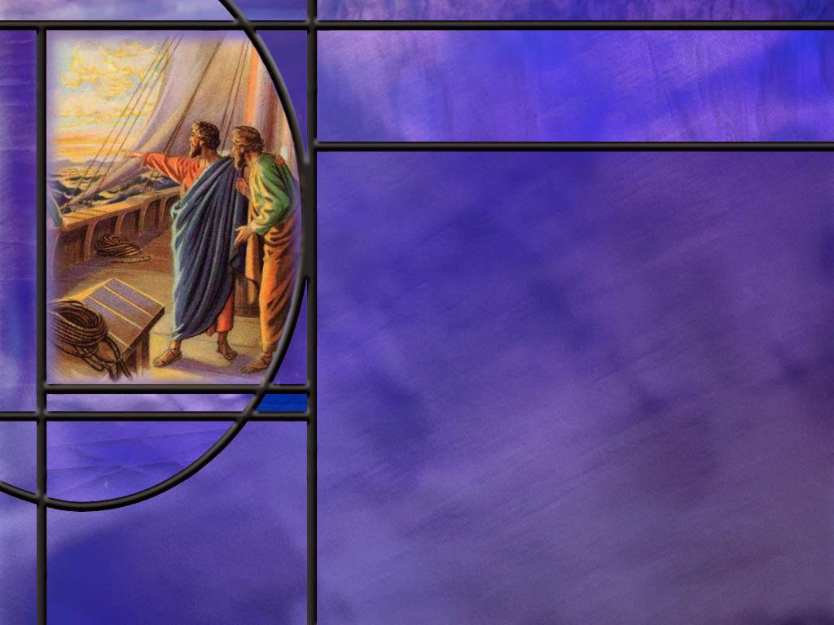
Knocked Down but Not Knocked Out
Where was Paul when he wrote the epistles of Philippians and Colossians? (Phil 1:7; Col 4:3)
How did the apostle Paul recount the difficulties he faced in spreading the Gospel as he wrote to the Corinthian church? (2 Cor 11:23-27)
What assurances do we have that the trials we face will not defeat us? (2 Cor 4:8-9; Rom 8:35)
What blessings have come to us as a result of Paul’s two imprisonments in Rome?
Notes:
B1:
[See notes on linked slide.]
B2:
[See notes on linked slide.]
B3:
[See notes on linked slide.]
B4:
1. Imprisonment gave him the time and opportunity to write five books of the New Testament.
2. These books have been an immeasurable blessing to Christians around the world for nearly 2,000 years.
3. We have the privilege of studying two of these books this quarter.

Slide 5
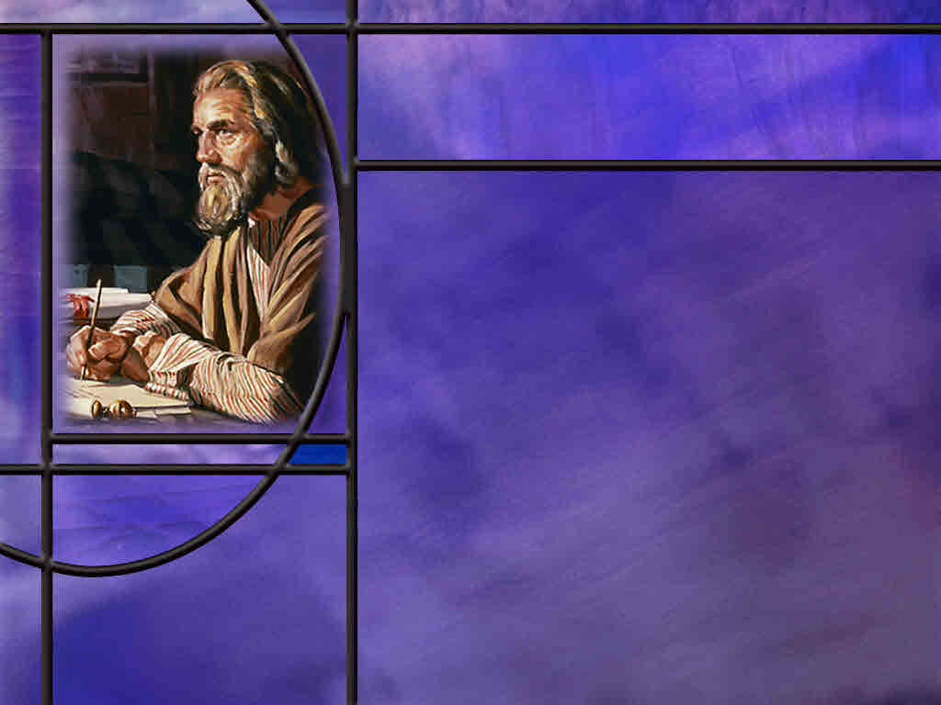
Church at Philippi
Where was Philippi, and how did Paul get there? [Map]
What do we know about the city of Philippi? [Link]
Where did Paul spend his first Sabbath in Philippi? (Acts 16:13-15)
What happened in Philippi that got Paul and Silas in trouble? (Acts 16:16)
Notes:
B1:
[See notes on linked slide.]
B2:
[See notes on linked slide.]
B3:
[See notes on linked slide.]
B4:
[See notes on linked slide.]

Slide 6
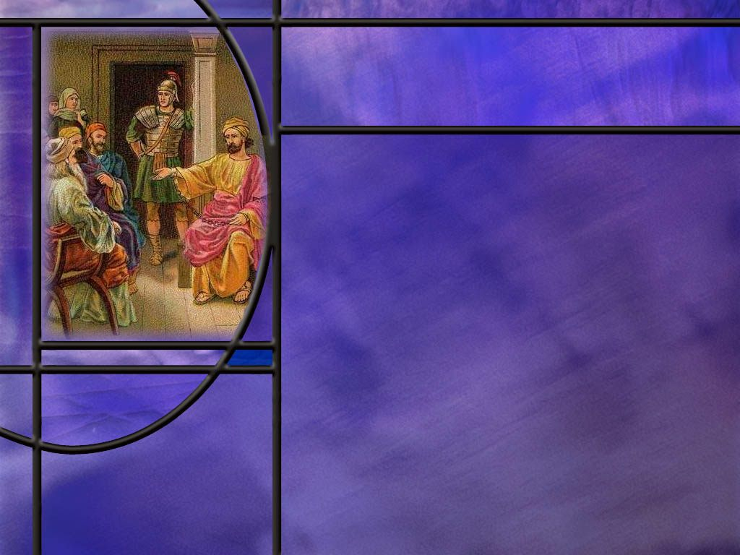
Church at Colossae
Where was Colossae and what do we know about this city? [Map]
How did the Gospel get to the Colossians? (Col 1:5-7; 4:12)
What other epistle did the apostle Paul write to a member of the church at Colossae? (Col 4:9)
Notes:
B1:
[See notes on linked slide.]
B2:
[See notes on linked slide.]
B3:
[See notes on linked slide.]

Slide 7
Outline of Philippians
I. Greeting (1:1-2)
II. Thanksgiving and prayer (1:3-11)
III. Paul’s personal Circumstances (1:12-26)
IV. Exhortations (1:27-2:18)
  A. Living a worthy life (1:27-30)
  B. Being a Servant like Jesus (2:1-18)
V. Fellow Servants in the Gospel (2:19-30)
  A. Timothy (2:19-24)
  B. Epaphroditus (2:25-30)
VI. Warnings (3:1-4:1)
  A. Against legalists (3:1-16)
  B. Against lawlessness (3:17-4:1)
VII. Final exhortations, Thanks, and Conclusions (4:2-23)
Notes:
1. We will outline Colossians when we come to that book.

Slide 8

Summary
Both Philippians and Colossians were written by the apostle Paul from prison in Rome, when he was under house arrest after appealing to Caesar.
They were likely written between 60 and 62 AD along with two other “prison epistles”: Ephesians and Philemon.
He also wrote 2 Timothy from a much more secure prison during his second Roman imprisonment in about 67 AD, just before he was executed by Nero.
The apostle Paul endured many hardships as he faithfully proclaimed the Gospel of Salvation by grace through faith in the Lord Jesus Christ.
He did so with great assurance that there was ultimate victory in Christ.

Slide 9
Summary
On his second missionary journey, Paul and Silas were led by the Holy Spirit to cross into eastern Europe and establish the first church in Europe at Philippi in northern Greece.
From this first foothold, Europe became the birthplace of western civilization based on biblical principles.
In the book of Acts, Luke records the encounters of Paul and Silas with Lydia and with the Philippian jailer.
Both received the gospel truth, trusted in Jesus, and were baptized along with their families.
Paul never visited the church in Colossae. It was established by Epaphras, one of Paul’s coworkers who lived there.

Slide 10
Summary
Epaphras was likely converted to Christianity during Paul’s third missionary journey wen he spent nearly three years in Ephesus, about 100 miles west of Colossae.
Paul also wrote a short letter to Philemon, a member of the Colossian church, encouraging him to receive Onesimus, his run-away slave, as a brother in the Lord rather than a slave.
In spite of being in prison and in spite of all he had suffered, Paul was in no way discouraged. His letter to the Philippians was full of joy and rejoicing.
Knowing that your future is secure in the hands of Jesus, will you rejoice in the Lord this week and always, trusting that He will work all things together for good for those who love Him?

Slide 12
Hebrews 12:2 KJV
Looking unto Jesus the author and finisher of our faith; who for the joy that was set before him endured the cross, despising the shame, and is set down at the right hand of the throne of God. [R]
Notes:
Q1: What was it that allowed Jesus to endure the cross.
1. It was “the joy that was set before Him.”
2. The cross was excruciating pain.
3. There is no indication of Jesus rejoicing as He was being put to death.
4. The joy was not the present pain but the future victory.
5. Jesus looked forward to the redemption and restoration of the universe.
6. He looked forward to the defeat of sin and Satan.
7. He looked forward to being reunited in glory with His Father.
8. He looked forward to a loving relationship with the saints throughout eternity in a world made new where righteousness dwells.
9. So too for us.
10. No matter how difficult our circumstances, we can rejoice “in the Lord” knowing that He has secured a glorious future for us.

Slide 13
Paul in Chains
Philippians 1:7 ESV - …you are all partakers with me of grace, both in my imprisonment and in the defense and confirmation of the gospel.
Colossians 4:3 ESV - At the same time, pray also for us, that God may open to us a door for the word, to declare the mystery of Christ, on account of which I am in prison. [R]
Notes:
Q1: Where is Paul when he writes these two letters?
1. He is in prison.
2. Both these verses, one from Philippians the other from Colossians, declare he is in prison.
Q2: What seems to be his attitude even as he writes from prison?
1. He doesn’t seem to be discouraged.
2. In the first text, he sees himself as a partaker of God’s grace along with them.
3. In the second, he asks for their prayers that the Lord may open a way to share the gospel of salvation in Christ, even while he is in prison.
4. In fact, let’s go back to our memory text: “Rejoice in the Lord always, and again I say rejoice!”
5. Paul can rejoice in his circumstance and encourage others to rejoice with him.
Q3: How many Epistles did Paul write from prison?
1. There are four prison epistles from his first imprisonment in Rome and one more from his second imprisonment.
2. The four epistles called the “Prison Epistles” are Ephesians, Philippians, Colossians, and Philemon.
3. They were written when Paul was under house arrest in Rome awaiting trial before Caesar.
4. These were probably written in the early 60’s maybe between 60 and 62 AD.
5. During this time, Paul could have visitors that could freely come and go and take his letters back to the church to which they were sent.
6. Paul was eventually freed from house arrest, but was again arrested in Rome shortly before his execution under Nero around 67 AD.
7. During his second arrest, he is believed to have been held in the Mamertine prison where he wrote his final epistle, 2 Timothy.
8. So Paul wrote a total of five epistles from prison.
9. Let’s look at the chronology of Paul’s epistles.
[Go to next slide.]

Slide 14
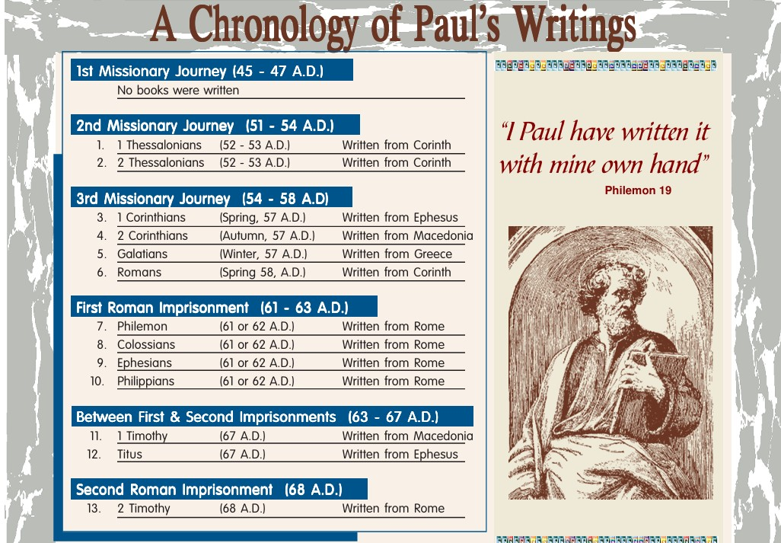
Chronology of Paul’s Epistles
[R]

Slide 15
2 Corinthians 11:23-27 (NIV)
²³ Are they servants of Christ? (I am out of my mind to talk like this.) I am more. I have worked much harder, been in prison more frequently, been flogged more severely, and been exposed to death again and again. ²⁴ Five times I received from the Jews the forty lashes minus one. ²⁵ Three times I was beaten with rods, once I was pelted with stones, three times I was shipwrecked, I spent a night and a day in the open sea, ²⁶ I have been constantly on the move. I have been in danger from rivers, in danger from bandits, in danger from my fellow Jews, in danger from Gentiles; in danger in the city, in danger in the country, in danger at sea; and in danger from false believers. ²⁷ I have labored and toiled and have often gone without sleep; I have known hunger and thirst and have often gone without food; I have been cold and naked. [R]
Notes:
Q1: And after all of this, how did his life end?
1. Nero accused the Christians of setting fire to Rome.
2. Paul was swept up in the arrests and executed by Nero’s command, by having his head chopped off.
3. As a Roman citizen, he would have been spared the far more excruciating death of crucifixion.
4. He was probably executed around 67 AD outside the walls of Rome.
Q2: When you look at this list of persecutions and trials that Paul endured, what comes to mind about your own trials.
1. By comparison, nothing to speak of.
2. What do we suffer for the cause of Christ? Too little to mention.
3. There are people who do suffer for their faith in Jesus in other countries.
4. We can think today particularly of Nigeria where terrorist Muslims have killed thousands of Christians.
5. This has recently come to the attention of our government who has carried out a strike against the terrorists this past Christmas day.
6. But here in our culture with a constitution that guarantees freedom of religion, Christians may be subject to ridicule by the anti-Christian left, but nothing like the brutal persecution in countries like Nigeria, China, No. Korea, Pakistan, Iran, Sudan, Yemen, Afghanistan, Somalia, and others.
7. Christianity is actually the most persecuted religion in the world.
Q2: How did Paul start out on a religious path that was much different that what he describes here?
1. Paul had not intentionally started out on such a harrowing life experience.
2. He calls himself a Hebrew of the Hebrews.
3. He was of the tribe of Benjamin, educated at the feet of one of great rabbis of the day, Gamaliel.
4. He was a strict Pharisee, very zealous for the law.
5. And far from being persecuted, he was the persecutor that was chasing down Christians and arresting them throwing them in prison, and holding the coats of those who stoned Stephen.
6. He seemed destined for fame, respect, and a life of relative ease.
Q1: What happened to change his direction in life?
1. He met the resurrected Lord on the road to Damascus.
2. That one meeting changed everything.
3. Everything he had valued before, his respect, his influence, his honor, his position, his education, his income, his career, became rubbish, garbage, dung.
4. He willingly lost it for a life of danger and deprivation.
5. Why? Because he had found the Pearl of Great Price: something far more valuable than anything he could have ever hoped for.
6. He found that Jesus was the Messiah who died for his sins.
7. He found that true saving righteousness does not come from works of the law but by faith in Jesus Christ for the forgiveness of sins.
8. He dedicated his life to proclaiming the gospel of salvation by grace through faith.
9. He was willing to endure whatever it took to complete his mission for Jesus.
10. O that we would be as faithful as he to complete the great commission the Lord has given to us.

Slide 16
Assurance in Difficult Times
2 Corinthians 4:8-9 KJV - We are troubled on every side, yet not distressed; we are perplexed, but not in despair; ⁹ Persecuted, but not forsaken; cast down, but not destroyed;
Romans 8:35, 37 KJV - Who shall separate us from the love of Christ? shall tribulation, or distress, or persecution, or famine, or nakedness, or peril, or sword? ... ³⁷ Nay, in all these things we are more than conquerors through him that loved us. [R]
Notes:
Q1: What assurance does Paul give us that there is no ultimate defeat for those who are Christs?
1. When we are in Christ, we are more than conquerors.
2. We may get knocked down, but we are not knocked out.
3. What ever doesn’t kill us makes us stronger.
4. Even death cannot separate us from the love of God.
5. Listen to how Paul finishes Romans 8:
Romans 8:35, 37-39 KJV - For I am persuaded, that neither death, nor life, nor angels, nor principalities, nor powers, nor things present, nor things to come, ³⁹ Nor height, nor depth, nor any other creature, shall be able to separate us from the love of God, which is in Christ Jesus our Lord.
6. When we are in Christ, we are always victorious.
7. The only thing that can separate us from Him is our choice to reject Him.

Slide 17
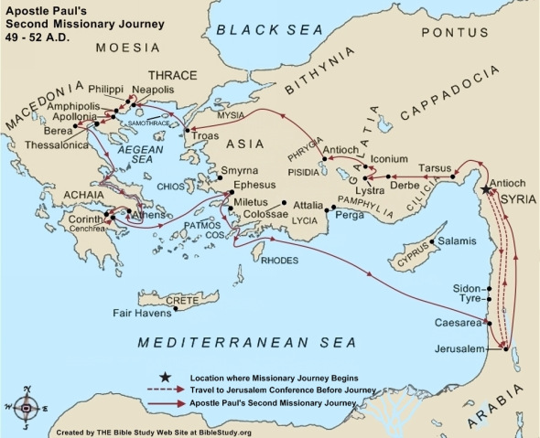
Philippi Map
[R]
Notes:
1. This is a map of Paul’s second missionary journey with Silas.
2. They start out from Antioch in Syria and visit the churches in Galatia that they established during Paul’s first missionary journey.
3. At Lystra they pick up Timothy who would become Paul’s adopted son in the faith.
4. Then they travel to the western coast of Asia Minor to Mysia.
5. There Paul wants to go north to Bithynia, but somehow, the Holy Spirit prevented them from going north.
6. So they went down to Troas, a port city on the Aegean Sea.
7. It was there that Luke records Paul’s famous vision.
8. He writes in:
Acts 16:9-10 ESV - And a vision appeared to Paul in the night: a man of Macedonia was standing there, urging him and saying, "Come over to Macedonia and help us." ¹⁰ And when Paul had seen the vision, immediately we sought to go on into Macedonia, concluding that God had called us to preach the gospel to them.
9. So, two things to note here:
10. First, they change continents from Asia Minor to Europe.
11. And second, it appears that this is where they pick up Luke.
12. It is here that Luke begins to use “we” and “us” rather than “they” and “them.”
13. In Eastern Europe, they travel a short distance from the port city of Neapolis to the city of Philippi.
14. All of the cities that Paul and his companions visited along the coast of the Aegean sea are in modern Greece today.
15. So, this is a major step in the spread of the Christian gospel.
16. Paul establishes a foothold for Christianity in eastern Europe.
17. Today, the birthplace of Western Civilization is considered to be Europe, and Christianity was the unifying religion.

Slide 18

Philippi Facts
Roman Colony: Philippi held special status as a Roman colony, making it like a "miniature Rome" in Greece, with Roman citizens and Latin as the official language.
Important Location: Philippi was located on a major Roman road between west and east and served as an important trading center for the port city of Neapolis.
Diverse Population: Its inhabitants included Romans, Macedonians, and a small Jewish population, with a mix of pagan religions and commerce.
Roman Administration: As a Roman colony, it had its own local government with two chief magistrates.
Archaeological Site: Today, Philippi is an impressive archaeological site featuring Roman ruins like the forum, theater, and baths, with early Christian basilicas also present. [R]
Notes:
So these are some of the facts we know about the city of Philippi.

Slide 19
Acts 16:13-15 ESV
And on the Sabbath day we went outside the gate to the riverside, where we supposed there was a place of prayer, and we sat down and spoke to the women who had come together. ¹⁴ One who heard us was a woman named Lydia, from the city of Thyatira, a seller of purple goods, who was a worshiper of God. The Lord opened her heart to pay attention to what was said by Paul. ¹⁵ And after she was baptized, and her household as well, she urged us, saying, "If you have judged me to be faithful to the Lord, come to my house and stay." And she prevailed upon us. [R]
Notes:
Q1: Why do you suppose Paul and his team went to the river instead of to the synagogue where he would normally go on the Sabbath?
1. The most probable reason is that there was no synagogue in the city.
2. It required 10 Jewish men to establish a synagogue.
3. There is no record of men at the place of prayer by the river.
4. Lydia had a house there in Philippi where she lived with her family.
5. Apparently, she had been born in Thyatira in Asia Minor which was famous for its purple dye.
6. Thyatira is one of the seven churches mentioned in Revelation 2 and 3.
7. As a business woman she had moved to Philippi to sell her purple items in the markets there.
Q2: How long did it take Lydia and her household to be baptized?
1. It doesn’t say for sure, but the implication is that it was that very afternoon.
2. After all, they were right there by the river.
3. And it came right before she invited their missionary team to make her home the center of their activity in the city.
4. People who worshipped the true God needed only to accept Jesus as the Messiah and their Savior and Lord.
5. Just as on the day of Pentecost or with the Ethiopian Eunuch, or with Cornelius, they just had to receive Jesus as their Savior, commit their lives to Him, and seal it with baptism.

Slide 20
Acts 16:16 ESV
As we were going to the place of prayer, we were met by a slave girl who had a spirit of divination and brought her owners much gain by fortune-telling. [R]
Notes:
Q1: What happened when Paul cast out this demon of divination from the slave girl?
1. Well, she could no longer profit her masters with useful information to earn them money.
2. So her owners brought Paul and Silas before the magistrates of the city with a complaint against them.
3. The crowd joined in and they beat them with rods giving them many blows.
4. Then they threw them in jail with their feet in the stocks in the inner prison.
5. But God wasn’t done with them.
6. At midnight, as Paul and Silas were singing hymns, the Lord sent an earthquake, and, no doubt angels to open the prison doors and remove the chains from the prisoners.
7. The Philippian jailer was ready to kill himself because he feared all the prisoners had escaped.
8. But Paul stopped him with the news that all the prisoners were still there.
9. The jailer asked, “What must I do to be saved?”
10. And Paul and Silas gave them the simple answer:
Acts 16:31 ESV - 31 And they said, "Believe in the Lord Jesus, and you will be saved, you and your household.“
11. So they shared the gospel with the jailer and his family and they were baptized that very night.
12. It is not hard to be saved.
13. All you need to do is believe in the Lord Jesus Christ for the forgiveness of your sins.
14. And when you receive the HS, you will want to be baptized and commit your life to Him.

Slide 21
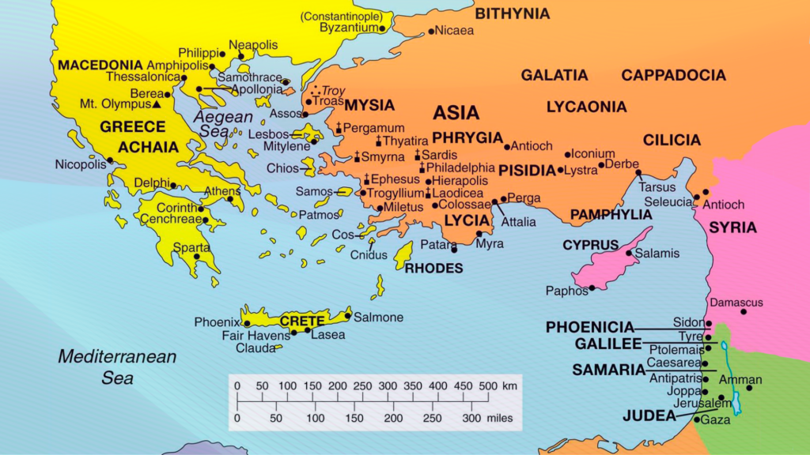
Map Colossae
[R]
Notes:
1. Colossae is located just a few miles south of Laodicea in Asia Minor.
2. You remember the seven letters to the seven church in Revelation.
[Point out the seven churches with the seven crosses in the circuit starting with Ephesus.]
3. Paul never actually went to the city of Colossae.
4. The church there was established by another person.
5. But on his third missionary journey, Paul spend two and a half years in Ephesus.
6. Ephesus is about 100 miles to the west of Colossae.
7. It was in Ephesus that his preaching had an influence on the whole region.
8. The city of Colossae was known for its dyed wool textile industry.
9. They were especially noted for purple and crimson dyed wool cloth.
10. They also had a thriving sheep raising business for the production of wool.
11. The culture and religion were mainly pagan with a significant Jewish population.

Slide 22
Gospel to Colossae
Colossians 1:5, 7 ESV - … you have heard before in the word of the truth, the gospel, ... ⁷ just as you learned it from Epaphras our beloved fellow servant. He is a faithful minister of Christ on your behalf. Colossians 4:12 NLT - Epaphras, a member of your own fellowship and a servant of Christ Jesus, sends you his greetings. [R]
Notes:
Q1: Who was Epaphras?
1. He was a fellow servant of Jesus Christ along with the apostle Paul.
2. It was probably in Ephesus that Epaphras heard Paul preach the Gospel and joined him in spreading the good news to other cities in the region.
3. Epaphras belonged to the church at Colossae, and Paul credits him with bringing the gospel there and establishing the church.

Slide 23
Colossians 4:9 ESV
and with him [that is with Tychicus, Paul is also sending] Onesimus, our faithful and beloved brother, who is one of you. They will tell you of everything that has taken place here. [R]
Notes:
Q1: Who was Onesimus?
1. Onesimus was a run-away slave that was owned by Philemon.
2. Paul is sending him back to his home town of Colossae along with Tychicus who is going to deliver the letter to the Colossians.
3. So Paul has to write another letter to Philemon asking him to accept Onesimus as a brother rather than a slave.
4. Paul makes this appeal to Philemon:
Philemon 1:17-18 ESV - So if you consider me your partner, receive him as you would receive me. ¹⁸ If he has wronged you at all, or owes you anything, charge that to my account.
5. So both Epaphras and Onesimus are coworkers with Paul, are residents of Colossae, and are being sent home by Paul to minister there.

